Slide 1
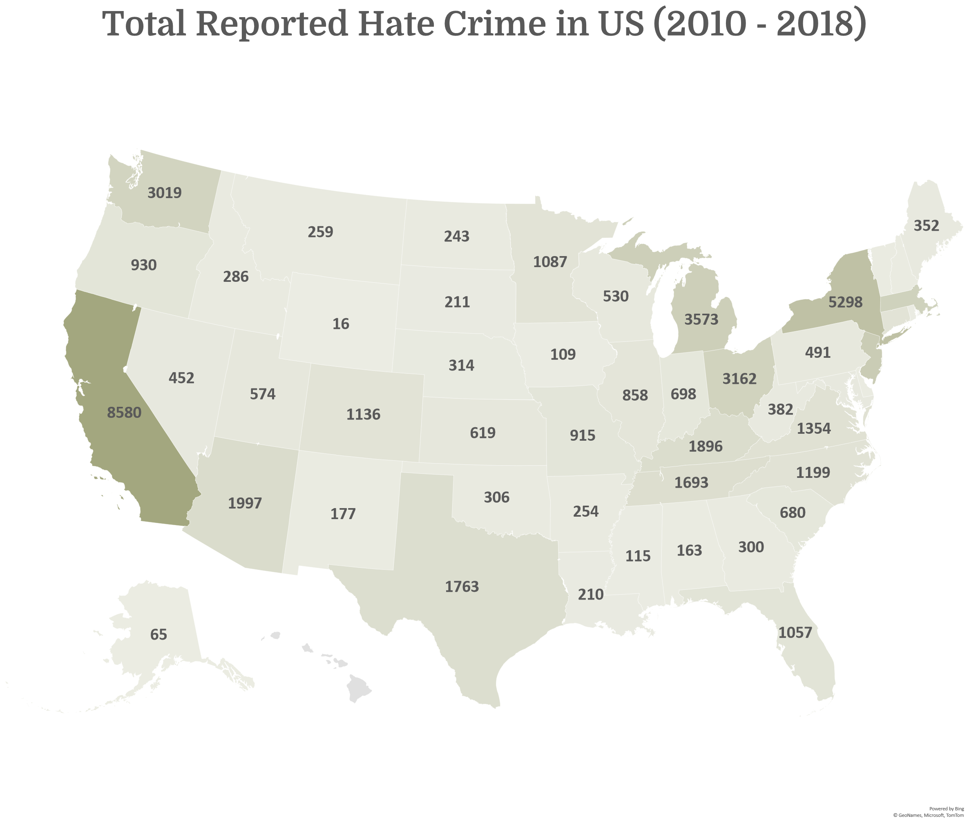
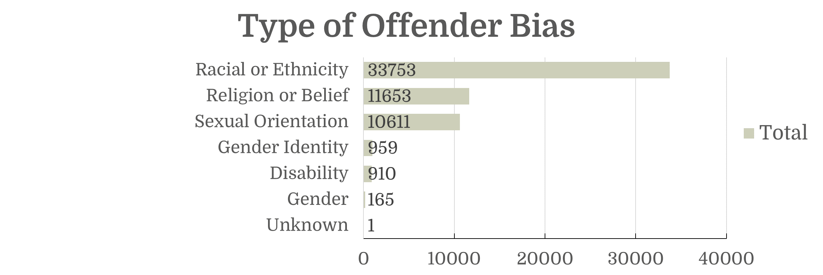
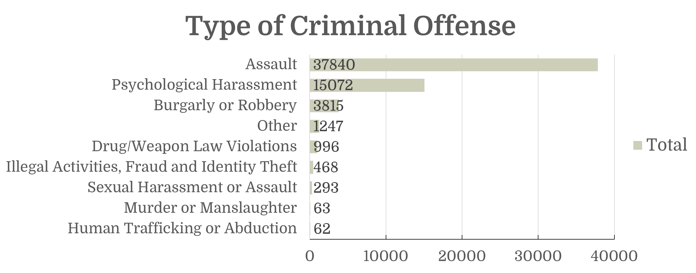
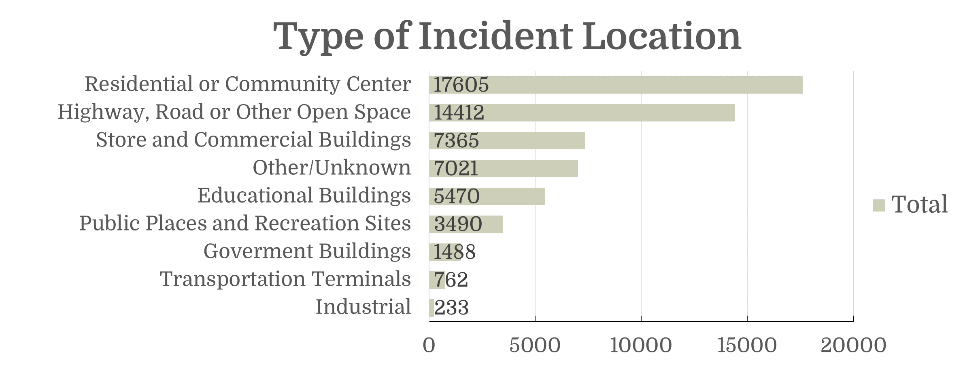
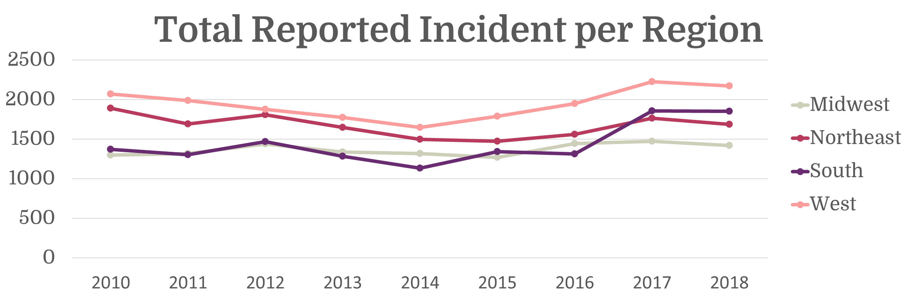



US Hate Crime Report (2010 - 2018)
Leonardi Fabianto
Count
16
8590
Powered by Bing
© GeoNames, Microsoft, Tom Tom
Data obtained from United States Hate Crimes (1991-2018) that preprocessed and posted by Louisse Bye in Kaggle. Raw data gathered from FBI: Crime Data Explorer.(link on description).
av.leonardif@gmail.com
Leonardi Fabianto
github.com/avidito

