Slide 1
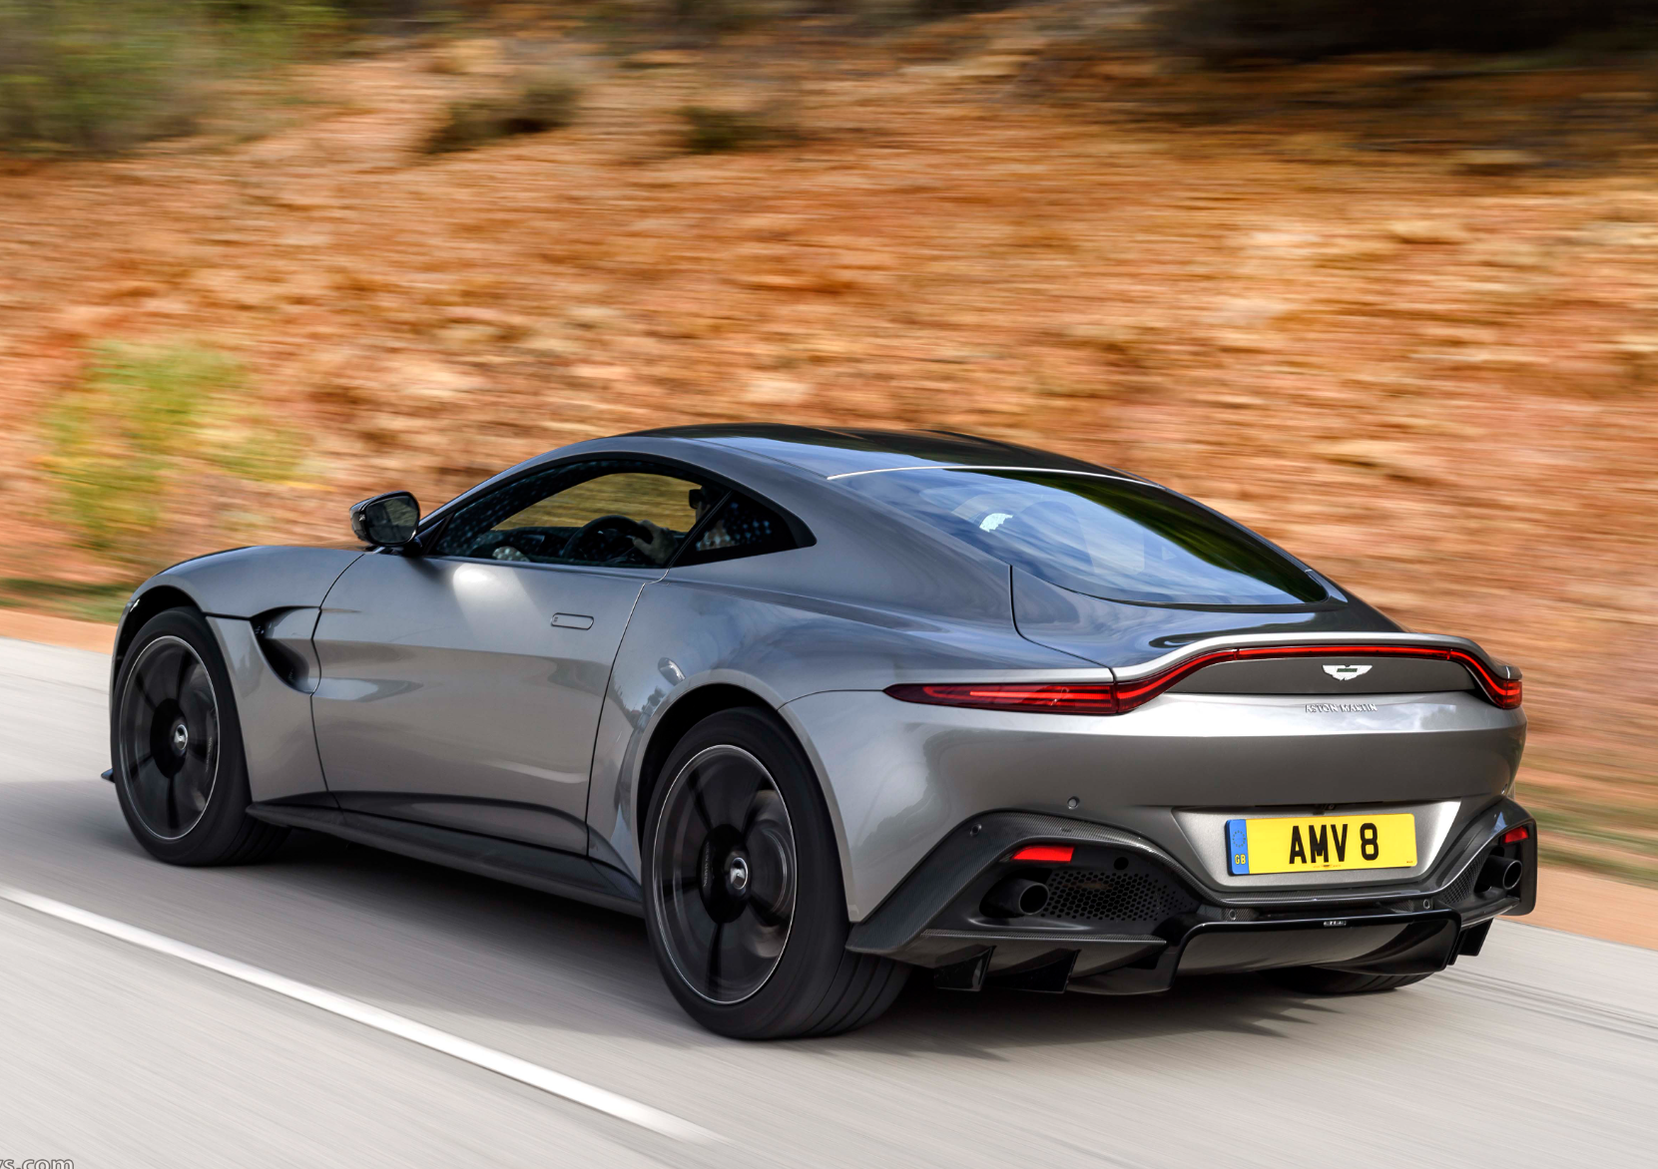
Used Car
Feature importance
&
Price
Prediction
Using
Machine Learning

Slide 2
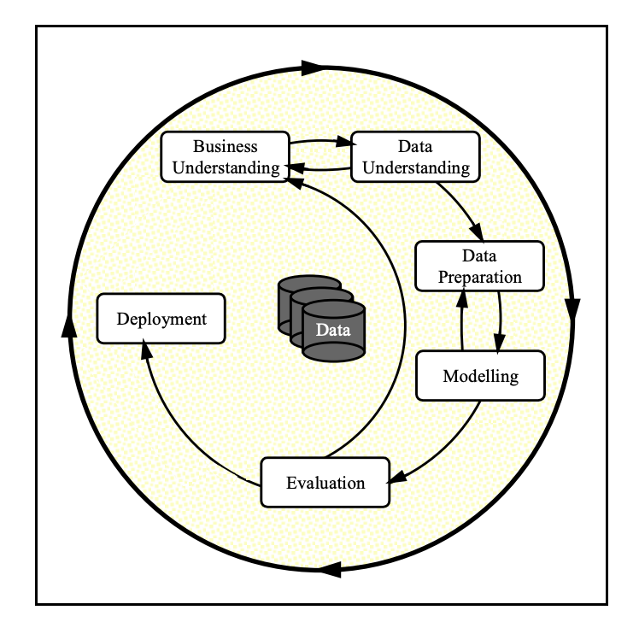
Data Science Principals Utilized

Slide 3
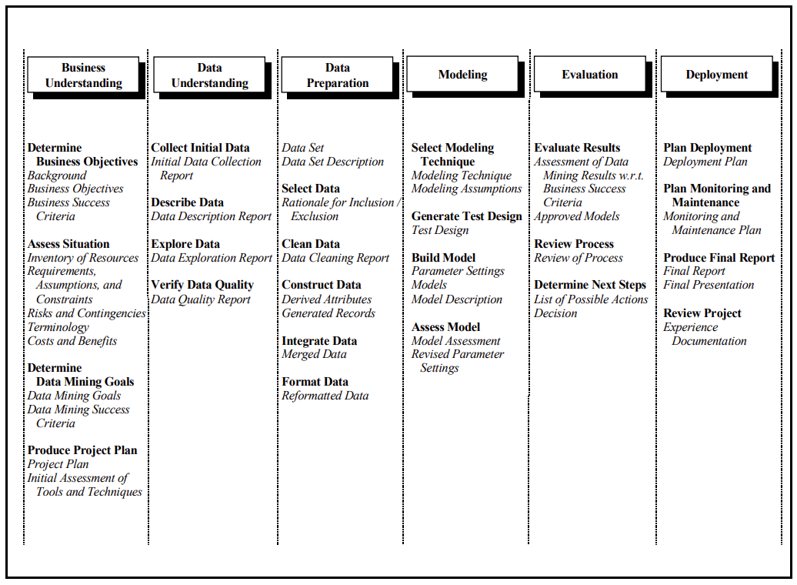
A Step-by-step Approach

Slide 4
Problem Statement and Objectives
Determine the factors that make car more or less expensive.
Features that most important for the customers

Slide 5
Data Understanding
The data spans across 10-yrs - from 1900 -2022
The prices range of all the vehicle is approximately bet - $1500-$39k with some outlier to be eliminated.
The data has vehicles from all 51 states in the US and 404 distinct regions
42 unique manufacturers
29629 unique car models
6 unique categories of vehicle conditions
8 unique cylinder types
5 unique fuel types
5 unique title status
3 unique transmission types
3 unique drive types
4 unique sizes
13 unique vehicle types
12 unique paint colors

Slide 6
Data Cleansing
Before process - 426880 rows, 18 columns
After process - 364420 rows, 16 columns
Total 62460 rows and 2 cols removed including outliers

Slide 7
Data Processing
Applied machine learning techniques like -
Label encoding
Imputation
Train/Test/Split the data to (train – 90% & test – 10%)

Slide 8
Data Modeling & Evaluation
Applied Modeling techniques like –
Linear Regression
Ridge Regression
Lasso Regression
K-Neighbors Regression
Random Forest Regression
Bagging Regression
AdaBoost Regression
XGBoost Regression
To determine the importance of the features for the customers.

Slide 9
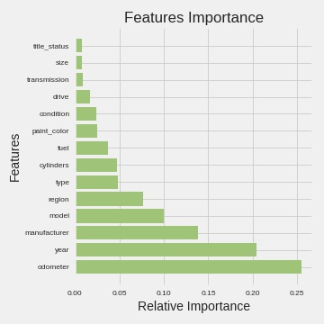
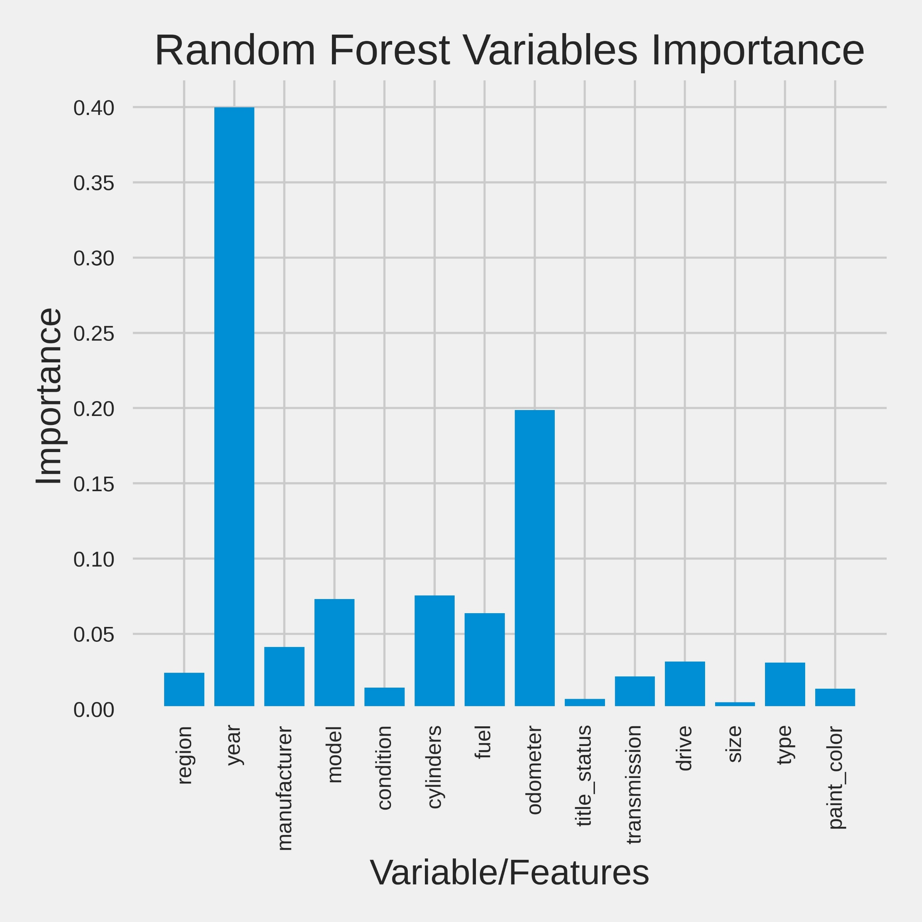
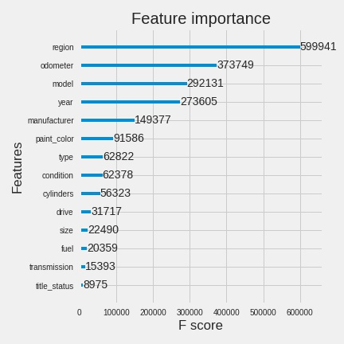
Feature Importance
AdaBoost
Random Forest
XGBoost

Slide 10
Model Deployment
Input criteria – to predict the price of the best used vehicle
Paint Color
Manufacturer
Year
Transmission
Cylinders
Size
Fuel
Condition
Drive
Type
Odometer

Slide 11
Process Summary
By performing different ML models, we aimed to get a better result or less error with max accuracy.
Our purpose was to predict the price of the used cars having multiple predictors and 364420 data entries.
Initially, data cleaning is performed to remove the null values and outliers from the dataset.
Next, the data visualization features were explored deeply and the correlation between the features is examined.
Subsequently, ML models are implemented to predict the price of car.

Slide 12
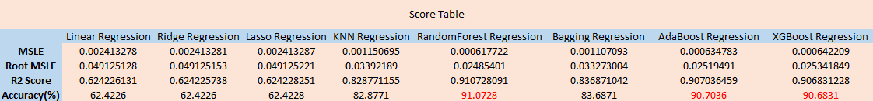
Model Score Summary

Slide 13
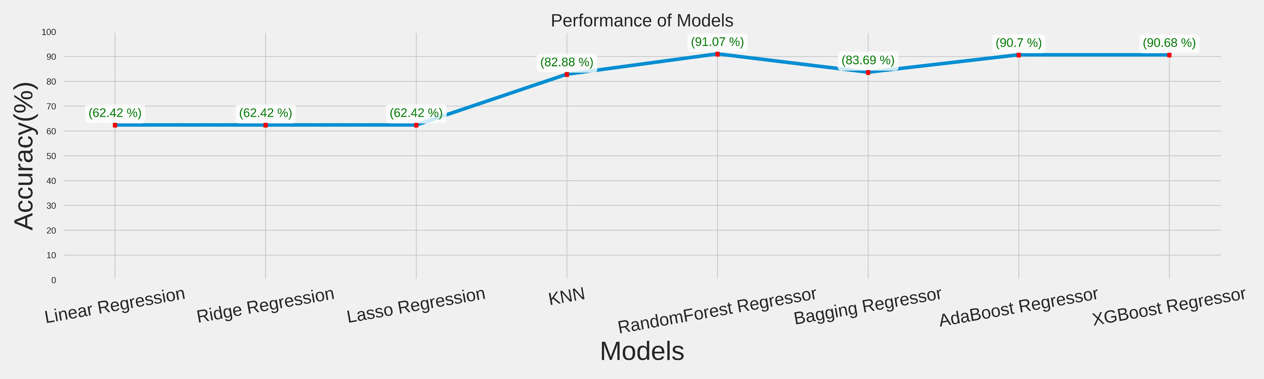
Graphical comparison

