Slide 1

Portuguese Banking Institution
Marketing Campaign
Subscription of Term Deposit Prediction

Slide 2
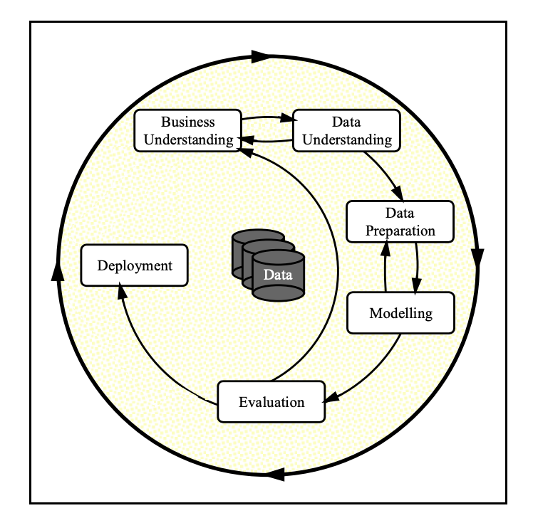
Data Science Principals Utilized

Slide 3
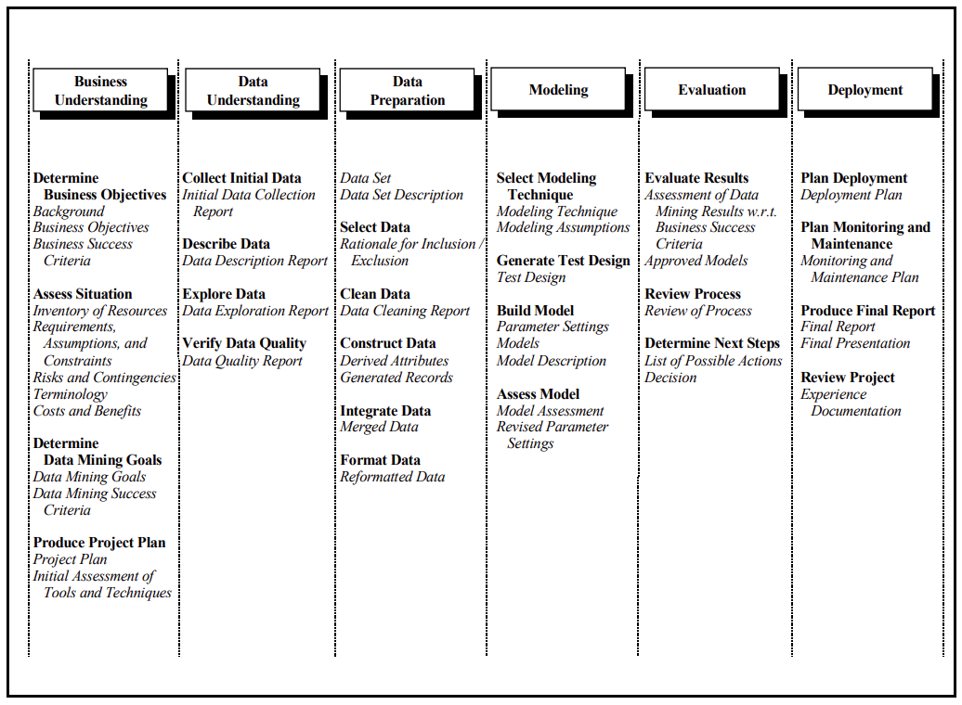
A Step-by-step Approach

Slide 4
Problem Statement and Objectives
Direct marketing campaigns of a Portuguese banking institution.
The marketing campaigns were based on phone calls.
Often, more than one contact to the same client was required, in order to access if the product – “bank term deposit” would be subscribed.
Subscribed = ('yes’)
Not subscribed = ('no')

Slide 5
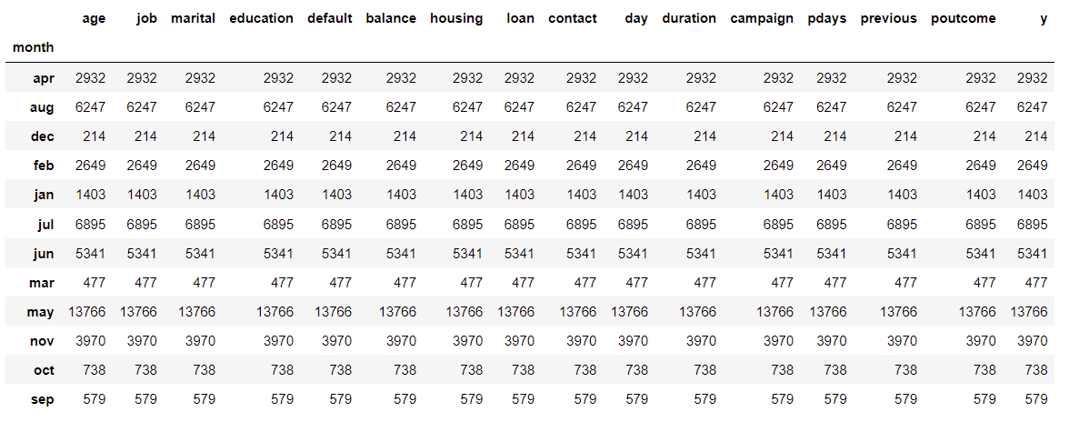
Calls made each month

Slide 6
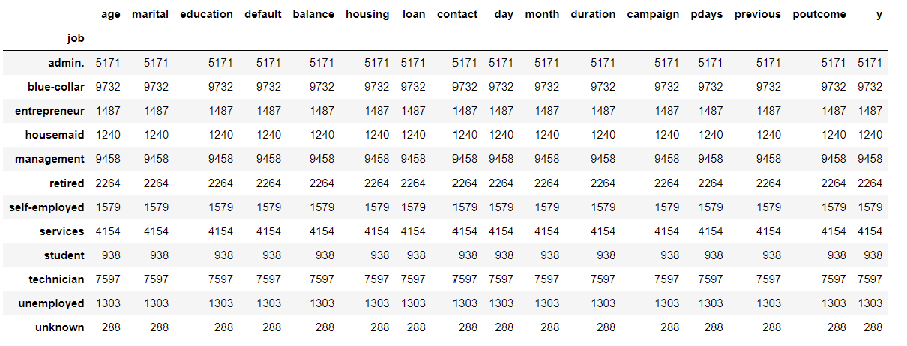
Calls made based on job profile

Slide 7
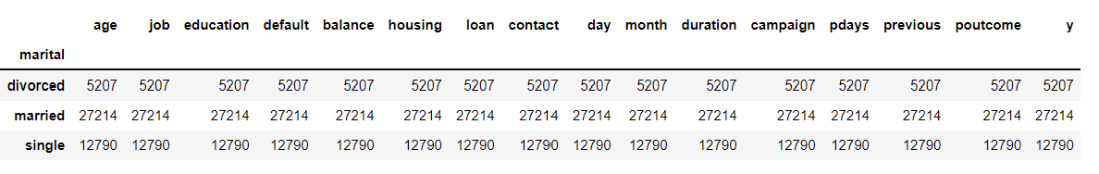
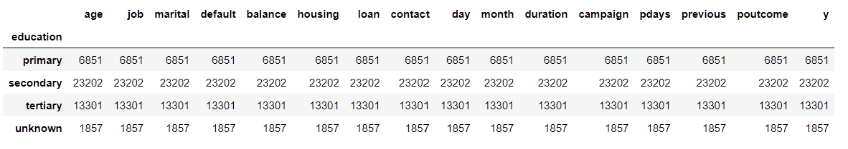
Calls made based on marital status, education

Slide 8
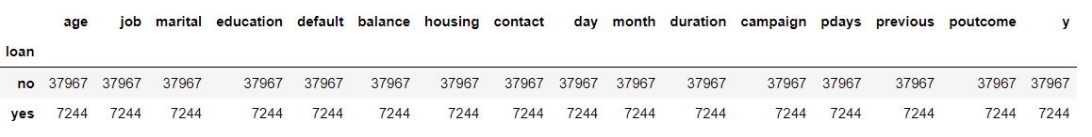
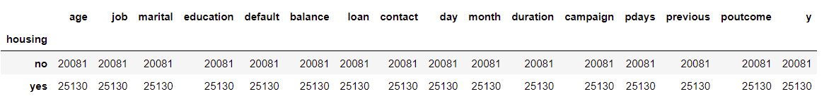
Calls made based on housing, loan status

Slide 9
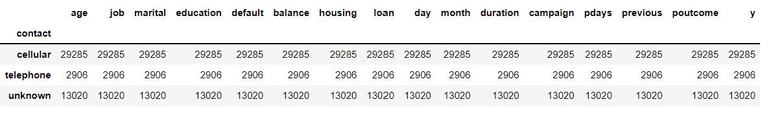
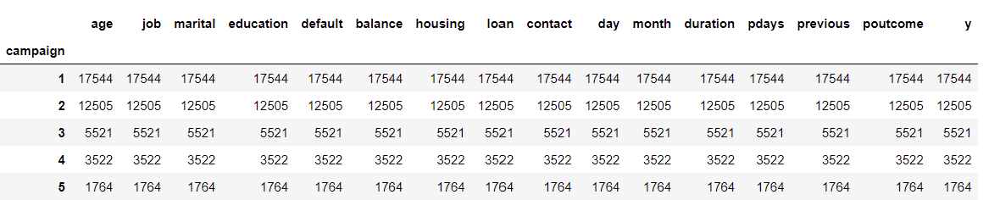
Contact method and top 5 campaign call count

Slide 10
Data Cleansing
Before process - 45211 rows, 16 columns
10 categorical variables found that have multiple values –
Job
Education
Marital
Default
Housing
Loan
Contact
Month (Jan-Dec)
Day of week (M-F)
Poutcome – (outcome of the previous marketing campaign ('failure’, 'nonexistent’, 'success’)
Dropped call “duration” column because it does not serve any purpose in producing accuracy of the model
There were no outliers detected

Slide 11
Data Processing
Applied machine learning techniques like -
Label encoding
Train/Test/Split the data to (train – 90% & test – 10%)

Slide 12
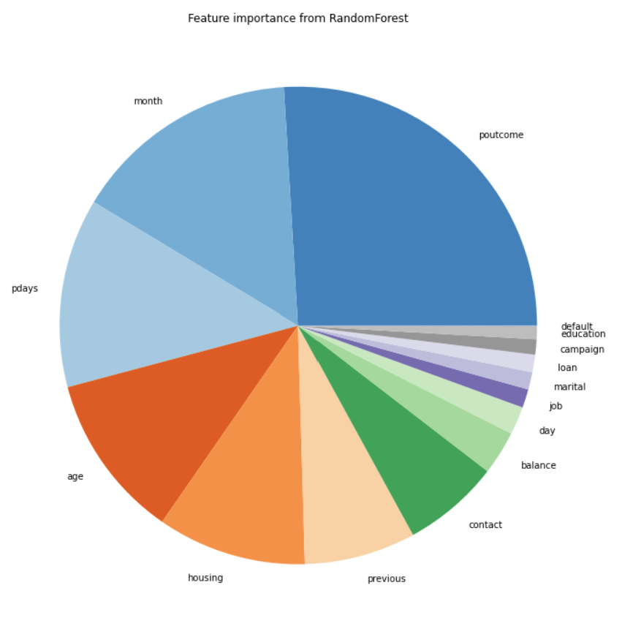
Feature Importance

Slide 13

Data Modeling, Evaluation, and Deployment
Applied Modeling techniques like –
K-Neighbors Regression
Logistics Regression
Decision Tree Regression
Support Vector Machine Regression
And the models are ready to be operationalized for frequent inferencing.

Slide 14

Process Summary
By performing different ML models, we aimed to get a better result or less error with max accuracy.
Our purpose was to predict the effectiveness of the marketing campaign for subscribers to subscribe to term deposit
The data visualization features were explored deeply and the correlation between the features is examined.
Subsequently, ML models are implemented to predict the likelihood of a subscriber subscribing to the term deposit.

Slide 15
Model Score Summary
Algorithm | ROC AUC Mean | ROC AUC STD | Accuracy Mean | Accuracy STD
KNN | 67.86 | 1.2 | 88.4 | 0.55
Logistic Regression | 71.72 | 1.01 | 62.53 | 0.79
Decision Tree | 71.61 | 0.93 | 89.06 | 0.57
SVM | 63.5 | 3.04 | 88.3 | 0.62

Slide 16
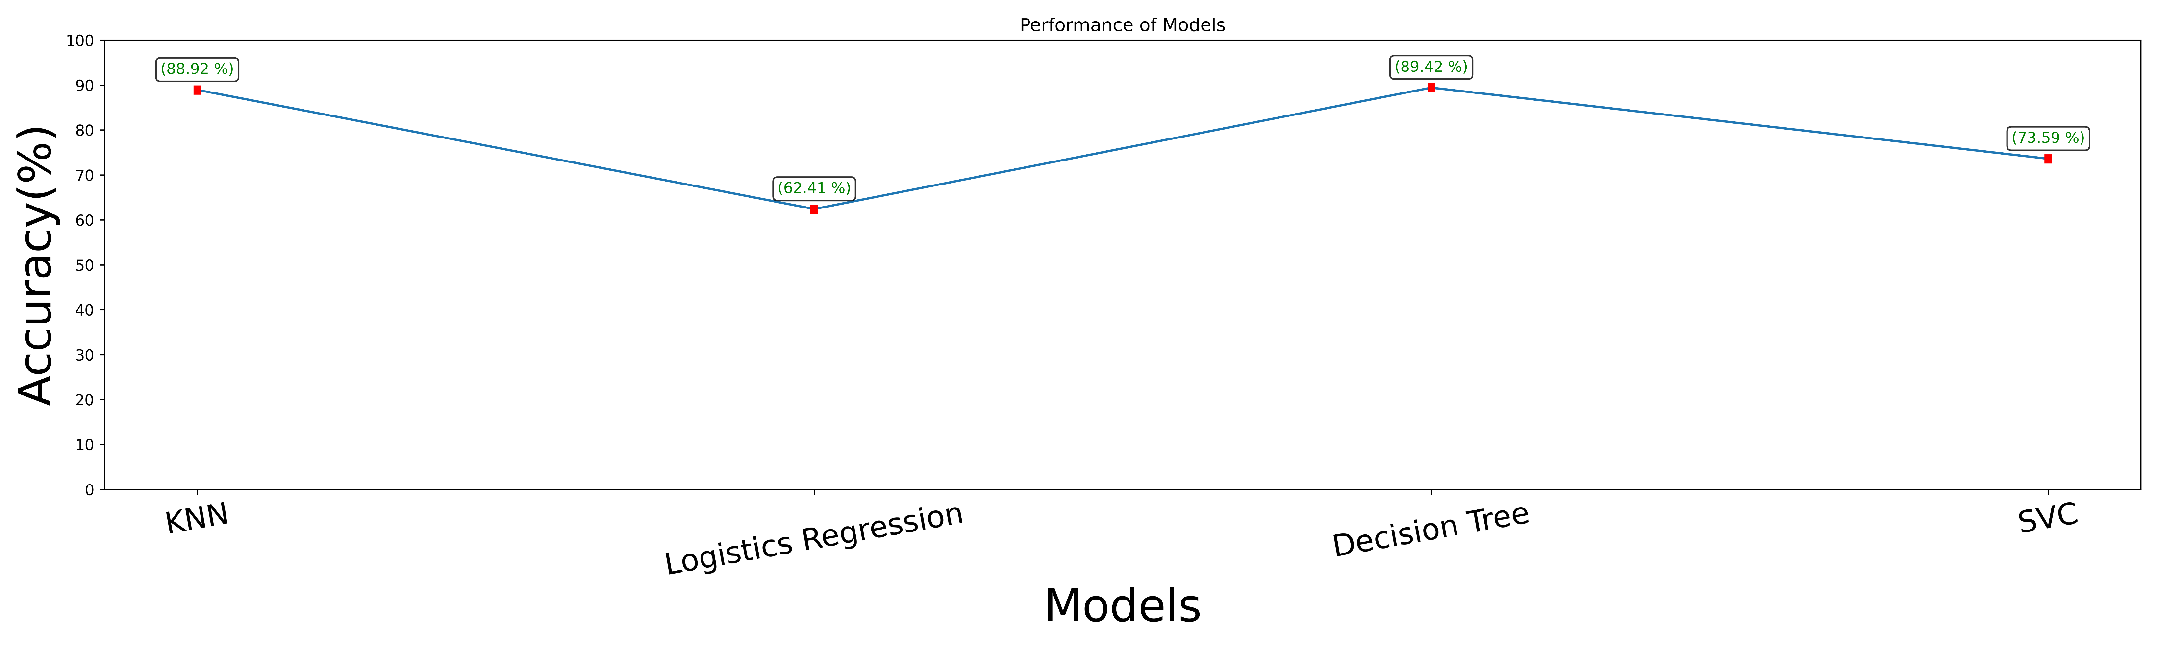
Performance – Graphical representation

