Slide 1
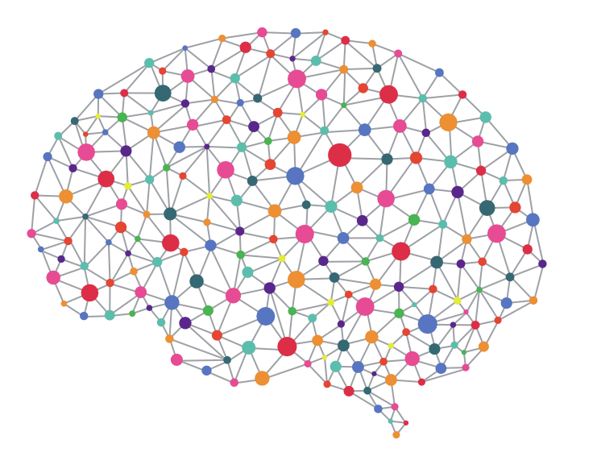


Predictive Maintenance of Cloud Data Center
Using
Machine Learning

Slide 2
What are we solving?
In the world of increasing continuous availability of services
Cloud Data Center up-time matters
Which means
Hardware, power supply, HVAC systems, & other supporting services must operate optimally
predictable up-time
near-zero downtime
or downtime that is transparent to the service user

Slide 3
Why does it matter?
Current challenges
Inventory control & Supply-chain is inefficient
Downtime needs to be scheduled
This leads to service unavailability, loss of productivity & revenue, CSAT, Retention
This affects Time-to-market strategy of service providers & users
Overall bottom-line becomes unpredictable

Slide 4
What can we do to achieve this?
Machine learning can help
We gather all the telemetry data on our back-end system
The data is captured data center wide and is as granular as:
A failure of component of any kind
A failure of a machine of any kind
Based on
Lack of continuous power supply to the functionality of the component itself
What is currently missing?
It is reactive in nature which explain scheduled down-times
As a part of this exercise, we are going to make it predictive enough to flag failures when they are in near-SLA violation stage with ample notice to take corrective action.

Slide 5
How did we achieve this?
A bit about how these types of problems are generally solved
This is an unsupervised learning problem because we need not assume anything before applying unlike statistical methods.
Hence it can be solved using Artificial Neural Networks in machine learning world.
An Artificial Neural Network (ANN) is an information processing paradigm that is inspired by the way biological nervous systems - such as the brain, process information.
The key element of this paradigm is the novel structure of the information processing system. It is composed of many highly interconnected processing elements (neurons) working in unison to solve a specific problems.
ANNs, like people, learn by example. An ANN is configured for a specific application, such as pattern recognition or data classification, through a learning process.
For the usage of ANNs, as mentioned earlier – we need not statistically assume anything.
Artificial Neural Networks are known as Universal approximators. They can approximate any type of function.
We applied a specific type of ANN called - Long Short-Term Memory(LSTM)

Slide 6
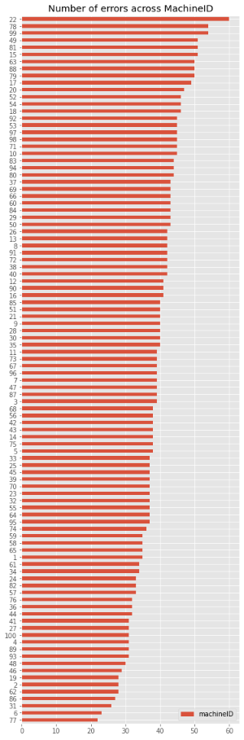
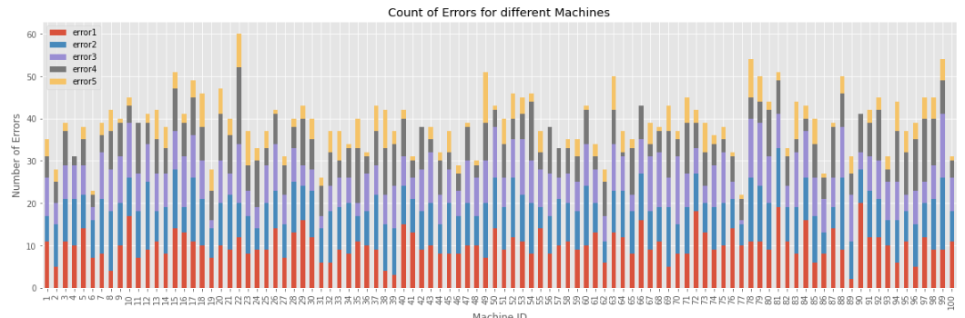
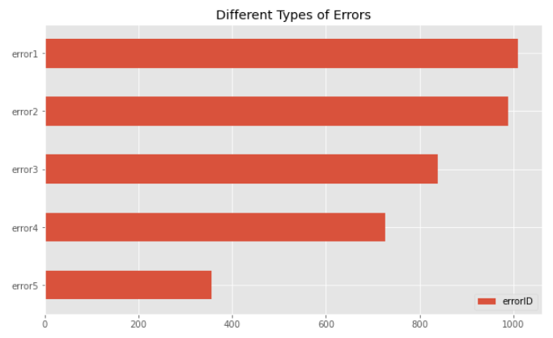
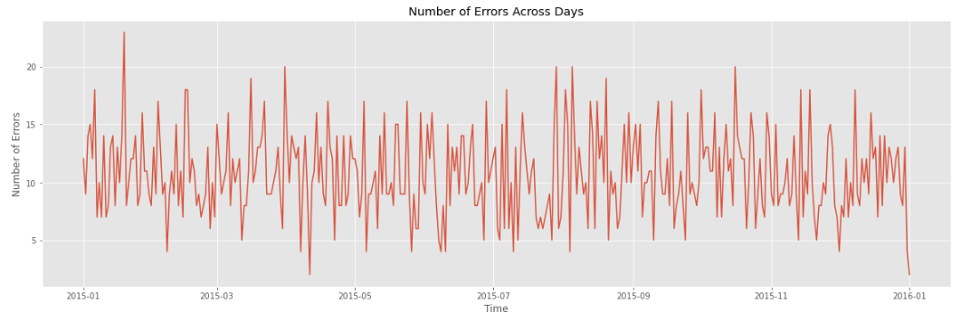
Data Insight

Slide 7
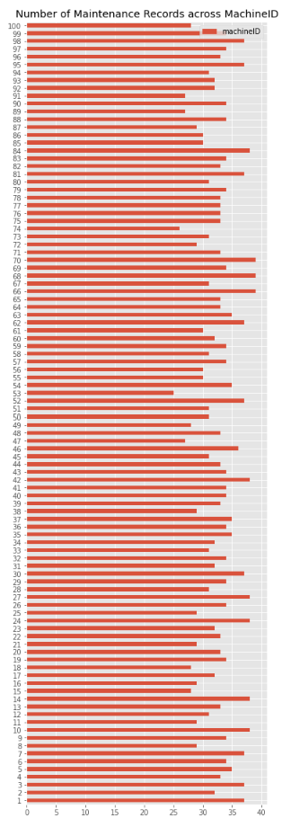
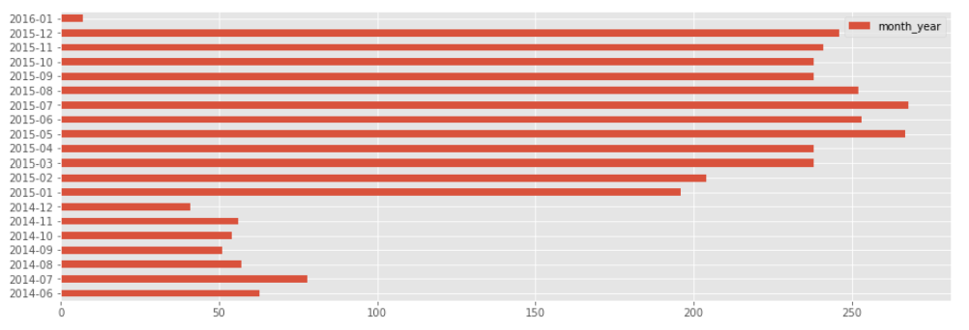
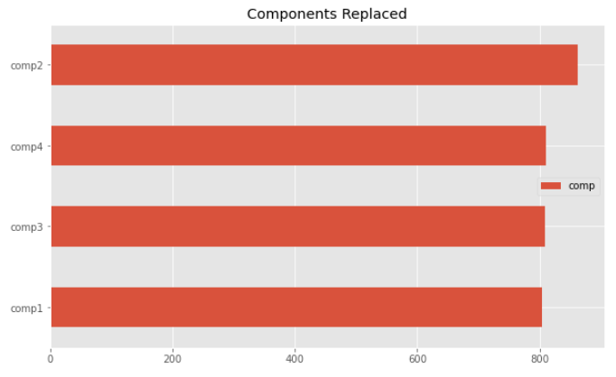
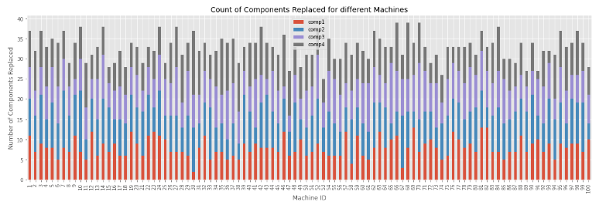
Data Insight

Slide 8
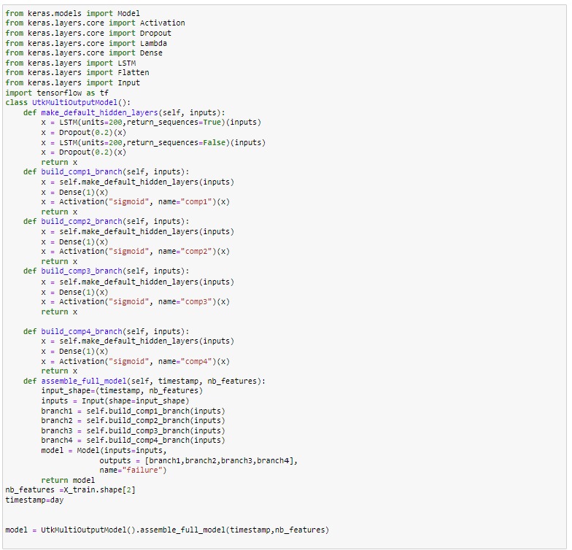
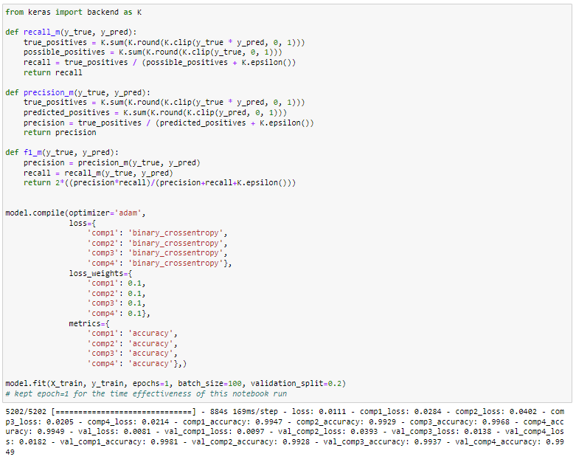
How we assembled components’ behavior

Slide 9
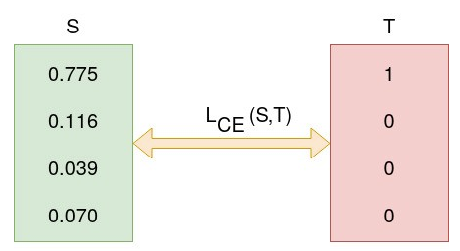
Explanation on loss function – cross_entropy
What the picture on the left says is -
L is loss function
CE indicates cross_entropy
T is a desired value
S is the value produced by a model
What cross_entropy does, is –
During model training, the model weights are iteratively adjusted accordingly with the aim of minimizing the Cross-Entropy loss. The process of adjusting the weights is what defines model training and as the model keeps training and the loss is getting minimized, we say that the model is learning.

Slide 10
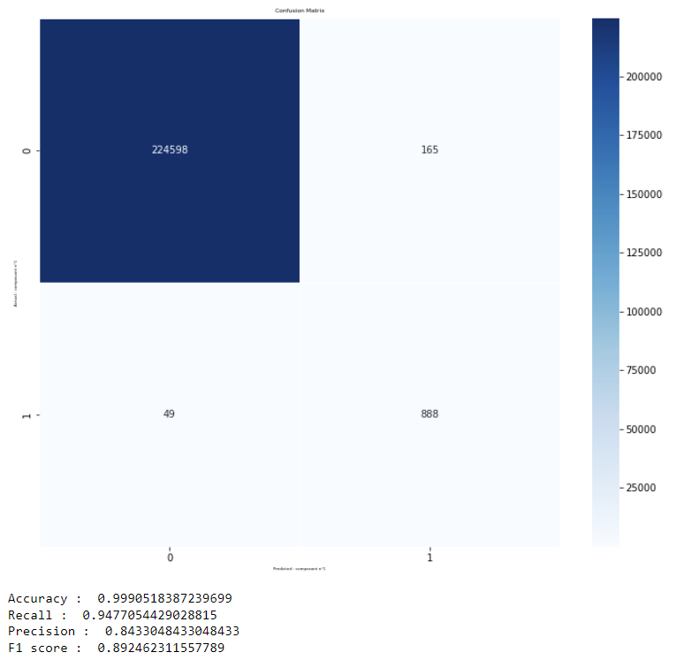
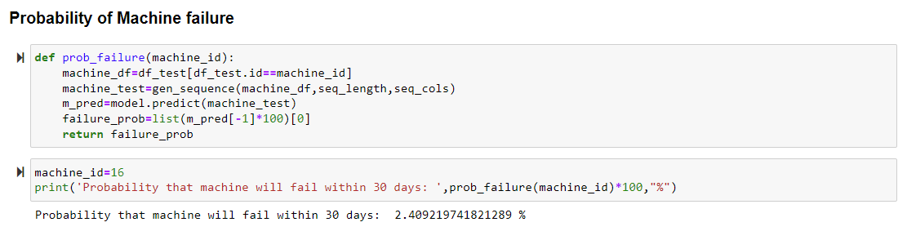
What was our outcome?
The metrics indicate
0.9990 – i.e.: 99% accuracy was produced by the model
The model also predicted that
There is a 2.4% likelihood of Machine #16 experiencing some failure in next 30-days
run into a failure in

Slide 11
Summary
The result
The model predicted the timeframe of the failure to provide ample time for inventory control and supply-chain
The model predicted the most granular failures to avoid scheduled downtime
The model predication will lead higher up-time and thus avoid any further business impact
The model prediction will avoid any impact to business bottom-line
The goal
Inventory control & Supply-chain is inefficient
Downtime needs to be scheduled
This leads to service unavailability, loss of productivity & revenue, CSAT, Retention
Overall bottom-line becomes unpredictable

Slide 12
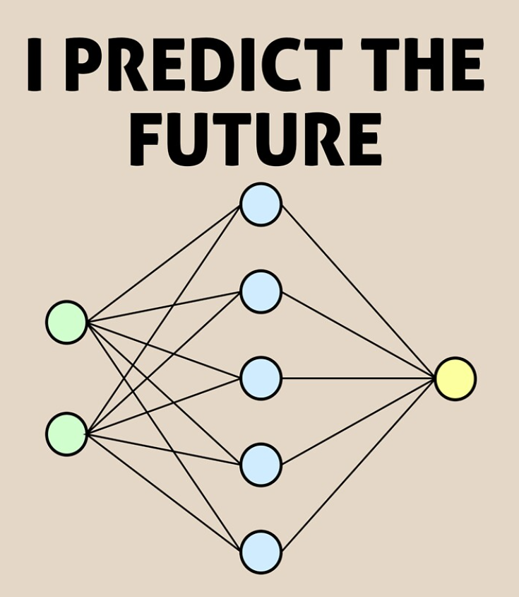

Join us @ - https://www.linkedin.com/groups/14097958/

