Slide 1
Recursion Zero to Hero Who are you?
By Avi Farah
https://www.linkedin.com/in/avi-farah/
avifarah@hotmail.com

Slide 2
Agenda and resources
Slides
Recursion: What, Why and How
Tail recursion vs Left recursion
Recursion for processing a binary tree
There are five GitHub repositories that are linked
https://github.com/avifarah/Recursion
https://github.com/avifarah/Recurson.Recursion1
https://github.com/avifarah/Recursion.Recursion-Stripped
https://github.com/avifarah/Recursion.TreeProcessing
https://github.com/avifarah/Recursion.TreeProcessing-Stripped

Slide 3
What is Recursion
A recursive solution is broken down into
Termination condition
Recursive logic—Same logic applied to n items is applied to n – 1 items
Example: n! = 1 * 2 .. * n
Recursive definition: n! = n * (n – 1)!
Terminating Condition: when n == 1 then n! == 1
C# code: Factorial(int n) { return n == 1 ? 1 : n * Factorial(n–1);
}
The above Factorial(..) will NOT work if n <= 0

Slide 4
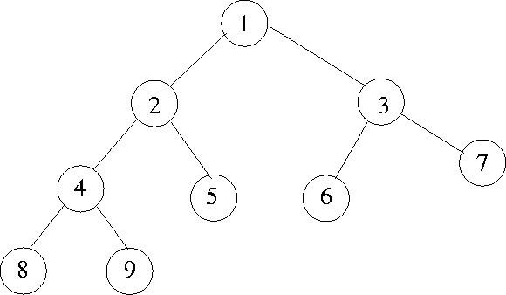
Why use Recursion
Every iteration process can be expressed as a recursion
Not every recursion process can be expressed as iteration
Example: There are structures like trees where iteration is not ideal

Slide 5
The How of Recursion
To implement recursion compilers use a stack, the same stack that is used to control the flow of function/method calls.
At the recursive call: local variables and return address are pushed
Upon return: top frame is popped and hydrate local variables.
A recursive solution is therefore more expensive then its iterative counterpart. Tail recursion is an exception…

Slide 6


Tail Recursion -- Desirable
Factorial of n
public static BigInteger Factorial(int n) {
if (n <= 0) throw new ArgumentException("...", nameof(n));
return FactorialHelper(n);
}
private static BigInteger FactorialHelper(int n) {
if (n == 1) return 1; /*option 1*/ return n * FactorialHelper(n-1);
/*option 2*/ return FactorialHelper(n-1) * n;
}
Option 1 is called “Tail Recursion”
Option 2 is called “Left Recursion”
The compiler will turn a Tail Recursion to an iteration.

Slide 7
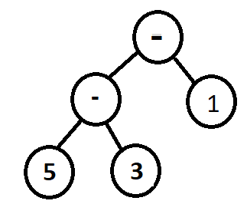
Left Recursion (example)
We need to translate an expression from its token parts. Ex: 5-3-1
Definition (A parser for arithmetic addition / subtraction) expr ::= expr (+|-) term | term
term ::= number (a string of digits)
Translating this to code – let’s think about it together
Each step through the recursive algorithm must move the process a step closer to the terminating condition
Fix expr definition: expr ::= term Rest Rest ::= (+|-) expr | empty

Slide 8
Binary Tree
Binary tree has
Node
Left subtree (a tree in its own right)
Right subtree (a tree in its own right)
A binary Tree can be recursively processed in:
n L R (prefix processing)
L n R (infix processing)
L R n (postfix processing)
If the needed operation does not fall into pre/in/post-fix processing then the tree structure given above is not the best data-structure. For example: For a given depth list all node values.

Slide 9
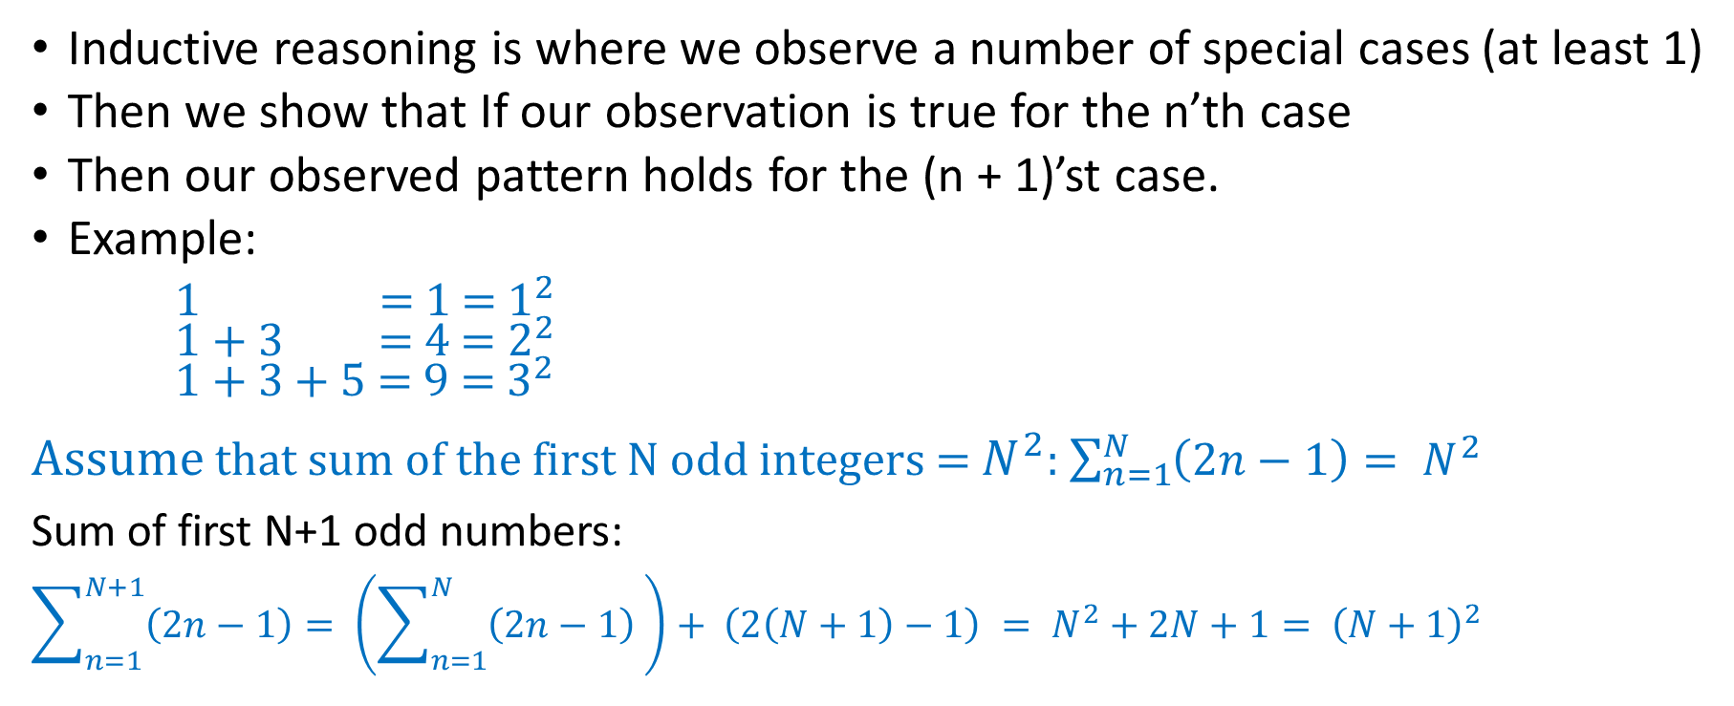
Induction
Inductive reasoning is where we observe a number of special cases (at least 1)
Then we show that If our observation is true for the n’th case
Then our observed pattern holds for the (n + 1)’st case.
Example:
1 = 1 = $1^{2}$ 1 + 3 = 4 = $2^{2}$ 1 + 3 + 5 = 9 = $3^{2}$
Assume that sum of the first N odd integers = $N^{2}$: $\sum_{n=1}^{N}{\left(2n−1\right)= N^{2}}$
Sum of first N+1 odd numbers:
$$\sum_{n=1}^{N+1}{\left(2n−1\right)}= \left(\sum_{n=1}^{N}{\left(2n−1\right) }\right)+ \left(2\left(N+1\right)−1\right) = N^{2}+2N+1= {\left(N+1\right)}^{2}$$

Slide 10
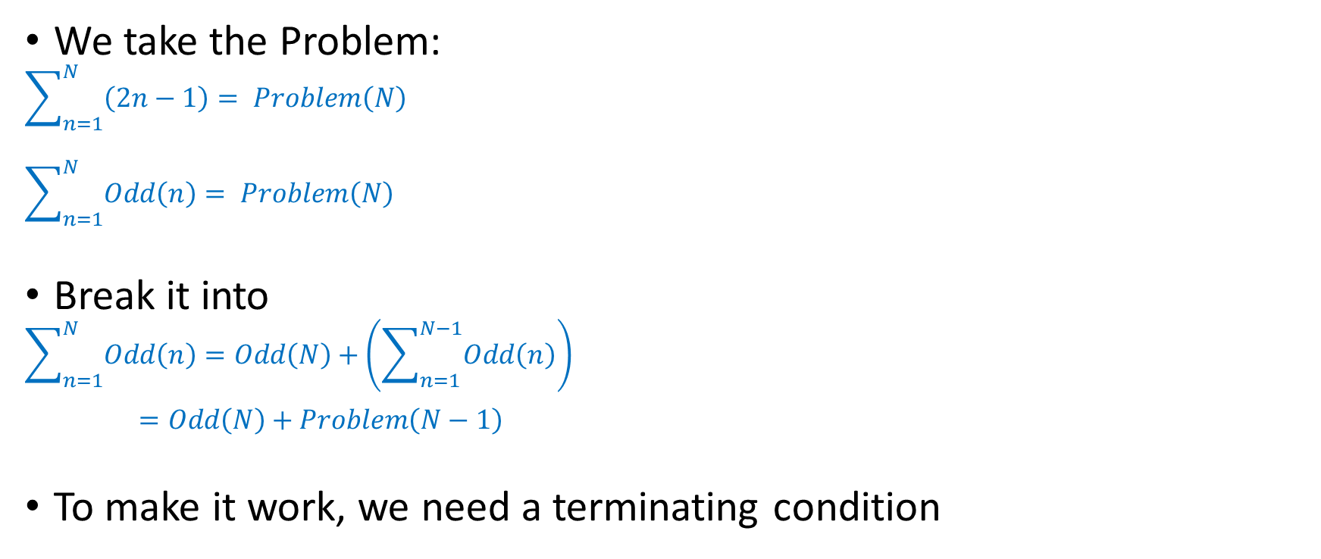
Induction to Recursion, reverse the process
We take the Problem:
$$\sum_{n=1}^{N}{\left(2n−1\right)= Problem\left(N\right)}$$
$$\sum_{n=1}^{N}{Odd\left(n\right)= Problem\left(N\right)}$$
Break it into
$$\sum_{n=1}^{N}{Odd\left(n\right)}=Odd\left(N\right)+\left(\sum_{n=1}^{N−1}{Odd\left(n\right)}\right)$$
$=Odd\left(N\right)+Problem\left(N−1\right)$
To make it work, we need a terminating condition

