Slide 1
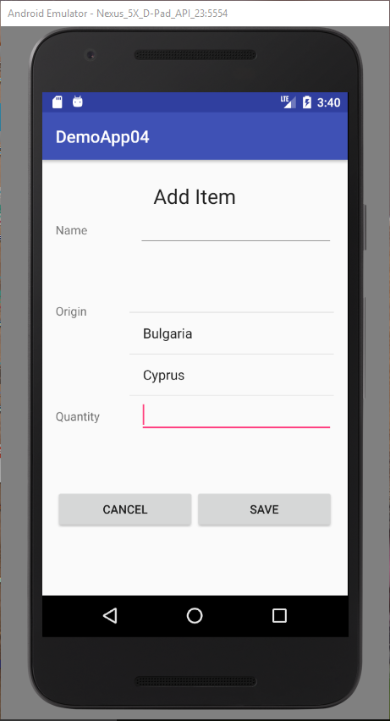
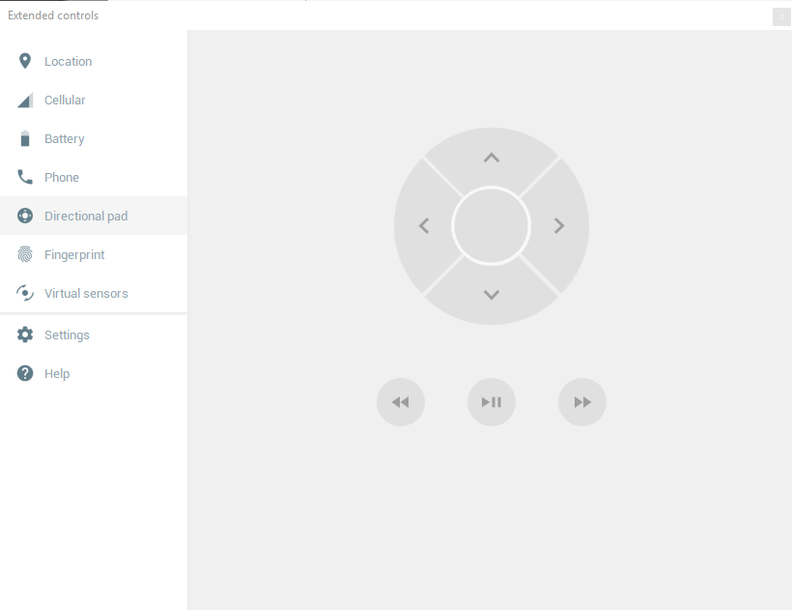
nextFocusUp
nextFocusLeft
nextFocusRight
nextFocusDown

