Slide 1
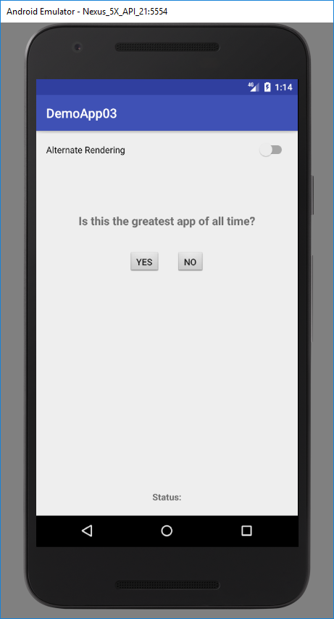
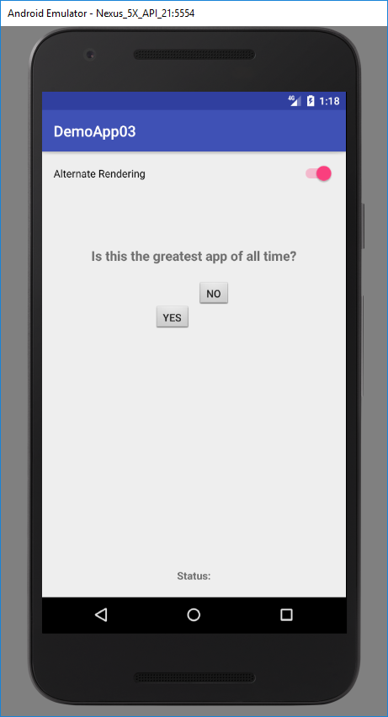
A user with motion impairment will find it difficult to tap small buttons that are placed close together.
The Alternate Rendering of the app moves the buttons around the screen to simulate a motion impairment user finding it difficult to tap the buttons.

