Slide 1
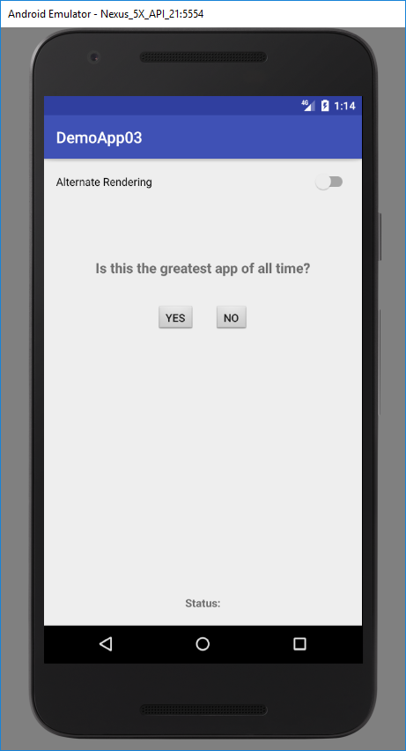
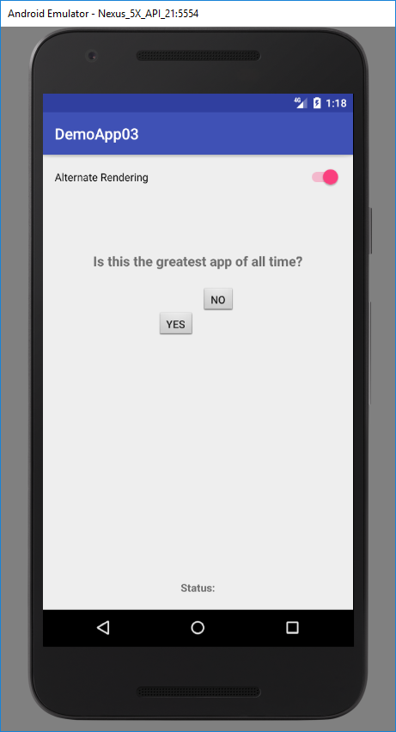
A user with motion impairments will find it difficult to tap small buttons that are placed close together.
The Alternate Rendering of the app moves the buttons around the screen as a means to simulate a motion impairment user finding it difficult to click the buttons.

