Slide 1
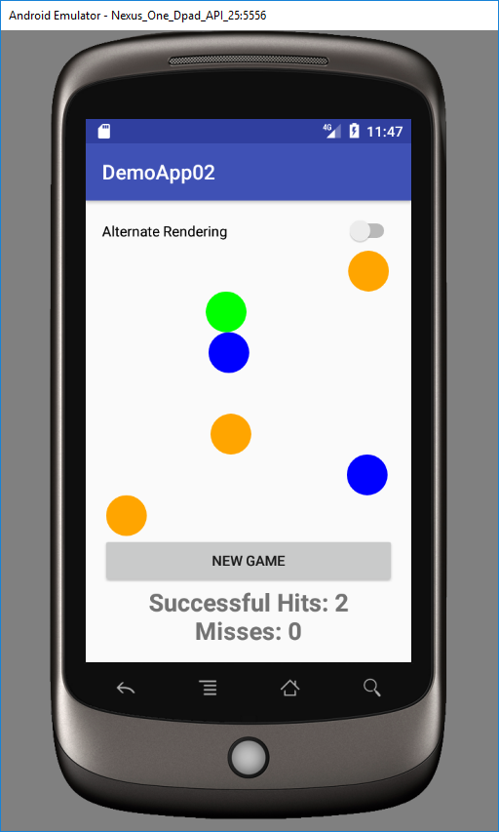
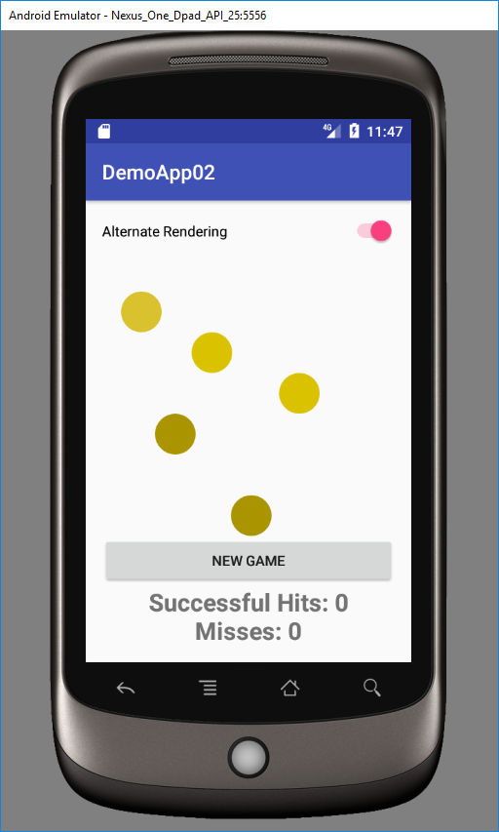
Circle colors are distinctly different when observed by a non-color blind person.
A color blind person has a limited observable color spectrum and hence, circle colors look almost identical.

