Slide 1
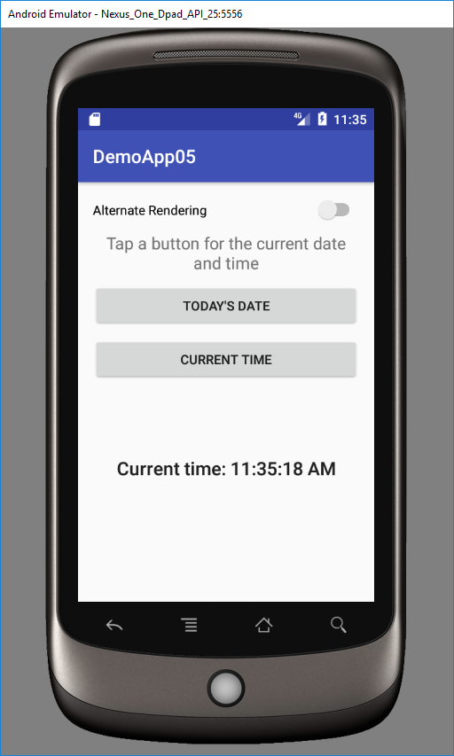
Clicking a button, displays text below.
The generation of the text will not be apparent to a blind user and hence, would need to be announced/spoken

