Slide 1
Salary Prediction Using Machine Learning
Ankit Seal
Nov/2025

Slide 2

About me
Ankit Seal
Project Developer
Nov/2025
Student @
Techno India University,
West Bengal

Slide 3
Contents
Nov/2025
1.
Project Roadmap
2.
Introduction
3.
Problem Statement & Solution Approach
4.
Workflow & Libraries Used
5.
Algorithms Used & Code Summary
6.
Results, Challenges & Future Improvements
7.
Thank You

Slide 4
Project roadmap
Data Preparation
Model Evaluation
Imputation
Encoding & Scaling
Model Building
Nov/2025
Ensuring the dataset is clean by handling missing values and separating numerical and categorical columns
Filling missing values using simple, consistent strategies for both numeric and categorical features.
Transforming categorical features into numeric form and standardizing numerical features for uniformity.
Training multiple regression models inside a unified pipeline setup.
Assessing model performance using metrics like MSE and R² to determine accuracy.

Slide 5
Salary Prediction Using Machine Learning
Nov/2025
Introduction
This project presents a brief exploration of how machine learning methods can assist in estimating employee salaries.
The work is based on a modest dataset that includes attributes such as experience, age, gender, and salary, allowing the model to learn meaningful patterns.
The aim is to build a predictive system that reflects practical use of both regression techniques and ensemble-based approaches.
The implementation is carried out in Python, supported by the Scikit-learn ecosystem for preprocessing, model development, and evaluation.

Slide 6
Understanding the Challenge and Solution Path
Nov/2025
Problem Statement
Organizations often require reliable estimates of employee compensation for planning, hiring, and analysis.
Given limited attributes such as years of experience, age, and gender, the task is to develop a model that can predict salary with reasonable accuracy.
Proposed Approach
Preprocess both numerical and categorical features appropriately.
Train multiple regression models to understand their behavior.
Combine them through an ensemble technique to achieve better overall performance.
Evaluate using standard metrics (RMSE and R²).

Slide 7
Project Workflow & Libraries
Used
Nov/2025
Overall Workflow
Load and inspect the dataset
Clean data and select relevant features
Divide data into training and testing subsets
Apply preprocessing (imputation, encoding, scaling)
Train individual models and an ensemble model
Compare performance using cross-validation
Test the final model with new sample inputs
Save the trained model for future use
Libraries Utilized
pandas, numpy for data handling
scikit-learn for preprocessing, modeling, and evaluation
matplotlib to make data visualisations

Slide 8
Algorithms Used & Code Overview
Nov/2025
Algorithms Applied
Linear Regression
  Used as an initial baseline model, helping us observe simple linear relationships within the salary data.
Random Forest Regressor
  An ensemble of multiple decision trees that reduces overfitting and provides more stable predictions.
Gradient Boosting Regressor
  Builds models sequentially, where each new model learns from errors made previously, allowing gradual refinement.
Voting Regressor
  Combines the predictions of all individual models, aiming to balance their strengths and reduce individual biases.

Slide 9
Algorithms Used & Code Overview
Nov/2025
Brief Code Summary
Preprocessing with ColumnTransformer
  Numeric features are imputed and scaled, while categorical features undergo imputation and one-hot encoding to make them model-ready.
Use of Pipelines
  Each model is paired with a preprocessing pipeline for consistent and automated handling of raw data.
Cross-Validation
  Helps estimate model performance more reliably by evaluating across multiple data splits.
Feature Insights
  Feature importance from the Random Forest model provides a preliminary understanding of which inputs contribute most to predictions.
Model Saving and Testing
  The best-performing model is stored using Joblib and demonstrated on sample input to verify correctness.

Slide 10
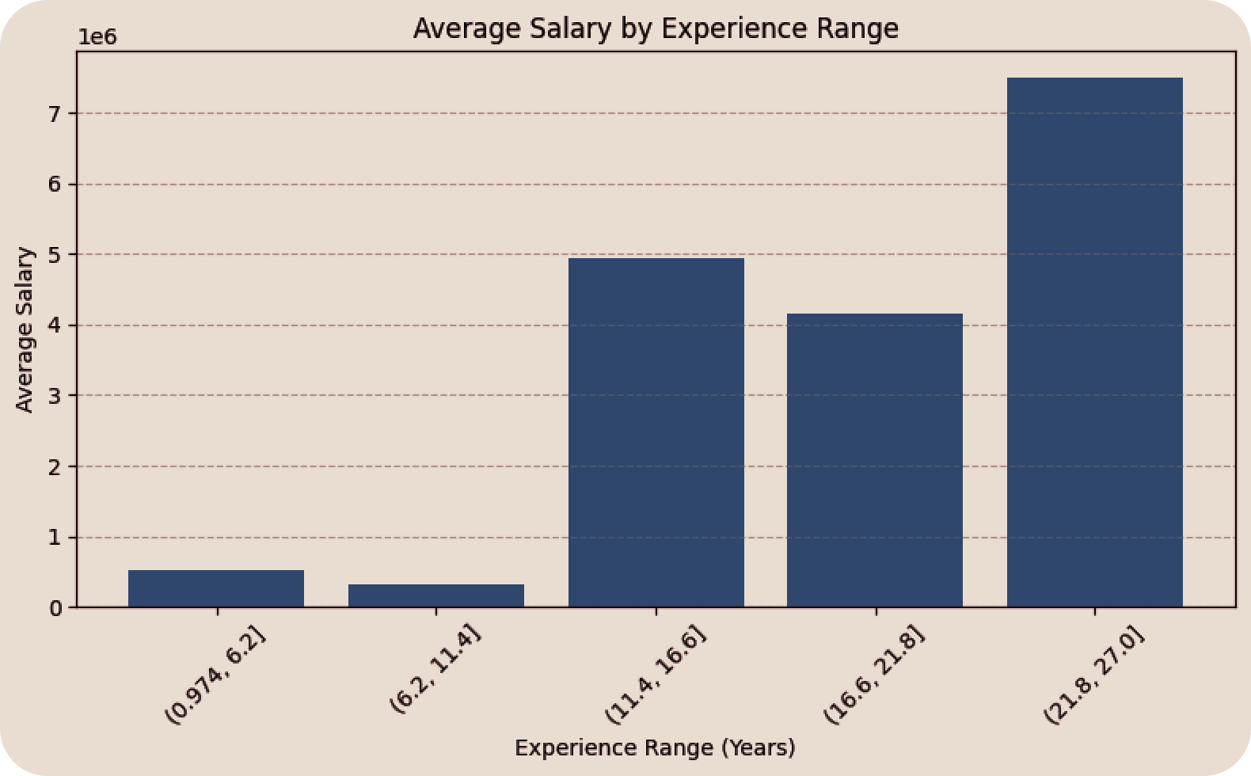
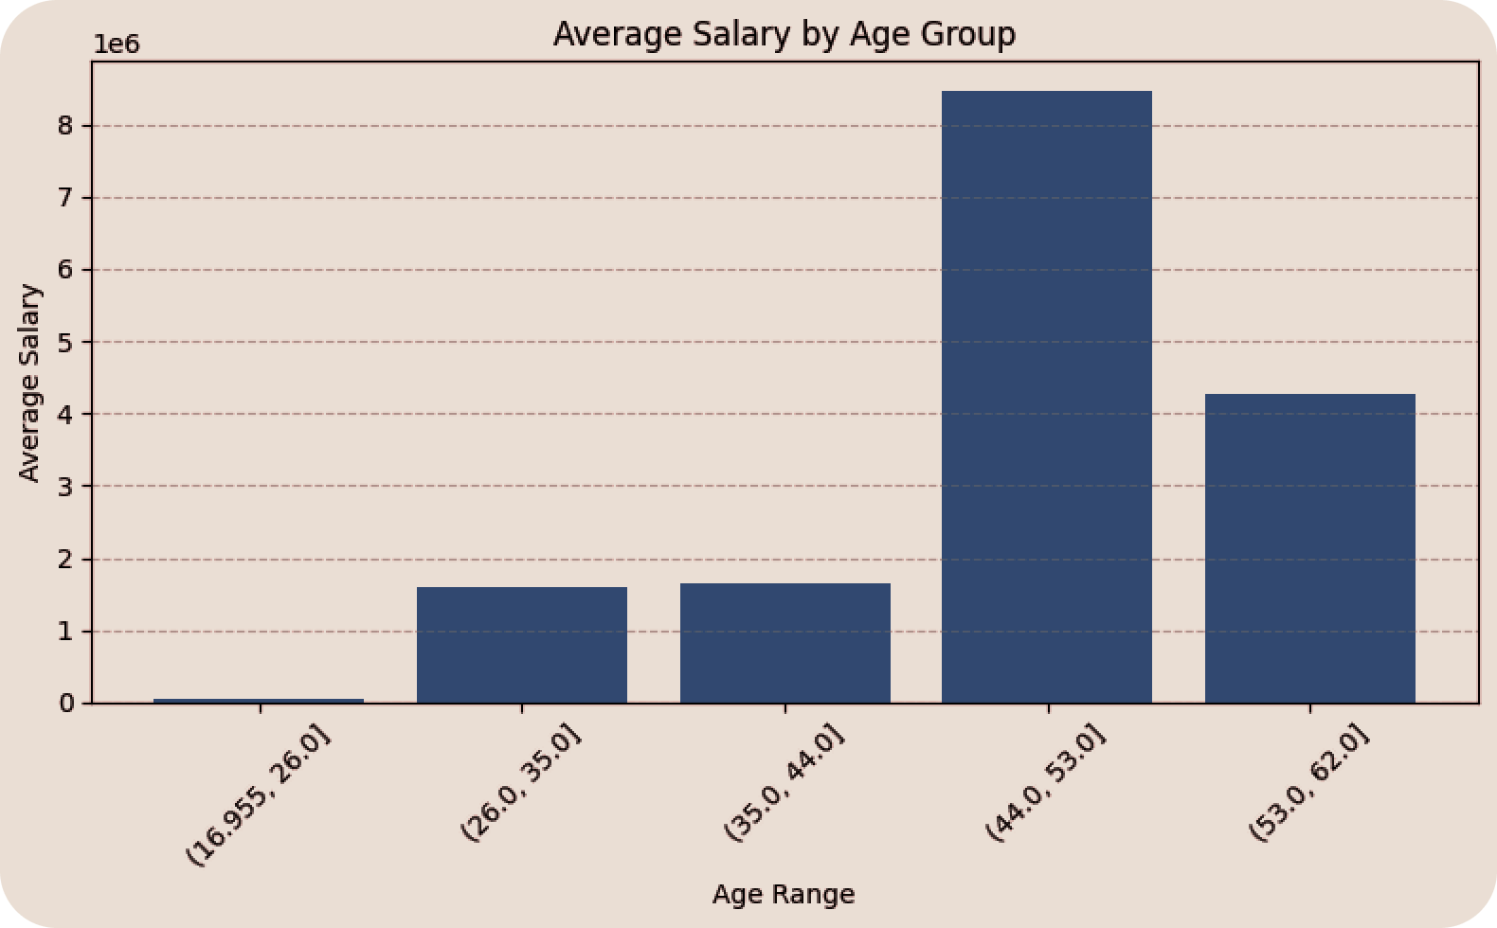
Results & Limitations
Nov/2025
Results Obtained
The ensemble model produced more consistent and balanced predictions compared to individual models.
Evaluation metrics such as RMSE and R² suggested that the model is able to learn meaningful salary patterns from the available features.
Overall, the combined approach offered a dependable baseline for salary prediction.
Current Limitations
The dataset is relatively small and lacks additional influential attributes such as education level, job role, or geographic region.
Salary prediction is influenced by numerous external factors that are not fully captured in the dataset.
Some models may still face generalization issues due to limited data diversity.

Slide 11
Company Name
Year/Quarter/Month
Nov/2025
Future Scope & Improvements
Future Enhancements
Add More Features
Better Algorithms
1
1
2
Introducing variables like skills, company size, job category, and location can significantly strengthen predictive power
Experiment with tuned hyperparameters and advanced models like XGBoost, CatBoost, or lightweight neural networks
Deployment
Dataset Expansion
3
4
Build a simple web interface or dashboard to make predictions accessible and improve presentation value.
Collecting more data from open sources or job portals can build a stronger and more representative training set

Slide 12
Thank you

