Slide 1

Hello! I’m...
Avigyan, doing an analysis taking parameters as movie budget and imdb_ratings based on couple of databases.

Slide 2
Table of Contents.
Summary
Business Problem
Data
Methods
Results
Conclusions
01
02
03
04
05
06

Slide 3
A visualization between the profit with respect to different gernes is the main objective of the project. The maximum profit values in different categories of movies such as drama, comedy has been presented
01

Slide 4
BUSINESS PROBLEMS AND SOLUTIONS
Customers can easily get disappointed by random suggestions.
Company will get to know promote high rated and profitable movie genre and can suggest the customer good movies based on that analysis.

Slide 5
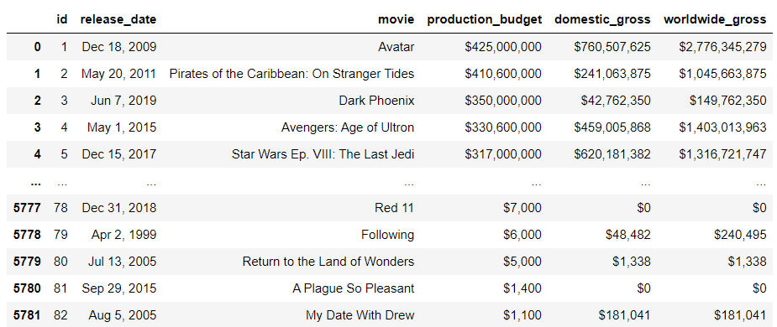
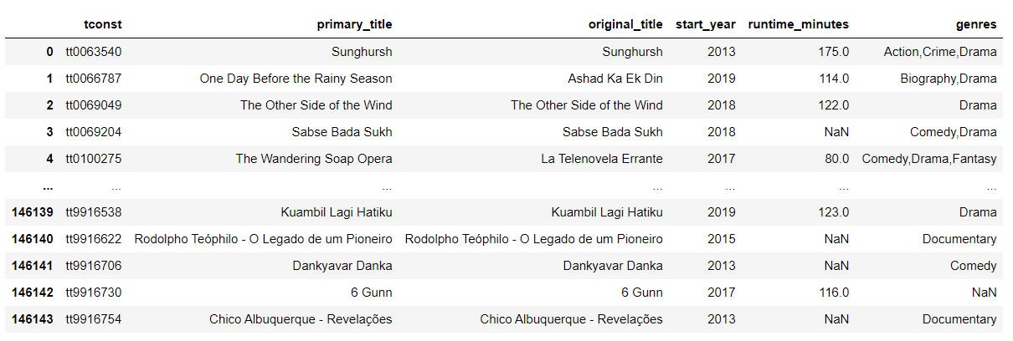
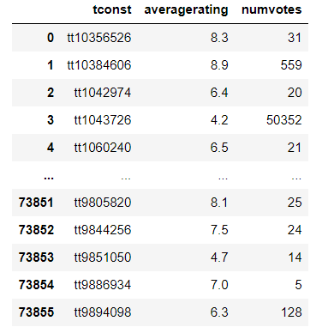
DATA
Table about production budget
Table formed from information based on different types of movies
Table about imdb rating

Slide 6
The graph has been plotted between domestic profit and types of movies with the help of matplotlib functions

Slide 7
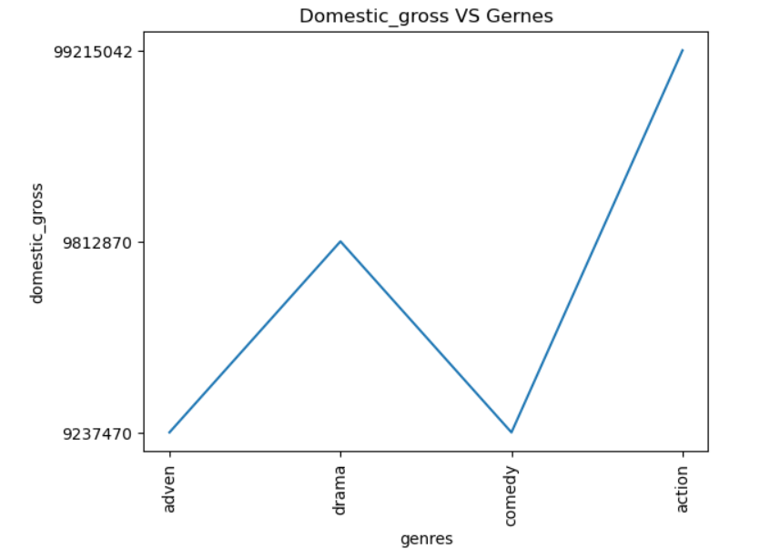
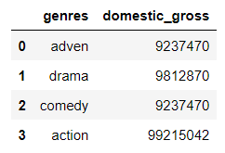
RESULTS

Slide 8
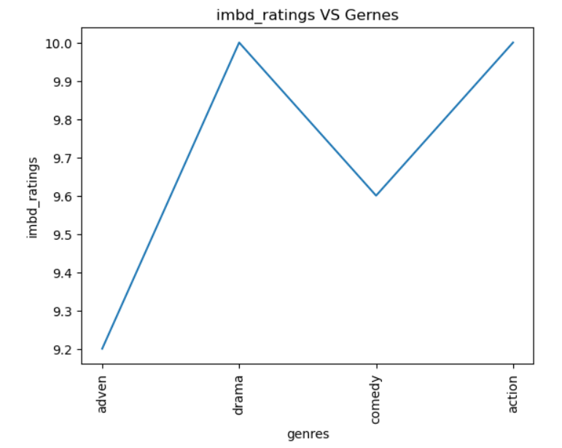
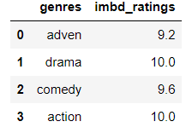
RESULTS (graph and table on imdb_ratings according to genres)

Slide 9
From the analysis between budget and gernes we can conclude that most profitable one is Action and then Drama. According to imdb_ratings the most-high rated categories are action and drama.
CLIMAX

Slide 10
Thank you!
GitHub:

Slide 11
Credits.
Presentation Template: SlidesMania
Sample Images: Unsplash
Fonts used in this presentation: Questrial and Rubik

