Slide 1
MiniNet: Enterprise OpenFlow Network on Your Laptop
MiniNet Tutorial
Spring 2013

Slide 2
Agenda
Introduction to mininet
Introduction to Python
Networking toolsInstalling mininet and its prerequisites
Write a simple OpenFlow controller
Play!

Slide 3
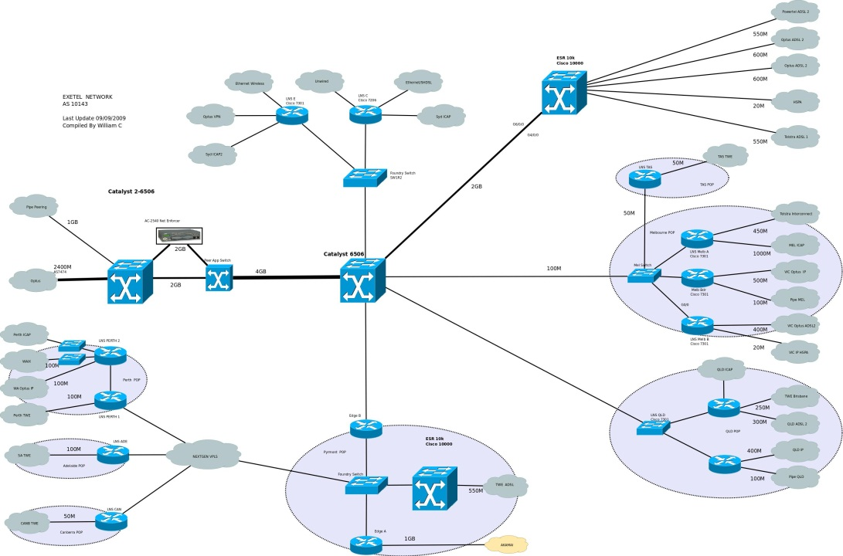
mininet
MiniNet creates scalable Software-Defined Networks (up to hundreds of nodes) using OpenFlow, on a single PC
It allows to quickly create, interact with and customize a software defined network prototype with complex topologies, and can be used to emulate real networks – all on your PC
MiniNet can work with any kind of OpenFlow controller
It takes seconds to install it
Easy to program
Of course, it is an open source project

Slide 4

Python
Python is a very easy-to-use programming (scripting) language
Interpreter based language
We will use it to program the POX OpenFlow controller
We begin with a short introduction…

Slide 5
Values and Types
Python is dynamically typed (no need to declare variables, or their type; parameters have no types)
Indentation is crucial: there are no { } blocks. Blocks are determined according to the indentation of the text
Indentation MUST NOT be done with the TAB character. Instead, in Python we use four spaces Most text editors allow setting this as default
We use Python 2.7.x, NOT Python 3
Detailed documentation: http://www.python.org/doc/
A nice beginners’ book: http://thinkpython.com

Slide 6
Python Functions
Defining functions in Python is easy:
def say_hello(first_name, last_name):
full_name = first_name + ' ' + last_name
print 'Hello ' + full_name + '!'
And calling it later:
say_hello('John', 'Doe')
Function name
Parameters
Four spaces

Slide 7
Python Classes
Python can be used as an Object-Oriented language
Let's define a new class:
import math
class Point2D:
def __init__(self, x, y):
self.x = x
self.y = y
def get_distance(self, p):
d = math.sqrt(math.pow(self.x - p.x, 2) +
math.pow(self.y - p.y, 2))
return d
To create an instance:
p1 = Point(1, 1)
p2 = Point(2, 2)
print p1.get_distance(p2)
We need this for math functions
Everything inside the block is the class
Constructor
self is the new this
Class method
self must be expected in every class method as the first parameter. However, when calling these methods we do not pass an argument for it

Slide 8
Python Classes
We can also inherit other classes:
# continues from previous slide...
class Point3D(Point2D):
def __init__(self, x, y, z):
Point2D.__init__(self, x, y)
self.z = z
def get_distance(self, p):
d = math.sqrt(math.pow(self.x - p.x, 2) +
math.pow(self.y - p.y, 2) +
math.pow(self.z - p.z, 2))
return d
Defines superclass
(can be more than one!)
Call whatever super-constructor you would like
Overriding method

Slide 9
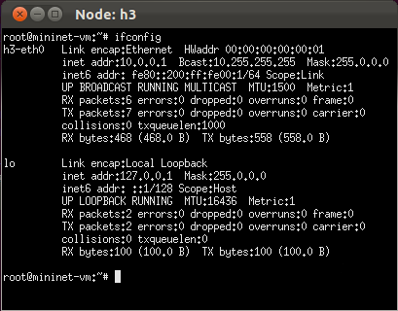
ifconfig
ifconfig is a unix command-line tool that prints the available network interfaces of the machine
Example:

Slide 10
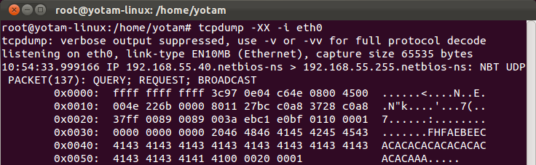
TcpDump
tcpdump is a unix command-line tool for packet sniffing and capturing
It is highly customizable and very easy to use
We will use tcpdump to capture traffic in our mininet network, in order to verify that things work as expected
Example:

Slide 11
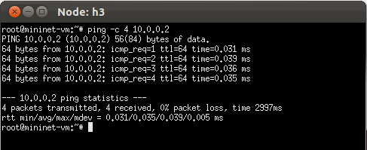
Ping
ping sends ICMP echo request and waits for response
Useful for quickly testing your network
Example:

Slide 12
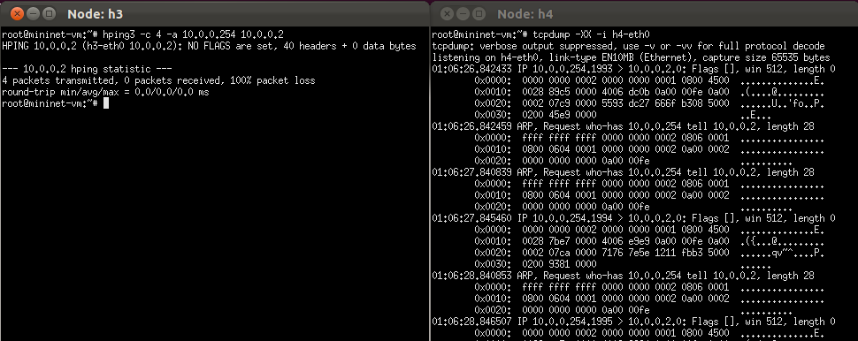
hping3
hping (or hping3) is a command-line tool for generating traffic
It can also modify and spoof layers 3/4 header fields
Example:
hping3 is not installed by default on the mininet VM. You should install it using the command:
sudo apt-get install hping3

Slide 13
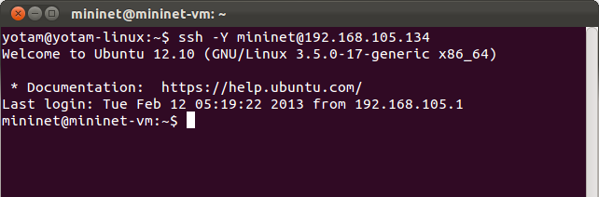
SSH (Secure Shell)
ssh is a tool for secure shell connection between unix machines
Native in Linux
In windows can be found in Cygwin project
We will use ssh to connect to the mininet machine and work with it
Example:

Slide 14
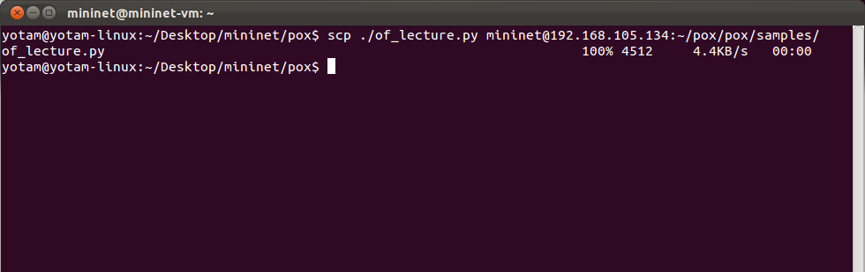
SCP (Secure Copy)
scp uses ssh to securely transfer files between hosts
We will use scp to transfer files to/from the mininet machine
Example:

Slide 15
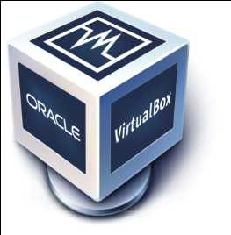

Installing a Virtual Machine Player
MiniNet comes as a virtual machine image, which can be excuted using any virtual machine player that supports OVF (Open Virtualization Format)
We recommend VMWare Player or Oracle VirtualBox
Both are freewares
Both take about a minute to install
VMWare Player is easier to configure
VMWare Player is available for Windows and Linux
VirtualBox is available for Windows, Linux and Mac
Mac users can also use VMWare Fusion
MiniNet can also be installed natively on Linux

Slide 16
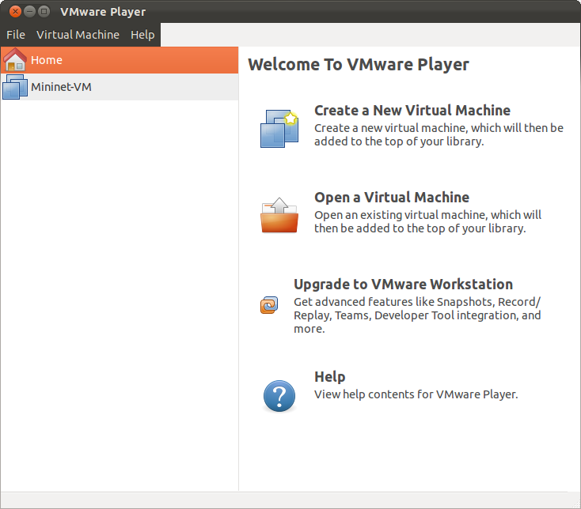
Install MiniNet
Download MiniNet OVF image from here: https://github.com/downloads/mininet/mininet/mininet-2.0.0-113012-amd64-ovf.zip
Unzip and import/open using the virtual machine player
Make sure that the network interface of the virtual machine is set to use NAT
In VirtualBox, NAT does not allow host-guest communication, use "Host Only" instead
When asked about the source of the image, answer "I copied it"
Start the virtual machine – You have MiniNet!

Slide 17
Install a Management Machine
The mininet machine is a linux server. We will control it remotely using ssh
Linux and OS-X has ssh natively and therefore do not need anything else
Windows users:
Option 1: Install Cygwin (cygwin.com)
Option 2: Install a Linux VM with GUI:
Download a ready-to-use VMWare image from here: ftp://ftp.idc.ac.il/Pub/courses/cs/OperationSystems/Ubuntu%20Development.rar
Alternatively, just get a clean installation disk of a linux distribution and install it in a virtual machine
Unrar and import/open using the virtual machine player
VMWare users: When asked about the source of the image, answer "I copied it"
Start the virtual machine

Slide 18
Connecting to the MiniNet VM
Start both VMs
In the mininet VM, login using the user/pass mininet/mininet, then run ifconfig to find the IP address of the mininet machine
In the GUI Linux VM (or in your native linux machine), open a Terminal window (in Mac, open Xterm or XQuartz)
ssh to the mininet machine: ssh -YX mininet@<IP Address> when prompted for password, type: mininet
You can later setup public key exchange to avoid typing password each login
You are connected!

Slide 19
Run MiniNet
Now that you are connected to the mininet machine, you can start the simulation:
Type: sudo mn -c sudo mn --topo single,3 --mac --switch ovsk This will run mininet with the default controller (NOX), a single Open vSwitch switch and three hosts that are connected to it
In the mininet console, type: xterm h1 h2 h3 This will open three terminal windows, each one for a different host
In the window of host h1, type: tcpdump -XX -i h1-eth0
In the window of host h2, type: ping –c 4 10.0.0.1
You are supposed to see the relevant ARP and ICMP packets in h1 terminal

Slide 20
Running mininet with External Controllers
Mininet can also work with a controller that runs somewhere else in the network, or just outside the VM
There are many choices for OpenFlow controllers, such as NOX (C++), POX (Python), FloodLight (Java), and more
To use mininet with such a controller, just specify its IP and port when starting mininet: sudo mn -c sudo mn --topo single,3 --mac --switch ovsk \ --controller remote \ --ip=<controller ip> \ --port=<openFlowPort (6633 by default)>
If the remote controller is located on the same machine, there is no need to specify the IP address

Slide 21

Downloading POX
We will use the POX controller as it is widely supported, cross-platform and easy to program
To download the sources, use the following command on the mininet machine shell: cd ~ git clone http://github.com/noxrepo/pox
As this controller is written in Python there is no need to compile anything

Slide 22
Write a Simple OpenFlow Controller
We will now write our own controller logic, as a Python class that will be loaded by POX instead of its own native code
At first, OpenFlow switches have nothing in their flow tables
Unless the controller does something, switches will ask it what to do every time they receive a packet
With no controller (or non-responsive controller as we begin with), they will not forward packets at all
Let's start with a very simple controller, that makes switches to behave as simple hubs…

Slide 23
Write a Simple OpenFlow Controller
From:
…00-00-03
To:
…00-00-02
From:
…00-00-03
To:
…00-00-02
Host 1
MAC:
…00-00-01
Host 2
MAC:
…00-00-02
Port 1
Switch 1
Port 2
Port 3
Port 4
Host 3
MAC:
…00-00-03
Host 4
MAC:
…00-00-04
From:
…00-00-03
To:
…00-00-02
From:
…00-00-03
To:
…00-00-02
Hub Behavior

Slide 24
Write a Simple OpenFlow Controller
To make the behavior of a hub, once receiving a packet from a switch, the controller should tell the switch to simply flood the packet
It can also teach the switch to flood packets forever
OpenFlow
Controller
From:
…00-00-03
To:
…00-00-02
From:
…00-00-03
To:
…00-00-02
Host 1
MAC:
…00-00-01
Host 2
MAC:
…00-00-02
OpenFlow Packet
buffer_id=1
out_port = FLOOD
OpenFlow Packet
buffer_id=1
in_port = 3
Port 1
Switch 1
Port 2
Port 3
Port 4
Host 3
MAC:
…00-00-03
From:
…00-00-03
To:
…00-00-02
From:
…00-00-03
To:
…00-00-02
Host 4
MAC:
…00-00-04

Slide 25
Write a Simple OpenFlow Controller
Open the file of_lecture.py
This is a Python class that will be used by the POX controller (we will load it instead of POX's default implementation)
The code runs on the controller! (not on the switch!)
Each class instance corresponds to an OpenFlow connection between the controller and a single OF switch
Each instance registers as an event handler for the connection it handles. This will cause triggering of the _handle_PacketIn method for every OF message the switch sends to the controller

Slide 26
Write a Simple OpenFlow Controller
Complete the method act_like_hub(...) in the file of_lecture.py
Put the file into the mininet VM using scp: (in terminal on the non-mininet machine, from the directory where the file reside) scp ./of_lecture.py mininet@<IP Address>:~/pox/pox/samples/
Open two terminals and connect both to the mininet VM using ssh
In the first terminal, run POX with the code we just wrote: cd ~/pox ./pox.py log.level --DEBUG samples.of_lecture
In the second terminal, run mininet with a remote controller: sudo mn -c sudo mn --topo single,3 --mac --switch ovsk \ --controller remote

Slide 27
Exercise
Make the switches in your network layer-2 learning switches
Part 1: Controller teaches switches how to forward layer-2 packets according to the destination MAC address
Part 2: Controller learns network topology, and avoids loops in the network by building a spanning tree over the graph of network links
Not a trivial exercise!

Slide 28
Network With a Loop
From:
Host 1
To:
Host 2
Host 1
1
From:
Host 1
To:
Host 2
Switch 1
2
3
1
1
Switch 2
Switch 3
2
2
From:
Host 1
To:
Host 2
1
2
Switch 4
3
Host 2
Switch 3 learns that Host 1 comes from port 2
Switch 3 learns that Host 1 comes from port 1
Switch 4 learns that Host 1 comes from port 2
Switch 4 learns that Host 1 comes from port 1

Slide 29
Loop Handling – Spanning Tree
Loops are resolved by computing a spanning tree over the graph of links
Only links that are in the spanning tree are used
In case of link failure, the tree may change to include the link that was previously excluded
Host 1
Switch 1
Switch 2
Switch 3
Switch 4
Host 2

Slide 30
Loop Handling – Spanning Tree
Many questions:
How controller knows the links?
How controller finds changes?
How controller makes switches avoid sending on specific links?
Synchronization issues?
You will answer these questions yourself in the exercise.
Host 1
Switch 1
Switch 2
Switch 3
Switch 4
Host 2

