Slide 1

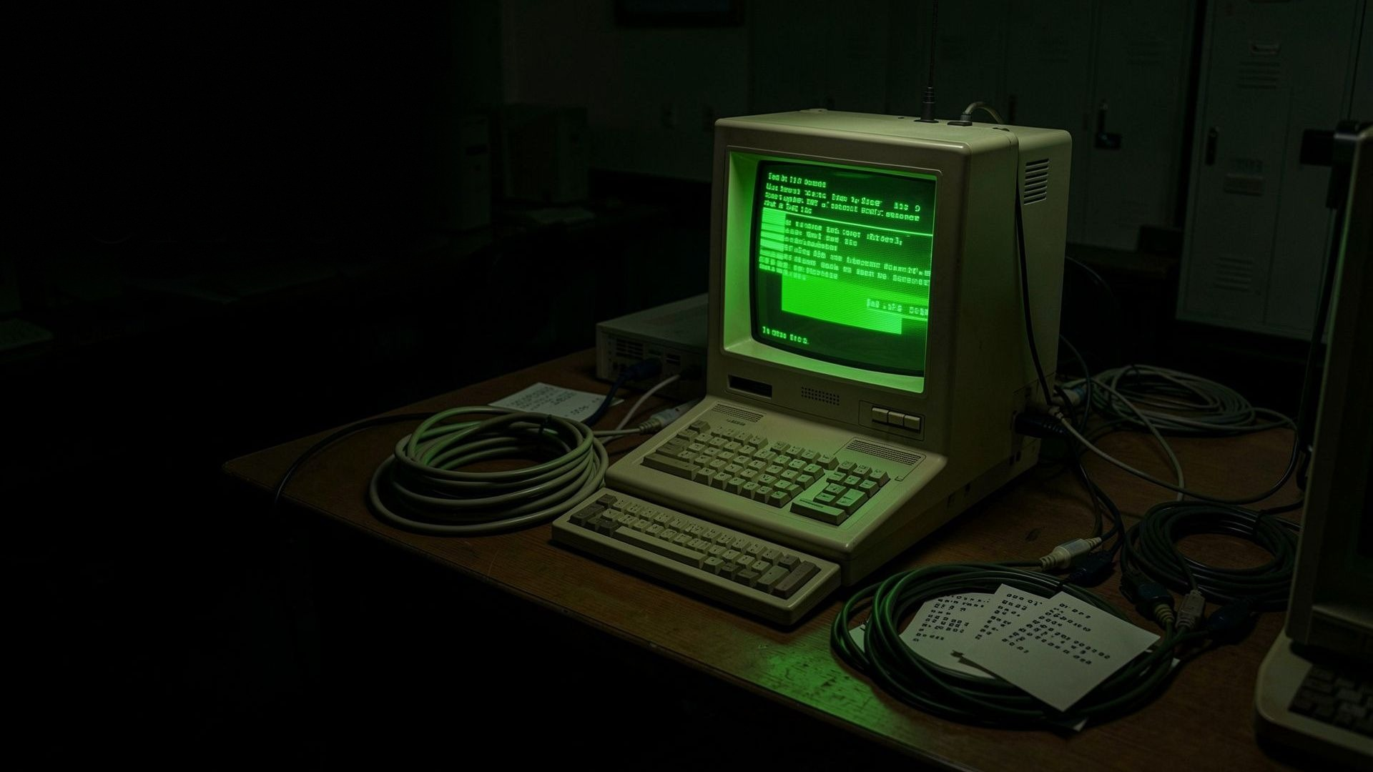
CYBER SECURITY · CASE STUDY
The Morris Worm
1988 Cyber Attack
One of the first self-replicating programs to disrupt the early Internet — released November 2, 1988.
Name: ______________
Enrollment No.: ______________
Class: ______________
Subject: ______________
Guided By: ______________
Cyber Security · Case Study
Notes:
Title slide. Introduce yourself and the topic: the Morris Worm, released on 2 November 1988, is widely regarded as the first major worm to spread across the Internet. Mention it was written by a Cornell graduate student and infected roughly 6,000 of the ~60,000 computers then online. Say you will cover what it was, how it worked, its impact, the response, and the lasting security lessons.

Slide 2





THE ENVIRONMENT
The Internet before the storm
In 1988 the network was small, open and built on mutual trust — with few of the defences we rely on today.
ARPANET and research networks linked universities, laboratories and government sites.
About 60,000 computers were connected to the Internet — small by modern standards.
Security monitoring, patching and incident response were immature and ad-hoc.
The World Wide Web did not yet exist; UNIX systems and email tied the network together.
2
Notes:
Set the scene. The 1988 Internet was a small, trusting research network of about 60,000 machines, mostly UNIX systems at universities, labs and government sites. There was no World Wide Web, little security monitoring, slow patching and no coordinated incident response. Explain that this trusting, loosely defended environment is exactly why a single self-replicating program could spread so widely.

Slide 3
DEFINITION
What was the Morris Worm?
A self-replicating program that copied itself from machine to machine across the Internet — a worm, not a virus, because it needed no host file and no user action to spread.
Type
Released
Author
Standalone self-replicating worm targeting UNIX
November 2, 1988 — launched via an MIT computer
Robert Tappan Morris, Cornell graduate student
Targets
Stated intent
Why historic
BSD-derived UNIX on VAX and Sun systems
To gauge the size of the Internet, not to destroy data
First worm to cause large-scale Internet disruption
3
Notes:
Define the worm precisely. A worm is a standalone program that copies itself across a network without needing a host file or a user to run it — that is the key difference from a virus. This one targeted BSD-derived UNIX on VAX and Sun machines, was released on 2 November 1988 through an MIT computer to hide its Cornell origin, and was written by Robert Tappan Morris. His stated aim was to measure the Internet, but a design flaw made it replicate far too aggressively. It is historic as the first worm to cause large-scale Internet disruption.

Slide 4
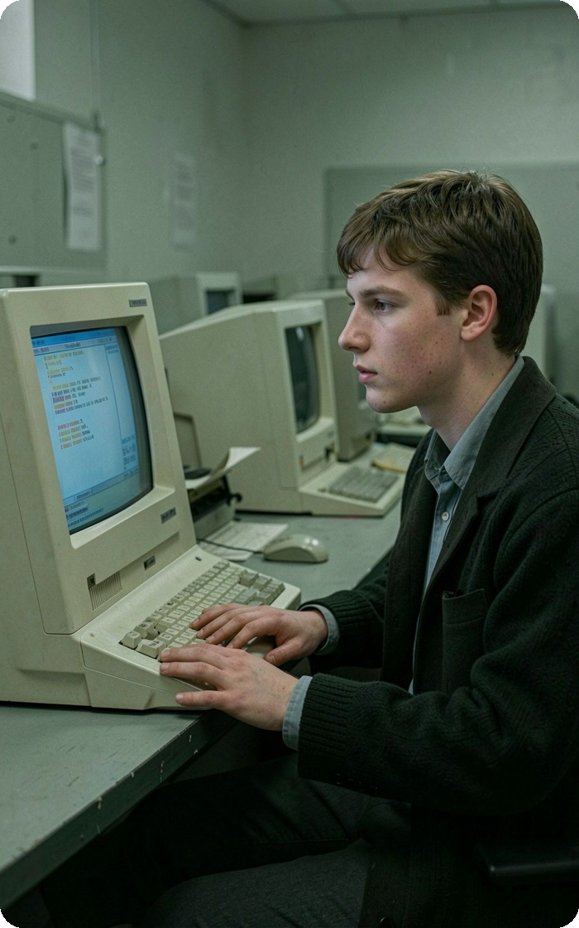
THE RELEASE
A graduate student
releases the worm
Robert Tappan Morris, a 23-year-old Cornell graduate student, launched the program through a computer at MIT on the evening of November 2, 1988 — routing it through MIT to disguise that it originated at Cornell.
1
Nov 2, 1988 — evening Worm released via an MIT machine.
2
Within hours It spreads rapidly across connected UNIX hosts.
3
Nov 3, early hours An apology and fix instructions are posted anonymously.
4
Notes:
Tell the story of the release. On the evening of 2 November 1988, Robert Tappan Morris, a 23-year-old Cornell graduate student, launched the worm through a machine at MIT so it would not look like it came from Cornell. Within hours it was spreading far faster than intended. In the early morning of 3 November an anonymous message — sent on Morris's behalf from Harvard — apologised and gave instructions for stopping it, but network congestion delayed its delivery. Emphasise that the intent was investigative, but the outcome was a major incident.

Slide 5

THE MECHANISM
How the Morris Worm worked
Each infected machine repeated the same cycle — and every new host became another launch point, driving exponential spread.
01
02
03
04
05
06
07
Find host
→
Identify vulnerability
→
Exploit
→
Copy worm
→
Execute
→
Scan again
→
Spread further
The cycle repeats. Because every newly infected host started scanning for more targets, one machine quickly became many — the hallmark of worm propagation.
5
Notes:
Walk through the lifecycle left to right. (1) Find a reachable host on the network. (2) Identify a vulnerability or weak account. (3) Exploit it to get a foothold. (4) Copy the worm across. (5) Execute the copy on the new machine. (6) Scan for more hosts. (7) Spread further. Then stress the loop: each new host repeats all seven steps, so the number of infected machines grows exponentially. Keep the explanation conceptual — this is about understanding the pattern, not reproducing the attack.

Slide 6






ATTACK METHODS
Vulnerabilities and attack methods
The worm combined several weaknesses in common UNIX services so that blocking one path alone could not stop it.
Sendmail debug mode
fingerd flaw
rsh / rexec trust
A debugging feature left enabled in the mail service allowed remote commands.
A flaw in the finger service (which reported who was logged in) was abused for entry.
Remote-shell services and trusted-host relationships let it hop between linked machines.
Weak passwords
Network connectivity
UNIX services
A small built-in word list plus account names cracked many weak passwords.
Open, trusting connections between hosts gave the worm many routes to travel.
Widely deployed, uniformly configured UNIX services multiplied the number of targets.
6
Notes:
Describe the attack surface at a high level. The worm did not rely on a single hole — it combined a debug feature left enabled in the sendmail mail service, a flaw in the finger service, trusted remote-shell relationships between machines, and weak passwords guessed from a small word list and account names. Because UNIX services were widely and uniformly deployed, each weakness opened many identical targets. The lesson: layered weaknesses meant closing one door was not enough.

Slide 7
WHY IT ACCELERATED
Why did it spread
so fast?
ONE HOST → MANY
×3
×9 …
1
Self-replication: every infected host actively sought new victims.
→
→
2
Each new system became another launch point — growth compounded.
Multiple propagation paths meant no single block could stop it.
1 infected
host
3
4
A reinfection-check flaw let extra copies pile up on the same machine.
each new host infects more — growth is exponential
7
Notes:
Explain the exponential dynamic using the diagram. Because the worm self-replicated, one infected host spawned several, each of which spawned several more — growth compounded instead of adding up. Multiple propagation paths meant defenders could not stop it by closing just one. Critically, a bug in its reinfection check meant it often re-infected machines it had already compromised, so extra copies piled up, consuming CPU and memory until systems slowed to a crawl. So the damage came less from destruction and more from runaway replication and overload.

Slide 8
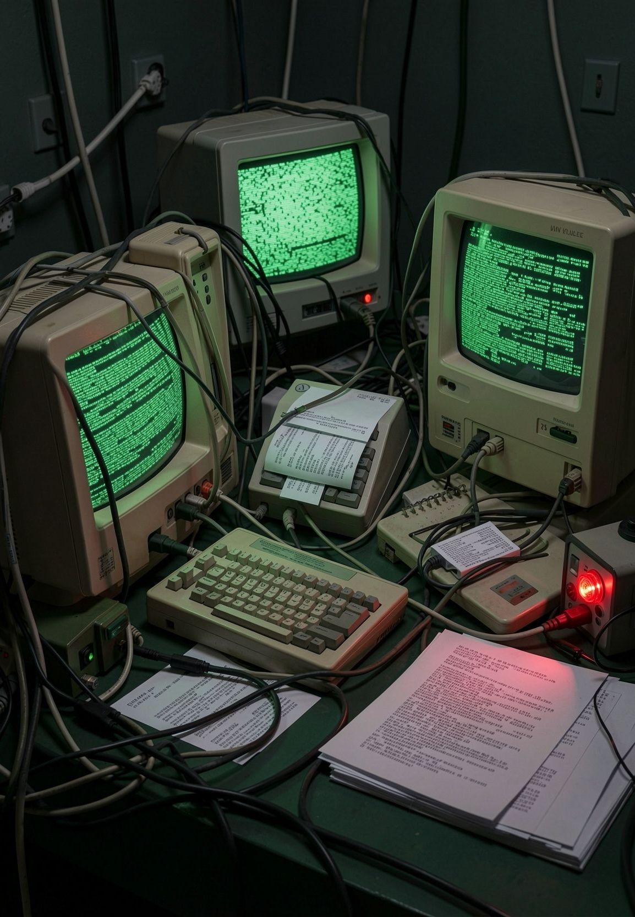
THE IMPACT
Disruption without
destroying data
The worm did not delete files — the harm came from systems being overwhelmed, slowed, and taken offline for cleanup.
≈ 6,000
~10%
$100K–$10M+
computers affected within ~24 hours
of the ~60,000 machines then online
estimated cost (contemporary estimates)
Universities, NASA sites and research laboratories were among those affected.
Computers slowed sharply, email was delayed, and research work was interrupted.
Figures are contemporary estimates, not an exact final census.
8
Notes:
Give the scale carefully, separating fact from estimate. Within about a day the worm affected roughly 6,000 computers — around 10% of the estimated 60,000 then connected. Affected sites included universities, NASA facilities and research labs. Crucially, it did not destroy data; the damage was operational — machines bogged down, email delayed, work halted, and many systems had to be taken offline to clean. Dollar damage estimates ranged widely, from about $100,000 to several million, and should be presented as contemporary estimates rather than an exact figure.

Slide 9




THE RESPONSE
Detection and response
With no formal incident-response system in place, administrators and researchers across sites improvised a coordinated defence.
→
→
→
→
Detect
Isolate
Analyze
Clean / Patch
Restore
Spot unusual load, duplicate processes and odd network traffic.
Disconnect or quarantine affected machines from the network.
Researchers reverse-engineer the code and share findings.
Remove the worm and apply fixes to the exploited services.
Bring systems back online and verify normal operation.
A community response. Teams at Berkeley, MIT and other sites worked in parallel — this spirit of coordination led directly to the first Computer Emergency Response Team (CERT/CC).
9
Notes:
Describe how the incident was handled. Administrators first noticed machines slowing and running duplicate processes. The response pattern was: Detect, Isolate (disconnect affected hosts), Analyze (teams at Berkeley, MIT and elsewhere reverse-engineered the code and shared fixes), Clean and Patch the exploited services, then Restore systems over the following days. The key takeaway: this was an improvised, community effort because no formal structure existed — and that gap is precisely what led to the creation of CERT/CC.

Slide 10


AFTERMATH
Legal and cybersecurity significance
Legal precedent
A wake-up call
First person convicted under the U.S. Computer Fraud and Abuse Act of 1986.
Showed the Internet was fragile and that security could no longer be an afterthought.
Convicted in 1990 following a jury trial.
Prompted creation of the first CERT Coordination Center for organised incident response.
Sentenced to three years' probation, a fine of roughly $10,000, and 400 hours of community service — no prison term.
Accelerated attention to secure coding, patching and network monitoring.
The case established that releasing such a program carried real criminal liability.
Marked the start of cybersecurity as a serious, professional discipline.
10
Notes:
Cover the two legacies. Legally: Morris became the first person convicted under the 1986 Computer Fraud and Abuse Act; in 1990 he received three years' probation, a fine of about $10,000, and 400 hours of community service — no jail. The case showed that unleashing such code carried genuine criminal liability. In cybersecurity terms it was a wake-up call: it exposed how fragile the network was and led directly to the first CERT Coordination Center, and it accelerated attention to secure coding, patching and monitoring — the beginning of cybersecurity as a profession.

Slide 11








WHAT WE LEARNED
Security lessons
Strong authentication
Secure configuration
Patch management
Enforce strong, unique passwords and multi-factor login.
Disable debug modes and unused services by default.
Apply security updates promptly and consistently.
Vulnerability mgmt
Network monitoring
Access control
Find and fix weaknesses before attackers reach them.
Watch for abnormal load and traffic to catch spread early.
Limit trust between hosts; apply least privilege.
Incident response
Secure coding
Network segmentation
Have a tested plan to detect, isolate and recover.
Validate input and avoid unsafe programming patterns.
Contain outbreaks by dividing networks into zones.
11
Notes:
Turn the incident into defensive principles. Run through the nine cards grouped loosely: identity and access (strong authentication, access control, least privilege), system hygiene (secure configuration — disable debug modes, patch management, vulnerability management), code quality (secure coding — validate input), and operations (network monitoring, segmentation to contain spread, and a tested incident-response plan). The message: every one of these maps directly to a weakness the Morris Worm exploited, and together they are how modern organisations prevent a repeat.

Slide 12
MODERN ANALYSIS
Morris Worm: then vs today
A comparison of the 1988 environment with modern cybersecurity practice (present-day analysis).
Aspect
1988
Today
Network trust
Open, highly trusted hosts
Zero-trust, segmented networks
Monitoring
Little to none
IDS / IPS, SIEM, continuous monitoring
Defences
Weak passwords, few controls
Firewalls, endpoint protection, MFA
Patching
Slow, manual, inconsistent
Automated vulnerability & patch management
Response
Improvised, ad-hoc
Dedicated CERT / SOC incident response
12
Notes:
Bridge 1988 to the present, and label it clearly as modern analysis. Point column by column: network trust moved from open and trusting to zero-trust and segmented; monitoring went from almost none to IDS/IPS, SIEM and continuous monitoring; defences from weak passwords to firewalls, endpoint protection and MFA; patching from slow and manual to automated; and response from improvised to dedicated CERT and SOC teams. Conclude that the Morris Worm exposed gaps that directly shaped every one of these modern controls.

Slide 13
KEY TAKEAWAY
A small self-replicating program showed how one vulnerable system could trigger a large-scale network crisis.
Attack
Propagation
Impact
Response
Lessons
→
→
→
→
Security must be designed, monitored and practised before an incident — not improvised after one. The Morris Worm made Internet security visible, and its lessons still define the discipline today.
Takeaway: a small program can have a very large blast radius.
13
Notes:
Close with the core message. A single self-replicating program, exploiting avoidable weaknesses, turned one vulnerable host into a network-wide crisis within a day. Summarise the arc: Attack, Propagation, Impact, Response, Lessons. End on the enduring point — security has to be designed in, monitored and practised before an incident, not improvised afterwards. The Morris Worm made Internet security visible and still shapes how we defend networks today.

Slide 14
SOURCES
Academic references
FBI
Federal Bureau of Investigation — “The Morris Worm: 30 Years Since First Major Attack on the Internet” (famous-cases history).
Spafford, 1989
Eugene H. Spafford, “The Internet Worm Program: An Analysis,” ACM SIGCOMM Computer Communication Review, 19(1), 1989 (Purdue Tech. Rep. CSD-TR-823).
Eichin & Rochlis
M. W. Eichin & J. A. Rochlis, “With Microscope and Tweezers: An Analysis of the Internet Virus of November 1988,” MIT, 1989.
U.S. GAO
U.S. General Accounting Office, “Computer Security: Virus Highlights Need for Improved Internet Management,” GAO/IMTEC-89-57, 1989.
U.S. v. Morris
United States v. Morris, 928 F.2d 504 (2d Cir. 1991) — conviction under the Computer Fraud and Abuse Act of 1986.
CERT/CC
CERT Coordination Center, Software Engineering Institute, Carnegie Mellon University (established November 1988).
Computer History Museum
Computer History Museum — exhibits and articles on the 1988 Internet Worm.
All historical facts drawn from the authoritative sources above; the “then vs today” comparison is present-day analysis.
14
Notes:
List the sources you relied on and note their authority: the FBI history, Spafford's technical analysis, the MIT 'With Microscope and Tweezers' paper, the U.S. GAO report, the Second Circuit court opinion for the legal facts, CERT/CC, and the Computer History Museum. Make clear the historical facts come from these sources, while the then-vs-today comparison is your own modern analysis. Invite questions.

