Slide 1
Purple Foods Case Study
Prepared By : Anisha Vijayan
https://avijay24.github.io/

Slide 2
About Purple Foods
Purple Foods, an established player in the meal kit industry, has been competing for market share for several years. It uses a subscription-based model where recipes are presented to customers in a specific order based on assigned slots.
Customer can provide feedback in the form of recipe scores or text box comments. Each meal kit box comes at a base price of $11, with additional surcharge fees of $5 for fast & fresh meals and $9 for premium meals.
Introduction
Task Details
Case Study
Weekly Recipe Score metric formulation.
Key actions to improve the weekly recipe score.
Revenue trend analysis.
QA

Slide 3
Data Cleaning & Transformation
Stage
Transform
Analyze
Extract data in Power BI
Create Charts & Analyze the trend
Append, Merge , Remove Nulls and Add Custom Columns & Measures

Slide 4
Weekly Recipe Score metric formulation
Problem Statement
Please create a metric called “weekly recipe score” that represents holistically how recipes within a given week performed, considering the most appropriate way to calculate this metric. Document any assumptions made.
How has the weekly recipe score been trending in the first half of 2023?
What would you recommend as a weekly recipe score target and why?
List the main factors contributing to low recipe scores.
Introduction
Case Study
Assumptions
Recipe Scores range from 1 to 4, where 1 represents the lowest (poor) and 4 signifies the highest (excellent).
Meal Choices that are either missing or blank have been excluded from the analysis.
Total Cooking Time = Prep Time + Cooking Time.
Quality Error Rate is a not derived from Recipe Score and is a separate metric.
QA

Slide 5
Formula
Recipe Score
Box Size
Weekly Recipe Score
Quality Error Rate
Step 1: Weighted Average Recipe Score = sum(Recipe Score * Box Size) / sum(Box Size)
Step 2: Weekly Recipe Score = Weighted Average Recipe Score * (1 – (QER/100))
Notes:
Recipe Score: Customer Rating for a recipe. Box Size: Serving size. Quality Error Rate: % of meals delivered that had quality issues.
Why QER? Higher QER will have their scores more heavily discounted.

Slide 6
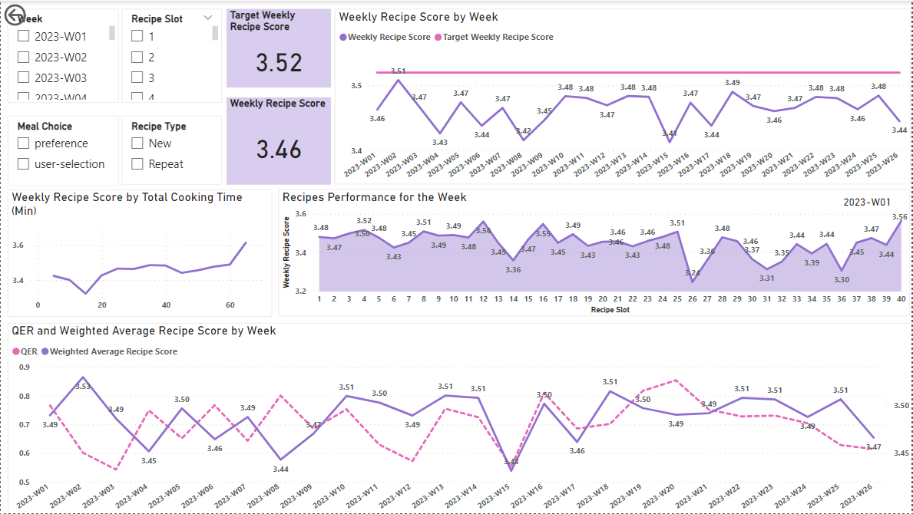
Performance Dashboard
Introduction
Case Study
QA

Slide 7
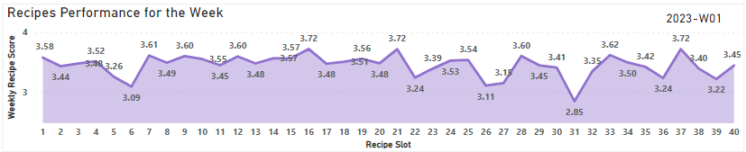
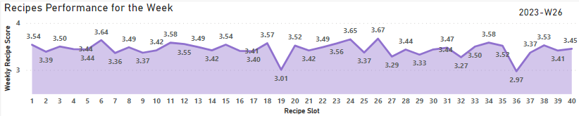
Recipe Performance for the Given Week
Introduction
Case Study
QA
Notes:
Choose a Particular Week in the Dashboard and get that weeks Recipes Performance.

Slide 8
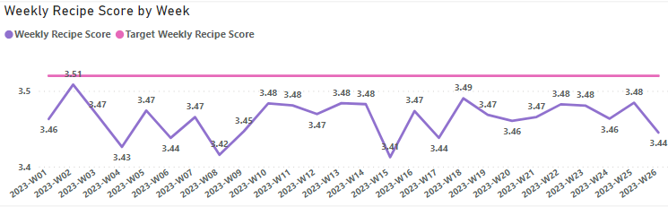
Weekly Recipe Score Trend (first half of 2023)
Introduction
Case Study
QA
Target Weekly Recipe Score : Minimum QER (0.11%) & Maximum Weighted Average Recipe Score (3.53)
(3.52)
Notes:
Pink line is the Expected Target Score. Almost like a cyclic trend with lot of fluctuations during the initial weeks and stabilized towards the end.

Slide 9
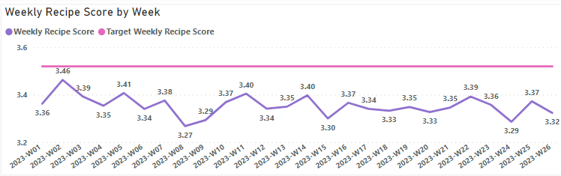

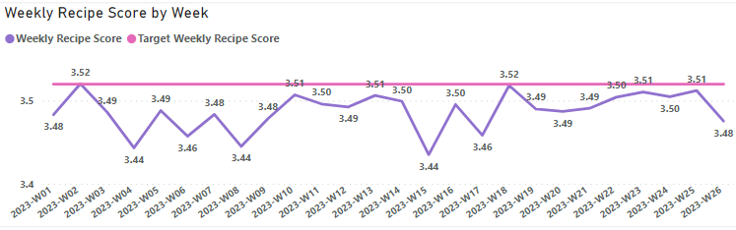
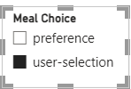
Main factors contributing to low recipe scores
Introduction
Meal Choice
Default Preferences causes lower customer satisfaction levels
Case Study
QA

Slide 10
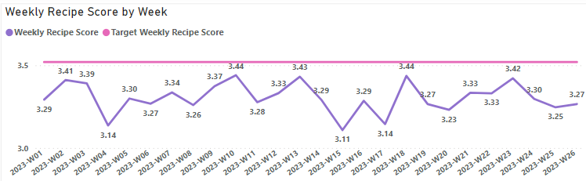

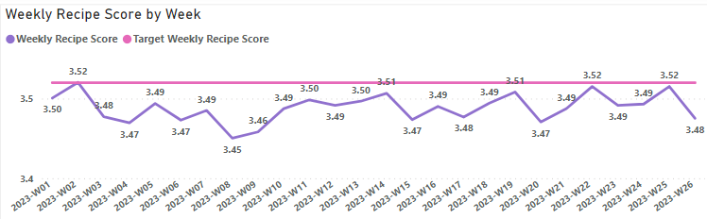

Main factors contributing to low recipe scores
Introduction
Recipe Type
Repeat recipes are well-received
Case Study
QA

Slide 11
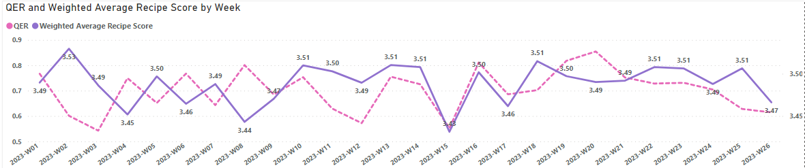
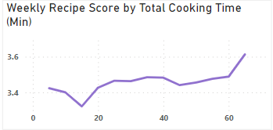
Main factors contributing to low recipe scores
Quality Error Rate
Introduction
Higher QER reduces the
Weighted Recipe Score
Case Study
Cooking Time
QA
Underestimating Total Cooking time resulted in customer dissatisfaction

Slide 12
Key actions to improve the weekly recipe score
Problem Statement
Introduction
If Purple Foods wanted to increase its recipe score, what should it focus on? Please list the top key actions you would take and why.
What financial and operational challenges do you think Purple Foods might encounter as it implements these options?
Case Study
QA

Slide 13
Key actions to improve the weekly recipe score
Improve Quality Error Rate
Focus Points
Customer Engagement Strategies
Customized Preferences
Recipe Innovation/Revision
Key Actions
Financial and Operational Challenges
Employ QC Team, Chef Training, Better Storage
Incentivize Feedback System
Offering New Recipes as Complimentary or Discounted Options
Empower Customers to Establish Default Preferences
Cooking Time/Recipe Revision to Improve Recipe Score
Training and Onboarding Cost
Elevated Storage Expenses to Avoid Food Spoilage
QC step leads to Increased Operational Time
Operational expense for Feedback & Custom Preferences System Integration
Cost of Incentives and Discounts; may affect Revenue

Slide 14
Revenue trend analysis
Problem Statement
Introduction
How did revenue trend during the first half of 2023? Please document any assumptions made. What were the main drivers of revenue?
What are some hypotheses about why revenue is trending in the direction it is?
Assumptions
Case Study
Recipe Scores range from 1 to 4, where 1 represents the lowest (poor) and 4 signifies the highest (excellent).
Meal Choices that are either missing or blank have been excluded from the analysis.
Total Cooking Time = Prep Time + Cooking Time.
Quality Error Rate is a not derived from Recipe Score and is a separate metric.
Revenue Calculation is based on the subset of data where the Customer Review are available.
QA

Slide 15
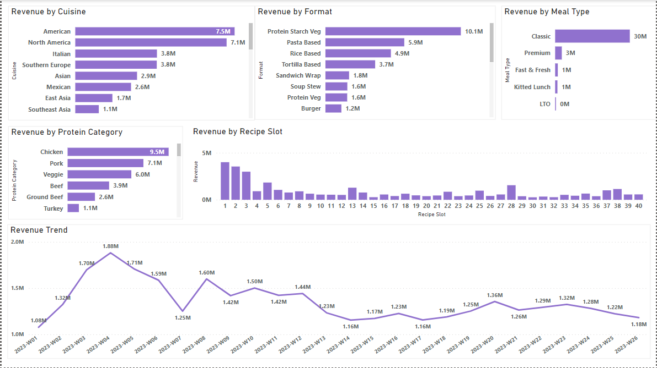
Revenue Dashboard
Introduction
Case Study
QA

Slide 16
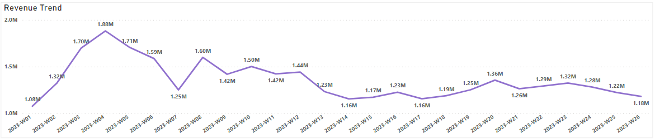
Revenue Trend (first half of 2023)
Introduction
Case Study
QA
Notes:
Following an initial peak, the revenue experienced a decrease and then stabilized, remaining consistent throughout the latter part of the period.

Slide 17
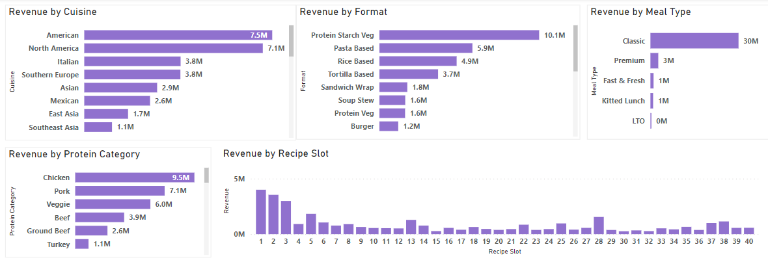
Main Drivers of Revenue
Introduction
Case Study
QA
Notes:
Interpretation: What are some of the factors which are driving the revenue as of now.

Slide 18
Hypotheses for Revenue Trend
Revenue
Seasonal Revenue Fluctuations
Increased Revenue in Colder Months
Shift in Consumer Behaviour: Preference for dining out in Summer
Impact of Lower Recipe Scores
Lower recipe scores correlate with customer dissatisfaction.
Consequence: Decreased revenue due to potential customer disengagement.
Influence of Quality Error Rate
Higher quality errors lead to potential customer dissatisfaction and reduced revenue.

Slide 19
Q/A
Introduction
Thank you
Case Study
QA
Notes:
Credits: slidesgo.com

