Slide 1

IDS 566 Advanced Text Analytics
Mini Projects
GROUP 8:
ANISHA VIJAYAN (UIN: 662618335)
SALONI KATARIA (UIN: 662519005)
JAHNAVI MUTHYALA (UIN:667960987)
NAINI NARAMA LNU (UIN:679008394)

Slide 2
Dataset
Language Models
Training
(40138)
Total tokens in training data corpus, N = 890689 (including the punctuations)
Vocabulary size of training data, |V| = 42235
Brown Corpus
(57340 Sentences)
Validation
(5734)
Test
(11466)
Preprocessing Steps
Remove punctuations Remove empty strings Convert to lowercase Append <s> and </s> at start and end of each sentence
Ngram Models
Unigram Model:
calculated the unigram frequencies ie, word frequency
computed the unigram probabilities
= word frequency / total tokens
if smoothing enabled then,
unigram probability =
smoothed word freq /
(total tokens + vocabulary size)
Bigram Model:
calculated the bigram frequencies ie, count of occurrence of wn-1 and wn together
computed the bigram probabilities
= bigram frequency for the current word / unigram frequency of the previous word
if smoothing enabled then,
bigram probability =
smoothed bigram freq of the current word / (unigram frequency of previous word + vocabulary size)
Trigram Model:
calculated the trigram frequencies ie, count of occurrence of (wn-2, wn-1, wn) words together
computed the trigram probabilities
= trigram frequency /
bigram frequency of wn-2, wn-1
if smoothing enabled, then
trigram probability =
smoothed trigram frequency /
(bigram frequency of wn-2, wn-1 + vocabulary size)

Slide 3
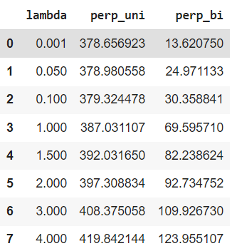
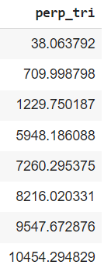
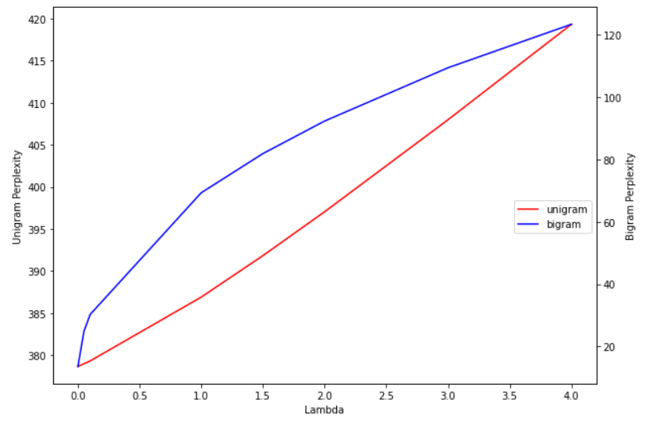
Evaluation Metric: How good is our model?
Perplexity for training and test data across models
Perplexity of upper n-gram models is lowest as they use the context, therefore the next word would not be that surprising.
Lower the perplexity, better the model.
 | Training Data | Test Data
Unigram | 730.13 | 377.65
Bigram | 49.87 | 14.24
Trigram | 5.19 | 2.19
Add – lambda smoothing
As lambda increases, perplexity also increases
Perplexity of trigrams is higher in table
since train + validation dataset was used
We experimented with different values of lambda and calculated the perplexity for each
lambda value for each ngram model on validation data
After adding lambda as 0.001
 | Test Data
Unigram | 370.53
Bigram | 11.84
Trigram | 2.19
Since the lambda value is close to 0,
the perplexity is almost the same as
compared to before smoothing.

Slide 4
Sentence Generation:
Unigram Model:
pips mistaken didnt is president printed
the family her project
anticipated of not the and and the hunted on which beethoven the of englanders the after door broaden fear the
owen with not the by additional
case we let not did the jew have
Bigram Model:
but he scored
the many precious little confidence
he would start of costs
youve finally made with sauces and science is its life in their
she liked the most species
Trigram Model:
this is not otherwise
then he went to visit
i dont know
you may save valuable
the recently appointed to
More meaningful sentences generated by trigram model

Slide 5
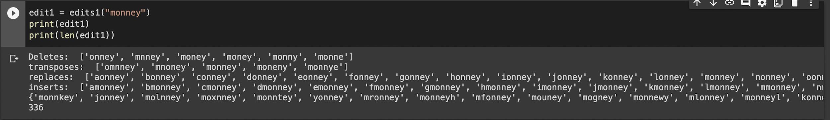
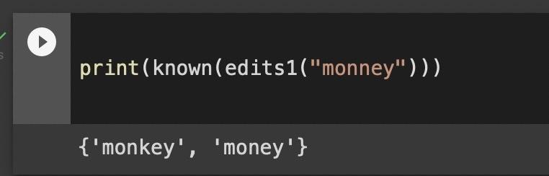
Application : Spell Checking
Step 1: We downloaded the "brown" corpus from the NLTK module, which is the dataset for this problem.
Step 2: Data Preprocessing: The words from Brown are all converted into lowercase. Following that, a regular expression is used to remove any punctuation or symbols. Any remaining white space is then removed.
Step 3: Calculate the frequency of each distinct word in the corpus.
Step 4: We used Peter Norvig's approach to spell check a word as our algorithm. Try every possible edit for a word, including Delete, Insert, Transpose, Replace, and Split. Every word is added to a list of words that could be used. We repeat this procedure for each word a second time to find words with a greater edit distance (for cases with two errors). A Unigram language model is used to estimate each possible word. Unigram probability is calculated for each word. The word with the highest probability is chosen from the list of possible words.
A delete (removing one letter), a transpose (swapping two letters next to each other), a replace (changing one letter for another), or an insert are all examples of simple word changes (adding a letter). edits1 returns a set of all the edited words (whether words or not) that can be made with a single simple edit.
The edits1 function returns all possible words after performing delete, transpose, replace, and insert. The list obtained has 336 possible words.
If we limit ourselves to known words, that is, words from the dictionary, the set becomes much smaller, just 2 words.

Slide 6
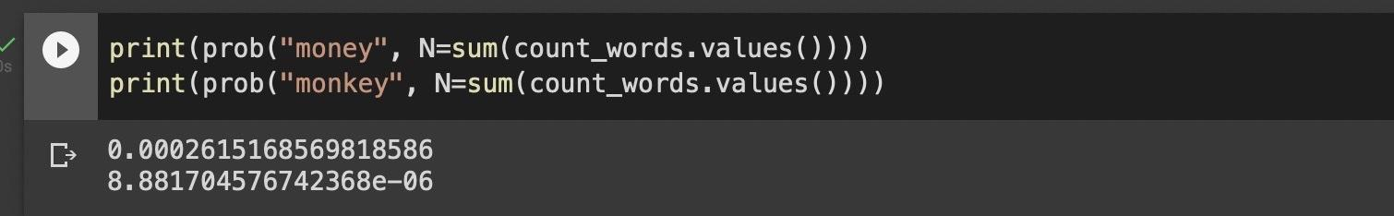
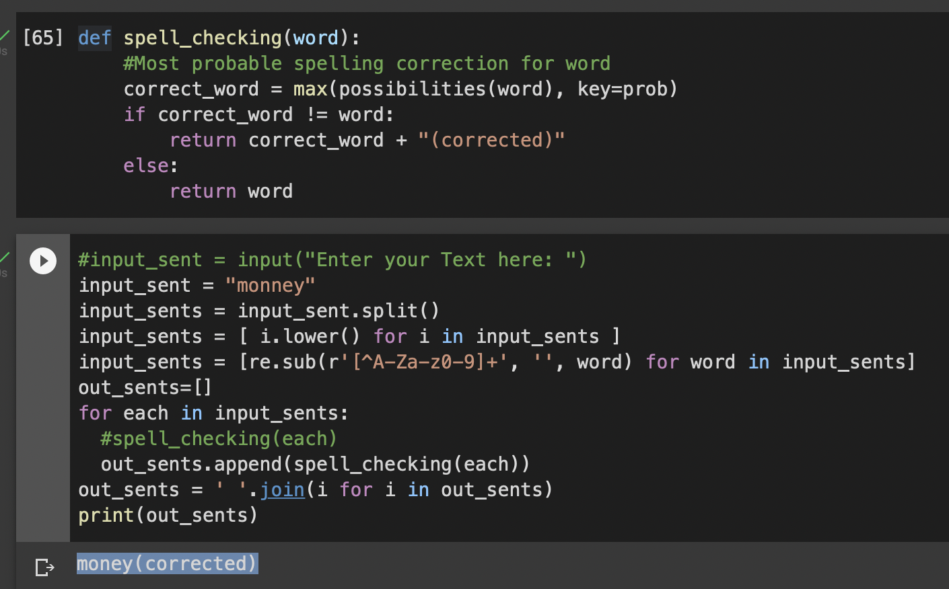
Corrections that require only two simple edits will also be considered. This generates a much larger set of possibilities, but only a few of them are commonly used words.
Step 5: Language Model. The Unigram probability of a "word" is found by dividing the number of times a word appears in the corpus by the total number of words in the corpus.
Step 6: Correction: To check the spelling of the word, we obtain all the possibilities of the word with one edit, two edits, or the same word if it is known (that is, in the data dictionary we have chosen). Then we choose the word that has the highest probability as our corrected word.

Slide 7
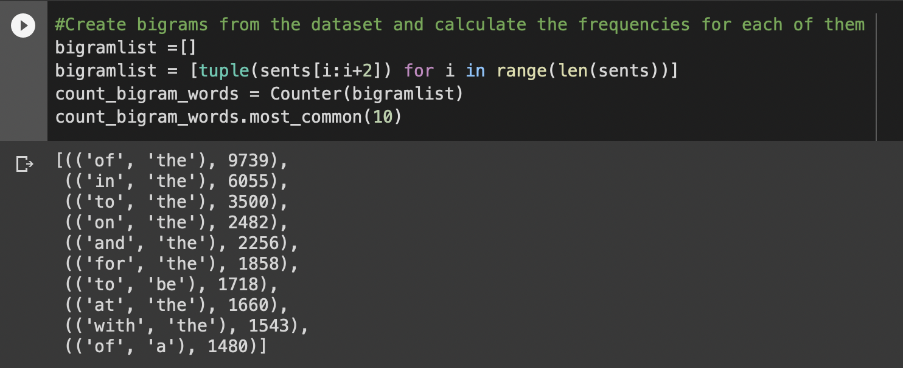
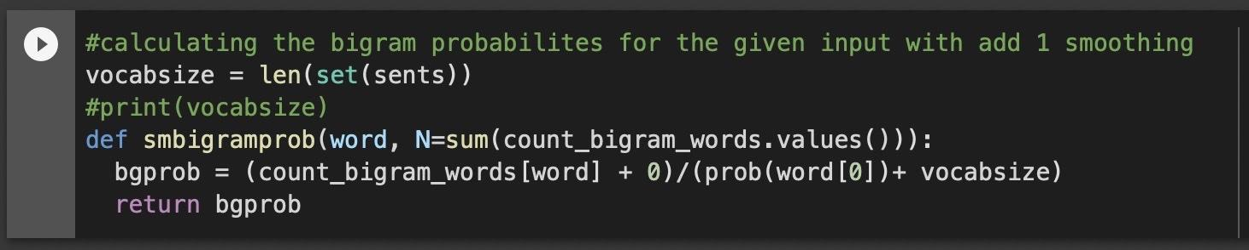
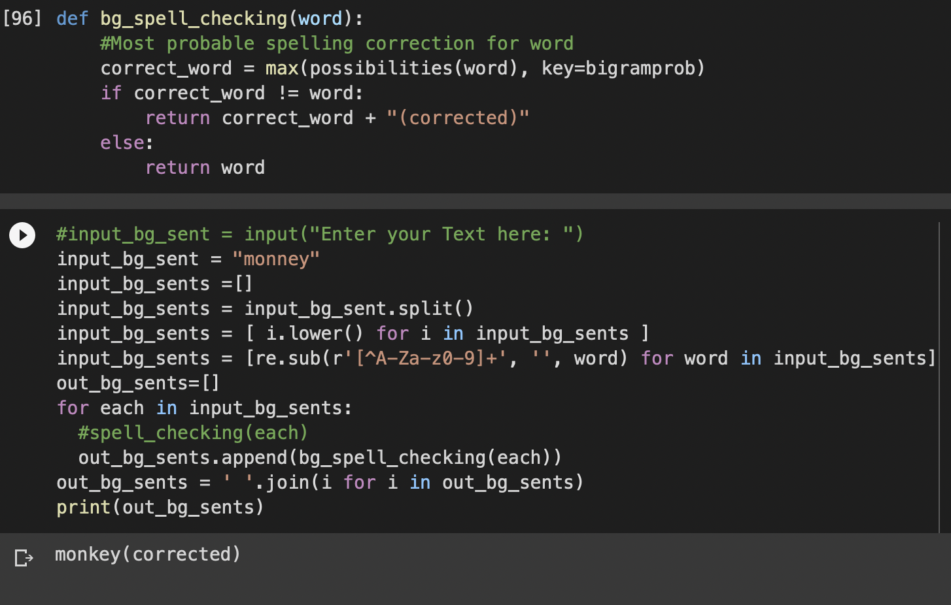
Step 7: Similarly, bigrams can be used to implement this.
The dataset is now used to generate bigrams, which are then used to calculate bigram frequencies.
Step 8: The bigram probabilities for each word are calculated with add-1 smoothing
Step 9: The spell check is then performed using the bigram probabilities, considering new probabilities for the word, and selecting the word with the highest probability.

Slide 8
Word Sense Disambiguation : Supervised WSD (Naive Bayes Model)
To extract the features, we have used the co-occurrence feature extraction method with window size, N = 1
- Call the function get_features
- Get count of different sense ids for target word
- Calculate prior prob
- Calculate occ of feature words within context of target word
- Calculate feature prob for each sense (Handles smoothing)
- Return train model [pos-feature word-sense id: prob] & prior prob
generate_train_model()
For each target word in test data:
- Fetch test instances for the target word
- Call the function generate_train_model
- For each sentence in test:
- Call the function get_features
- For each unique sense id:
- Get pos-feature word-sense id
- Check if exists in train model
- Get individual feature prob
- Calculate prob = p(s) * product p(f | s)
- Take sense id with max prob
- Return sense id as prediction
main()
Get test & train data file
- Data Cleansing
- Transformation (Split into words, fetch pos tag and lemma,
remove stop words)
- Computation (fetch index for ‘%%’ & fetch feature words for
given window size)
- Return [[pos, prev word], [pos, next word]]
get_features()
Csv file with predicted sense id for each target word in test data
End

Slide 9
Analysis/Findings
The table below shows the accuracy of our model with different values of lambda and window size on validation data:
Lambda | Window Size | Accuracy
1 | 1 | 53.59%
0.01 | 1 | 81.14%
0.01 | 2 | 74.17%
We have finally used the lambda value as 0.01 and window size as 1 for predicting the sense ids of the test data
We also used the combination of training and validation data for test sense id prediction
We built a Baseline model as well, which predicts the most frequent sense id of the target word
The accuracy for the Baseline Model: 80.70%

Slide 10



Simple Lesk Algorithm
Data Used:
Dictionary
Train data
Validation data
Test data
Lemmatization is used to increase matching of the meanings of words for better accuracy.
Step 4: Simple Lesk model: For each sense id of target word, we calculate the count of overlapping words between the target word’s gloss + examples from the dictionary provided, and the lemmatized words from the given test sentence. This count is taken as the score for each sense id.
Step 1: Split the test data set into columns: Target Word, SenseID and Sentence
Step 5: The sense id with the maximum score is taken as the predicted sense id for the target word.
Step 2: Data cleansing: remove punctuations and lowercase all words
Accuracy achieved: Validation Data: 49.09% Train Data: 47.65%
Step 3: A list of lemmatized words with POS using WordNet is generated and stop words are removed from that list

Slide 11
Original Lesk Algorithm
Lemmatization is used to increase matching of the meanings of words for better accuracy.
Metric used for trial to increase matching: BIGRAMS
We tried calculating the score of overlaps by adding the intersection score of the (target + context) senses calculated before and twice the score of bigram context score.
Data Used:
Dictionary
Train data
Validation data
Test data
Step 1: Split the data set into columns: Target Word, SenseID and Sentence
Single word score: Overlapping score of target sense and context sense
Step 2: Data cleansing : removed punctuations and lowercase all words
Consecutive word score: Bigrams for the target and context sense are generated and the overlapping words are counted. This count is added twice to the single word score to give higher weightage.
Step 3: A list of lemmatized words with POS using WordNet is generated and stop words are removed from that list
Step 5: The scores are computed for each sense ID and the sense ID with maximum score is taken as the predicted sense ID.
Step 4: To build model on Original Lesk algorithm, we derive the following:
Target Sense: senses of the target words from the dictionary given, lemmatize them
Accuracy achieved: Validation Data: 41.26% Train Data: 40.02%
Context Words: these are all words from given sentence apart from stopwords and the target word itself, lemmatize them
Context Sense: Sense of each lemmatized context word is generated, lemmatize them

Slide 12
Corpus Lesk Algorithm
Data Used:
Dictionary
Train data
Validation data
Test data
Accuracy on Validation Data
Algorithms | Accuracy
Baseline Model | 80.70%
Supervised WSD (Naïve Bayes) | 81.14%
Simple Lesk | 49.09%
Original Lesk | 41.26%
Corpus Lesk | 83.39%
Step 1: We created new augmented dictionary by adding the training data sentences as examples to existing dictionary
Step 2: Repeated the first three steps same as Simple Lesk: splitting, cleansing and POS and lemmas of test sentences
Step 3: Corpus Lesk Model: For each sense if of target word, we calculate the count of overlapping words between the target word’s gloss + examples from the new dictionary, and lemmatized words from the given test sentence for each sense of the target word. The count is taken as the score for each sense id
Step 4: The sense id with the maximum score is taken as the predicted sense id for the target word.
Accuracy achieved: Validation Data: 83.39%
Training Data: 98.69%

