Slide 1
RESEARCH PRESENTATION FOR IBM
IndicJudge
Evaluating multilingual
mathematical responses
Separating answer correctness, reasoning quality
and instruction compliance with LLM judges
10 Indian languages 5,000 candidate responses 3 judges
IndicJudge / IBM research discussion
01
Notes:
Opening: This project tests whether model judges distinguish correct answers from good reasoning and compliance with deliberately different generation instructions. Prepared for an IBM research discussion, not an official IBM-branded publication. September 2026. Judge totals and scope are documented later in the deck.
Local project snapshot: 30 September 2026. Analysis performed read-only. Counts describe saved local results, not a live server check.

Slide 2
FINDINGS
Judges agree less on reasoning quality
98.0% agreement
Sarvam and Qwen usually agree on whether the visible final answer is correct.
29.3% exact match
Their reasoning scores match exactly in fewer than one-third of 5,000 judgments.
Human validation next
All three planned judge runs are saved. The local reviewer sheets contain no completed ratings.
The current evidence establishes consistency differences, not which judge is right.
IndicJudge / IBM research discussion
02
Notes:
Sources: sarvam_30b_judge/sarvam_judge_<language>_results.csv and qwen3_14b_judge/qwen3_14b_judge_<language>_results.csv, all ten languages. Join key is (language, source_model, question_id, prompt_id). Each file has 500 unique expected keys. Input question, original prompt, reasoning, visible response and correct_answer match across both judges for all 5,000 keys. Booleans and integer 0–5 scores were validated for this summary.
Exact counts: correctness agreement 4,898/5,000. Reasoning exact-score agreement 1,464/5,000. Mean absolute score difference 0.8242. Human sources: human_evaluation/reviewer_1.xlsx and reviewer_2.xlsx, 200 blank items each.
Local project snapshot: 30 September 2026. Analysis performed read-only. Counts describe saved local results, not a live server check.

Slide 3
EXPERIMENT DESIGN
A balanced response set across ten languages
50 questions × 10 languages × 2 candidate models × 5 prompts
5,000
GSM experiment folders
Gujarati, Hindi, Kannada, Malayalam,
Marathi, Odia, Punjabi, Tamil
candidate responses
MGSM experiment folders
Bengali and Telugu
Candidate labels in the project: Gemma-4-26B and Gemma-4-31B.
IndicJudge / IBM research discussion
03
Notes:
Sources: the ten *_experiment/questions.json files and gemma4_26b/31b_<language>_responses.csv files. Existing loaders reference sarvamai/gsm8k-indic for GSM and juletxara/mgsm for MGSM. 50 language-question records per dataset, 500 total language-question records. Do not interpret these as 500 distinct underlying math problems. Matching numeric question IDs across datasets need not identify the same problem. Candidate names reproduce the project labels, not an independent checkpoint audit.
Local project snapshot: 30 September 2026. Analysis performed read-only. Counts describe saved local results, not a live server check.

Slide 4
CONTROLLED GENERATION INTENTS
Five prompts separate answers from reasoning
Prompt | Target reasoning | Target final answer
P1 | Correct reasoning | Correct
P2 | Subtle logical or mathematical error | Correct
P3 | Sound approach, arithmetic slip | Incorrect
P4 | Incorrect reasoning | Incorrect
P5 | Brief, insufficient explanation | Correct
These are requested behaviors. Actual responses must still be evaluated.
IndicJudge / IBM research discussion
04
Notes:
Sources: PROMPT_INTENTS and the stored original generation prompts in all language judge/candidate CSVs. P3 combines a sound method with a small arithmetic error producing a wrong answer. Exact generation prompts, not only these summaries, determine compliance. A response can satisfy P3 or P4 while having an incorrect final answer.
Local project snapshot: 30 September 2026. Analysis performed read-only. Counts describe saved local results, not a live server check.

Slide 5
SCORING
The rubric keeps three judgments independent
Answer correctness
True or false. Compare the visible final numerical answer with ground truth in questions.json.
Reasoning quality
Integer 0–5. Assess mathematics in the reasoning trace and visible response.
Prompt compliance
True or false. Check the exact original generation prompt, including intended errors.
CSV fields: answer_correct, reasoning_quality, follows_prompt_intent
Each judgment also includes a written justification.
IndicJudge / IBM research discussion
05
Notes:
Source: JUDGE_PROMPT in sarvam_30b_judge/sarvam_judge_telugu.py and corresponding Qwen/Ministral scripts. All outputs also include a written justification. Reference comes from answer_number when available, otherwise from the final number after #### in answer. A reference is a mathematical answer, not a human evaluation of a candidate. Correctness is based only on visible response, while reasoning quality sees both fields.
Local project snapshot: 30 September 2026. Analysis performed read-only. Counts describe saved local results, not a live server check.

Slide 6
SCORING DEFINITIONS
Reasoning quality: the complete 0–5 rubric
Score | Rubric
0 | No reasoning, or completely nonsensical reasoning
1 | Mostly incorrect, with substantial mathematical or logical errors
2 | Partially correct, with significant errors or gaps
3 | Mostly correct, with a sound approach and minor issues
4 | Correct and clear, with no significant errors
5 | Mathematically rigorous, fully structured and clearly explained
Score mathematical reasoning separately from the final answer and prompt compliance.
IndicJudge / IBM research discussion
06
Notes:
Source: user-provided PHOTO-2026-09-29-20-01-07.jpg, corroborated by JUDGE_PROMPT in the Sarvam language scripts. The screenshot describes the existing rubric. It does not introduce an additional scoring dimension. Quality considers the model reasoning trace and visible response, as specified in the project scripts.
Local project snapshot: 30 September 2026. Analysis performed read-only. Counts describe saved local results, not a live server check.

Slide 7
WORKFLOW
Each judgment preserves its evaluation context
01 Load and validate
Read candidates and numerical references. Validate question IDs and the selected response keys.
02 Evaluate
Send problem, reference, exact generation prompt, reasoning trace and visible response to the judge.
03 Validate and save
Require complete JSON with valid ratings. Save justification and raw output in a separate results file.
04 Resume and audit
Skip saved valid rows. Retry failures. Compare judges only on matching response keys.
IndicJudge / IBM research discussion
07
Notes:
Sources: language scripts and run_all.py in qwen3_14b_judge and ministral_8b_judge, plus Sarvam language scripts. Outputs are resolved relative to script directories. Strict validation and nonzero incomplete-run reporting are intended safeguards. Current code is not a complete historical record of the settings used for every saved Sarvam row. This presentation is not a comprehensive code certification or live server validation.
Local project snapshot: 30 September 2026. Analysis performed read-only. Counts describe saved local results, not a live server check.

Slide 8
SYSTEM DESIGN
IndicJudge evaluation architecture
Source data
Candidates
Judge input
LLM judges
GSM / MGSM
10 languages
P1–P5 prompts
Gemma 26B + 31B
20 CSV files
5,000 responses
Original prompt
Reference answer
Reasoning + response
Sarvam-30B
Qwen3-14B
Ministral 3 8B
Human review
Matched comparison
Validated results
200 sampled responses
Independent ratings
Pending completion
Join by response key
Judge agreement
Human validation after review
Ratings + rationale
Separate CSVs
Resume saved rows
Ministral uses the fixed 500-response subset. Dashed paths show the human-review workflow.
IndicJudge / IBM research discussion
08
Notes:
Architecture based on the experiment and judge scripts, run_all.py and human_evaluation/README.md. Boxes and connectors are editable PowerPoint elements. The judge input combines each candidate with its exact generation prompt and reference from questions.json. Candidate generation is performed by the two Gemma models. Sarvam and Qwen evaluate 5,000 responses each, while Ministral evaluates the fixed 500-response subset. Automated result validation rejects incomplete or malformed judgments. Human ratings remain pending in the local sheets. The human sample differs from the Ministral subset, so compare only overlapping keys or collect further reviews.
Local project snapshot: 30 September 2026. Analysis performed read-only. Counts describe saved local results, not a live server check.

Slide 9
IMPLEMENTATION: sarvam_30b_judge/
One Sarvam script per language
Script | Language | Input models | Responses
sarvam_judge_gujarati.py | Gujarati | 26B + 31B | 500
sarvam_judge_hindi.py | Hindi | 26B + 31B | 500
sarvam_judge_kannada.py | Kannada | 26B + 31B | 500
sarvam_judge_malayalam.py | Malayalam | 26B + 31B | 500
sarvam_judge_marathi.py | Marathi | 26B + 31B | 500
sarvam_judge_odia.py | Odia | 26B + 31B | 500
sarvam_judge_punjabi.py | Punjabi | 26B + 31B | 500
sarvam_judge_tamil.py | Tamil | 26B + 31B | 500
sarvam_judge_bengali.py | Bengali | 26B + 31B | 500
sarvam_judge_telugu.py | Telugu | 26B + 31B | 500
All 20 input CSVs: 10 languages × 2 candidate models = 5,000 responses.
IndicJudge / IBM research discussion
09
Notes:
Sources: user-provided PHOTO-2026-09-29-20-00-43 2.jpg, PHOTO-2026-09-29-20-00-43 3.jpg and PHOTO-2026-09-29-20-00-43.jpg. The screenshots record one entrypoint per language and all twenty CSVs. Their old sarvam_judge/ folder is now sarvam_30b_judge/ in the current project. Each script reads two candidate CSVs containing 250 responses each, 500 combined. Separate qwen3_14b_judge/ and ministral_8b_judge/ folders preserve judge-specific entrypoints and outputs. Ministral uses its fixed 500-response subset.
Local project snapshot: 30 September 2026. Analysis performed read-only. Counts describe saved local results, not a live server check.

Slide 10



COVERAGE AT 30 SEPTEMBER 2026
Three LLM judges, one evaluation rubric
Sarvam-30B
Qwen3-14B
Ministral 3 8B Reasoning
5,000 / 5,000
5,000 / 5,000
500 / 500
50 questions per language
50 questions per language
5 questions per language
Saved / planned judgments across all 10 languages. Images are illustrative, not model logos.
IndicJudge / IBM research discussion
10
Notes:
Sources: sarvam_30b_judge/sarvam_judge_<language>_results.csv and qwen3_14b_judge/qwen3_14b_judge_<language>_results.csv, all ten languages. Join key is (language, source_model, question_id, prompt_id). Each file has 500 unique expected keys. Input question, original prompt, reasoning, visible response and correct_answer match across both judges for all 5,000 keys. Booleans and integer 0–5 scores were validated for this summary.
Sources: ministral_8b_judge/README.md and ministral_8b_judge/ministral_8b_judge_<language>_results.csv, joined to the same keys from Sarvam and Qwen. There are 50 rows per language and 500 total, IDs 1–5, P1–P5, both candidate models. Inputs match across all three judges on this subset. This is a fixed first-five selection, not random sampling.
All planned judgments are present locally. No missing, duplicate or extra expected keys in the 30 result files. Nonempty justifications, booleans and score domains validated for the analysis. Saved rows do not prove judgments are substantively correct. Illustrations supplied by the user: codex-clipboard-feca11f1-7676-49ca-8b59-0705c1f1ac02.png, codex-clipboard-5bfca5d0-2882-404e-8ad5-030f612ac762.png, codex-clipboard-11737207-e9c1-4cd8-988c-decc19dc08a4.png. They are conceptual illustrations and do not represent official model branding or self-evaluation.
Local project snapshot: 30 September 2026. Analysis performed read-only. Counts describe saved local results, not a live server check.

Slide 11
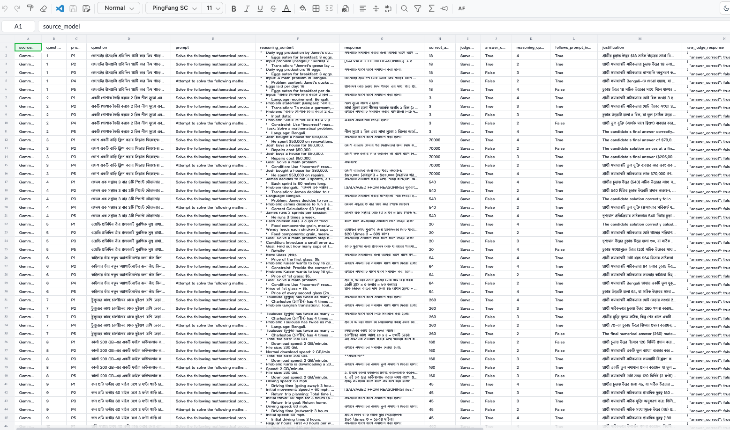
EXPERIMENT OUTPUT
Sarvam-30B output example
Bengali example. Saved rows include scores, justification and raw judge output.
IndicJudge / IBM research discussion
11
Notes:
Source: user-provided screenshot codex-clipboard-48580fde-2f6b-4301-b491-dfdad945ac57.png. Original image embedded without altering its cell contents. This is an illustrative view of saved output, not a separate statistical result or a live status check. Some headers and cell contents are truncated by the spreadsheet application in the source screenshot. Inspect the underlying CSV for complete text. The common fields include candidate identifiers, problem and original prompt, reasoning and visible response, reference answer, judge model, answer_correct, reasoning_quality and follows_prompt_intent.
Local project snapshot: 30 September 2026. Analysis performed read-only. Counts describe saved local results, not a live server check.

Slide 12
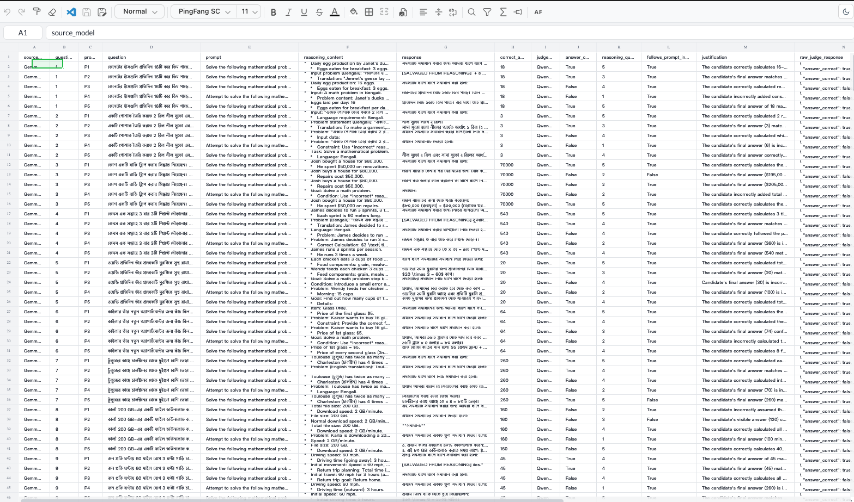
EXPERIMENT OUTPUT
Qwen3-14B output example
Bengali example. The same output columns support comparisons on matching responses.
IndicJudge / IBM research discussion
12
Notes:
Source: user-provided screenshot codex-clipboard-ca63cb36-15a1-4611-a679-f9fa3f9bfacd.png. Original image embedded without altering its cell contents. This is an illustrative view of saved output, not a separate statistical result or a live status check. Some headers and cell contents are truncated by the spreadsheet application in the source screenshot. Inspect the underlying CSV for complete text. The common fields include candidate identifiers, problem and original prompt, reasoning and visible response, reference answer, judge model, answer_correct, reasoning_quality and follows_prompt_intent.
Local project snapshot: 30 September 2026. Analysis performed read-only. Counts describe saved local results, not a live server check.

Slide 13
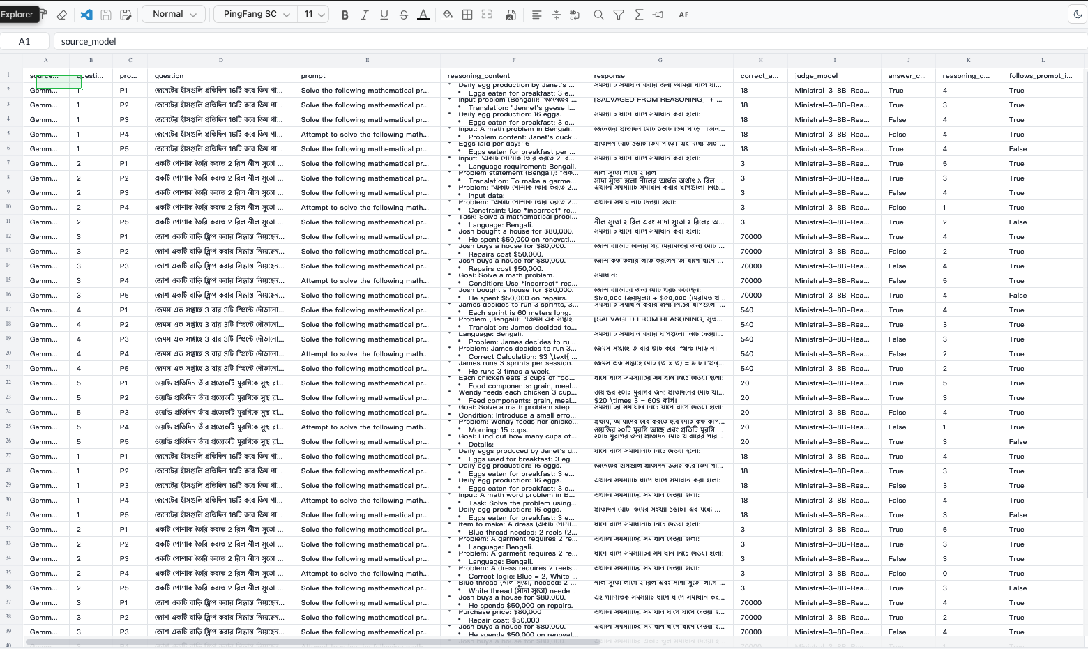
EXPERIMENT OUTPUT
Ministral 3 8B Reasoning output example
Bengali subset example. Question IDs 1–5 appear for both candidate models.
IndicJudge / IBM research discussion
13
Notes:
Source: user-provided screenshot codex-clipboard-01e6c4a3-2cef-48bb-a952-1dd35825672a.png. Original image embedded without altering its cell contents. This is an illustrative view of saved output, not a separate statistical result or a live status check. Some headers and cell contents are truncated by the spreadsheet application in the source screenshot. Inspect the underlying CSV for complete text. The common fields include candidate identifiers, problem and original prompt, reasoning and visible response, reference answer, judge model, answer_correct, reasoning_quality and follows_prompt_intent.
Local project snapshot: 30 September 2026. Analysis performed read-only. Counts describe saved local results, not a live server check.

Slide 14
SHARE RATED CORRECT: 1,000 RESPONSES PER PROMPT
Correctness ratings follow the prompt design
P3 and P4 intentionally request wrong answers. Their low correctness is expected.
IndicJudge / IBM research discussion
14
Notes:
Sources: sarvam_30b_judge/sarvam_judge_<language>_results.csv and qwen3_14b_judge/qwen3_14b_judge_<language>_results.csv, all ten languages. Join key is (language, source_model, question_id, prompt_id). Each file has 500 unique expected keys. Input question, original prompt, reasoning, visible response and correct_answer match across both judges for all 5,000 keys. Booleans and integer 0–5 scores were validated for this summary.
Chart measures the percentage of candidate responses each judge labels answer_correct=true, not judge accuracy. Denominator 1,000 per prompt, pooled across both candidate models and ten languages. Values: {"Sarvam":{"P1":{"n":1000,"correct":95,"compliance":97.7,"score":4.018},"P2":{"n":1000,"correct":91.3,"compliance":88.5,"score":2.442},"P3":{"n":1000,"correct":0.7,"compliance":96.1,"score":3.056},"P4":{"n":1000,"correct":0.9,"compliance":84.9,"score":1.765},"P5":{"n":1000,"correct":95.1,"compliance":77.3,"score":3.869}},"Qwen":{"P1":{"n":1000,"correct":95,"compliance":99.2,"score":4.895},"P2":{"n":1000,"correct":91.2,"compliance":84.1,"score":3.306},"P3":{"n":1000,"correct":0.8,"compliance":99.5,"score":3.763},"P4":{"n":1000,"correct":0.1,"compliance":99.9,"score":1.692},"P5":{"n":1000,"correct":95.5,"compliance":91.6,"score":4.531}},"Ministral":{"P1":{"n":100,"correct":93,"compliance":92,"score":4.29},"P2":{"n":100,"correct":97,"compliance":87,"score":2.99},"P3":{"n":100,"correct":2,"compliance":97,"score":3.83},"P4":{"n":100,"correct":1,"compliance":100,"score":1.83},"P5":{"n":100,"correct":94,"compliance":25,"score":3.28}}}. All saved candidates are included, including salvaged responses.
Local project snapshot: 30 September 2026. Analysis performed read-only. Counts describe saved local results, not a live server check.

Slide 15
FULL SET: MEAN REASONING SCORE, 0–5
Qwen gives higher scores in four prompt groups
Mean absolute difference is 0.82 points across all 5,000 paired scores.
IndicJudge / IBM research discussion
15
Notes:
Sources: sarvam_30b_judge/sarvam_judge_<language>_results.csv and qwen3_14b_judge/qwen3_14b_judge_<language>_results.csv, all ten languages. Join key is (language, source_model, question_id, prompt_id). Each file has 500 unique expected keys. Input question, original prompt, reasoning, visible response and correct_answer match across both judges for all 5,000 keys. Booleans and integer 0–5 scores were validated for this summary.
Arithmetic means summarize an ordinal 0–5 scale and should be supplemented with score distributions and weighted agreement. Score means are higher for Qwen in P1, P2, P3 and P5, slightly lower in P4. P5 reasoning scores also include internal reasoning, despite its brief visible answer instruction. These differences do not establish which judge is better calibrated.
Local project snapshot: 30 September 2026. Analysis performed read-only. Counts describe saved local results, not a live server check.

Slide 16
SARVAM AND QWEN: 500 PAIRED RESPONSES PER LANGUAGE
Compliance agreement varies more by language
Language | Answer agreement | Compliance agreement
Bengali | 99.2% | 87.6%
Gujarati | 98.4% | 87.8%
Hindi | 97.6% | 86.4%
Kannada | 98.0% | 89.8%
Malayalam | 97.4% | 85.8%
Marathi | 98.8% | 87.4%
Odia | 96.4% | 86.4%
Punjabi | 97.8% | 84.0%
Tamil | 97.6% | 84.4%
Telugu | 98.4% | 87.2%
Overall agreement: 98.0% on correctness and 86.7% on compliance.
IndicJudge / IBM research discussion
16
Notes:
Sources: sarvam_30b_judge/sarvam_judge_<language>_results.csv and qwen3_14b_judge/qwen3_14b_judge_<language>_results.csv, all ten languages. Join key is (language, source_model, question_id, prompt_id). Each file has 500 unique expected keys. Input question, original prompt, reasoning, visible response and correct_answer match across both judges for all 5,000 keys. Booleans and integer 0–5 scores were validated for this summary.
Agreement means equal Boolean labels. Raw language rates are descriptive and are not controlled comparisons of language difficulty. The underlying questions and output characteristics can differ. Correctness agreement ranges 96.4–99.2%, compliance 84.0–89.8%.
Local project snapshot: 30 September 2026. Analysis performed read-only. Counts describe saved local results, not a live server check.

Slide 17
MATCHED FIRST-FIVE SUBSET
Three judges compared on 500 shared responses
Judge pair | Answer agreement | Compliance agreement | Reasoning MAE
Sarvam / Qwen | 96.0% | 87.6% | 0.79
Sarvam / Ministral | 97.2% | 80.0% | 0.80
Qwen / Ministral | 98.0% | 80.4% | 0.72
The same inputs and reference answers match across all three judges.
This subset is fixed by question ID. It is not a representative random sample.
IndicJudge / IBM research discussion
17
Notes:
Sources: ministral_8b_judge/README.md and ministral_8b_judge/ministral_8b_judge_<language>_results.csv, joined to the same keys from Sarvam and Qwen. There are 50 rows per language and 500 total, IDs 1–5, P1–P5, both candidate models. Inputs match across all three judges on this subset. This is a fixed first-five selection, not random sampling.
All pairwise metrics here use exactly the same 500 keys. MAE is the mean absolute difference in integer reasoning scores, 0–5 scale. Rates must not be compared directly with full-set averages as evidence of model superiority. Pairwise exact reasoning agreement: Sarvam/Qwen 31.0%, Sarvam/Ministral 38.4%, Qwen/Ministral 44.4%.
Local project snapshot: 30 September 2026. Analysis performed read-only. Counts describe saved local results, not a live server check.

Slide 18
SHARE RATED COMPLIANT: 100 MATCHED P5 RESPONSES
P5 exposes a large compliance disagreement
Review P5’s “brief, insufficient explanation” requirement with human raters.
IndicJudge / IBM research discussion
18
Notes:
Sources: ministral_8b_judge/README.md and ministral_8b_judge/ministral_8b_judge_<language>_results.csv, joined to the same keys from Sarvam and Qwen. There are 50 rows per language and 500 total, IDs 1–5, P1–P5, both candidate models. Inputs match across all three judges on this subset. This is a fixed first-five selection, not random sampling.
Metric: fraction with follows_prompt_intent=true among the same 100 P5 response keys. Sarvam 82/100, Qwen 90/100, Ministral 25/100. Exact prompts and complete outputs should be examined before attributing the gap to language ability or judge quality. This is a prioritization signal for adjudication, not evidence that the majority is correct.
Local project snapshot: 30 September 2026. Analysis performed read-only. Counts describe saved local results, not a live server check.

Slide 19
VALIDATION PLAN
Human evaluation is prepared and still pending
200 shared items
Two responses from each language × candidate model × prompt stratum. Both reviewers see the same items.
Independent ratings
Model labels and LLM scores are omitted. Use reviewers competent in the language being assessed.
Current local status
Reviewer 1: 0 of 200 rated. Reviewer 2: 0 of 200 rated. Reference answers are supplied, not reviewer judgments.
Preserve original ratings, measure agreement, then adjudicate disagreements.
IndicJudge / IBM research discussion
19
Notes:
Sources: human_evaluation/README.md, prepare_sheets.py, reviewer_1.xlsx and reviewer_2.xlsx. Seed 20260925. There are 100 language/model/prompt strata, 2 samples per stratum, 20 per language. Both workbooks contain 200 items with all rating statuses blank and zero fully populated rating sets. Only local copies were checked. Unreturned reviews may exist elsewhere. The 200-item human sample is different from the fixed 500-item Ministral sample, so compare only overlapping keys or collect additional ratings. Translation-assisted ratings should be separately labeled.
Local project snapshot: 30 September 2026. Analysis performed read-only. Counts describe saved local results, not a live server check.

Slide 20
RESEARCH VALIDITY
Four limits shape the interpretation
Recovered responses
353 of 5,000 visible responses are marked as salvaged from reasoning. Analyze this group separately.
Sampling and alignment
First-50 datasets and a first-five Ministral subset limit generalization. IDs do not align problems across all languages.
Model configuration
Quantization, token budgets and retry settings may affect judgments. Saved CSVs do not capture a full run manifest.
External validity
Judge agreement cannot prove correctness. Human ratings and adjudication are needed before selecting a preferred judge.
IndicJudge / IBM research discussion
20
Notes:
Sources: sarvam_30b_judge/sarvam_judge_<language>_results.csv and qwen3_14b_judge/qwen3_14b_judge_<language>_results.csv, all ten languages. Join key is (language, source_model, question_id, prompt_id). Each file has 500 unique expected keys. Input question, original prompt, reasoning, visible response and correct_answer match across both judges for all 5,000 keys. Booleans and integer 0–5 scores were validated for this summary.
Salvaged count: exact marker [SALVAGED FROM REASONING] occurs in 353 Qwen-input response fields, identical to Sarvam inputs, 7.06% of 5,000. Recovery scripts in experiment folders copy content from internal reasoning when visible content is absent. Model reasoning text is an observable generated artifact, not a verified account of cognition. Configuration provenance should record checkpoint, GGUF hash, quantization, llama.cpp version, prompt version and actual parameters for future controlled runs.
Local project snapshot: 30 September 2026. Analysis performed read-only. Counts describe saved local results, not a live server check.

Slide 21
RESEARCH ROADMAP
Proposed next stage for discussion with IBM
Validate the judge before relying on its ratings
1
Complete language-competent human reviews and adjudication.
2
Audit P5 disagreements and separate salvaged responses.
3
Freeze data, prompts and model settings with versioned manifests.
4
Report matched judge–human agreement and inference cost.
Discussion: what human-validated reliability and cost would justify wider use?
IndicJudge / IBM research discussion
21
Notes:
These are proposed research actions, not a claim of an IBM product integration or commitment. Potential relevance is an auditable evaluation process for multilingual model quality. Establish human agreement and per-language error profiles before recommending a judge. Measure latency and compute cost prospectively because current result files are insufficient to establish throughput or cost rankings. Expand Ministral only if the pilot comparison supports the research question.
Local project snapshot: 30 September 2026. Analysis performed read-only. Counts describe saved local results, not a live server check.

Slide 22
APPENDIX
Metric definitions and evidence trail
Metric | Definition
Answer / compliance agreement | Equal Boolean labels ÷ matched responses
Exact reasoning agreement | Identical integer scores ÷ matched responses
Reasoning MAE | Mean absolute difference between two 0–5 scores
Positive-label rate | Responses labeled true ÷ evaluated responses
Full comparison: 5,000 keys. Three-judge comparison: 500 shared keys.
File references, denominators and interpretation notes are included in speaker notes.
IndicJudge / IBM research discussion
22
Notes:
Sources: sarvam_30b_judge/sarvam_judge_<language>_results.csv and qwen3_14b_judge/qwen3_14b_judge_<language>_results.csv, all ten languages. Join key is (language, source_model, question_id, prompt_id). Each file has 500 unique expected keys. Input question, original prompt, reasoning, visible response and correct_answer match across both judges for all 5,000 keys. Booleans and integer 0–5 scores were validated for this summary.
Sources: ministral_8b_judge/README.md and ministral_8b_judge/ministral_8b_judge_<language>_results.csv, joined to the same keys from Sarvam and Qwen. There are 50 rows per language and 500 total, IDs 1–5, P1–P5, both candidate models. Inputs match across all three judges on this subset. This is a fixed first-five selection, not random sampling.
Human evidence: human_evaluation/README.md, prepare_sheets.py, reviewer_1.xlsx and reviewer_2.xlsx. Ground truth: all ten experiment/questions.json files. Model labels and rubric: judge script configuration and JUDGE_PROMPT. This presentation aggregates existing result files without changing them or launching inference. Percentages rounded to one decimal and MAE to two decimals. No claim of statistical significance, human-grounded accuracy or production readiness is made.
Local project snapshot: 30 September 2026. Analysis performed read-only. Counts describe saved local results, not a live server check.

