Slide 1

CAPSTONE-PROJECT-1
DATASET USED – work-at-olist-data

Slide 2
Top Categories in Very Slow Delivery Orders
The top 15 categories with the highest count of extremely delayed orders.
Slow deliveries are concentrated in a few high-volume categories rather than being evenly spread.
Categories with bulky or complex items tend to appear more frequently.
Indicates operational bottlenecks in specific product lines.
These categories likely contribute disproportionately to customer dissatisfaction.
Key Insight / Business Implication:
Focus on logistics optimization for the top delayed categories — targeted SLA improvements here will immediately reduce overall delivery delays.

Slide 3
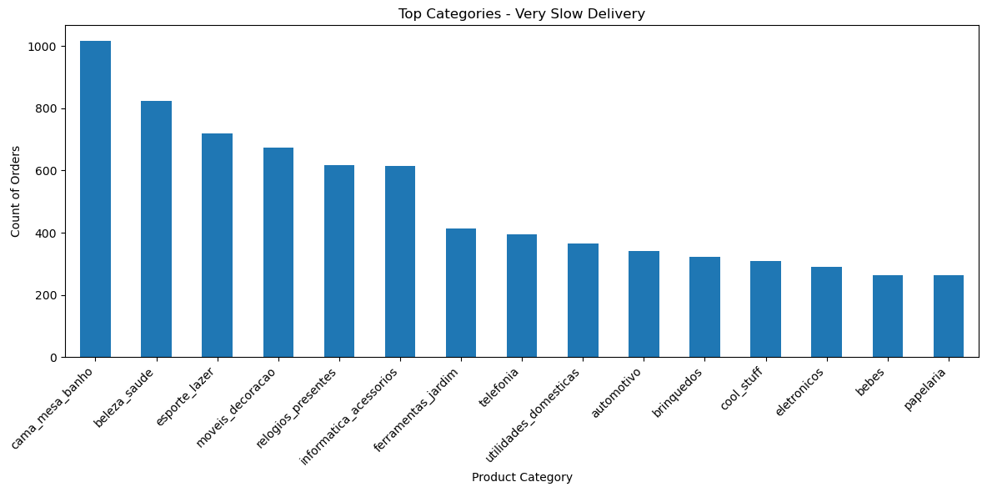

Slide 4
Top Categories in Not Approved Orders
Displays categories where orders most frequently fail approval.
High counts may indicate issues in payment verification or customer abandonment.
Some categories may attract more fraudulent attempts or risky transactions.
Order approval failures can also hint at pricing or trust-related friction.
Patterns show operational inefficiencies at the pre-fulfillment stage.
Key Insight / Business Implication:
Investigate checkout and payment workflows for these categories — reducing approval failures can recover lost revenue without additional customer acquisition.

Slide 5
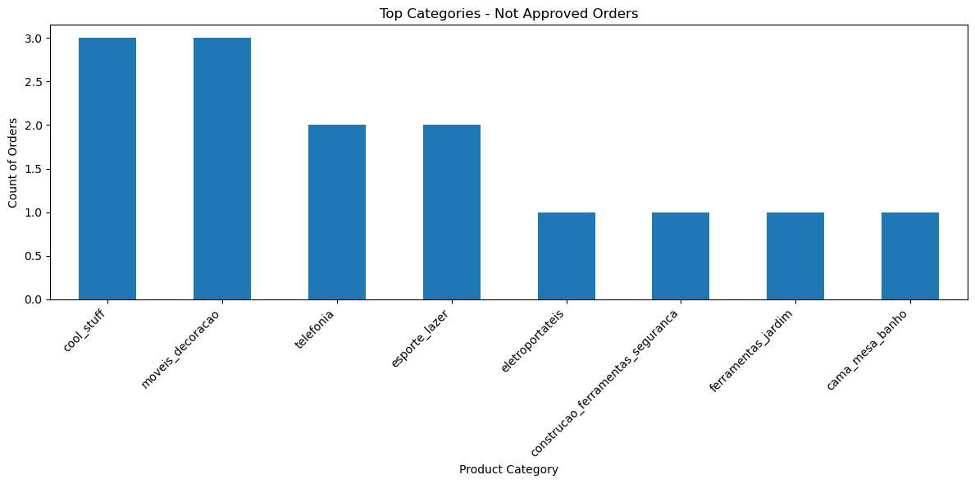

Slide 6
Top Categories Containing Outlier Orders
These are the top 15 product categories with unusually high or low statistical values (e.g., extreme delivery times or payment amounts).
Outliers cluster around specific product categories, suggesting inconsistent operational performance.
Could represent VIP/high-value orders or problematic logistics.
Presence of extreme values may distort forecasting models.
Identifying them helps build more reliable predictive pipelines.
Key Insight / Business Implication:
Perform category-level anomaly analysis to separate genuine high-value orders from operational errors — improves both forecasting accuracy and customer experience strategy.

Slide 7
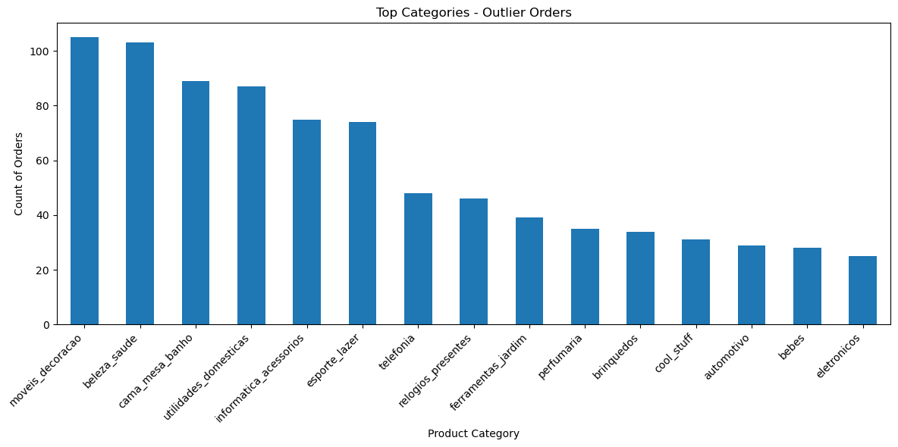

Slide 8
Very Slow Delivery by Installment
Bars show total orders per installment count; line shows % of orders classified as “very slow”.
Identifies installment buckets with elevated delivery latency relative to others.
Can indicate logistical strain for certain payment terms (e.g., multi-installment orders needing special handling).
Use this to prioritize logistics or vendor performance reviews.
Key insight / action: Introduce targeted SLA changes or expedited routing for installment buckets with high % very slow — negotiate carrier SLAs or change fulfillment strategy for these segments.
Caption (1 line): High % very slow in specific installment buckets points to category-level or fulfillment pathway problems.
Speaker notes (short): This plot helps us see whether split-payment orders are systematically slower. If multi-installment orders show higher latency, we should check packing priorities, warehouse allocation, and carrier selection for those orders.

Slide 9
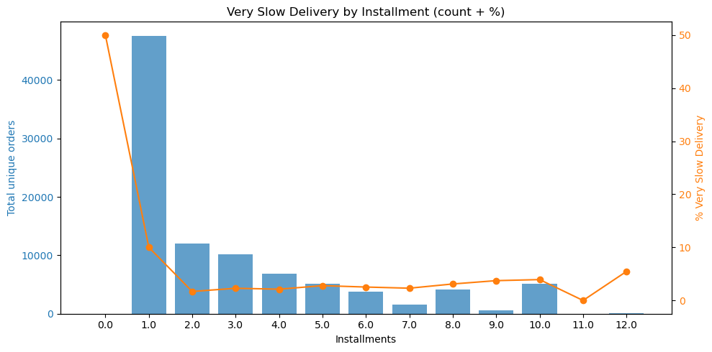

Slide 10
Compare: % Never Delivered vs % Very Slow by Installment
Two line series compare % Never Delivered (risk of loss) vs % Very Slow (customer experience) across installments.
Buckets where both metrics spike are high-priority: they cause lost revenue and bad CSAT.
Buckets where only % Very Slow is high suggest operational slowness; high % Never Delivered alone suggests fraud or fulfillment failure.
Use the comparison to split root-cause paths (logistics vs fraud/checkout).
Key insight / action: Create two remediation tracks: (1) logistics/operations for high-very-slow buckets, (2) payment verification / fraud controls for high-never-delivered buckets.
Caption (1 line): Overlaying both percentages reveals whether issues are delivery delays, non-fulfillment, or both.
Speaker notes (short): When both metrics align, the problem is systemic and urgent. When they diverge, we can more precisely assign responsibility — ops vs payments/fraud — and deploy targeted fixes.

Slide 11
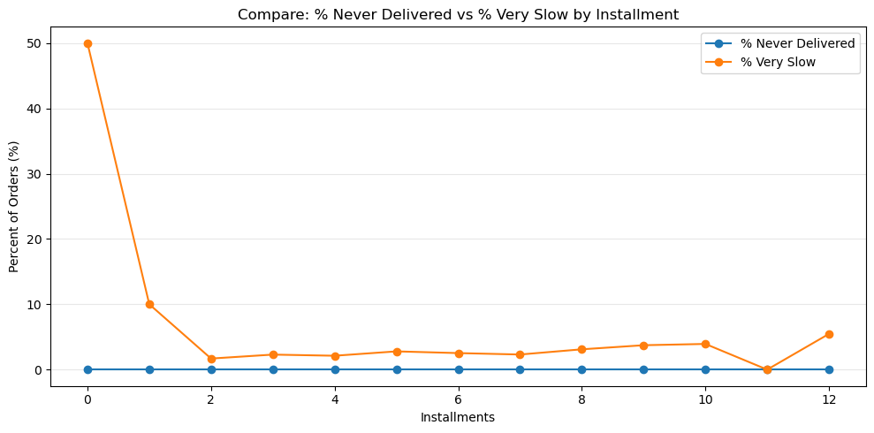

Slide 12
Top Sellers by % Very Slow Delivery
X sellers plotted (top by % Very Slow) with a minimum order threshold of 20 to avoid tiny-sample noise.
Bars = total unique orders per seller; line = % Very Slow delivery for each seller.
High % Very Slow with high order volume identifies sellers causing the largest customer-impact.
High % Very Slow but low volume may indicate isolated issues (packaging, location, or occasional carrier failures).
Use the chart to separate volume-driven problems from sample-noise anomalies.
Key insight / action: Prioritize operational audits and SLA renegotiation for sellers that combine high order volume and high % Very Slow. For high-% low-volume sellers, run sample audits before taking punitive action.
Caption (1 line): This chart highlights sellers whose fulfillment performance most negatively affects delivery speed and customer experience.
Speaker notes (short): We filtered sellers with at least 20 orders to reduce noise. The dual-axis view lets us spot sellers that both deliver many orders and have a high share of severe delays — these are priority targets for logistics improvements or contract review. For low-volume outliers, validate with a manual check first.

Slide 13
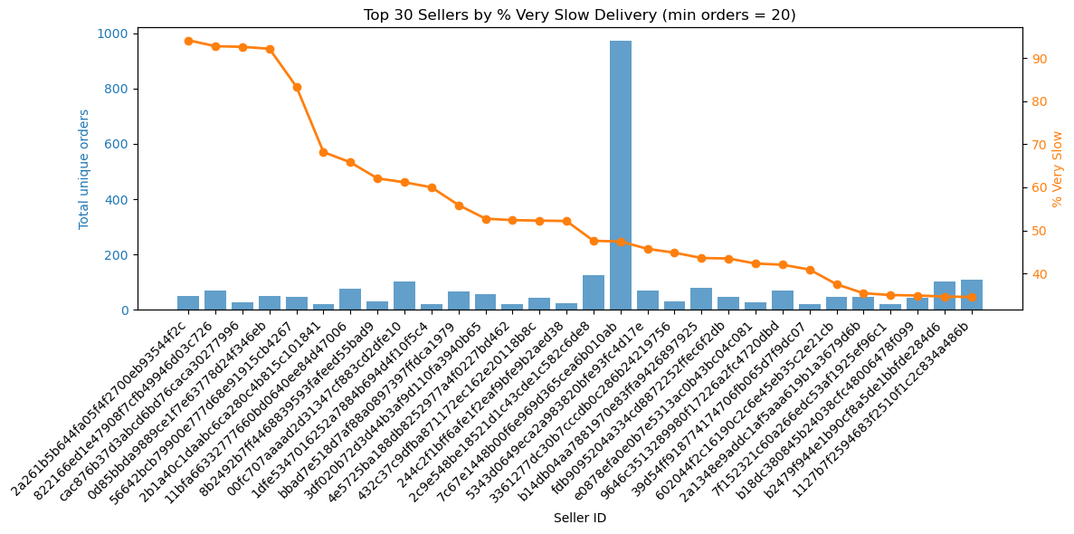

Slide 14
Median Freight Ratio by Product Category
Shows the median freight-to-order-value ratio for each product category.
Categories with a high freight ratio indicate disproportionately expensive shipping relative to product price.
Low-ratio categories have more cost-efficient logistics or higher product value.
Categories with extreme ratios may signal issues in package dimensions, weight classifications, or courier pricing.
Useful for identifying segments where shipping costs heavily erode margins.
Key Insight / Action: Prioritize cost-optimization strategies (courier renegotiation, packaging redesign, dimensional-weight adjustments) for categories with the highest freight ratios — these categories cause the largest margin compression.
Caption (1 line): Freight ratio highlights categories where logistics cost is disproportionately high relative to product value.
Speaker Notes (short): This plot reveals which categories suffer from inefficient shipping economics. High freight ratios usually mean either lightweight but oversized items, poor packaging choices, or courier misalignment. Focusing on the top costly categories could recover margin quickly.

Slide 15
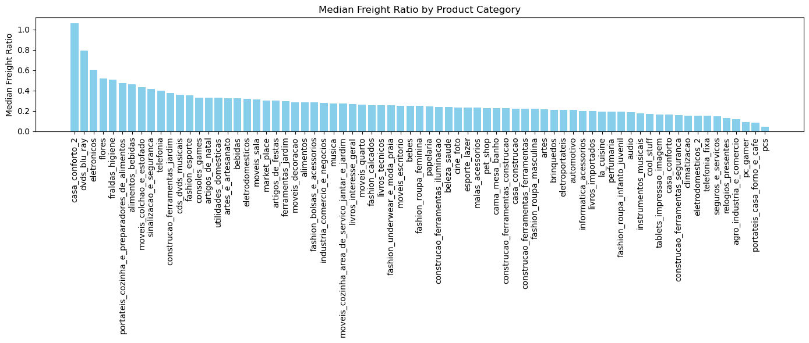

Slide 16
Max Freight Ratio by Product Category
Displays the highest freight-to-order-value ratio observed in each product category.
High max ratios indicate categories where some orders experience extreme shipping inefficiency.
These outliers may result from oversized packaging, misclassified dimensional weight, or long-distance routing.
Categories with very high max ratios pose a risk of severe margin loss on individual orders.
Helps isolate extreme cases that distort average cost calculations.
Key Insight / Action: Investigate categories with the most extreme max ratios — review packaging standards, weight/dimension inputs, and courier billing accuracy. Fixing these outliers can significantly reduce unpredictable shipping losses.
Caption (1 line): Max freight ratio highlights the worst-case logistics cost scenarios hidden within each category.
Speaker Notes (short): This plot isn’t about typical performance — it exposes the worst freight costs per category. Even a small number of poorly handled orders can destroy profitability. These extreme cases are usually fixable through packaging, courier negotiation, or correcting weight/dimension entries.

Slide 17
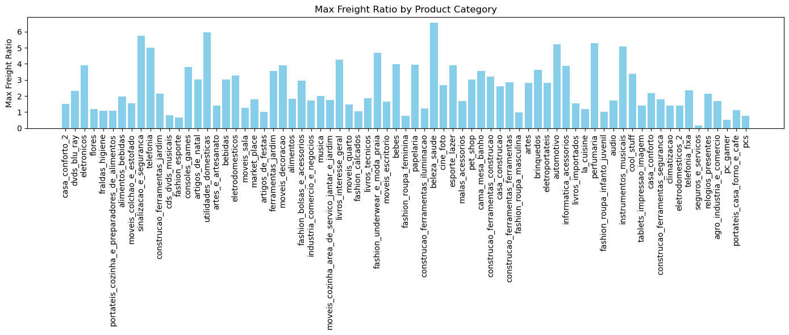

Slide 18
Freight Ratio vs Product Weight Bin
Product weights are grouped into bins (0–200g, 200–500g, 500g–1kg, etc.) for clearer comparison.
The line plot shows how the freight-to-order-value ratio changes as product weight increases.
Certain lightweight or mid-weight bins may show unexpectedly high freight ratios due to oversized packaging or dimensional weight charges.
Heavy bins with moderate ratios indicate more predictable, weight-based pricing.
Identifies weight brackets where shipping cost is disproportionately high relative to product value.
Key Insight / Action: Investigate bins with unusually high freight ratios—review packaging dimensions and courier billing rules to correct inefficiencies and reduce unnecessary shipping cost.
Caption (1 line): Weight-based analysis reveals which product sizes generate the most inefficient freight costs.
Speaker Notes (short): This visualization helps isolate which weight classes create margin pressure. Sometimes the smallest items have the worst freight ratios because of incorrect packaging or volumetric weight billing. Fixing these classes has a direct margin impact across thousands of orders.

Slide 19
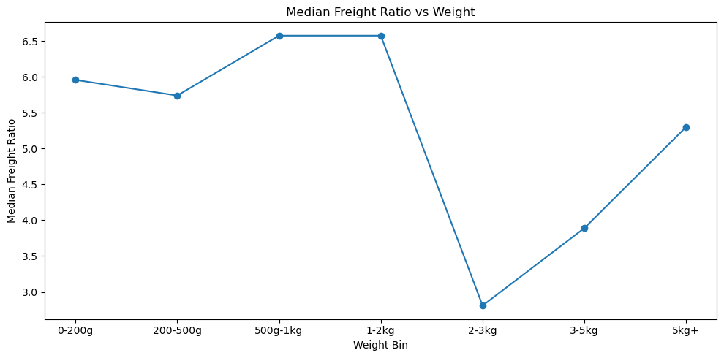

Slide 20
Customer Installment Segmentation
Pie chart shows how customers split across different installment counts.
Reveals whether customers prefer single-payment orders or multi-installment financing.
Higher share of multi-installment usage may indicate price sensitivity or reliance on credit-based payments.
Helps identify the financial behavior of buyers and potential risks associated with delayed or failed payments.
Useful for designing pricing strategy, payment offers, and risk controls.
Key Insight / Action: If a large share of customers use 3+ installments, consider optimized EMI plans, upfront-discount strategies, or fraud checks for high-risk installment groups.
Caption (1 line): Installment segmentation highlights customer payment behavior and credit dependence.
Speaker Notes (short): This segmentation helps us understand how customers prefer to pay. Higher installment counts usually correlate with more checkout friction, greater risk of non-approval, and sometimes slower fulfillment. This informs both pricing strategy and risk management.

Slide 21
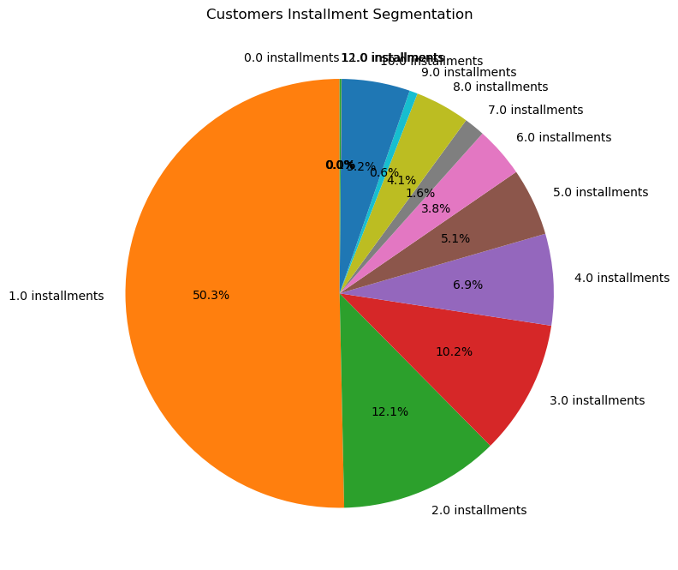

Slide 22
Customer Segmentation by Payment Behavior
Customers are grouped into behavioral segments: High EMI, COD/Boleto, Low-Value Impulse, Premium, and Regular buyers.
High-EMI buyers (≥ 3 installments) indicate higher price sensitivity and dependency on credit.
COD/Boleto shoppers prefer cash-linked or offline payment modes, often linked with higher abandonment or verification delays.
Low-value impulse buyers make small, frequent purchases and react strongly to discounts and fast shipping.
Premium buyers contribute disproportionately to revenue but demand consistent delivery quality.
Key Insight / Action: Design separate retention and risk strategies: tighten fraud rules for COD/Boleto, offer EMI-friendly bundles for credit-heavy users, and create loyalty perks for premium buyers.
Caption (1 line): Customer payment behavior reveals distinct buyer personas that require different operational and marketing strategies.
Speaker Notes (short): This segmentation helps us see how different buyer types behave financially. High-EMI customers are more price-sensitive, COD/Boleto buyers are operationally riskier, and premium buyers drive revenue but expect reliability. Tailoring communication, offers, and risk controls per segment increases both conversion and retention.

Slide 23
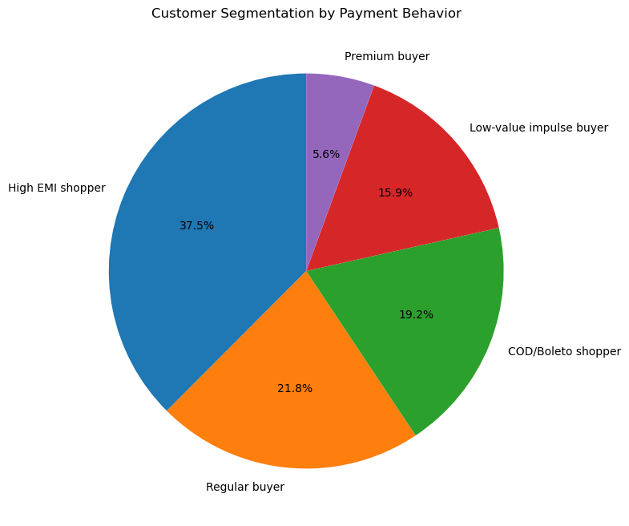

Slide 24
Customer Segmentation by Payment Value Quantiles
Customers are segmented using value quantiles: Ultra Low, Low, Middle, Premium, Ultra Premium, and Top 1% Buyers.
Middle segment (25–75%) typically represents the mainstream volume buyers.
Premium and Ultra Premium segments pay significantly higher than average, contributing a large share of revenue.
Top 1% Buyers represent extremely high-value orders — small in count but critical for margin.
Ultra Low and Low segments indicate budget-sensitive customers with lower-ticket purchases.
Key Insight / Action: Develop differentiated strategies: retention for high-value buyers, targeted upsell/cross-sell for mid-tier customers, and discount-driven acquisition for low-value segments.
Caption (1 line): Quantile-based segmentation exposes how customer value is distributed across low-, mid-, and high-spending groups.
Speaker Notes (short): Quantile segmentation helps us separate the heavy spenders from the low-ticket users. The top 1% and premium segments drive revenue and need tailored retention. Meanwhile, ultra low-value buyers are more discount-driven, and the middle segment represents scalable upsell opportunities.

Slide 25
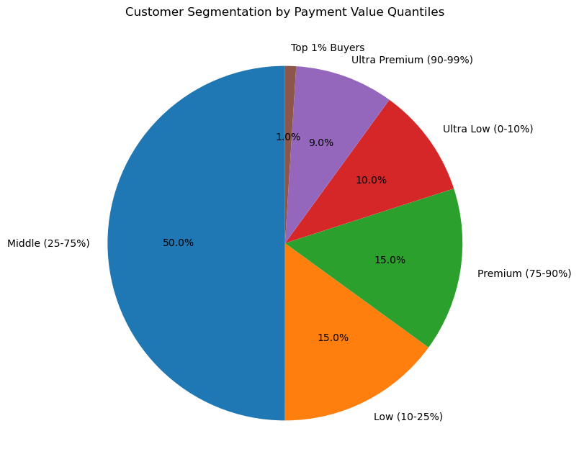

Slide 26
Customer Repeat Behavior
Pie chart shows how many customers purchased only once vs how many returned for additional orders.
One-time customers typically reflect acquisition success but weak retention.
Repeat customers signal satisfaction, trust, and strong product–market fit.
A low repeat share indicates high churn and possible issues in delivery, pricing, or category mix.
Understanding this split helps design retention programs and loyalty campaigns.
Key Insight / Action: If repeat customers form a small percentage, invest in post-purchase experiences — faster delivery, proactive communication, personalized offers — to boost repeat rates.
Caption (1 line): Repeat behavior reveals the long-term value and loyalty potential of the customer base.
Speaker Notes (short): This metric is critical for business sustainability. New acquisitions are expensive; retention is cheaper and more profitable. A strong repeat customer base is a sign of operational excellence and product satisfaction. A weak one means the business is leaking value despite high acquisition.

Slide 27
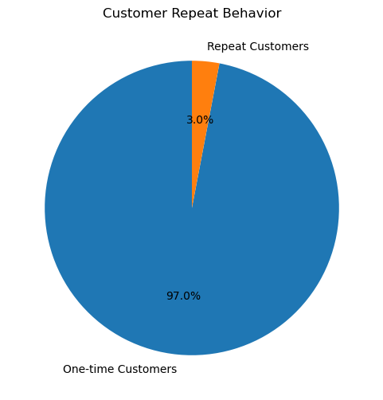

Slide 28
Monthly Revenue Heatmap
Heatmap displays total monthly revenue, with darker red representing higher revenue months.
Clearly highlights seasonal peaks and dips in revenue performance.
Easy to identify high-demand periods vs low-activity months at a glance.
Single-column heatmap emphasizes trend progression across time without visual noise.
Useful for forecasting, inventory planning, and campaign scheduling.
Key Insight / Action: Focus marketing + inventory strategy around high-revenue months, and create targeted promotions during low-revenue periods to stabilize demand.
Caption (1 line): Monthly heat intensity reveals clear seasonal revenue patterns.
Speaker Notes (short): This heatmap is designed to show revenue momentum month-by-month. Darker shades indicate stronger performance. It’s ideal for spotting seasonal behavior, performance surges, and possible operational bottlenecks in slower months. This directly informs budgeting, supply chain, and promotional timing.

Slide 29
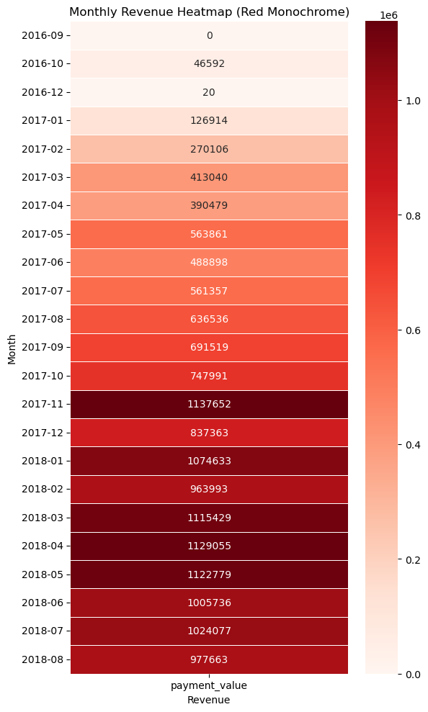

Slide 30
Highest Price Sales by State
Displays the lowest-priced order per state — often ultra-low-value or impulse purchases.
States with very low minimum values may have higher sensitivity to discounts and pricing.
Indicates where customers frequently place micro-orders (budget-friendly or convenience-driven items).
Useful for identifying regions suitable for bulk discounts, small-ticket products, or free-shipping thresholds.
Helps detect markets with stronger low-income or price-conscious demand patterns.
Key Insight / Action: Run discount-driven acquisition strategies or low-ticket product promotions in states with extremely low minimum order values.
Caption (1 line): Min payment values help identify states with stronger low-ticket purchasing behavior.
Speaker Notes (short): Minimum-value variation guides tactical pricing strategy. Some states act as low-ticket markets; understanding these can optimize discount usage and reduce unnecessary marketing spend.

Slide 31
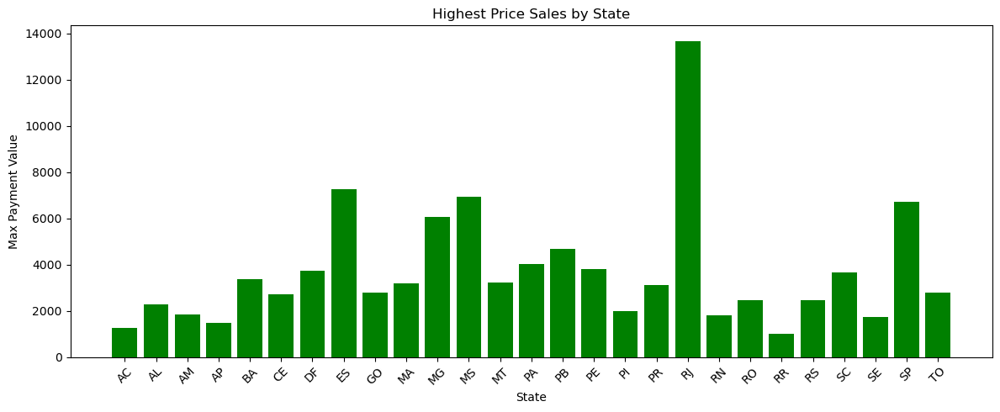

Slide 32
Lowest Price Sales by State
Displays the lowest-priced order per state — often ultra-low-value or impulse purchases.
States with very low minimum values may have higher sensitivity to discounts and pricing.
Indicates where customers frequently place micro-orders (budget-friendly or convenience-driven items).
Useful for identifying regions suitable for bulk discounts, small-ticket products, or free-shipping thresholds.
Helps detect markets with stronger low-income or price-conscious demand patterns.
Key Insight / Action: Run discount-driven acquisition strategies or low-ticket product promotions in states with extremely low minimum order values.
Caption (1 line): Min payment values help identify states with stronger low-ticket purchasing behavior.
Speaker Notes (short): Minimum-value variation guides tactical pricing strategy. Some states act as low-ticket markets; understanding these can optimize discount usage and reduce unnecessary marketing spend.

Slide 33
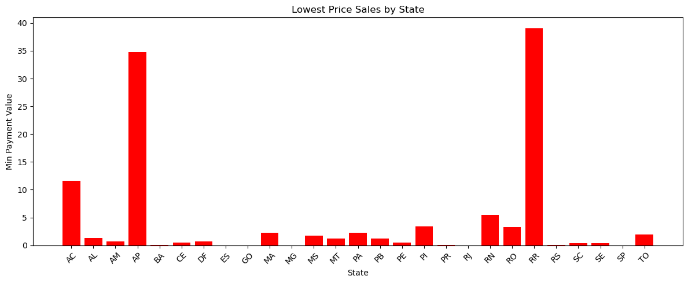

Slide 34
State-Wise Average Delivery Completion Time
Delivery time includes seller processing, carrier pickup, and final delivery to the customer.
States show clear variation in total delivery days due to distance, logistics network strength, and carrier availability.
Faster states indicate strong fulfillment infrastructure or closer proximity to sellers/warehouses.
Slower states reveal bottlenecks such as long-distance routing, inefficient carrier coverage, or late seller dispatch.
Helps identify regions where delivery SLAs are consistently at risk.
Key Insight / Action: Prioritize improving logistics routes and onboarding regional sellers/carrier partners in states with the highest delivery times to reduce delays and boost customer satisfaction.
Caption (1 line): State-level delivery times reveal operational strengths and weaknesses in the national supply chain.
Speaker Notes (short): The chart shows where the logistics network performs well and where it struggles. High delivery times usually mean carrier delays or long-distance shipments. This insight guides decisions like new warehouse locations, carrier negotiations, or seller onboarding to reduce end-to-end delivery time.

Slide 35
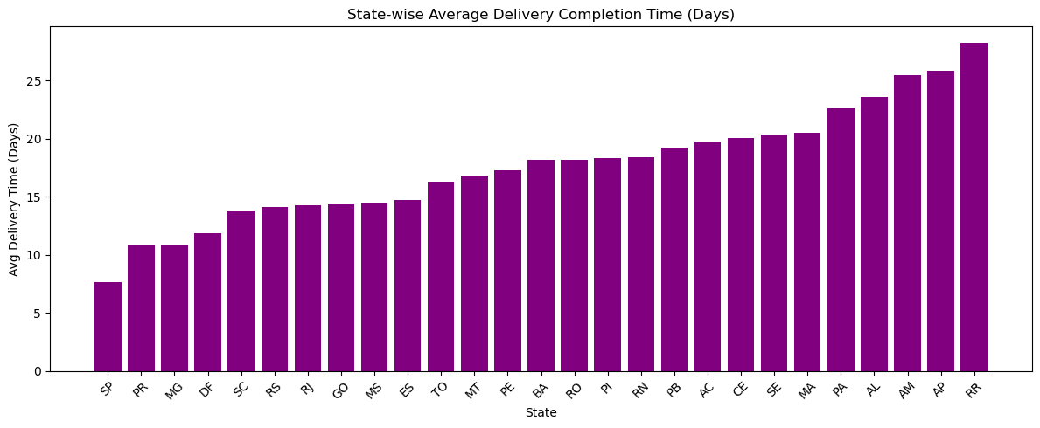

Slide 36
Correlation Heatmap: Weight, Freight & Delivery Time Factors
Heatmap displays pairwise correlations between key operational metrics: product weight, freight ratio/cost, and delivery time components.
Positive correlations indicate factors that increase together, such as heavier products often having higher freight cost.
Negative or near-zero correlations reveal metrics that operate independently.
Helps uncover hidden drivers influencing delivery delays or inflated shipping charges.
Guides feature selection for predictive modeling (delay prediction, logistics optimization, cost forecasting).
Key Insight / Action: Focus optimization efforts on variables that show strong correlation with freight cost and delivery time — these are the most influential levers for reducing delays and improving margin.
Caption (1 line): Correlation matrix highlights which factors meaningfully impact logistics cost and delivery performance.
Speaker Notes (short): This heatmap is crucial for diagnosing relationships inside the supply chain. If weight strongly correlates with freight cost but weakly with delivery time, we know delays come from other factors. Strong freight–delay correlations may signal poor carrier handling or inefficient routing.

Slide 37
