Slide 1
Health Monitoring of VMs using Analytics
Avijit Basu
2017HT12184
ZG628T Dissertation
Second Sem 2018-19 (Jan –April 2019)

Slide 2
Objectives
Background
Some sample problems with virtualization
Requirement of Monitoring & Predicting S/W
Format of Input Data
Algorithm
Overview of Software Module
Various Graphs, to analyze correctness of Model
Proof of Correctness of Software
Innovation

Slide 3
Background
Cloud and virtualizations are a growing trend for Networking Industries.
Also lots of internal IT resources like build etc are being host in contrail VM.
Analysis of health of VM/contrail involves understanding the correlation between various stats parameters like process profile, vm load, I/O operation stats.
Automation is the key for quick detection of anomalies and then quick turn around for corrective actions. Automation with static rules does not reap much benefit.

Slide 4
Snippet of Problems in VM based Enviorment
Some user reports his build process is too slow:
RCA: This apparently may be caused due to a high CPU usage from other VMs on the same physical box as your contrail.
When CPU usage goes high, suddenly all VMs start seeing lots of sheaf rebalancing
RCA: When CPU usage is high, then I/O set becomes sluggish. The typical monitoring software, sees memory latency increasing, so tries sheaf rebalancing to improve I/O.But the rebalancing algorithm spawns up more process on the CPU which is already sluggish.
Thus adding a chain effect and adverse to the condition.
When we add more parameter for monitoring, time to up the new monitoring software is a concern, lots of static rules needs to be changed.
RCA: On a Monitoring and Analyzer software based on neural networks, this is a simply a problem of retraining the neural network.

Slide 5
Requirement from Monitoring Software
Data collected for monitoring will undergo change, new params will be monitored.
Accommodate of new monitoring params in software should be easy.
Monitoring software should be able to predict future load characteristics of VM based on present load. Thus prevent interruption to other VM users.

Slide 6
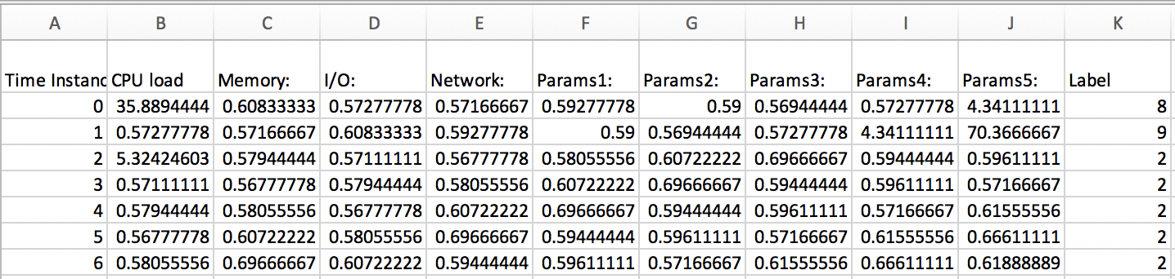
Parameters monitored for VM
There is a separate script that collects following set of data for each VM
Each tuple has 10 parameters (describing a set of different parameters monitored at any instance for a VM)
tuple has what class the load of the VM host reached in some time.
The class is a multilevel of 10 values 0 to 9.

Slide 7
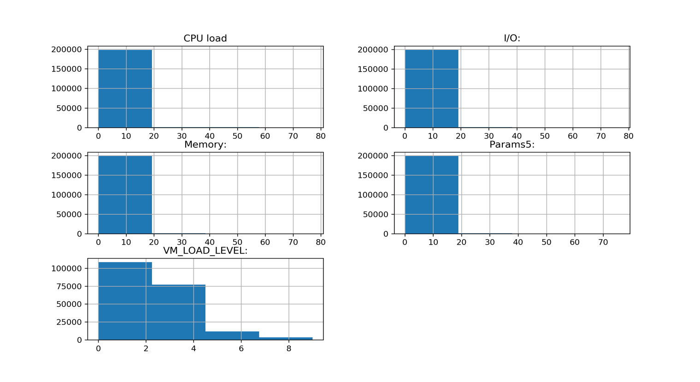
Characteristics of Data feed to Monitoring SW

Slide 8
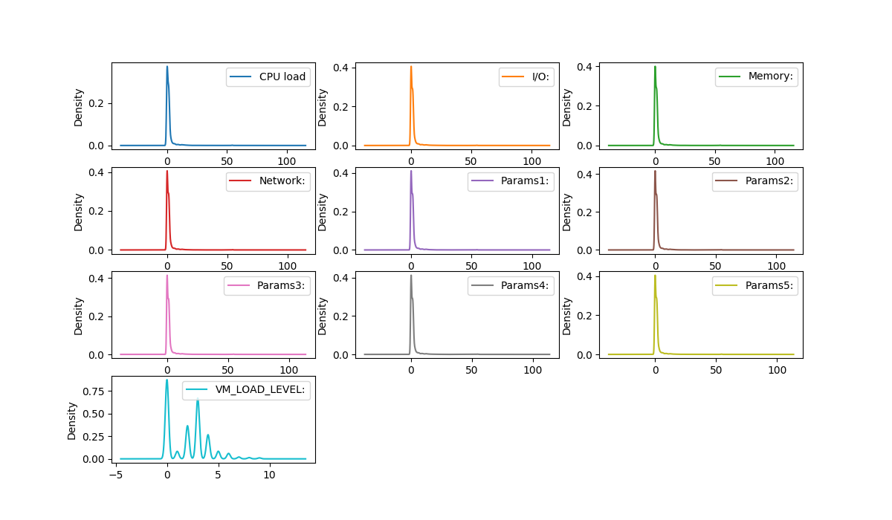

Slide 9
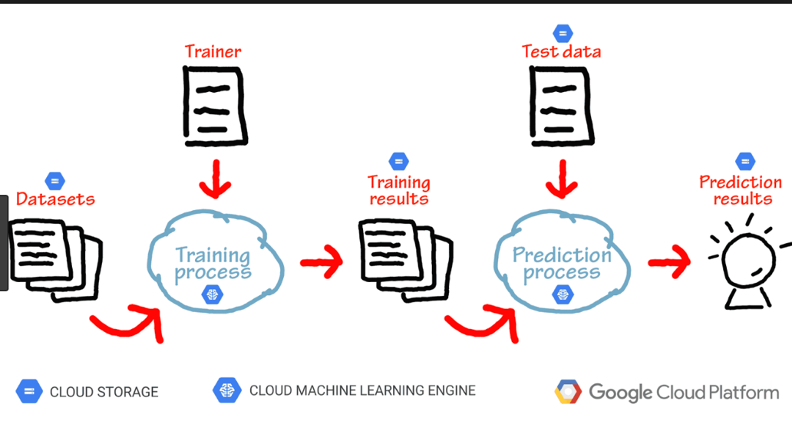
How Machine learning works
Neural Networks trained through supervised learning(on past data) solves the above requirement of VM load factor based on monitored params.
But how to choose hyper parameters like number of layers, number of neurons, activation functions for NN ?

Slide 10
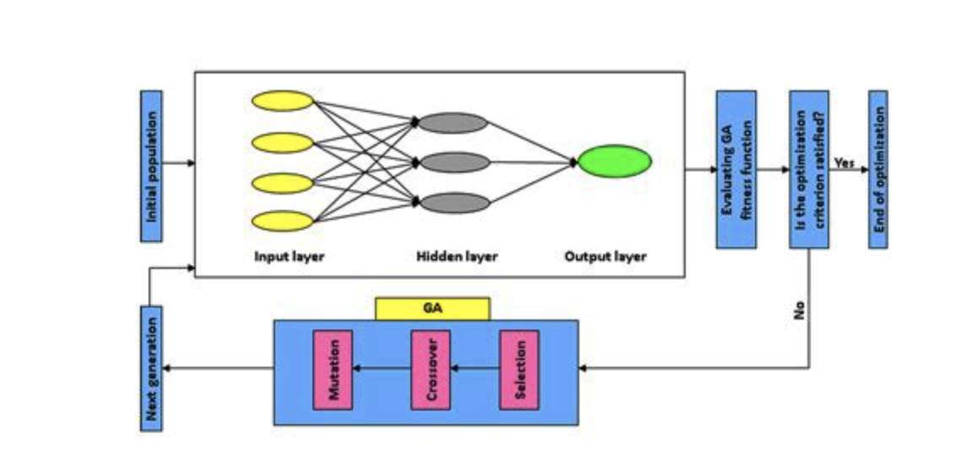
Over view of Algorithm
This algorithm relies on Neural Network for training and Genetic algorithm for evolving a population of neural networks and choosing the fittest.

Slide 11
External Links
Date | Work Plan | Status
11/01/2019- 01/02/2019 | Evaluation of the model and algorithm of the software. This includes determine what ML techniques to be used. | Completed, Finalized to use Neural networks. Augment genetic algorithm to tune hyper parameters
02/02/2019- 15/02/2019 | Design of finer and lower level details. | Completed: Algorithm has been stated.
16/02/2019- 10/03/2019 | Implementation of code and attempt to refine the algorithm to improve accuracy. | Completed
11/03/2019- 31/03/2019 | Testing, Final Report Submit | Completed
Links | Content
https://github.com/avijitbasu19811891/Sem4_project | Code Checkin
https://github.com/avijitbasu19811891/Sem4_project_sample_runs/tree/master/Recording_of_sample_run_demo/sample_run1 | Snippet of sample run

Slide 12
Sample Run
Training data had a set of around 1.6 Lakh tuples.
Each tuple has 10 parameters (describing a set of different parameters monitored at any instance for a VM) and tuple has what class the load of the VM host reached in some time.
The class is a multilevel of 10 values 0 to 9.
Class number | Resource utilisation (formula)
1(very cold) | 0-20%
2(cold) | 20-40%
3(warm) | 40-60%
4(hot) | 60-80%
5(very hot) | 80-100%

Slide 13
Data Characteristics

Slide 14
Software
Software has 2 modules: Training Module and Analyzer Module.
Training Module will be responsible to create a population of NN, train and evolve the population through generations. Finally after some generations choose the most fittest, save the model and weight in some file.
Analyzer Module will read the file saved earlier launch the NN.
Then periodically read the Monitored data and provide prediction of estimated load.
For time being We are updating the report to a file.

Slide 15
Generate Module
We create a population of 25 NN and train and evolve(choose fittest into next generation, breed next generation from fittest) and train recursively.
This Phase involves both genetics as well as neural network training and testing for accuracy.
generate Keras model for each NN in population.
Train and test the NN for prediction accuracy
An example NeuralNetwork of the population:
{'nb_layers': 2, <<<<< Number of hidden layers>>>
'activation': 'selu’, << Act functions of hidden layer >>
'optimizer': 'adagrad’,
'nb_neurons': 256}. <<< Each hidden layer has 256 neurons >>
accuracy 0.0. <<< Every NN starts with 0 accuracy, training and evolution improves>>

Slide 16
Keras Module for NN
NN is implemented as keras model.
Then the model is trained and then tested for accuracy on test data This will return the accuracy of this NN Logic of create of Keras: 1. Get following parameters from NN activation, num of layers, num of neurons per layer, optimizer 2. launch a keras Sequential model, as per dimension of input data Add layers(as specified in num of layer params of NN) specify activation function. 3. This is for multi label Keras. O/p of model, should provide an idea of possible class for this dataset. Class in our example is a label 0 to 9, indicating how much loaded host be in short future. So convert the label[0 to 9] to category 0 : [1 0 0 0 0 0 0 0 0 0] 1: [0 1 0 0 0 0 0 0 0 0]

Slide 17
Keras Module
4. Dimension of model will be as follows Input layer: can accept data of dimension of each data set activation None Output layer: dimension same as num of class activation softmax hidden layers: dimension., as per num of neurons in NN param activation as per 'activation' param of NN
5. Compile the model Training: Fit() on the training set Use early stopping is loss not improving across more than 2 consecutive iterations 6. Estimate model on Test data If accuracy more than last accuracy of the NN: update weight, save model, update accuracy 7. For debug and performance monitoring of algorithm update following to NN accuracy of this iteration of training. how loss trend through multiple epoch of this training iteration

Slide 18
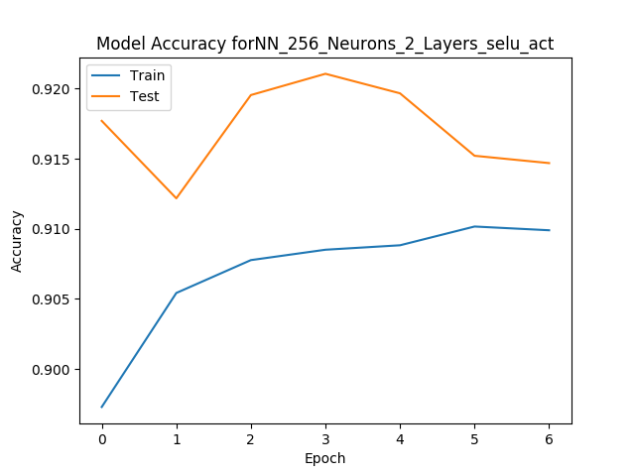
Snippet of Training of Keras Model
For the training set, keras works in set of epochs.
I used an epoch count of 150.
But used early stopping if accuracy is not improving across epoch.
More or less across epochs, accuracy of each NN, did improve.

Slide 19
Evolution of NN population
After training population of networks, every NN gets updated with following:
Accuracy.
Weights.
Model of keras
There is an optimization and important design decision employed.
If the accuracy is not improved from what the accuracy of this model, for the past generation of same NN, then neither of weight or model are updated.
Note: for debug and judging how well this algorithm is working, I do maintain for each NN, how the accuracy did progress across generations of training.
Choose top few as fittest parents.
Generate New child NNs, but cross over of hyper prams from 2 fit parents.
Mutate some hyper prams of child NN.

Slide 20
Accuracy Does Increase Across Generations
Snippet of improvement on different generation
Triggering training for network:
Training
{'nb_layers': 2, 'activation': 'selu', 'optimizer': 'adagrad', 'nb_neurons': 256}
Accuracy:0.9191677865770349. <<< Initial accuracy
Shape:
10
Reusing old weights:
Initiating training
End of training
[0.27411011362527926, 0.9212333880812501] <<< after training
Updating accuracy
_________________________________________________________________
Layer (type) Output Shape Param #
=================================================================
dense_225 (Dense) (None, 256) 2816
_________________________________________________________________
dense_226 (Dense) (None, 256) 65792
_________________________________________________________________
dense_227 (Dense) (None, 10) 2570
=================================================================
Total params: 71,178
Triggering training for network:
Training
{'nb_layers': 2, 'activation': 'selu', 'optimizer': 'adagrad', 'nb_neurons': 256}
Accuracy:0.9191677865770349

Slide 21
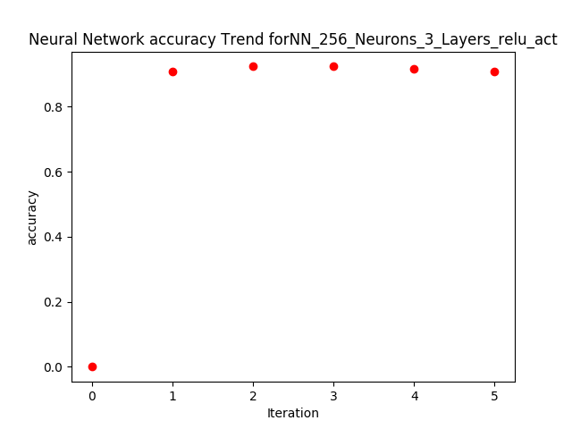
Improvement of Accuracy -CONTD
Change of fitness wrt iterations
0.9434044748046242 << after first generation
0.8063560675037053 << initial
Training Trend:
Num of times accucracy improved:40
Num of times accucracy dec:17

Slide 22
Choosing the top few – End of training
After a few generations of evolving the populations, following is done
Choose the final top NN of the final generation of population
For that NN, we need to save following
Json config of the Model in Result/config.txt
Weight in Result/Weight
The above 2 data will be useful to recreate the model.
This completes the Generate Module.

Slide 23
Analyzer Module
Analyzer Module
Software can start in analyzer mode too, provided the weight and json config of a generation module run earlier, is saved to Result/Weight and Result/Config.txt
This includes:
Spawn a keras Sequential Model from the json confg and add the weight available from the last trained weight.
Run iteratively.
At a periodic interface of 1 min, wake up, read the data(format of data similar to the training data). This data is collected by maintenance script (a different VM monitoring S/W).

Slide 24
Analyzer Module Predicting Result
Update the result to a csv, file.
Predict the class and corresponding action from the data.
This csv, can be ftp( there is a code added for the same), to some server.
An Application running on server can analyze the suggested action.
Step 7 is beyond scope of this project and a separate activity.
A sample weight and json generate by Generate Module has been checked in to

Slide 25
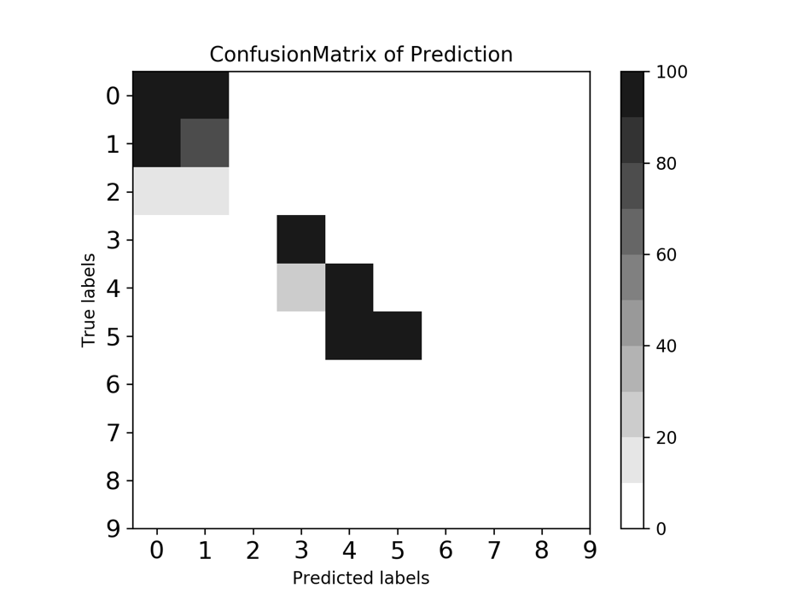
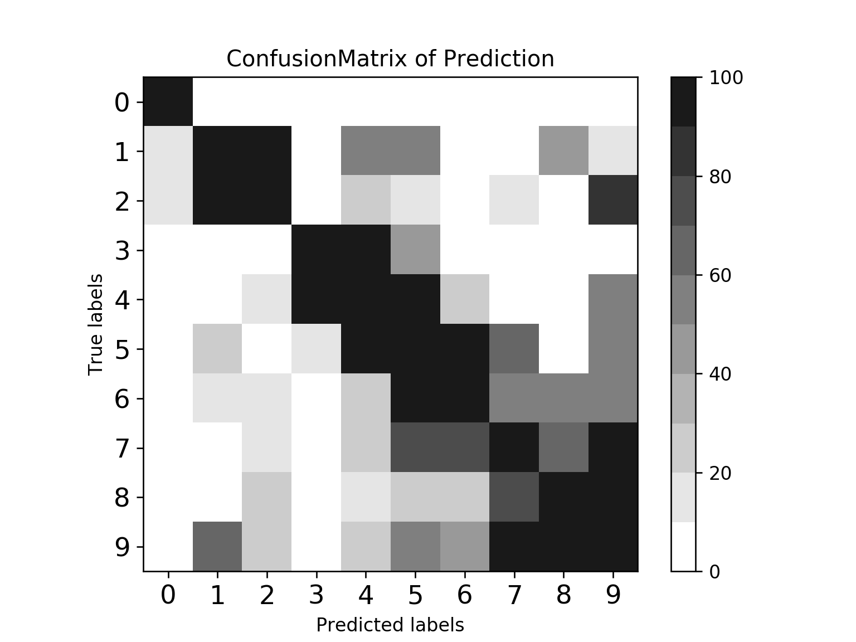
Verification of Result
Plot confusion Matrix of predicted result vs how the VM actually behaved.
Diagonal heavy confusion Matrix Proves the Correctness of the Software !!!!

Slide 26
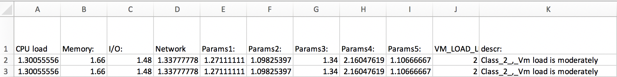
Format of Report Generated by Prediction Module
For a given set of monitored data, above software predicted possible condition of VM in near future and suggested action

Slide 27
Proof of Correctness of Algorithm
We did train the set of neural networks with data distributed across multiple classes.
There was a set of data having equal distribution of data from each of the class.
Testing accuracy is high. I plot following graphs to prove the above
Plot of change in fitness wrt various iteration of generations of NN. It is observed we see an improvement(or very small degradation in prediction accuracy).
While training, keras model progress in terms of epoch. It is observed accuracy increases across epochs, for most of sample runs.
Graph show improvement of accuracy for both
Accuracy of single NN across epoch.
Accuracy of a fit NN across multiple generations.
Compared prediction done by this software vs prediction done by set of static rules. Confusion matrix has highest density across diagonal.

Slide 28
Demo
We can run one cycle of software.
software launches in ‘Analyzer Mode’
Reads saved keras model and weights(based on last training).
At regular interval an offline software feeds a set of data to this Predictor.
Predictor predicts the possible condition of VMs(being monitored).
https://github.com/avijitbasu19811891/Sem4_project_sample_runs/tree/master/Recording_of_sample_run_demo/sample_run1

Slide 29
Future Works
Improve the UI of this software.
Incorporated a mechanism to FTP result to remote database.
Migrate from Sequential model of NN to RNN(recurring model).
RNN will provide prediction of VMM wrt time.
due to their ability to retain information and accurately make predictions for time series problems, RNN is a promising candidate to predict CPU utilization with greater accuracy when compared to sequential NN.
THANKING YOU

