Slide 1
RiskPulse
88%
sentiment accuracy after fine-tuning (from 72%)
89%
An AI/NLP risk engine that turns news and tweets into structured financial risk signals
event-type accuracy
3.2x
Avijit Dutta
Vellore Institute of Technology, Vellore
S&P Global & Crisil Campus Hackathon 2026
normal price move on high-impact days
Notes:
Introduce yourself. One line on the idea: risk shows up in text before it shows up in prices, so RiskPulse reads tweets and live news and turns them into structured signals. The three numbers on the right are the headline results: sentiment accuracy raised from 72% to 88% by fine-tuning, 89% event accuracy, and high-impact days moving 3.2x their normal amount.

Slide 2
Risk appears in text before it appears in prices
A downgrade, a lawsuit, a Fed comment or a sanctions headline is written down before the market fully reacts. Risk teams cannot read thousands of posts an hour, so the early signal is missed.
1
Read
2
Score
3
Act
80,793 stock tweets, replayed in time order
Live global news from GDELT
Entity linking: a text counts for a company only if it names it
Sentiment from -1 to +1 (fine-tuned FinBERT)
Event type: 9 classes
Impact score from 1 to 10
Module A: tilt a 15-stock index by sentiment
Module B: stress-test a banking book on impact 7+ events
Signal API and live dashboard
Notes:
The business problem in my own words: risk shows up in text first. The approach has three steps: read two sources and link each text to the right company, score each text three ways, then act on the scores in two downstream modules.

Slide 3
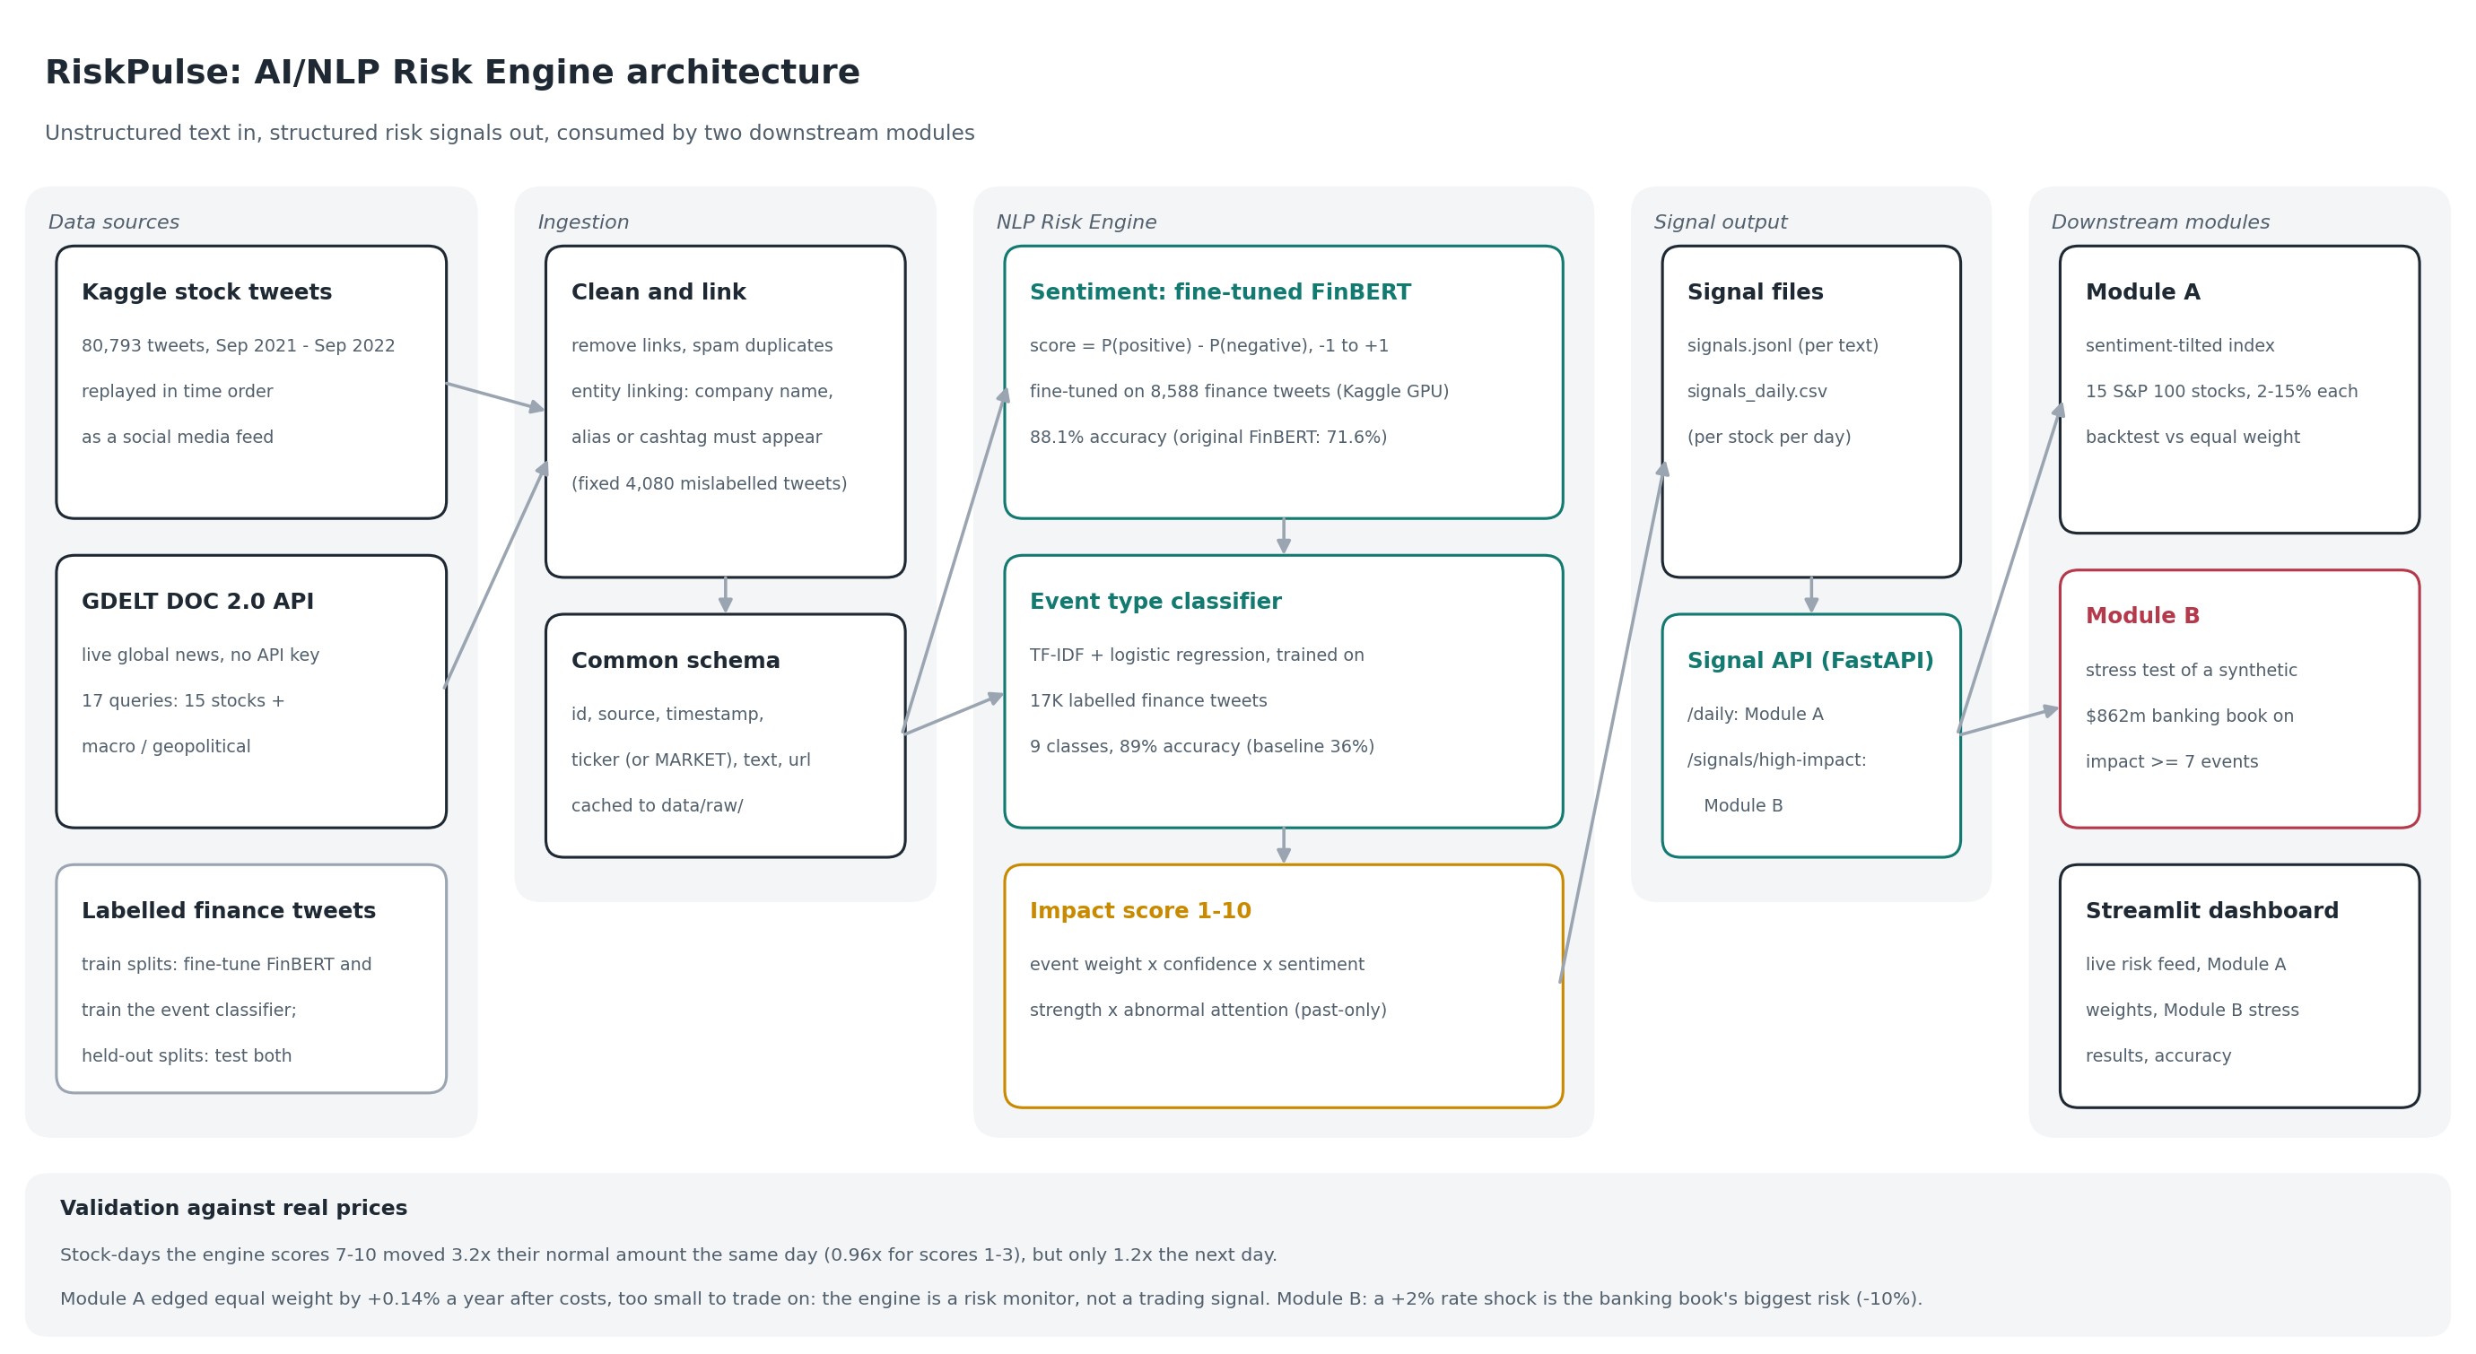
System design: one engine, two consumers
Notes:
Walk left to right: sources, ingestion with entity linking, the three engine components with their accuracy, the signal files and API, then Module A, Module B and the dashboard. Everything is cached, so the demo runs offline without API keys.

Slide 4
Implementation choices, and why
Entity linking
Fine-tuned FinBERT
Event classifier
A name, alias or cashtag must appear. It caught a data bug: 4,080 tweets copied under three companies.
Fine-tuned on 8,588 finance tweets on a free Kaggle GPU. Held-out accuracy rose from 71.6% to 88.1%.
TF-IDF + logistic regression: trains in a minute and labels 57K texts in seconds on a CPU. Zero-shot would take hours.
Impact score
Signal API
Honest backtests
Event severity x confidence x sentiment strength x abnormal attention, using past days only (no look-ahead).
FastAPI endpoints: Module A subscribes to /daily, Module B to /signals/high-impact.
Equal-weight benchmark, 10 bps trading costs, and a 9-setting robustness grid.
Notes:
Six choices the jury may ask about. Key ones: entity linking found a real bug in the source data; FinBERT was fine-tuned on one split and tested on another it never saw; the event classifier is fast enough for 57K texts on a laptop; and the impact score uses only past days, so no look-ahead.

Slide 5
Every component beats its naive baseline on unseen data
Fine-tuning lifted sentiment from 71.6% (original FinBERT) to 88.1%. Macro-F1: sentiment 0.85 (original 0.66, naive 0.26), events 0.87. 56,931 signals; the impact score ranks price moves better than tweet volume alone (0.078 vs 0.059).
Notes:
Left: both models beat a naive baseline on data they never saw. Fine-tuning FinBERT on 8,588 labelled tweets raised held-out accuracy from 71.6% to 88.1% and macro-F1 from 0.66 to 0.85. Right: on days the engine scores 7 to 10, stocks moved 3.2x their normal amount the same day, but only 1.2x the next day. Only 49 stock-days scored 7+, so this is strong evidence, not proof.

Slide 6
A real-time risk monitor, not a trading signal
A
Module A: sentiment-tilted index
After fine-tuning, it edged equal weight by +0.14% a year after 10 bps costs (6 of 9 settings positive), but that is too small to trade on: tweets mostly react to moves that already happened.
B
Module B: event-driven stress tests
31 stress tests triggered on a synthetic $862m banking book. Example: a story that Florida could face Disney's $1B district debt (22 Apr 2022, impact 9) triggers a Disney credit shock costing $14.2m.
Notes:
Module A now edges equal weight after costs, but the edge is tiny. The domain insight: the engine detects market-moving events as they happen, which is what a risk team needs. Module B uses exactly that: a +2% rate shock costs this bond-heavy book 10%, four times a geopolitical shock. The same risk that brought down Silicon Valley Bank in 2023.

Slide 7
Limitations and next steps
Limitations
Next steps
Fine-tuned on news-style tweets; retail chatter ("EARNINGS THREAD") can still score strongly
Word-based event model is fooled by slang ("Gold secured! $TSLA")
Event weights are hand-set; only 49 stock-days scored 7+
Stress shocks are fixed per scenario, first-order valuation
Fine-tune further on labelled retail stock tweets
Learn impact weights from realised price moves
Size each shock to the specific event; full repricing
Streaming news feed instead of rate-limited GDELT polling
Code, data and demo: github.com/avijitdutta1230000-crypto/VIT_Vellore-Avijit_Dutta-hackathon
Notes:
Be upfront about limitations; the jury will ask anyway. Each limitation has a concrete next step. Close by thanking the jury and pointing to the repository.

