Slide 1
Gesture Recognition (HPS-Integrated Orientation and Pitch/ Roll Detection System)
Advanced Digital Systems (ENGI 9865)
Onwukanjo Innocent O. (202487225)
Avijit Hazra (202580731)

Slide 2
Project Overview
Objective: Implement a real-time orientation detection system using the DE10-Standard board.
Core Feature: Meaningful integration of the ARM Hard Processor System (HPS) with custom VHDL hardware.
Output: Real-time visual feedback of board orientation (UP, DO, RI, LE) and precise tilt angles.

Slide 3
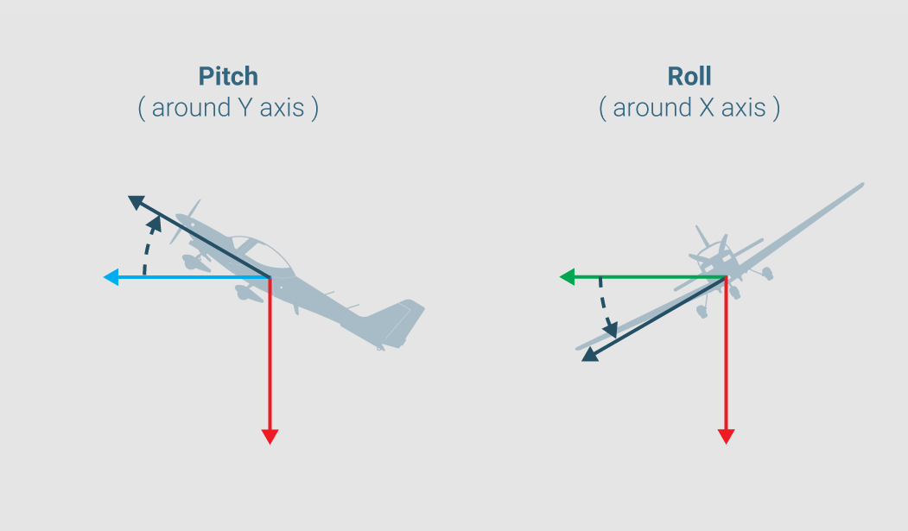
Project Overview (Pitch and Roll)

Slide 4
System Architecture & Partitioning
HPS Domain:
Reads raw X, Y, Z data via I2C protocol
Computes Pitch/Roll using floating-point math arctan2
FPGA Domain:
Maps values to directions
Displays in HEX output
Interconnect:
HPS-to-FPGA Bridge

Slide 5
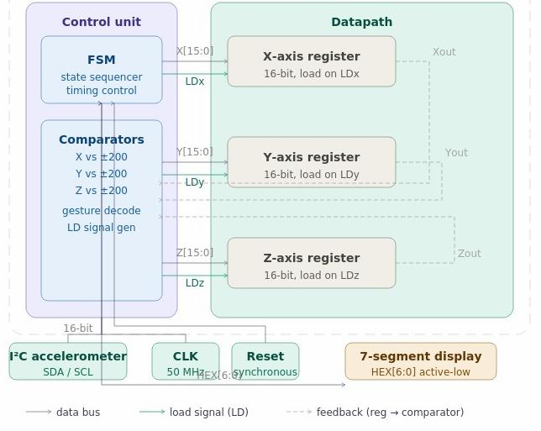
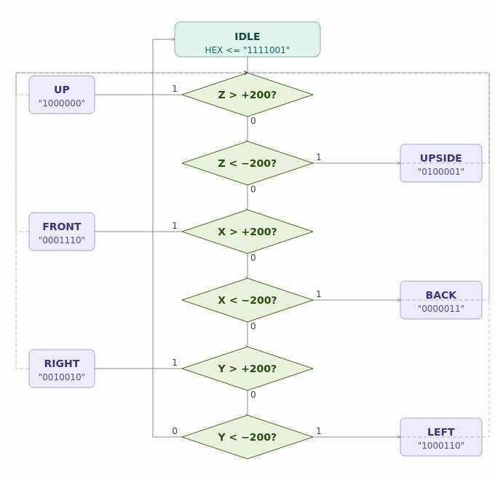
DataPath and ASM Chart

Slide 6
Data Acquisition
Every .05s as human action not fast as clock speed of 50HZ
Average of 8 values
I2C (Inter-Integrated Circuit) protocol from ADXL345 to HPS
Sensitivity: 3.9mg/LSB. 1g is 256
Range -2g to +2g

Slide 7
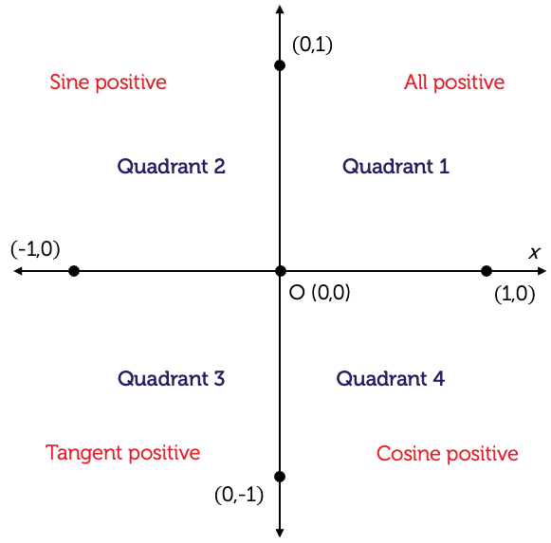
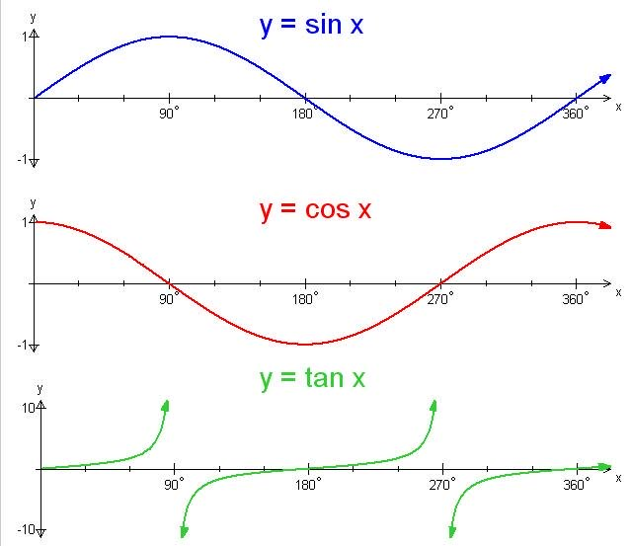
Why tan (not sine/cosine)?

Slide 8
Implementation
Input Condition | Detected Orientation | VHDL Status Output
Z > 200 | Upright / Flat | “UP”
Z < -200 | Inverted | “DO”
X > 200 | Tilted Right | “RI”
X < -200 | Tilted Left | “LE”
Y > 200 | Tilted Front | “FR”
Y < -200 | Tilted Back | “BA”
Default | Idle / Undetermined | “ID”
+/- 200 threshold
tan (pitch) = x / z
tan (roll) = y / z

Slide 9
Conclusion and Future Work
Robust integration of HPS and FPGA domains
Leverages the ARM processor for complex math
Utilizing the FPGA for deterministic, real-time peripheral control
Future Work
Sign language recognition
Drone control

Slide 10
Questions?
Thank you for Listening

