Slide 1
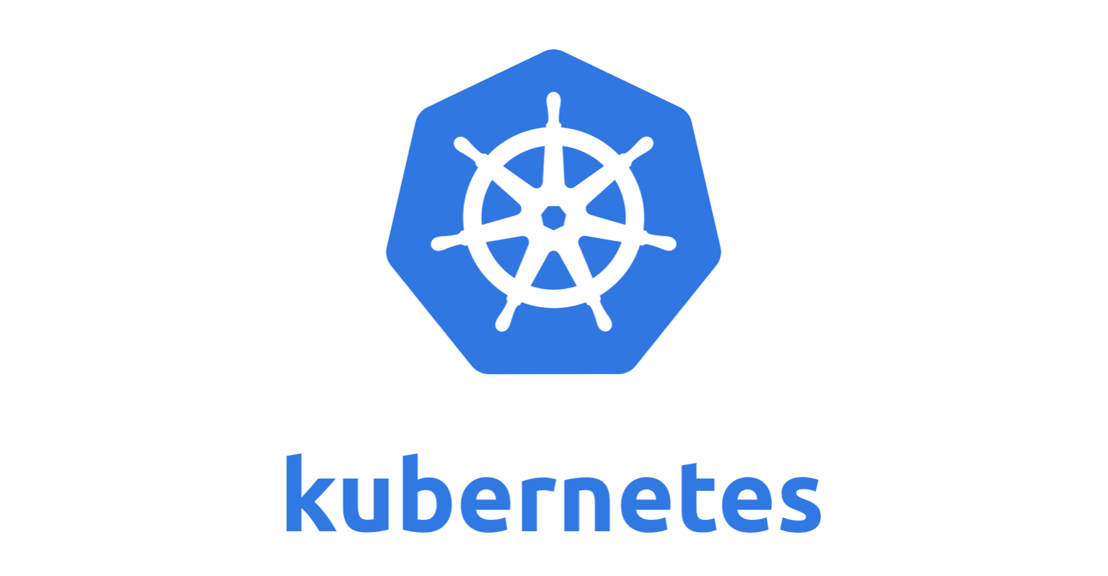
basics

Slide 2
Agenda
Why to use Kubernetes
What is Kubernetes
How to use Kubernetes

Slide 3
Docker
Python
Scala
Database
Windows / Linux

Slide 4

Python
.NET
Linux
Windows
Linux
Windows
Python
.NET

Slide 5
Python
.NET
…
Hypervisor ( Virtual Box / VMWare )
Linux
Windows
…
Windows / Linux

Slide 6
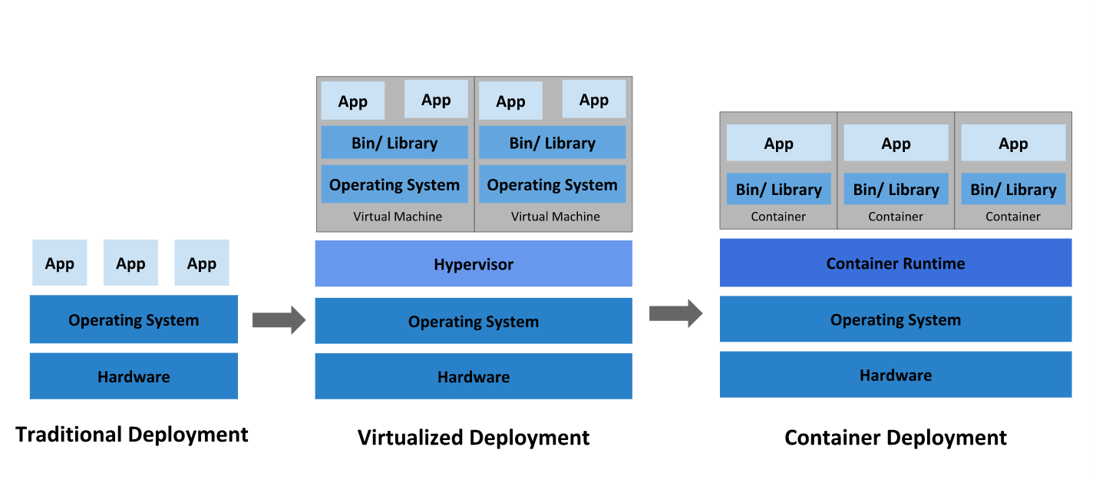

Slide 7
Python
Python

Slide 8
Disadvantages of docker
Complicated automatic horizontal scaling set up
Has poor monitoring option.
Manual handling multiple instances
Complicated manual cluster deployment
Basic infrastructure handling
All the actions must be performed in CLI.

Slide 9
What is Kubernetes?
Kubernetes is a portable, extensible, open-source platform for managing containerized workloads and services.
Kubernetes orchestration allows you to build application services that span multiple containers, schedule containers across a cluster, scale those containers, and manage their health over time.
Kubernetes eliminates many of the manual processes involved in deploying and scaling containerized applications.

Slide 10
POd
The basic scheduling unit in Kubernetes is a pod.
A pod consists of one or more containers that are guaranteed to be co-located on the same node.
Each pod in Kubernetes is assigned a unique IP address within the cluster, which allows applications to use ports without the risk of conflict.
Within the pod, all containers can reference each other on localhost, but a container within one pod has no way of directly addressing another container within another pod; for that, it must use the Pod IP Address.

Slide 11
POD
POD 2
POD 2
container 1
container 1
container 1
…
…
…
container n
container n
container n
10.2.0.1
10.2.0.2
10.2.0.3

Slide 12
Useful commands
kubectl get po
kubectl describe po <pod name>
kubectl logs –f <pod name>
kubectl delete po <pod name>
kubectl apply –f <path to pod definition file>

Slide 13
etcd is a persistent, lightweight, distributed, key-value data store that reliably stores the configuration data of the cluster, representing the overall state of the cluster at any given point of time.
it serves the Kubernetes API using JSON over HTTP, which provides both the internal and external interface to Kubernetes. The API server processes and validates REST requests and updates state of the API objects in etcd, thereby allowing clients to configure workloads and containers across Worker nodes.
The scheduler is the pluggable component that selects which node an unscheduled pod runs on, based on resource availability. The scheduler tracks resource use on each node to ensure that workload is not scheduled in excess of available resources
A controller is a reconciliation loop that drives actual cluster state toward the desired cluster state, communicating with the API server to create, update, and delete the resources it manages (pods, service endpoints, etc.). The controller manager is a process that manages a set of core Kubernetes controllers.
etcd
It is responsible for the running state of each node, ensuring that all containers on the node are healthy. It takes care of starting, stopping, and maintaining application containers organized into pods as directed by the control plane.
API Server
The Kube-proxy is an implementation of a network proxy and a load balancer, and it supports the service abstraction along with other networking operation
Scheduler
A container resides inside a pod. The container is the lowest level of a micro-service, which holds the running application, libraries, and their dependencies. Containers can be exposed to the world through an external IP address
Controller manager
Kubelet
Kube-proxy
Container runtime

Slide 14
etcd
API Server
Scheduler
Controller manager
Kubelet
Kubelet
Kube-proxy
Kube-proxy
Container runtime
Container runtime
Worker Node
Master Node
Worker Node

Slide 15
Useful commands
kubectl get no
kubectl describe no <node name>
kubectl delete rc <replication controller name>
kubectl apply –f <path to replication controller definition file>
kubectl delete –f <path to replication controller definition file>

Slide 16
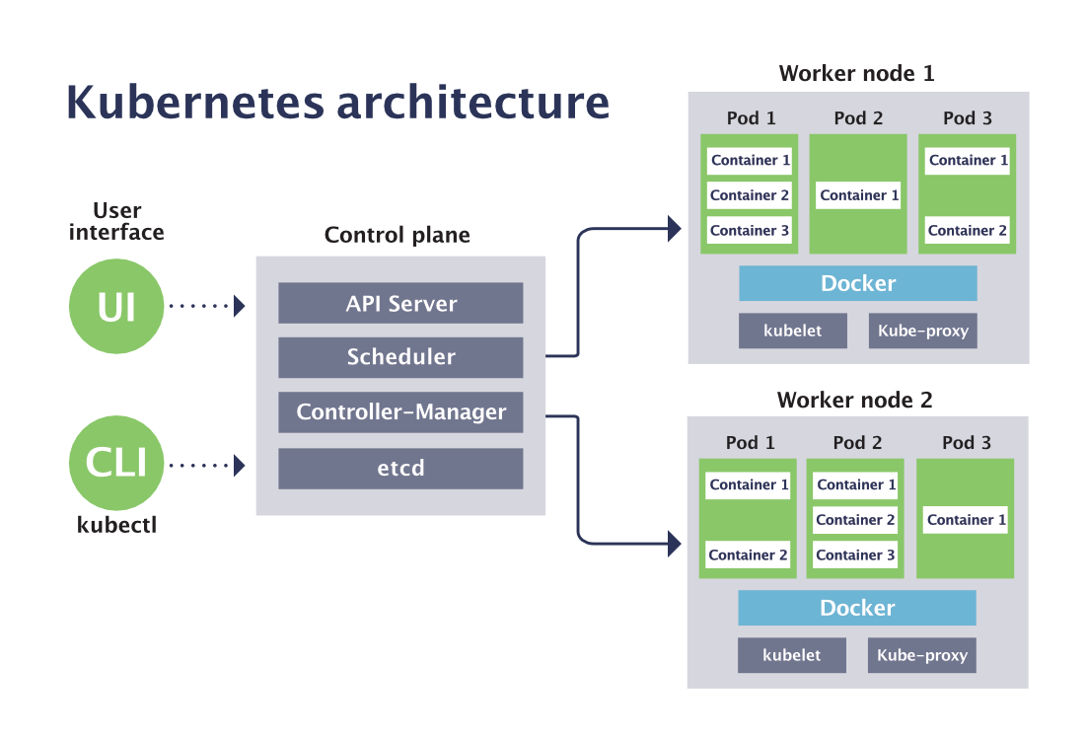

Slide 17
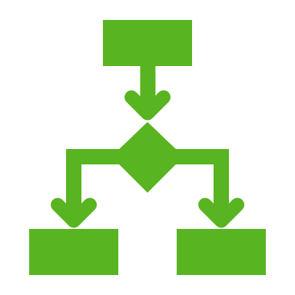
Replication controller
Replication Controller is responsible for managing the pod lifecycle. It is responsible for making sure that the specified number of pod replicas are running at any point of time. It is used wants to make sure that the specified number of pod or at least one pod is running. It has the capability to bring up or down the specified no of pod.

Slide 18
Useful commands
kubectl get rc
kubectl describe rc <replication controller name>
kubectl delete rc <replication controller name>
kubectl apply –f <path to replication controller definition file>
kubectl delete –f <path to replication controller definition file>

Slide 19
Replica sets
Replica Set ensures how many replica of pod should be running. It can be considered as a replacement of replication controller.
Key difference between the replica set and the replication controller is, the replication controller only supports equality-based selector whereas the replica set supports set-based selector.

Slide 20
Useful commands
kubectl get rs
kubectl describe rs <replica set name>
kubectl delete rs <replica set name>
kubectl apply –f <path to replica set definition file>
kubectl delete –f <path to replica set definition file>

Slide 21
deployment
Deployment is higher version of replica set. It has the capability to update the replica set and are also capable of rolling out new updated and/or roll back to a previous version.

Slide 22
Useful commands
kubectl get deploy
kubectl describe deploy <deployment name>
kubectl delete deploy <deployment name>
kubectl apply –f <path to deployment definition file>
kubectl delete –f <path to deployment definition file>

Slide 23
service
A service can be defined as a logical set of pods. It can be defined as an abstraction on the top of the pod which provides a single IP address and DNS name by which pods can be accessed. With Service, it is very easy to manage load balancing configuration. It helps pods to scale very easily.
There are three types of Services
Cluster IP → The default value. The service is only accessible from within the Kubernetes cluster – you can’t make requests to your Pods from outside the cluster!
NodePort → This makes the service accessible on a static port on each Node in the cluster. This means that the service can handle requests that originate from outside the cluster.
LoadBalancer → The service becomes accessible externally through a cloud provider's load balancer functionality. The cloud provider will create a load balancer, which then automatically routes requests to your Kubernetes Service.

Slide 24
Useful commands
kubectl get svc
kubectl describe svc <service name>
kubectl delete svc <service name>
kubectl apply –f <path to service definition file>
kubectl delete –f <path to service definition file>

Slide 25
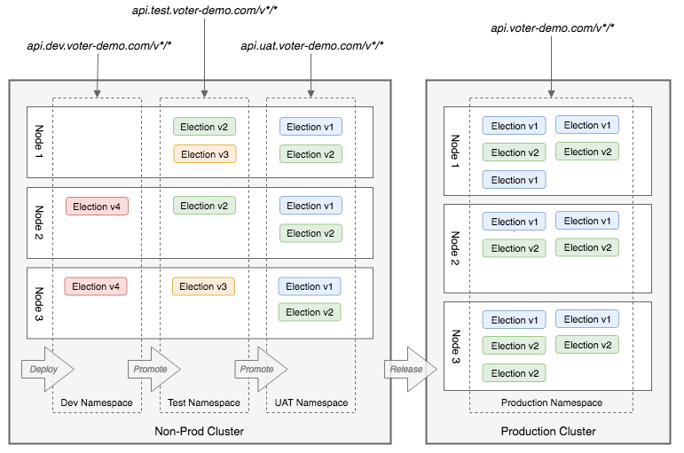
Namespace
Namespace provides an additional qualification to a resource name. This is helpful when multiple teams are using the same cluster and there is a potential of name collision. It can be as a virtual wall between multiple clusters.

Slide 26
Useful commands
kubectl get ns
kubectl describe ns <namespace name>
kubectl delete ns <namespace name>
kubectl apply –f <path to namespace definition file>
kubectl delete –f <path to namespace definition file>

Slide 27
Other Resource types of kubernetes
Deployments
Rolling Updates
Rollbacks
Environment Variable
Config Map
Secret
Access Control
Service Account
Node selectors
Taints and Tolerations
Node Selectors
Node Affinity
Pod Status
Readiness Probe
Liveness Probe
Worker
Jobs
Cron Jobs
Networking
Ingress
Network Policies
Volume
Persistent Volume
Persistent Volume Claim
Storage Class
Stateful Set
Headless Service
Horizontal Pod Autoscaler
Resource Quotas
Pod Security Policy
Pod Disruption Budget
Limit Range
Events
Endpoint
Daemon Set
Component Status
Certificate Signing Requests

Slide 28
Kubernetes alternative
Docker swarm
Apache Mesos
AWS Fargate
Openshift Container Platform

Slide 29
Useful links
Kubernetes Cluster https://www.katacoda.com/contino/courses/kubernetes
Course https://www.udemy.com/course/certified-kubernetes-application-developer
Install Kubernetes on ubuntu https://ubuntu.com/kubernetes/install#single-node
Deploy k8s dashboard https://github.com/kubernetes/dashboard#getting-started
Pod networking https://www.youtube.com/watch?v=7LRtytR6ZbA
Source https://avijitmondal.github.io/kubernetes-tutorial
Install Docker and K8s on windows 10 https://dev.to/devcrafter91/how-to-install-kubernetes-on-windows-10-55b6 (VirtualBox VM might not work)
Practice K8s - https://www.katacoda.com/contino/courses/kubernetes

Slide 30
Start exploring Kubernetes…

