Slide 1
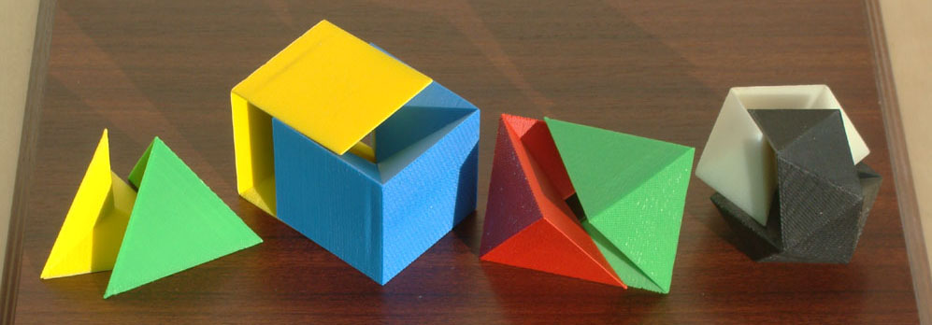
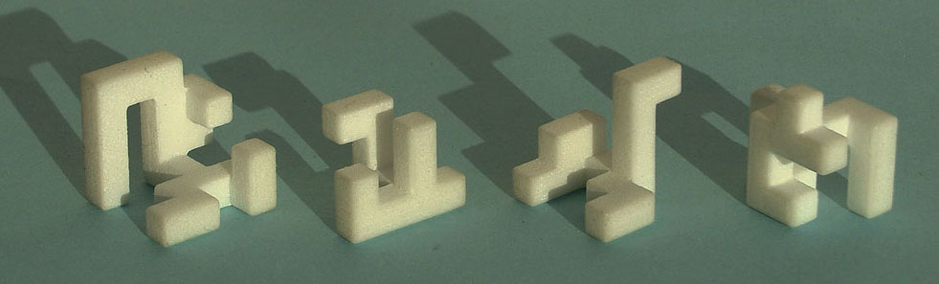
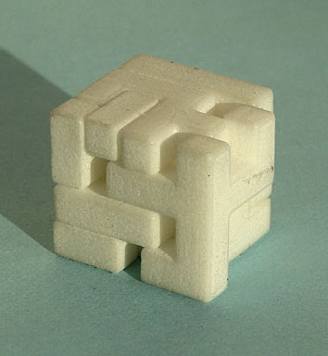
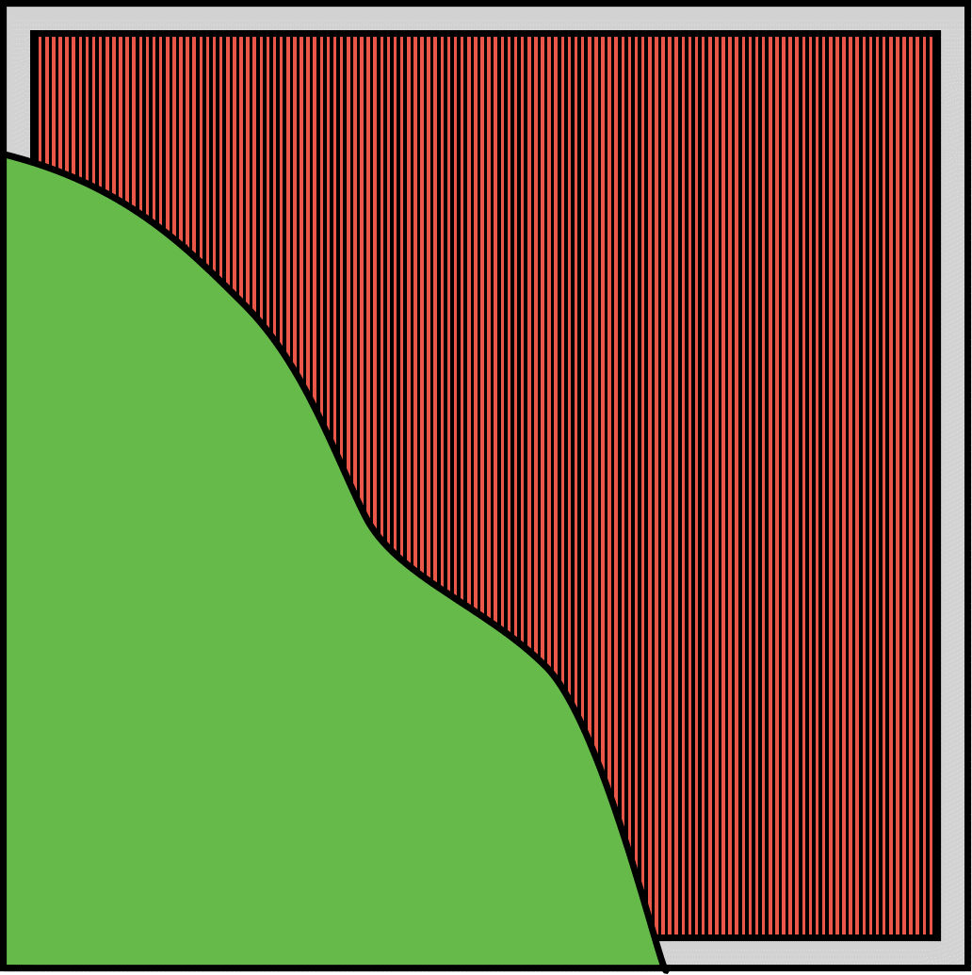
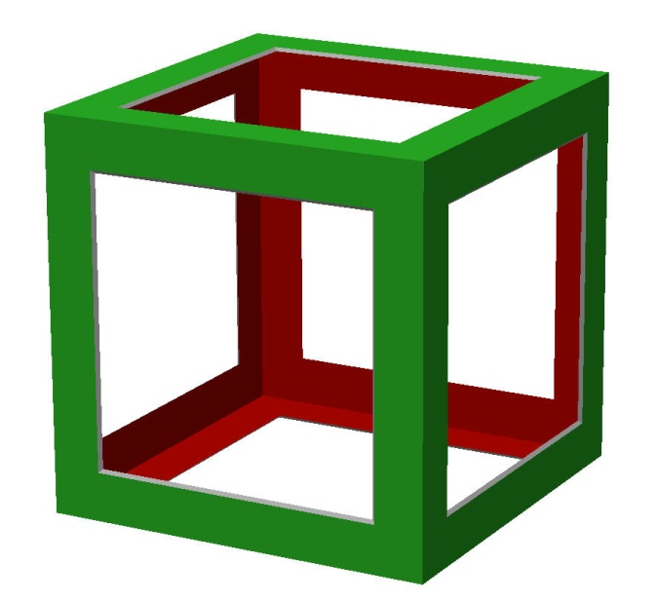
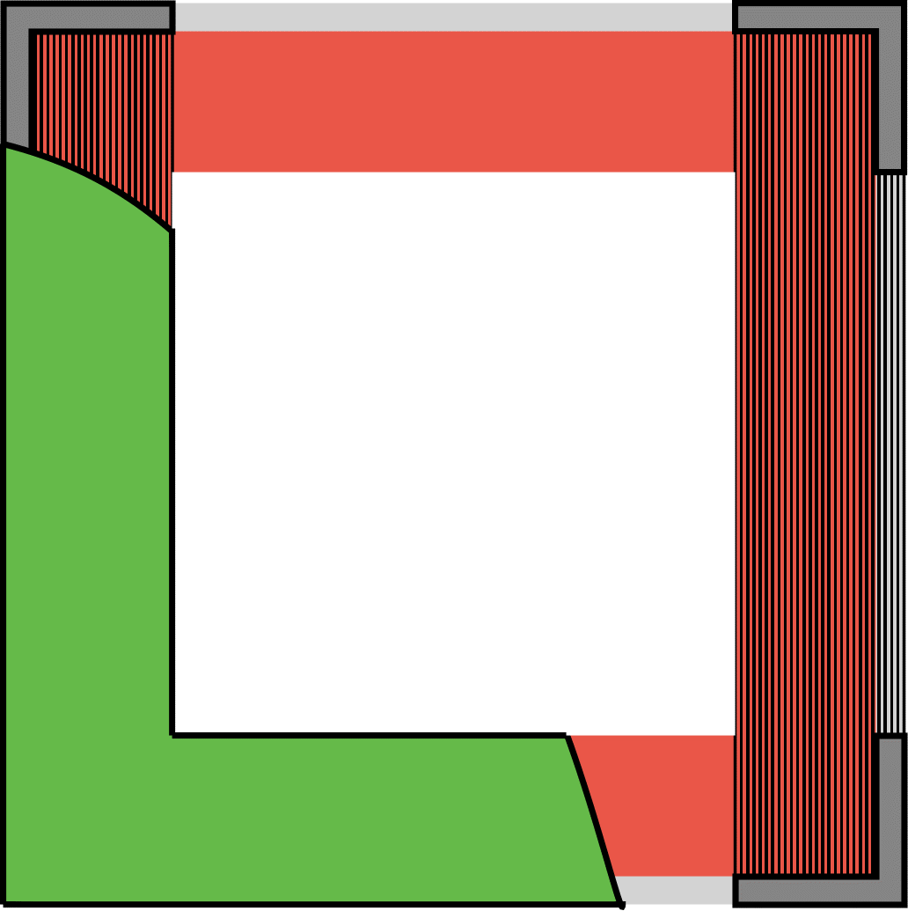
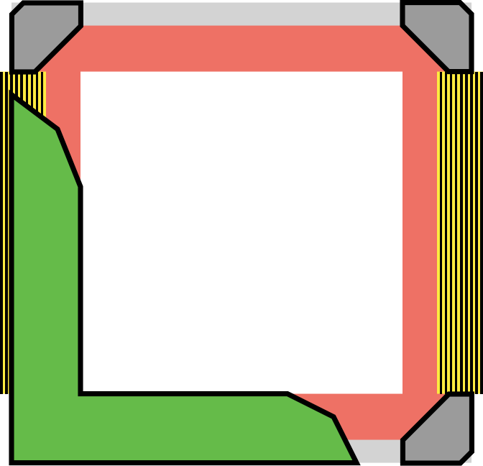
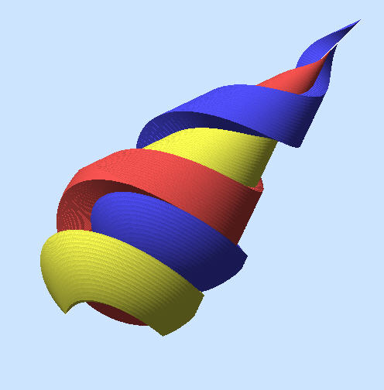
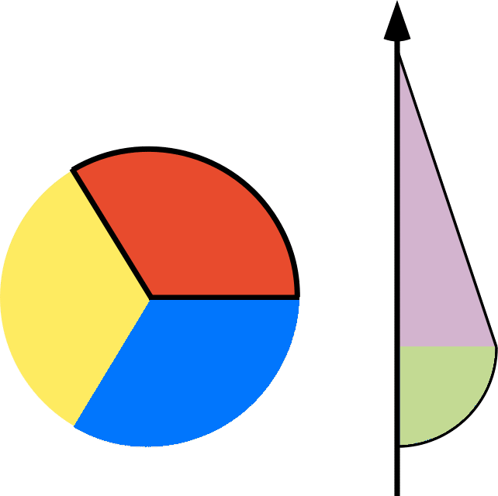
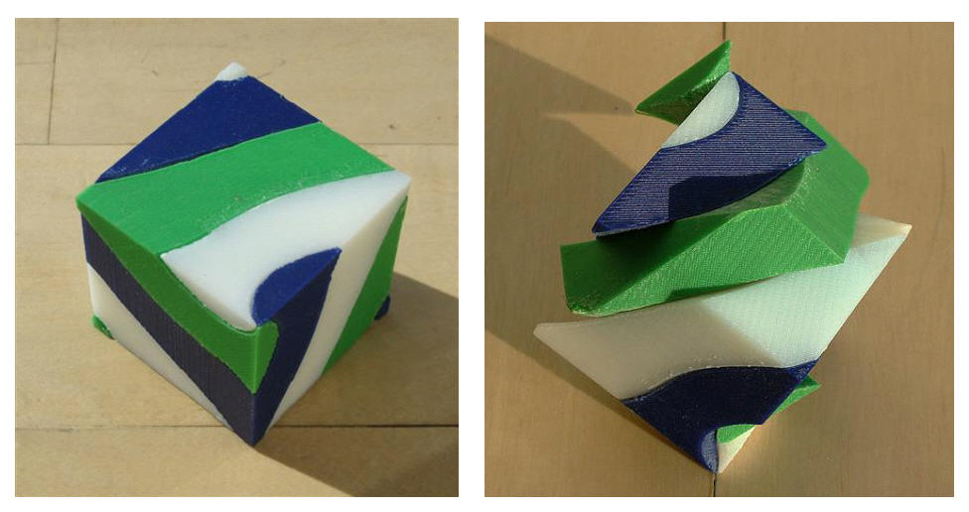
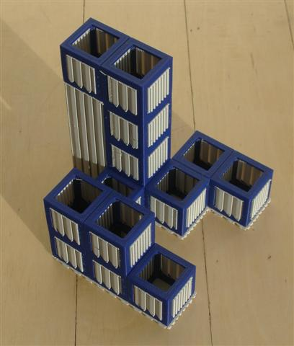
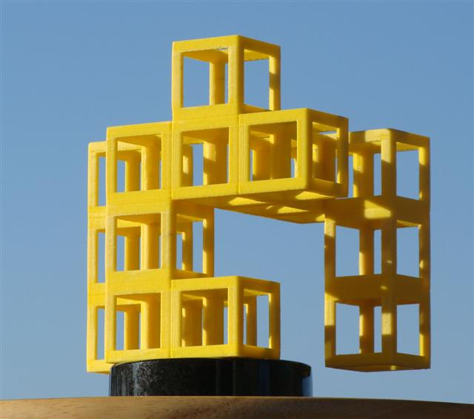
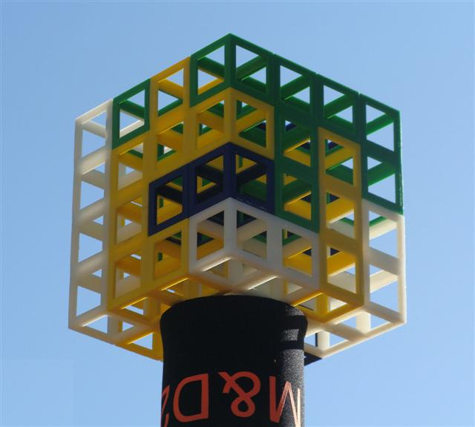
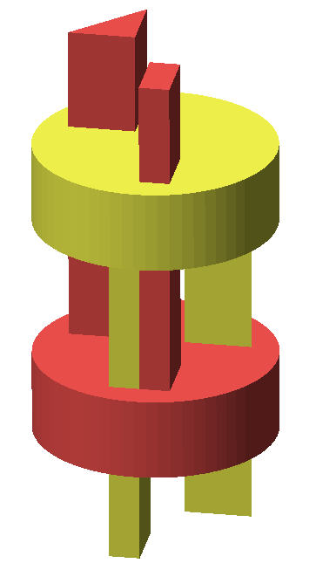
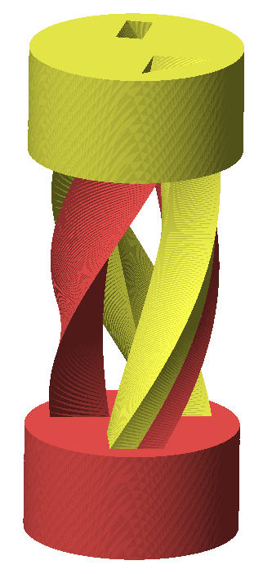
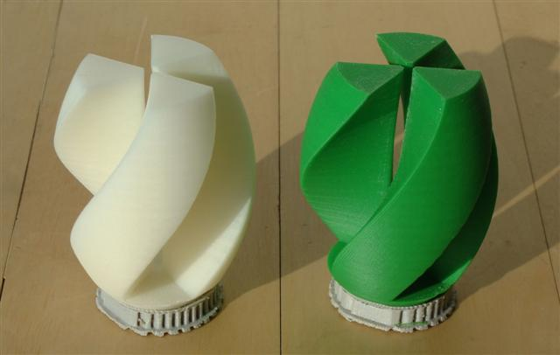
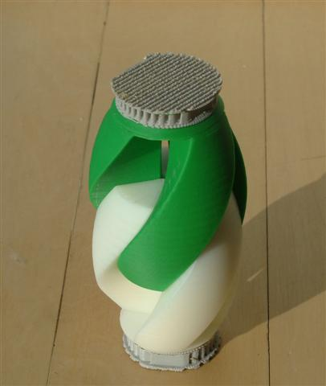
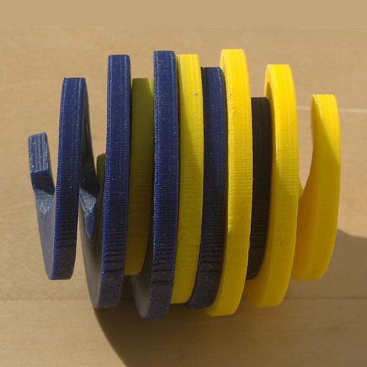
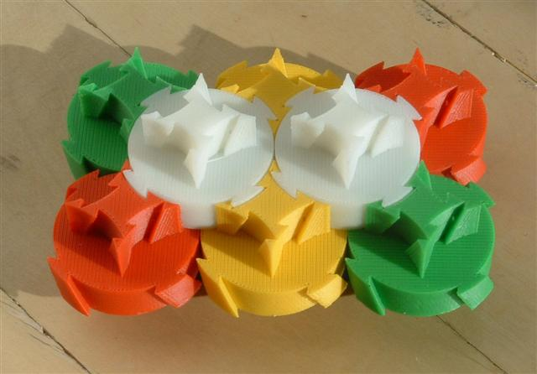
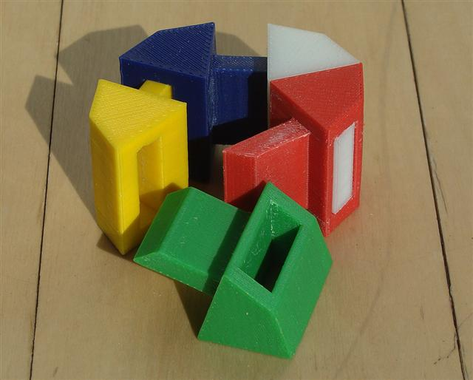
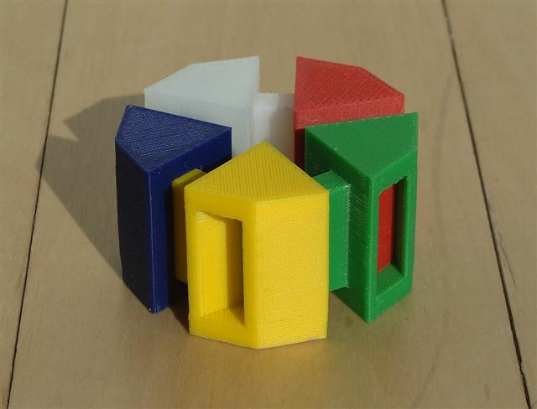
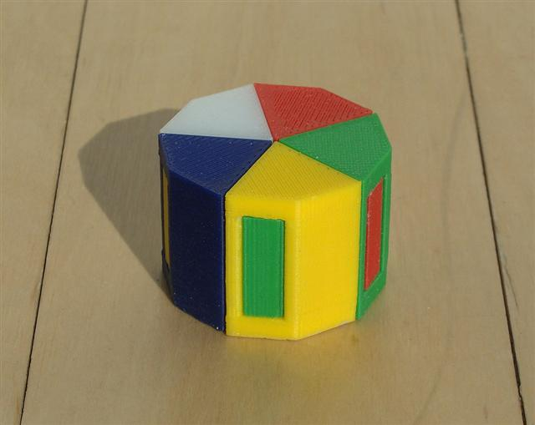
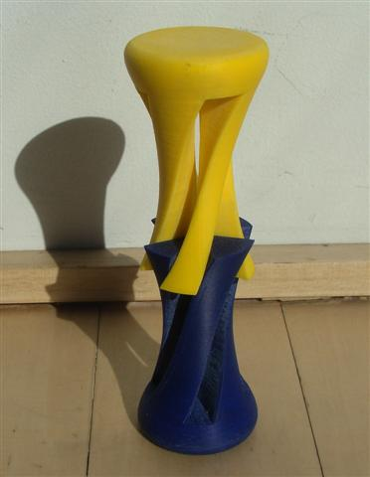
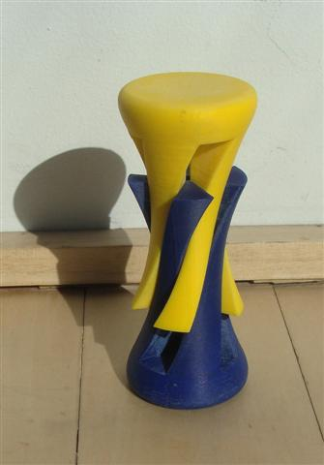
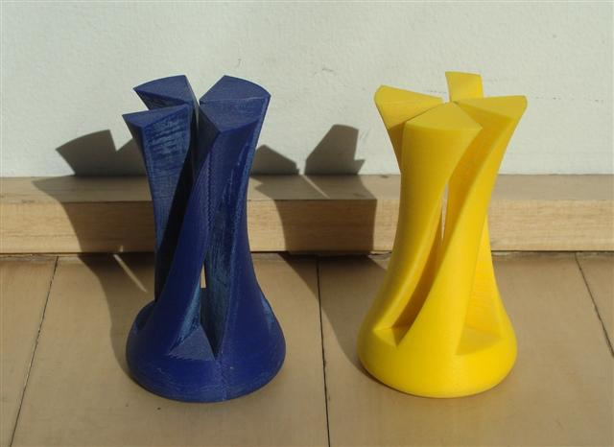
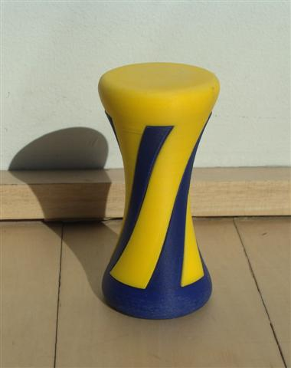
Interactive 3D Rapid-Prototyping Models
---
Carlo H. Séquin
U.C. Berkeley, EECS, CS Division
Dissection Geometries
Fabrication Issues
A Simple Introduction to Polyhedral Dissections
Interlocking Cubic Burr Puzzle
Problem Statement:
Here is a picture of a neat cube-dissection puzzle. We would like to have one like it,
-- but at a much bigger scale (say, scaled up by a factor of 8 or 10)!
Find a design that can be built at this larger scale in an economical way
with a layered manufacturing process.
Making Truly Interactive 3D Models
Hamiltonian dissections of Platonic Solids: The cutting surface is formed by a line sweeping
from the centroid of the solid along a Hamiltonian cycle on the polyhedron edges.
Not just virtual displays that can be twiddled with a mouse.
But tangible 3D models that can be physically manipulated.
Dissection puzzles are excellent tutorial examples:
Helicoidal Dissections
Solution: Use a grid / frame approach to outline each unit cube:
Problem Statement:
Design a two- or three-piece geometrical puzzle in which a simple shape
partitions into all congruent parts via a helical screw motion.
Instructional / Educational Value
of 3D Dissection Puzzles
Possible cubelet designs: (a) cross section through a hollow cube shell; (b) Leonardo-style
cube frame; (c) cross section through this cube frame with support structure
(dark vertical lines); (d) final cubelet frame design with beveled edges.
Used in course on Solid Modeling & Rapid Prototyping:
The design of the 3D puzzle geometry
requires spatial visualization skills.
The design of the physical artifacts
requires attention to tolerances
and to materials properties.
A first approach: Define one or more helicoidal cutting planes around the z-axis
and use those to cut up a shape with proper rotational symmetry around this axis.
Tangible Models
Provide relevant feedback on whether parts fit together
and have the right amount of resistance to movements:
so that they don’ t fall apart by themselves;
so that they don’t stick too tightly together.
Success is judged by manipulating the model.
(a) One frame part as it comes out of the FDM machine; (b) another part after removal of the support structure; (c) the whole 4x4x4 burr puzzle assembled.
A second approach: Define the extrusion of a suitable cross section and its complement;
Helically twist the whole configuration around the z-axis.
Tolerances ! Dissecting All of 3D Space
Play with the models !
Multi-hand Dissections
In this ring of 5 tiles at least 3 tiles have to be moved simultaneously in different directions
in order to take this puzzle apart.
Too tight ??
Isohedral helicoidal tiles (Matthias Goerner)

Slide 2
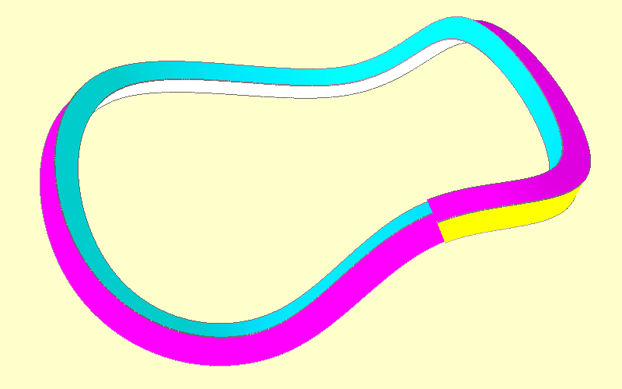
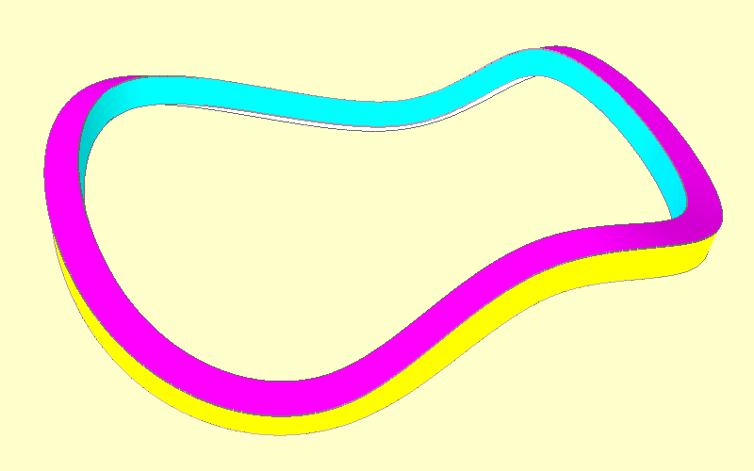
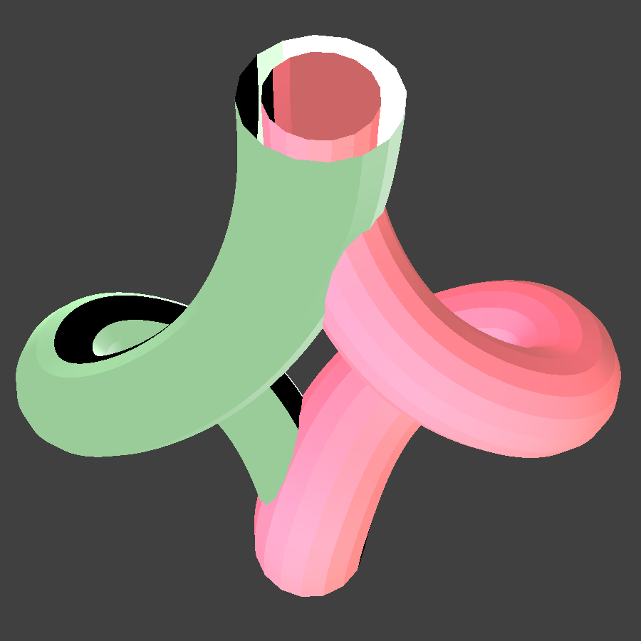
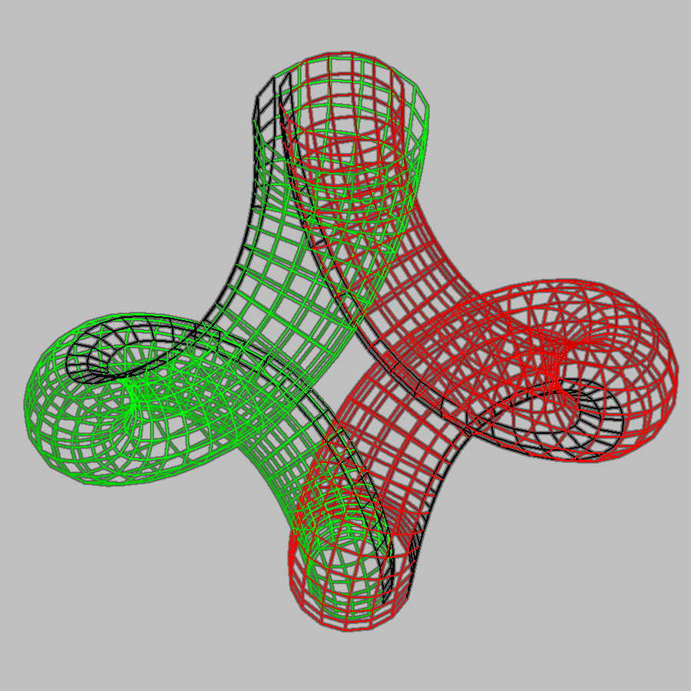
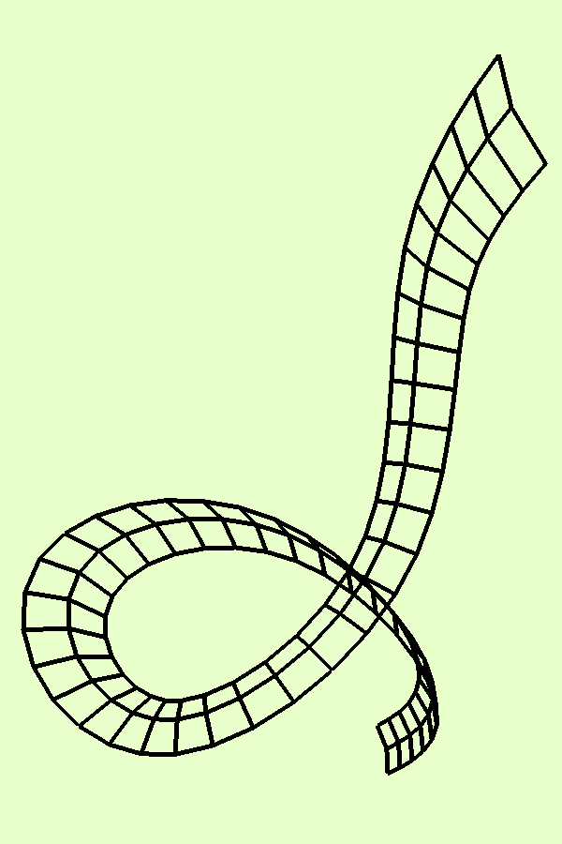
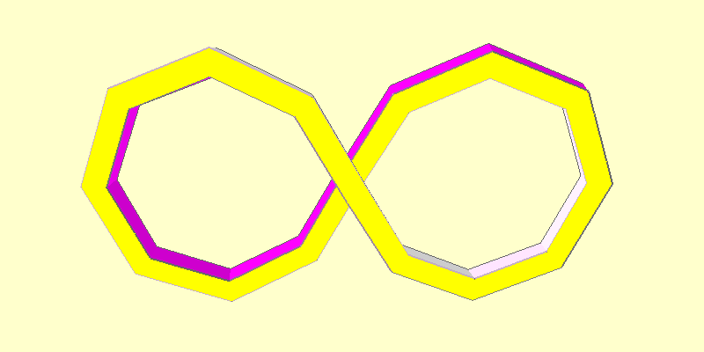
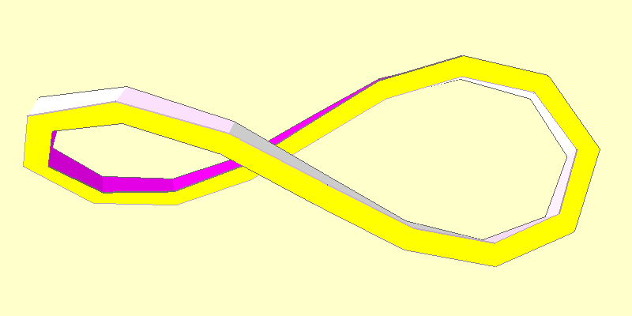
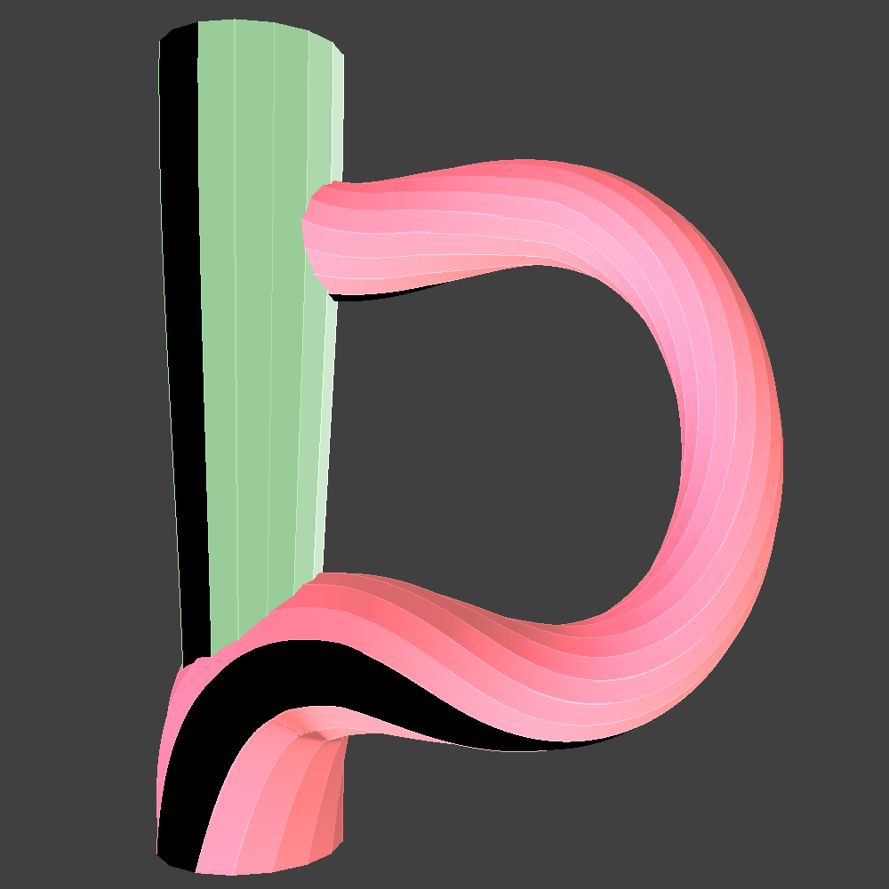
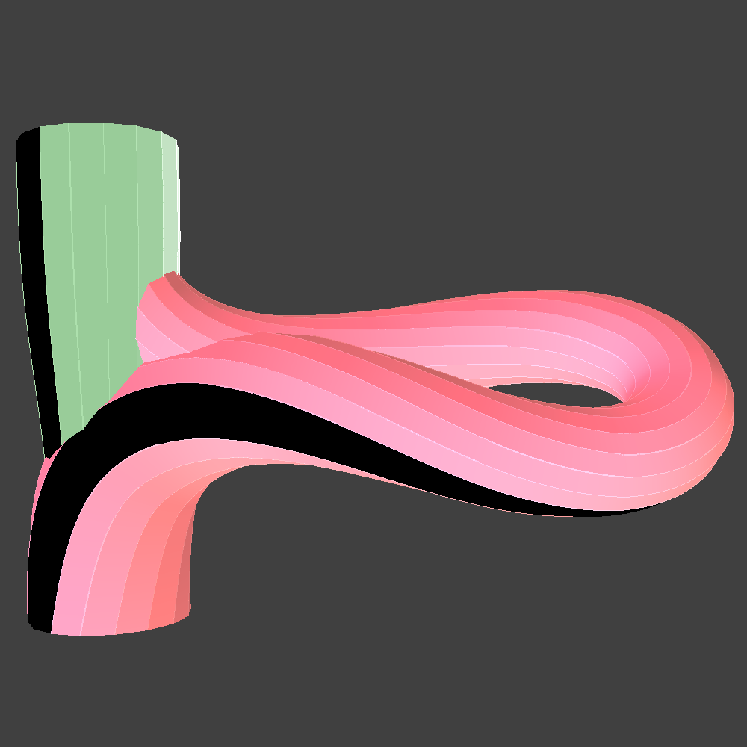
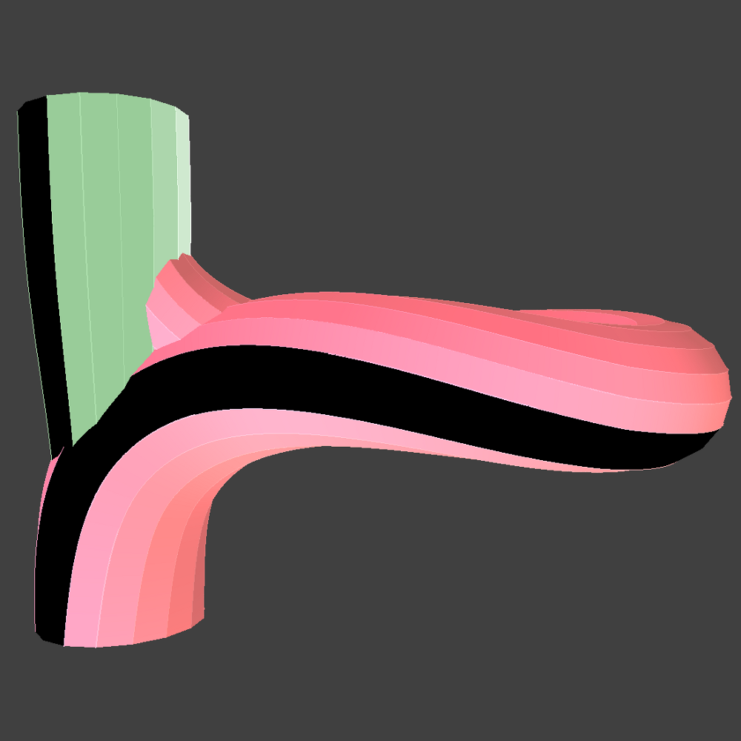
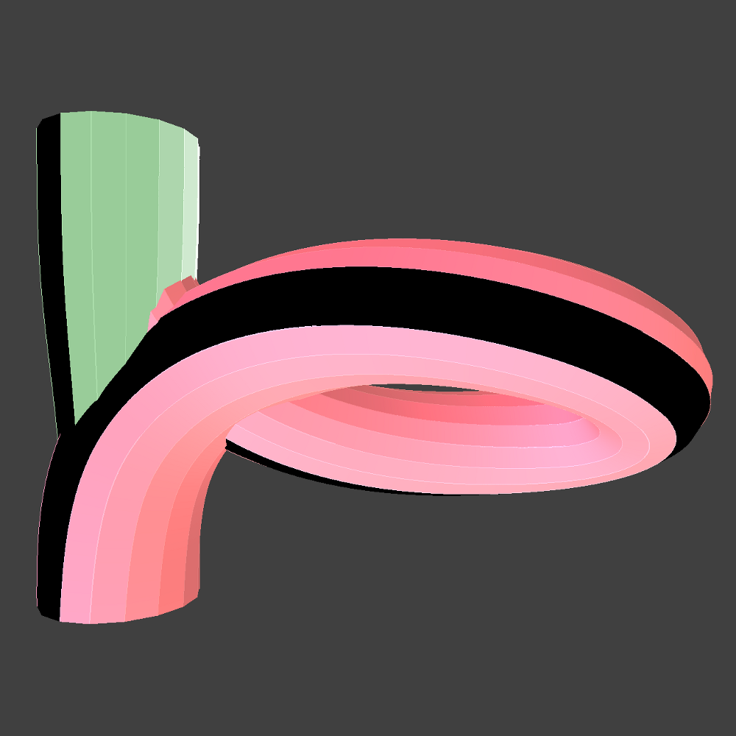
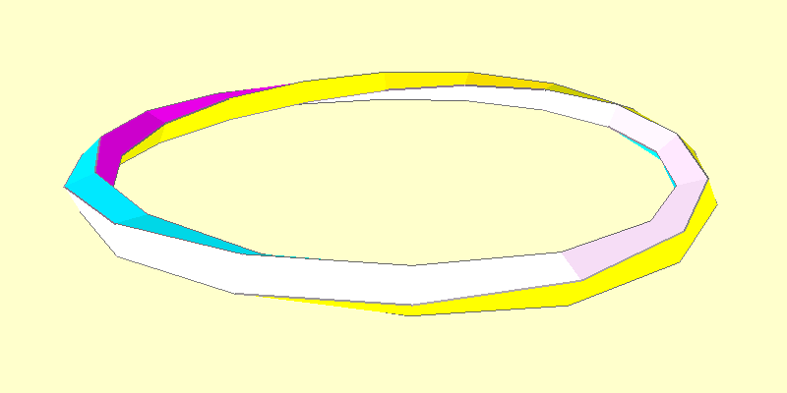

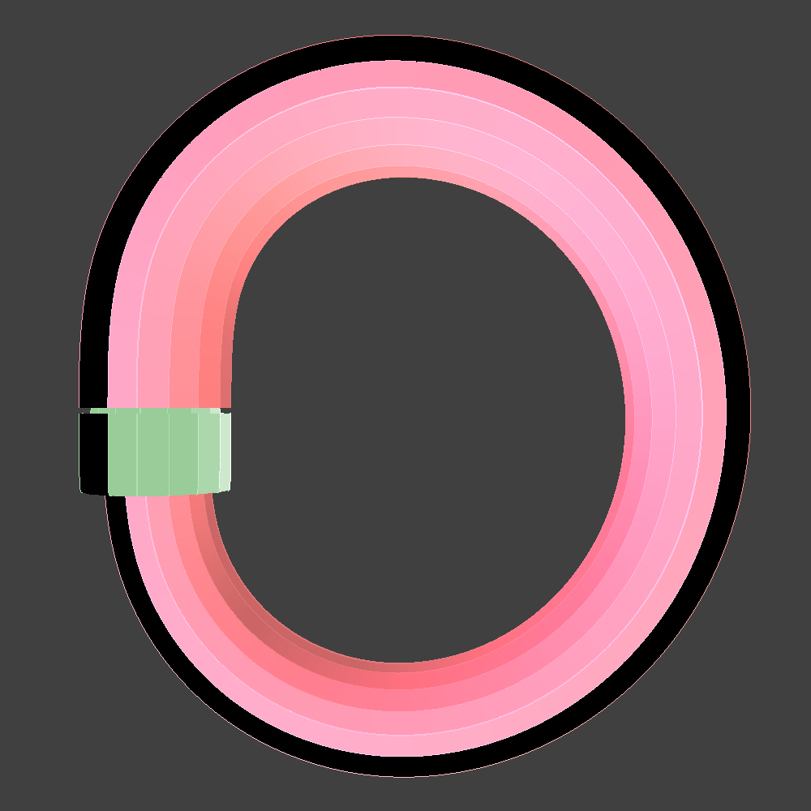
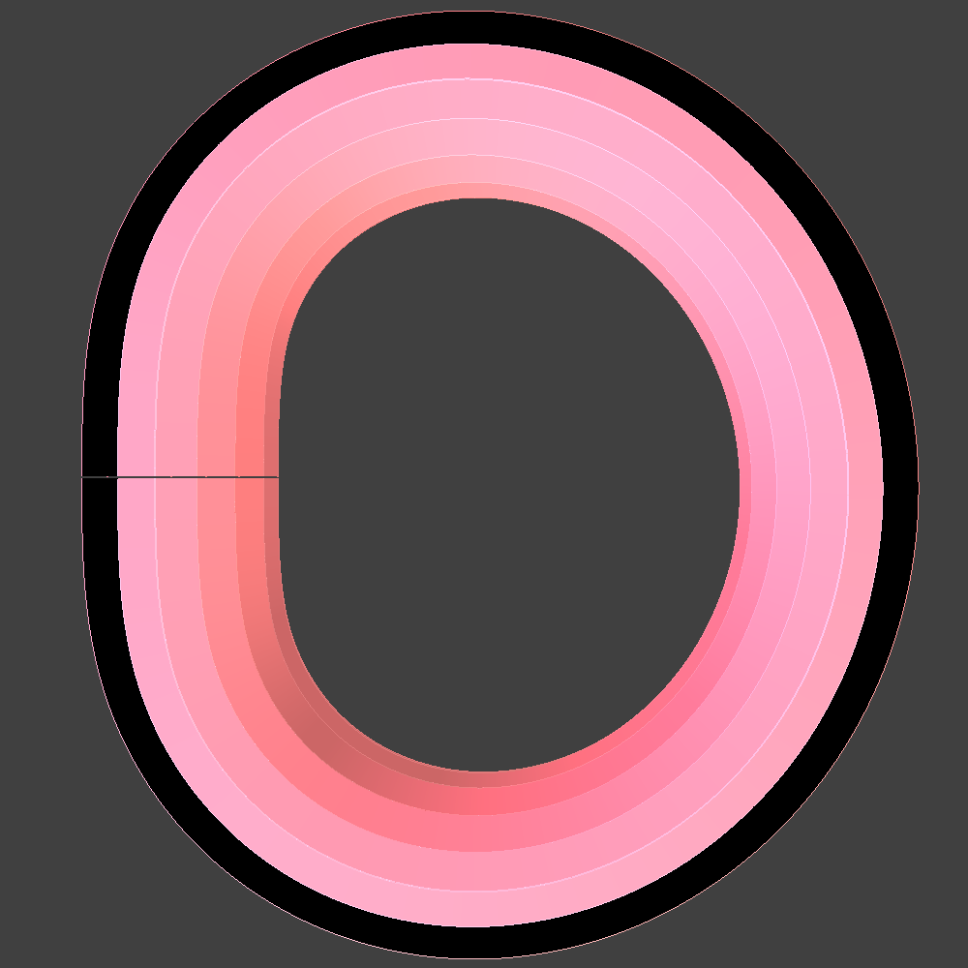
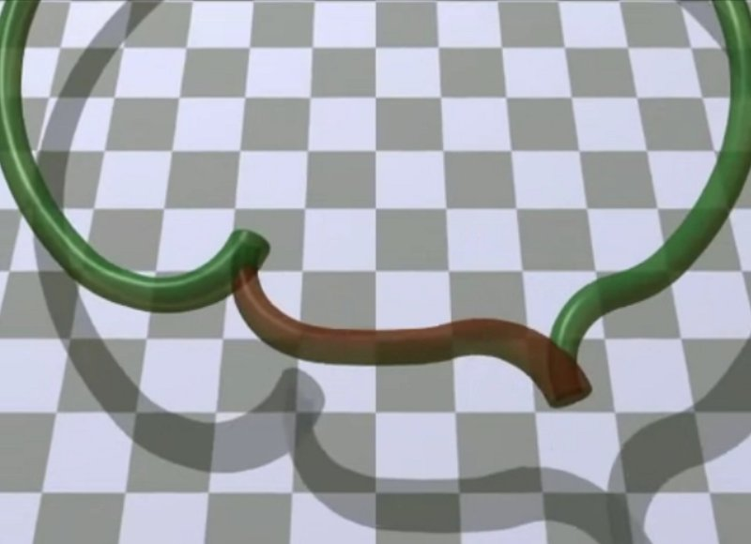
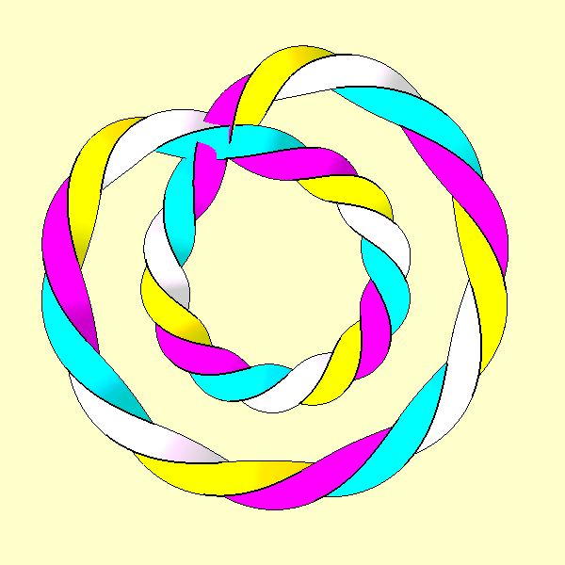
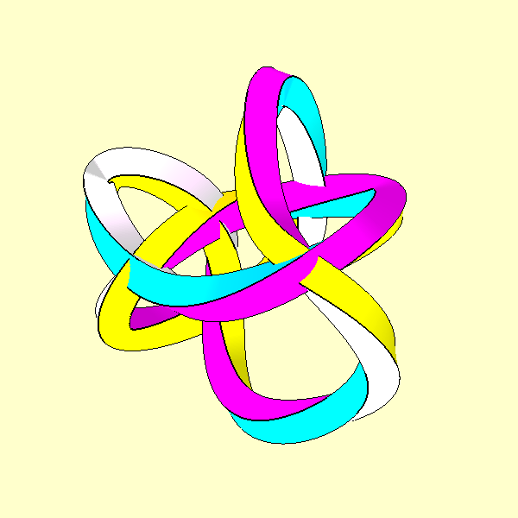
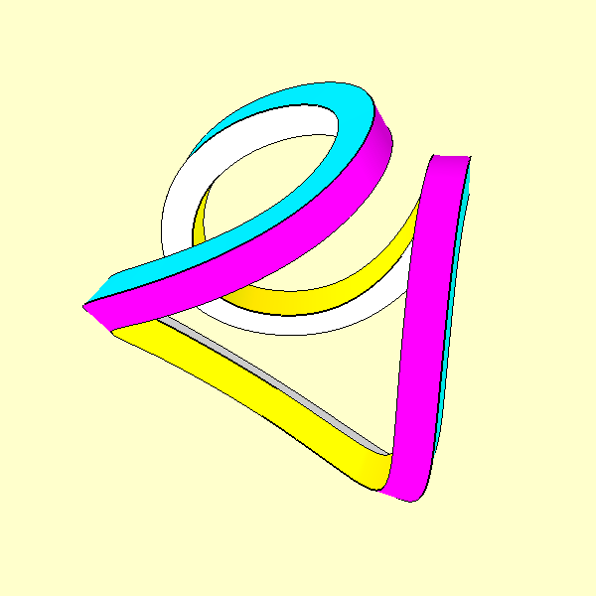
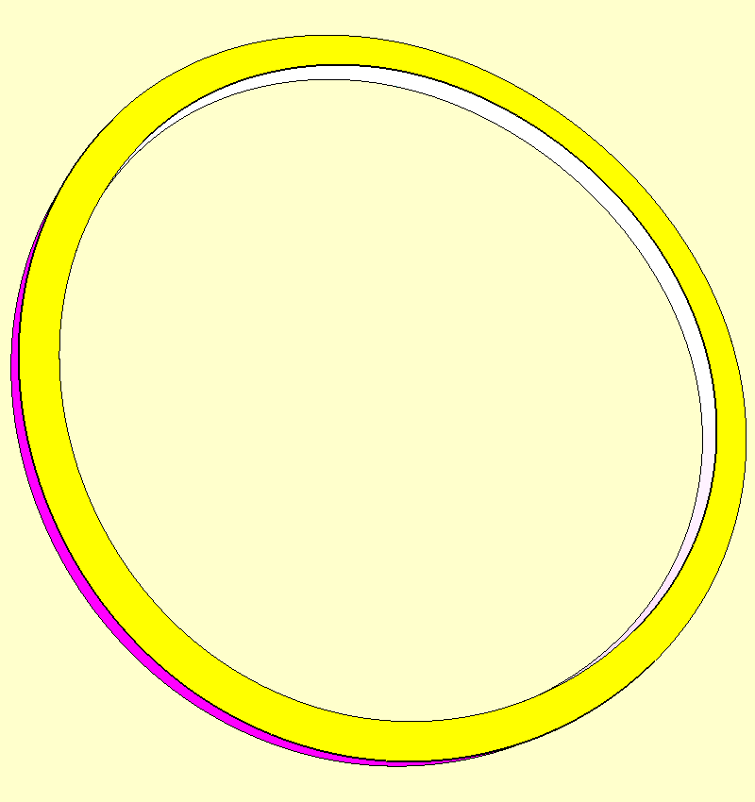
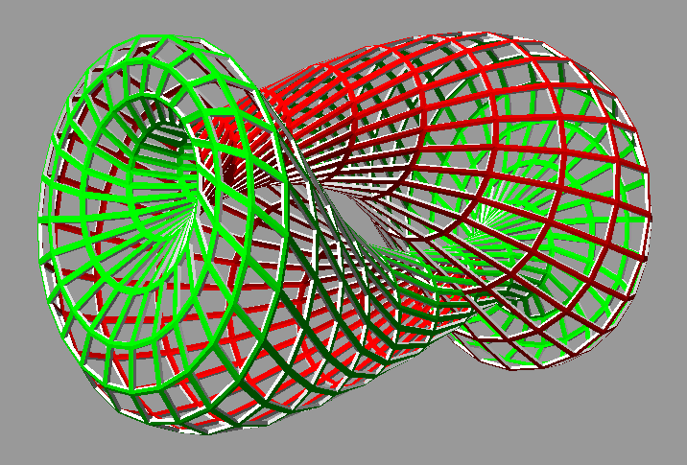
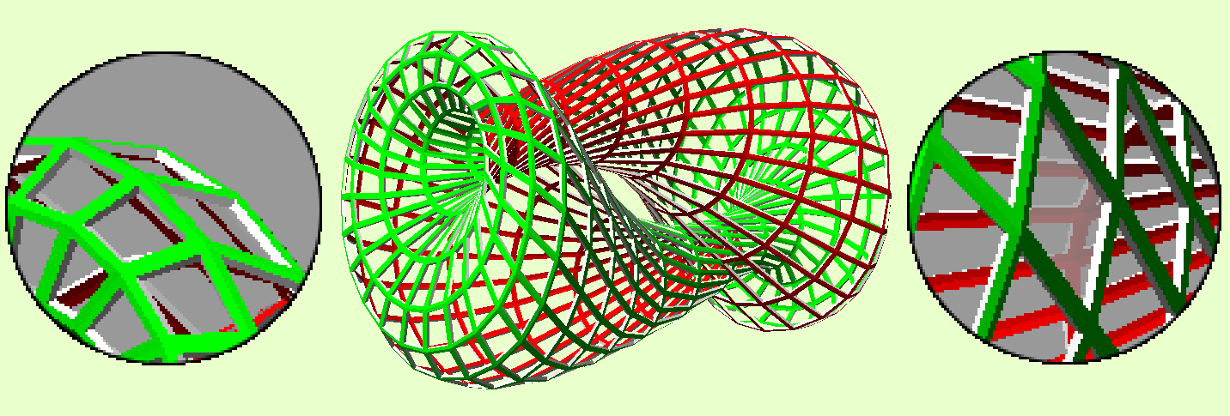
Shape Optimization of Toroidal Sweeps
Bending and Twisting
Optimizing the Eversion Process
Sweeping out a curve in space causes start and end orientations to be mismatched. The amount of mismatch is the twist. Rotating curve by this amount gradually across the sweep matches up the endpoints.
A halfway point: First approach. Model two arms as separate, non-closed space curves, connected by end caps (not shown). Minimize bending and twist of each arm separately. Both arms incur 180° twist for a total of 360° twist across both arms.
Avik Das
Advisor: Carlo H. Séquin
EECS
The stripe on the right arm is shown here. If an ant were to walk on the stripe, it would end up rotating 180°.
Smooth Transformations
Homotopy:smooth transformation from one surface to another without introducing sharp creases or tears
Want to visualize such transformations without specifying intermediate states, achieved by an optimization process over some energy functional
Everting a torus is a homotopy
Want to visualize eversion process proceeding spontaneously from some halfway point
Straightening out one arm: By allowing the green arm to straighten and the end caps to come closer together, the red arm is forced to incur all 360° of twist. The twist is then removed by folding the red arm until it is untwisted.
A planar figure-8 with no twist, but more bending than a circle
Unfolding the figure-8
Same homotopy class
Torus Eversion
Turn an torus inside-out by deforming it into two Klein-bottle mouths attached to each other
Proceed from symmetrical halfway point by minimizing energy. Can we find such an energy functional?
Fully unfolded into a circle with 360° of accumulated twist from the unfolding
Gradient Descent
Surfaces represented as polylines with circular cross-sections
Optimization via Gradient Descent
Vary the coordinates of each control point (parameters), revert change if energy does not decrease
Iterate, then stop when no decrease possible
Susceptible to local minima in energy functional
Klein-bottle mouths
Collapsing the straight arm: Finally, the green arm is shortened until it completely collapses and only the inverted torus remains.
A highly twisted and bent curve unfolds into a circle with no twist, using gradient descent.
Future Work
Fully gridded parameterization of surface
Requires many control points, so many parameters over which to optimize
Torus eversion, rendered by Chéritat
Energy Functionals
Bending: Compute angle between two struts and take deviation from collinearity
Twisting: Using rotation minimizing frames,
Closed Curves: compare beginning and end orientations
Non-closed curves: forward project normal vectors and compare to a priori expected ending orientation
Can weigh these parts to trade-off between them
Bending calculated as deviation of adjacent patches from co-planarity
Twisting calculated based on deviation of edges from right angles.
A possible halfway point in the eversion process.
Integrate these over entire surface area

