Slide 1
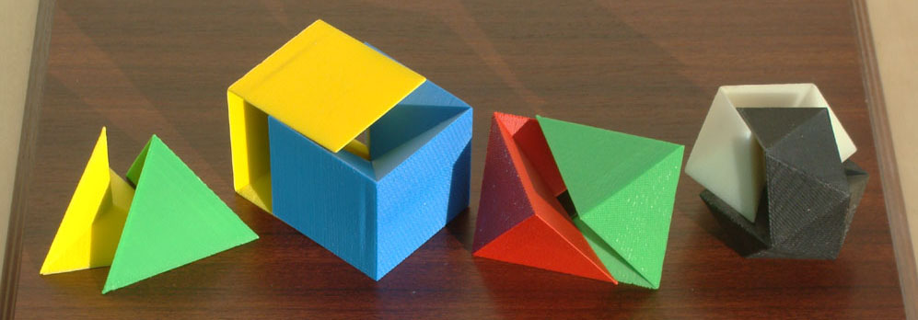
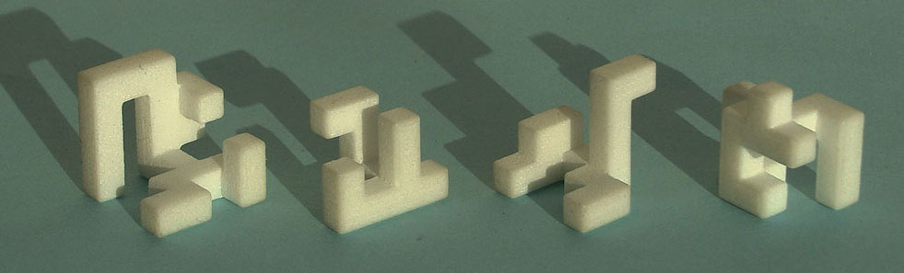
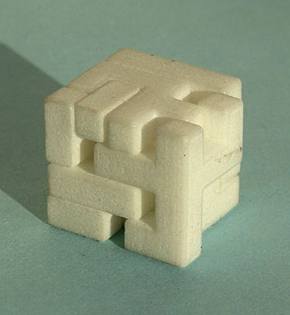
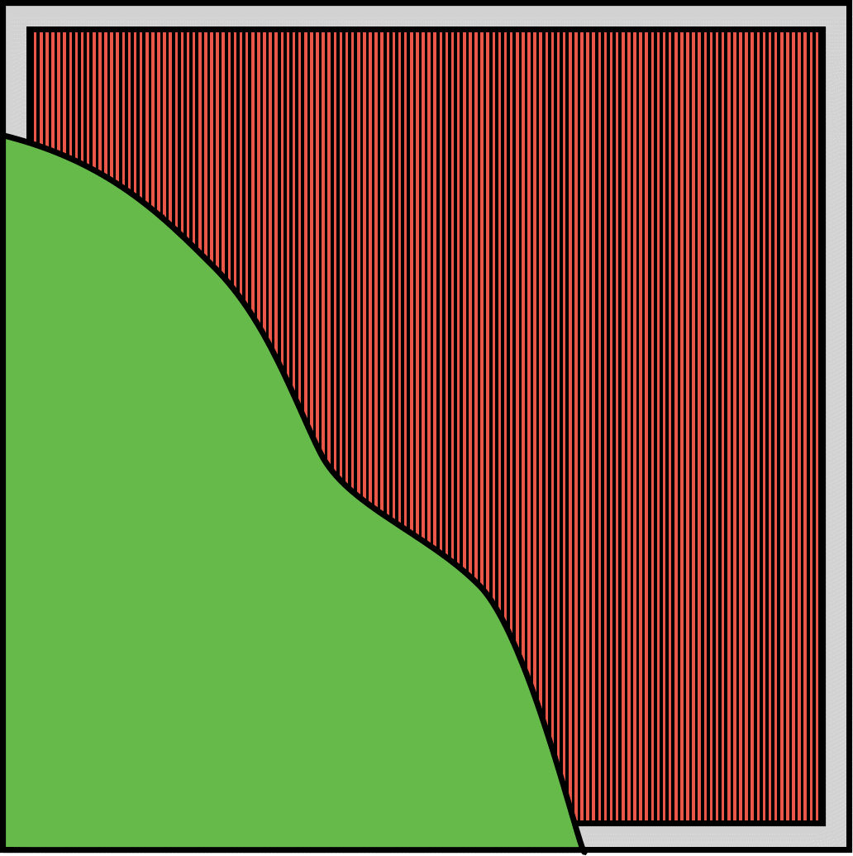
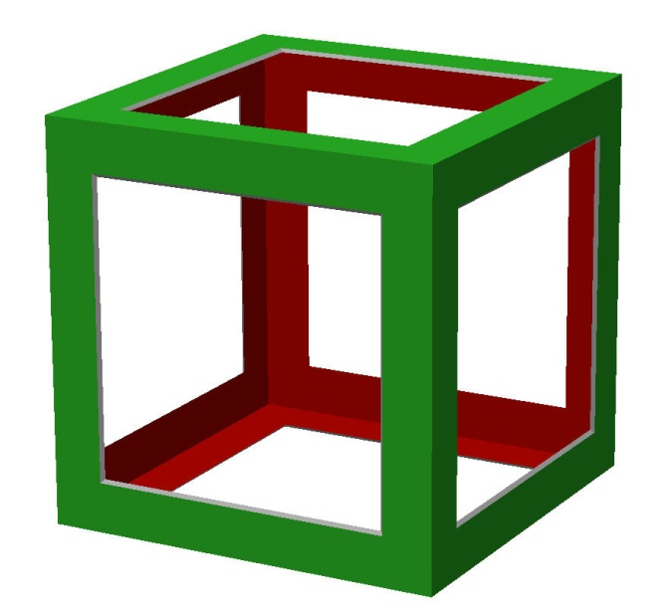
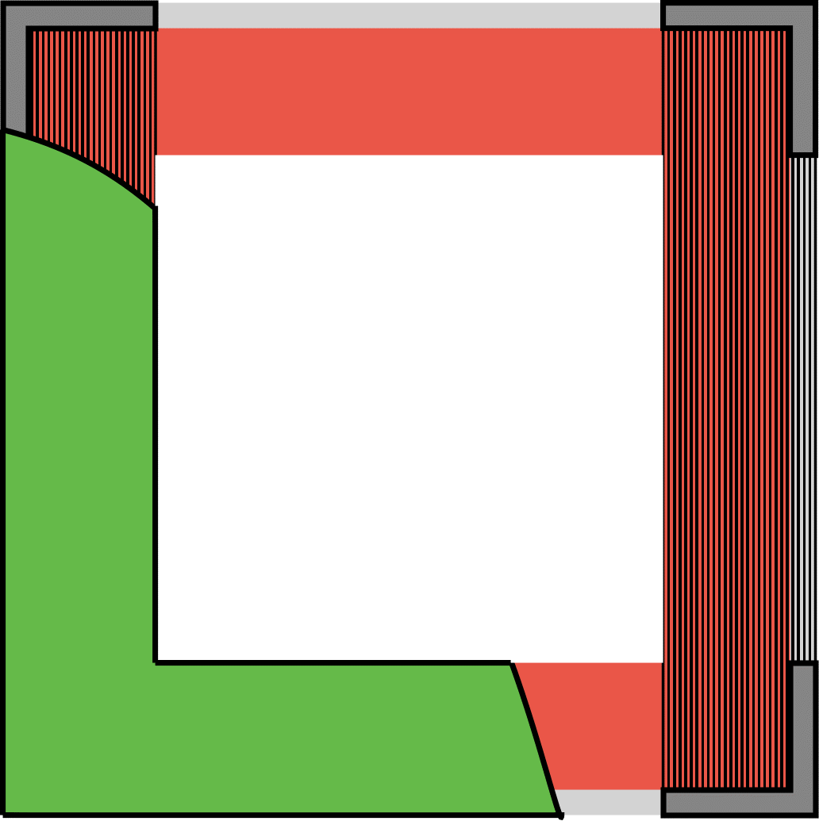
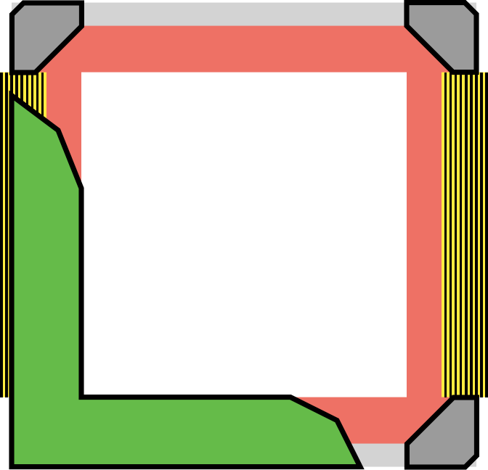
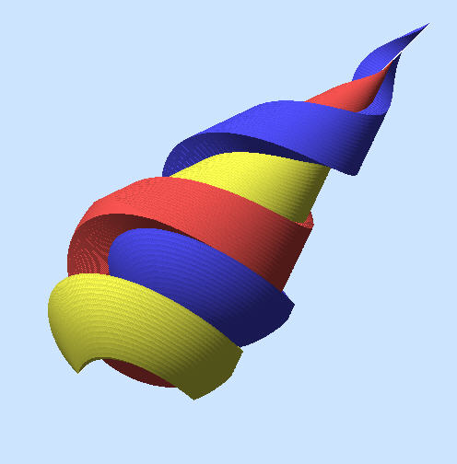
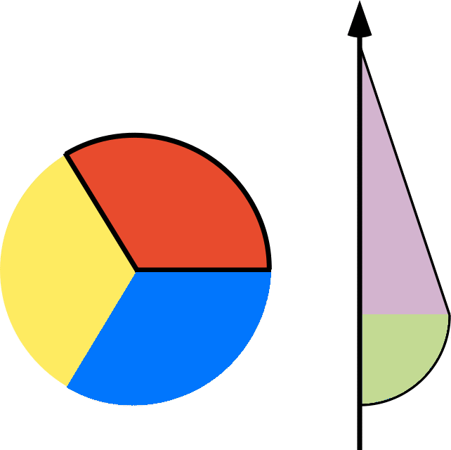
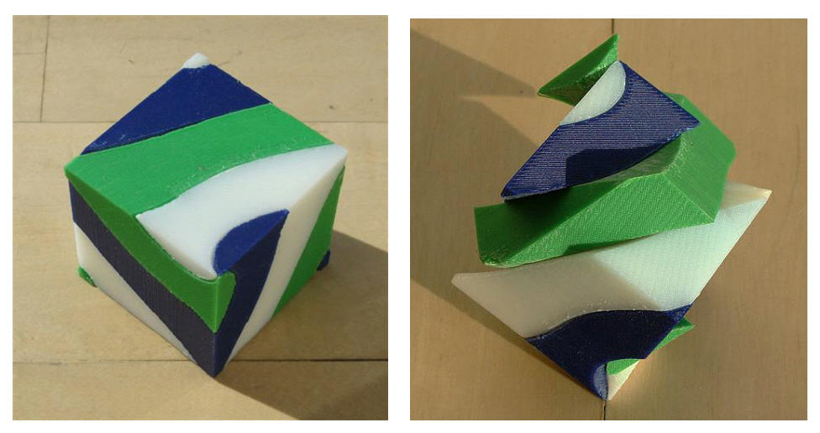
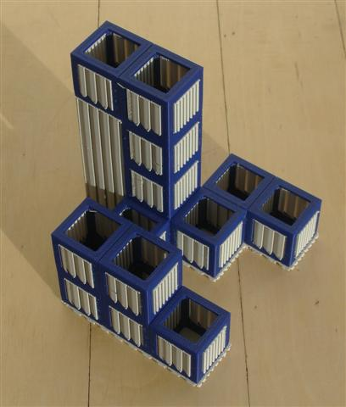
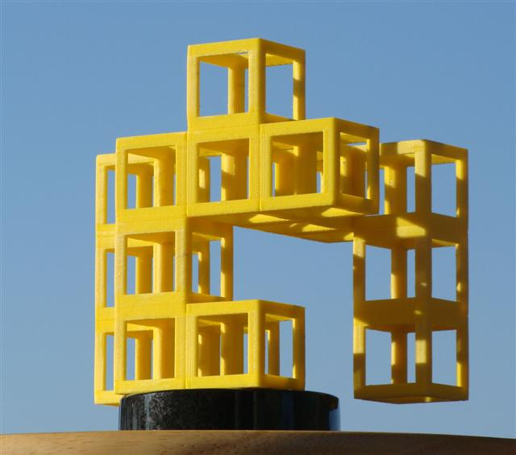
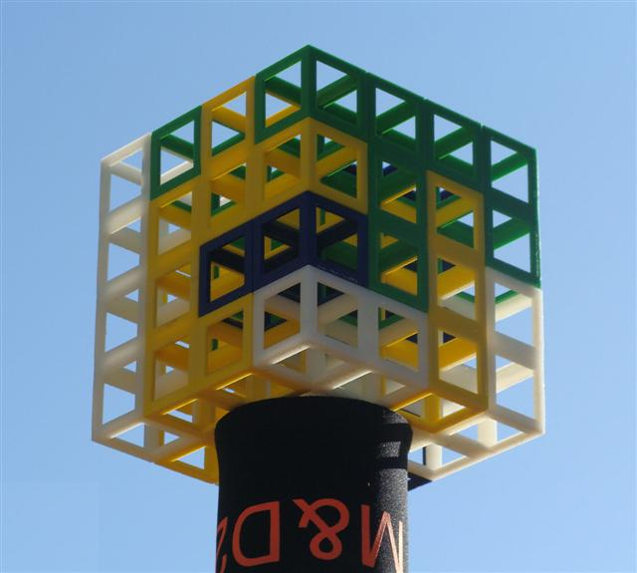
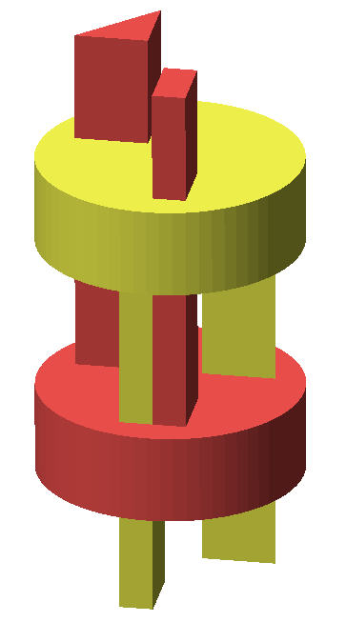
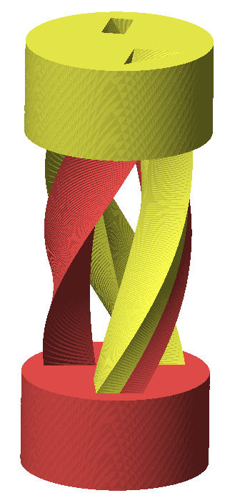
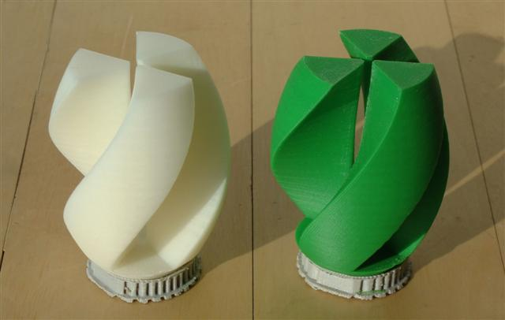
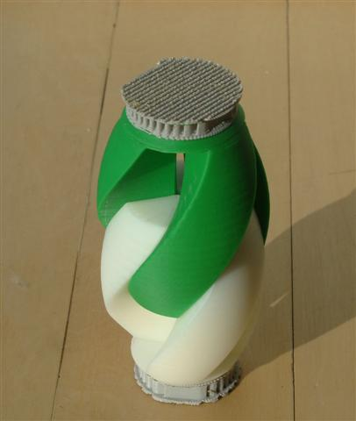
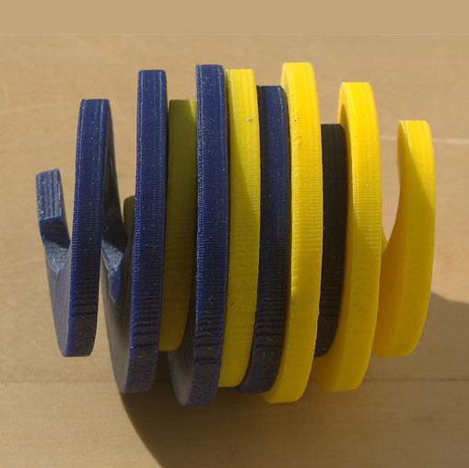
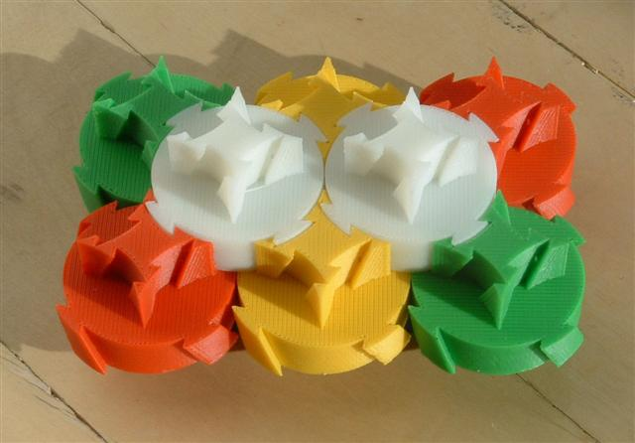
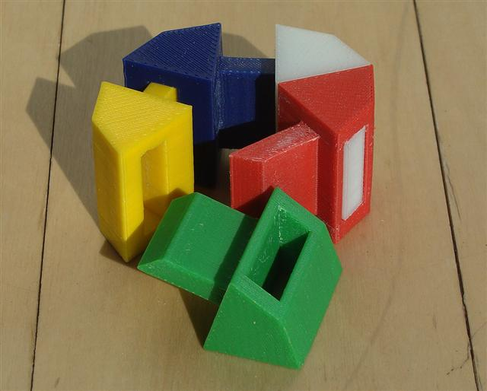
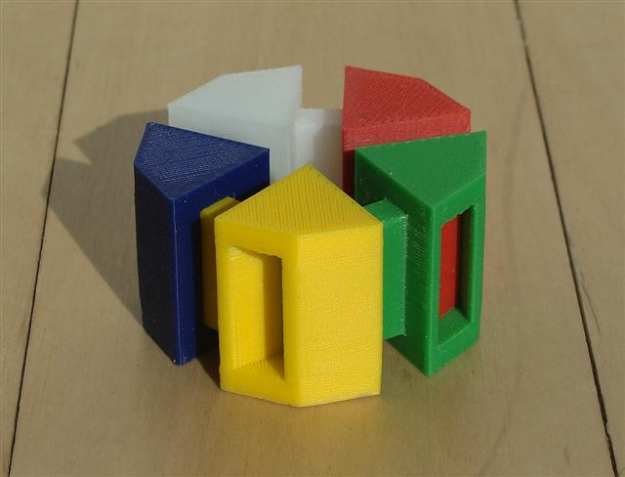
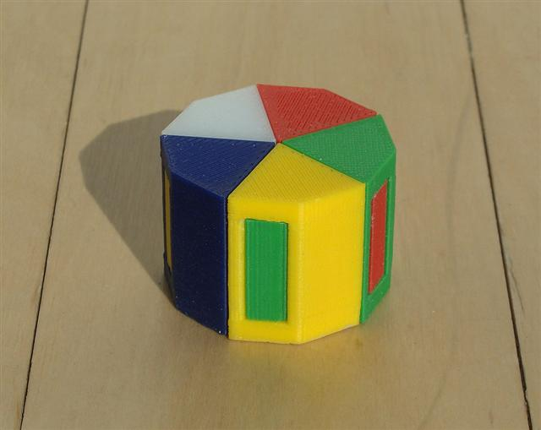
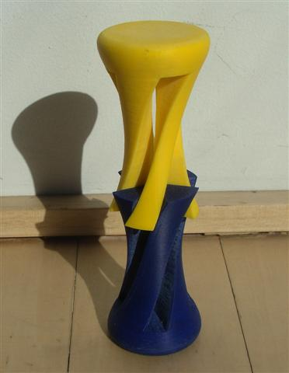
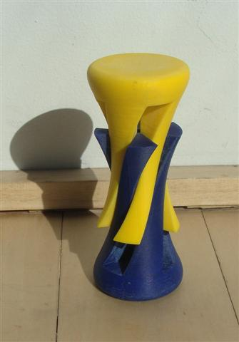
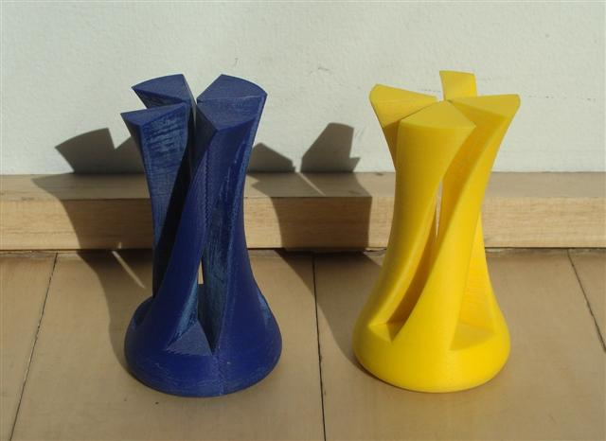
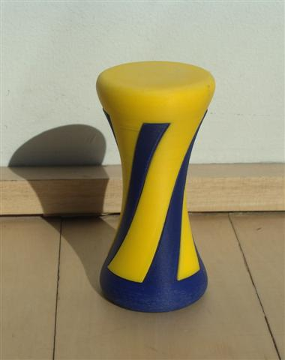
Interactive 3D Rapid-Prototyping Models
---
Carlo H. Séquin
U.C. Berkeley, EECS, CS Division
Dissection Geometries
Fabrication Issues
A Simple Introduction to Polyhedral Dissections
Interlocking Cubic Burr Puzzle
Problem Statement:
Here is a picture of a neat cube-dissection puzzle. We would like to have one like it,
-- but at a much bigger scale (say, scaled up by a factor of 8 or 10)!
Find a design that can be built at this larger scale in an economical way
with a layered manufacturing process.
Making Truly Interactive 3D Models
Hamiltonian dissections of Platonic Solids: The cutting surface is formed by a line sweeping
from the centroid of the solid along a Hamiltonian cycle on the polyhedron edges.
Not just virtual displays that can be twiddled with a mouse.
But tangible 3D models that can be physically manipulated.
Dissection puzzles are excellent tutorial examples:
Helicoidal Dissections
Solution: Use a grid / frame approach to outline each unit cube:
Problem Statement:
Design a two- or three-piece geometrical puzzle in which a simple shape
partitions into all congruent parts via a helical screw motion.
Instructional / Educational Value
of 3D Dissection Puzzles
Possible cubelet designs: (a) cross section through a hollow cube shell; (b) Leonardo-style
cube frame; (c) cross section through this cube frame with support structure
(dark vertical lines); (d) final cubelet frame design with beveled edges.
Used in course on Solid Modeling & Rapid Prototyping:
The design of the 3D puzzle geometry
requires spatial visualization skills.
The design of the physical artifacts
requires attention to tolerances
and to materials properties.
A first approach: Define one or more helicoidal cutting planes around the z-axis
and use those to cut up a shape with proper rotational symmetry around this axis.
Tangible Models
Provide relevant feedback on whether parts fit together
and have the right amount of resistance to movements:
so that they don’ t fall apart by themselves;
so that they don’t stick too tightly together.
Success is judged by manipulating the model.
(a) One frame part as it comes out of the FDM machine; (b) another part after removal of the support structure; (c) the whole 4x4x4 burr puzzle assembled.
A second approach: Define the extrusion of a suitable cross section and its complement;
Helically twist the whole configuration around the z-axis.
Tolerances ! Dissecting All of 3D Space
Play with the models !
Multi-hand Dissections
In this ring of 5 tiles at least 3 tiles have to be moved simultaneously in different directions
in order to take this puzzle apart.
Too tight ??
Isohedral helicoidal tiles (Matthias Goerner)

Slide 2
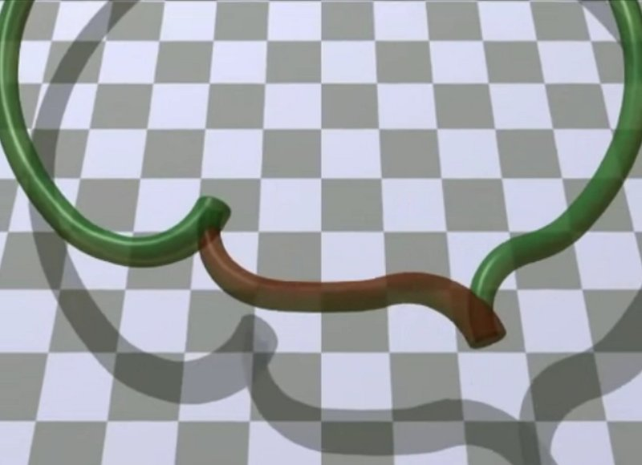
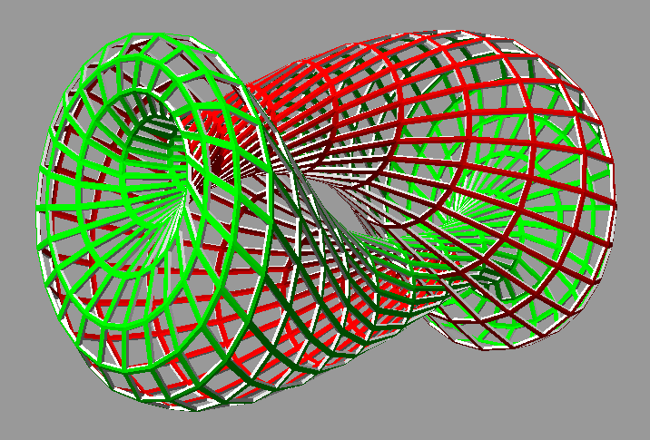
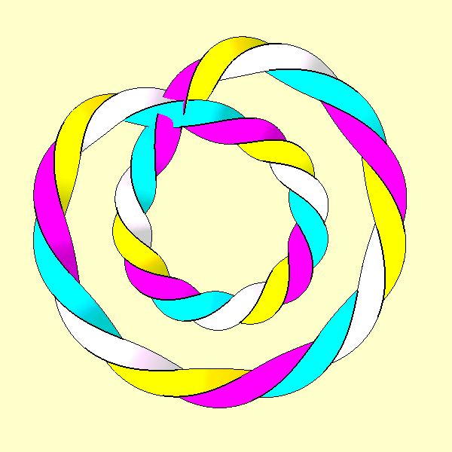
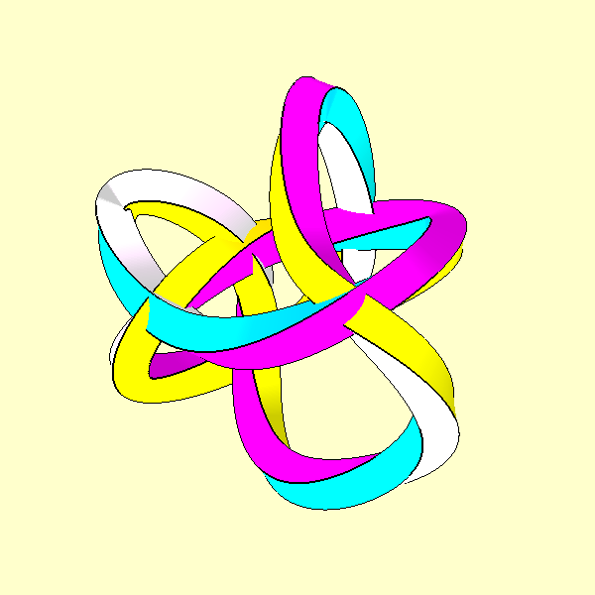
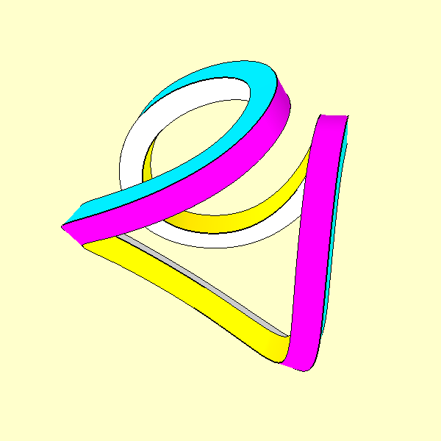
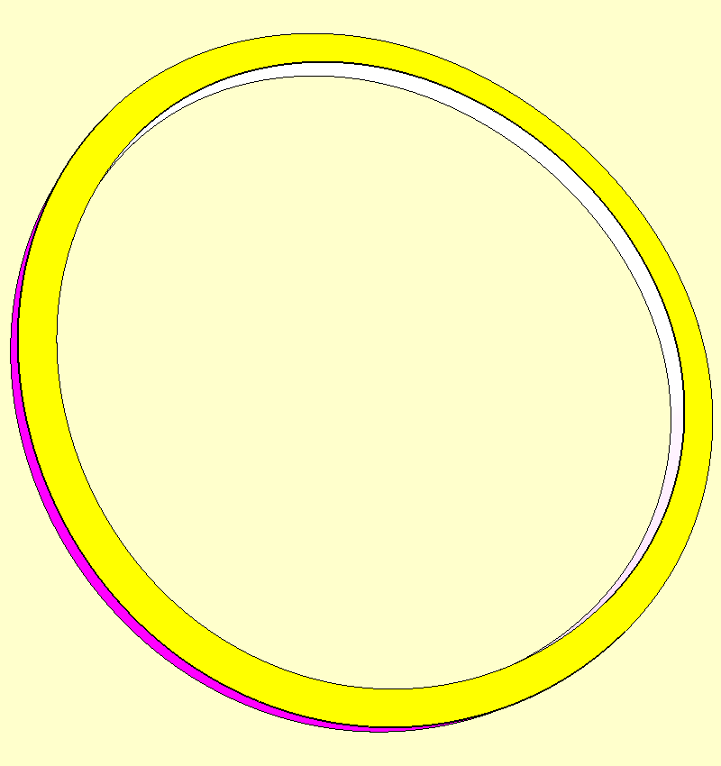
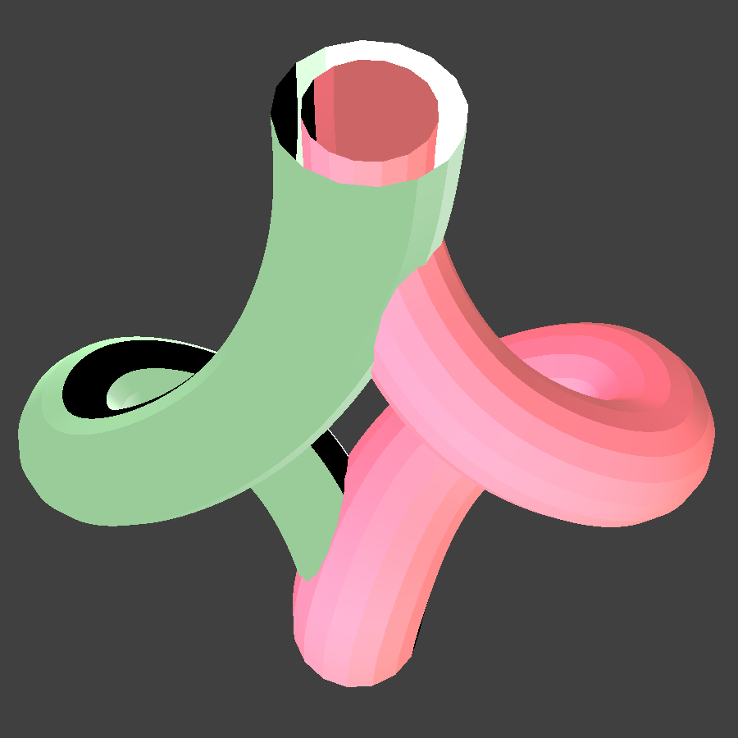
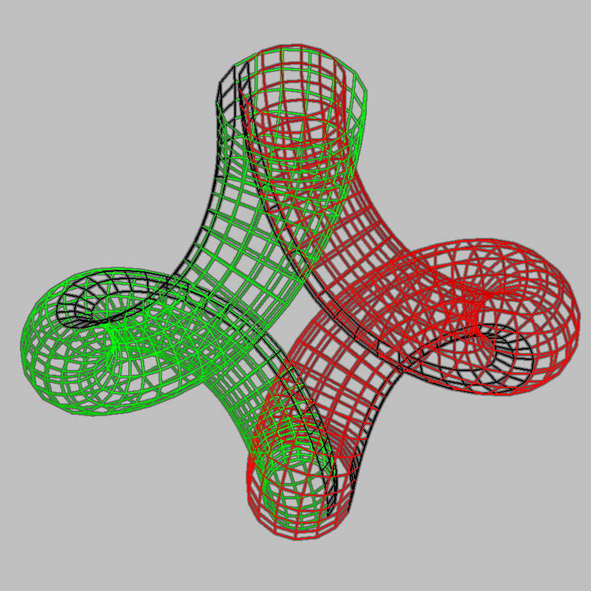
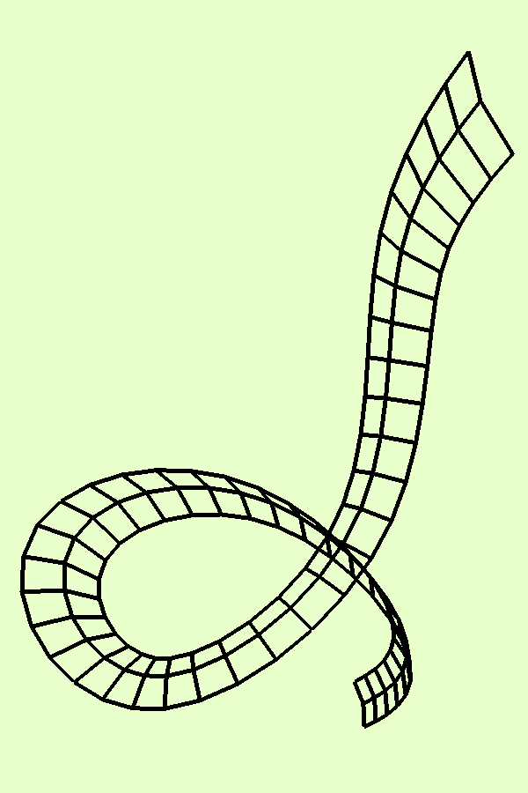
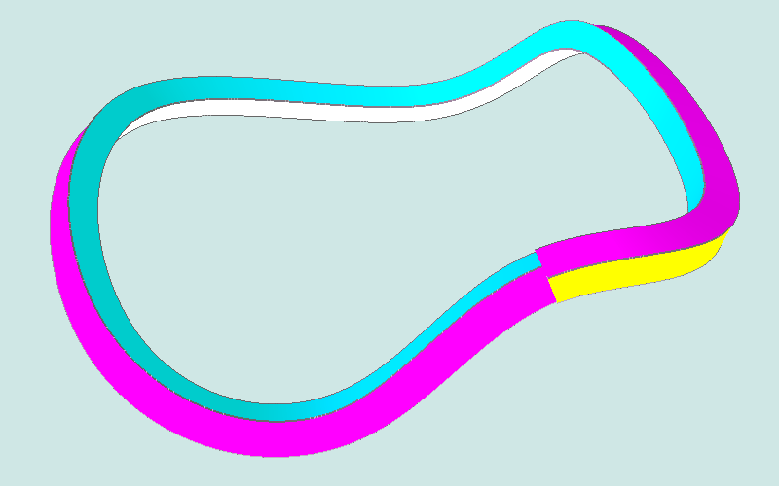
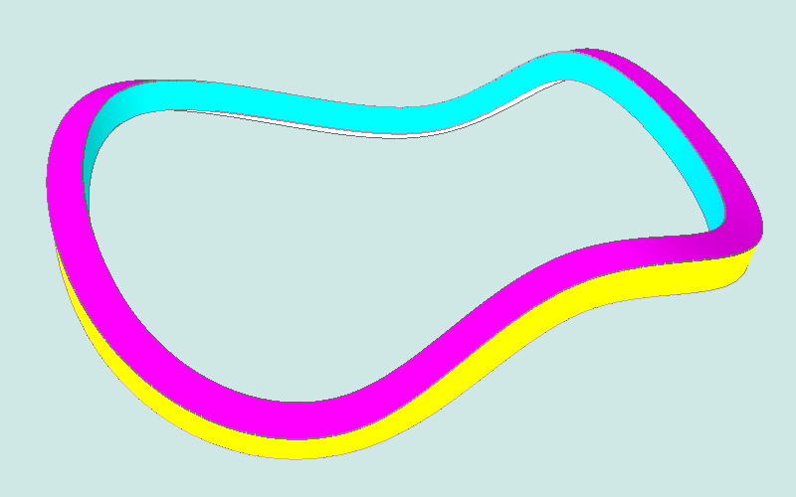
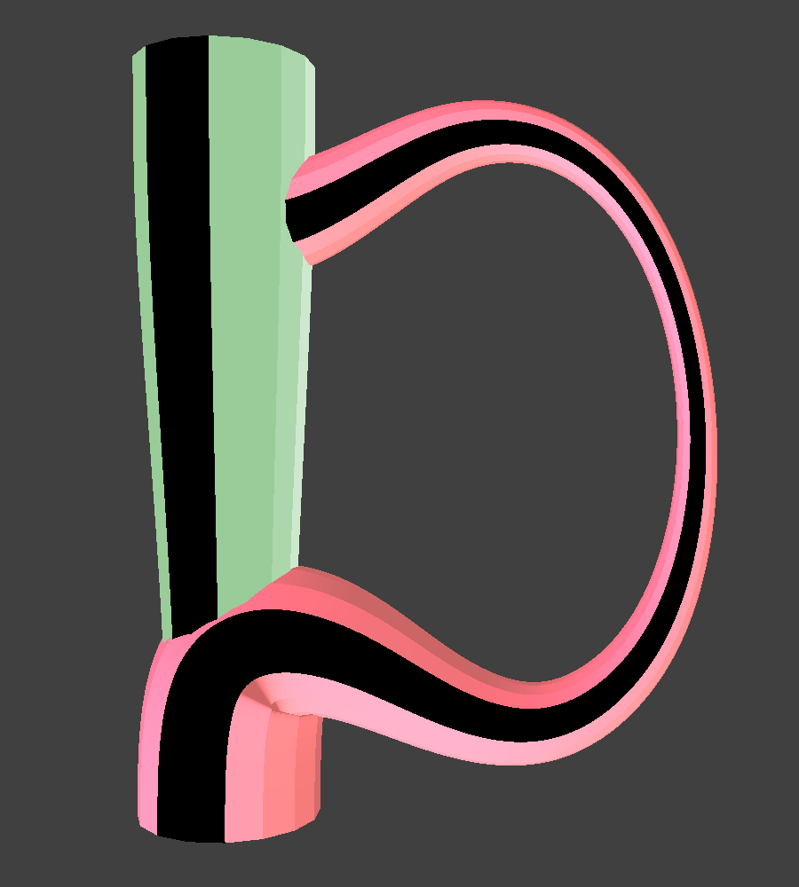
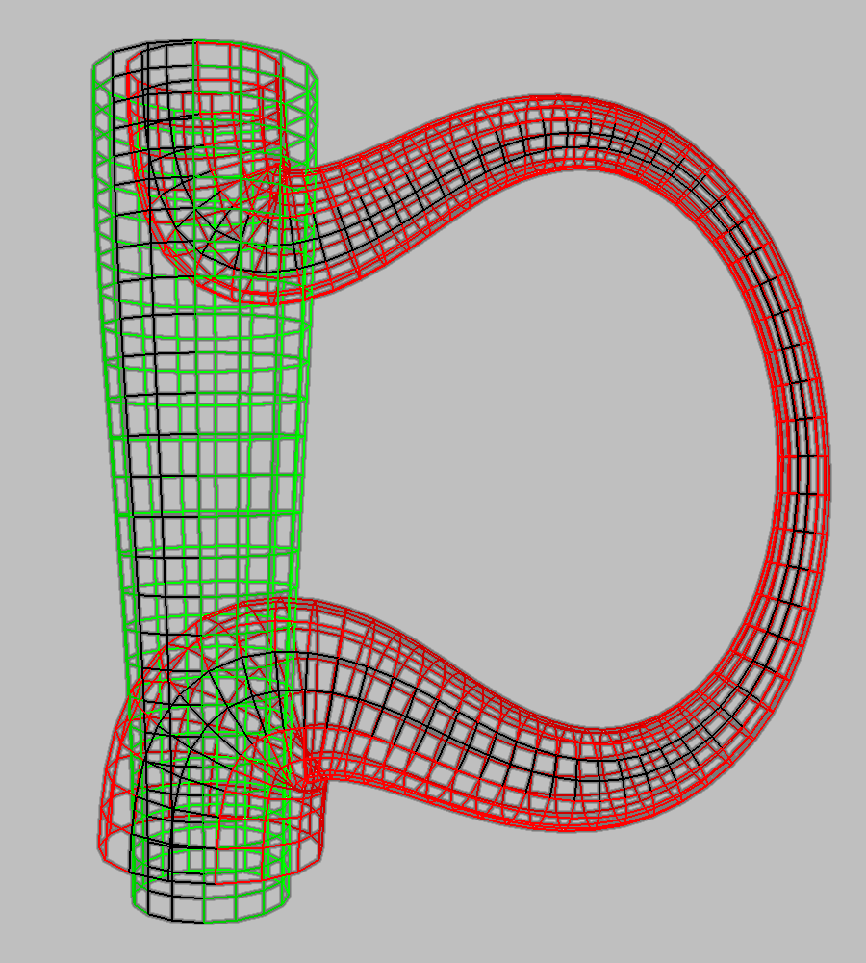
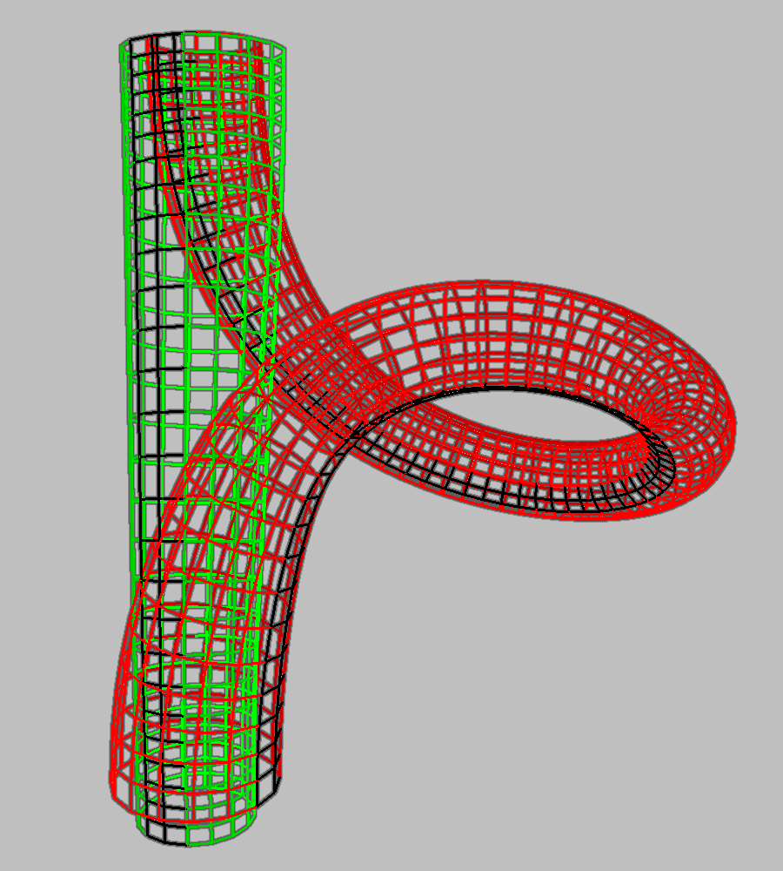
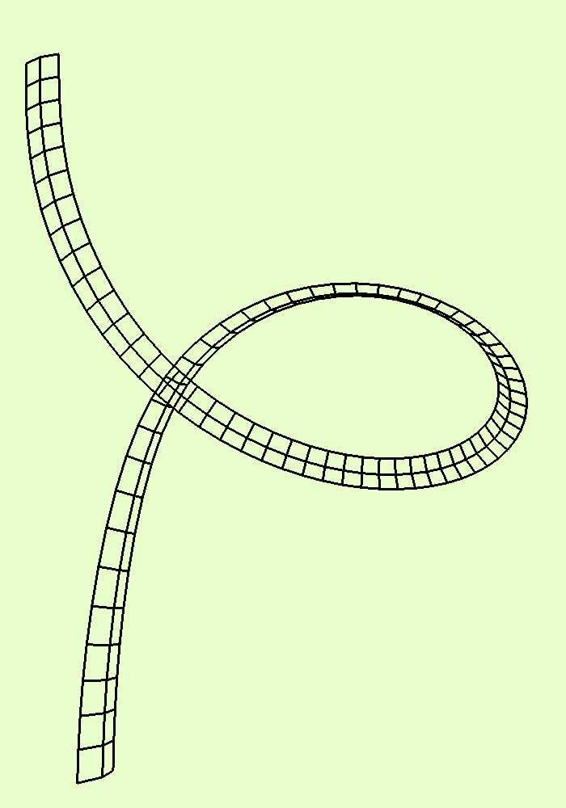
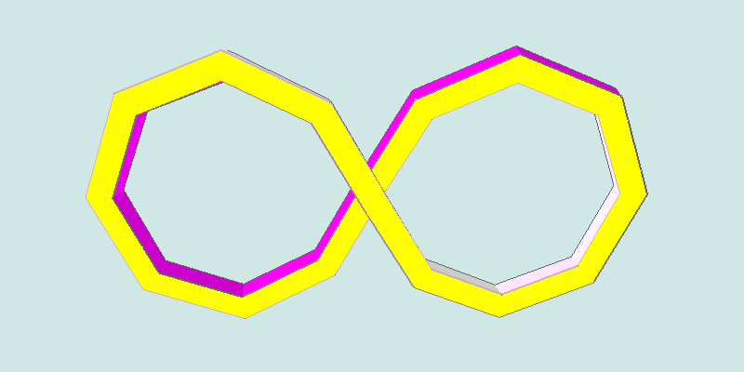
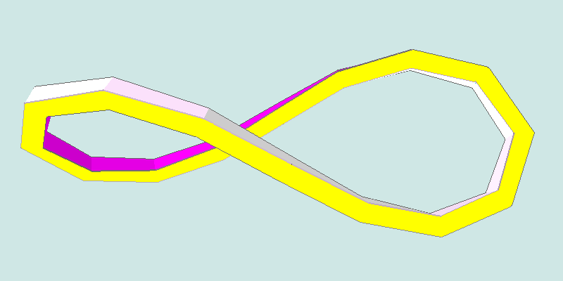
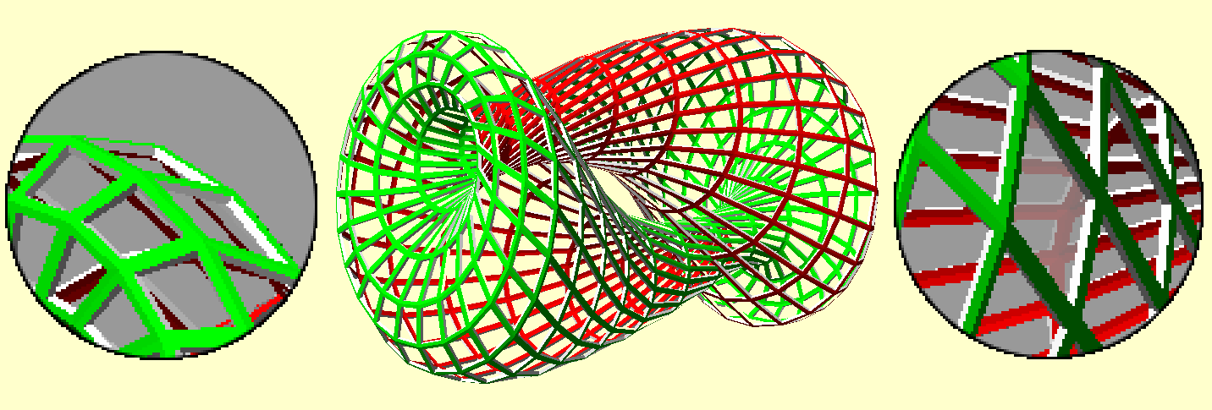
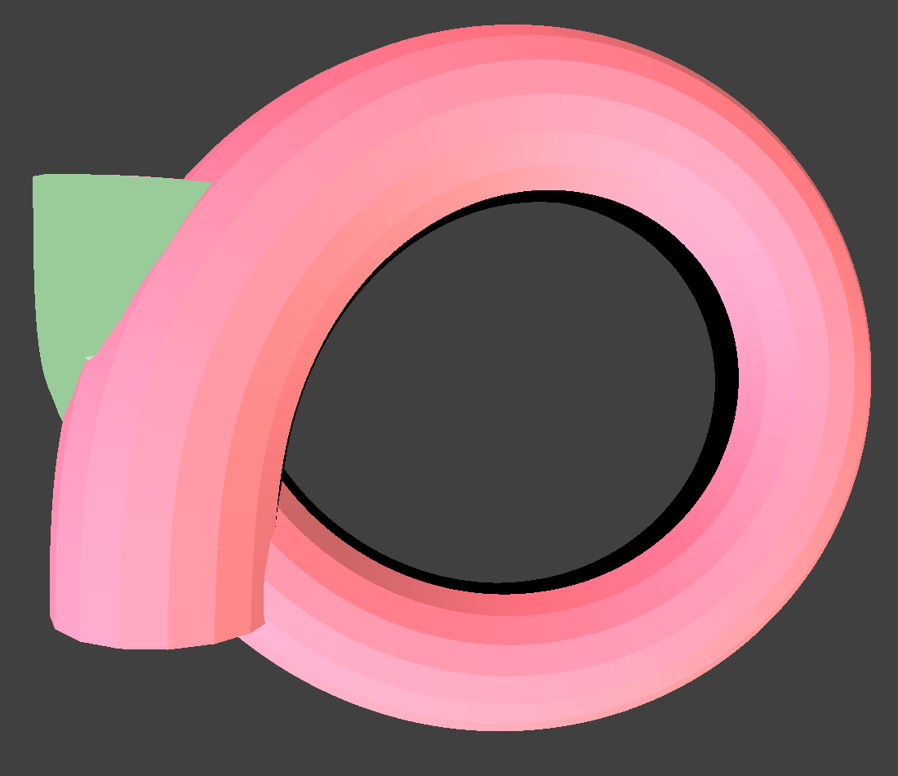
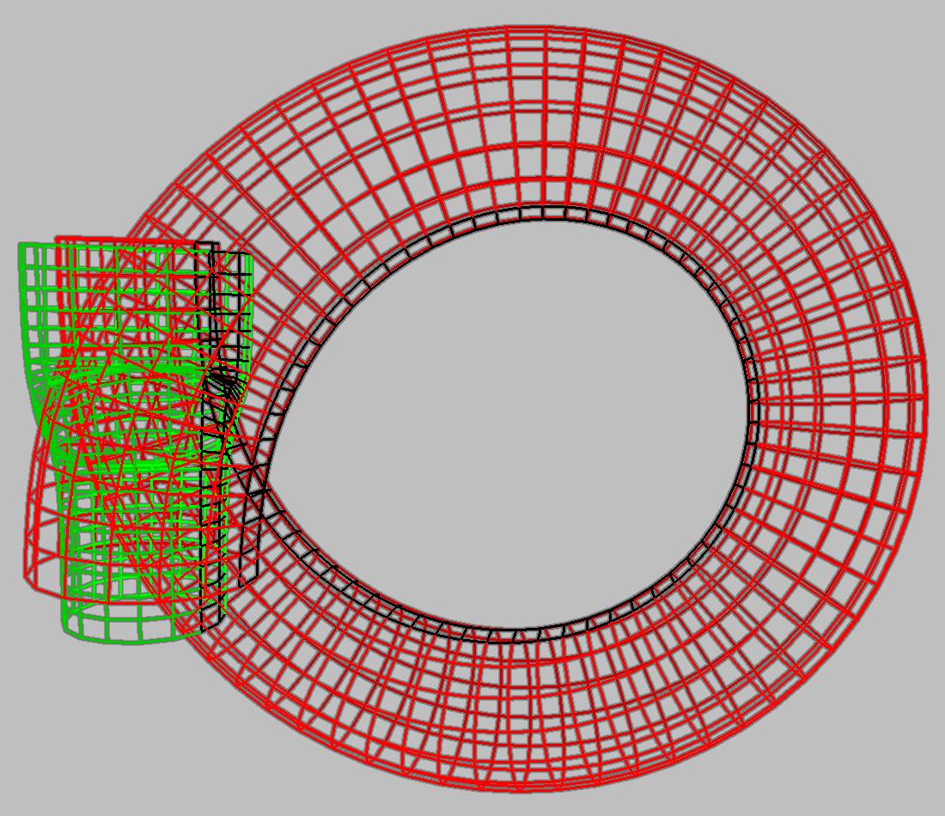
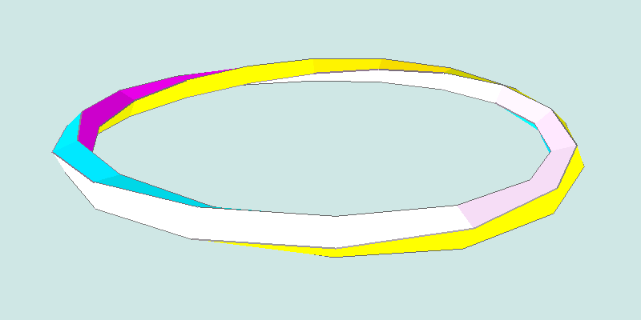
Shape Optimization of Toroidal Sweeps
Torus Eversion
Turn an torus inside-out by deforming it into two Klein-bottles attached to each other
Additionally, minimize energy along the way
Gradient Descent
Surfaces represented as curves with cross-sections
Optimization via Gradient Descent
Vary one parameter, see if energy decreases
Change all parameters according to amount by which energy decreases
Susceptible to local minima in energy functional
Avik Das
Advisor: Carlo H. Séquin
EECS
Klein-bottle mouths
A highly twisted and bent curve unfolds into a circle with no twist, using gradient descent.
Objective
Minimize energy of a curve incurred by bending and twisting
Evert a torus in a minimal energy fashion
Torus eversion, rendered by Chéritat
Visualizing the Klein-bottle mouths
A halfway point: First approach. Model two arms as separate, non-closed space curves, connected by end caps (not shown). Minimize bending and twist of each arm separately. Both arms incur 180° twist for a total of 360° twist across both arms.
Energy Functionals
Bending: Compute angle between two struts and take deviation from collinearity
Twisting: Using rotation minimizing frames,
Closed Curves: compare beginning and end orientations
Non-closed curves: forward project normal vectors and compare to a priori expected ending orientation
Length Constraints: Bound length of struts by treating them like stretched springs
Trading Off Bending and Twisting
The stripe on the right arm is shown here. If an ant were to walk on the stripe, it would end up rotating 180° around the Z-axis.
Straightening out one arm: By allowing the green arm to straighten and the end caps to come closer together, the red arm starts incurring the full 360° of twist. Here, the red arm has incurred 270° of twist in the last two images.
Sweeping out a curve in space causes start and end orientations to be mismatched. The amount of mismatch is the twist. Adding this amount back to gradually across the sweep matches up the endpoints.
Future Work
Fully gridded parameterization of surface
Requires many control points, so many parameters over which to optimize
A planar figure-8 with no twist, but more bending than a circle.
Unfolding the figure-8.
Collapsing the straight arm: As the end caps move closer together, the green arm becomes shorter and the red arm absorbs all 360° degrees of twist. Now, the green arm can be fully collapsed and the red arm unfolded into a torus with no twist.
Bending calculated as deviation of adjacent patches from co-planarity
Twisting calculated based on deviation of edges from right angles.
Fully unfolded into a circle with 360° of accumulated twist from the unfolding.
Integrate these over entire surface area

