Slide 1
COVID-19 Vaccine Side Effects
Avik Gomes, Ally Hu

Slide 2
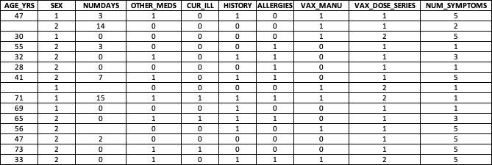
Our Dataset
Compilation of data from VAERS(Vaccine Adverse Effect Reporting System)
3 .csv files(patient info, vax info and symptoms)
After preprocessing: age, sex, number of days for symptom onset, any current illnesses, medical history, allergies, which vaccine, how many doses and number of symptoms

Slide 3
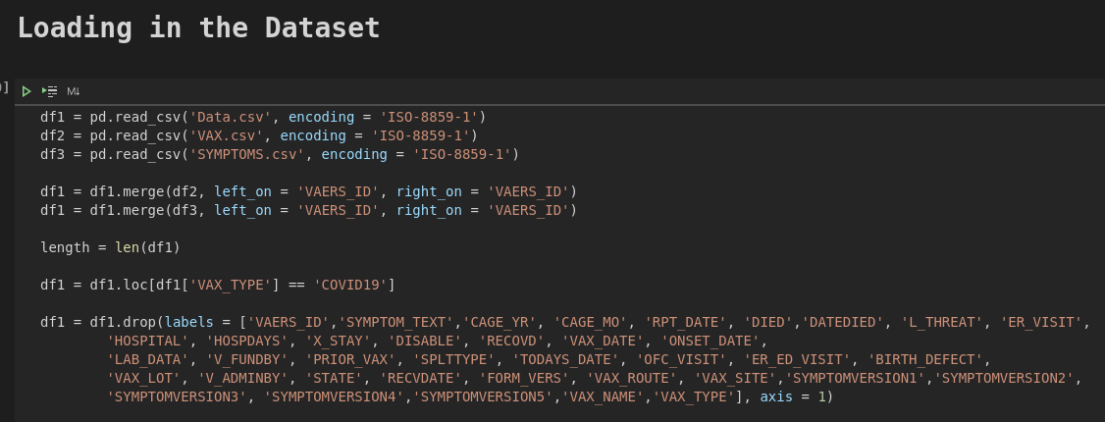

Slide 4
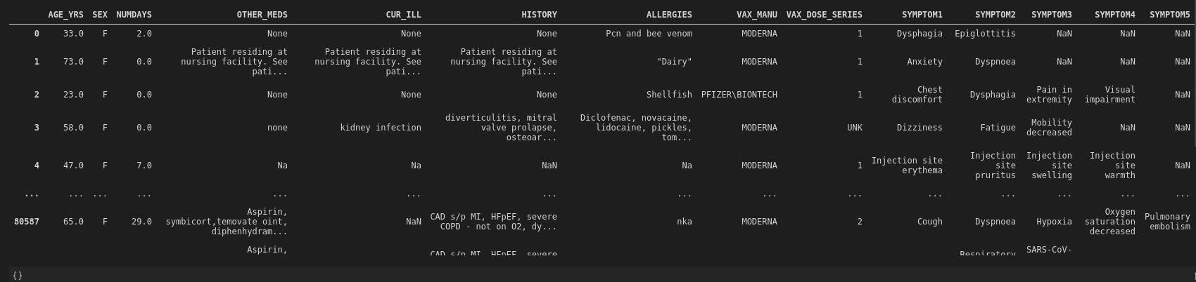

Slide 5
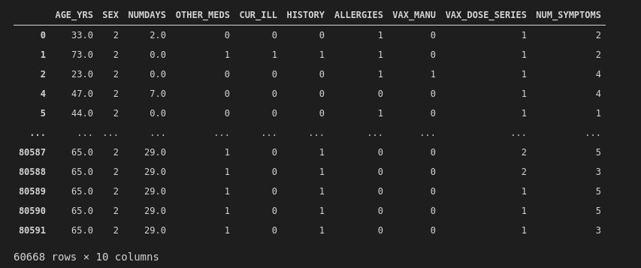

Slide 6
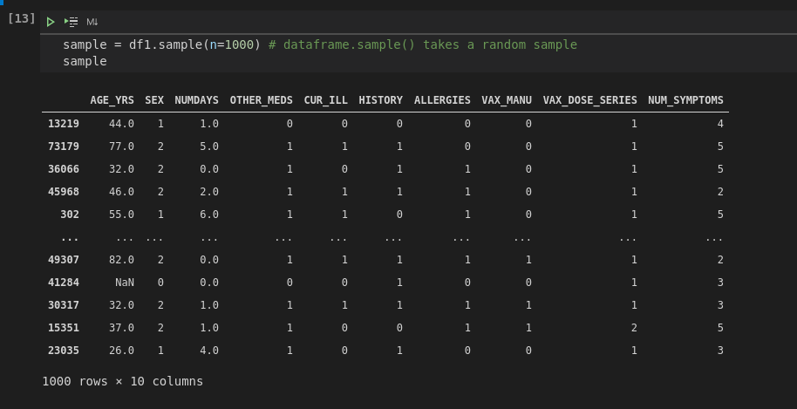

Slide 7
Models Used
Neural Network
01
SVM
02
Logistic Regression
03
Activations: Tanh and Sigmoid
Kernels: Radial Basis Function, Linear and Polynomial
Regularization: L1 and L2

Slide 8
Neural Network Models
Tanh and Sigmoid

Slide 9
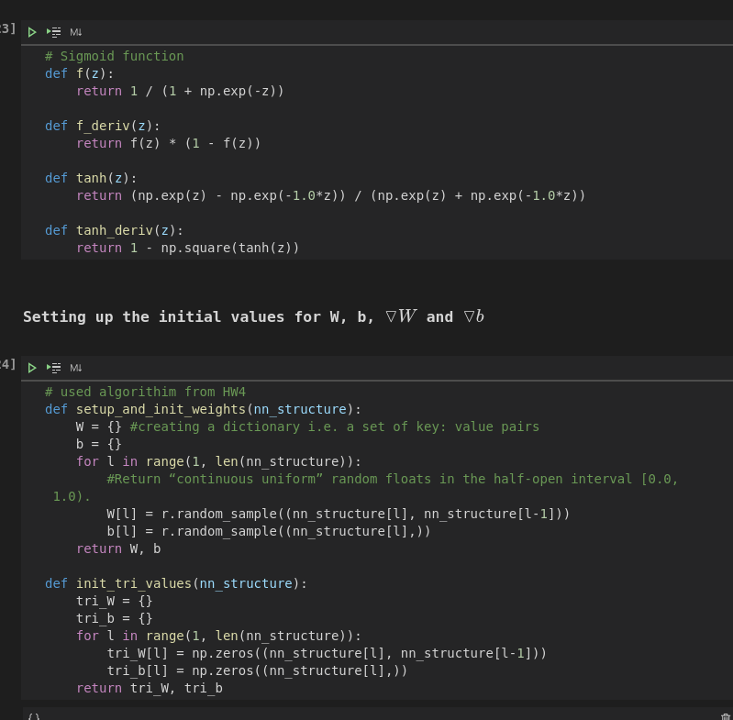
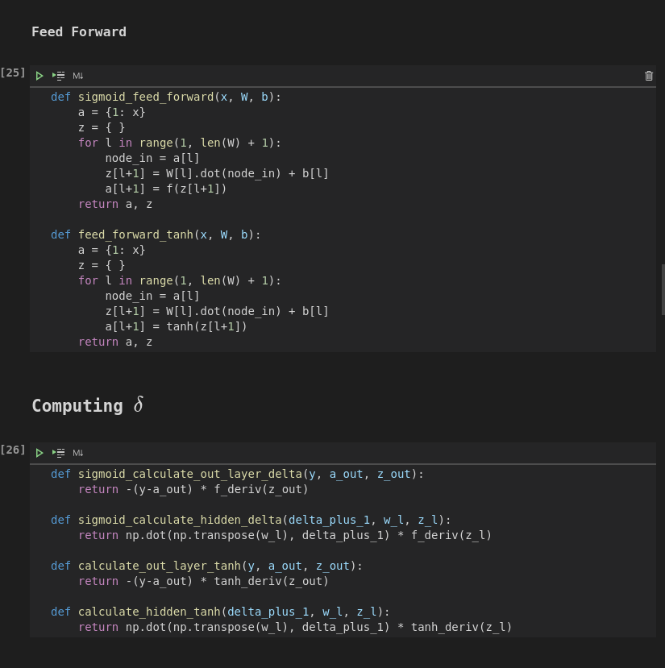

Slide 10
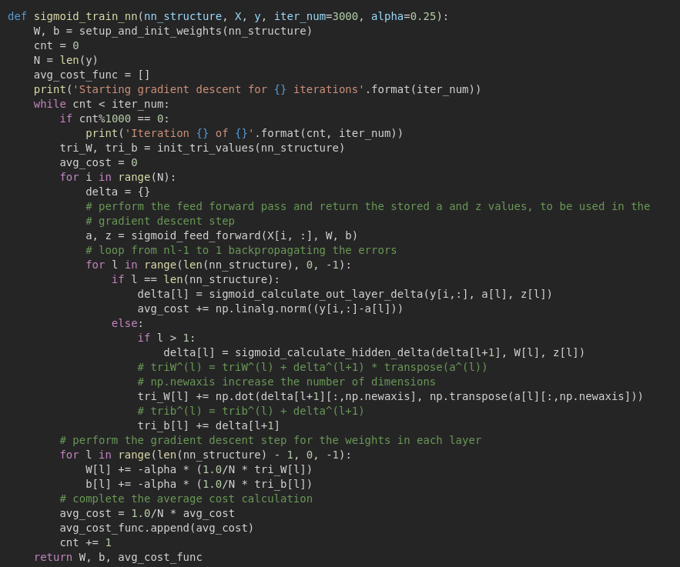

Slide 11
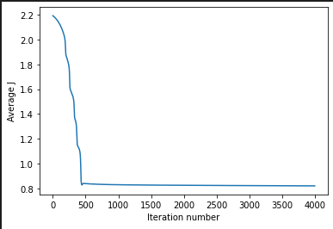
Sigmoid Activation

Slide 12
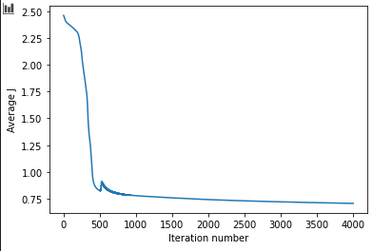
Tanh Activation

Slide 13
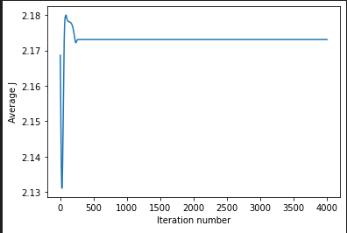
L1 + Sigmoid

Slide 14
Best Neural Network Model
Sigmoid
Tanh
L1 + Sigmoid
Test Accuracy:
43.66%
Test Accuracy:
32.96%
Test Accuracy:
0%

Slide 15
SVM Models
RBF, Linear and Polynomial

Slide 16
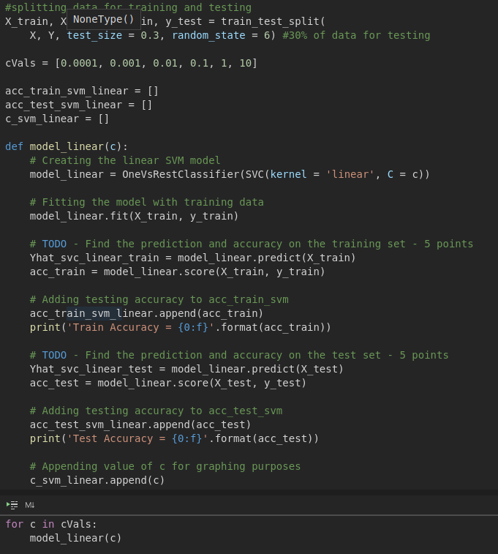
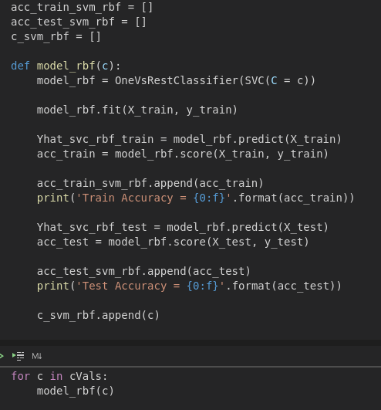

Slide 17
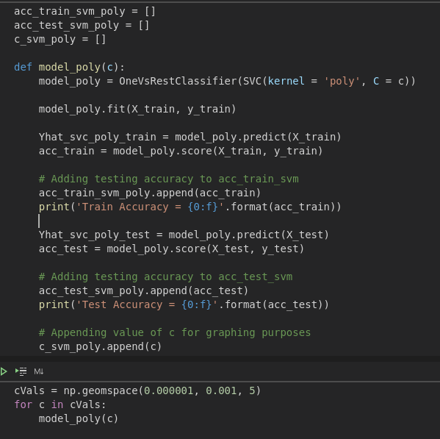

Slide 18
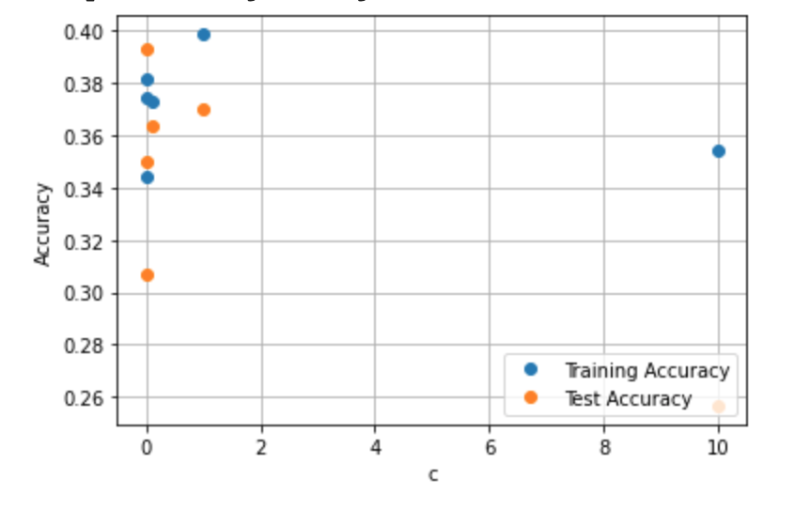
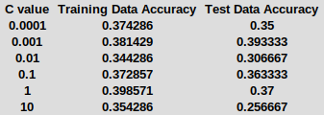
Radial Basis Function Kernel

Slide 19
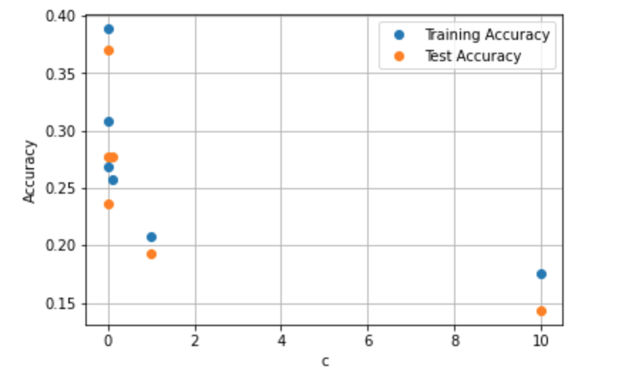
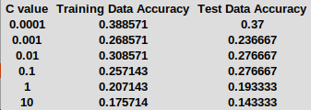
Linear Kernel

Slide 20
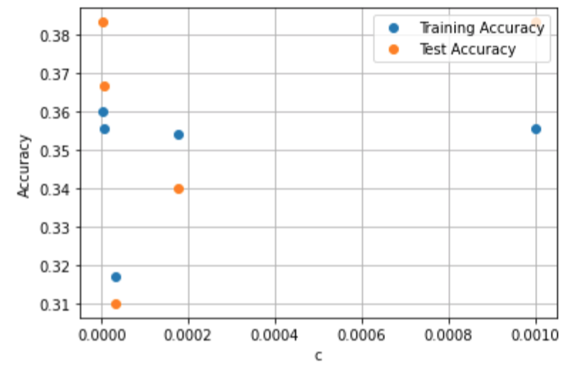
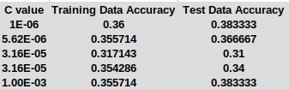
Polynomial Kernel

Slide 21
Best SVM Model
RBF
Linear
Polynomial
C:
.001
Training Accuracy:
38.1429%
Test Accuracy:
39.3333%
C:
.0001
Training Accuracy:
38.8571%
Test Accuracy:
37.0000%
C:
.000001
Training Accuracy:
36.0000%
Test Accuracy:
38.333%

Slide 22
Logistic Regression Models
L1 and L2

Slide 23
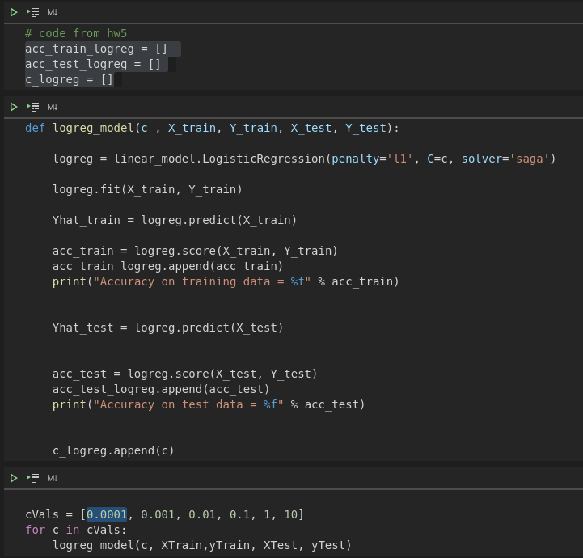
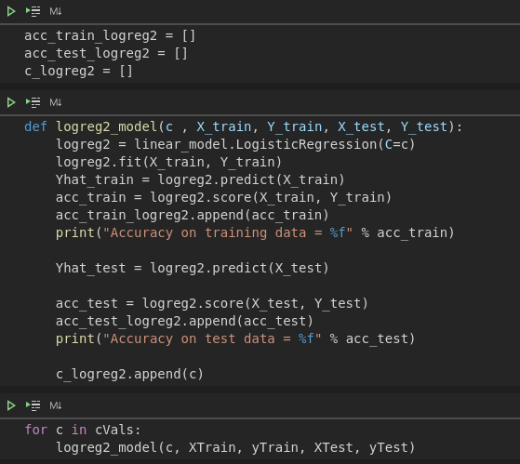

Slide 24
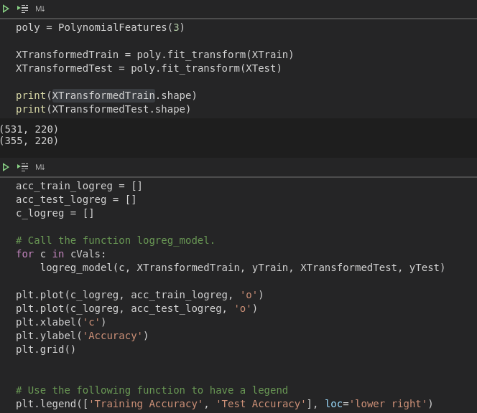

Slide 25
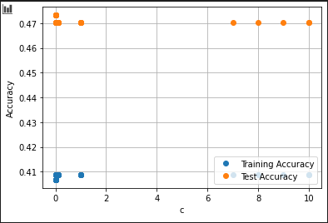
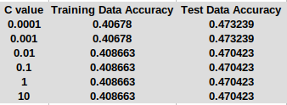
L1

Slide 26
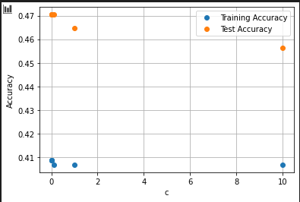
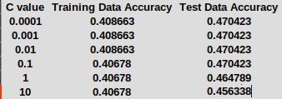
L2

Slide 27
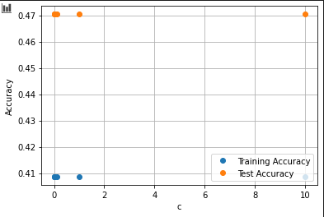
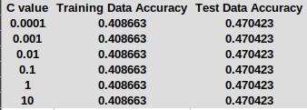
Polynomial Feature + L1 Penalty

Slide 28
Best Logistic Regression Model
L1
L2
L1 + Poly Feature
C:
.01
Training Accuracy:
40.8663%
Test Accuracy:
47.0423%
C:
.01
Training Accuracy:
40.687%
Test Accuracy:
47.0423%
C:
.0001
Training Accuracy:
40.8663%
Test Accuracy:
47.0423%

Slide 29
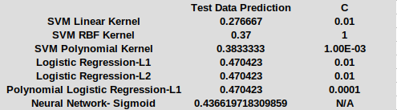
Best Model Overall

Slide 30
Conclusion
Most accurate model: logistic regression model with 47.0423% accuracy
All 3 logistic regression models(L1, L2, L1+poly) had the same accuracy
Underfitting: low accuracy, low variance and high bias
Highest accuracy < 50%
Best our results can do would be less than guessing Heads or Tails :(
Improvements: more detailed features
Account for specific health issues
Specify which allergies, medications, illnesses, etc.

