Slide 1

MID TERM PRESENTATION
Prepared by
Anirudha Deepak Bedre
Avikal Chhetri

Slide 2
Introduction
The following report consists of three cases, namely:
Case 1: Predicting the year of song using classification and regression techniques
Case 2: Determining the income of an individual weather greater than 50k or less than 50k using classification techniques
Case 3: Using clustering model to identify commercial blocks in news videos.
We primarily used Scala as our algorithm of choice in the main modules of all the three cases and used Apache Spark libraries wherever possible.
We ran all of our Scala Code in Apache Zeppelin in a Mac OS environment.

Slide 3
Case 1: Regression and Classification– Songs Dataset
Regression
Linear Regression with and without PCA
Gradient Boosted Trees (GBT ) with and without PCA
The following are the results we obtained:
Algorithm | Training score(RMS Error) | Test score(RMS Error)
Linear Regression Pipeline with PCA | 10.46535826 | 10.39148337
Linear Regression Pipeline | 9.588152804 | 9.529267232
GBT Regressor Pipeline with PCA | 0.120496263 | 0.118432861
GBT Regressor Pipeline | 0.120496263 | 0.118432861

Slide 4
Case 1: Regression and Classification– Songs Dataset
Classification
Logistic Regression was performed- with and without PCA
AlAlgorithm | Training score(Accuracy) | Test score(Accuracy)
Classification Pipeline with PCA | 0.857498643 | 0.854570848
Classification Pipeline | 0.894304322 | 0.895376243

Slide 5
Case 2: Classification – Adult Dataset
Data Transformation
For classification, the values target output column ‘Income’ were changed to 0, 1 for values >50k and <50k respectively.
Conversion process was done in Python using the Pandas package & output of this file was fed in Apache Spark

Slide 6
Case 2: Classification – Adult Dataset
Logistic Regression with Pipeline API
Training Output (Accuracy) = 0.8930300922430976
Test Output (Accuracy) = 0.8925648193179296
Gradient Boosted Trees (GBT) with Pipeline API

Slide 7
Case 3: Clustering – TV News Channel Dataset
K-Means
Calculated Sum of Squared Errors with different number of clusters and kept the iteration cycle constant.
Gaussian Mixture Model

Slide 8
Clustering Analysis
Following are the Sum of Squared Errors obtained with different number of clusters and keeping the iteration cycle constant.
No of Clusters | Sum of Squared Errors (WSSSE)
2 | 2605.2540840819343
3 | 1602.0297950672048
4 | 1133.9341159579435
5 | 928.2588138608354
6 | 807.6327045338741
7 | 698.324164966572
8 | 638.0527278734086
9 | 583.3397620174323
10 | 552.8560206593854
11 | 516.3461122909365
12 | 478.47017309247667
13 | 468.8158253601142
14 | 432.6391959617786
15 | 411.56842266444505

Slide 9
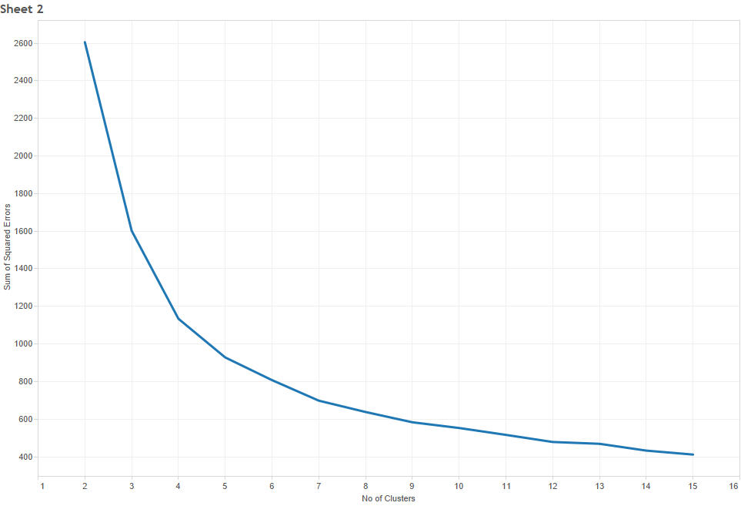
K-Means Elbow Graph

Slide 10
Lessons learnt and challenges faced
Many of the functions executed perfectly on the Linux/Mac environment but did not execute in Windows spark-shell because of “ Out of Memory : Java Heap Space issue “
There were also situations were certain modules worked in Apache Zepplin, but did not work in the spark-shell.
A lot of the functionalities were still not support by Python in the Spark environment, so were forced to stick with Scala throughout the project.
There are certain syntax (of Scala) that are not supported by Apache Zepplin like setting the parameter values with .(dot) operator.
The documentation for a lot of the functionalities were sparse and did not provide concrete examples.
Overall, in a way, it was a good learning experience where we tried to fix issues where there was not much scope for ‘googling’ (Since a lot of the code was recently published) and with sparse documentation for support.

Slide 11
Thank You

