Slide 1
Group 101
Project 8
Healthcare Answer Summarization
Shubhankar Tiwary MT24139
Sai Krishna Kota MT24078
Avikalp Rewatkar MT24022

Slide 2
Introduction
Healthcare platforms contain a vast amount of user-generated content: medical information, personal experiences, and recommendations.
It makes difficult for users to extract important and relevant information regarding their question and answers.
Our project helps users by generating summaries of answers for required perspectives.

Slide 3
PUMA Dataset
The PUMA dataset is a collection of healthcare question-answer threads, annotated with diverse perspectives (e.g., INFORMATION, SUGGESTION, EXPERIENCE).
The PUMA dataset includes 2,236 training samples, 959 validation samples, and 640 test samples.
The PUMA dataset includes the following columns: uri, question, context, answers, labelled_answer_spans, labelled_summaries, and raw_text.

Slide 4


What we did!
Baselines
Baseline 1 : Benchmarked Deepseek and BART with zero-shot setup.
Baseline 2 : Replicated PLASMA model as guided in the paper.

Slide 5
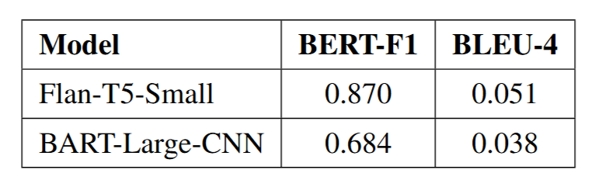
What we did! (contd..)
Fine-Tuning
BART : Used BART-Large-CNN model (406M parameters) to fine-tune on the given PUMA dataset .
Flan-T5 : Used Flan-T5-Small model (77M parameters) to fine-tune on the given PUMA dataset.

Slide 6
What we did! (contd..)
Mixture of Experts Architecture
We tried a MoE architecture by fine-tuning a separate model for each perspective of the summary.
Generated an expanded dataset where each instance has a unique perspective summary instead of having a dict of summaries and tuned 1 model for each perspective summary.
Then we created a pipeline to generate summary for respective perspective from that model.

Slide 7
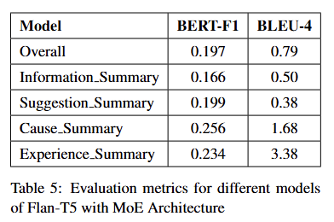
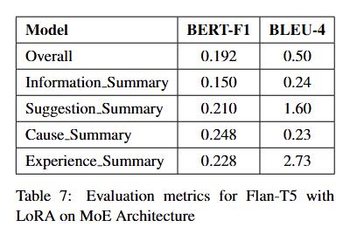
What we did! (contd..)
Mixture of Experts Architecture
We used the following models :
Flan-T5 : Fine-Tuned Flan-T5-base model for upto 3 epochs on the dataset , we also tried to set minimum length for generated summary.
Flan-T5 with LoRA: Used Low Rank Adaptation technique to modify the fine-tuning method

Slide 8
Conclusion
For Fine-tuning:
We concluded that that standard fine-tuning of Flan-T5-Small performs better than BART-Large-CNN with comparatively high scores.
For Mixture of Experts (MoE):
The Mixture of Experts architecture shows potential for perspective-aware summarization but is limited by insufficient and imbalanced training data, especially for under-represented perspectives (such as QUESTION perspective).

Slide 9
Thank You
Group 101

