Slide 1
B.TECH | ARTIFICIAL INTELLIGENCE AND DATA SCIENCE | BIG DATA PROJECT
Public Transport
Delay Analysis
PROJECT DETAILS
Team Members:
Aastha Goyanka(B2-B1-01)
Avika Mishra(B2-B1-06)
Analyzing railway journey delays using Hadoop, MapReduce, Cassandra and Streamlit
1,500,000
70
journeys
summary rows
Synthetic Kaggle dataset. Not official Indian Railways data.
Notes:
Good morning, everyone. My project is called Public Transport Delay Analysis. I took a large railway dataset, about 1.5 million journey records, and used big data tools to find delay patterns in it. The final results are shown in a small dashboard.
One thing I want to say right at the start: the dataset is synthetic. It was made for learning, so it is not official Indian Railways data, and I will not claim the numbers are real railway statistics.
[Before presenting: fill in your name, roll number, class, college, guide name and academic year on this slide. You can click each text box and type directly.]

Slide 2


Introduction, Objectives and Scope
PLATFORM 02 | INTRODUCTION
Background
Objectives
Train delays affect passengers and make planning harder.
Journey data is huge. This file has 1.5 million rows and 45 columns, more than one Excel sheet can hold.
Big data tools can store and process such data in parallel.
This project builds a full pipeline: store, process, save and show.
1
Analyze railway journey data
2
Find delay patterns
3
Compare delays across railway zones and train types
4
Study departure hours and reported delay causes
Problem statement
5
Show the results in a dashboard
Railway journey data is too large to analyze by hand. We need to process about 1.5 million records, summarize delays by railway zone, train type, departure hour and reported cause, and show the results in a simple dashboard.
In scope
Batch analysis of 1.5M records
Zones, train types, hours, causes
HDFS and Cassandra storage
Streamlit dashboard
Notes:
Train delays hurt passengers, and they also make scheduling difficult. The problem is that journey data grows very fast. My file has 1.5 million rows and 45 columns. That is more than a single Excel sheet can even open, so normal tools are not enough here.
So my problem statement is simple: take this large data, summarize the delays by zone, train type, departure hour and reported cause, and show the result in a dashboard that anyone can read.
I had five objectives. First, analyze the journey data. Second, find delay patterns. Third, compare zones and train types. Fourth, look at departure hours and the reported causes. And fifth, show everything in a dashboard.
On the scope side, what I did is a batch analysis of the full 1.5 million records, with storage in HDFS and Cassandra and a Streamlit dashboard.

Slide 3
Dataset Description and Technologies Used
PLATFORM 03 | DATASET & TECHNOLOGY
1.5 M
45
321.5 MB
Technology | Version | Role in the project
Hadoop HDFS | 3.2.4 | Stores the input railway CSV dataset
Java MapReduce | – | Processes about 1.5M records into summary statistics
Java JDK | 8 | Compiles the MapReduce program
Apache Cassandra | 3.11.0 | Stores the aggregated results in a table
Cassandra Python driver | – | Connects Python to Cassandra
Python | 3.14 | Integration and dashboard development
Pandas | – | Handles the tabular data shown in the dashboard
Streamlit | 1.65.0 | Web-based dashboard
rows (journeys)
columns
file size in HDFS
Column | Meaning
zone | Railway zone of the journey (16 zones)
train_type | Category of train (15 types)
departure_hour | Scheduled departure hour, 0 to 23
primary_delay_cause | Main reported cause (15 values, incl. On Time)
delay_minutes | Delay of the journey in minutes
is_delayed | 1 = delayed, 0 = not delayed
Synthetic, India-themed data. Source: Kaggle, Indian Railways: Predict Train Delay (ir_train.csv). Not official Indian Railways data.
Notes:
The dataset is a file called ir_train.csv from a Kaggle competition named Indian Railways: Predict Train Delay. It has about 1.5 million rows and 45 columns, and it is 321.5 MB in HDFS.
Again, this data is synthetic. It looks like Indian railway data, with zones and train names, but it is generated, so it is not official.
Out of the 45 columns I only use six for my summaries: zone, train type, departure hour, the main delay cause, delay minutes, and the is_delayed flag.
These are the tools I actually used. Hadoop HDFS, version 3.2.4, stores the CSV file. The processing is done by a MapReduce program that I wrote in Java and compiled with JDK 8. The summary results go into Apache Cassandra, version 3.11.0.
Python 3.14 ties everything together. The Cassandra Python driver lets Python talk to Cassandra, Pandas holds the table data, and Streamlit 1.65.0 makes the web dashboard.

Slide 4





System Architecture
PLATFORM 04 | HADOOP ARCHITECTURE
STORAGE
PROCESSING
RESULTS STORAGE
VISUALISATION
1
2
3
4
5
Dataset
Hadoop HDFS
Java MapReduce
Aggregated results
part-r-00000
70 records
Cassandra
Streamlit Dashboard
ir_train.csv
stores the CSV
processes the data
delay_summary
app.py
1.5M rows
321.5 MB
1.5M → 70
70 rows
4 tabs
WHAT HAPPENS AT EACH ARROW
1
Dataset → HDFS
ir_train.csv is uploaded to /public_transport_delay/input/
2
HDFS → MapReduce
TransportDelayAnalysis.java reads the CSV from HDFS
3
MapReduce → Output
70 summary records are saved to /public_transport_delay/mapreduce_output/part-r-00000
4
Output → Cassandra
load_to_cassandra.py inserts 70 rows into transport_analysis.delay_summary
5
Cassandra → Streamlit
app.py reads Cassandra and shows the data in Streamlit
Notes:
This diagram shows the whole project from left to right. We start with the dataset, ir_train.csv. I upload it to Hadoop HDFS. Then my Java MapReduce program reads it from HDFS and processes it. The output is only 70 summary records, and it is written back to HDFS in a file called part-r-00000.
A Python script then loads those 70 rows into a Cassandra table. Finally, the Streamlit app reads that table and draws the charts.
The main idea is that the heavy work happens once, in MapReduce. The dashboard only reads a tiny summary table, so it is fast.

Slide 5
Methodology
PLATFORM 05 | METHODOLOGY & HDFS
1
2
3
4
Prepare the data
Store in HDFS
Compile the program
Run MapReduce
Download the dataset and read the data dictionary
Put ir_train.csv in the HDFS input folder
Compile the Java code (JDK 8) into a JAR
The Hadoop job writes
part-r-00000 to HDFS
Hadoop and Cassandra were run locally on one machine.
7
6
5
Visualize
Load the results
Create the Cassandra table
app.py reads Cassandra; Streamlit shows 4 tabs
load_to_cassandra.py inserts the 70 summary rows
Keyspace transport_analysis, table delay_summary
Evidence: dataset uploaded to HDFS (hdfs dfs -put, -ls, -du)
Notes:
These are the seven steps I followed. One: I downloaded the dataset and read the data dictionary to understand the columns. Two: I uploaded the CSV into HDFS. The screenshot at the bottom is from my own terminal. You can see the put command, the listing, and the size, 321.5 MB.
Three: I compiled the Java program into a JAR with JDK 8. Four: I ran the MapReduce job. Five: I created the Cassandra keyspace and table. Six: I loaded the 70 summary rows with a Python script. Seven: I built the Streamlit dashboard.
Everything ran locally on one machine, not on a real cluster.

Slide 6
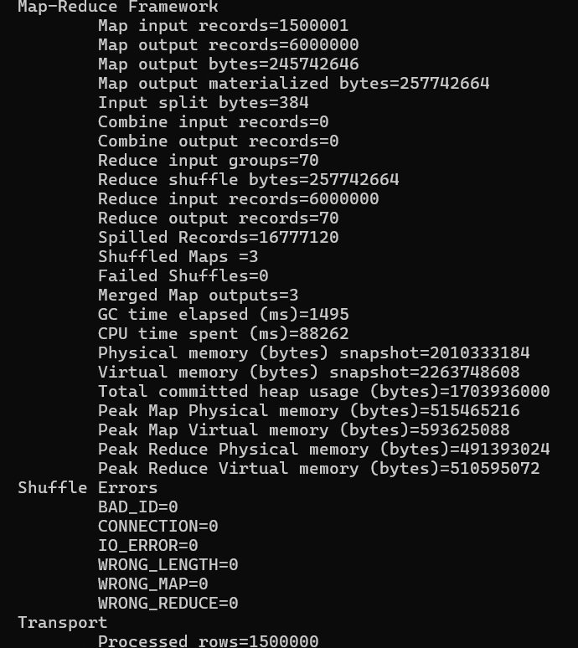
MapReduce Processing
PLATFORM 06 | MAPREDUCE
1,500,000
70
input records
summary records
1
Map Each row sends 4 key-value pairs (zone, train type, hour, cause): 6,000,000 map output records.
2
Shuffle Groups the values by key. There are 70 unique keys.
3
Reduce Adds up journeys and delay minutes, then calculates delay rate and averages.
16 zones + 15 train types + 24 hours + 15 causes = 70
Actual job counters from the Hadoop console
Notes:
This is the heart of the project. MapReduce has three steps.
In the Map step, each journey row is read and sends out four key-value pairs, one each for its zone, train type, departure hour and delay cause. That is why 1.5 million input rows turn into 6 million map output records.
The Shuffle step groups the values by key. There are 70 unique keys. In the Reduce step I add up journeys and delay minutes for each key, and calculate the delay rate and averages. So the final output is 70 records: 16 zones, 15 train types, 24 hours and 15 causes.
The screenshot on the right is the real counter output from my job. One small detail: Map input records shows 1,500,001, which I believe is because the CSV header line is also read. My own counter, Processed rows, shows exactly 1,500,000.

Slide 7
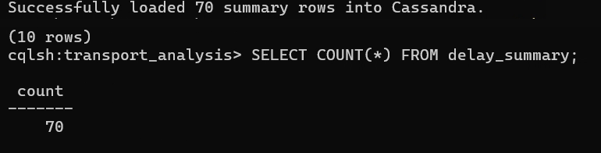
Storing Results in Cassandra
PLATFORM 07 | CASSANDRA
Table design
70
rows verified with
SELECT COUNT(*)
Keyspace
transport_analysis
Table
delay_summary
Primary key
category, category_name
Replication
SimpleStrategy, factor 1
Loaded by
load_to_cassandra.py
Columns
Evidence: loading and verification in cqlsh
category
category_name
total_journeys
delayed_journeys
delay_rate
avg_delay_all
Purpose: keeps the 70 MapReduce summary rows in one table. Each row is a group, such as one zone or one hour. The dashboard reads only this table.
avg_delay_when_delayed
avg_delay_all: average delay (minutes) over all journeys in a group
avg_delay_when_delayed: average over delayed journeys only
Notes:
After MapReduce, the 70 summary rows are stored in Cassandra. I made a keyspace called transport_analysis and a table called delay_summary. Each row is one group, for example one zone or one departure hour. It has the category, the name, total journeys, delayed journeys, the delay rate, and two averages.
The two averages are different. avg_delay_all is the average delay over every journey in that group. avg_delay_when_delayed only counts the journeys that were actually delayed.
The screenshot shows my Python script saying it loaded 70 rows, and then the cqlsh command SELECT COUNT star returning 70. That is how I checked that all the data reached Cassandra.

Slide 8
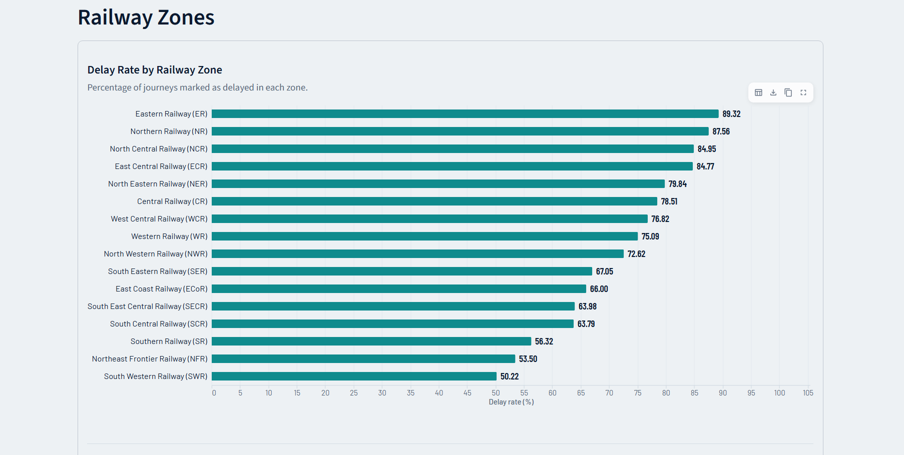
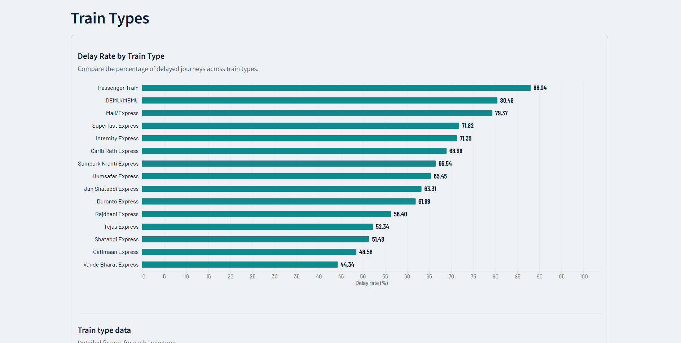
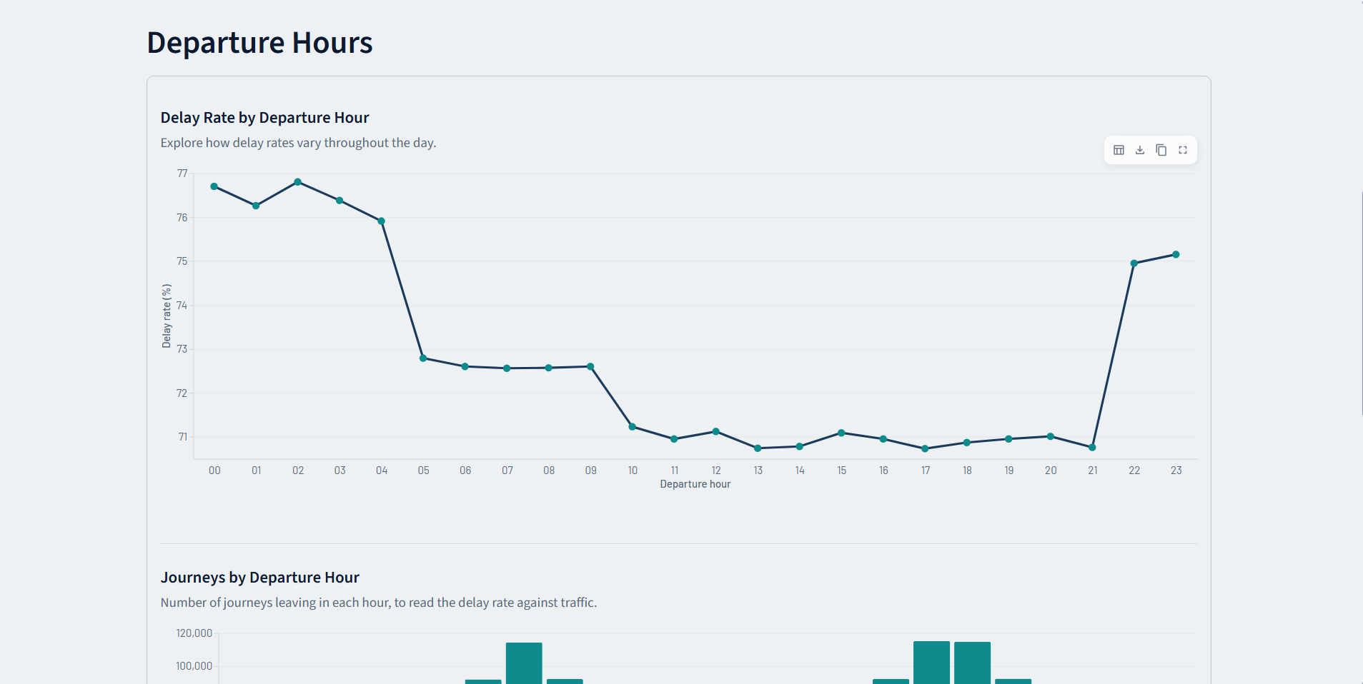
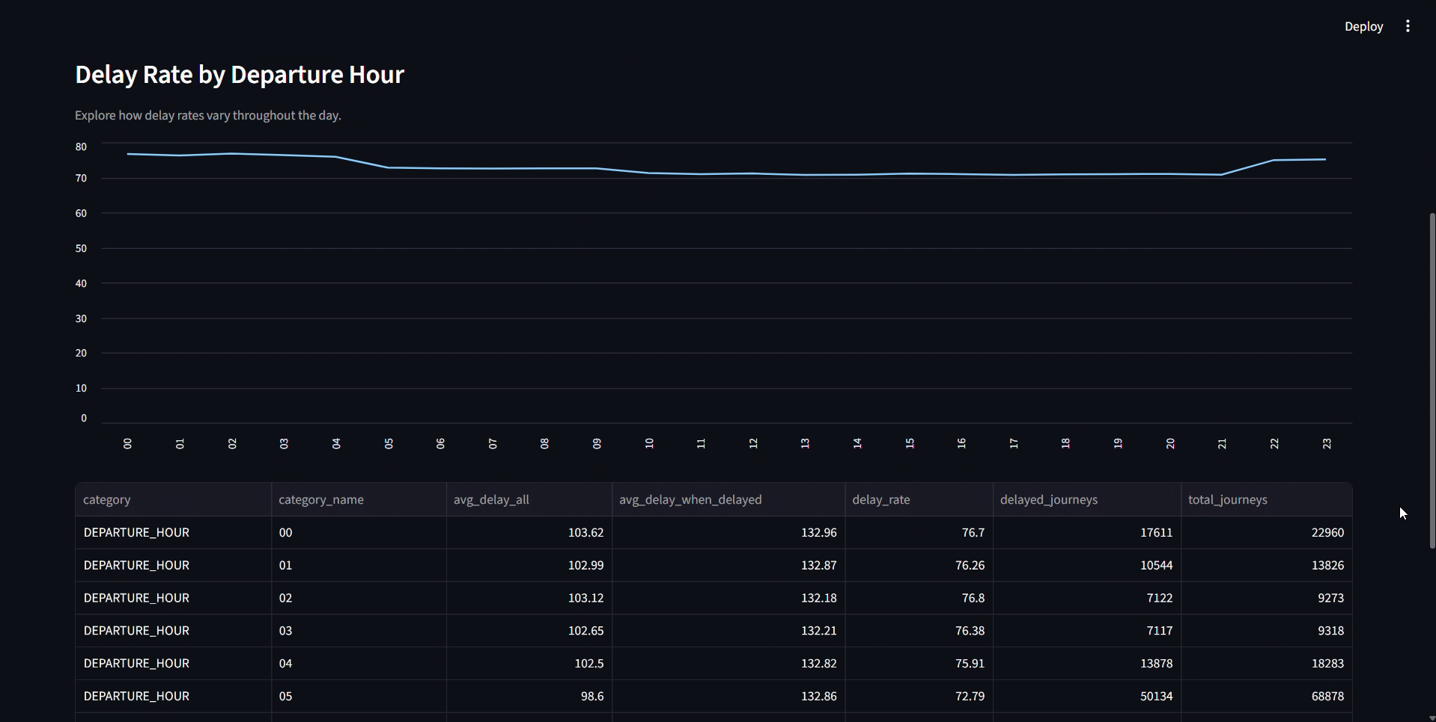
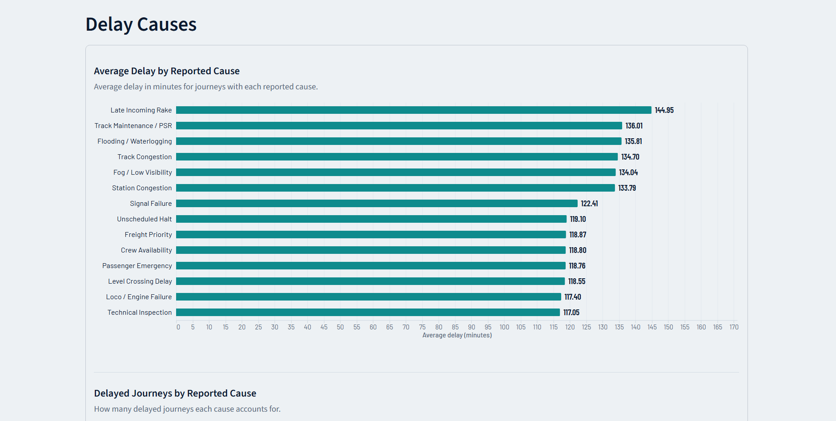
Dashboard: Zones, Train Types, Hours and Delay Causes
PLATFORM 08 | DASHBOARD
TOTAL JOURNEYS
DELAYED JOURNEYS
OVERALL DELAY RATE
1,500,000
1,078,329
71.89%
1
TAB 1
2
TAB 2
3
TAB 3
4
TAB 4
Railway Zones
Train Types
Departure Hours
Delay Causes
89.32%
88.04%
75.9–76.8%
144.95 min
highest delay rate: Eastern Railway (16 zones)
highest delay rate: Passenger Train (15 types)
delay rate for 00:00 to 04:00 departures
longest average delay: Late Incoming Rake
Stays between about 71% and 77% all day
Table below the chart is read from Cassandra
On Time is left out of the chart
Every listed cause has a 100% delay rate
Notes:
This is the Streamlit dashboard, and these are real screenshots from it. At the top are three overview numbers: 1,500,000 total journeys, 1,078,329 delayed journeys, so an overall delay rate of 71.89 percent.
The dashboard has four tabs. The first is Railway Zones. It compares the delay rate for all 16 zones, and in this dataset Eastern Railway is the highest at 89.32 percent. The second tab is Train Types, for 15 categories. Passenger Train is the highest at 88.04 percent.
Please remember the data is synthetic, so these numbers say nothing about the real Indian Railways.
The third tab shows the delay rate for each of the 24 departure hours as a line chart. The line is fairly flat, between about 71 and 77 percent, and it is a little higher late at night, from midnight to around 4 AM.
The fourth tab shows the average delay in minutes for each reported cause. I left out the On Time category because it is not a cause. Late Incoming Rake has the longest average delay, about 145 minutes.
In this tab every cause has a 100 percent delay rate. That is because only delayed journeys have a reported cause. Each tab also shows the table read from Cassandra. I did not add any extra filters.

Slide 9

Results, Limitations and Future Scope
PLATFORM 09 | RESULTS
Results Confirmed from this dataset
OVERALL DELAY RATE
HIGHEST ZONE
HIGHEST TRAIN TYPE
LONGEST AVERAGE DELAY
71.89%
89.32%
88.04%
144.95 min
1,078,329 of 1,500,000 journeys
Eastern Railway
Passenger Train
Late Incoming Rake
Night departures (00 to 04 h) have higher delay rates.
Limitations What this project does not do
Future scope
Proposed, not implemented
Synthetic data, not real railway data
Batch analysis only, no real-time data
Fixed summaries, no dashboard filters
Local single-machine setup
Descriptive only, no prediction
Add a combiner to reduce shuffled data
Add filters and more charts
Use more columns, such as fog and season
Test on real operational data
Run on a multi-node cluster
Notes:
Results first. These are the findings that I confirmed from my dataset. Overall, 71.89 percent of journeys are delayed. Eastern Railway has the highest zone delay rate, Passenger Train has the highest train type delay rate, late-night departures have slightly higher rates, and Late Incoming Rake has the longest average delay. All of this comes from synthetic data, so I do not present them as real railway findings.
Limitations. The data is synthetic, the analysis is batch only, the dashboard has no filters, everything ran on one machine, and it is descriptive, not predictive.
Future scope is only an idea list, I have not done it. We could add a combiner to reduce the shuffled data, add filters and more charts, use more columns, test on real data, or run on a multi-node cluster.

Slide 10

Conclusion and References
PLATFORM 10 | CONCLUSION
CONCLUSION
References
From 1.5 million records to a working 4-tab dashboard.
[1] Kaggle, “Indian Railways: Predict Train Delay” (competition dataset, 2026). kaggle.com/competitions/indian-railways-predict-train-delay
[2] Apache Software Foundation, Apache Hadoop 3.2.4 documentation. hadoop.apache.org
[3] J. Dean and S. Ghemawat, “MapReduce: Simplified Data Processing on Large Clusters,” OSDI, 2004.
[4] Apache Software Foundation, Apache Cassandra documentation. cassandra.apache.org
[5] A. Lakshman and P. Malik, “Cassandra: A Decentralized Structured Storage System,” ACM SIGOPS Operating Systems Review, 44(2), 2010.
[6] Streamlit documentation. docs.streamlit.io
[7] pandas documentation. pandas.pydata.org
[8] DataStax, Python Driver for Apache Cassandra. docs.datastax.com/en/developer/python-driver
Implemented: HDFS storage, Java MapReduce, Cassandra, Streamlit dashboard
Demonstrated: 1.5M records into 70 summary rows, checked in Cassandra
Limits: synthetic data, analysis only, not official statistics
Dataset
HDFS
MapReduce
Cassandra
Streamlit
Notes:
To conclude, I built a working big data pipeline. HDFS stores the data, a Java MapReduce program turns 1.5 million records into 70 summary rows, Cassandra stores those rows, and a Streamlit dashboard shows the delay patterns by zone, train type, departure hour and cause.
This is a learning project on a synthetic dataset, so the numbers are not official Indian Railways statistics, and it is an analysis project, not a prediction model. Thank you. I am happy to take questions.
The references on the right include the dataset, the Hadoop, Cassandra and Streamlit documentation, and the original MapReduce and Cassandra papers. [Add the date you accessed the web sources if your guide asks for it.]

