Slide 1
Capstone Project | Superstore Marketing Campaign
Superstore Marketing Campaign Analysis
Customer segmentation + response prediction + Power BI dashboard
Notes:
[Sources]
- Superstore Marketing Campaign dataset: D:/CapstoneProjects/SuperstoreMarketingCampaignAnalysis/superstore_campaign_analysis_ready.csv
- Python notebook: C:/Users/Avikansh/OneDrive/Desktop/Capstone_Projects/SuperstoreMarketingCampaignProject/Superstore_Marketing_Campaign_Analysis_updated.ipynb
- Power BI dashboard referenced in the source deck.

Slide 2
The business problem is campaign targeting
The goal is to improve campaign efficiency by finding customers most likely to accept membership offers.
14.91%
Key decision
Business questions
Which customer groups should marketing prioritize for the next campaign?
Who responds?
What behaviors matter?
Which segments deserve budget?
How should the dashboard guide action?
Overall response rate
Only 334 of 2,240 customers accepted the campaign, so broad outreach wastes budget.
KPI frame: response rate, customer count, average spend, high-value share.
Source: Superstore Marketing Campaign dataset, Python analysis, Power BI dashboard
02
Notes:
[Sources]
- Superstore Marketing Campaign dataset: D:/CapstoneProjects/SuperstoreMarketingCampaignAnalysis/superstore_campaign_analysis_ready.csv
- Python notebook: C:/Users/Avikansh/OneDrive/Desktop/Capstone_Projects/SuperstoreMarketingCampaignProject/Superstore_Marketing_Campaign_Analysis_updated.ipynb
- Power BI dashboard referenced in the source deck.

Slide 3
The workflow turns raw data into decisions
The notebook and dashboard follow a business-first path instead of isolated Pandas practice.
01
02
03
04
05
Validate
Engineer KPIs
Explore
Segment
Recommend
Check shape, types, missing values, duplicates.
Create spend, age, tenure, channel, and segment fields.
Compare response by income, recency, channel, and household.
Translate patterns into targetable customer groups.
Prioritize campaigns using response and value signals.
Feature engineering used for decisions
Total spend, total purchases, discount purchase rate, spend per purchase, customer tenure, age group, income bracket, recency group, preferred channel, high-value flag, and customer segment.
Source: Superstore Marketing Campaign dataset, Python analysis, Power BI dashboard
03
Notes:
[Sources]
- Superstore Marketing Campaign dataset: D:/CapstoneProjects/SuperstoreMarketingCampaignAnalysis/superstore_campaign_analysis_ready.csv
- Python notebook: C:/Users/Avikansh/OneDrive/Desktop/Capstone_Projects/SuperstoreMarketingCampaignProject/Superstore_Marketing_Campaign_Analysis_updated.ipynb
- Power BI dashboard referenced in the source deck.

Slide 4
Three signals explain the campaign opportunity
Response is strongest when customer value, recent engagement, and preferred buying channel line up.
Meaning for the business
The next campaign should not treat every customer equally. The data points toward a smaller, higher-probability audience where response likelihood compounds.
26.61%
23.90%
35.62%
Very high income
Recent customers
Catalog shoppers
Customers in the top income bracket respond at nearly 1.8x the overall average.
Customers with lower recency are much more likely to accept the campaign.
Catalog is the strongest purchase channel signal for campaign acceptance.
Source: Superstore Marketing Campaign dataset, Python analysis, Power BI dashboard
04
Notes:
[Sources]
- Superstore Marketing Campaign dataset: D:/CapstoneProjects/SuperstoreMarketingCampaignAnalysis/superstore_campaign_analysis_ready.csv
- Python notebook: C:/Users/Avikansh/OneDrive/Desktop/Capstone_Projects/SuperstoreMarketingCampaignProject/Superstore_Marketing_Campaign_Analysis_updated.ipynb
- Power BI dashboard referenced in the source deck.

Slide 5
Combined signals reveal the strongest target group
Recent high-value Web and Catalog customers respond at more than three times the overall average.
Response rate by target audience
Best audience
58.54%
Recent + Web + High Value
This segment is small, but it is the cleanest starting point for a high-efficiency test campaign.
Baseline response: 14.91%
Response rate (%)
Source: Superstore Marketing Campaign dataset, Python analysis, Power BI dashboard
05
Notes:
[Sources]
- Superstore Marketing Campaign dataset: D:/CapstoneProjects/SuperstoreMarketingCampaignAnalysis/superstore_campaign_analysis_ready.csv
- Python notebook: C:/Users/Avikansh/OneDrive/Desktop/Capstone_Projects/SuperstoreMarketingCampaignProject/Superstore_Marketing_Campaign_Analysis_updated.ipynb
- Power BI dashboard referenced in the source deck.

Slide 6
Segments translate analysis into campaign actions
Each segment ties customer behavior to a practical next step for marketing.
Segment | Customers | Response | Avg Spend | Campaign action
High-Value Active Catalog/Web | 134 | 48.51% | 1,479.61 | Prioritize premium offers
Catalog Shoppers | 50 | 22.00% | 679.04 | Catalog-led follow-up
General Customers | 291 | 21.31% | 1,025.71 | Personalized test campaign
High-Value At-Risk | 224 | 20.54% | 1,498.65 | Win-back offer
Digital Shoppers | 488 | 17.21% | 356.93 | Web/email promotion
Bargain Hunters | 505 | 8.71% | 121.00 | Low-cost offer only
48.51%
1,479.61
Use the segment table as a campaign priority list: protect budget for high-response, high-spend groups first.
Top segment response
Avg spend in top segment
Source: Superstore Marketing Campaign dataset, Python analysis, Power BI dashboard
06
Notes:
[Sources]
- Superstore Marketing Campaign dataset: D:/CapstoneProjects/SuperstoreMarketingCampaignAnalysis/superstore_campaign_analysis_ready.csv
- Python notebook: C:/Users/Avikansh/OneDrive/Desktop/Capstone_Projects/SuperstoreMarketingCampaignProject/Superstore_Marketing_Campaign_Analysis_updated.ipynb
- Power BI dashboard referenced in the source deck.

Slide 7
The model supports targeted outreach
Because the response class is imbalanced, ROC-AUC, recall, precision, and F1 matter more than accuracy alone.
Best model
Random Forest
Accuracy 0.879
Precision 0.623
Recall 0.493
F1-score 0.550
ROC-AUC 0.904
Interpretation
The model is useful for ranking customers by likelihood, then sending targeted campaigns to the highest-scoring groups.
Source: Python notebook model evaluation output
07
Notes:
[Sources]
- Superstore Marketing Campaign dataset: D:/CapstoneProjects/SuperstoreMarketingCampaignAnalysis/superstore_campaign_analysis_ready.csv
- Python notebook: C:/Users/Avikansh/OneDrive/Desktop/Capstone_Projects/SuperstoreMarketingCampaignProject/Superstore_Marketing_Campaign_Analysis_updated.ipynb
- Power BI dashboard referenced in the source deck.
- Model metrics and targeting lift were recalculated from the notebook feature set on 2026-08-03.

Slide 8
Model scoring lifts response in the top 20%
Ranking unseen test customers by predicted probability concentrates actual responders.
Actual response rate by targeting approach
Targeting lift
3.61x
Top 20% predicted customers
The model selected 89 of 448 test customers and captured a much higher actual response rate.
Full test baseline: 14.96%
Actual response rate (%)
Source: Superstore Marketing Campaign dataset, Python analysis, Power BI dashboard
08
Notes:
[Sources]
- Superstore Marketing Campaign dataset: D:/CapstoneProjects/SuperstoreMarketingCampaignAnalysis/superstore_campaign_analysis_ready.csv
- Python notebook: C:/Users/Avikansh/OneDrive/Desktop/Capstone_Projects/SuperstoreMarketingCampaignProject/Superstore_Marketing_Campaign_Analysis_updated.ipynb
- Power BI dashboard referenced in the source deck.
- Model metrics and targeting lift were recalculated from the notebook feature set on 2026-08-03.

Slide 9
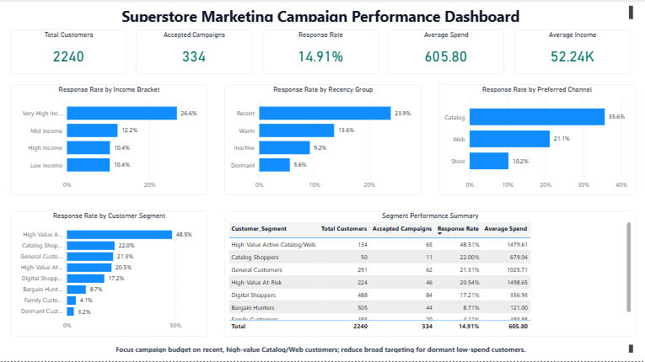
The dashboard makes the recommendation actionable
Power BI turns the notebook findings into an executive view for filtering, explaining, and prioritizing campaign audiences.
Superstore Marketing Campaign Performance Dashboard
Dashboard view: campaign KPIs, response drivers, and segment performance summary.
Source: Power BI dashboard file SuperStorePowerBiProject_AutoDashboard.pbix
09
Notes:
[Sources]
- Superstore Marketing Campaign dataset: D:/CapstoneProjects/SuperstoreMarketingCampaignAnalysis/superstore_campaign_analysis_ready.csv
- Python notebook: C:/Users/Avikansh/OneDrive/Desktop/Capstone_Projects/SuperstoreMarketingCampaignProject/Superstore_Marketing_Campaign_Analysis_updated.ipynb
- Power BI dashboard referenced in the source deck.

Slide 10
Recommendation: focus spend where response compounds
The business should move from broad outreach to segmented campaign execution.
01
Prioritize recent high-value Catalog/Web customers
Start with the highest response audience for premium offers and personalized follow-up.
02
Use focused win-back offers for high-value at-risk customers
Do not ignore high spenders with longer recency; use urgency, loyalty, or bundle offers.
03
Limit spend on dormant and low-spend customers
Use low-cost channels or test-only budgets until these groups show stronger intent.
Expected impact: higher conversion per campaign spend, lower wasted outreach, and a clear audience for the next A/B test.
Source: Superstore Marketing Campaign dataset, Python analysis, Power BI dashboard
10
Notes:
[Sources]
- Superstore Marketing Campaign dataset: D:/CapstoneProjects/SuperstoreMarketingCampaignAnalysis/superstore_campaign_analysis_ready.csv
- Python notebook: C:/Users/Avikansh/OneDrive/Desktop/Capstone_Projects/SuperstoreMarketingCampaignProject/Superstore_Marketing_Campaign_Analysis_updated.ipynb
- Power BI dashboard referenced in the source deck.

