Slide 1
Computing Systems
Memory Hierarchy

Slide 2
Memory: characteristics
Location
  on-chip, off-chip
Cost
  Dollars per bit
Performance
  access time, cycle time, transfer rate
Capacity
  word size, number of words
Unit of transfer
  word, block
Access
  sequential, random, associative
Alterability
  read/write, read only (ROM)
Storage type
  static, dynamic, volatile, nonvolatile
Physical type
  semiconductor, magnetic, optical

Slide 3
Memory: array organization
Storage cells are organized on a rectangular array
The address is divided in row and column parts
There are M = 2^{r} rows of N bits each
M and N are usually powers of 2
  Total size of a memory chip = M x N bits
The row address (r bits) select a full row of N bits
The column address (c bits) selects k bits out of N
The memory is organized as T=2 ^{r+c} addresses of k-bit words

Slide 4
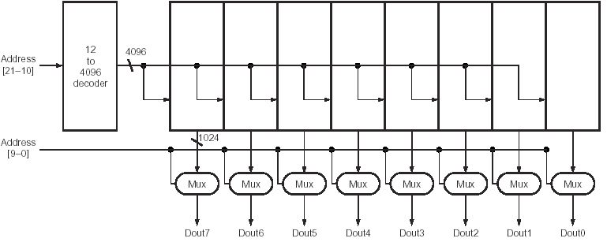
Memory: array organization
Example: 4 MB memory

Slide 5
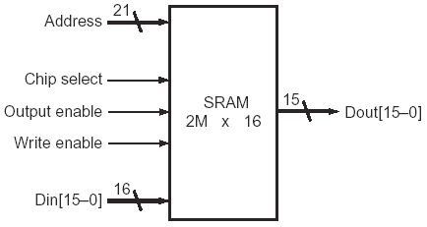
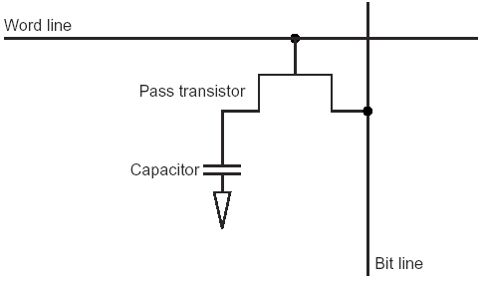
Memories
Static Random Access Memory (SRAM):
  value is stored on a pair of inverting gates
  very fast but takes up more space than DRAM
  Dynamic Random Access Memory (DRAM):
  value is stored as a charge on capacitor (must be refreshed)
  very small but slower than SRAM (factor of 5 to 10)

Slide 6
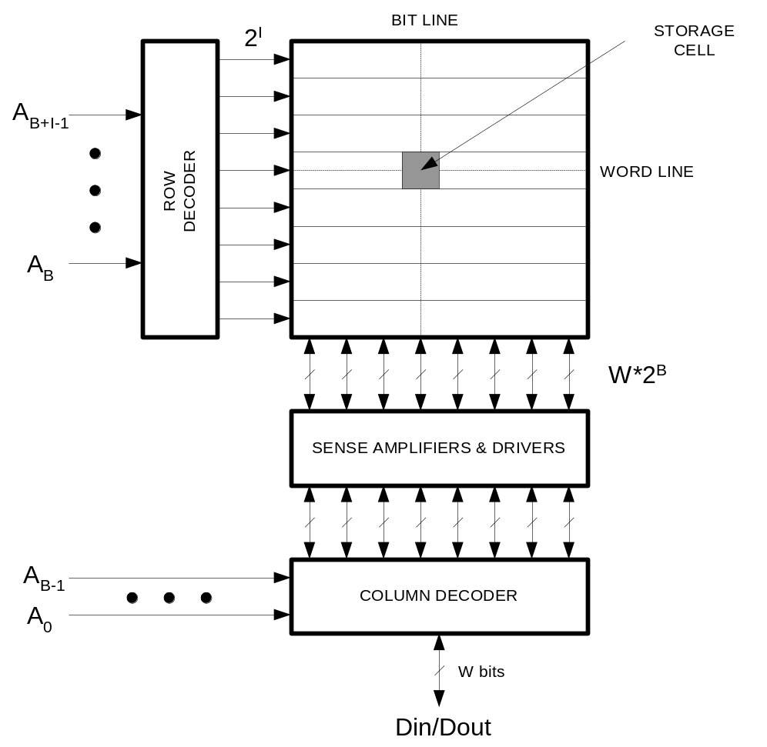
SRAM structure

Slide 7
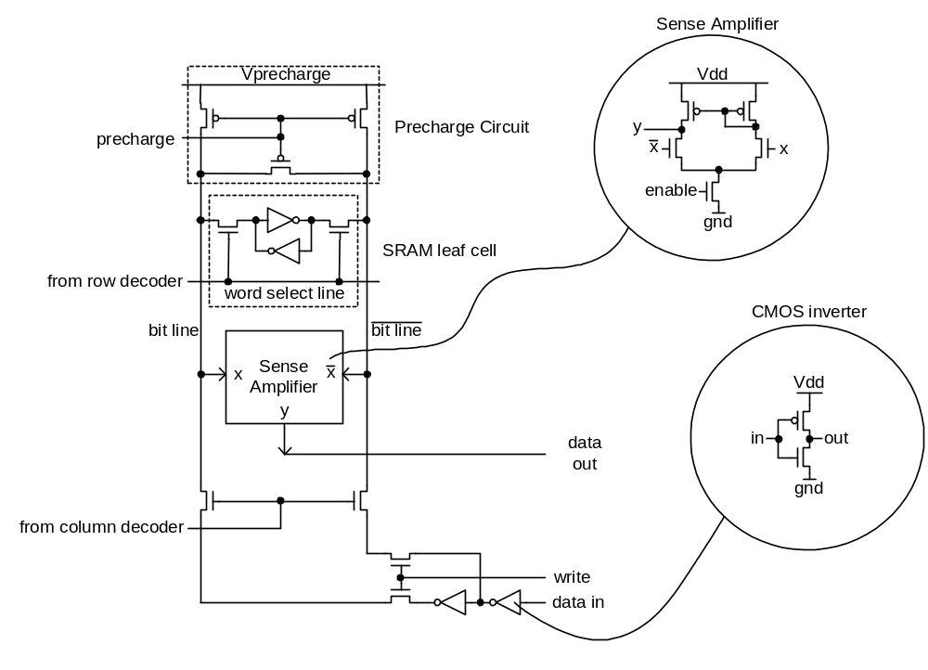
SRAM internal snapshot

Slide 8
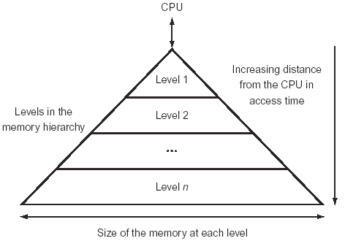
Exploiting memory hierarchy
Users want large and fast memories !
  SRAM access times are 0.5-5ns at cost of $4000 to $10000 per GB.
  DRAM access times are 50-70ns at cost of $100 to $200 per GB.
  Disk access times are 5 to 20 ms at cost of $0.50 to $2 per GB.
Give them the illusion !
  build a memory hierarchy

Slide 9
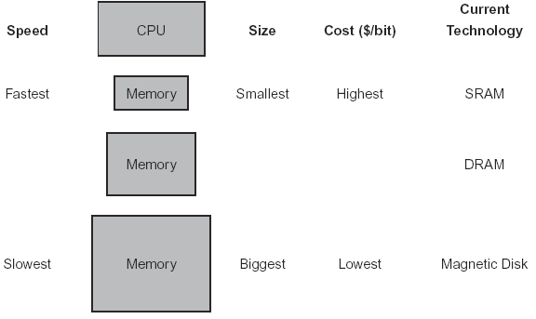
Basic structure of a memory hierarchy

Slide 10
Locality
A principle that makes having a memory hierarchy a good idea
  Locality principle states that programs access a relatively small portion of their address space at any instant of time
If an item is referenced,
  temporal locality: it will tend to be referenced again soon
  spatial locality: nearby items will tend to be referenced soon.
Why does code have locality?
A memory hierarchy can consists of multiple levels, but …
  data is copied between only two adjacent levels at the time
Our focus: two levels (upper, lower)
  Block (or line): minimum unit of data
  hit: data requested is in the upper level
  miss: data requested is not in the upper level
Notes:
Loops → instructions and data are accessed repeatedly → locality in Time
Arrays, instructions are normally accessed sequentially → locality in space
Memory hierarchies take advantage of:
Temporal locality: by keeping more recently accessed items closer to the processor
Spatial locality: by moving blocks of contiguous words in memory to upper levels of the hierarchy

Slide 11
Cache
Two issues:
  How do we know if a data item is in the cache?
  if it is, how do we find it?
The simplest solution:
  block size is one word of data
  "direct mapped"
for each item of data at the upper level (Mp), there is exactly one location in the cache where it might be.
i.e., lots of items at the lower level (cache) share locations in the upper level (Mp)

Slide 12
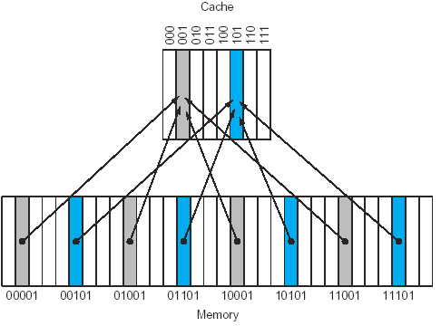
Direct mapped cache
Mapping: (block address) modulo (number of blocks in the cache)

Slide 13
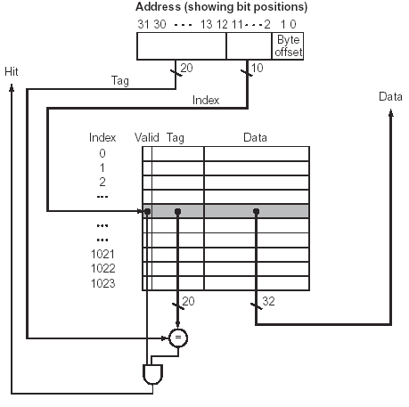
Direct mapped cache for MIPS
Temporal
What kind of locality are we taking advantage of ?
Notes:
At start up the cache does not have good data !
We need a way to recognize that a cache block doe not have valid information ! → Valid bit

Slide 14
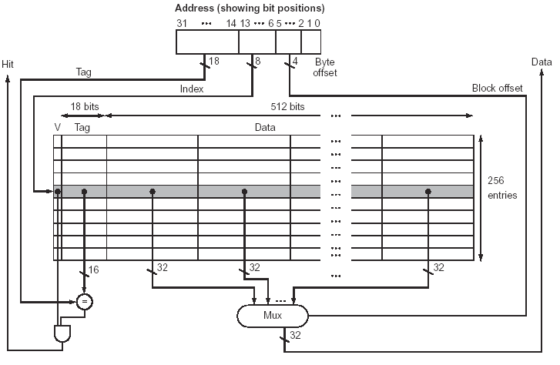
Direct mapped cache
Taking advantage of spatial locality (multiword cache block):
Notes:
Larger blocks exploit spatial locality
Increasing the block size usually decreases the miss rate
The miss rate may eventually go up if the block size become significant
The increases in the miss penalty overwhelm the decrease in the miss rate for large blocks and cache performance thus decreases

Slide 15

Example: bits in a cache
Assuming a 32 bit address, how many total bits are required for a direct-mapped cache with 16 KB of data and blocks composed of 4 words each ?
  We have 2¹² words of data in cache:
  Each block (=line) of data cache is composed of 4 words.
  Assuming memory is word-addressed (MIPS), we need only 30 bits of the 32-bit address issued by the CPU
  Each block has: 4 x 32 = 128 bits of data, 1 valid bit, and 30–10–2 = 18 bits of tag
  Thus:
  We need 15% more bits than needed for the storage of data
  (18.375 KB / 16 KB = 1.15)
. . .
2¹⁰ lines

Slide 16
Example: mapping an address to a multiword cache block
Consider a cache with 64 blocks and a block size of 16 bytes. What block number does byte address 1200 map to ?
  byte address 1200 is word address: 1200 / 4 = 300
  word address 300 is block address: 300 / 4 = 75
  cache address is: 75 modulo 64 = 11
…
64 blocks

Slide 17
Hits vs. misses
Read hits
  this is what we want !
Read misses
  stall the CPU, fetch block from memory, deliver to cache, restart
Write hits:
  can replace data in cache and memory (write-through)
  write the data only into the cache (write-back to memory later)
Write misses:
  read the entire block into the cache, then write the word

Slide 18
Performance
Simplified model:
execution time = (execution cycles + stall cycles) × cycle time
stall cycles = # of memory accesses × miss rate × miss penalty
Two ways of improving performance:
  decreasing the miss rate
  decreasing the miss penalty
What happens if we increase block size?

Slide 19
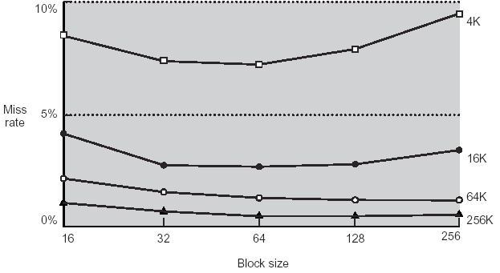
Performance
Increasing the block size “usually” decrease the miss rate
However, if the block size becomes a significant portion of the cache
  the number of blocks that can be held in cache will become small ➔
  there will be a great competition for those few blocks ➔
  the benefit in the miss rate become smaller
Notes:
Use split caches: separate instruction and data caches
There is more spatial locality on instructions

Slide 20
Performance
Increasing the block size, increases the miss penalty
Miss penalty is determined by:
  time to fetch the block from the next lower level of the hierarchy and load it into the cache
  It has two parts:
    latency to the first word (it will not change with block size), and
    transfer time for the rest of the block
To decrease miss penalty:
  common solutions:
    the bandwidth of main memory must be increased to transfer cache blocks more efficiently
      making memory wider
      Interleaving
  advanced solutions:
    Early restart
    Critical word first
Notes:
Early restart → resume execution as soon as the word requested is returned instead of waiting for the entire block
Critical word first → the requested word is transferred from memory to cache first. The remainder of the block is then transferred
Starting with the address after the requested word and wrapping around to the beginning of the block

Slide 21
Example: Cache Performance
cache miss rate for a program (= instruction cache miss rate) 3%
data cache miss rate 4%
processor CPI of 2.0
miss penalty 100 cycles for all kind of misses
load/store instruction frequency 36%
How much faster a processor would run with a perfect cache that never miss ?
  instruction miss cycles = IC x 3% x 100 = IC x 3 cycles
  data miss cycles = IC x 36% x 4% x 100 = IC x 1.44 cycles
  memory-stall-cycles = IC x 3 + IC x 1.44 = IC x 4.44 cycles
  execution cycles with stalls = CPU cycles + memory-stall-cycles =
  = IC x 2.0 + IC x 4.44 = 6.44 cycles
  The amount of execution time spent on memory stalls is 69% (= 4.44/6.44)

Slide 22
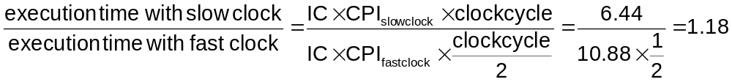
Example: Cache Performance
What is the impact if we reduce the CPI of the previous computer from 2 to 1 ?
  CPI perfect = 1 cycle / instruction
  CPI with stalls = 1 + 4.44 = 5.44 cycle / instruction
  The amount of execution time spent on memory stalls is 82% (= 4.44/5.44)
What if we keep the same CPI but we double the CPU clock rate ?
  measured in the faster clock cycles, the new miss penalty will double
  (200 cycles)
  stall-cycles per instruction = 3% x 200 + 36% x 4% x 200 = 8.88 cycles / instruction
  execution cycles per instruction with stalls = 2.0 + 8.88 = 10.88 cycles / instruction
Because of the cache, doubling
clock rate makes the computer
only 1.18 times faster instead
of 2 times faster (Amdahl’s Law)
we stall 82%
(8.88/10.88)
of the time

Slide 23
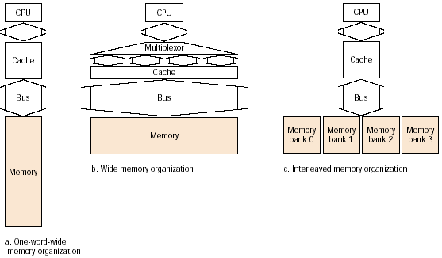
Designing the memory system to support caches
additional silicon area
potential increase in
cache access time
Instead of making
the entire path
between memory
and cache wider
we organize the
memory chips in
banks
Increase the physical width
of the memory system
Increase the logical width
of the memory system

Slide 24
Example: higher memory bandwidth
Cache block of 4 words
1 memory bus clock cycle to send the address
15 memory bus clock cycles for each DRAM access initiated
1 memory clock cycle to send a word
  One-word memory ?
  miss penalty = 1+ 4 x 15 + 4 x 1 = 65 memory cycles
  bandwidth = 4x4 / 65 = 0.25 bytes / memory cycle
  Two-word memory ?
  miss penalty = 1 + 2 x 15 + 2 x 1 = 33 memory cycles
  bandwidth = 4x4 / 33 = 0.48 bytes / memory cycle
  Four-word memory ?
  miss penalty = 1 + 15 + 1 = 17 memory cycles
  bandwidth = 4x4 / 17 = 0.96 bytes / memory cycle
  Interleaving with four banks ?
  miss penalty = 1 + 1 x 15 + 4 x 1 = 20 memory cycles
  bandwidth = 4x4 / 20 = 0.80 bytes / memory cycle
Notes:
DDR SDRAM = dual date rate synchronous DRAM
Data transfers are on both edges of the clock
Burst access → A starting address and a burst length are supplied

Slide 25
Decreasing miss ratio with associativety
Basic idea:
  use a more flexible scheme for placing blocks
Direct mapping
  a memory block can be placed in exactly one location in cache
Fully associative
  a block can be placed in any location in the cache
  to find a given block in cache, all the entries must be searched
set associative (n-way)
  there is a fixed number of locations n (with n at least 2) where each block can be placed
  all entries in a set must be searched
A direct mapping cache can be thought as a one-way associative cache
A fully associative cache with m-entries can be thought as an m-way set associative cache
block replacement policy: the most commonly used is LRU
Notes:
LRU = least recently used
For a 2-way cache, LRU can be implemented with an extra bit (U bit)

Slide 26
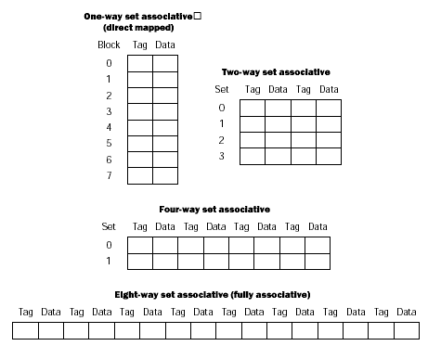
Decreasing miss ratio with associativety

Slide 27
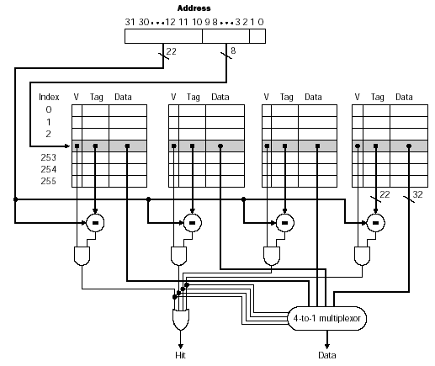
An implementation
Costs:
extra comparators and mux
extra tag and valid bits
delay imposed by having
to do the compare and the
muxing
set
4-way set associative cache
Notes:
The cost of comparators makes large fully associative caches impractical !!

Slide 28
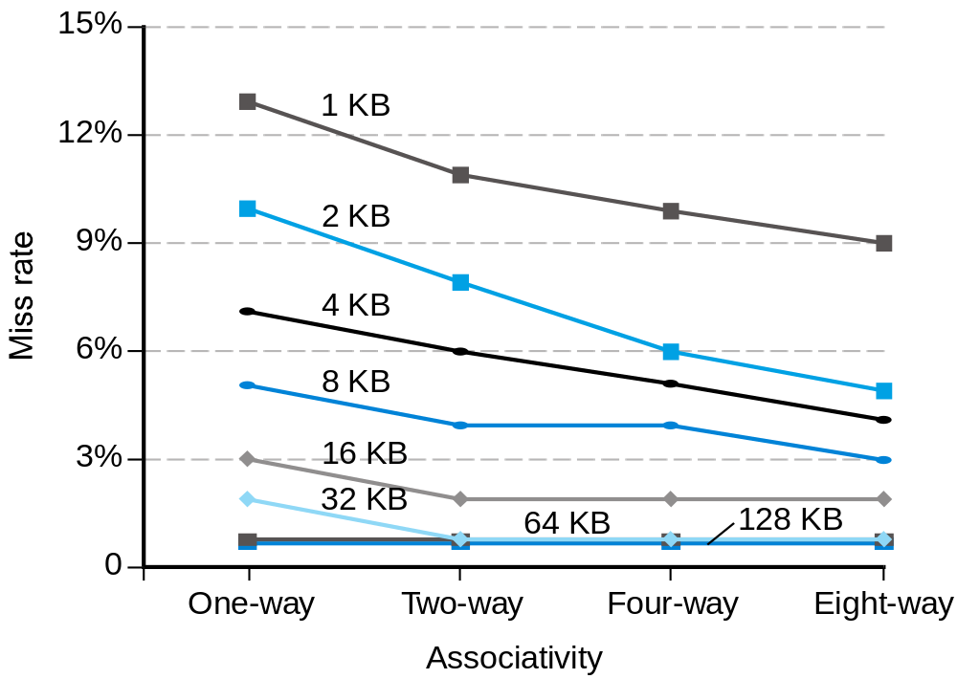
Choosing cache types

Slide 29
Example: misses and associativety
Assume 3 small caches, each consisting of four one-word blocks. One cache is fully associative, a second two-way set associative, and the third is direct mapped.
Find the number of misses for each cache given the following sequence of block addresses: 0,8,0,6,8. Assume LRU replacement policy
  Direct mapped
    0 modulo 4 = 0
    8 modulo 4 = 0
    6 modulo 4 = 2
5 miss for
5 accesses
address | Hit or miss | Content of cache blocks
 |  | 0 | 1 | 2 | 3
0 | miss | Mem[0]
8 | miss | Mem[8]
0 | miss | Mem[0]
6 | miss | Mem[0] |  | Mem[6]
8 | miss | Mem[8] |  | Mem[6]

Slide 30
Example: misses and associativety
  Two-way set associative
    0 modulo 2 = 0
    8 modulo 2 = 0
    6 modulo 2 = 0
  Full associative
4 miss
1 hit
address | Hit or miss | Content of cache blocks
 |  | Set 0 | Set 0 | Set 1 | Set 1
0 | miss | Mem[0]
8 | miss | Mem[0] | Mem[8]
0 | hit | Mem[0] | Mem[8]
6 | miss | Mem[0] | Mem[6]
8 | miss | Mem[8] | Mem[6]
3 miss, 2 hit
address | Hit or miss | Content of cache blocks
 |  | 0 | 1 | 2 | 3
0 | miss | Mem[0]
8 | miss | Mem[0] | Mem[8]
0 | hit | Mem[0] | Mem[8]
6 | miss | Mem[0] | Mem[8] | Mem[6]
8 | hit | Mem[0] | Mem[8] | Mem[6]

Slide 31
Reducing miss penalty with multi-level caches
Add a second level cache:
  usually primary cache is on the same chip as the processor
  use SRAMs to add another cache above main memory (DRAM)
  miss penalty goes down if data is in 2nd level cache rather then main memory
Using multilevel caches:
  Focus on minimizing the hit time on the 1st level cache
  Focus on minimizing the miss rate on the 2nd level cache
Primary cache often uses a smaller block size (access time is more critical)
Secondary cache, is often 10 or more times larger than the primary

Slide 32
Example: performance of multilevel caches
System A
  CPU with base CPI = 1.0
  Clock rate 5 GHz ( Tclock = 0.2 ns)
  Main-Memory access time 100 ns
  Miss rate per instruction in Cache-1 is 2%
System B
  Let’s add Cache-2
    reduce the miss rate to Main-Memory to 0.5%
  Cache-2 access time 5ns
How faster is System B ?

Slide 33
Cache complexities
Not always easy to understand implications of caches:
1
2
0
0
2
0
0
0
1
0
0
0
R
a
d
i
x
s
o
r
t
R
a
d
i
x
s
o
r
t
1
6
0
0
8
0
0
1
2
0
0
instructions / item
clock cycles / item
6
0
0
4
0
0
8
0
0
2
0
0
Q
u
i
c
k
s
o
r
t
4
0
0
Q
u
i
c
k
s
o
r
t
0
0
4
8
1
6
3
2
6
4
1
2
8
2
5
6
5
1
2
1
0
2
4
2
0
4
8
4
0
9
6
4
8
1
6
3
2
6
4
1
2
8
2
5
6
5
1
2
1
0
2
4
2
0
4
8
4
0
9
6
S
i
z
e
(
K
i
t
e
m
s
t
o
s
o
r
t
)
S
i
z
e
(
K
i
t
e
m
s
t
o
s
o
r
t
)
Theoretical behavior of
Radix sort vs. Quicksort
Observed behavior of
Radix sort vs. Quicksort

Slide 34
Cache complexities
Here is why:
Memory system performance is often critical factor
  multilevel caches, pipelined processors, make it harder to predict outcomes
  Compiler optimizations to increase locality sometimes hurt ILP
Difficult to predict best algorithm: need experimental data
5
R
a
d
i
x
s
o
r
t
4
3
cache misses / item
2
1
Q
u
i
c
k
s
o
r
t
0
4
8
1
6
3
2
6
4
1
2
8
2
5
6
5
1
2
1
0
2
4
2
0
4
8
4
0
9
6
S
i
z
e
(
K
i
t
e
m
s
t
o
s
o
r
t
)

