Slide 1

Covid-19 Case Predictions Using Regression Models
Avik Ghosh

Slide 2
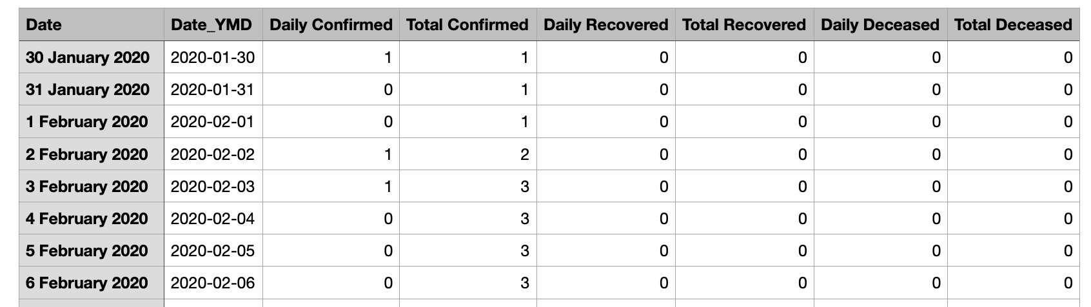
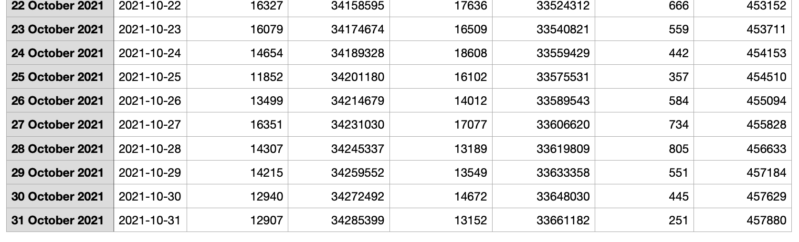
Used Dataset
Covid 19 cases over time in India: https://data.covid19india.org/csv/latest/case_time_series.csv
Data from 30th Jan, 2020 to 31st Oct, 2021.

Slide 3
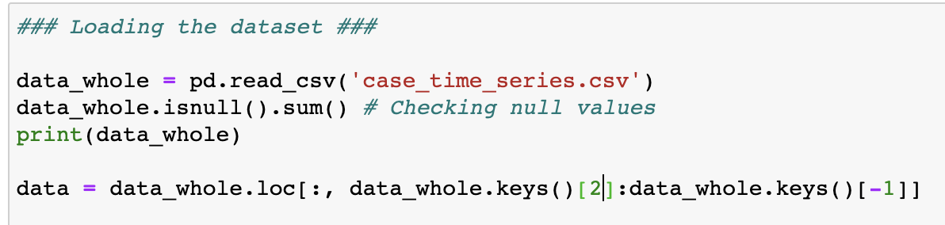
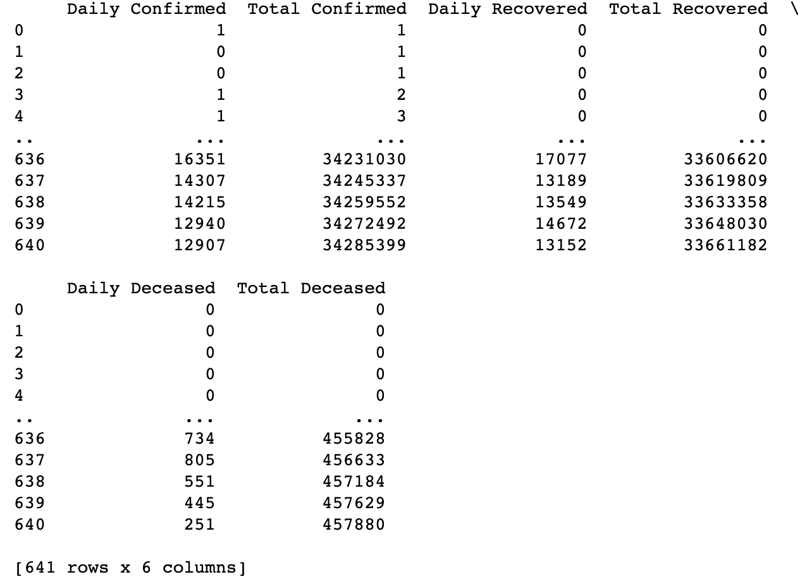
Data Clean-up
The dataset didn’t have any null values or discrepancies.
Made sure all the rows were in order.
2 columns of non numerical information (Date and Date_YMD). Therefore, dropped them before training.

Slide 4
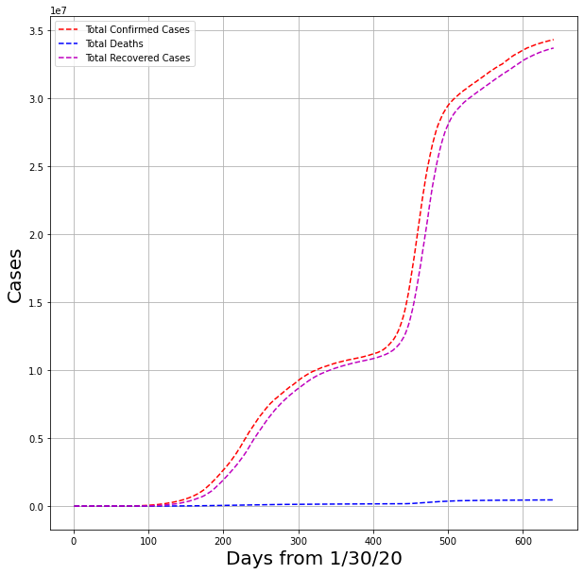
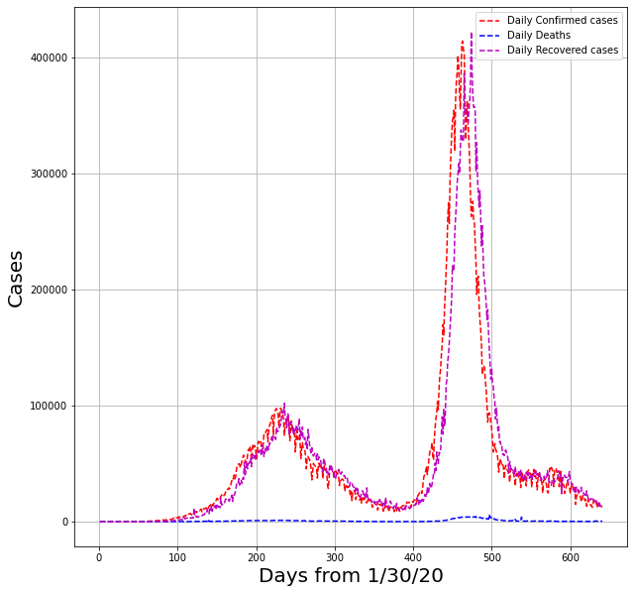
Data Visualisation
Left plot: Time evolution of total confirmed, total recovered and total deceased cases.
Right plot: Time evolution of daily confirmed, daily recovered and daily deceased cases.

Slide 5
Goal in Mind
Train a regression model and use that model to predict confirmed cases, recovered cases etc.
Try different Regression models and find out which one gives the best accuracy for this dataset.
Try different train-test split to find out which split gives best predictions.

Slide 6
Models Used
Linear Regression : It assumes a linear relationship between the dependent variable and the independent variable(s) and looks for the best fit line.
Polynomial Regression : Assumes a polynomial relationship between the dependent variable and the independent variable(s) and looks for the best fit curve.
For this project I only used Linear Regression and Polynomial Regression of 2nd order.
Due to extreme overfitting 3rd order polynomial regression and decision tree regression models were discarded.

Slide 7
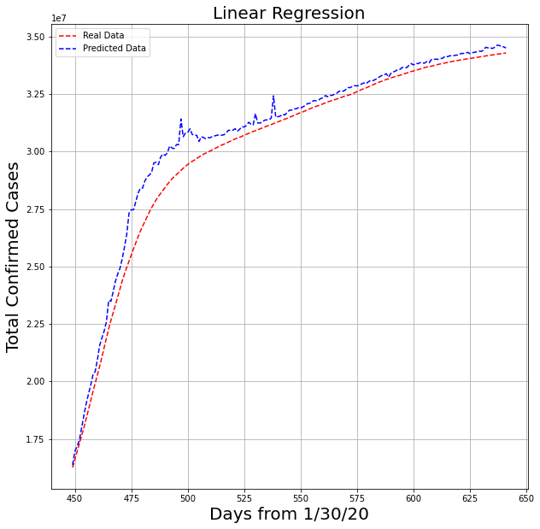
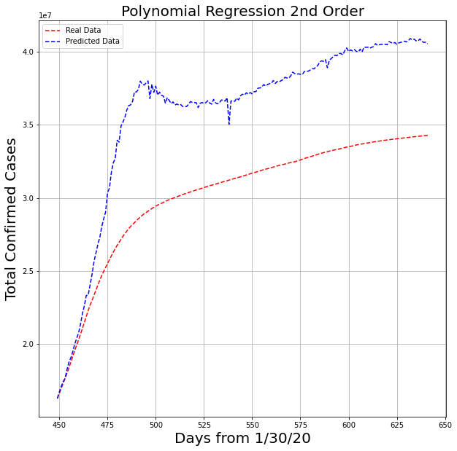
Predicting Total Confirmed Cases
70 percent training data, 30 percent test data
R2 Score for LR : 0.9695
R2 Score for PR : -0.9739

Slide 8
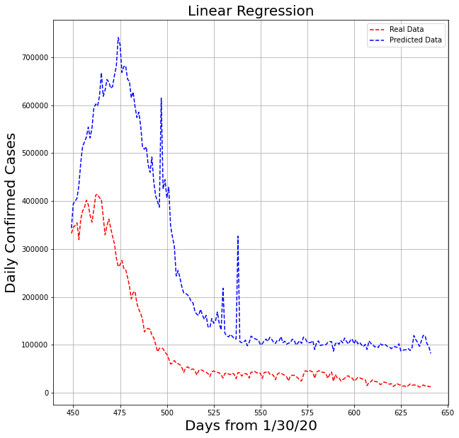
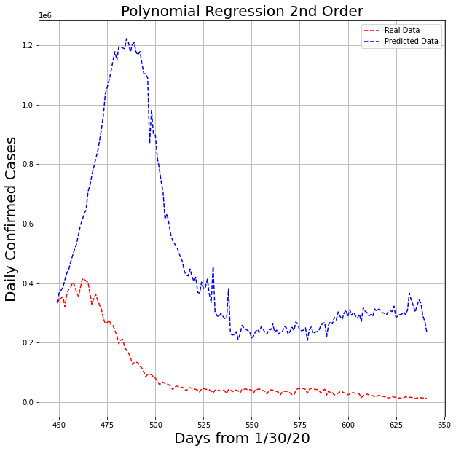
Predicting Daily Confirmed Cases
70 percent training data, 30 percent test data
R2 Score for LR : -1.617
R2 Score for PR : -14.58

Slide 9
Identifying Problems
Very unfortunate (negative!!) R2 scores when predicting Daily Confirmed Cases.
Polynomial regression is way off with predictions while linear regression performs well.
The Dataset might be too simple and only has few features leading to overfitting issue.
Solution : Reducing the amount of training data might be useful.

Slide 10
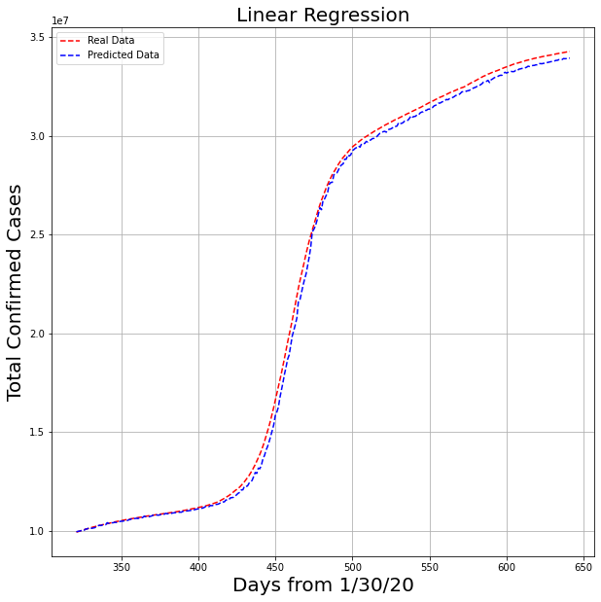
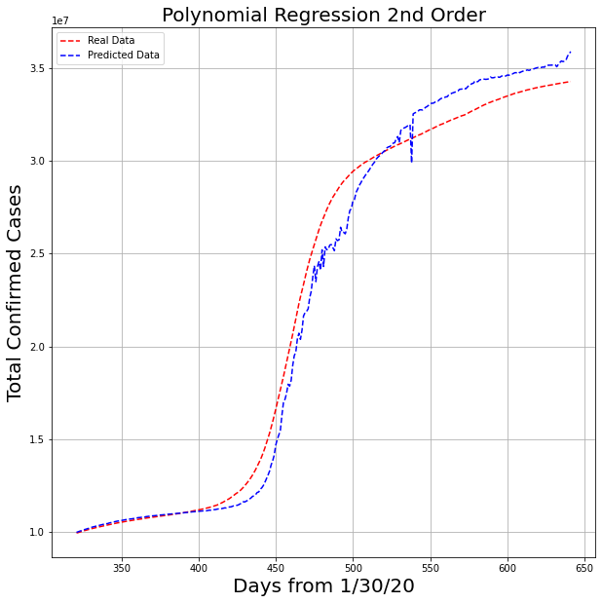
Predicting Total Confirmed Cases (again)
50 percent training data, 50 percent test data
R2 Score for LR : 0.9986
R2 Score for PR : 0.9849

Slide 11
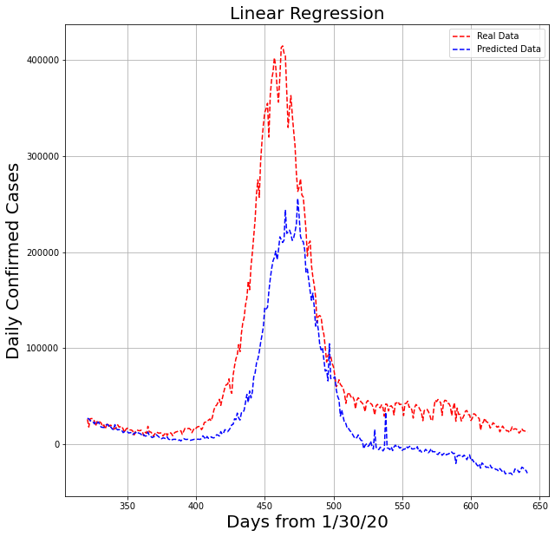
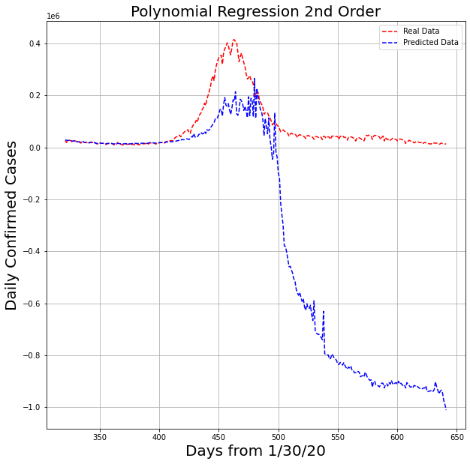
Predicting Daily Confirmed Cases (again)
50 percent training data, 50 percent test data
R2 Score for LR : 0.5821
R2 Score for PR : -30.16

Slide 12
Identifying Problems (again)
With 0.5 test split we get better accuracy in polynomial regression than before while predicting total confirmed cases.
For predicting daily confirmed cases polynomial regression behavior is way off again.
Solution : Use Linear Progression only while predicting Daily cases.

Slide 13
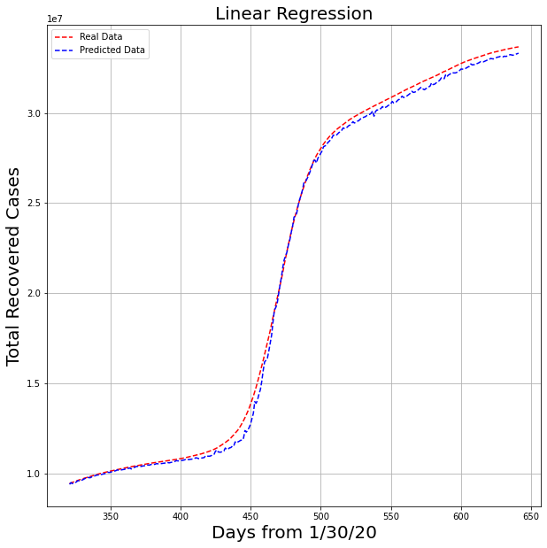
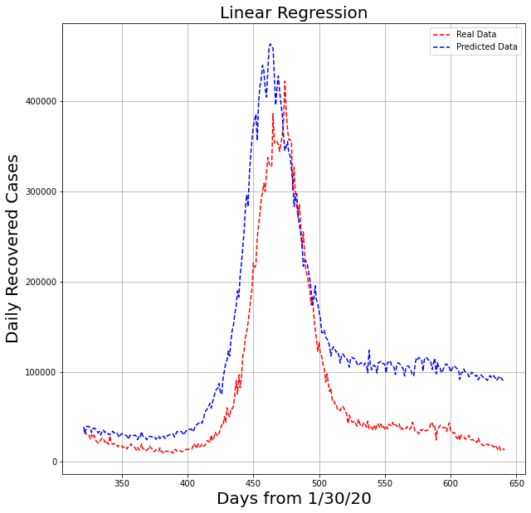
Predicting Recovered Cases
50 percent training data, 50 percent test data
R2 Score for Total Recovered Cases (LR) : 0.9987
R2 Score for Daily Recovered Cases (LR) : 0.5827

Slide 14
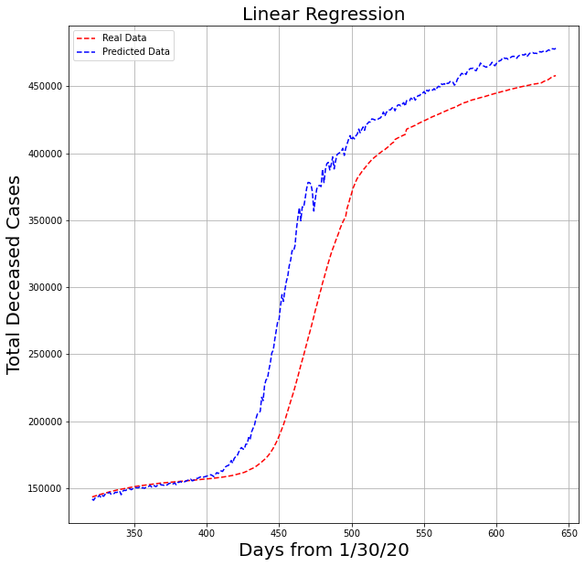
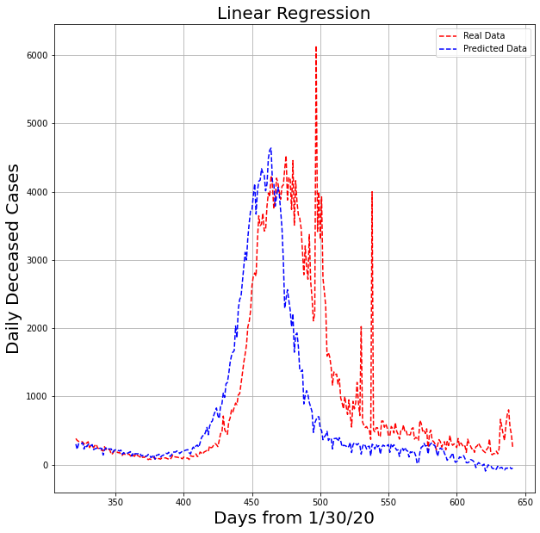
Predicting Deceased Cases
50 percent training data, 50 percent test data
R2 Score for Total Deceased Cases (LR) : 0.8968
R2 Score for Daily Deceased Cases (LR) : 0.5198

Slide 15
R2 Score Table
Model | Test Split | Total Confirmed | Daily Confirmed | Total Recovered | Daily Recovered | Total Deceased | Daily Deceased
Linear | 0.5 | 0.9986 | 0.5821 | 0.9987 | 0.5827 | 0.8968 | 0.5198
Poly | 0.5 | 0.9849 | -30.1617 | -0.2118 | -99.0301 | 0.8917 | -74.8444
Linear | 0.3 | 0.9695 | -1.6168 | 0.9916 | 0.5233 | 0.7309 | 0.4477
Poly | 0.3 | -0.9739 | -14.5789 | -3.2132 | -120.2154 | -1.5914 | -5.2335
Linear | 0.1 | 0.9764 | -0.1243 | 0.9889 | -0.1104 | 0.2692 | -4.7512
Poly | 0.1 | 0.9269 | -11.1504 | 0.9851 | -0.1126 | -1.2879 | -4.0954

Slide 16

Conclusion
Best Model for this dataset : Linear Regression With Test Split 0.5
Linear Regression and Polynomial Regression both worked for predicting:
Total Recovered Cases with 0.1 Split
Total Confirmed Cases with 0.5 Split
Total Confirmed Cases with 0.1 Split
Total Deceased Cases with 0.5 Split
With the best model found from this study we can predict future data if we are given the required feature values.

Slide 17
Future Work
Working with a more complex dataset and try other regression models like higher order polynomial regression, decision tree regression etc.
Predict future cases (i.e. beyond 31st October, 2021) and compare with real data to see how the model performs.

Slide 18
Thank You

Slide 19

Extra Slides

Slide 20
Test Split 0.1
Results

Slide 21
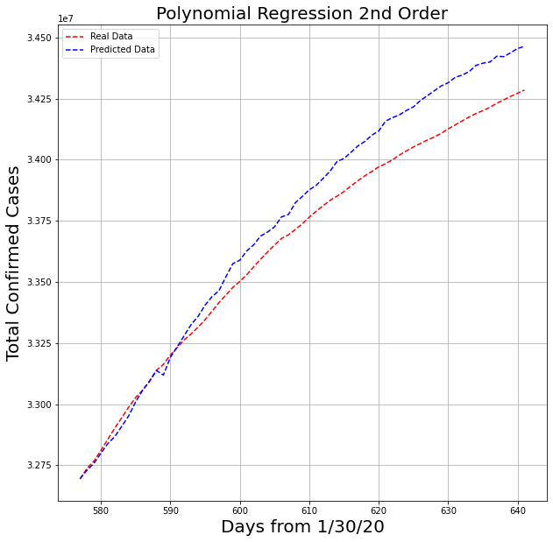
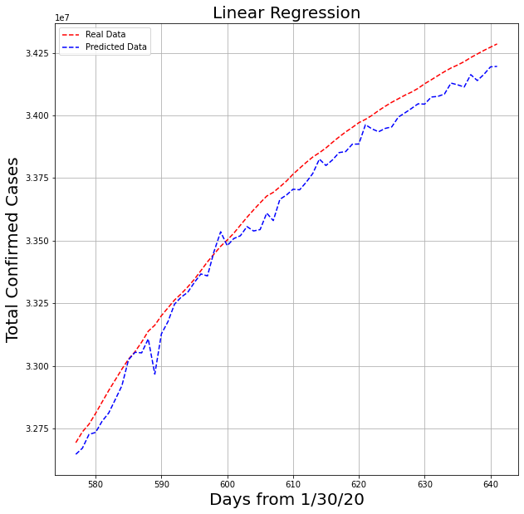
Total Confirmed Case Prediction

Slide 22
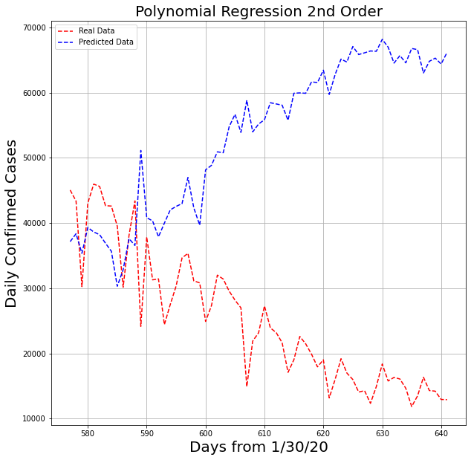
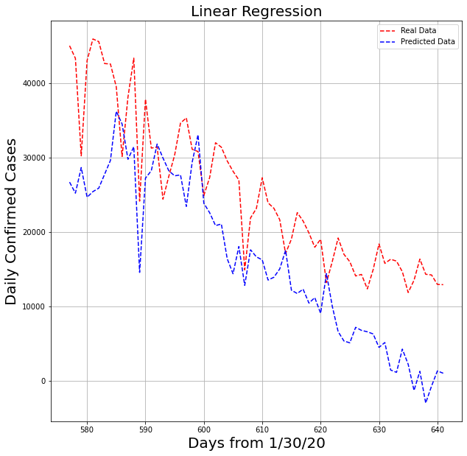
Daily Confirmed Case Prediction

Slide 23
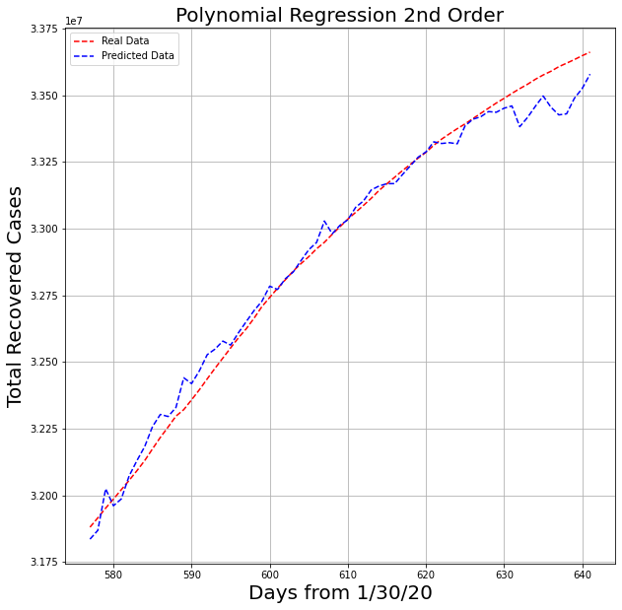
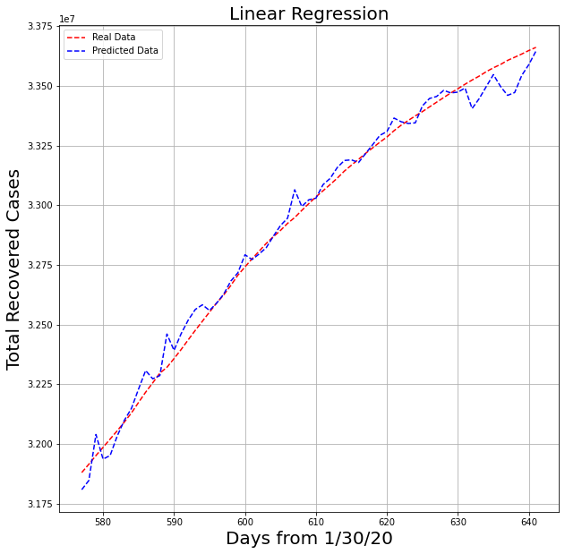
Total Recovered Case Prediction

Slide 24
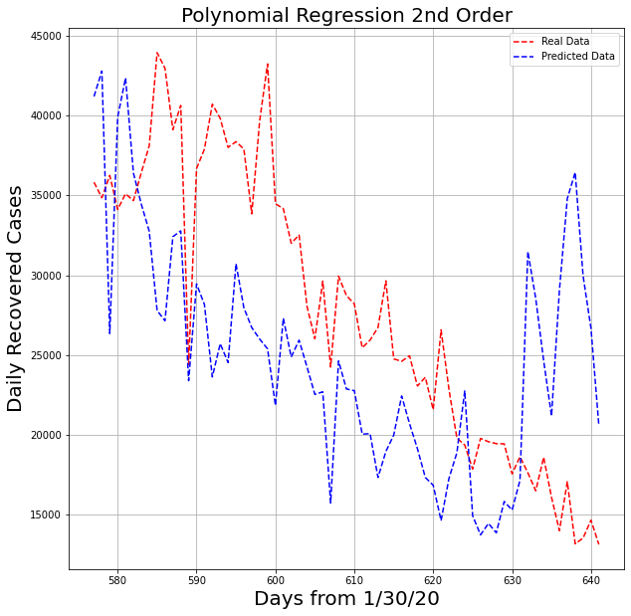
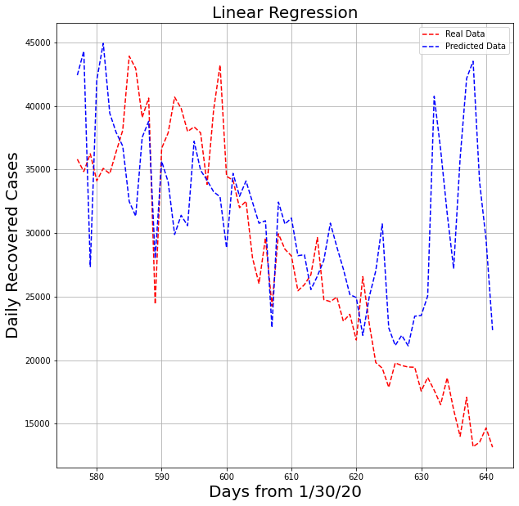
Daily Recovered Case Prediction

Slide 25
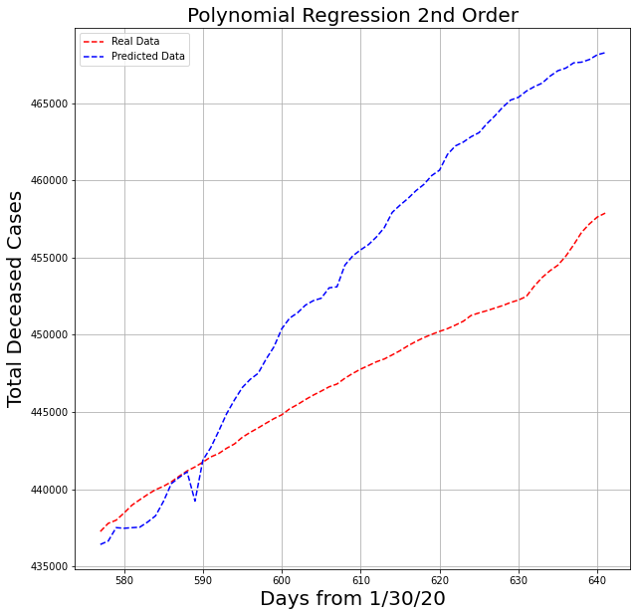
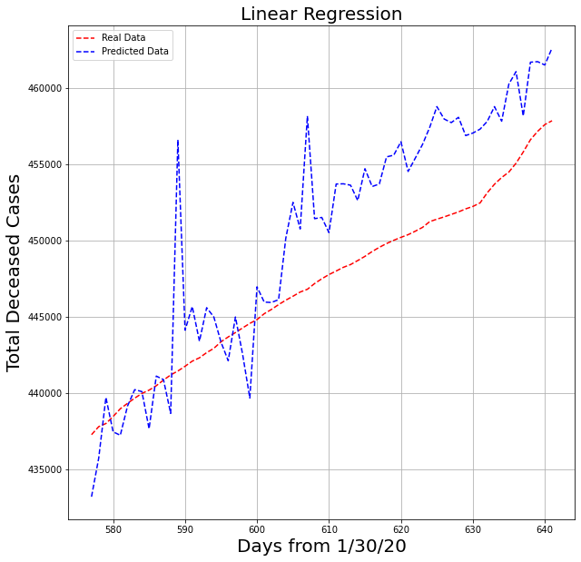
Total Deceased Case Prediction

Slide 26
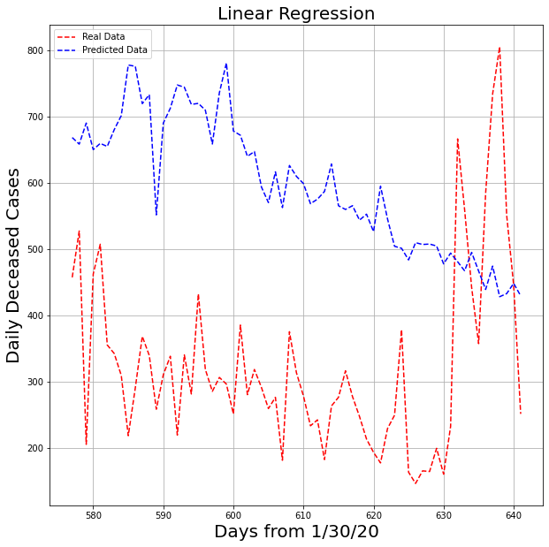
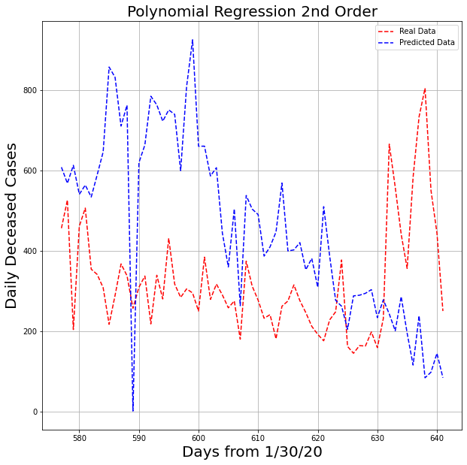
Daily Deceased Case Prediction

Slide 27
Test Split 0.3
Results

Slide 28
Total Confirmed Case Prediction

Slide 29
Daily Confirmed Case Prediction

Slide 30
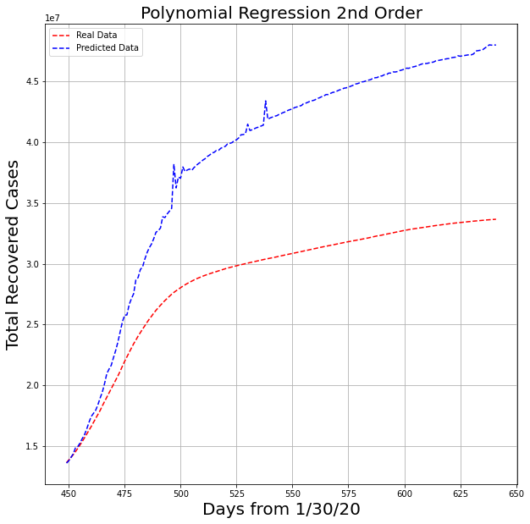
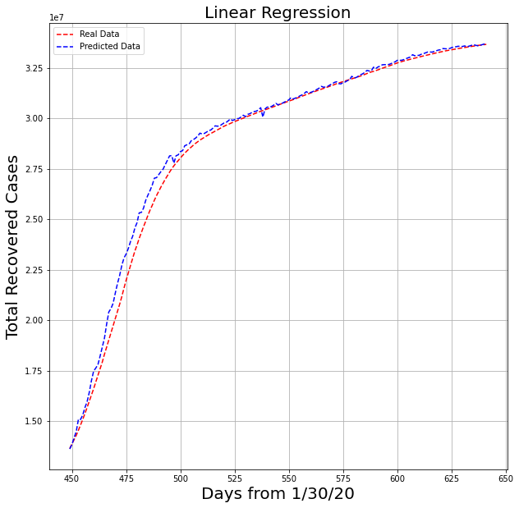
Total Recovered Case Prediction

Slide 31
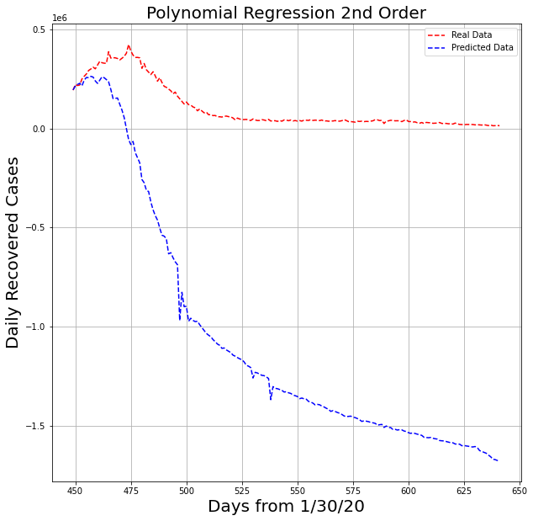
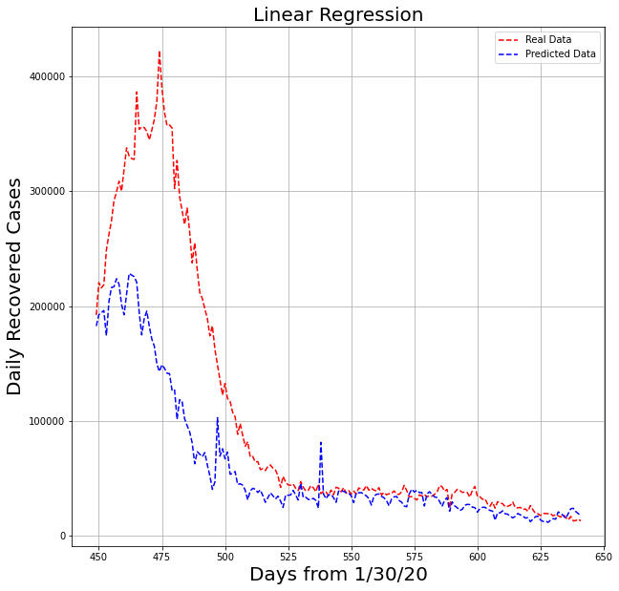
Daily Recovered Case Prediction

Slide 32
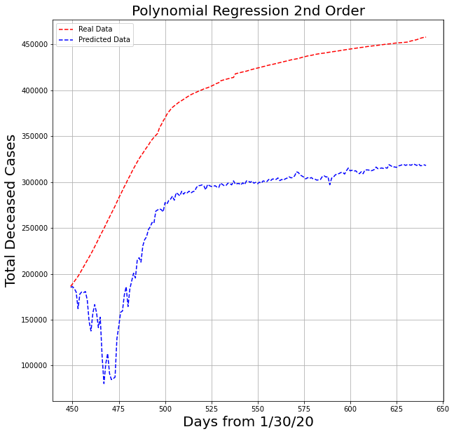
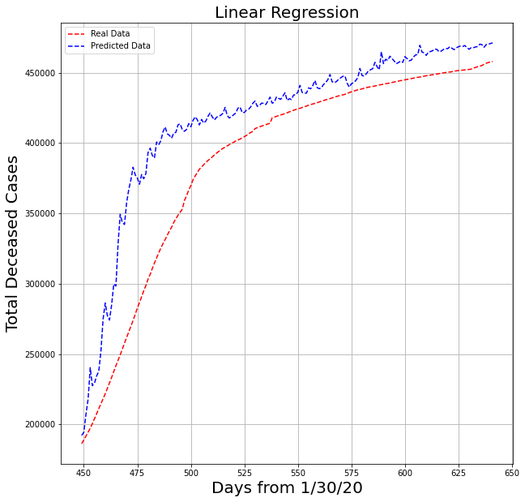
Total Deceased Case Prediction

Slide 33
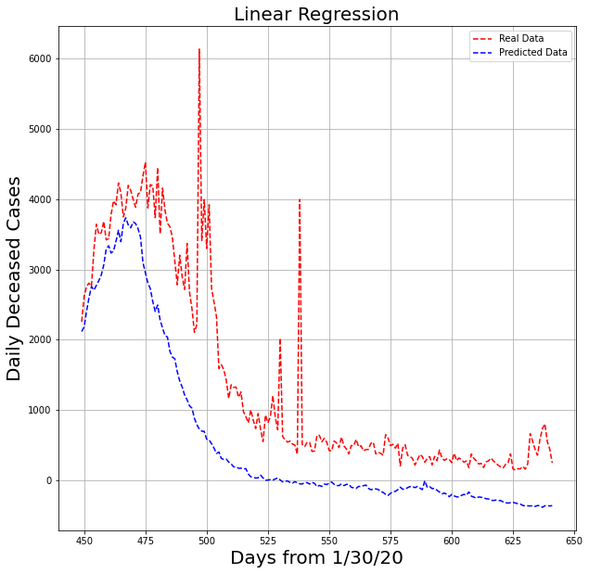
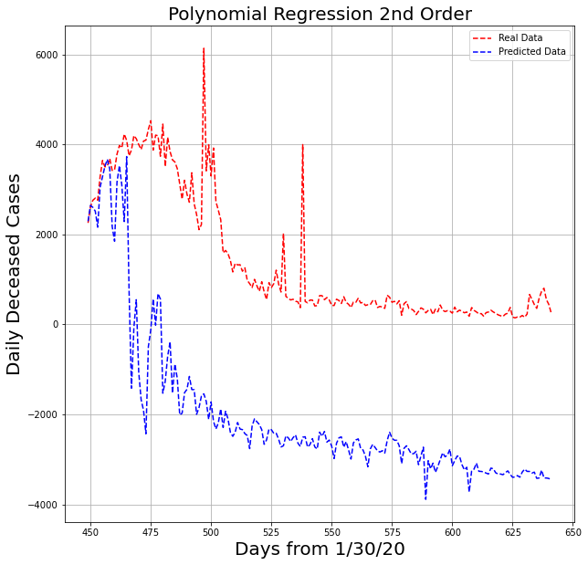
Daily Deceased Case Prediction

Slide 34
Test Split 0.5
Results

Slide 35
Total Confirmed Case Prediction

Slide 36
Daily Confirmed Case Prediction

Slide 37
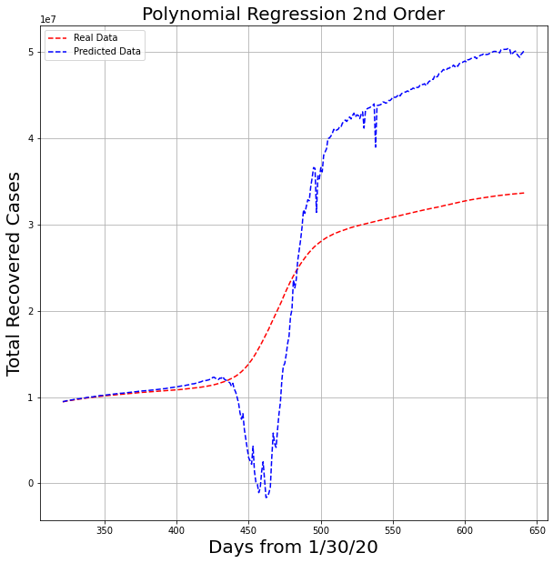
Total Recovered Case Prediction

Slide 38
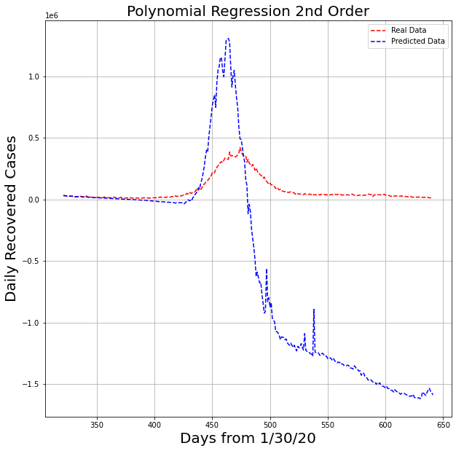
Daily Recovered Case Prediction

Slide 39
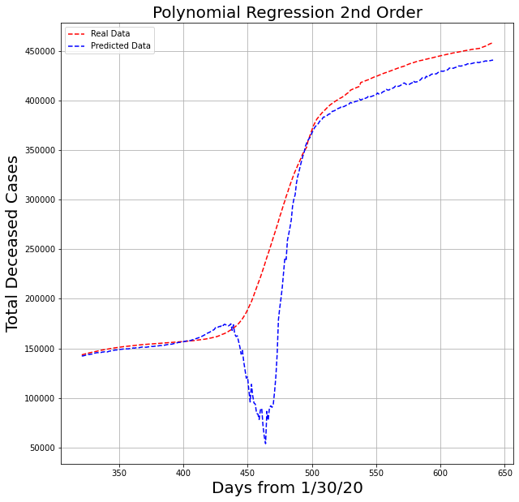
Total Deceased Case Prediction

Slide 40
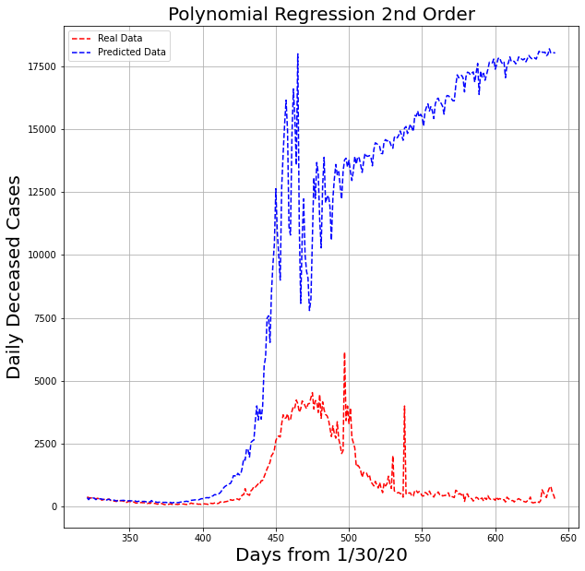
Daily Deceased Case Prediction

