Slide 1

PROBLEM STATEMENT
USE CASES ADDRESSED :
Trend-Demand forecasting
Engagement on a shopping platform
TITLE:
Revolutionizing Fast Fashion for Gen Z: Real-Time Trend Forecasting and Dynamic User Engagement
PROBLEM STATEMENT :
The fast fashion sector has two major problems: first, keeping the attention of demanding millennials and second, correctly predicting fleeting trends to prevent stockouts and overproduction. Particularly among Generation Z, the goal should go beyond mere retail therapy: creating lively, interactive spaces that bring people together via shared interests in style. Due to their dependence on out-of-date data, traditional demand forecasting approaches fall short of fulfilling these demands, resulting in lost opportunities and decreased profitability.

Slide 2
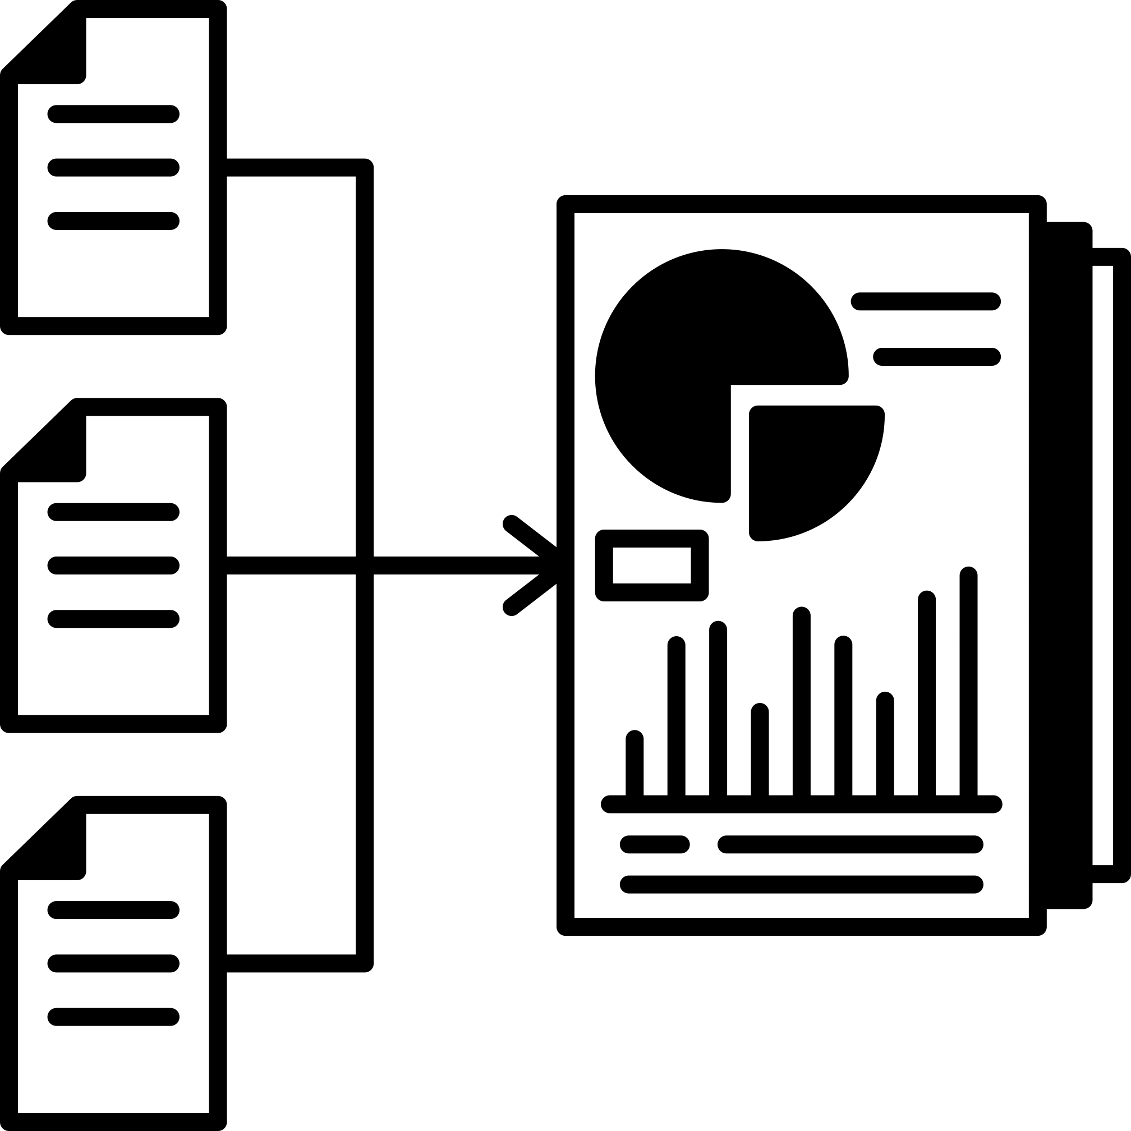

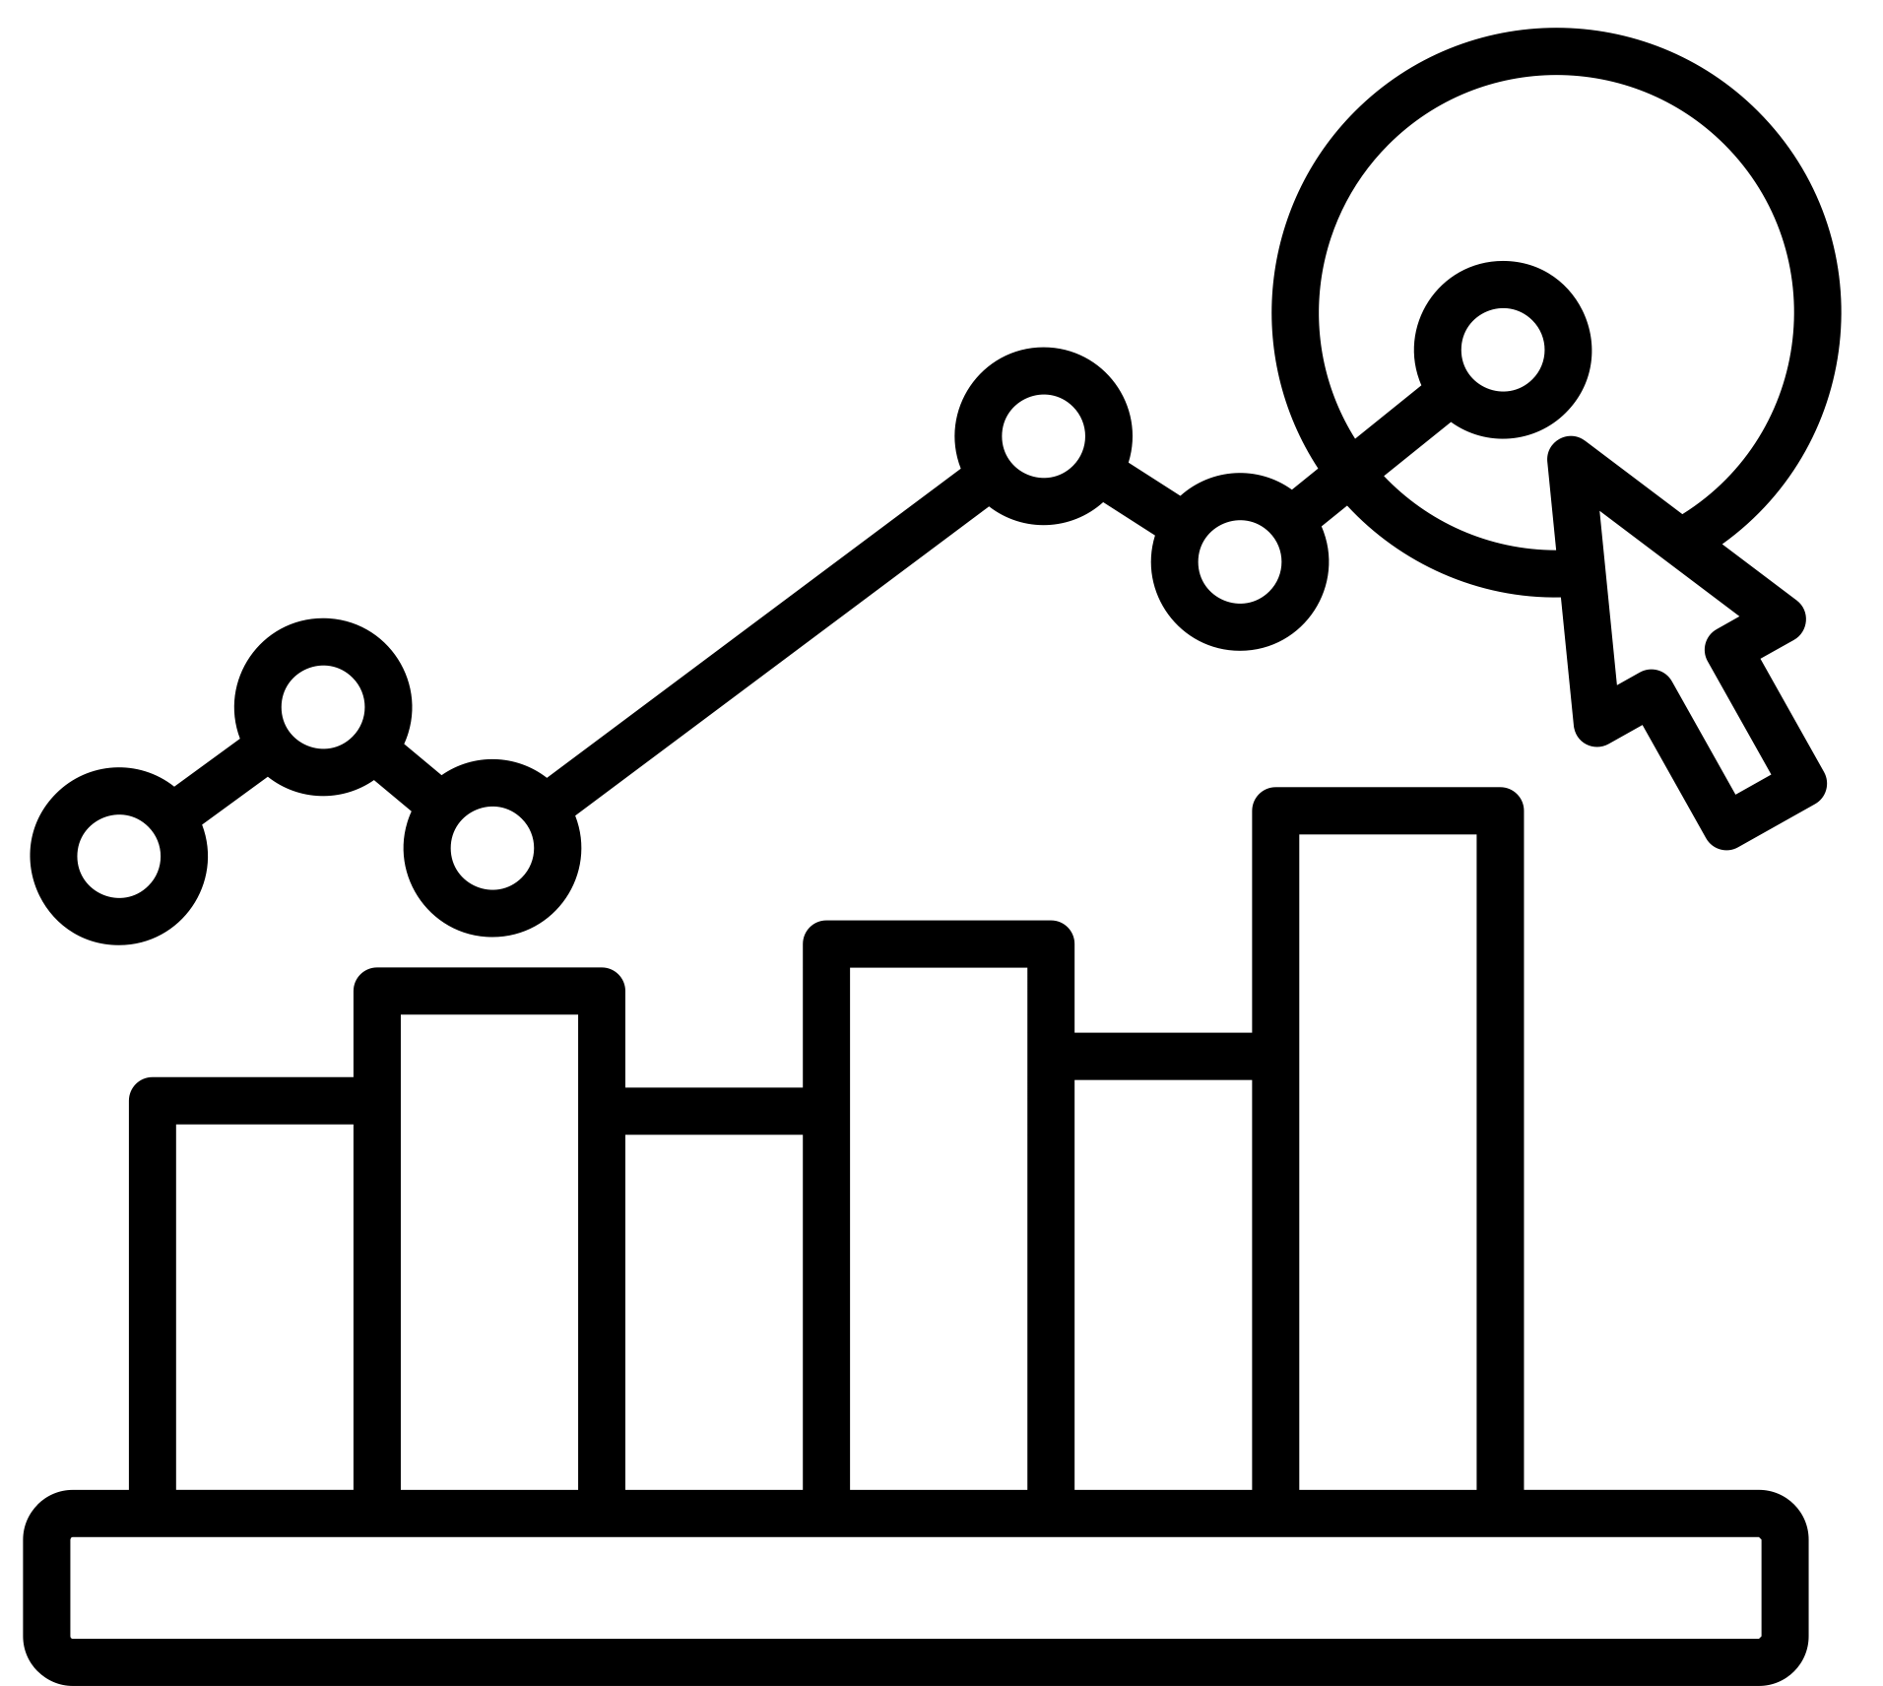

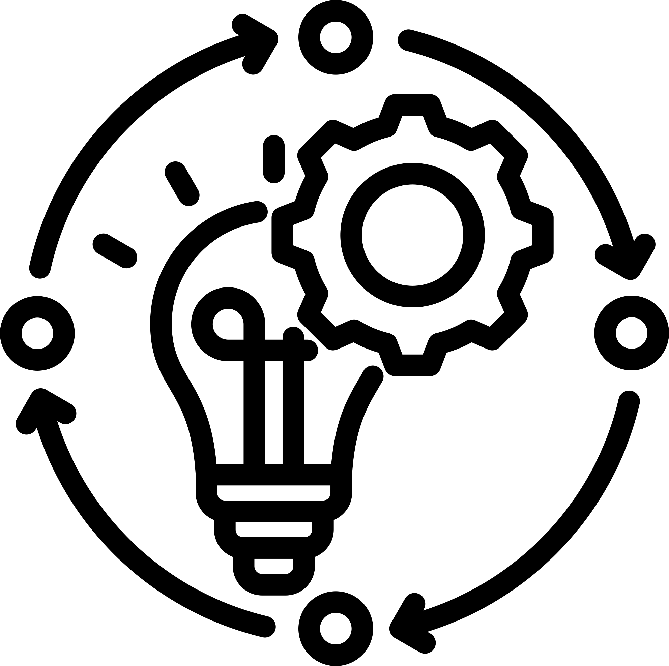

OBJECTIVES
1.Integrate Real-Time Data Sources
3.Optimize Inventory Management
2.Enhance Predictive Analytics Capabilities
4.Measure and Improve Engagement Metrics
6.Continuous Innovation and Adaptation
5.Drive Virality and User-Generated Content (UGC)

Slide 3

SOLUTION
1. Integrate Real-Time Data Sources:
Develop a robust real-time data integration system to gather and analyze information from trend predicting organizations, fashion blogs, social media platforms (e.g., Instagram, Facebook), and e-commerce websites.
Implementation Steps:
1.⁠ ⁠Use API Integrations and Web Scraping Tools to Gather Real-Time Data
2.⁠ ⁠Employ Data Pipelines and ETL Processes to Clean and Harmonize Data
3.⁠ ⁠Utilize Cloud-Based Storage and Processing Solutions
2. Enhance Predictive Analytics Capabilities:
Develop advanced machine learning models and algorithms to predict short-term fashion trends accurately.
Implementation Steps:
1.⁠ ⁠Utilize Supervised Learning Techniques
2.⁠ ⁠Implement Time Series Forecasting Models
3.⁠ ⁠Integrate Natural Language Processing (NLP)
3. Optimize Inventory Management:
Utilize accurate demand forecasts to optimize inventory levels and reduce overproduction and stockouts.
Implementation Steps:
1. Integrate Demand Forecasting Outputs into Inventory Management Systems
2. Implement Dynamic Pricing Strategies and Markdown Optimization
3. Establish Agile Supply Chain Processes

Slide 4
SOLUTION
4. Measure and Improve Engagement Metrics :
Implement a comprehensive analytics framework to monitor and optimize user engagement metrics.
Implementation Steps:
1. Define Key Performance Indicators (KPIs)
2. Utilize Analytics Tools
3. Conduct User Surveys
4. Continuous Monitoring and Optimization
5.⁠Drive Virality and User-Generated Content (UGC):
Foster a community-driven environment through viral marketing campaigns and user-generated content initiatives.
Implementation Steps:
1. Launch Interactive UGC Campaigns
2. Integrate Social Sharing Features
3. Collaborate with Fashion Influencers
6.Continuous Innovation and Adaptation
Foster a culture of innovation and agility to continuously evolve and meet changing consumer preferences.
Implementation Steps:
1. Establish Cross-Functional Teams
2. Gather Customer Feedback and Market Insights
3. Experiment with New Technologies and Features

Slide 5

BENEFITS
Enhanced Customer Insights : With access to consumer data in real-time, personalized marketing strategies and product recommendations are made possible.
Behavioural Analysis : Analyzing consumer behavior can help with focused marketing and client retention by revealing their preferences and habits.
⁠Data-driven insights : With data-driven insights, we may set competitive prices by analyzing competition data and responding to changes in demand.
Eliminating Excess Inventory and Stockouts : By enhancing inventory forecasting, we can reduce surplus inventory and guarantee that popular items remain regularly in stock.
⁠Sustainable Practices : Maintain an appropriate stock level in relation to actual demand; this will help cut down on waste and environmental damage.
⁠Increased Customer Loyalty : Invest in Your relationships by motivating consumers to talk about their experiences and fashion choices; this will increase the visibility of your business by building a social proof effect.
Increased Brand Visibility : Keep ahead of the competition and maintain your position as market leader by constantly improving your products, services, and customer experiences using data that is recorded in real-time.
Market Leadership : Maintain relevance and drive sustainable development by swiftly adapting to shifting consumer tastes and market trends.
Adaptability : Look for patterns in consumer behavior that can point to untapped markets for your products or services.
Improved Trend Forecasting : The ability to see new patterns more quickly because to real-time data makes trend forecasting better, which in turn lowers the likelihood of stockouts and excess production.

