Slide 1
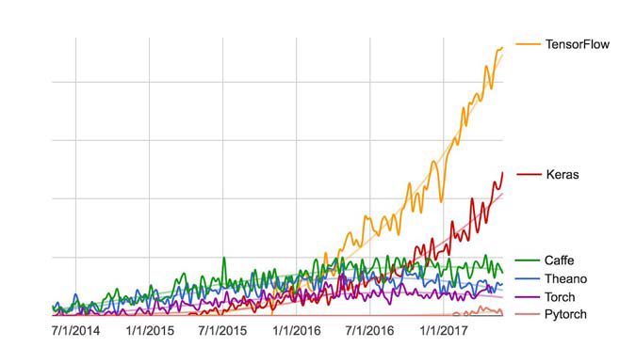
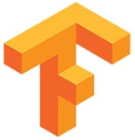
Deep learning space is exploding with new frameworks and platforms very rapidly
Frameworks are different programming languages and has its own way of communicating with the systems and optimizing the usage of hardware
Popularity of the frameworks depends on Open Source license, GPU support, approach of coding and obviously backend optimization resulting in better and faster computational capacity
TensorFlow and Keras has been most used framework for implementing deep learning algorithms
TensorFlow is an open source software library for high performance numerical computation.
Its flexible architecture allows easy deployment of computation across a variety of platforms (CPUs, GPUs, TPUs)
Originally developed by researchers and engineers from the Google Brain team within Google’s AI organization, it comes with strong support for deep learning and the flexible numerical computation

Slide 2
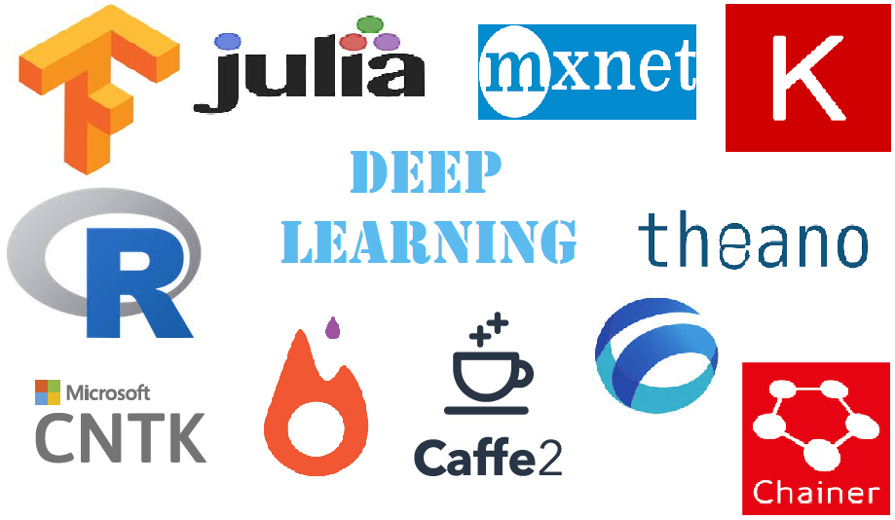
Keras is a high-level neural networks API, written in Python and capable of running on top of TensorFlow, CNTK, or Theano
Keras allows easy and fast prototyping through User friendliness, Modularity and Easy extensibility and Runs seamlessly on CPU and GPU.
Theano is a numerical computation library for Python.
In Theano, computations are expressed using a NumPy like syntax and compiled to run efficiently on either CPU or GPU architectures.
Theano is an open source project primarily developed by a machine learning group at the Université de Montréal
The Microsoft Cognitive Toolkit - previously known as CNTK, is a free, easy-to-use, open-source, commercial-grade toolkit that trains deep learning algorithms to learn like the human brain
It provides uncompromised scaling, speed, and accuracy with commercial-grade quality and compatibility with the programming languages and algorithms users already use.
Caffe is a deep learning framework developed with cleanliness, readability, modularity and speed
Written in C++, The Networks are specified in simple config files, with no hard-coded parameters in the code
Switching between CPU and GPU in Caffe is as simple as setting a flag
It is developed by Berkeley AI Research (BAIR) and by community contributors

Slide 3

PyTorch is an open source machine learning library for Python, based on Torch, used for applications such as natural language processing.
It is primarily developed by Facebook's artificial-intelligence research group, and Uber's "Pyro" software for probabilistic programming is built on it
Apache MXNet is a modern open-source deep learning framework used to train and deploy deep neural networks
It is scalable, allows fast model training and supports a flexible programming model and multiple languages
The MXNet library is portable and can scale to multiple GPUs and multiple machines.
MXNet is supported by major Public Cloud providers including AWS and Azure
H2O’s Deep Learning is based on a multi-layer feed-forward artificial neural network that is trained with stochastic gradient descent using back-propagation.
The network can contain a large number of hidden layers consisting of neurons with tanh, rectifier and maxout activation functions.
Advanced features such as adaptive learning rate, rate annealing, momentum training, dropout, L1 or L2 regularization, check pointing and grid search enable high predictive accuracy
Few other popular Deep learning platforms are : Apache Singa, Deeplearning4J, Chainer, ConvNetJs, Julia, BigDL, Torch etc.

Slide 4
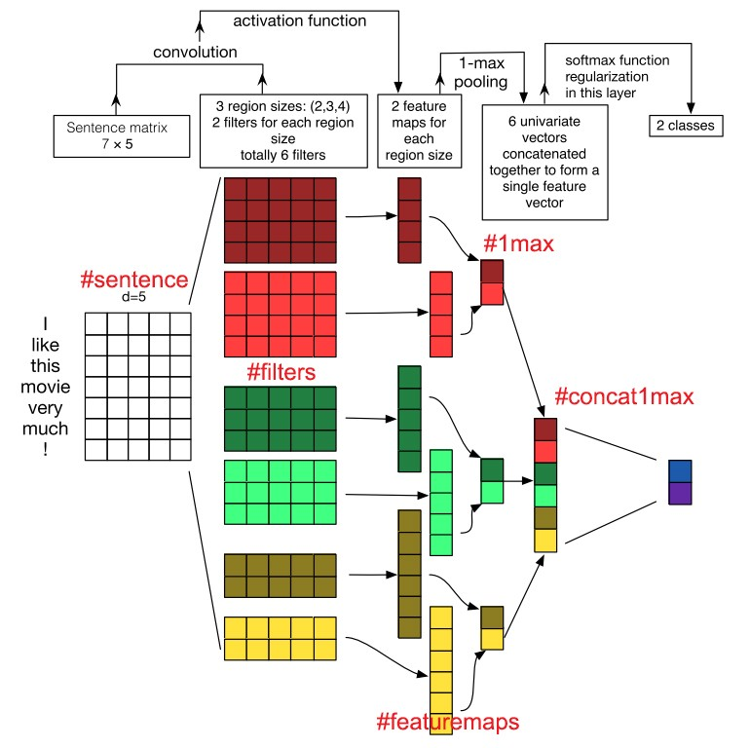
CNN preserves 2D spatial orientation in computer vision. Texts, like pictures, have a one-dimensional structure where words sequence matter.
CNN has been successful in various text classification tasks with little hyper parameter tuning
Lets use a one-layer CNN on a 7-word sentence, with word embedding of dimension 5, which will give 7*5 word vector matrix
One dimension of filter has been fixed to be 5 and the height has been varied to get different feature captured
Convolution operation gives 1D vectors for each filters
Max pooling extracts the largest of each feature vectors and concatenate them to form the final fully connected layer
This fixed length(fully-connected) vector can then be fed into a softmax activation to perform the classification

