Slide 1
CHAPTER 1 - The Human Body: An Orientation
Marieb: Anatomy and Physiology
AVIK NIGAM – MEDICAL STUDENT

Slide 2
Overview of Anatomy and Physiology
Anatomy = Structure
Physiology = Function
Topics of Anatomy
Gross (macroscopic)
Regional anatomy
Systemic anatomy
Surface anatomy
Microscopic
Cytology (cells)
Histology (tissues)
Developmental
Embryology
Topics of Physiology
Renal
Neuro
Cardiovascular

Slide 3
Complementarity of Structure & Function
Principle of complementarity of structure and function
Functional capabilities based on the structural limitations
E.g.
Bones support and protect body organs
Contain hard mineral deposits
Blood flows -> 1 way through heart
Valves to stop backflow

Slide 4
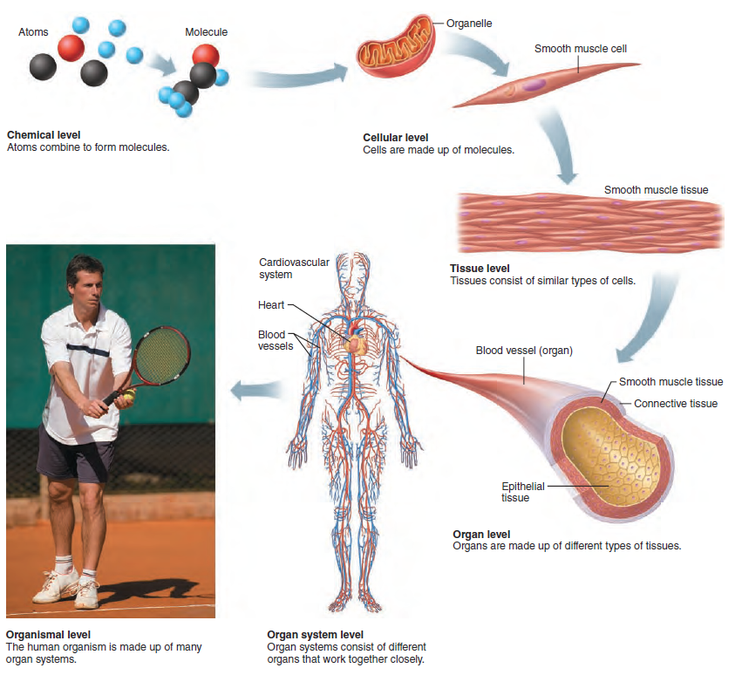
Levels of Structural Organisation
Chemical
Atoms -> molecules -> organelles
Cellular
Tissue
Epithelium, Muscle, CT and Nervous
Organ
Organ System
Organism

Slide 5
Systems of the Body
Integumentary
Skeletal
Muscular
Nervous
Endocrine
Cardiovascular
Lymphatic/Immune
Respiratory
Digestive
Urinary
Male Reproductive
Female Reproductive

Slide 6
Maintaining Life
Necessary Life Functions
Maintaining Boundaries
Movement
Responsiveness
Digestion
Metabolism
catabolism, anabolism & respiration
Excretion
Reproduction
Growth

Slide 7
Survival Needs
Nutrients
Oxygen
21% O₂ in air.
Water
60%-80% bm
Normal Body Temperature
37°C (98.6°F)
Normal Atmospheric Pressure

Slide 8
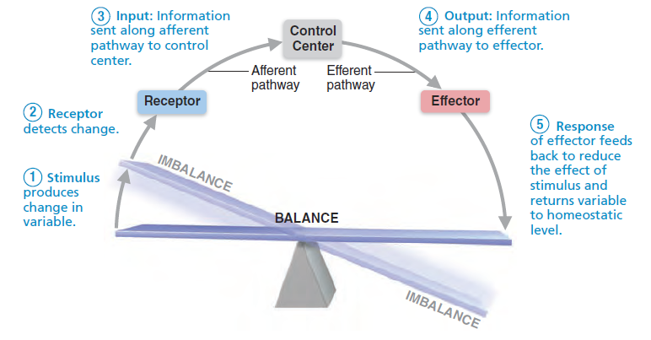
Homeostasis
Ability to maintain relatively stable internal conditions
Dynamic state of equilibrium

Slide 9
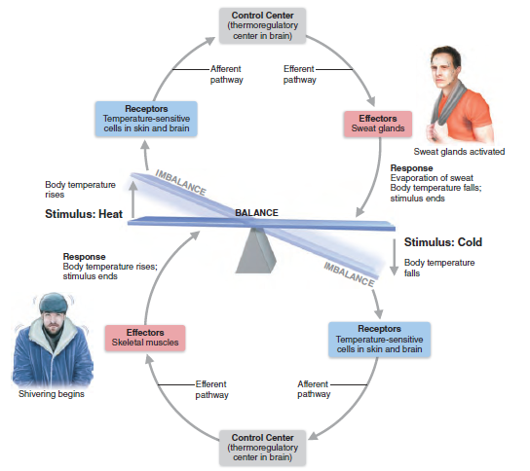
Negative Feedback Loops

Slide 10
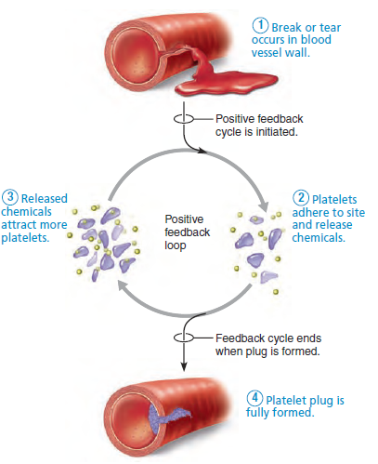
Positive Feedback Mechanism

Slide 11
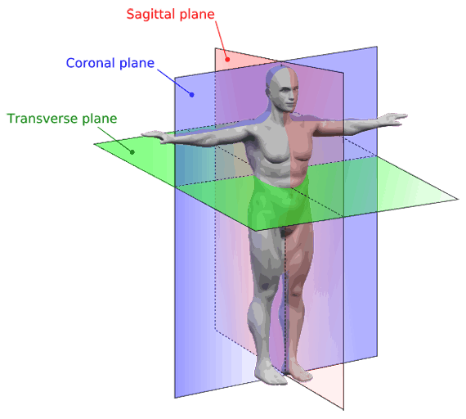
Anatomical Positions and Directions

Slide 12
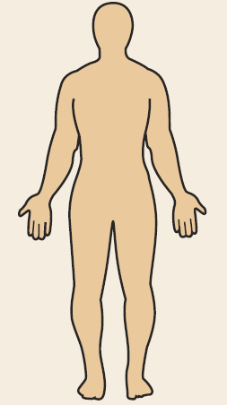
Anatomical Positions and Directions
Superior/Inferior
Anterior/Posterior
**Ventral/Dorsal**
Medial/Lateral
Proximal/Distal
Superficial/Deep
Abduction/Adduction
Supinate/Pronate

Slide 13
End of Chapter 1: Intro to Human Body
Make sure to SUBSCRIBE ☺
POST IN COMMENTS ON WHICH TEXTBOOK YOU USED FOR LEARNING 1st YEAR MED
+ WHICH COUNTRY YOU’RE FROM!

