Slide 1
social media user purchase predictions
Daniel Avila
cs5535 – Machine learning
Dr. Parry
December 3, 2020

Slide 2
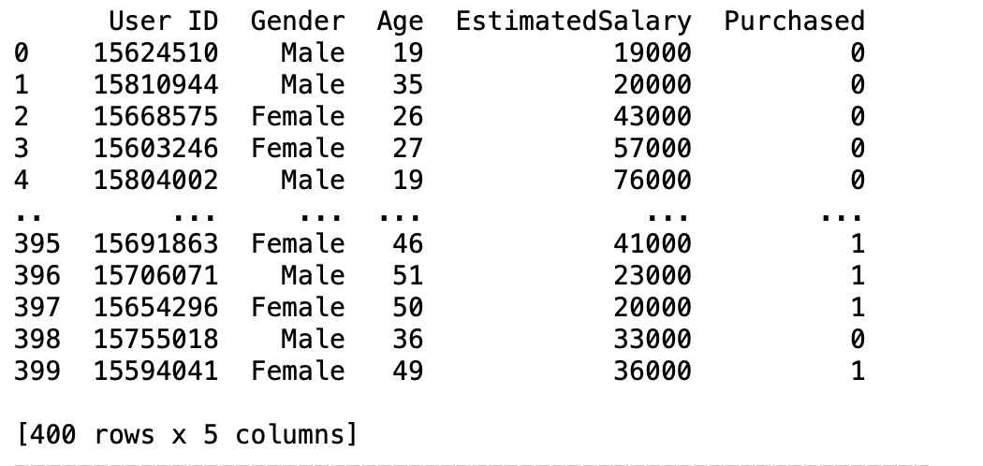
Data Description

Slide 3
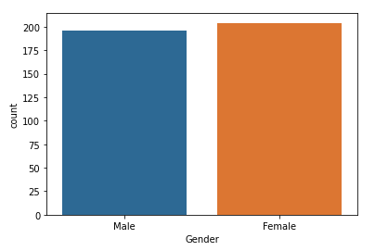
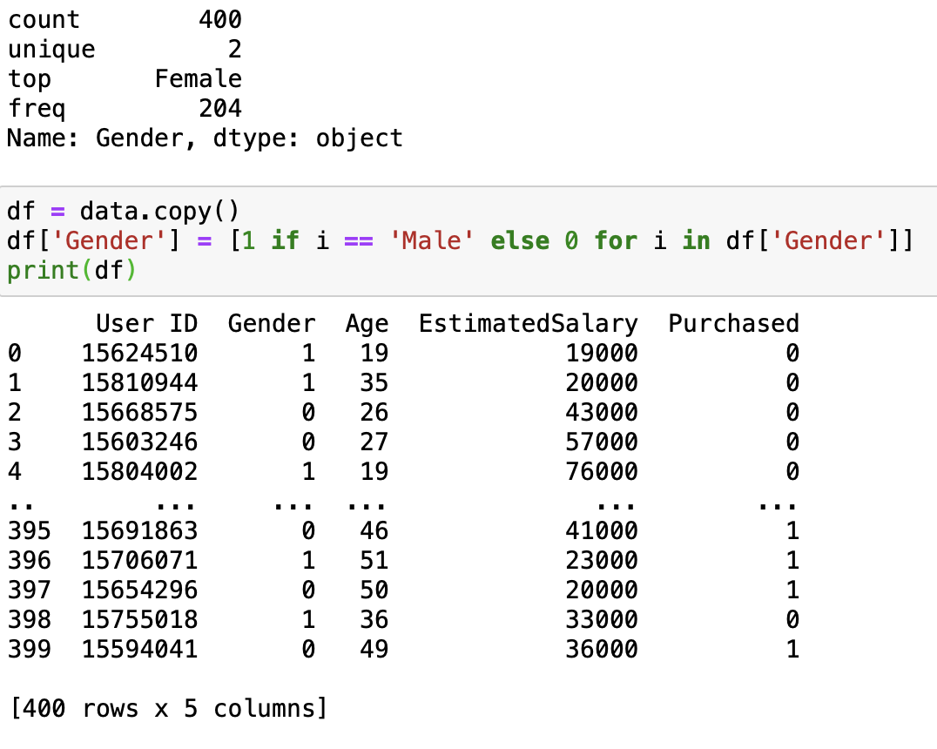
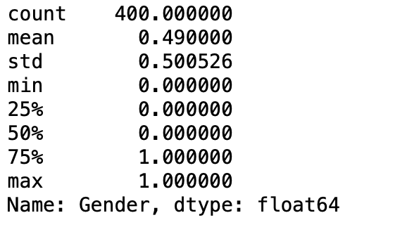
Gender
Data is fairly distributed between both female and male users

Slide 4
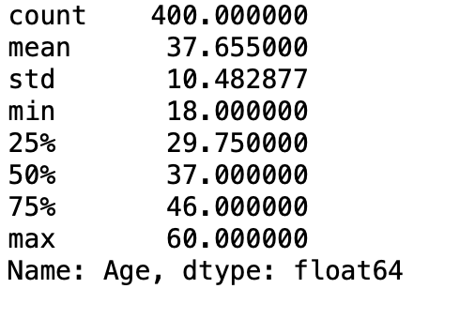
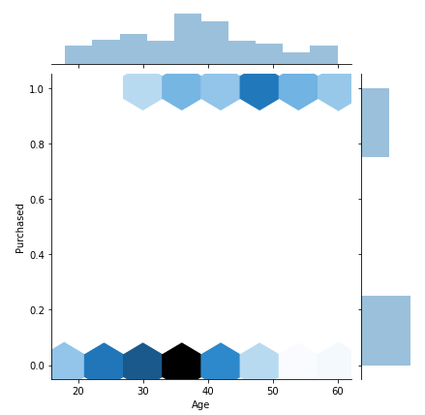
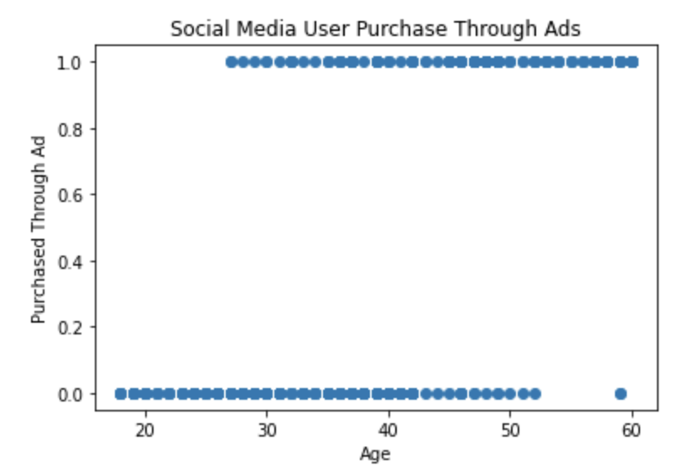
Age
Good distribution of ages within the dataset with most being
in late 30s / early 40s

Slide 5
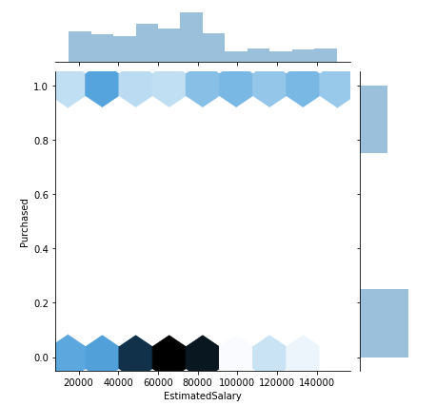
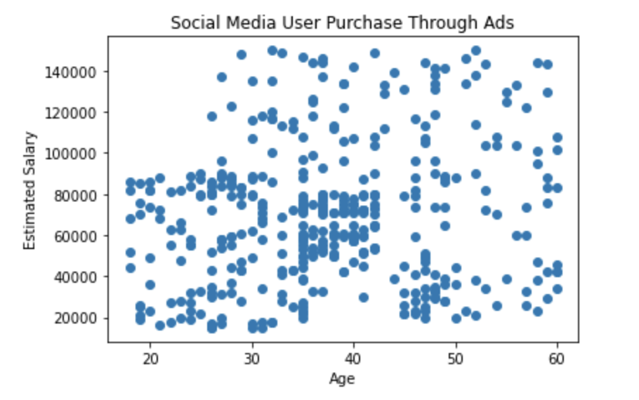
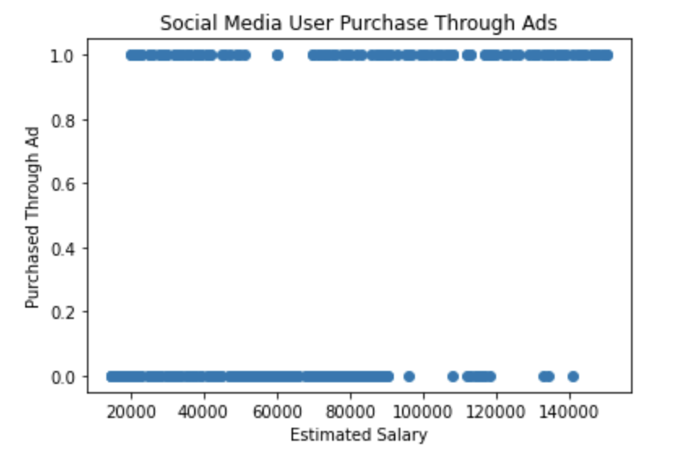
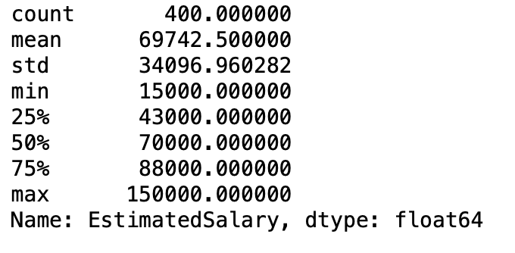
Estimated salary

Slide 6
Methods: Algorithms and models used for Predictions
Data Analysis with Visualization, Split, Normalize, and implement different models with Scikit Learn and Matplotlib
Make instance, Train, and Predict
Splitting data 85% training and 15% testing
MinMaxScaler vs StandardScaler (Bug with visualization of model)
Each instance with different parameters (or default)
Models Used: Perceptron, Logistic Regression, Support Vector Machine, and Decision Tree
Accuracy given with accuracy_score function
Accuracy classification score

Slide 7
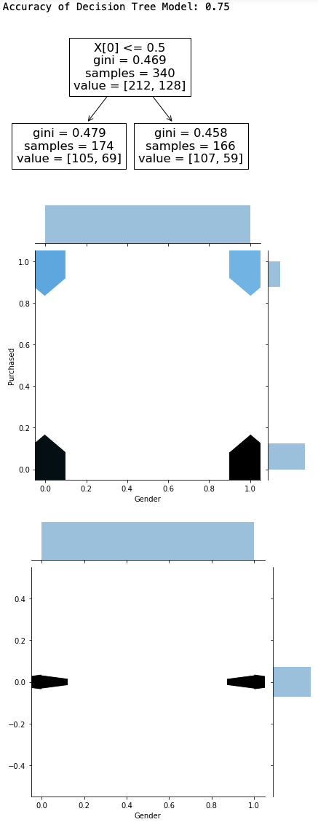
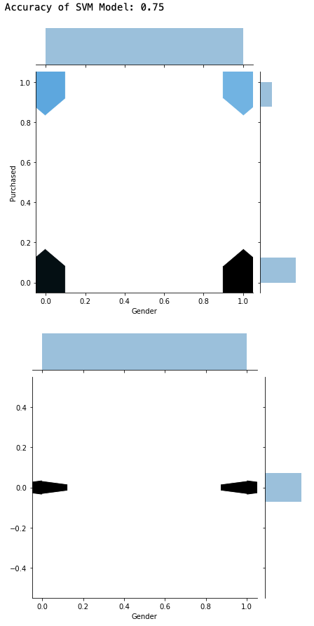

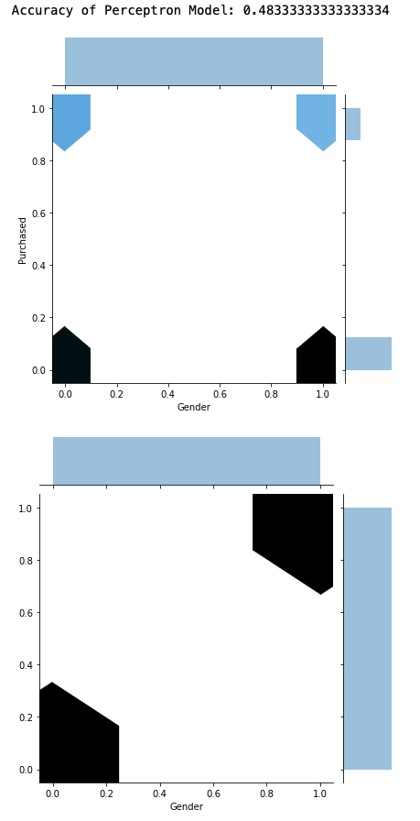
results with gender column

Slide 8
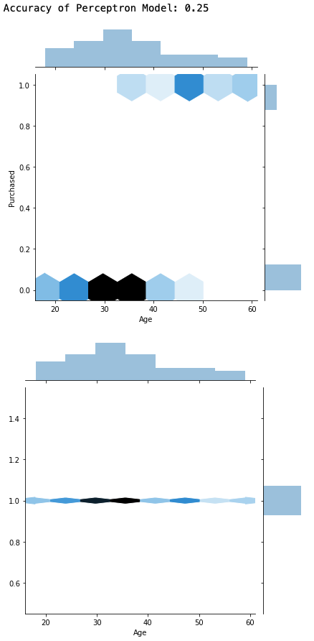
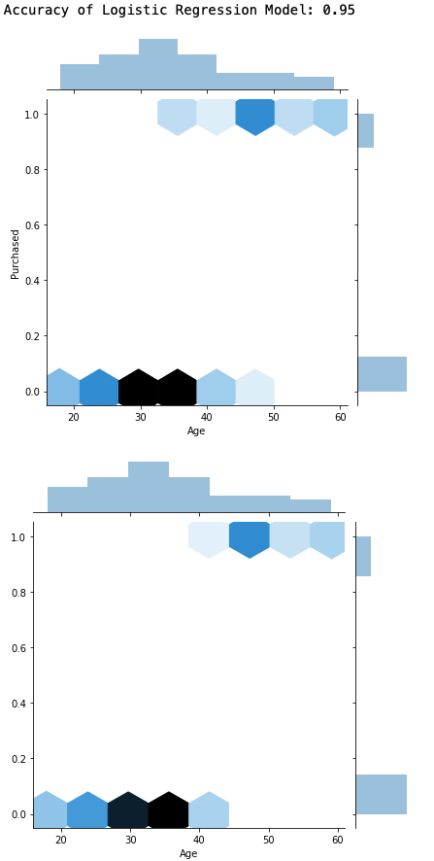
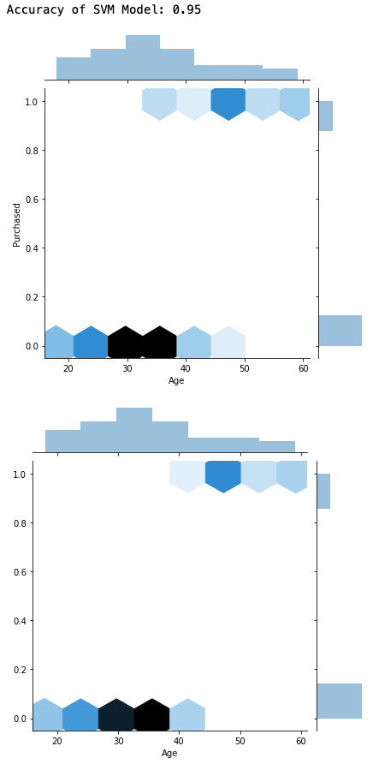
results with age column
Tree and Models in Notebook

Slide 9
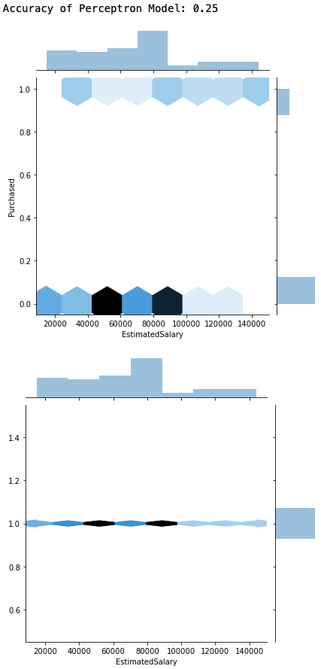
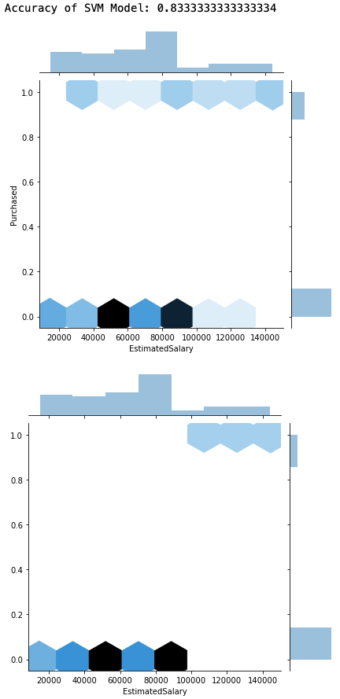
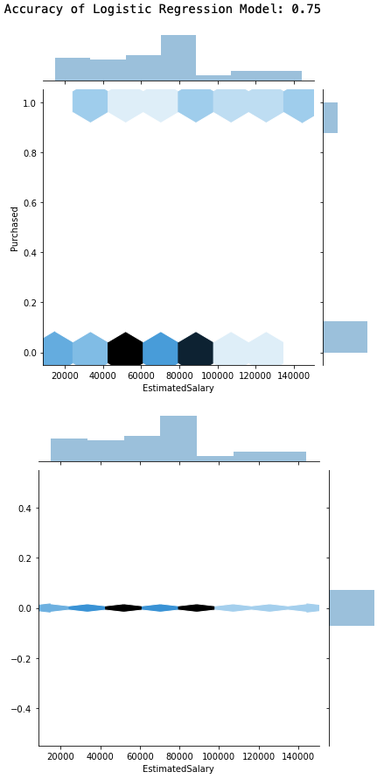
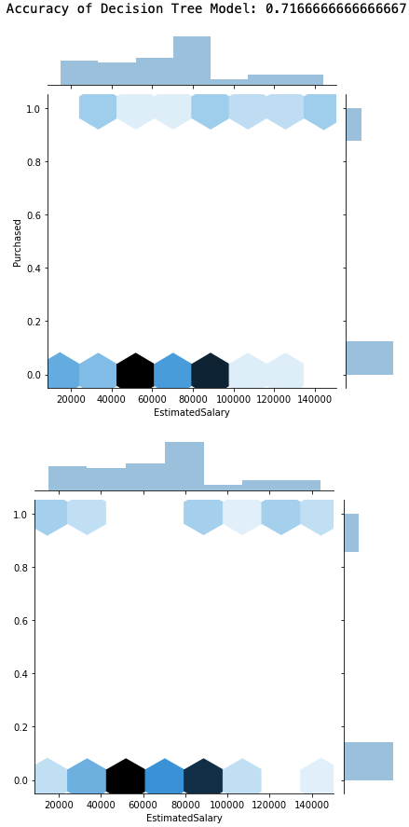
Results with estimated salary column

Slide 10
Conclusion
Predicting whether a social media user purchased an item through an Ad using age was by far the best feature column to use
Accuracy of Both Logistic Regression and SVM were .95 while Decision Tree was .9
Perceptron was very underwhelming
Gender was inefficient due to the distribution of the data being binary
Logistic Regression and SVM (SVC in sklearn) were the best algorithms to predict target

Slide 11
Source
https://www.kaggle.com/rakeshrau/social-network-ads

