Slide 1
Miami Neighborhood Restaurant Market Analysis
Alejandro Villasmil
February 23, 2020

Slide 2
Introduction/background
Miami, FL is considered one of the cultural epicenters of the United States .
There is vast opportunity for business growth in the city of Miami if one can pinpoint the right market and location to open a new business .
It is essential to find a location that will guarantee a wide customer base while at the same time not be incorporating itself into an overly saturated part of town.

Slide 3
Problem
My client, a young restaurant entrepreneur, has come to me for help in assisting him in choosing the optimal location in Miami for his new upscale Peruvian grill restaurant, Los Pollos.

Slide 4
Data acquisition / cleaning
Neighborhood data scraped from https://en.wikipedia.org/wiki/List_of_communities_in_Miami-Dade_County,_Florida
Geographical coordinates retrieved using geopy’s geolocator.
Venue information for each neighborhood retrieved using Foursquare API (Radius = 1000 meters)
In total, training set consists of 268 samples and and 109 features.
Had to adjust some of the neighborhood names in order to get the proper coordinates using goopy.

Slide 5
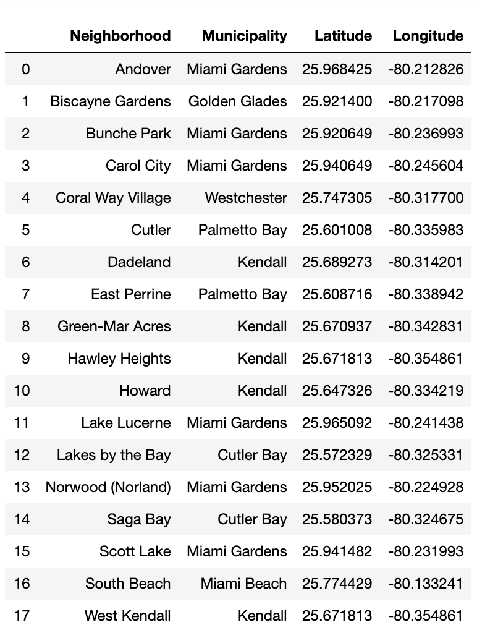
Data acquisition / cleaning
Scraped Neighborhood data joined with coordinate data retrieved using geopy geolocator.

Slide 6
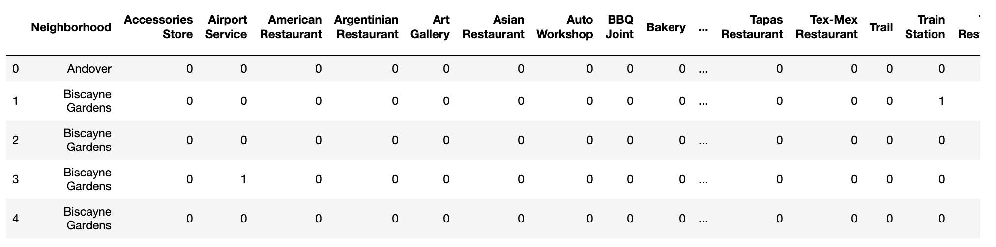
Data acquisition / cleaning
One-hot encoded venue category features. A total of 268 rows (venues) and a total of 108 feature columns (venue categories)

Slide 7
Methodology

Slide 8
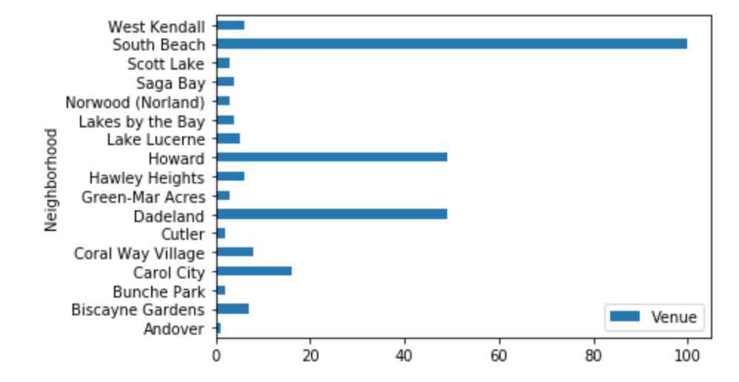
Exploratory data analysis
Venue Count per Neighborhood
Number of venues in each of the neighborhoods. South beach is extremely saturated with venues while Howard and Dadeland look to be moderately populated. All others do not have much of a business market presence.

Slide 9
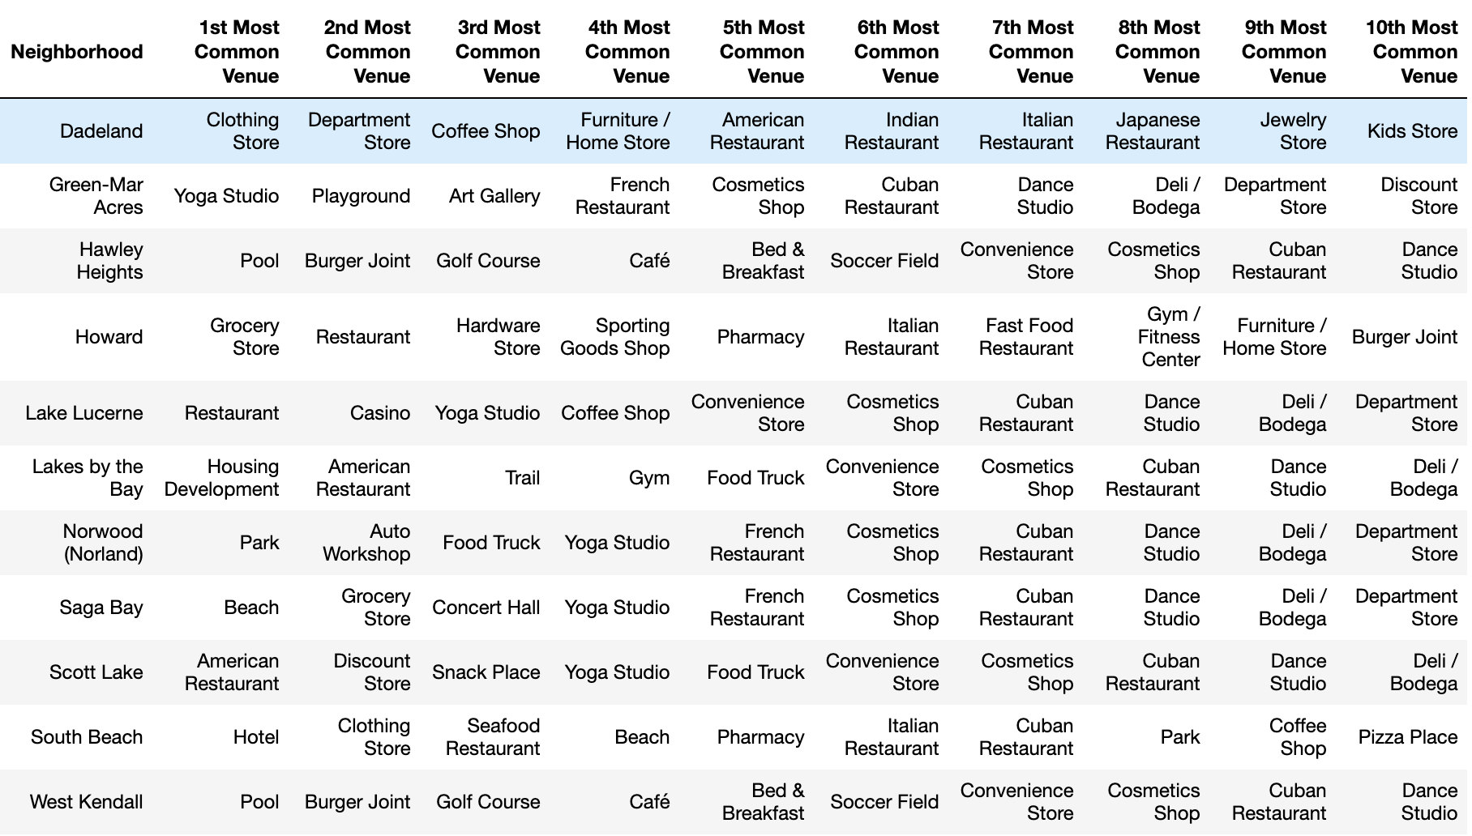
Exploratory data analysis
Prevalent Venue Categories in Each Neighborhood
South Beach’s leading venue are hotels followed closely by stores and restaurants. Dadeland’s leading categories are mainly all comprised of stores and coffeeshops. This is insightful because it shows that just because a neighborhood is saturated with venues doesn’t necessarily mean it’s a negative factor for a new and upcoming restaurant. It all depends on the venue categories.

Slide 10
Machine learning algorithm
I Chose to implement a k-means clustering algorithm in order to cluster the neighborhoods into independent clusters based on the distinct venue categories found in each one.
Choose an appropriate value of k that will minimize the amount of inertia found in the resulting clusters.
Inertia is used as a distortion metric in the model to gauge how internally coherent the clusters are. Essentially attempting to minimize the intra-cluster distances between samples while maximizing the inter-cluster distances.

Slide 11
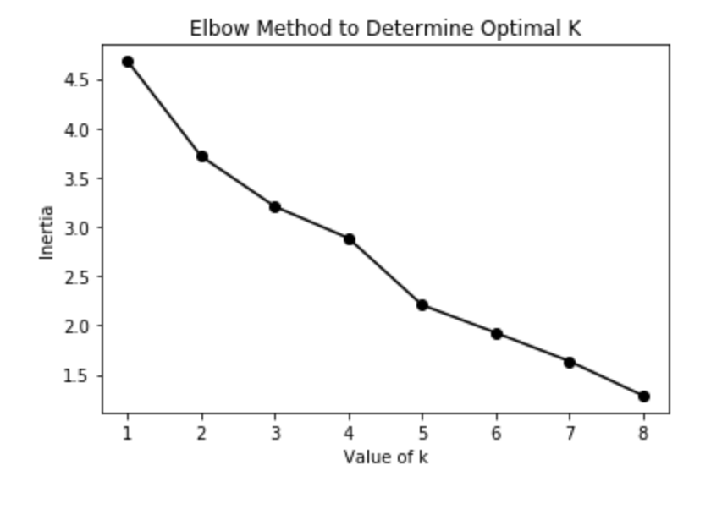
Machine learning algorithm
The elbow method was implemented in order to determine what value of k would be the best fit for the model.
The value of 5 was chosen for k as it resulted in smaller drops in inertia after increasing k thereafter.

Slide 12
Results

Slide 13
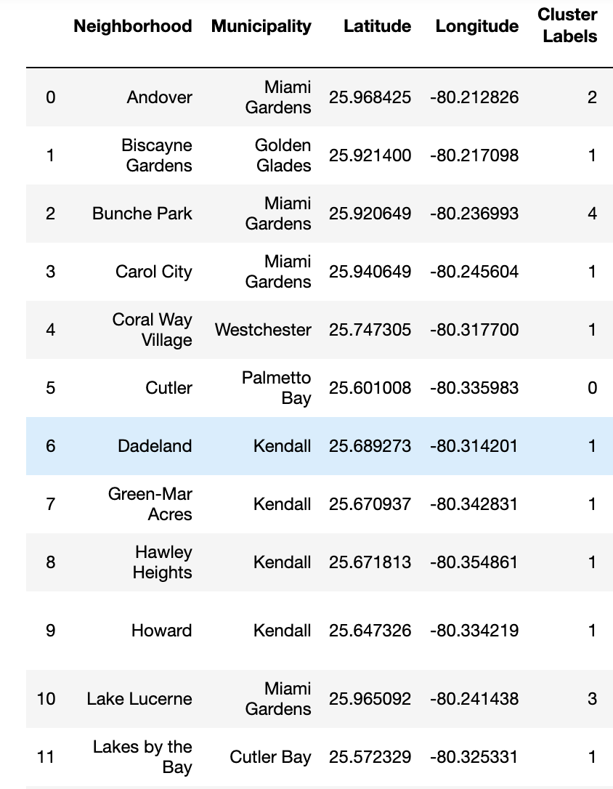
K-means (k=5) model outputs a cluster (0-4) for each of the neighborhoods as seen here.

Slide 14
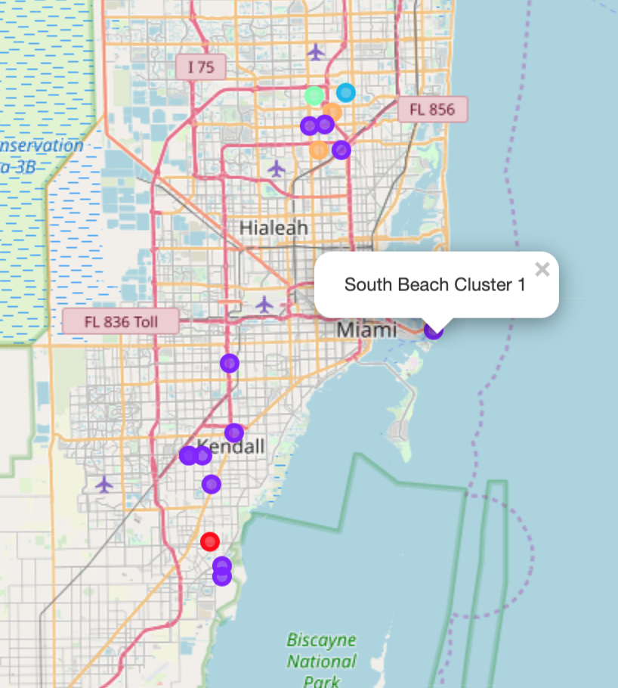
Prediction geographical Visualization

Slide 15
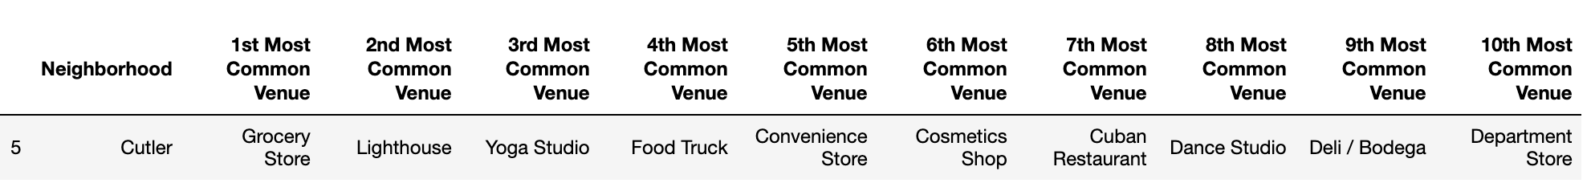
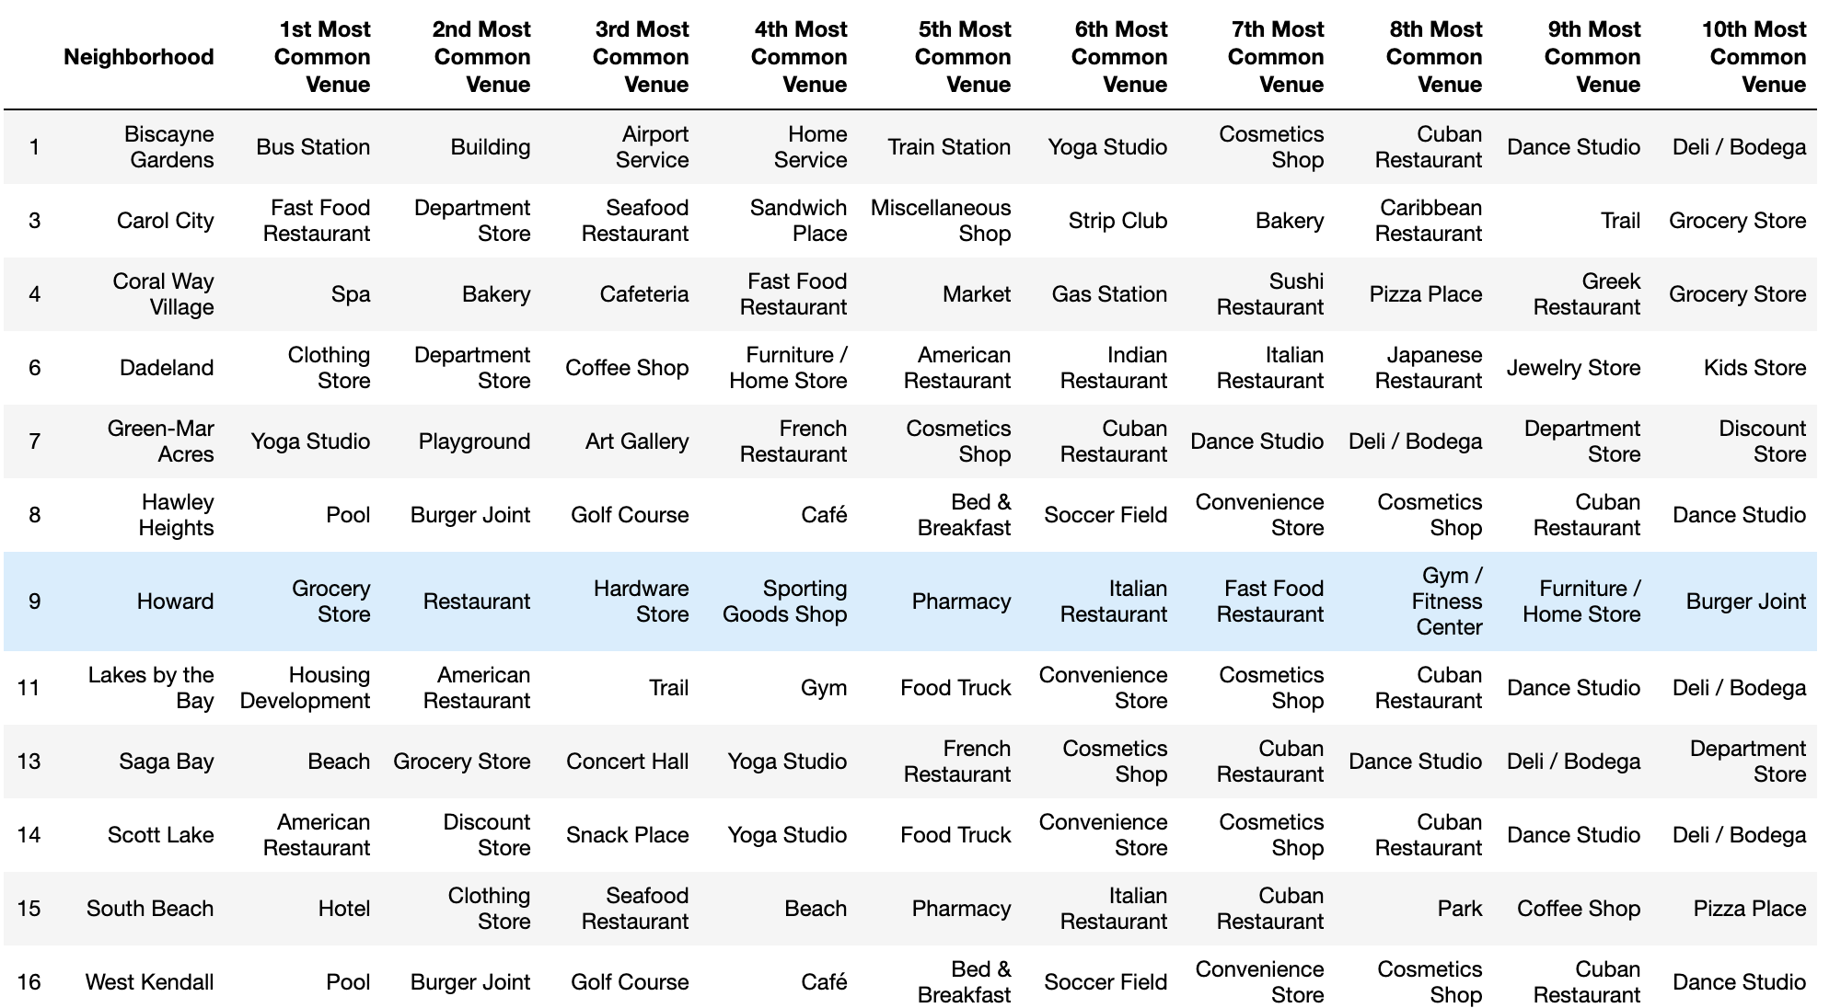
Distinctive features of each cluster
Cluster 1
Cluster 2

Slide 16
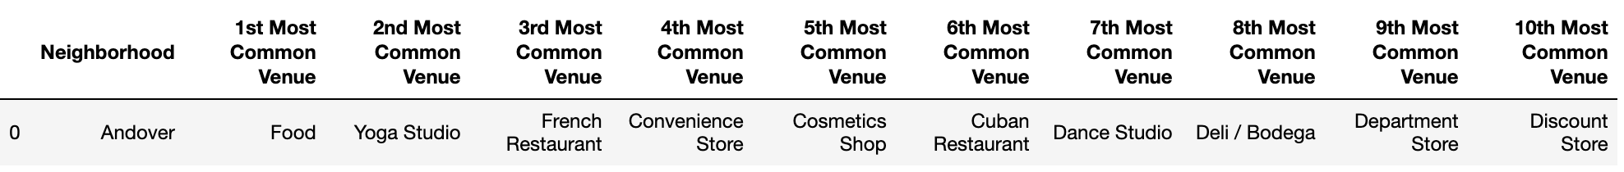
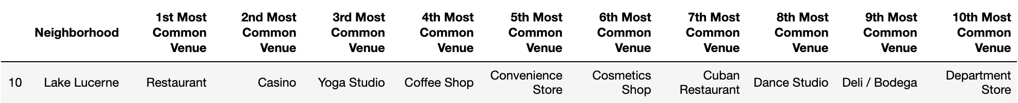
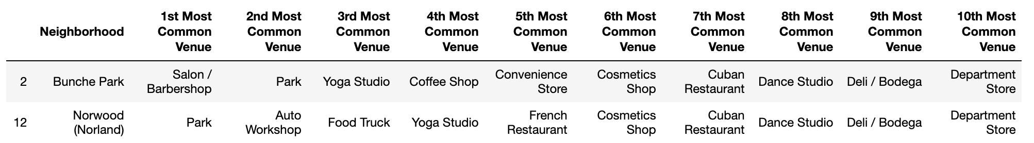
Distinctive features of each cluster
Cluster 3
Cluster 4
Cluster 5

Slide 17
discussion

Slide 18
Deduction of cluster distinctions
Cluster 1: Calm and tranquil, neighborhoods not associated with much foot traffic.
Cluster 2: Touristy sections of Miami, associated with large foot traffic, shops, and restaurants.
Cluster 3: Food centric neighborhoods.
Cluster 4: Neighborhoods with an older population.
Cluster 5: Neighborhoods with a large focus on the outdoors and urban development.

Slide 19
recommendation
From the descriptions derived for each cluster, it is evident that one of the neighborhoods within cluster 2 would be the most suitable, as it would drive the most business and foot traffic for the new business.
Looking further into cluster 2, we can see that South Beach would probably not be the best choice for his first restaurant as it is heavily saturated with other competition and it would potentially not allow him to obtain an initial customer market that easily.
From the looks of it, either Howard or Dadeland would be suitable locations as they are popular destinations but are not overly saturated.

Slide 20
recommendation
Looking further into these two neighborhoods it is evident that Dadeland is populated with numerous shops and stores while Howard’s second most common category is Restaurants.

Slide 21
recommendation
Given this information, it would be a wise choice to bring this new restaurant to the Dadeland area as it will serve as a perfect complement to the plethora of stores present in the area. People will want a suitable place to eat while out shopping for the day.

Slide 22
Conclusion
Scraped data off Wikipedia and extracted venue data using Foursquare API.
Determined best model (k-means) with the optimal value of k to cluster neighborhoods based on venue categories.
Made sense of the different clusters generated.
Delivered recommendation of best location in Miami for a new Peruvian restaurant to my client.

