Slide 1
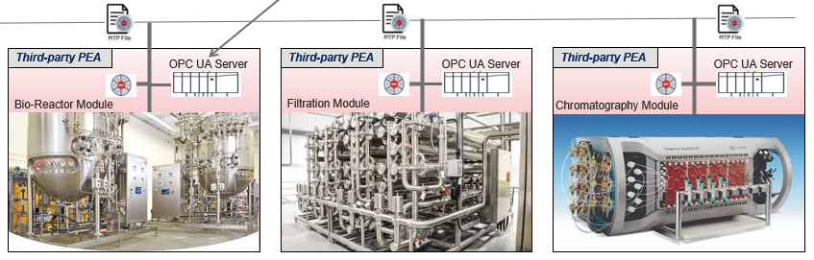
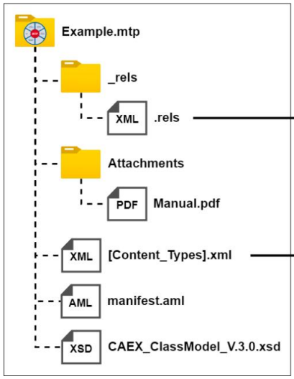
What’s mtp?
Key elements
Module Type Package offers a method to streamline the integration of third-party devices within a Distributed Control System (DCS).
PEA (Process Equipment Assembly):
Third-party vendor’s equipment which consists of an OPC UA Server that allows clients (POL) to communicate for data access.
POL (Process Orchestration Layer):
Distributed Control System (DCS) that allows to integrate PEA by auto-generating the configurations required to communicate with PEA’s OPC UA Server.
MTP (Module Type Package):
Binary file contains description of the interfaces and functions of an equipment (PEA), exported from PEA.
Why mtp?
Reduces cost of engineering effort
Reduces time-to-market
Increases operational flexibility

Slide 2
Problem Statement
To integrate the third-party equipment (PEA), EPKS system provides MTP Builder, tool that generates configuration to automate integration.
To test the generated configuration, customers need to have the PEA equipment to validate the configuration. Instead, it is recommended to validate the configuration using simulated PEA, before to integrate with physical PEA. Hence need to develop a simulation server to mimic any third-party PEA functionality using the PEA’s MTP file.
The simulation server is a Windows exe based OPC UA Server. It takes MTP file as input and reads the OPCUA Items details from it. Using this, it shall construct the UA nodes in the OPCUA address space. Finally, allows the POL to connect to it as OPCUA Clients for data access (read/write).
Expected output
Demonstrate to view the available OPCUA items and allow to configure the simulated values
Demonstrate POL can communicate to Simulation Server through Endpoint Url
Demonstrate the values can be read/write through OPCUA test client tools like uaexpert, etc.
Input data provided
Tailored MTP file that contains OPCUA item details
UaExpert tool to test the simulation server
software/ infrastructure required
Programming languages –
.net core 8 C#/WPF
nuget packages - OPCFoundation.NetStandard.Opc.Ua.Server
Tools –
UaExpert - OPCUA test client

