Slide 1
Classifying Consumer Complaints Using Natural Language Processing

Slide 2
PROJECT OVERVIEW

Slide 3
About the Data
Submitted by consumers to the Consumer Financial Protection Bureau, a
“U.S. government agency that makes sure banks, lenders, and other financial companies treat you fairly.”
Consumers can submit a narrative of their complaint and are prompted to classify their complaint in four categories:
product
sub-product
issue
sub-issue

Slide 4

Sample Narrative
Hello my name is XXXX XXXX, I am being scammed by Comenity bank a credit card provider
for companies The Children’s place, New York & Co. , Forever 21 and Victoria Secret.
My original credit from XXXX was {$500.00} Comenity bank then lowers my limit to
{$300.00} and began to charge overage fees along with late fees. I then began to pay close attention to my other cards to find that my limits were also changed on them as well incurring overages and late fees.
I reached out to the company Comenity bank they stated that they would change my credit limit to its original limits but did not. I reached out to them again and told them I will not summit any payment until my accounts are corrected. Comenity bank credit cards has impacted my credit scores plummeted to a negative status.
I’m currently paying the price due to the corruption in which has affected me in detrimental way. I am now in debt over {$2000.00} due to the company charging overage fees as well as late fees even through COVID-19. The initial credit limits are fluctuating tremendously and the company charges major fees on each of those 4 accounts. They are not willing to correct my account and was nervous when I said I had an attorney, that is the reason I’m reaching out to you.

Slide 5
Purpose of Project
Project Purpose
Develop a Natural Language Processing model which can use the narratives’ text
alone to categorize the complaints.
Business Case
An NLP model will make the classification of complaints and their routing to the appropriate teams more efficient than manually tagged complaints.

Slide 6
EXPLORATORY DATA ANALYSIS

Slide 7
Data Overview
Includes a year’s worth of submissions from March 2020 to March 2021
After removing submissions without narratives, about 162,400 complaints remained.
Complaints were tagged with one of nine product areas.
For the other categories (sub-product, issue, sub-issue), there were too many tags, often with too few instances, to be useful to train an NLP model.

Slide 8
Class Consolidation
Consolidated the products into five classes:
credit reporting
debt collection
mortgages and loans
credit cards
retail banking

Slide 9
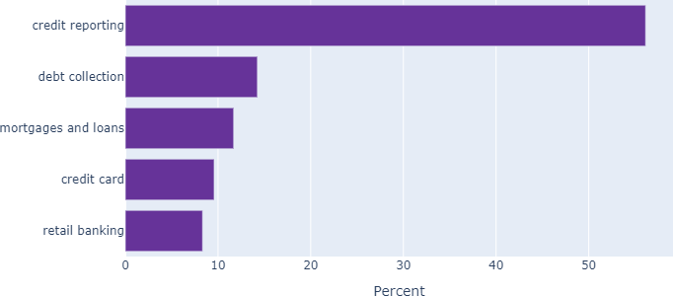
Class Imbalances

Slide 10
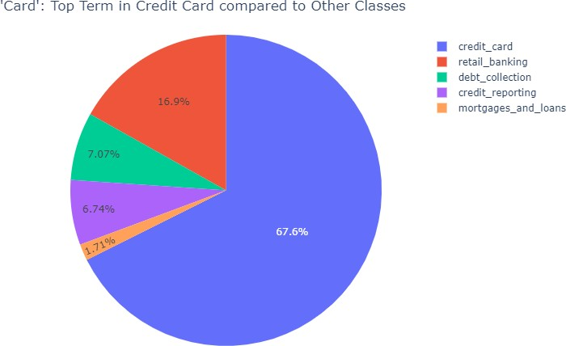
WORD PROMINENCE

Slide 11
MODELING

Slide 12
Modeling Process
Data Preparation
Removed stopwords like “the” and “if”
Lemmatized words (“banks” → “bank”)
Vectorized data (transformed words into their numerical frequencies)
Separated data into training set to train model and testing set to verify performance
Baseline Modeling
Ran six different baseline models (Multinomial Naïve Bayes, Random Forest, Decision Tree, KNN, Gradient Boosting, XG Boost)

Slide 13
Modeling Process (cont’d)
Scoring
Used recall as the primary metric since the five classes are imbalanced
Looked for similar results between training and test results to minimize overfitting
Refinement
Experimented with various parameters on three of the best baseline models
Multinomial Naïve Bayes had best overall score, classifying narratives correctly 86% of the time.

Slide 14
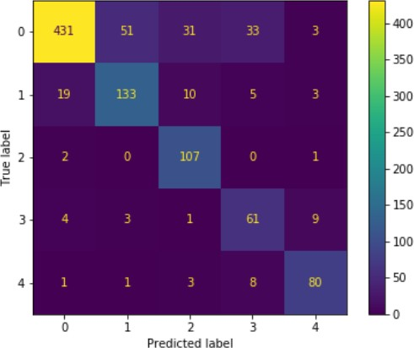
Running Model on Fresh Data
Downloaded 1,000 new
narratives from CFPB’s API
The trained model categorized class 2 narratives (mortgages and loans) particularly well – more than 97% correct.

Slide 15
POST-MODELING EDA

Slide 16
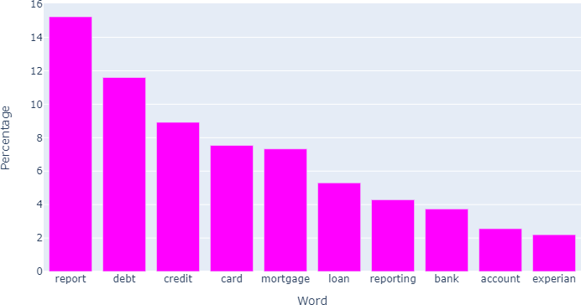
Top 10 Most Important Features

Slide 17
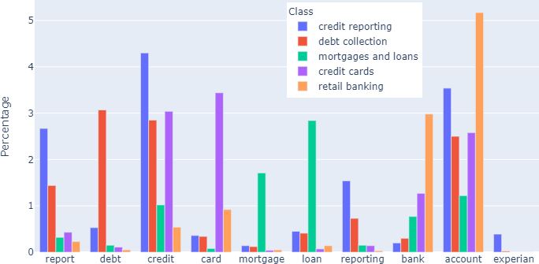
Feature Importances:
Percentage of Word Prominence per Class

Slide 18
NEXT STEPS

Slide 19
Improve Business Case
Since consumers classified their own complaints, ask CFPB employees to double-
check narratives’ classes, particularly those that the model misclassified
Understand how the CFPB routes and processes consumer complaints and develop further modeling capabilities for sub-product, issue, and sub-issue
Refine Models
Use more than one year’s worth of data and further refine parameters
Create Latent Dirichlet Allocation (LDA) model to develop new classification categories and learn if they might be useful to CFPB

