Slide 1
Topics to be covered :
UNIT-2. REGULAR EXPRESSION AND LANGUAGES
Regular Expression and Lnguages : Regular Expression, Finite Automata and Regualar Expressions, Properties of Regualar Languages (RL) : Proving Languages not to be regular. Equivalence and minimization of Automata(DFA). Applications of Regular Expressions
Upon completion you will be able to
Explain the concepts of Regular expression and its Applications.
Explain connection between Regualar expression and Finite Automata
Demonstrate the equivalence of DFA, NFA and Ԑ-NFAs.
Prove Cetain Languages are not Regular using Pumping Lemma

Slide 2
Regualar Expressions and Languages
Introduction to Regular expression
1.1. Formal Defination for Regualar Expression.
1.2. Language associated with Regular Expression
1.3. Building Regular Expression for the Languages
2. Finite Automata and Regular expressions
2.1. Building Ԑ-NFA from Regular Expression
2.1.1. Examples on building Ԑ-NFA from Regular Expressions (Thomson’s Scheme)
2.2. Building Regular Expressions from DFA and NFA (State Elimination Method).
3. Minimization Of Automata(DFA)
Algorithm and Examples
4. Properties of Regular Languages
4.1. Introcuction
4.2. Statement of Pumping Lemma and Proof.
4.3. Stretegy for Proving Languages not be Regular
4.4. Examples
5. Applications Of Regular Expressions

Slide 3
1. Introduction to Regular expression
We know that DFA, NFA and Ԑ-NFA are three mechanism to describle the Regular Languages. These descriptions are machine like descriptions and are not a declarative way to describe the the Regular Languages.
Regular expression is another mechanism to describle the Regular Languages which is algebraic like descriptions and is more declarative way to describe the the Regular Languages than DFA.
Informally, Regular expression is a notation to describe the Regular Languages that involves a combination of strings of symbols from some alphabet ∑, paranthesis and operators such as +(UNION), • (Concatenation) and * (Star Closure).
Example-1. Simplest case L = {a}, the regular expression is → a
Example-2. L = {a, b}, the regular expression is → a+b or (a+b)
Example-3. L = {Ԑ, a, aa,aaa,aaaa,..........} , the regular expression is → a*

Slide 4
1.1. Formal Defination of Regular Expression :
Formally, Regualar Expression can be defined as follows :
Let ∑ be a given alphabet. Then
Rule -1. Ø, Ԑ and a € ∑ are all Regular expressions. These are all called primitive Regular Expressions.
Rule - 2. if R1 and R2 are Two Regular Expressions, so are R1 + R2, R1 • R2, R1* and (R1).
Rule - 3. A string is Regular Expression if and only if it can derived from the primitive regular expressions (mentioned in Rule - 1), by finite number of application of the Rules mentioned In Rule - 2.
Example -1. ∑ = { a b } be a given alphabet
The string - (a+b) is a Regular Expression, since it is constructed by applications of the above mentioned Rules, i.e Here R1=a,R2=,b are primitive regular expressions and Rule -2 is is applied 2 number of times ( R1+R2 - Union and (R1) - Paranthesized Regular Expression) to get a string - (a+b) .

Slide 5
Example -2. ∑ = { a,b,......z} be a given alphabet,
The string - sachin is a Regular Expression, since it is constructed by applications of the above mentioned Rules, i.e Here R1=s,R2=a,R3=c,R4=h,R5=i and R6=n are primitive regular expressions and Operator • is applied 5 number of times (s•a•c•h•i•n) to get a string sachin (In between alphabets • is implied) .
Priority of the Operators :
+ → Union Operator → Least Precedence
• → Concatenation Operator → next Least Precedence
* → Star closure Operator → Highest Precedence

Slide 6
Some examples of Regular expressions and their assicated language :
→
Regular expressions | Meaning
(a+b)* | Set of strings of a’s and b’s of any length including the NULL string.
(a+b)*abb | Set of strings of a’s and b’s ending with the string abb
ab(a+b)* | Set of strings of a’s and b’s starting with the string ab.
(a+b)*aa(a+b)* | Set of strings of a’s and b’s having a sub string aa.
a*b*c* | Set of string consisting of any number of a’s(may be empty string also) followed by any number of b’s(may include empty string) followed by any number of c’s(may include empty string).
a⁺b⁺c⁺ | Set of string consisting of at least one ‘a’ followed by string consisting of at least one ‘b’ followed by string consisting of at least one ‘c’.
aa*bb*cc* | Set of string consisting of at least one ‘a’ followed by string consisting of at least one ‘b’ followed by string consisting of at least one ‘c’.
(a+b)* (a + bb) | Set of strings of a’s and b’s ending with either aor bb
(aa)*(bb)*b | Set of strings consisting of even number of a’s followed by odd number of b’s
(0+1)*000 | Set of strings of 0’s and 1’s ending with three consecutive zeros(or ending with 000)
(11)* | Set consisting of even number of 1’s

Slide 7
1.2. Language associated with Regular Expression :
If R is a Regular Expression then L(R) denote the Language(Regular) associated with the Regular Expression R. The Language L(R) denoted by Regular Expression R is defined by the following rules.
1. Ø is a Regular Expression denoting the empty language i.e L(R) = Ø .
2. Ԑ is a Regular Expression denoting the language containing empty string - Ԑ i.e L(R) = { Ԑ }
3. For every a € ∑, a is a Regular Expression denoting the language containing a. i.e L(R) = { a }.
If R1 and R2 are Regular Expressions then
4. L(R1 + R2) = L(R1) Ụ L(R2) → i.e Union of langauges associated with R1
and R2
5. L(R1 • R2) = L(R1) • L(R2) → i.e Concatenation of langauges associated
with R1 and R2.
6. L((R1)) = L(R1) → i.e It is just a langauge associated with R1
7. L(R1*) = (L(R1))* → i.e It is just a STAR closure of a langauge associated
with R1

Slide 8
Example -1. ∑ = { a, b} be a given alphabet then
Demonstate the Language associated with Regular expression
R = (a*• (a+b))
Answer : L( R ) = L( (a*• (a+b)) )
= L(a*) • L(a+b)
= (L(a))* • (L(a) Ụ L(b))
= {Ԑ, a, aa, aaa,.....} • {a, b}
= {a, aa, aaa, aaaa,......., b, bb, bbb, bbbb,.........}
Example -2. ∑ = { a, b} be a given alphabet then
Demonstate the Language associated with Regular expression
R = (a + b)* • (a + bb)
Answer : L( R ) = L ((a + b)*•(a + bb))
= L( (a+b)*) • ( L(a) Ụ L(bb) )
= ( L(a+b) )* • { a, bb }
= { Ԑ, a, aa,... b, bb,..., aab, aaab...,.....} • {a, bb}
= { a, aa,aaa,... ba, bba,.., aaba, aaaba,...., bb, abb,aabb,......}
Exercise Problems : Demonstate the Language associated with Regular expression : 1. R = (aa)* (bb)* b. 2. R=(a+b)* aa(a+b)*

Slide 9
1.3. Building Regular Expression for the Langauges :
Write Regular Expressions for the following Language descriptions on the Alphabet ∑ = { a, b }
SET-1
1. The set of all strings that begin with bba
2. Strings of a’s and b’s with Length two.
3. Strings of a’s and b’s with length <= 2
4. Strings of a’s and b’s having even length.
5. Strings of a’s and b’s having odd length.
6. Strings of a’s and b’s having at least three consecutive (aaa) a’s.
7. Strings of a’s and b’s starting ‘a’ and ending with ‘b’
8. Strings of a’s and b’s having no consecutive a’s
9. Strings of a’s and b’s having length either even or multiple of Three.
10. Strings of a’s and b’s having with alternate a’s and b’s

Slide 10
Write Regular Expressions for the following Language descriptions :
SET-2
L = { a^{n} b^{m} | n>=4, m<=3 }
L = { w | such that |w| mod 3=0, w € (a+b)*}
L = { vuv | such that u,v € (a+b)* and |v| =2 }
L = { a^{2n} b^{2m} | n>=0, m>=0 }
L = { a^{2n} b^{2m+1} | n>=0, m>=0 }
L = { a^{n} b^{m} | m + n is even}
L = { a^{n} b^{m} | m>=1, n>=1 and nm >=3}
L = { w | such that N_{a}(w) mod 3=0, w € (a+b)*}
L = { |w| mod 3 >= |w| mod 2, w € (a+b)* }
L = { |w| mod 3 <= |w| mod 2, w € (a+b)* }
L = { |w| mod 5 <> 0, w € (a+b)* }

Slide 11
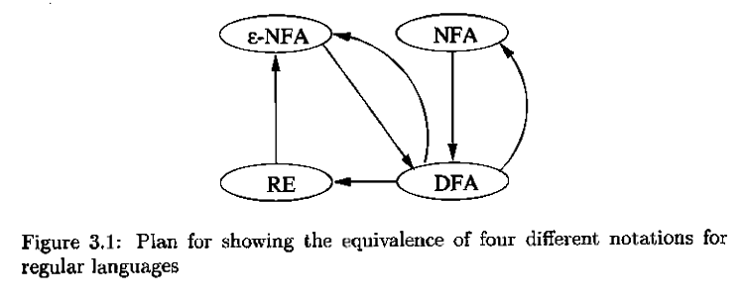
2. Finite Automata and Regular expressions
We know that If a Language L is Regular then there exist a DFA, NFA Ԑ-NFA and Regular Expression. Conversly, the language denoted or described by DFA, NFA Ԑ-NFA and Regular Expression is always a Regular Language.
The Figure 3.1 shows the equivalence of all these four Representations of Regular Languages.
Further, For a Regular language L, If one representation exists then it is possible to get other representation without affecting the language description.

Slide 12
2.1. Building Ԑ-NFA from Regular Expression
As mentioned in the equivalance of four diffirent notaions namely, DFA, NFA, Ԑ -NFA and Regular Expression, Let us discuss that for every language L that is L(R) for some Regular Expression R, there exist a L(E) for Some Ԑ -NFA E.
The process is to have structural induction on the Regular Expression. In otherwords we start by constructing Ԑ -NFA/NFA for primitive Regular expressions namely, Ø, Ԑ and a € ∑. Later we combine these automata into larger automata that accepts the Union, Concatenation and star closure of the language accpeted by smaller automata.
Statement of theorem associated with Ԑ-NFA from Regular Expression is as follows :
Theorem - Every Language L defined by a Regular Expression is also defined by Finite Automata Ԑ-NFA. Consequently, L(R) is regular.

Slide 13
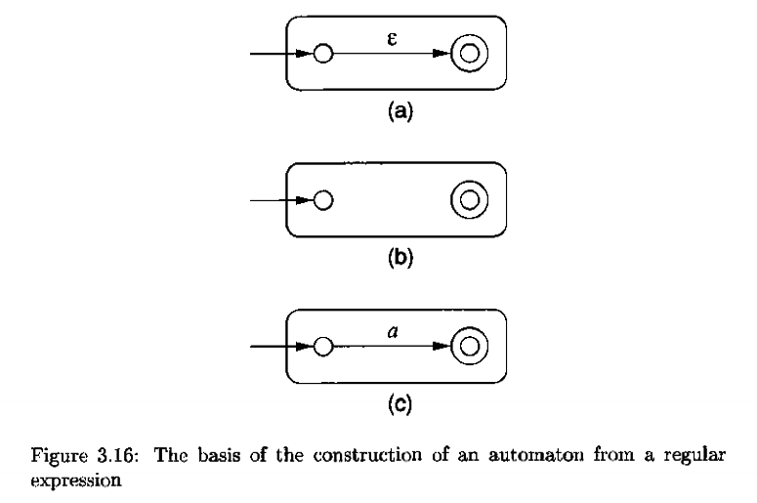
Proof : We begin with automata that accepts the languages for the primitive Regular Expressions namely Ԑ Ø, and a € ∑, . The Primitive diagrams are shown in figure 3.16. i.e Figure 3.16 (a) → Ԑ,
Figure 3.16 (b) → Ø and
Figure 3.16 (c) → a € ∑

Slide 14
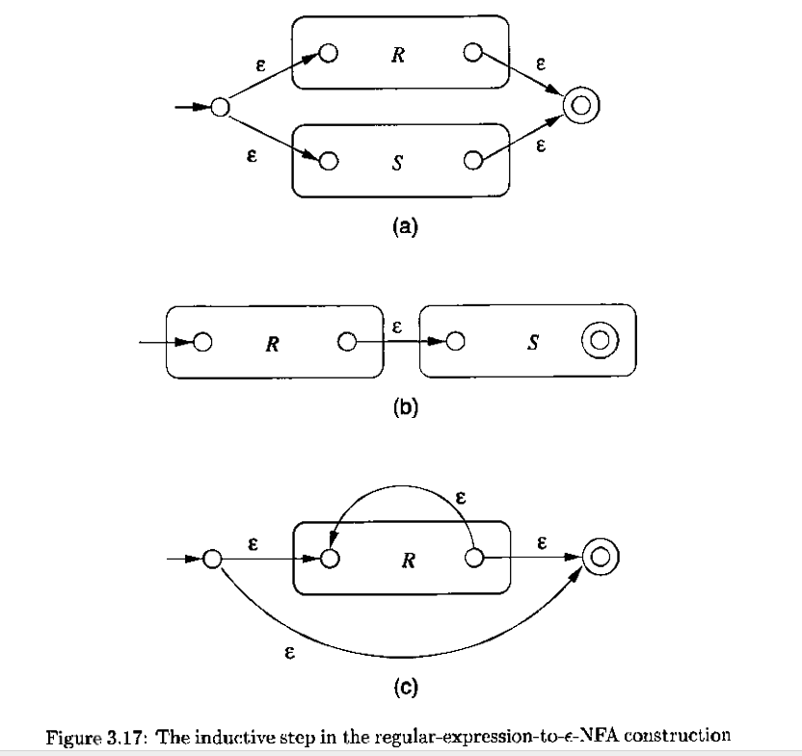
Assume that we have M(R) and M(S) are Two automata accepting the languages denoted by the regular expression R and S.
With M(R) and M(S) represented in this way, we then construct automata for the Regular expressions R + S, R • S and R*.
The Constructions are shown in the figure 3.17. i.e.
Figure 3.17 (a) → R + S,
Figure 3.17 (b) → R • S
Figure 3.17 (c) → R*
As indicated in the drawings, the initial and final states of the constituents machines lose their status and replaced by new initial and new final state.
By stringing together several such steps, we can build Automata for arbitary complex regular Expression
It is clear from the interpretetion of the graphs that this construction works for arbitary any Regular Expression R denoting the Language L(R).

Slide 15
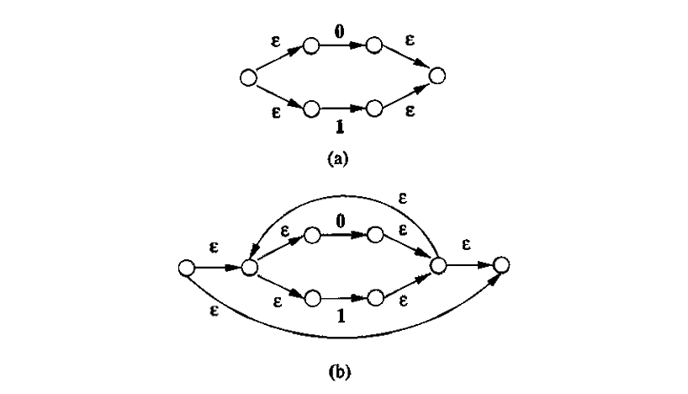
2.1.1. Examples on building Ԑ-NFA from Regular Expressions
Example -1. Convert the Regular Expression :
(0 + 1)* 1(0 + 1) to an Ԑ-NFA
Answer :
Step -1. We need to construct the Automata For 0 + 1 using primitive Automata Diagrams for input 0 and 1, we combine using the UNION. The same is Shown in Figure -3.18 (a).
Step - 2. In the second step we construct for ( 0 + 1 )* by using STAR CLOSURE.
The result is shown in Figure -3.18 (b).
Step - 3. we construct for (0 + 1)* 1 by using primpitive digram for Input 1 and Concatenation.

Slide 16
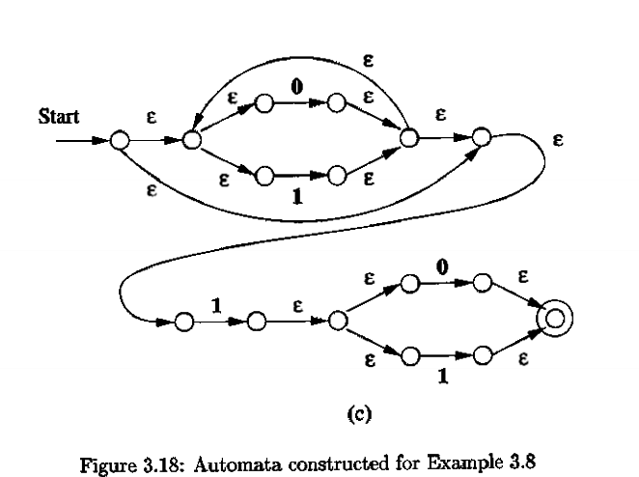
2.1.1. Examples on building Ԑ-NFA from Regular Expressions
Example -1. Convert the Regular Expression :
(0 + 1)* 1(0 + 1) to an Ԑ-NFA
Step - 4. Finally we string all the Automata of Figure -3.18 (a) and Figure -3.18 (b ) to get Automata for (0 + 1)* 1 ( 0 + 1 ). The Resulting the final Automata as shown in Figure -3.18 (c)
Exercise problems to Convert the Regular Expression to an Ԑ-NFA.
1. (01 + 1)* → ∑ = {0, 1}
2. 011(0 + 1)* → ∑ = {0, 1}
3. (a + bb)* (ba* + Ԑ) → ∑ = {a, b}
4. (ab*aa + bba* ab) → ∑ = {a, b}

Slide 17
2.2. Building Regular Expressions from DFA and NFA by (State Elimination Method).
Kleen’s theorem can be applied for NFA or even ε-NFA. However the construction of the regular expression is expensive i.e for an n-state automaton we have to construct about n³ expressions.
Also the length of the expression can grow by a factor of 4 on an average. If there is no simplification of the expressions then it could reach on the order of 4^{n} symbols
To address this issue and improve the performance State elimination method is used.
Here we Eliminate the intermediate states between start state and Final state of the automaton and replaces the edges with regular expressions that includes the behavior of the eliminated states until Eventually we get down to the situation with just a start and final node,

Slide 18
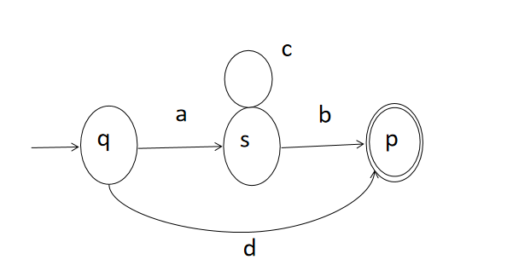
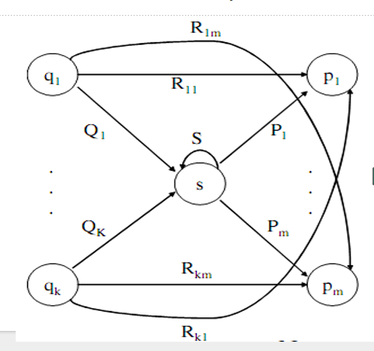
Principle :
Starting with the start state considering the intermediate states one at a time and then moving towards accepting states, apply the state elimination process to produce an equivalent automaton with regular expression labels on the edges.
Process Of Elimination :
In general If a state s is to be eliminated then we have to consider each pair of successor and predecessor (q, p).
The two situations are shown in Figure -1 and Figure -2.
Figure -1
Figure -2

Slide 19
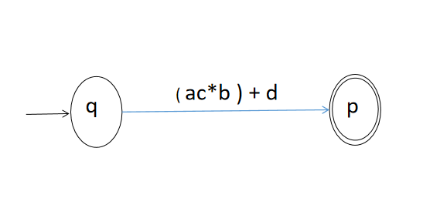
As Indicated in the Drawings Of Figure -1 and Figure-2 . the followings steps can followed in the process of state elimination. The result of drawings are shown in the Figure -3 and Figure-4
Let us Consider an intermediate state s that is to be eliminated.
Let state p be its successor and state q be its predecessor.
It is observed that all the strings of the form ‘ac*b’ take the automata from state q to state p that pass through state s and also, the string ‘d’ that does not pass through state s . So, We can now remove state s and attach an edge labeled ‘ac*b +d’ from state q to state p directly.
During this process the transitions are labeled by regular expression . The resulting diagrams are called as Generalized Transition Diagrams.
Figure - 1
Figure - 3

Slide 20
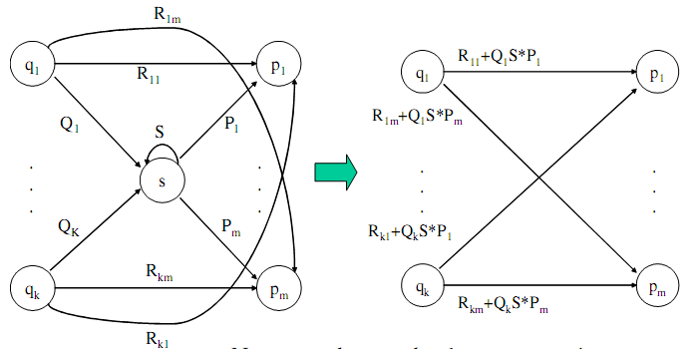
Consider the Figures - below, which shows a generic state s about to be eliminated.The labels on all edges are regular expressions.
To remove state s, we must make labels from each qi to p1 up to pm that include the paths we could have made through state s. The result of elimination is shown in the figure below.

Slide 21
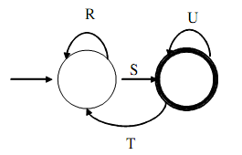
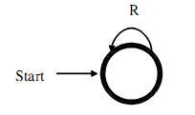
By this process we eliminate all intermediate states and the result will be a one or two state automata with a start state and accepting state.
The configuration at the end is one of the following patterns
No intermediate states between start and final state (generic Two state automaton.)
No intermediate state with Genaric One state Automata (start state and final states are same ).
The regular expression in this case is (R+SU*T)*SU*
The regular expression in this case is - R*

Slide 22
If there are n accepting states, we must repeat the above steps for each accepting states to get n different regular expressions, R1, R2, … Rn.
For each repeat we turn any other accepting state to non-accepting.
The desired regular expression for the automaton is then the union of each of the n regular expressions: R1 U R2… U RN

Slide 23
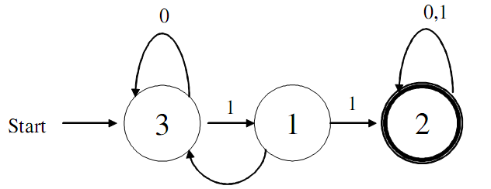
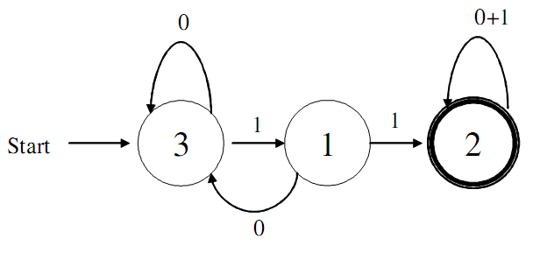
Examples on Building Regular Expression from DFA
Example - 1. Convert the following to a RE:
First convert the label on edges to RE’s:

Slide 24
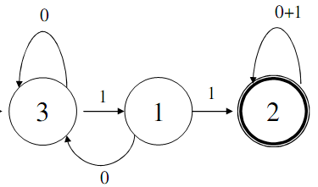
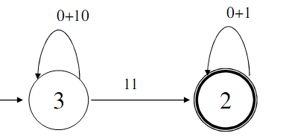

Step -1 : Eliminate the Intermediate state -1, as indicated in the digram, 3 is predecessor and 2 is successor:
Path starts from state-3, enters into state -1 and returns to state -3.
The string ‘10 ‘ assocated with the path 3→1→3, is attached to state-3 as it is looping after eliminating the state-1 and connecting edge is state -3 to state -3
Also the path starts from state -3, enters into state -1 and reaches State - 2.
The string ‘11’ associated with path 3→1→2 is attached to to state -2, after eliminating the state-1 and connecting edge is state -3 to state -2
The resulting diagram is shown in below mentioned Figure.

Slide 25
Step-2 : It is observered that after eliminating the Intermediate state -1, we are left out with two state automata and the corresponding Regular Expression is obtained by mapping, with genaralized Transition Diagram as indicated in the below diagram,
R = 0 + 10, S = 11, U = 0 + 1 and T = Ø
Therefore the Corresponding Regular Expression is :
RE = (R+SU*T)*SU*
= (( 0 + 10) + (11) (0 + 1)* Ø)* 11(0+1)* → Applying Law - L Ø = Ø
= (( 0 + 10) + Ø)* 11(0+1)* → Applying Laws - L + Ø = Ԑ
= (0+10)*11(0+1)*
Figure - 1. Genarlized Two State Automata

Slide 26
Algebraic Laws for Regular Expression :
Assocaitive and Commutative
( L, M are Two langauges)
a. L + M = M + L
b. (L + M) + N = L + ( M + N )
c. (LM)N = L(MN) →Note : LM <> ML
2. Identities and Annihiilators:
a. Ø + L = L + Ø = L
b. ԐL = LԐ = L
c. Ø L = L Ø = Ø
3. Distributive Laws :
a. L(M + N) = LM + LN
b. (M + N)L = ML + NL
4. Idempotent Law :
a. L + L = L
5. Laws Involving Closures :
a. (L*)* = L*
b. Ø * = Ԑ
c. Ԑ * = Ԑ
d. L⁺ = LL* = L* L
e. L* = Ԑ + L⁺
f. L? = Ԑ + L
g. (R*S*) = (R + S)*
h. (Ԑ + L)* = L*

Slide 27
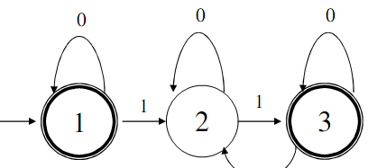

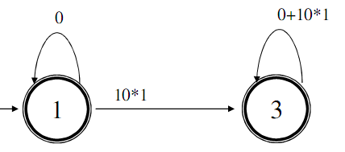
Example -2. Convert the following to a RE:
Path starts from state-3, enter into state-2, loops at 2 and reaches State-3.
The string ‘10*1 ‘ assocated with the path 3→2→3, is attached to state-3, after eliminating the state-2 and connecting edge is state -3 to state -3
The resulting diagram is shown in below mentioned Figure.
Step-1 : Eliminate the Intermediate state -2, as indicated in the digram, 1 is predecessor and 3 is successor:
Path starts from state-1, enter into state-2, loops at 2 and reaches State-3.
The string ‘10*1 ‘ assocated with the path 1→2→3, is attached to state-3, after eliminating the state-2 and connecting edge is state -1 to state -3

Slide 28
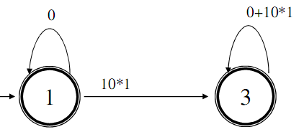
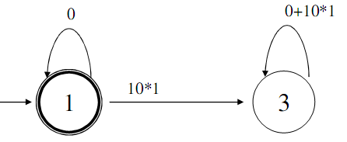
Step-2 : It is observered that after eliminating the Intermediate state -1, we are left out with two state automata. Since Finite Automata has two final states - 1 and 3, the corresponding Regular Expressions for two Final states are obtained by mapping, with genaralized Transition Diagram as indicated in the below diagram,
1. Two accepting states, turn off state 3 first
Here State-3 is Dead state and after elimination we will have one state Automata and the Corresponding to this the Regualr expression is :
RE = R* = 0* → R1

Slide 29
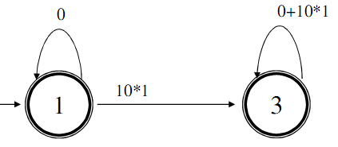
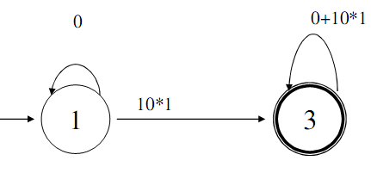
Here the Automata is a Two State automata and the Corresponding to this the Regualr expression is obtained by mapping with genaralized Diagram:
R = 0, S=10*1, U = 0+10*1 and T=Ø
Therefore the Corresponding Regular Expression is :
RE= (R+SU*T)*SU*
= ((0 + 10*1(0 +10*1)* Ø)* 10*1 (0 +10*1)*
= ((0 + Ø)*10*1 (0 +10*1)*
= 0*10*1 (0 +10*1)* → R2
Final Regular Expression is :
R = R1 + R2 = 0* + 0*10*1 (0 +10*1)*
Second time Turn off state - 1

Slide 30
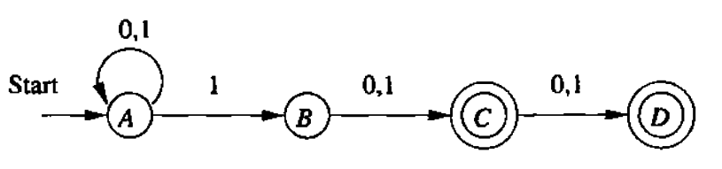
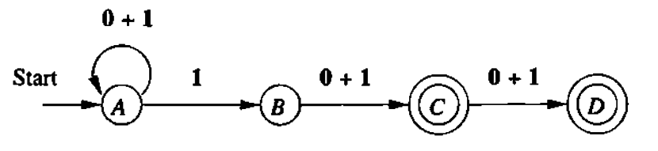
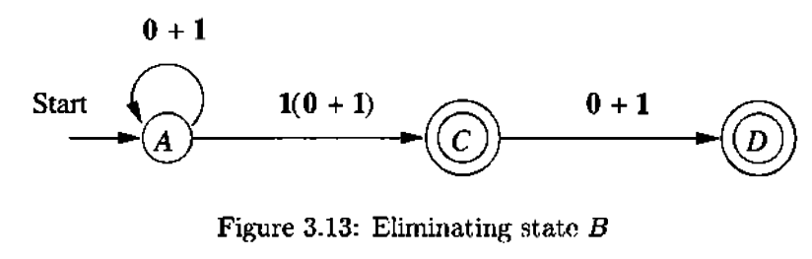
Example -2. Convert the following to a RE:
First the label on edges to a Regular Expression
Step-1 : Eliminate the state B, the Path starting at A passing through B and
reaching C - A →B → C and The RE corresponding to this path is 1(0+1)

Slide 31
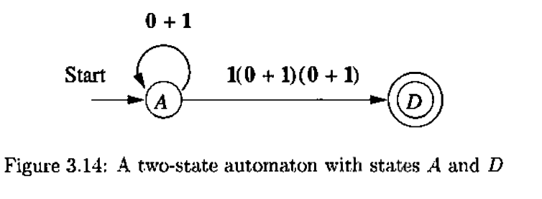
Step-2. There are Two final states. Firstly, turn off C. Then Eliminate the state C. The Path starting at A passing through C and reaching D - A →C → D. The RE corresponding to this path is - 1(0+1)(0+1). The resulting Automata is Two state Automata and The corresponding Regular Expression is obtained by mapping with genaralized Transition Diagram as indicated below.
R = 0+1, S=1(0+1)(0+1), U = Ø and T=Ø
Therefore the Corresponding Regular Expression is :
RE= (R+SU*T)*SU*
= ((0+1) + 1(0+1)(0+1)Ø*Ø)*1(0+1)(0+1)Ø*
= ((0 + 1) + Ø)* 1(0+1)(0+1)Ԑ
= (0 + 1) *1(0 + 1)(0 + 1) → R1

Slide 32
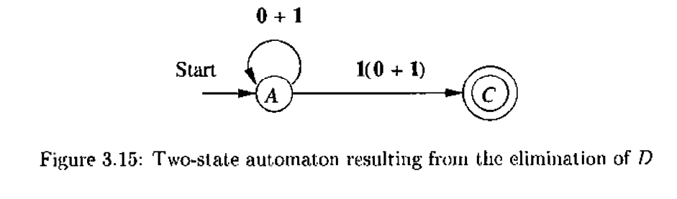
Step-3 : Secondly, turning off D. Eliminate the state D. Here, the path Starts at C and Reaches D - C → D. The State D becomes Dead as there are no out going edge. The Regular Expression corresponding to this path is →(0+1). The resulting Automata is Two state Automata and The corresponding Regular Expression is obtained by mapping with genaralized Transition Diagram and indicated below.
R = 0+1, S=1(0+1), U = Ø and T=Ø
Therefore the Corresponding Regular Expression is :
RE= (R+SU*T)*SU*
= ((0+1) + 1(0+1)Ø*Ø)*1(0+1)Ø*
= ((0 + 1) + Ø)* 1(0+1)Ԑ
= (0 + 1) *1(0 + 1) → R2
Final Regular Expression is :
R = R1 + R2 = (0 + 1) *1(0 + 1)(0 + 1) + (0 + 1) *1(0 + 1)
RE = (0 + 1) *1(0 + 1)(0 + 1) + (0 + 1) *1(0 + 1)

Slide 33
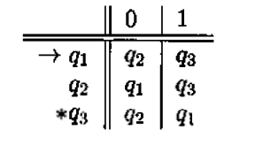
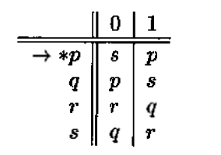
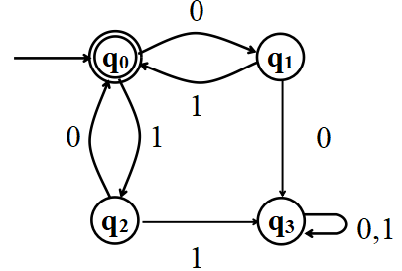
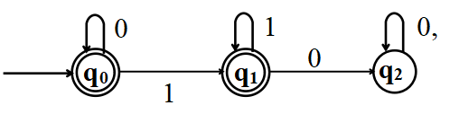
Exercise problems on building Regular Expression from NFA or DFA
Example -1
Example -2
Example -3
Example -4

Slide 34
3. Minimization Of Automata(DFA) Using Table Filling Algorithm
Let p and q are two states in DFA. Our goal is to understand when p and q (p ≠ q) can be replaced by a single state.
What are Distinguishable and Indistinguishable States ?.
Table filling Algorithm
Procedure Mark( )
Minimize_states( )
Examples

Slide 35
What are Indistinguishable pair and Distinguishable pair of states ?
Two states p and q of a DFA are called Indistinguishable if
δ*(p, w) Є F implies δ*( q, w) Є F
and
δ*(p, w) ∉ F implies δ*( q, w) ∉F for all w Є ∑*.
If on the other hand, there exists some string w Є ∑* such that
δ*(p, w) Є F implies δ*( q, w) ∉ F
or vice versa, then the state p and q are said to be a distinguishable by a string w.

Slide 36
Procedure Mark( )
Begin
Remove all inaccessible states. This can be done by enumerating all simple paths of the graph of the DFA starting at the initial state. Any state not part of such a path is inaccessible.
Consider all pairs of states (p, q).
If p Є F and q ∉F or vice versa Then
mark the pair (p, q) as distinguishable.
Repeat the following step until no previously unmarked pairs are marked.
For all pairs (p, q) and all aЄ∑, Compute
δ(p, a)= p_{a} and δ(q, a) = q_{a}.
If the pair (p_{a}, q_{a}) is marked as distinguishable Then
mark the pair (p, q) as distinguishable.
End.
Note : Marking of distinguishable and indistinguishable states are shown in the Lower tringular matrix.

Slide 37
Procedure Minimize_states()
Begin
. Using procedure MARK() obtain the table that gives pairs of distinguishable and Indistinguishable states which are indicated by * and blank respectively
For each indistinguishable state set say qi,qj….qk create new state labeled ij…k. for minimized DFA
For each transition rule of old DFA of the formδ (qr,a)=qp
Begin
Find the sets to which qr and qp belongs
. If qr ∈ to (qi, qj.....qk) And qp ∈ to (ql.qm…..qn) then
add the following transition rule to minimized DFA
δ(ij…k,a) = lm….n
End
The initial state q0 for minimized DFA is the state whose label includes 0
The Final states for minimized DFA is the set of all the states whose label Contains i such that qi ∈ F ( set of final sates of old DFA)
End

Slide 38
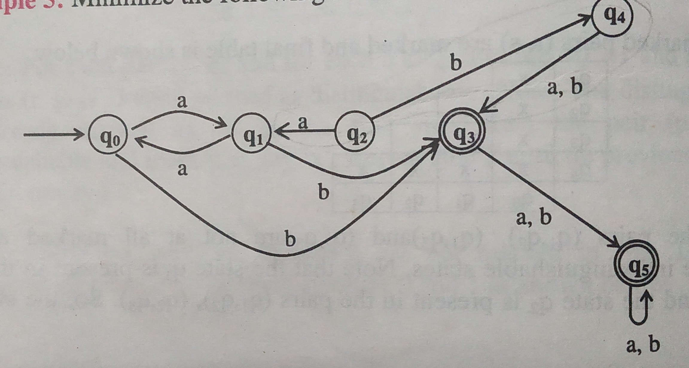
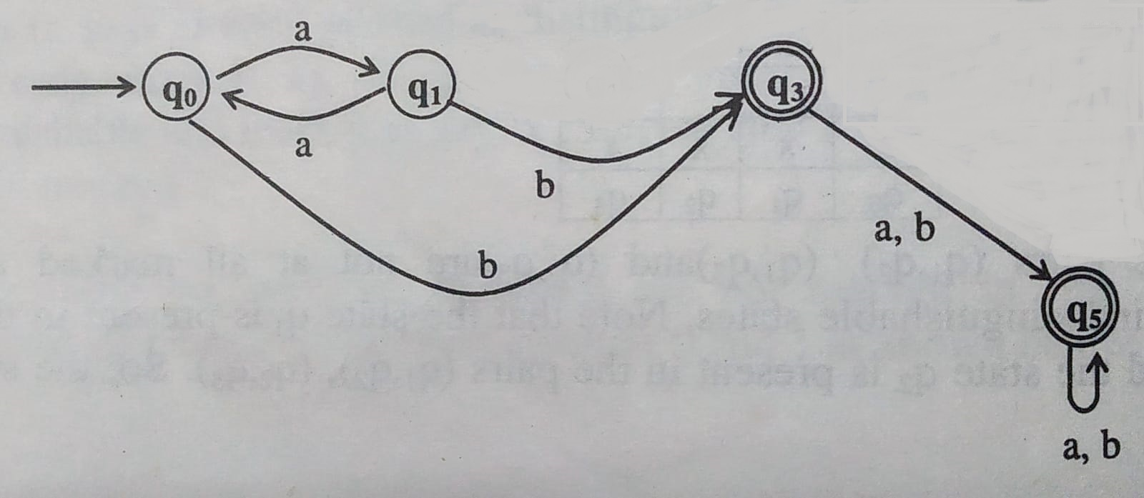
Examples on Minimization of DFA Using Table Filling Algorithm:
Example -1 :
Use Table Filling Algorithm to Minimize the states of DFA shown in the FIGURE-1. Also, Draw the Table showing the pair of Distingwishable and Indistingwishable States and Minimized DFA.
Answer :
Step-1 : Find the states which are inaccessible. It is clear from the FIGURE-1, that the states q2 and q4 are not accessible from Start state - q0. Hence these states (q2,q4) along with connecting edges are eliminated.
FIGURE-2 shows the DFA after eliminating the states q2 and q4
FIGURE - 1
FIGURE - 2

Slide 39
Examples on Minimization of DFA Using Table Filling Algorithm:
Example -1 :
Step-2 : Draw the Table (Two dimentional Lower Tringular Matrix ) to consider the pairs of states(p,q) for marking them as Distingwishable and Indistingwishable. Figure-3 Shows the Table.
Step -3 : Use Mark() procedure to find the pair of Distingwishable and Indistingwishable.
Initially, the pairs (q0, q3), (q0, q5), (q1,q3) and (q1, q5) are Marked as Distingwishable as one of state in the pair is a final state. Figure-4. Shows the Table
FIGURE - 2
q1
q3
q5
 | q0 | q1 | q3
←FIGURE - 3
q1
q3 | D | D
q5 | D | D
 | q0 | q1 | q3
←FIGURE - 4

Slide 40
Examples on Minimization of DFA Using Table Filling Algorithm:
Example -1 :
Then Unmarked pairs namely,(q0,q1) and (q3, q5) are considered for marking. This is done as follows and Fiqure-5 Shows final marked Table :
←FIGURE - 5
q1
q3 | D | D
q5 | D | D
 | q0 | q1 | q3
δ | a | b | Computaions
(q0, q1) | (q1,q0) | (q3, q3) | δ(q0, a)= q1 and δ(q1, a)= q0 →Pair is (q0,q1) Not Marked δ(q0, b)= q3 and δ(q1, b)= q3 →Pair is (q3,q3) Not a Pair
(q3, q5) | (q5, q5) | (q5, q5) | δ(q3, a)= q5 and δ(q5, a)= q5 →Pair is (q5,q5) Not a Pair δ(q3, a)= q5 and δ(q5, a)= q5 →Pair is (q5,q5) Not a Pair

Slide 41
Example -1 :
Step-4.
Find the minimized DFA . It is clear from the table shown in the Figure -5 that the pairs (q0, q1) and (q3, q5) are not marked and hence they are Indistingwishable States.
These can be combined as one state.
Finaly minimized DFA has only two states - (q0,q1) and (q3, q5).
Its trasitions - δ is obtained by consulting Original DFA.
Transition Table is shown in Figure -6
←FIGURE - 5
q1
q3 | D | D
q5 | D | D
 | q0 | q1 | q3
←FIGURE - 4
Step -5. Start state of the minimized DFA is the group which has start state of the Original DFA.
Step -6. Final state of the Minimized DFA is the group which has Final state of the Original DFA. Figure -7 shows the Final Minimized DFA
δ | a | b
(q0, q1) | (q0,q1) | (q3, q5)
(q3, q5) | (q3,q5) | (q3, q5)
δ | a | b
→(q0, q1) | (q0,q1) | (q3, q5)
*(q3, q5) | (q3,q5) | (q3, q5)
←FIGURE - 6
←FIGURE - 7

Slide 42
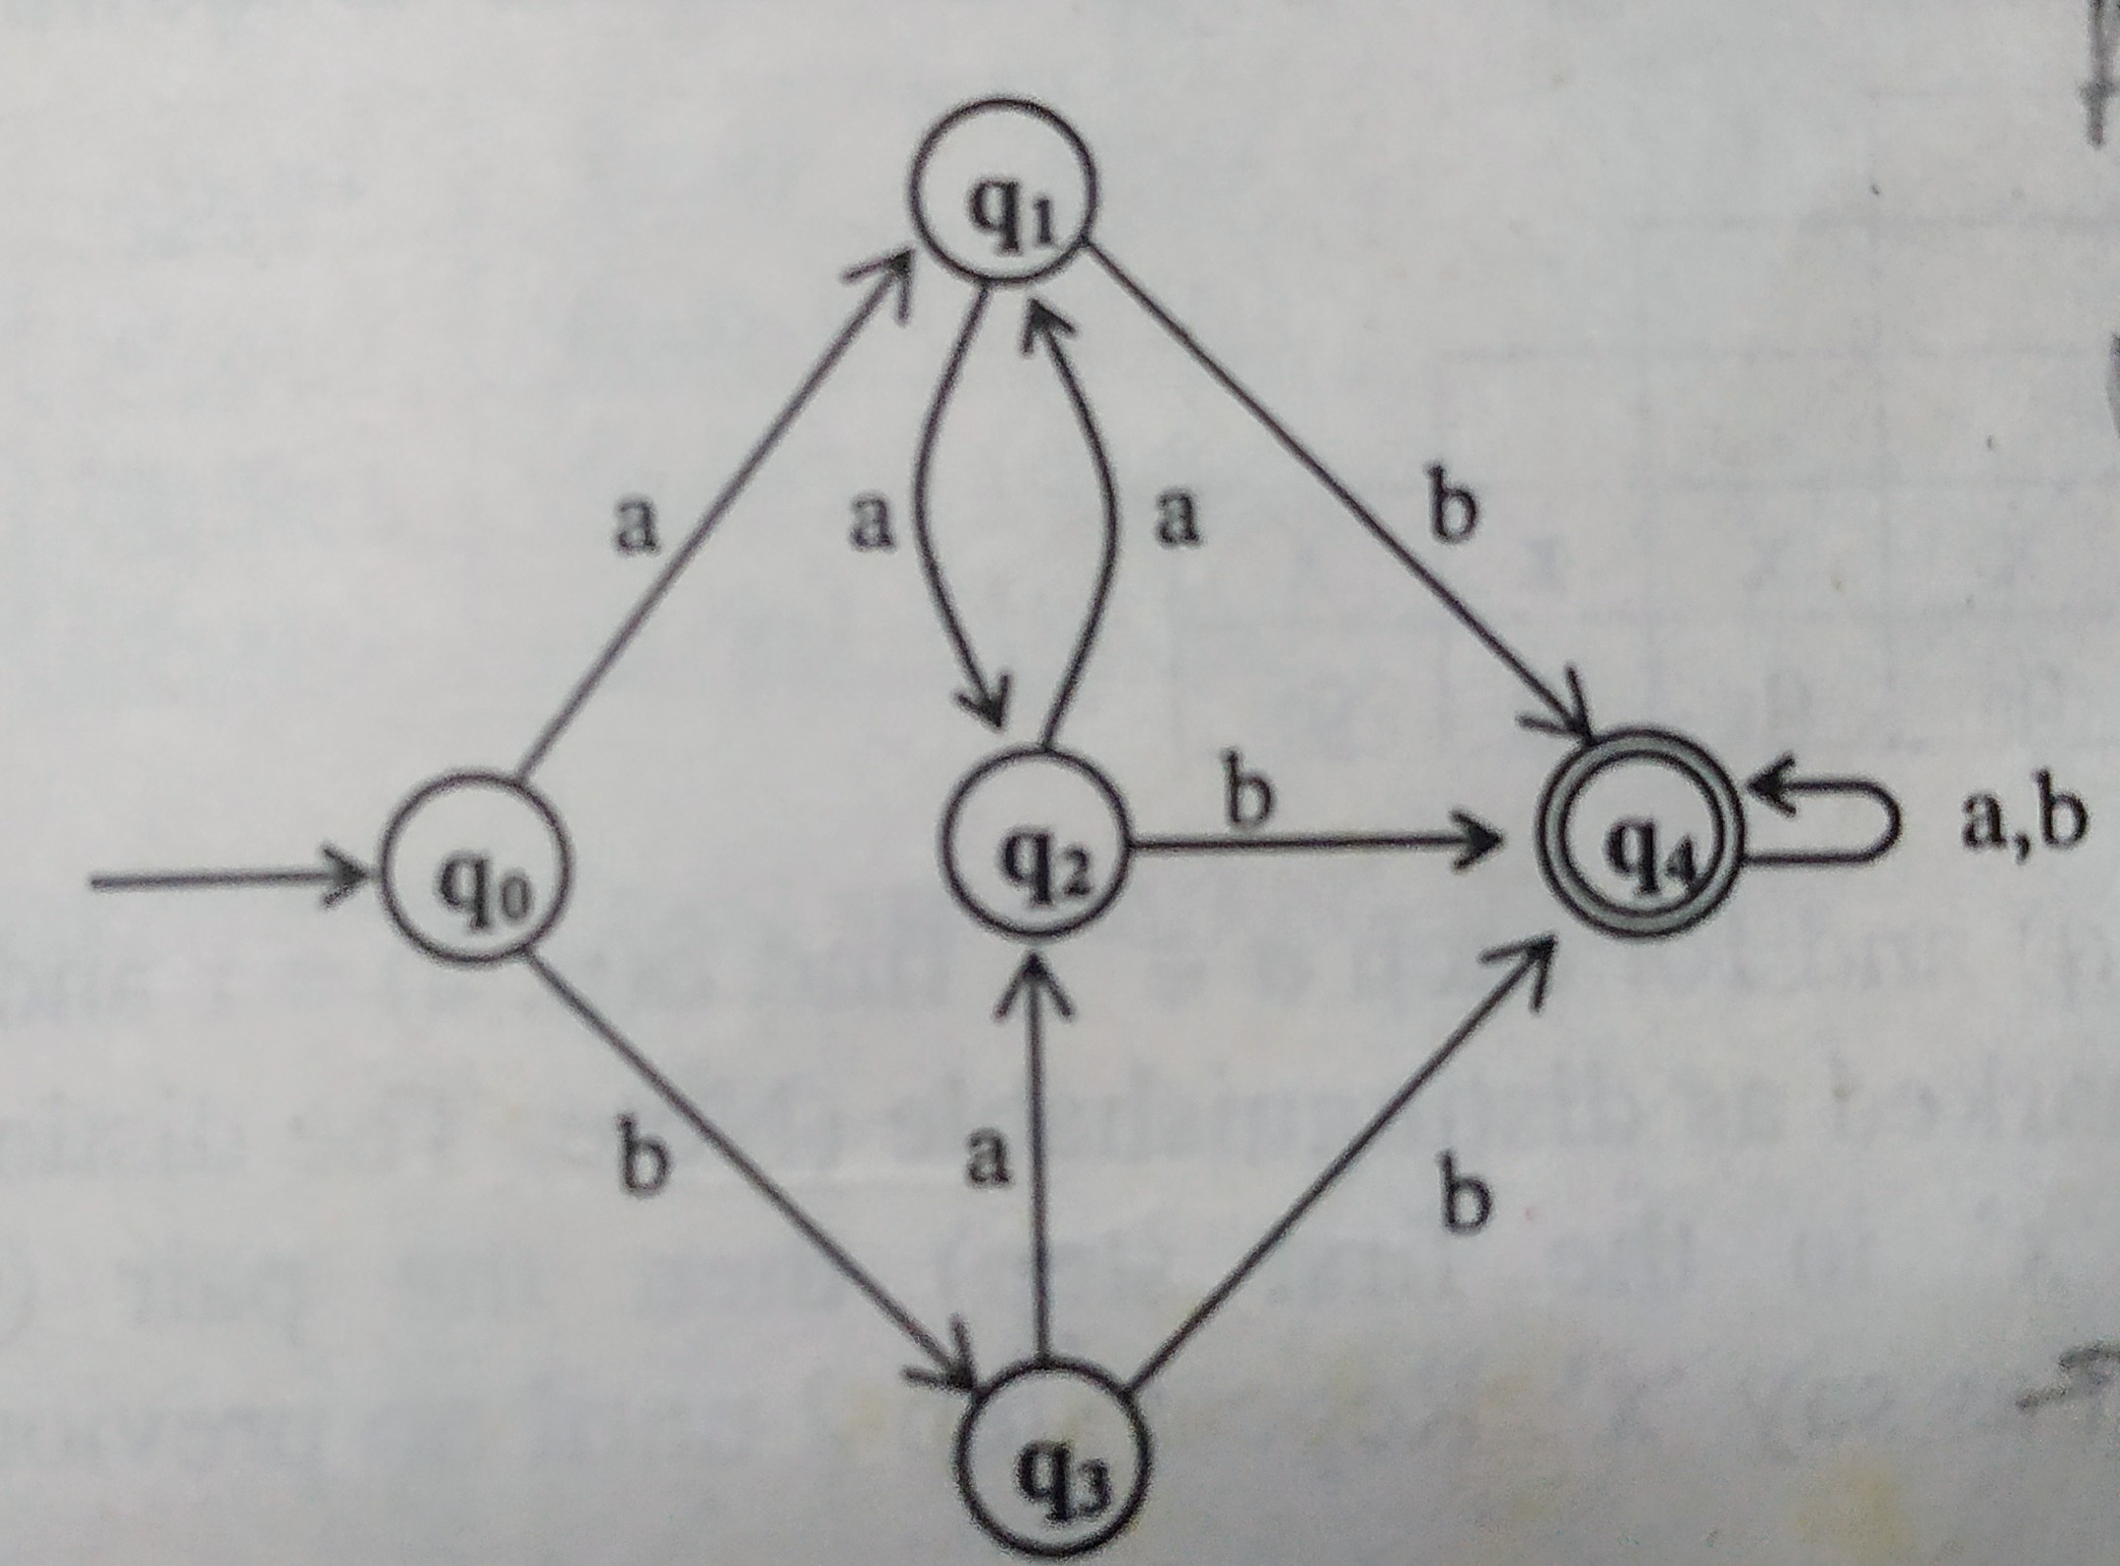
Example -2
Step-1 : Find the states which are inaccessible. It is clear from the Figure-1, that the all the states are accessible and no State gets eliminated. and DFA remains the same.
Step-2 : Draw the Table (Two dimentional Lower Tringular Matrix ) to consider the pairs of states(p,q) for marking them as Distingwishable and Indistingwishable. Figure-2 Shows the Table.
Figure -1
q1
q2
q3
q4
 | q0 | q1 | q2 | q3
←Figure -2

Slide 43
Step -3 : Use Mark() procedure to find the pair of Distingwishable and Indistingwishable.
Initially, the pairs (q0, q4), (q1, q4), (q2,q4) and (q3, q4) are Marked as Distingwishable as one of state in the pair is a final state. Figure-3. Shows the Table
Then Unmarked pairs namely,(q0,q1), (q0, q2),(q0, q3),(q1, q2), (q1, q3) and (q2, q3) are considered for marking. This is done as follows and Fiqure-4 Shows final marked Table :
←FIGURE - 3
q1
q2
q3
q4 | D | D | D | D
 | q0 | q1 | q2 | q3

Slide 44
δ | a | b | Computaions
(q0, q1) | (q1,q2) | (q3, q4) | δ(q0, a)= q1 and δ(q1, a)= q2 →Pair is (q1,q2) is Not Marked δ(q0, b)= q3 and δ(q1, b)= q4 →Pair is (q3,q4) is Marked so (q0, q1) is Marked
(q0, q2) | (q1, q1) | (q3, q4) | δ(q0, a)= q1 and δ(q2, a)= q1 →Pair is (q1,q1) is Not a Pair δ(q0, b)= q3 and δ(q2, b)= q4 →Pair is (q3,q4) is Marked so (q0, q2) is Marked
(q0, q3) | (q1, q2) | (q3, q4) | δ(q0, a)= q1 and δ(q3, a)= q2 →Pair is (q1,q2) Not Marked δ(q0, b)= q3 and δ(q3, b)= q4 →Pair is (q3,q4) is Marked so (q0, q3) is Marked
(q1, q2) | (q1, q2) | (q4, q4) | δ(q1, a)= q2 and δ(q2, a)= q1 →Pair is (q1,q2) is Not Marked δ(q1, b)= q4 and δ(q2, b)= q4 →Pair is (q4,q4) is Not a Pair
(q1, q3) | (q2, q2) | (q4, q4) | δ(q1, a)= q2 and δ(q3, a)= q2 →Pair is (q2,q2) is Not pair δ(q1, b)= q4 and δ(q3, b)= q4 →Pair is (q4,q4) is Not a Pair
(q2, q3) | (q1, q2) | (q4, q4) | δ(q2, a)= q1 and δ(q3, a)= q2 →Pair is (q1,q2) is Not Marked δ(q2, b)= q4 and δ(q3, b)= q4 →Pair is (q4,q4) is Not a Pair
←FIGURE - 4
q1 | D
q2 | D
q3 | D
q4 | D | D | D | D
 | q0 | q1 | q2 | q3

Slide 45
Step-4.
Find the minimized DFA . It is clear from the table shown in the Figure -4 that the pairs (q1, q2) , (q1, q3) and (q2, q3) are not marked and hence they are all Indistingwishable States.
These can be combined as one state. Further, by applying equivalnce property all q1, q2, q3 are indistingwishable and hence all three can be combined - (q1,q2,q3), as One state
Finaly minimized DFA has only three states - (q0), (q1, q2, q3) and (q4).
Its trasitions - δ is obtained by consulting Original DFA.
Transition Table is shown in Figure -5
←Figure - 4
q1 | D
q2 | D
q3 | D
q4 | D | D | D | D
 | q0 | q1 | q2 | q3
δ | a | b
(q0) | (q1, q2, q3) | (q1, q2, q3)
(q1, q2, q3) | (q1, q2, q3) | (q4)
(q4) | (q4) | (q4)
Figure - 5

Slide 46
Step -5. Start state of the minimized DFA is the group which has start state of the Original DFA.
Step -6. Final state of the Minimized DFA is the group which has Final state of the Original DFA. Figure -6 shows the Final Minimized DFA
δ | a | b
→(q0) | (q1, q2, q3) | (q1, q2, q3)
(q1, q2, q3) | (q1, q2, q3) | (q4)
*(q4) | (q4) | (q4)
← Figure - 6

Slide 47
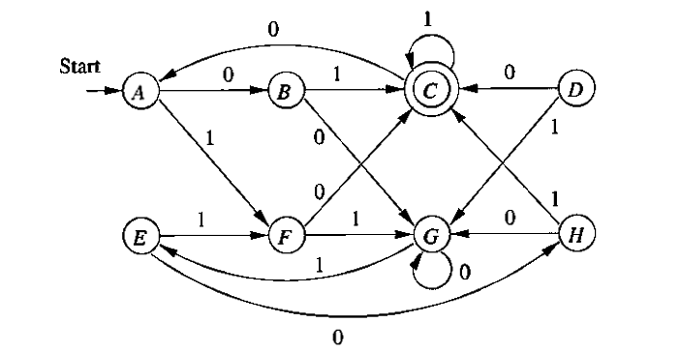
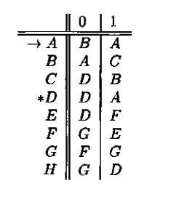
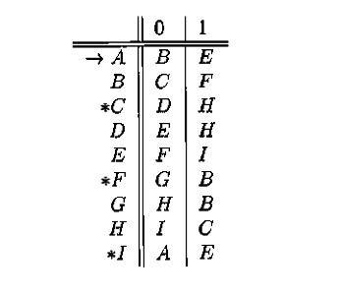
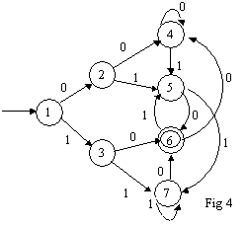
Exercise Problems on minimization of DFA
Example -1
Example -3
Example -4
Example -2

Slide 48
4. Properties of Regular Languages :
4.1. Introduction
It is observed from the previous chapters that the language is powerful tool for effective communication where one can express our thoughts and ideas.
Initiallly we dealt with the class of language known as Regular language which are very primitive in nature.
We also know that If a Language L is Regular then there exist a DFA, NFA Ԑ-NFA and Regular Expression. Conversly, the language denoted or described by DFA, NFA, Ԑ-NFA and Regular Expression are always a Regular Language.
Not every language is Regular. It means that beyond Regular language there are some other languages and they are called Non Regular language.
In order to prove certain languages are not regular we use pumping Lemma

Slide 49
Basically, the Pumming Lemma works on the Principle called Pigeon Hole Principle and it is stated as follows :
Statement of Pigeonhole principle:
The term Pigeonhole principle is used by mathematicians, that refers to the simple observation made.
“ if there are ‘n’ objects and ‘m’ boxes (pigeonholes), if all the ‘n’ objects to be placed into ‘m’ boxes and n>m then atleast one box must have more than one object in it “

Slide 50
4.2. Statement of Pumping Lemma for Regular Languages:
Applying Pumping Lemma one can prove certain Languages are Non Regular Languages.
The Statement of Pumping Lemma is as follows :
Let D = { Q, ∑, δ, q₀, F} be the Deterministic Finite Automata -DFA and has ‘n’ number of states.
Let L(D) is the language associated with DFA- D and is Regular.
Let every string x € L(D) or L, then there exists a constant ‘m’ such that | x | >=n, i.e the length of the string is as larger as possible with respect to the number of states ‘n’.
Now if the string ‘x’ is decomposed into three substrings u, v and w, such that |uv| <= n and |v|>=1 then x= uv^{i}w € L for all i=0,1,2,3,........
Proof :
Given that DFA D = { Q, ∑, δ, q₀, F} and L(D) or L is the language accepted by the DFA D. Hence the given Language L is regular.
Let x = a1, a2, a3,........am be the string whose length ‘m’ is as larger as possible with respect to the number of states -n. i.e | x | >=n or m >= n

Slide 51
We have ‘m’ number of symbols in a given String x.
To accept one symbol by DFA, we require Two distinct states say q0, q1. For Two symbols, we require Three distinct states say q0, q1, q2.
Since we have ‘m’ number of symbols in the string x, we reguire ‘m+1’ states in the sequence, q0, q1, q2,.......qn.
The constructed DFA is as shown in the following figure :
Here q0 is start State and qm is the final state.
Since | x | >= n, according to the pigeion principle, we cannot have m+1 distinct states and transitions, there must be one state within DFA that can have a loop.
In otherwords there exists two indices j and k such that 0 <= j <= k <= n and assocated states qj and qk must be equal to accept the substring of a given string x.
q₀
a₁
a₂
a_{m}
q₁
q₂
q_{n-1}
q_{n}

Slide 52
Let x is divided into three substrings u, v, and w, with prefix string, Loop string and suffix string.
i.e. u is prefix of string x → a1, a2,.........aj
v is Loop within the string x → aj+1, aj+2,.........ak
w is suffix of string x → ak+1, ak+2, ak+3,.........am
The same is shown in the following Figure.
From the above figure it is very clear that the
The Prefix string u takes the DFA from q0 to qj.
The Loop String v takes the DFA from qj to qk (qj=qk → Pigeion Principle).
The Suffix string w takes the DFA from qk to qm.
a_{j+1} to a_{k}
q₀
qj = qk
q_{n}
a₁ to a_{j}
a_{k+1} to a_{m}
| u | v | w |

Slide 53
It can also be interpreted as follows :
if i = 0, the string uw is accepted by DFA - D
if i = 1, the String uvw is accepted by a DFA -D
If i = 2, the String uvvw is accepted by a DFA -D
This can be continued for any value for i.
In genaral, for i > 0 :
the DFA goes from q0, accepting the substring u → a0, a1, a2,....aj and reaches to state qj.
Then DFA loops from qj to qk, accepting the substring v →aj+1, aj+2,.........ak and remains in state qk (qj=qk).
Finally starts from qk, accepteting the string w → ak+1, ak+2, ak+3,.........am and reaches to state qm.
If qm € F , the string x is accepted.

Slide 54
From this it is quite evident that the string X whose length is greater than the number of states, is divided into Three substrings u, v and w then the string x=uv^{i}w € L for i=0, 1, 2,.........
This can be expressed as follows :
δ*(q0, a1, a3,.....am)
= δ*(q0, a1, ...aj, aj+1, aj+2,..ak, ak+1, ak+1,.....am)
= δ*(qj, aj+1, aj+2,..ak, ak+1, ak+1,.....am) ( accepting Prefix string,
staying in qj)
= δ*(qk, ak+1, ak+1,.....am) ( accepting Loop string and staying in
qj=qk )
= qm ( accepting suffix string and staying in qm )
if qm € F then string x is accepted by DFA. This proves the agrument of pumping lemma for Regular Languages.

Slide 55
4. 3. Genaral stretegy to apply Pumping Lemma to prove certain languages are not Regular.
1. Assume that the given Language L is Regular and ‘n’ be the number of states present for DFA.
2. Select the string ‘x’, such that | x | >= n, for some positive value for ‘n’. In otherwords, |x| is as large as possible with respect to number of states ‘n’.
3. Divide the string x into three substrings namely, u, v, and w, i.e. x=uvw, such that |uv| <= n and |v| >=1.
4. Find any value for i such that x=uviw ∉L. According to Pumping Lemma x=uviw € L, the result obtained is contradiction to the assumption that the given Language L is Regular, therefore the language L is NOT REGULAR.

Slide 56
4.4. Examples on Pumping Lemma
Apply Pumping Lemma and Prove that the Following Languages are NOT Regular :
1. L = { a^{n} b^{n} | n>=1 }
2. L = { ww^{R} | w € (a+b)* }
3. L = { a^{i} b^{j} | i > j }
4. L = { (ab)^{n} a^{k} | n > k, k>=0 }
5. L = { w | n_{a}(w) = n_{b}(w) and w € (a+b)* }
6. L = { w | n_{a}(w) < n_{b}(w) and w € (a+b)* }.
7. L = { w | n_{a}(w) > n_{b}(w) and w € (a+b)* }
8. L = { a^{n} | n is prime }
9. L = { a^{n!} | n >=0 }
10. L = { a^{n} | n is perfect square } .

Slide 57
Example -1 : Consider L = { a^{n} b^{n} | n>=1 } Apply Pumping Lemma and prove that the Laguage is not Regular
Answer :
1. Assume that the given Language L is Regular and ‘n’ be the number of states present for DFA.
2. Select the string ‘x’, such that | x | >= n, for some positive value for ‘n’. In otherwords, |x| is as large as possible with respect to number of states ‘n’.
x = a^{n} b^{n} and |x| = n+n = 2n > n, the number of states
3. Divide the string x into three substrings namely, u, v, and w, i.e. x=uvw, such that |uv| <= n and |v| >=1.
i.e x = a^{n-1} a b^{n}
|←u→| | v | |←w→| where |u| = n-1 and | v | =1
therefore | uv | = n-1+1 = n
| u | v | w |

Slide 58
4. Find any value of i and prove that x=uviw ∉L. According to Pumping Lemma x=uv^{i}w € L, the result obtained is contradiction to the assumption that the given Language L is Regular, therefore the language L is NOT REGULAR.
For i = 0, the v does not exists
i.e. x = uv^{i}w
= uv⁰w
= uw
= a^{n-1} b^{n} ∉ L →
|←u→| |←w→|
According to Pumping Lemma x=uv^{i}w € L and now x = a^{n-1} b^{n} ∉L. This is contradiction to the assumption that the Language L Is Regular, therefore the Language is not Regular.

Slide 59
Example -2 : Consider L = { a^{n!} | n >=0 }. Apply Pumping Lemma and prove that the Laguage is not Regular
Answer :
1. Assume that the given Language L is Regular and ‘n’ be the number of states present for DFA.
2. Select the string ‘x’, such that | x | >= n, for some positive value for ‘n’. In otherwords, |x| is as large as possible with respect to number of states ‘n’.
Note : n! = 1*2*3.........n
x = a^{n!} and |x| = n! this is > the number of states
3. Divide the string x into three substrings namely, u, v, and w, i.e. x=uvw, such that |uv| <= n and |v| >=1.
i.e x = a^{n!} = a^{j} a^{k} a^{n!-j-k}
|←u→| | v | |←w→| where |u| = j and | v | = k
therefore | uv | = j+k < = n

Slide 60
4. Find any value of i and prove that x=uviw ∉L. According to Pumping Lemma x=uv^{i}w € L, the result obtained is contradiction to the assumption that the given Language L is Regular, therefore the language L is NOT REGULAR.
x = uv^{i}w =
= a^{j} (a^{k}) ^{i} a^{n!-j-k} For i = 0, the v does not exists
= a^{j} a^{n!-j-k}
|←u→| |←w→|
= a^{n!-k} ∉ L →
According to Pumping Lemma x=uv^{i}w € L and now x = a^{n!-k} ∉L (n!-k never be equal to n! for k=1, 2,....). This is contradiction to the assumption that the Language L Is Regular, therefore the Language is not Regular.

Slide 61
5. Applications of Regular Expressions :
The regular Expressions are mainly used in pattern matching applications, where are compiled, behind the scenes into deterministic or non deterministic automata, which are then simulated to produce a program that recognizes a pattern in a text.
There are two classes of regular based applications :
1. Lexical Analysis and 2. pattern matching or text search.
1. Lexical Analysis :
It is one of the major componet of a compiler, that scans the source program line by line and character by character and groups them into a meaningful sequence of characters called tokens. These tokens include : Keywords, identifiers etc..
The UNIX command lex and GNU version flex uses these specifications of tokens in the form of Regular expression as input and genarate the section of code that mimics the working of lexical analyser.

Slide 62
2. Pattren Matching :
An application of patten matching occurs in text editing. All the text editors allows files to be scanned for the occurance of a given string.
For example,. the VI editor in the UNIX OS recognizes the command /aba*c/ as an instruction to search for the file for the first occurance of the string ab, followed by arbitrary number of a’s followed by c

Slide 63
END of UNIT-2

