Slide 1
Software Testing

Slide 2
Why Do we Test.?
To make a judgment about quality or acceptability.
Discover Problems
Check whether all specifications(Requirements) are met or not?

Slide 3
Software Testing
It is a method to check whether the actual software product matches the expected requirements and to ensure that software product is defect free.
The purpose of software testing is to identify errors, gaps or missing requirements in contrast to actual requirements.

Slide 4
Importance of Software Testing
Software Testing is important because if there are any errors or bugs in the software it can be identified early and can be solved before the delivery of the software product.
Properly tested software ensures reliability, security, high performance which further in time saving, cost effectiveness and customer satisfaction.

Slide 5
Basic Definitions
Error(mistake): Mistakes done in the program while coding by which developer cant compile the program.
Fault(defect):It is a condition that causes a system to fail in performing its required functionality.
Failure: Once the software is ready to use ,end user is using it but the end user is facing some issues in the production then it is said to be failure.
Incident: Alerts user occurrence of a Failure

Slide 6
Basic Definitions
Incident- An incident is any situation where the system exhibits questionable behaviour.
An incident is any event occurring where actual results vary from expected results.
Any inconsistency between the actual output and expected output caused by---
Test Environment issue, Issue with developer code, Invalid expected results, Tester mistake, Issue with test data, Issue with hardware.

Slide 7
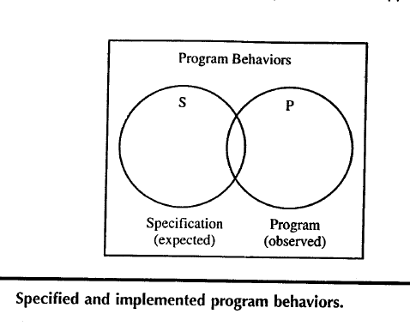
Insights from a Venn Diagram

Slide 8
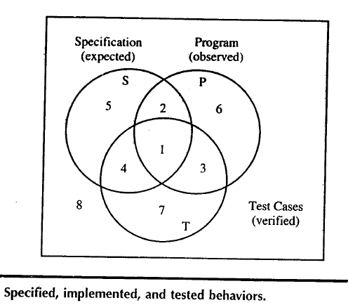
Cont.,

Slide 9
Venn diagram Continues…
2,5 Specified Behaviour that are not tested
1,4 Specified behaviour that are tested
3,7 Testcase corresponding to unspecified behaviour (They are programmed and tested but not specified)
2,6 Programmed behaviour that are not tested
1,3 Programmed behaviour that are tested
4,7 Test cases that are unprogrammed behaviour.

Slide 10
Venn diagram Continues…
If there are specified behaviours, which are not tested ,the testing is incomplete.
The test cases which are unspecified behaviour such test cases are unwarranted.
If certain specified behaviour have not been programmed then it is said as fault of omission.
If certain programmed behaviours have not been specified such thing is said as faults of commission.

Slide 11
Venn diagram Continues…
The intersection of specified and programmed is the correct portion,i,e behaviour that are both specified and implemented such testing can be said as Good Testing.

Slide 12
Venn diagram Continues…
Draw the Venn diagram for the following
2,4,5 are Specified behaviors
3,6,8 are Programmed behaviors
1,7,9 are Tested behaviors
10,11, are Specified and Programmed behaviors
14,17 are Programmed and Tested behaviors
12, 13 are Specified and Tested behaviors
15,16,19 are Specified ,Programmed and tested behaviors.

Slide 13
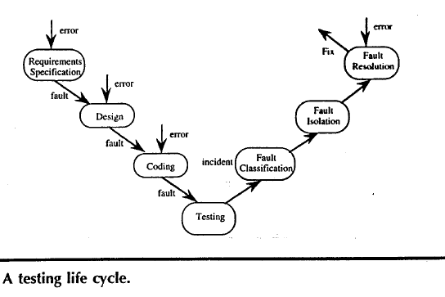

Slide 14
Process of testing
Test planning
Test case development
Running test cases
Evaluating test results

Slide 15
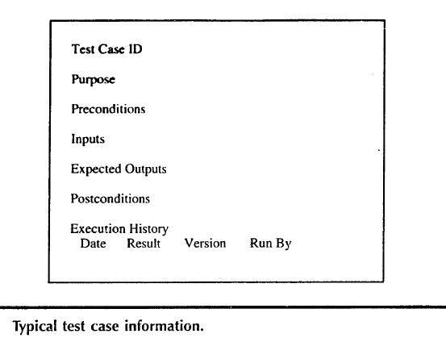
Test Cases

Slide 16
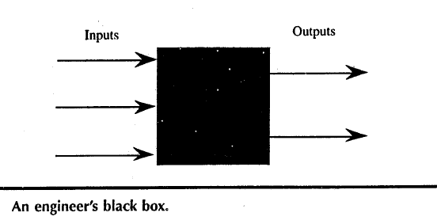
Identifying Test Cases
Functional Testing( Black Box Testing): implementation of Black box is not known.
Function of black box is understood by i/p & o/p.

Slide 17
Functional Testing
Advantages
Independent of how the software is implemented.
If implementation change test cases are still useful
Test case development can occur in parallel with the implementation.
Disadvantage:
Redundancies may exist among test cases
Possibility of gaps of untested software.

Slide 18
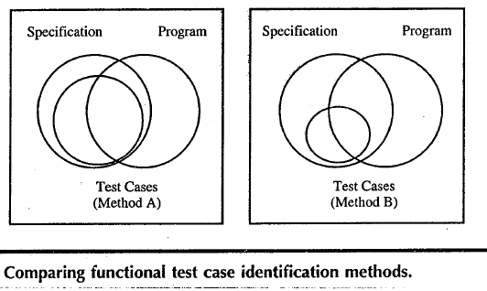
Conti.,

Slide 19
Structural Testing
Also called white box testing( even clear box Testing)
Implementation (of the Black box) is known & used to identify test cases.

Slide 20
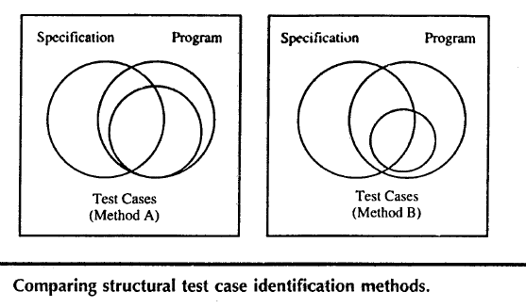

Slide 21
The functional VS Structural Debate
Goals of both approach is to identify test cases.
Functional testing uses only the specification to identify test cases.
Structural testing uses the programs source code(implementation) as the basis of test case identification.
Functional testing is behavior testing of software
Structural testing is logic testing of software
Functional testing is carried out by a group of people belongs to testing team
Structural testing is carried out by S/w developer.

Slide 22
The functional VS Structural Debate
Mendatory to have have knowledge of programming.
Knowledge of programming is not mendatory
Applicable to higher level of testing of software
Generally applicable to lower levels of software testing
Testing can be done by trial and error method
One should have domain and programming knowledge
Functional testing is closed box testing
Structural testing is called as clear box testing

Slide 23
Contd….
Types of Black box (Functional) testing
i. Functional testing
ii. Nonfunctional testing
iii. Regression testing
Types of White box (Structural ) testing
i. Loop testing
Conditional testing
Path testing

Slide 24
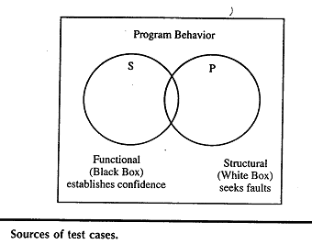
Cont.,
When functional test cases are executed in combination with structural test coverage metrics twin problems redundancies & gaps faced by functional testing can be recognized & resolved.

Slide 25
Testing as a craft
When we know what kind of error we are prone to make
If we know what kind of faults are likely to reside in software to be tested.
We can use this to employ more appropriate test case identification methods.
At this point testing really becomes a craft.

Slide 26
Error & Fault Taxonomies
Definition of error & fault hinge on the distinction between process & product
Process-refer to how we do something.
Product-end result of a process.
SQA- tries to improve the product by improving the process.
Testing is clearly more product oriented.
Faults can be classified in several ways

Slide 27
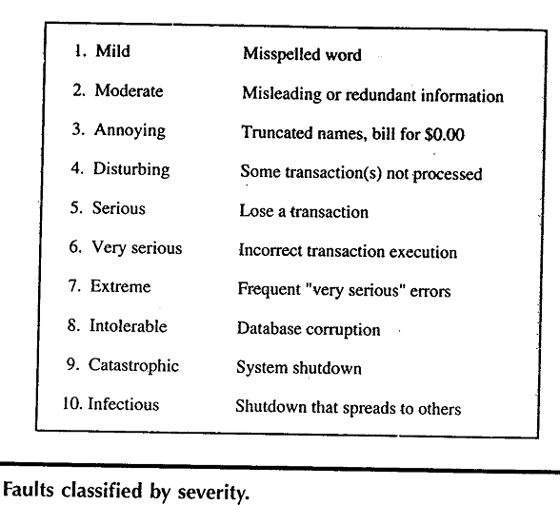

Slide 28
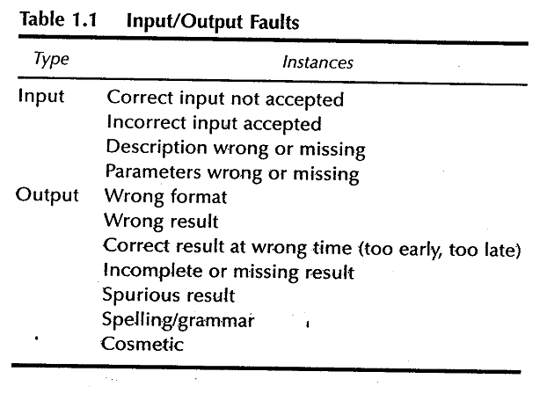

Slide 29
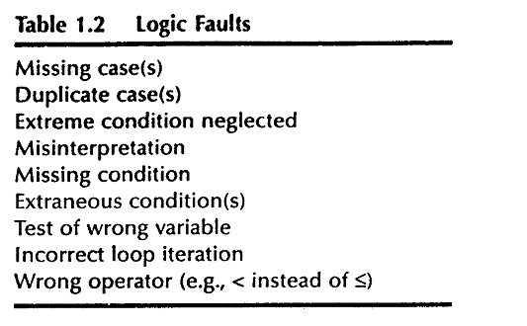

Slide 30
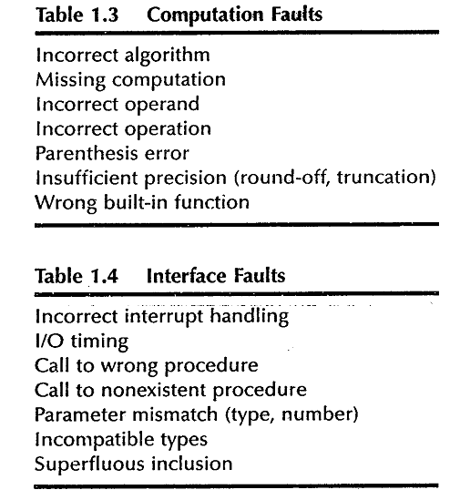

Slide 31
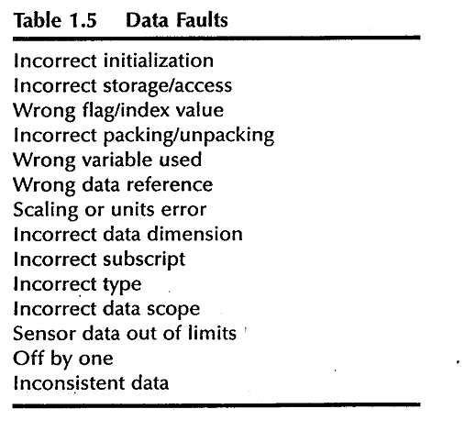

Slide 32
Levels of Testing
Levels of testing echo the levels of abstraction found in the waterfall model of the SDLC.
In functional testing 3 levels of definition (specification, preliminary design, detailed design) correspond directly to 3 levels of testing –system, integration & unit testing.

Slide 33
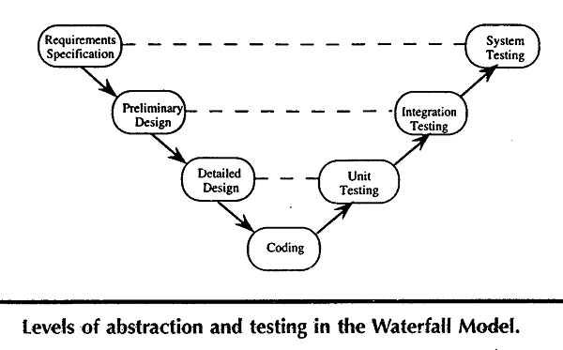

Slide 34
Examples
Three examples to illustrate various unit Testing methods.
These examples raise most of the issues that testing craftsperson's will encounter at the unit level.
For the purpose of structural testing, pseudocode implementation of 3 unit-level eg. are given.
The triangle problem
NextDate
Commission problem

Slide 35
Generalized Psuedocode
Pseudocode provides a “language neutral” way to express program source code.
Pseudocode given here is based on visual basic.

Slide 36
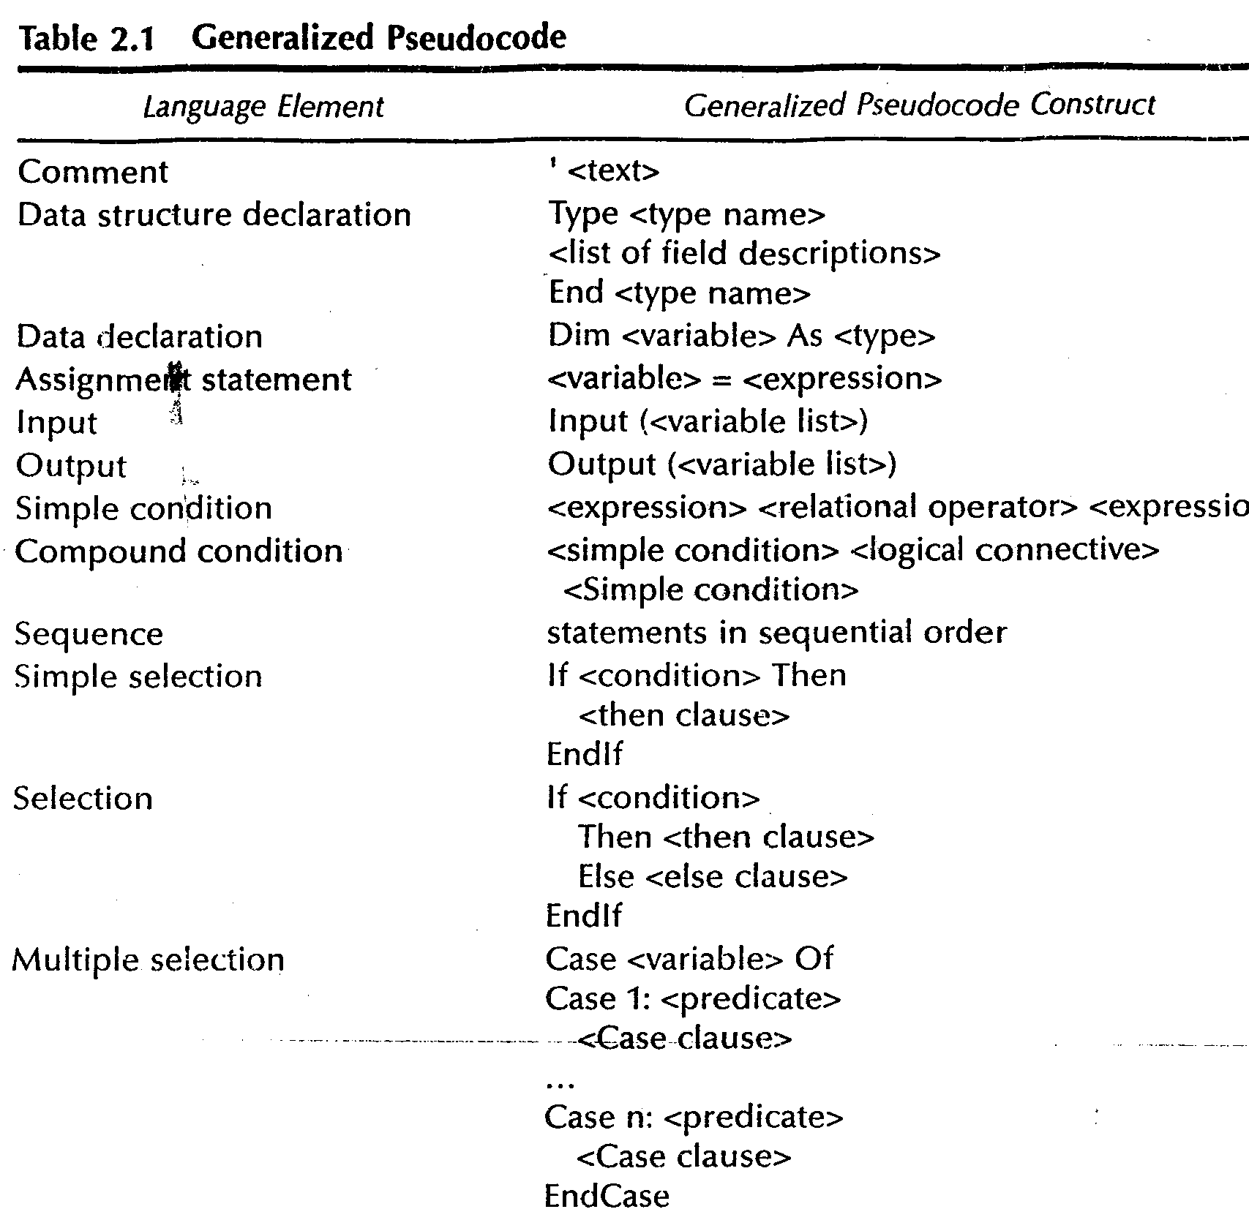

Slide 37
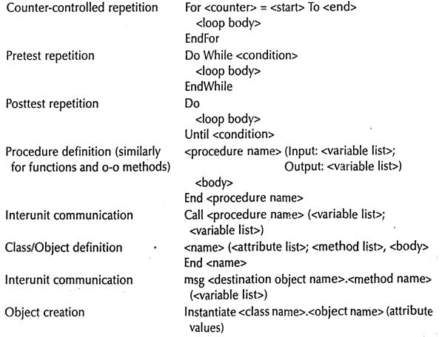

Slide 38
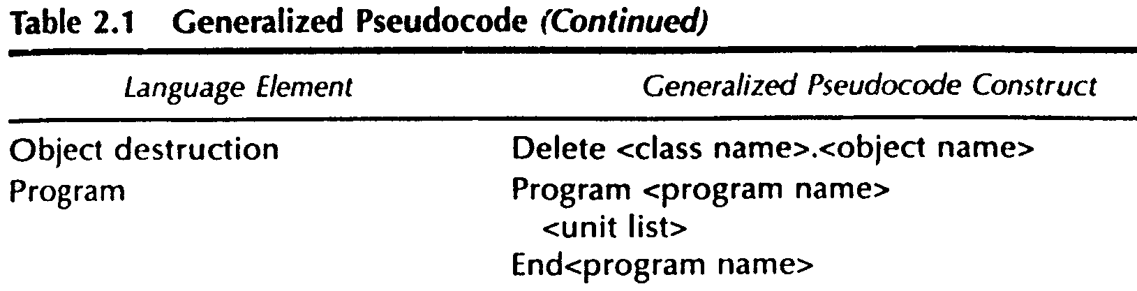

Slide 39
Triangle Problem
Problem statement
Simple version: The triangle program accepts 3 integers a, b, c as input to be sides of a triangle
o/p is type of triangle determined by 3 sides
Equilateral, Isosceles, Scalene, Not a triangle.

Slide 40
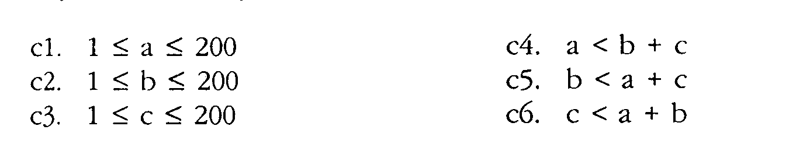
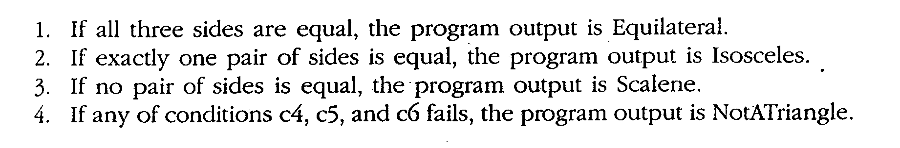
Improved version
Sides of triangle integer a, b, c must satisfy the following conditions
One of the 4 mutually exclusive output is given

Slide 41
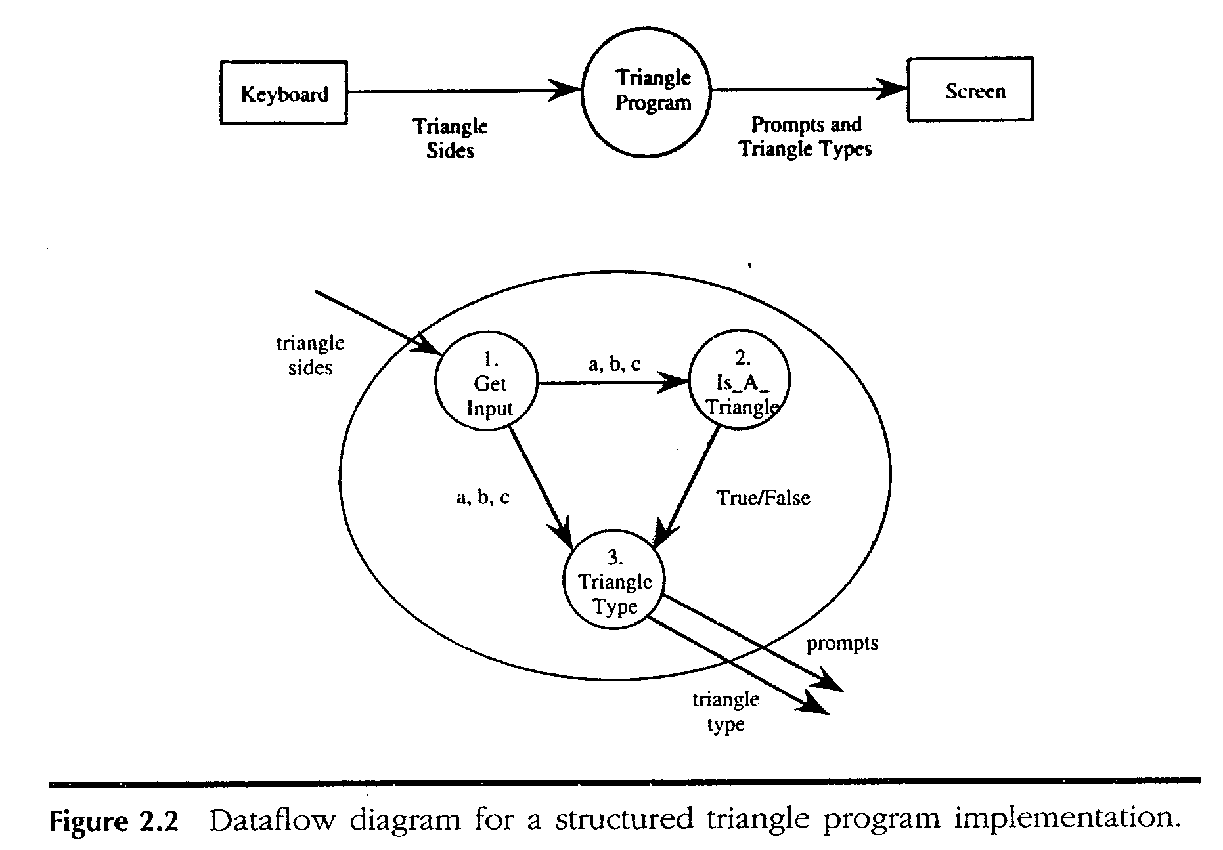

Slide 42
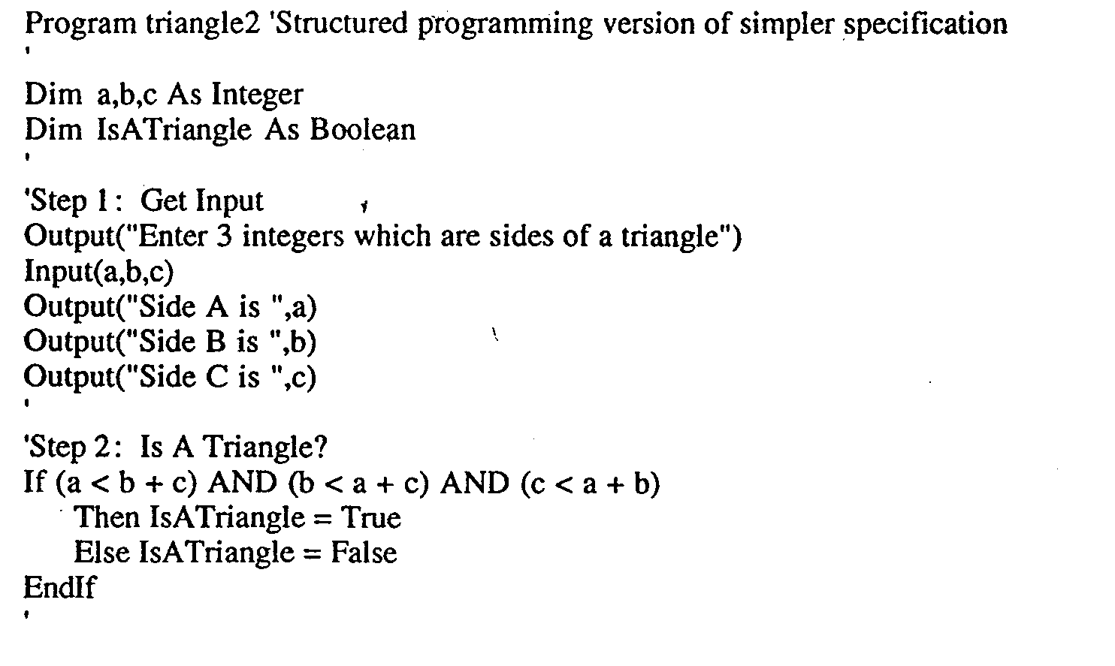

Slide 43
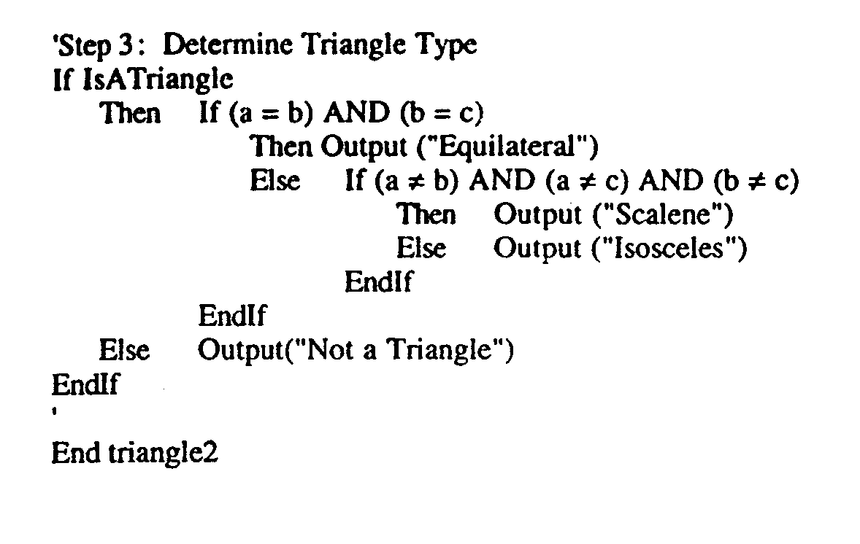

Slide 44
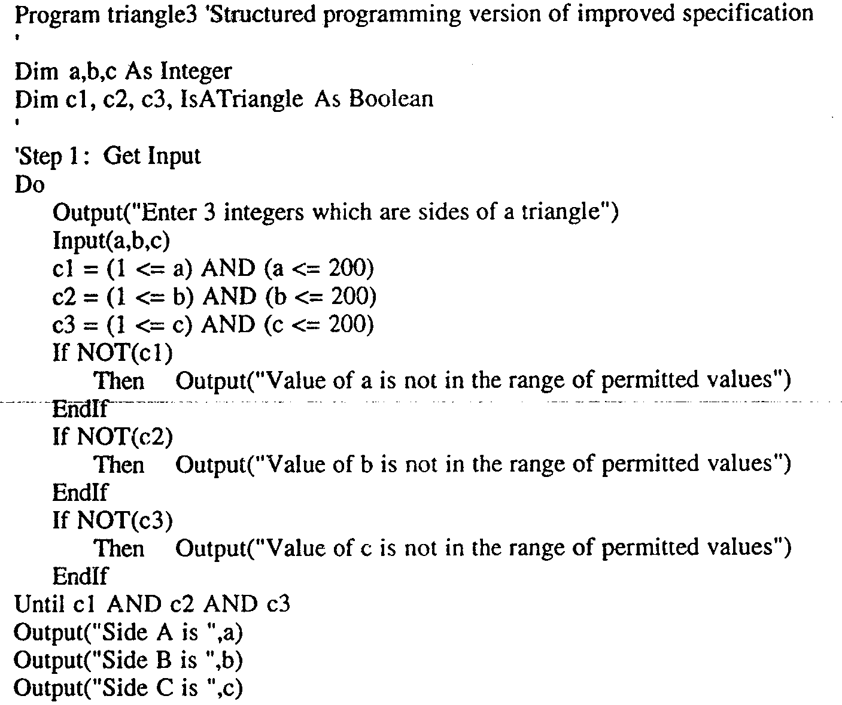

Slide 45
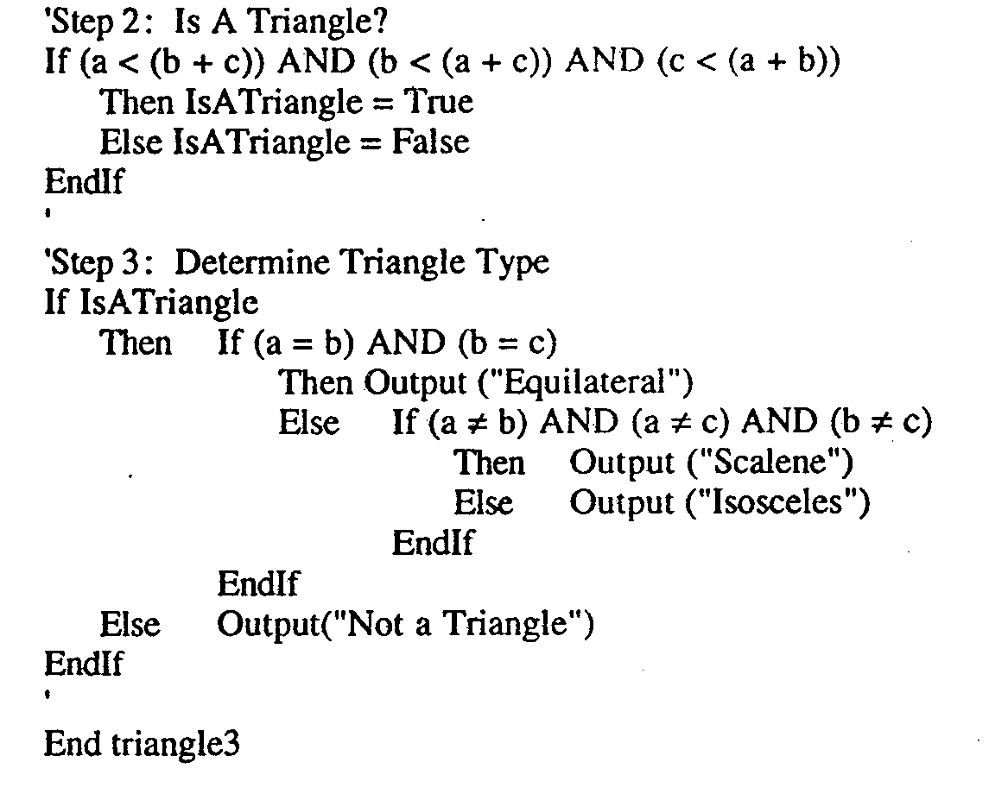

Slide 46
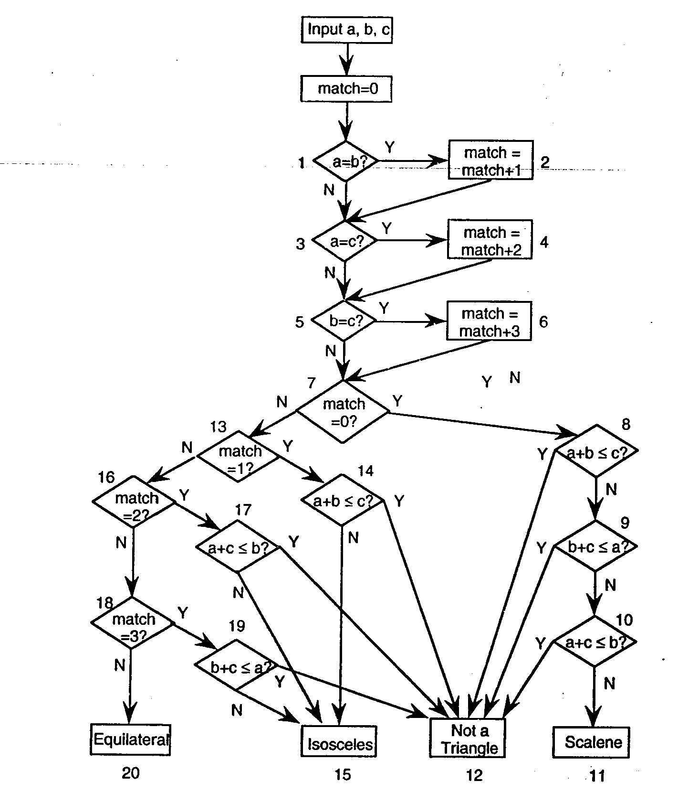
Traditional Implementation

Slide 47
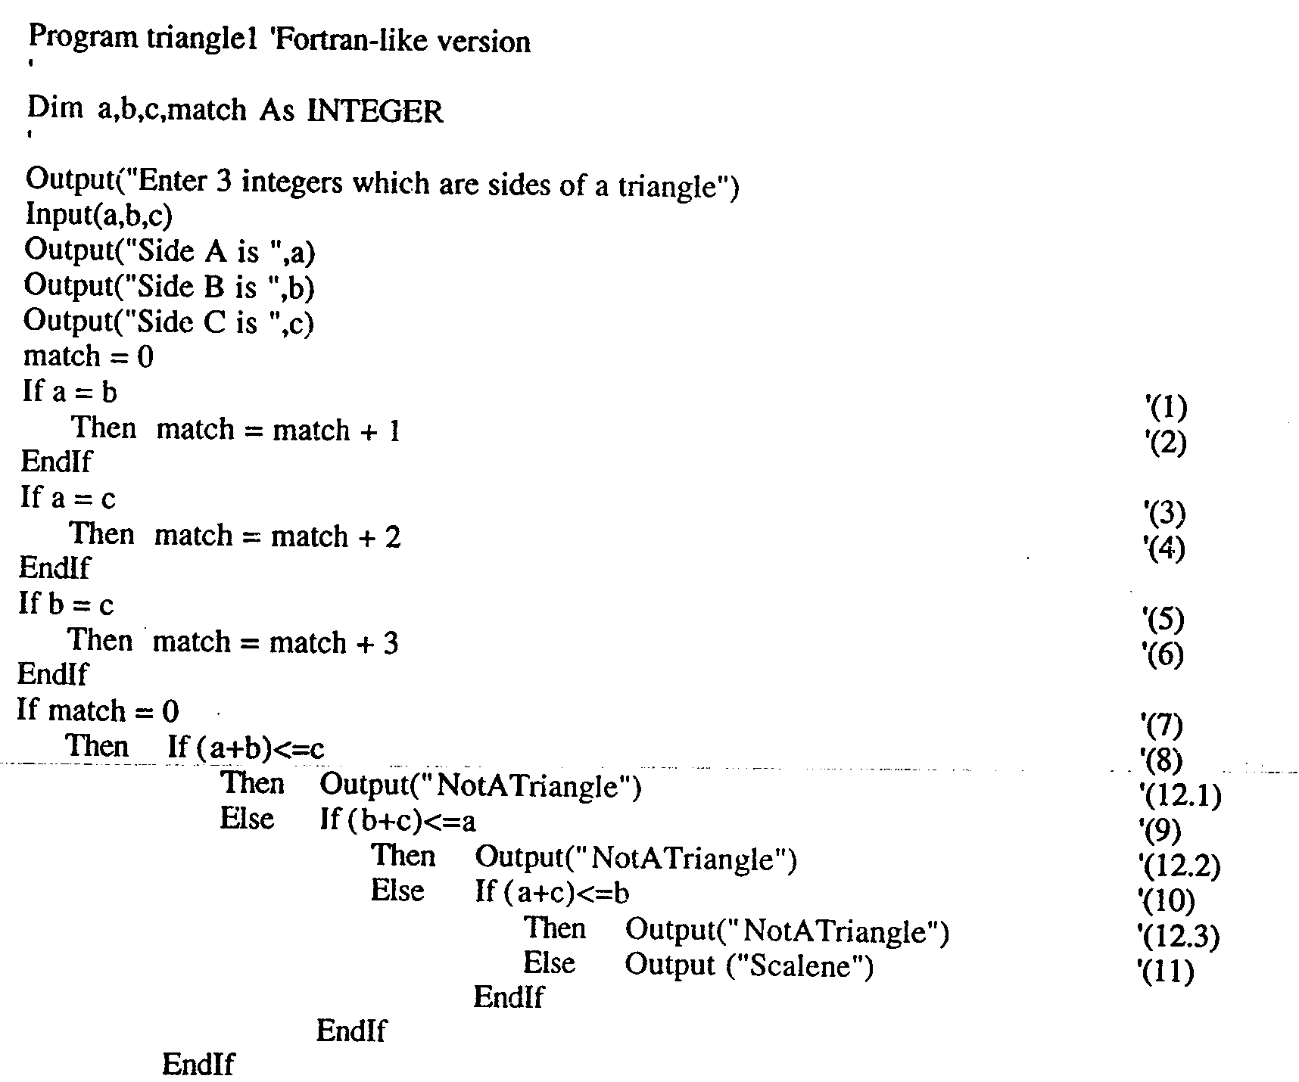

Slide 48
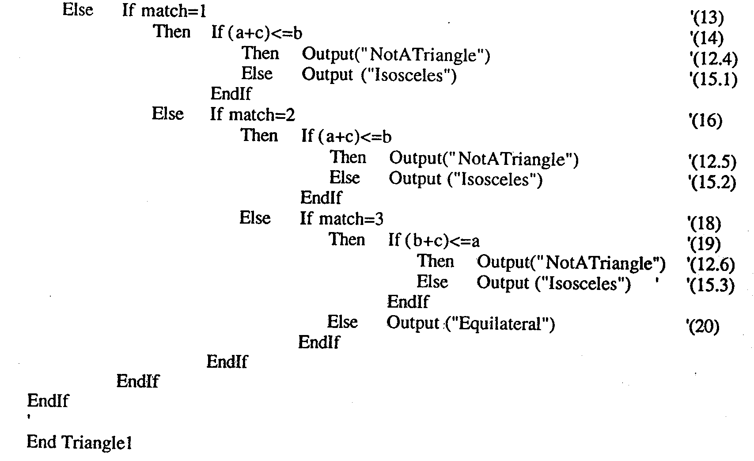

Slide 49
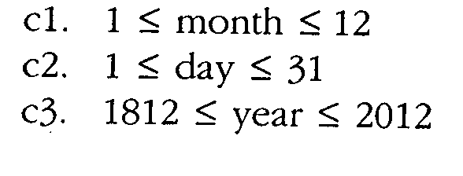
The NextDate Function
Illustrate complexity
Logical relationship among the i/p variables
Problem statement:
NextDate is a function of 3 variables Month, Day, Year.
It returns the date of the day after the i/p date.
condition

Slide 50
Problem statement
Responses for invalid values of i/p values for day, month, year.
Responses for invalid combination of i/p june 31 any year.
If any of the conditions C1, C2, or C3 fails
Corresponding variables has out-of-range values.
Eg. “Value of month not in range 1…12”
If invalid day-month- year combination exist NextDate collapses these into one message
“Invalid input date”

Slide 51
Discussion
Two source of complexity
Complexity of input domain
Rule that determine when a year is leap year.
A year is 365.2422 days long
Leap years are used for the “extra day” problem.
According to Gregorian calendar
A year is a leap year if it is divisible by 4, unless it is a century year.
Century years are leap years only if they are multiples of 400
So 1992, 1996, 2000 are leap years… 1900 is not

Slide 52
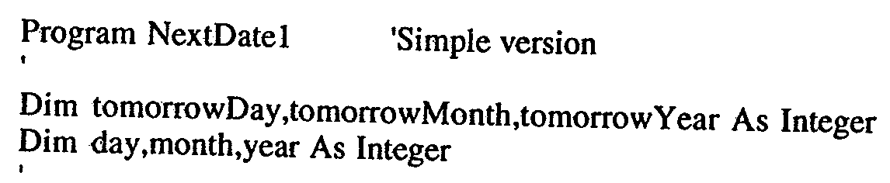
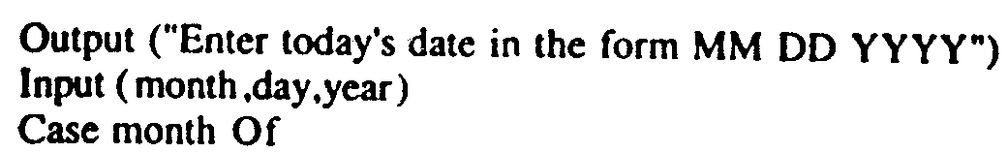
Implementation

Slide 53
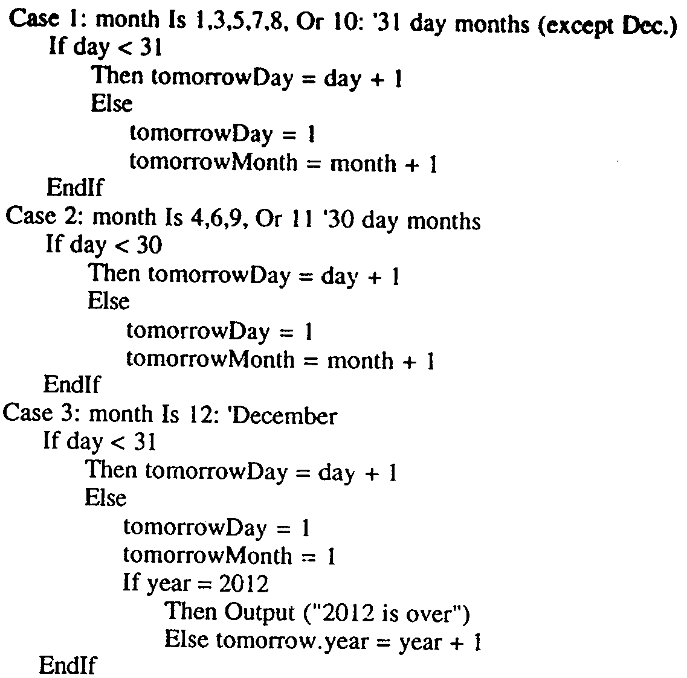

Slide 54
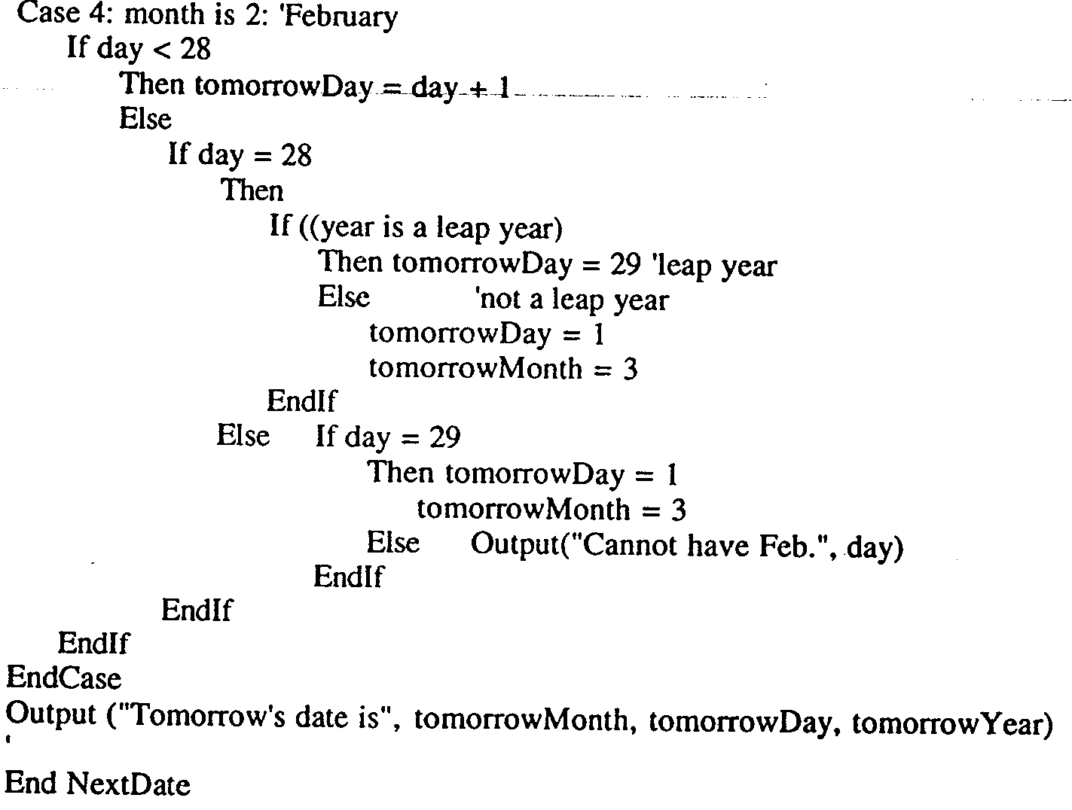

Slide 55
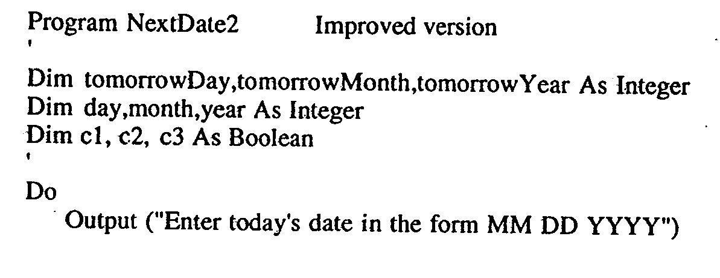
Improved Version

Slide 56
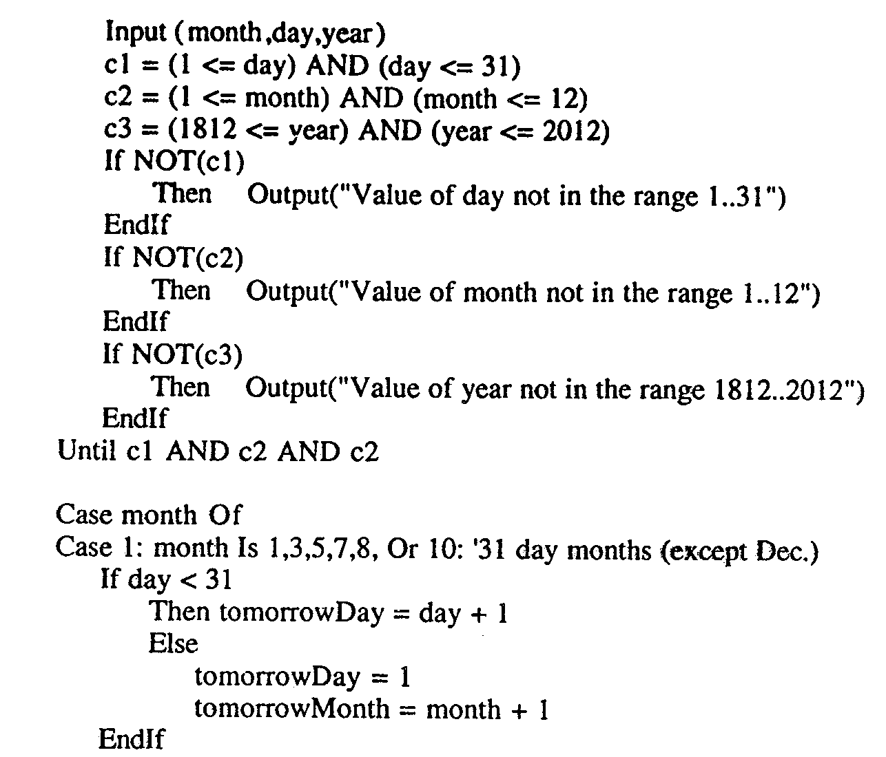

Slide 57
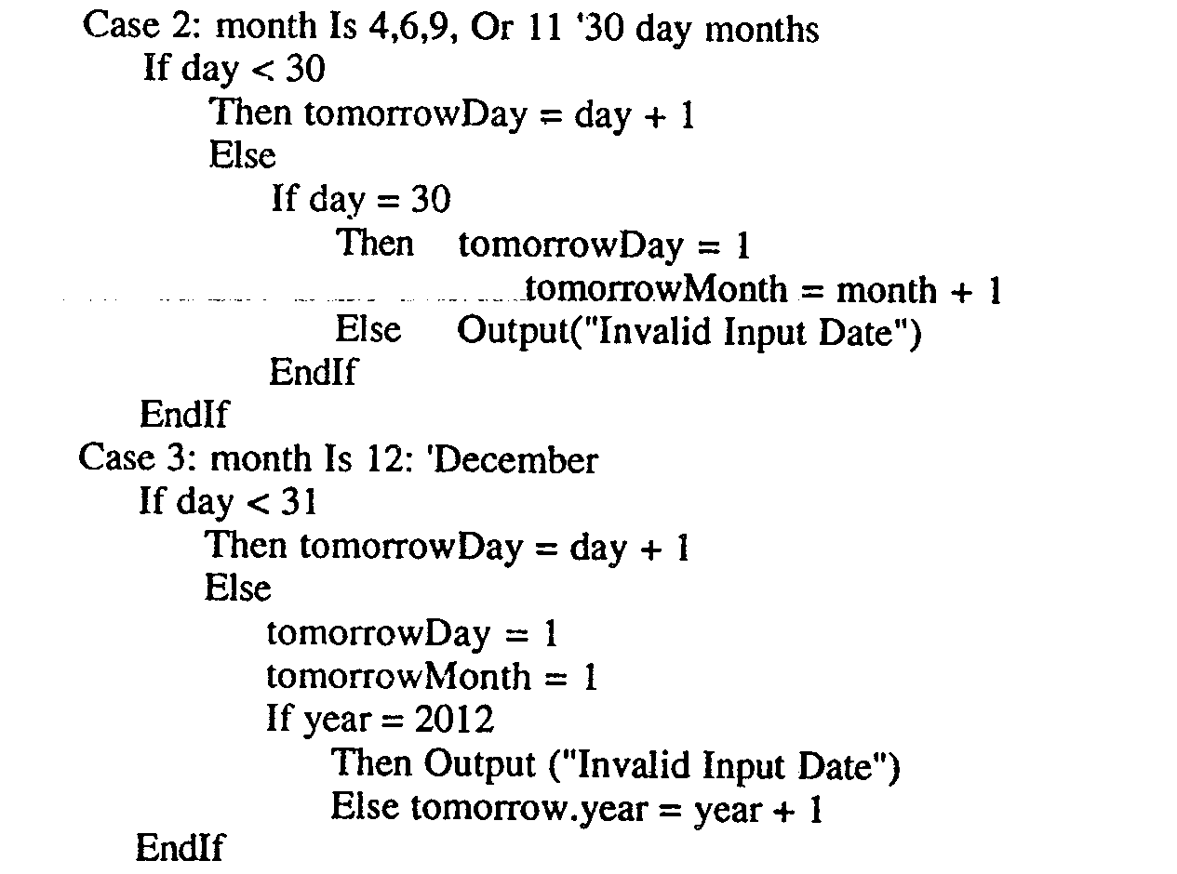

Slide 58
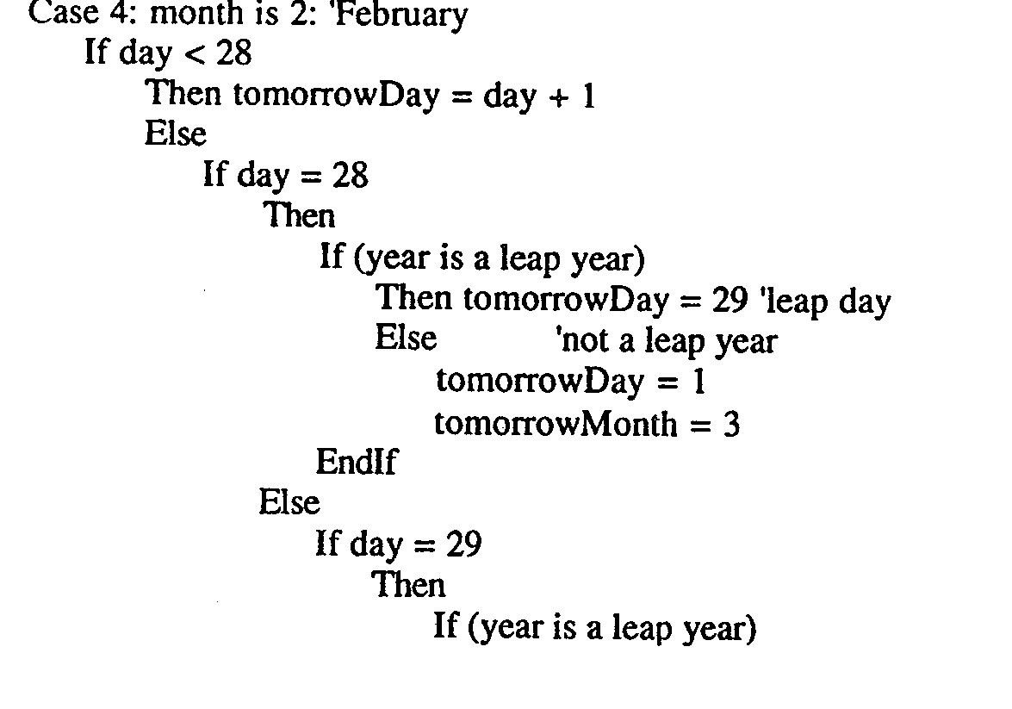

Slide 59
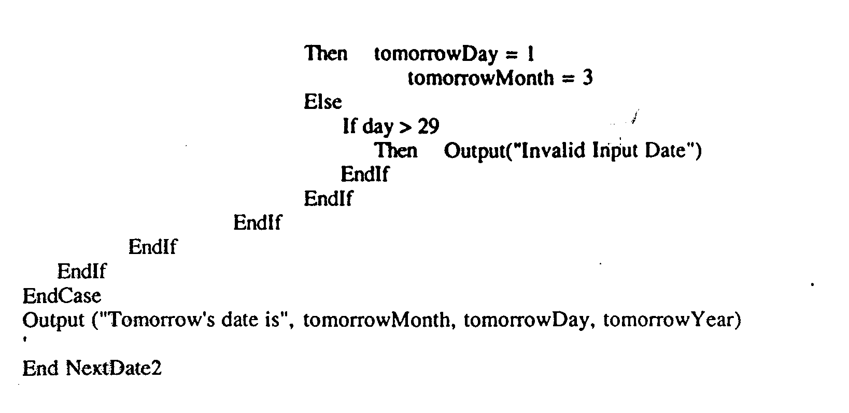

Slide 60
The commission Problem
It contains a mix of computation & decision making.
A rifle salesperson in the former Arizona territory sold rifle lock’s, stocks, & barrel’s made of a gunsmith in Missouri.
Locks cost $45, stocks cost $30, Barrel Cost $ 25.
Sales person has to sell at least 1 complete rifle per month
Production limitation such that 1 sales man can sell 70 locks, 80 stocks, 90 barrels per month.

Slide 61
After each town visit salesperson update sale of no of locks, stocks, barrels through a telegram to gunsmith
At the end of month salesperson sent a shot telegram showing -1 locks sold.
Gunman knew sales for month are over & compute the commission of sales person
10% on sales up to $1000
15% on the next $800
20% on any sales in excess of $1800
The commission program produces a monthly sales report that gave total no. of locks, barrels, stocks sold. Sales persons total dollar sale & commission.

Slide 62
Discussion
This problem separates into 3 distinct pieces
The input data portion( data validation) ignore here
Sales calculation
Commission calculation problem.

Slide 63
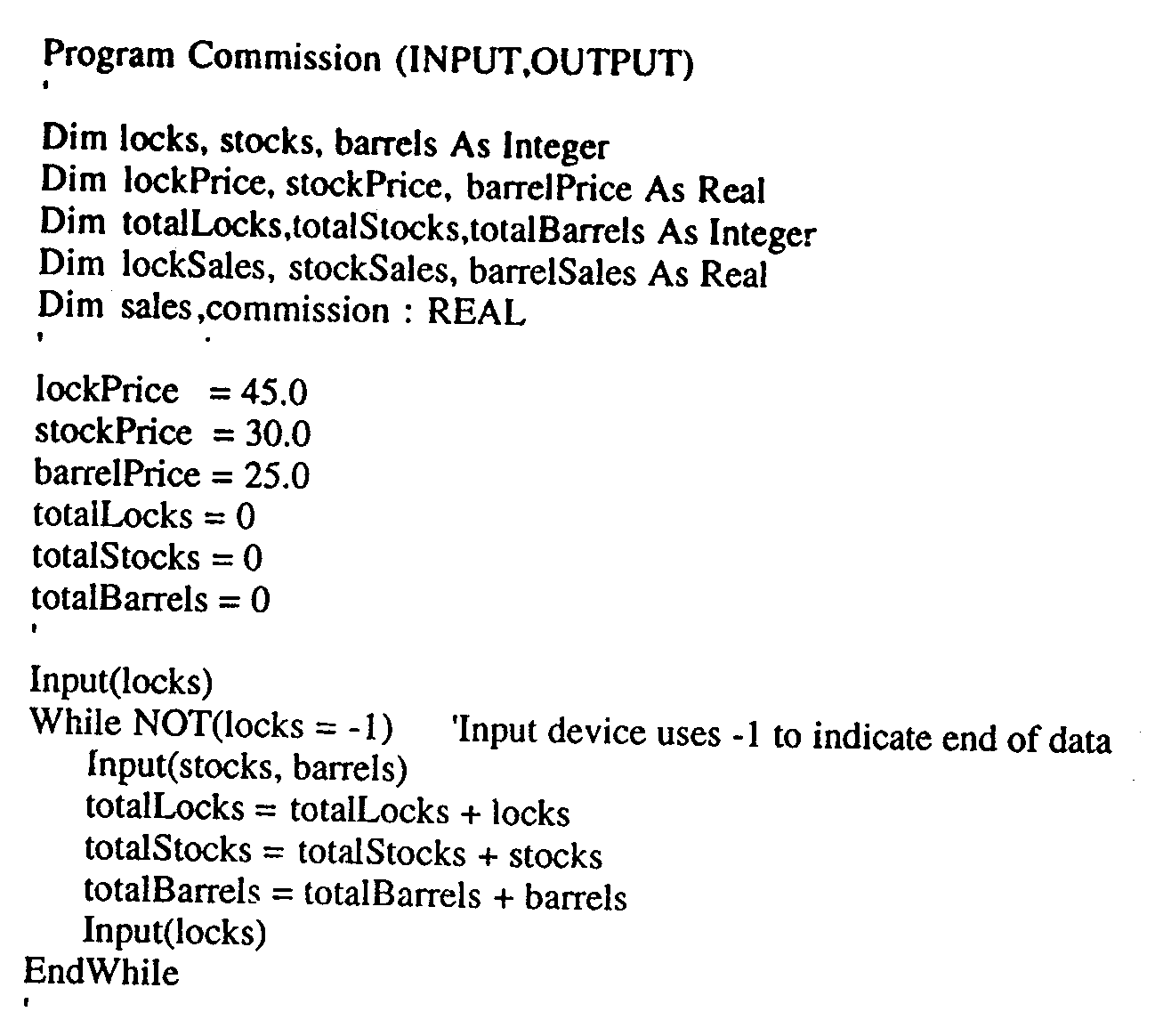
Implementation

Slide 64
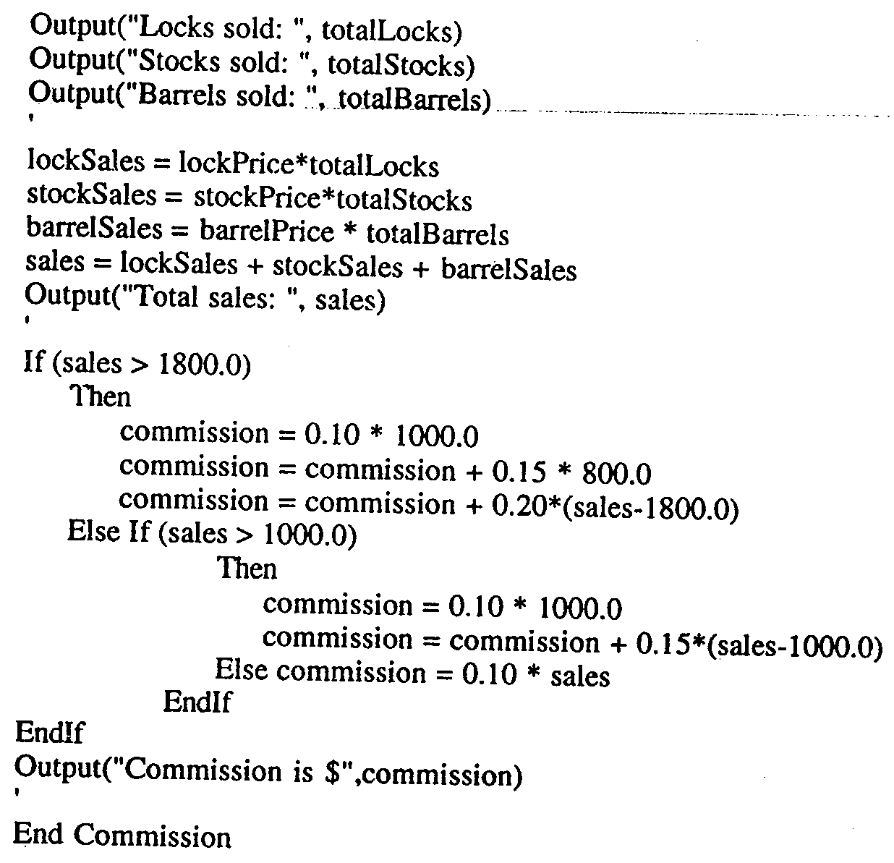

Slide 65
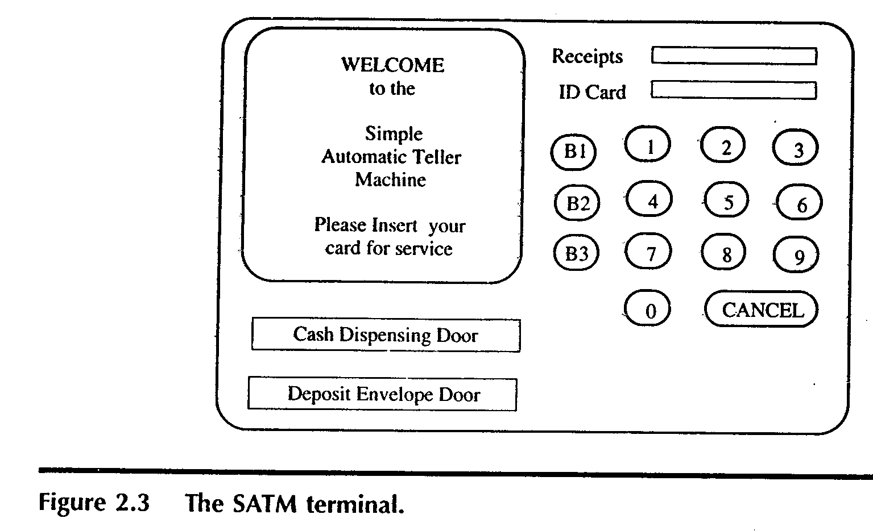
The SATM System
To better discuss the issues of integration & system testing

Slide 66
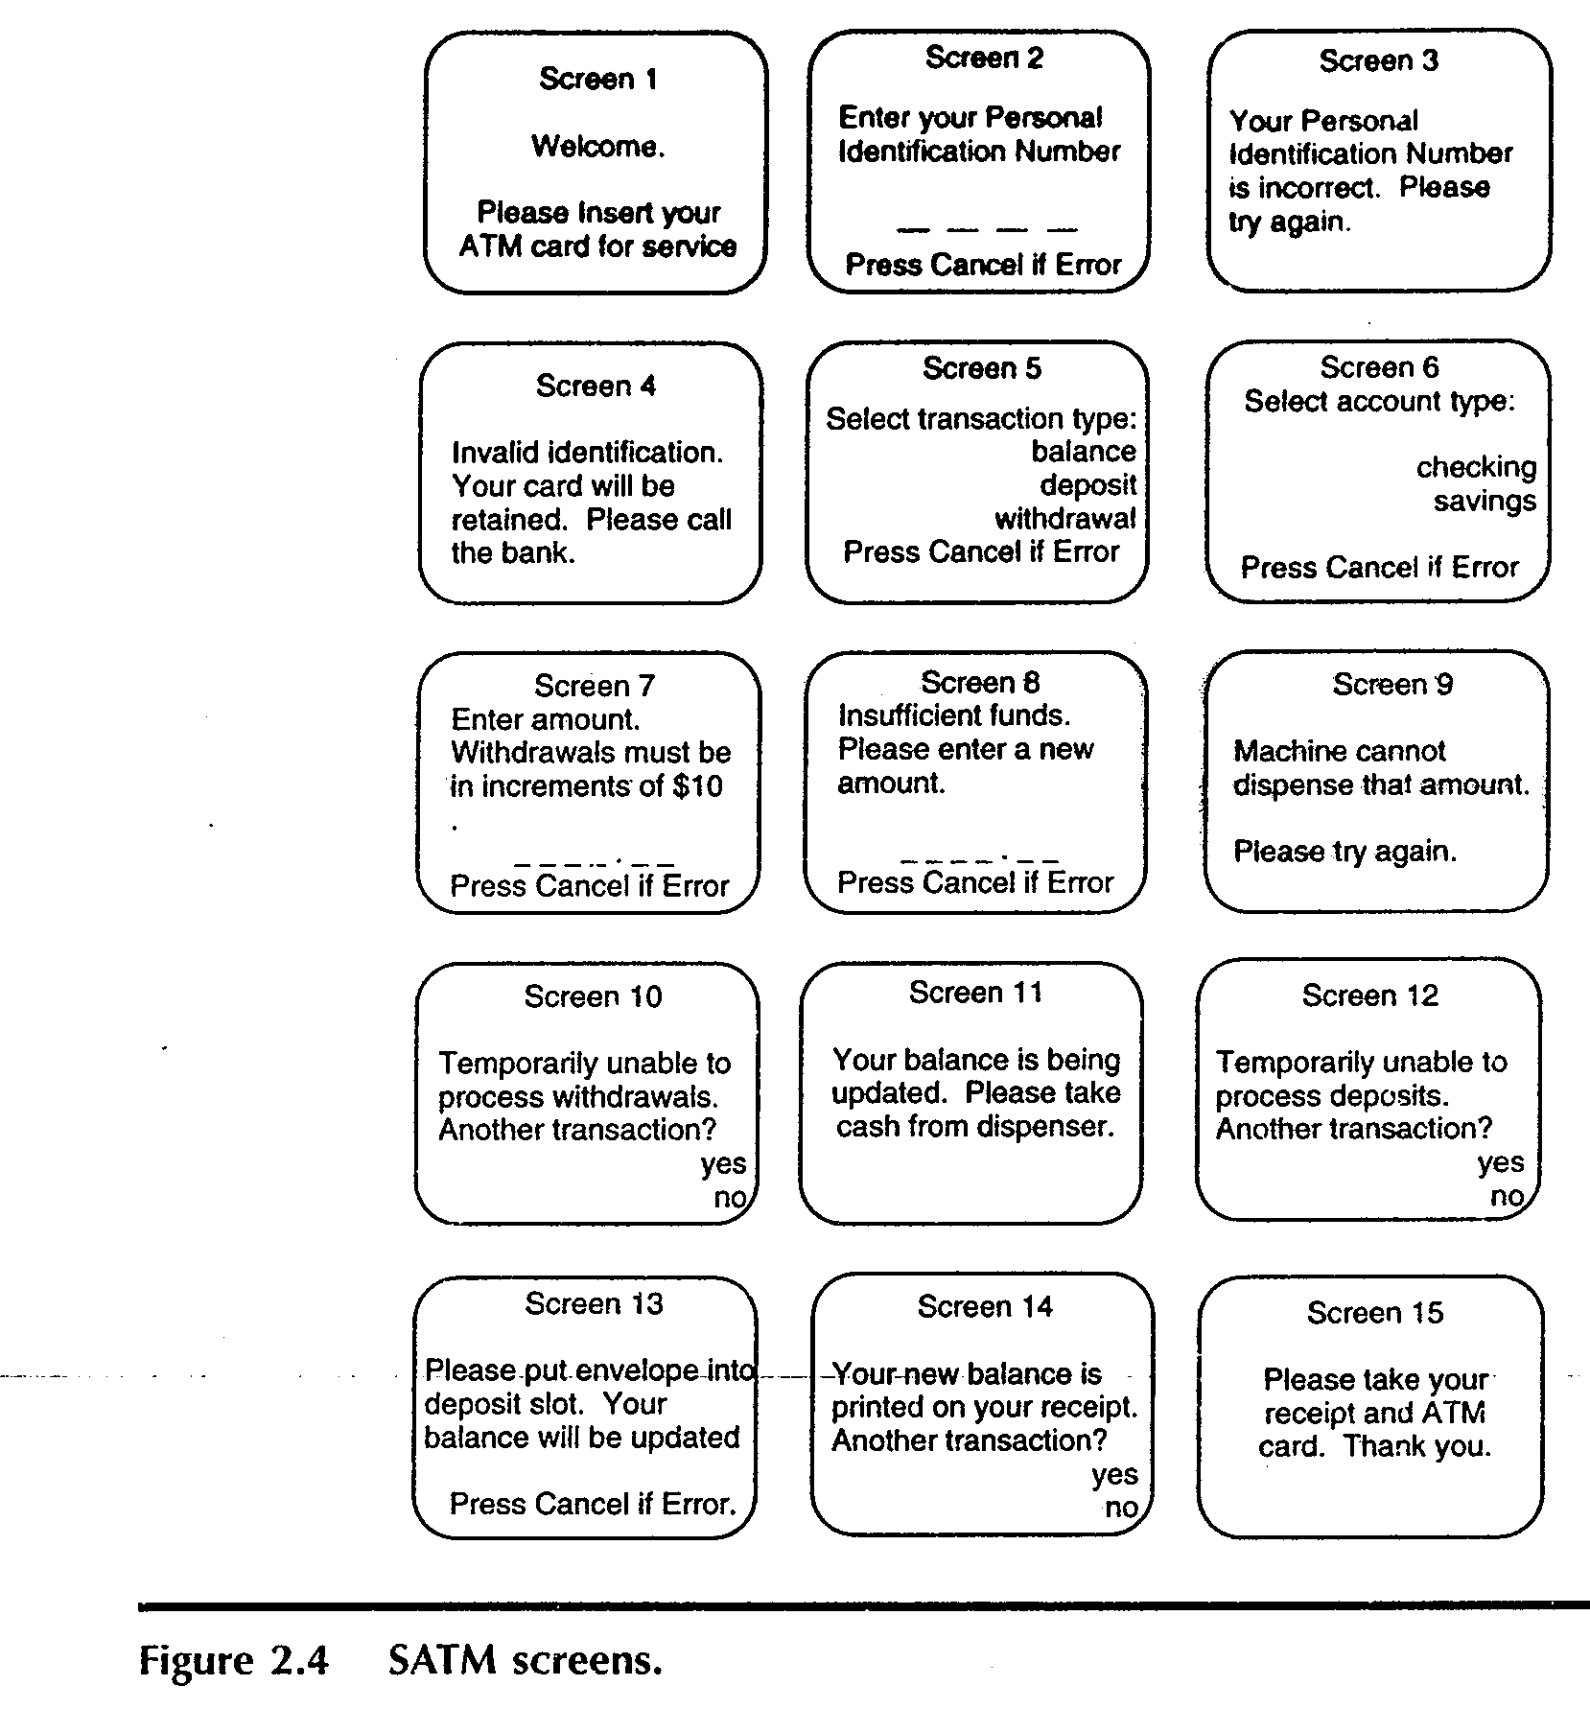

Slide 67
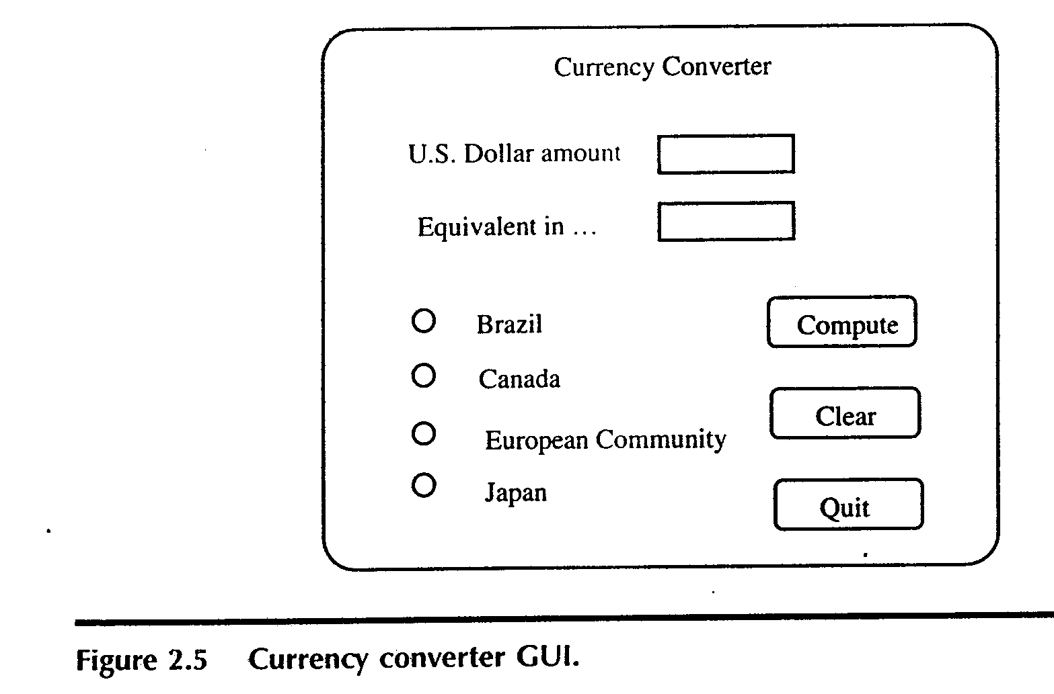
The currency converter
Another event driven program that emphasizes code associated with a GUI
A sample GUI built with visual basic is shown.

Slide 68
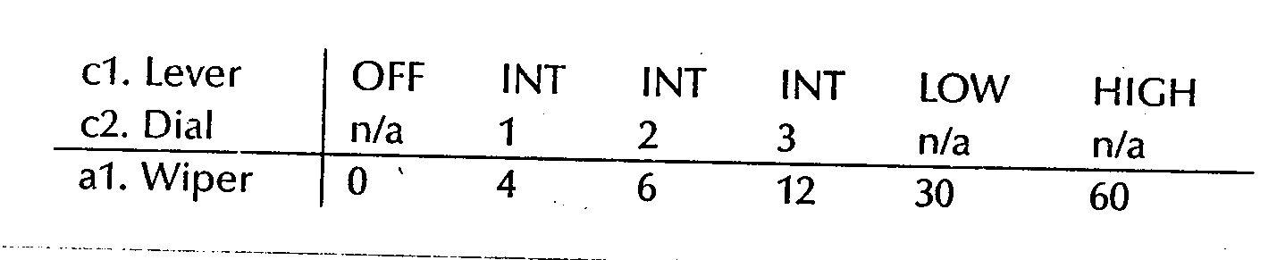
Saturn Windshield Wiper Controller

Slide 69
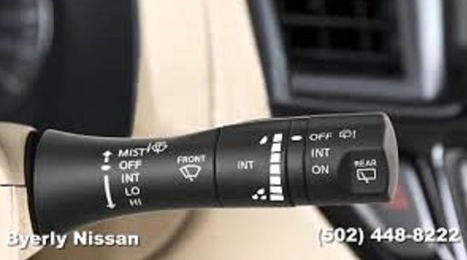

Slide 70
Thank you ???

Slide 71
References
Software Testing Craftsman’s Approach-Paul C Jorgensen.

