Slide 1






LIBRARY MANAGEMENT SYSTEM
By
Mounika koppala
Chaitra kumbara
Avinash tilavalli
Chandhana basavaraju

Slide 2
PROBLEM STATEMENT
The data needs to secured in the system. So that no other can access the information apart from respective owners.
The uniqueness in usernames is to be maintained to make the data more secured

Slide 3
SHORT DESCRIPTION
In Library Management System, Login page is used by the user to login into system. They are required to enter user id and password before they are allowed to enter the system. They will be verified and if invalid credentials are provided, user is not allowed to access the data and redirected to error page. In registration page where user should enter their information i.e., Name, Branch, Email id, Contact number, Username and Password. Validations of entered details are made in order to make data secured. Every validation should be satisfied in order to redirect to home page else it will be redirected to the error page.

Slide 4
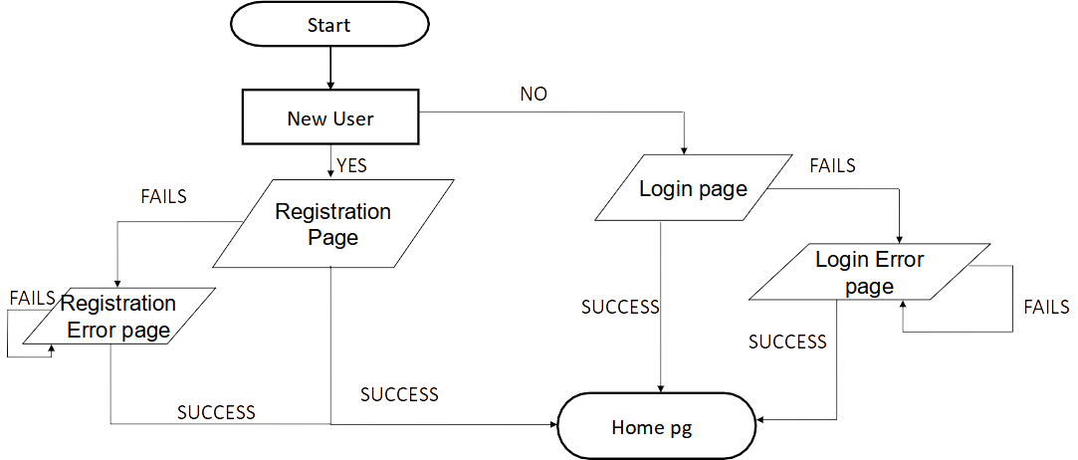
ARCHITECTURE

Slide 5
TECHNOLOGIES
The technologies used our project
Frontend:
HTML, CSS, JavaScript
Backend:
Java, Spring Boot, MySQL

Slide 6
TOOLS
The tools used in our project
Eclipse IDE
MySQL Workbench

Slide 7
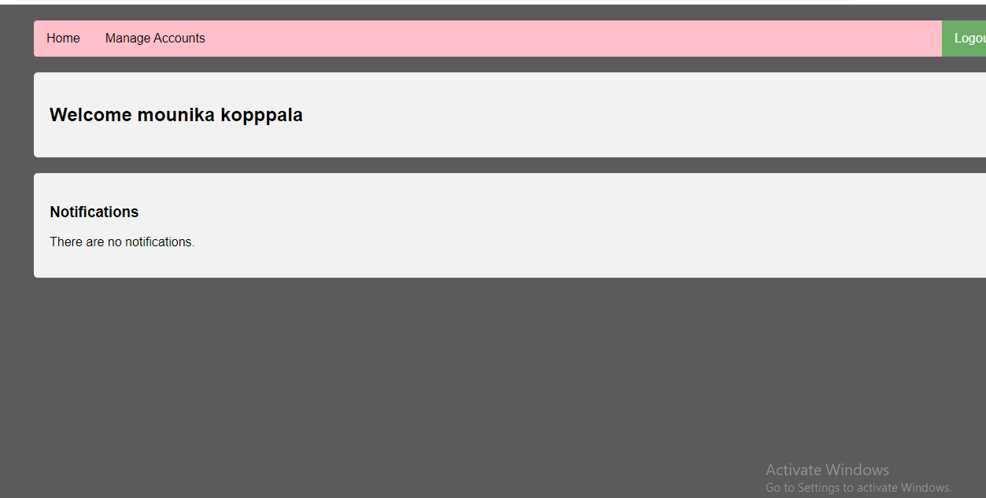
RESULTS

Slide 8




THANK YOU

