Slide 1
Task 3 – Interactive Sales Dashboard
Data Analyst Internship
Vipparthi Avinash
05-06-2025

Slide 2
Objective
Goal:
Design an interactive dashboard using Power BI to help business stakeholders analyze sales data across regions, categories, sales channels, and order statuses. The aim was to build meaningful KPIs and visuals that help in business decision-making.

Slide 3
Dataset Overview
Dataset Name: Amazon Sales Report
Source: Kaggle (CSV format)
Key Columns:
- Amount (used as Sales)
- Qty (Quantity Sold)
- Category, Size, Style
- ship-state, ship-country
- Sales Channel, Fulfilled-by
- Status, Courier Status
- date

Slide 4
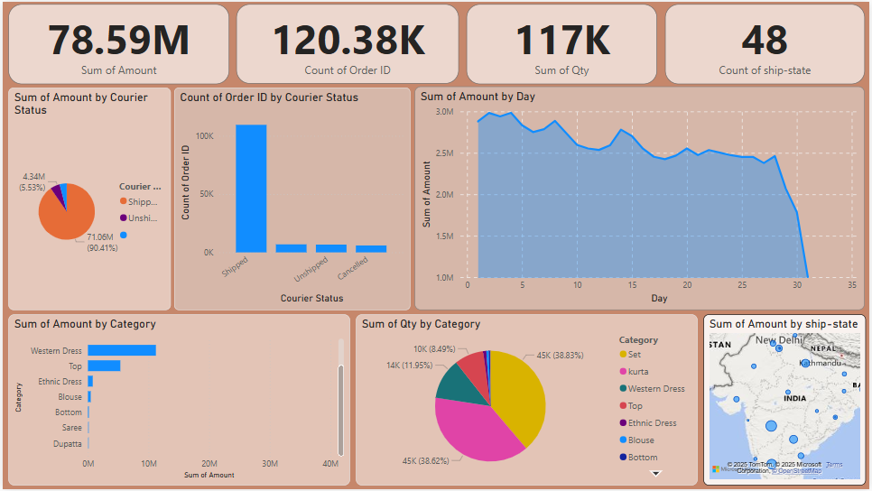
Dashboard Overview
Caption: Overview of all visuals and KPIs used in the dashboard.

Slide 5
Key Performance Indicators (KPIs)
- Total Sales (₹): Sum of all transaction amounts
- Total Orders: Count of unique Order IDs
- Total Units Sold: Sum of quantity
- States Covered: Unique ship-state values

Slide 6
Visuals & Interactivity
Visual Types:
- Bar/Pie Charts: Category, Fulfillment, Status
- Line Chart: Sales over time (date vs amount)
- Slicers Used: Category, Region, Channel, Date

Slide 7
Insights & Observations
- The majority of sales are concentrated in [Top 2-3 categories]
- [Top states] generate the highest revenue
- Most orders are fulfilled by [Fulfilled-by method]
- Some orders are still pending/delayed as per Courier Status

Slide 8
Challenges & Learnings
Challenges:
- Dataset was large (GitHub file size issue)
- Identifying appropriate KPIs and visuals
What I Learned:
- Power BI dashboard creation from raw data
- How to use filters, slicers, and cards
- How to derive insights using visual analytics

Slide 9
Files & Submission
Files Created:
- Power BI Dashboard (.pbix)
- PPT Summary
- README.md
GitHub Link:
[https://github.com/avinash2025-da/TASK_3]

