Slide 1
Hadoop
Avinash

Slide 2
Day 1
Why Hadoop
Big Data
Distributed Systems
Apache Hadoop
Hadoop Components
Hadoop and EDW
Hadoop Use Cases
References

Slide 3
Day 2
Hadoop Ecosystem
NoSQL
HBase
Flume
Scoop
Pig
Hive

Slide 4
Why Hadoop

Slide 5
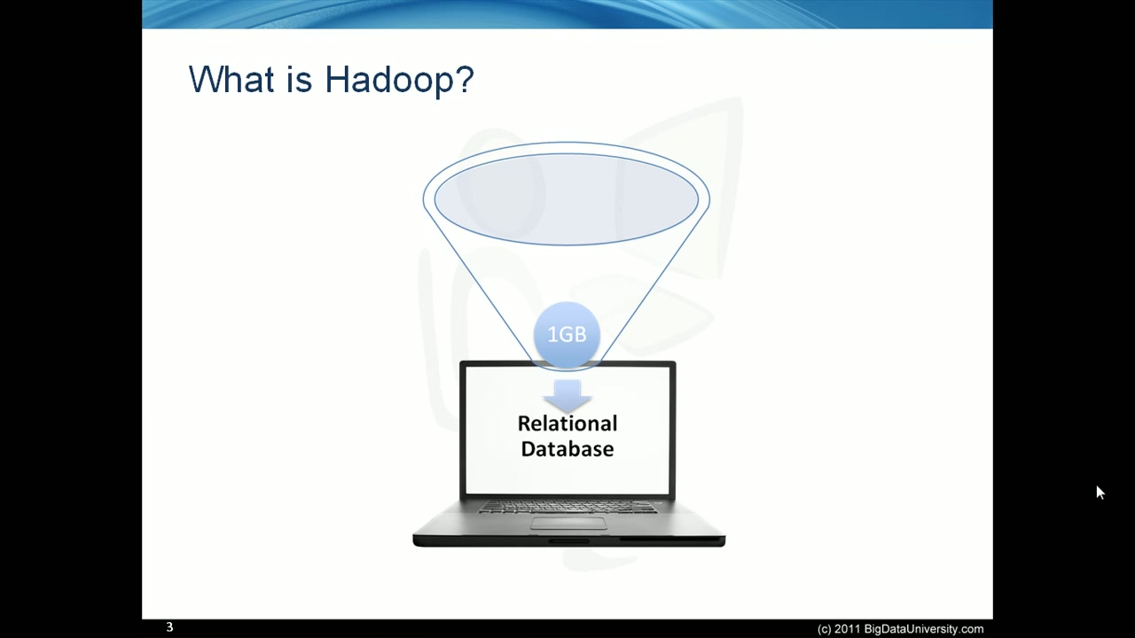

Slide 6
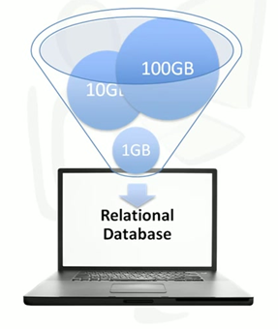

Slide 7
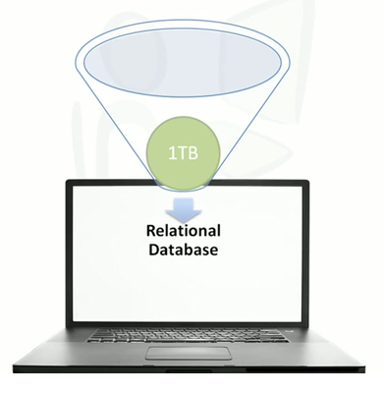

Slide 8
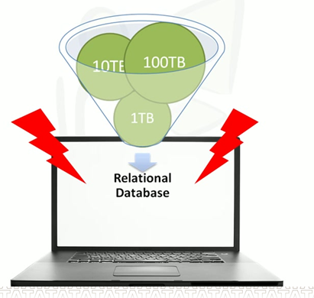

Slide 9
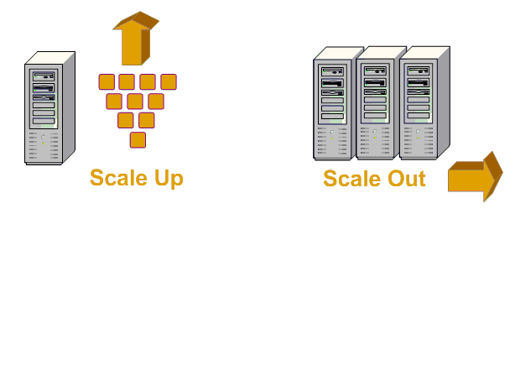


Data is Everywhere

Slide 10




Slide 11
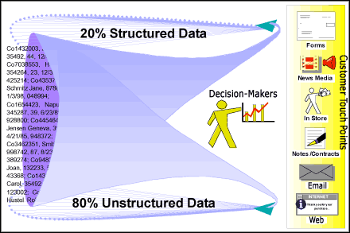

Slide 12

Data in 60 seconds

Slide 13
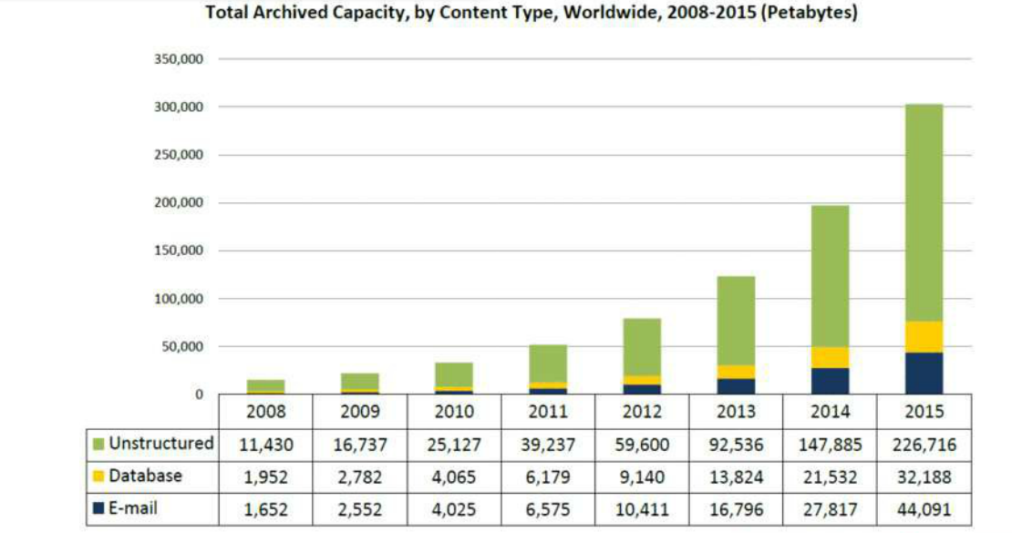

Slide 14
Big Data

Slide 15
In Wikipedia:
Big data is a collection of data so large and complex that it becomes difficult to process using on-hand database management tools or traditional data processing applications.
Demystifying Big Data:
Big Data is defined as “large volumes of high velocity, complex and variable data that require advanced techniques and technologies to enable the capture, storage, distribution, management, and analysis of the information

Slide 16
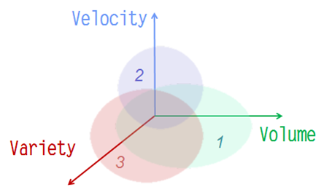
3 Characteristics of Big Data

Slide 17
Big Data Contd..
Exponential data growth (Yahoo, Google etc.)
RDBMS systems unable to handle this growth
Solution - Map-Reduce, Big-Table, GFS
BIG Data Management Problem – Industries have started realizing
Problems in handling Big DATA
Not all MPP relational databases have the ability to store and manage petabytes of data
Ability to load
Monitor processing of large data sets
Backup
Hostile to shared storage
Expectations of Big DATA Analytics
High System Performance
Commodity Infrastructure
Low Cost
Ability to handle large data with ease
Adapts to shared storage

Slide 18
Distributed Systems

Slide 19
Distributed Systems : Storage
Disk performance has also increased in the last 15 years
Unfortunately, transfer rates haven’t kept pace with capacity
Year
Capacity (GB)
Transfer Rate (MB/s)
Disk Read Time
1997
2.1
16.6
126 seconds
2004
200
56.5
59 minutes
2012
3,000
210
3 hours, 58 minutes
Working in parallel with 100 drives, we could read the data in under two minutes
We can store one hundred datasets, each of which is one terabyte, and provide shared access
to them.
There’s more to being able to read and write data in parallel to or from multiple disks

Slide 20
Distributed Systems : Problems
Partial Failure support
Should result in graceful degradation of application performance
Component recovery
No data loss.
If HDD fails then have replace without restarting the cluster.
Consistency
End user gets the same result irrespective of the failures.
Scalability
Adding more nodes to cluster increase performance.
Finite bandwidth is available
Temporal dependencies are complicated
Data exchange requires synchronization

Slide 21
Apache Hadoop

Slide 22
Apache Hadoop
Hadoop is a open-source software for reliable, scalable, distributed computing and is designed to scale up from single servers to thousands of machines, each offering local computation and storage.
Hadoop consists of two core components
– The Hadoop Distributed File System (HDFS)
– MapReduce Software Framework
Core Concepts of Hadoop
1) Distribute the data as it is initially stored in the system. – Bandwidth
2) Replication of data is done in 3 sets(default) – Component recovery
3) A Master Node monitors all other nodes(Slaves) -- Fault Tolerance
4) Applications re written in a high level paradigm(MapReduce) - Scalability

Slide 23

Hadoop Origin
Developed by Doug Cutting based on Google’s paper
Early adoption by Yahoo, Facebook and others
Hadoop is the name of Doug Cutting’s son Toy.
Nutch spun off
Google publishes
Google publishes
Nutch rewritten
from Lucene
GFS paper
MapReduce paper
for MapReduce
2002
2003
2004
2005

Slide 24
Hadoop vs. RDBMS
 | Traditional RDBMS | Hadoop
Data Size | Gigabytes | Petabytes
Access | Interactive and batch | Batch
Updates | Read and write many times | Write once, read many times
Structure | Static schema | Dynamic schema
Integrity | High | Low
Scaling | Nonlinear | Linear
Hadoop suits for applications where the data is written once, and read many times, whereas a RDBMS is good for datasets that are continually updated.
Hadoop is good for analyzing the whole dataset, whereas RDBMS is good for point queries or updates.
Over time, the differences between RDBMS and Hadoop(MapReduce) are likely to blur

Slide 25
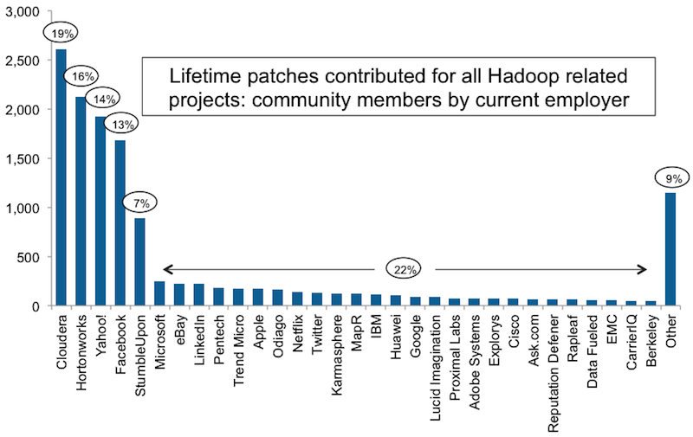
Contributors and Development

Slide 26
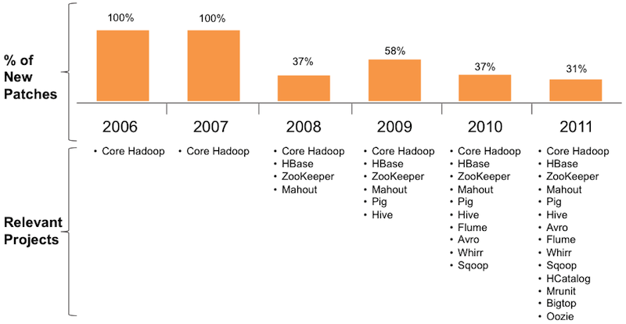
Contributors and Development

Slide 27
Hadoop File System(HDFS)
HDFS, the Hadoop Distributed File System, is responsible for storing data on the cluster follows master-slave architecture
Data files are split into blocks of fixed size(64MB,128MB..) which are distributed across multiple nodes in the cluster and stores on top of existing file system
Advantages of blocks:
Fixed size and easy to calculate how many fit on a disk
A file can be larger than any single disk in the network
If a file or a chunk of the file is smaller than the block size, only required size is required
100% Fault-tolerance is achieved through blocks
HDFS performs best with a ‘modest’ number of large files
Files in HDFS are ‘write once’
HDFS is optimized for large, streaming reads of files

Slide 28
NameNode
Only one per Hadoop cluster and is the Master in HDFS architecture
Manages the Filesystem namespace and metadata
Single point of failure
NameNode executes file system namespace operations like opening, closing, and renaming
files and directories
Two major data structures
fsimage
edit log
fsimage contains a complete snapshot of the Filesystem metadata whereas edits contains only incremental modifications made to the metadata.

Slide 29
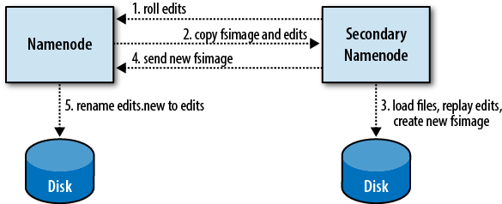
Secondary NameNode
The secondary NameNode instructs the NameNode to roll its edits file and begin writing
to edits.new.
The secondary NameNode copies the name node's fsimage and edits files to its local checkpoint directory.
The secondary NameNode loads fsimage, replays edits on top of it, and writes a new, compacted fsimage file to disk.
The secondary NameNode sends the new fsimage file to the NameNode, which adopts it.
The NameNode renames edits.new to edits.

Slide 30
Data Node
Data Nodes are the slave in HDFS architecture.
Manages blocks with data and serves them to clients
Periodically reports to name node the list of blocks it stores
DataNodes are many per Hadoop cluster
The DataNodes also perform block creation, deletion, and replication upon instruction from the NameNode

Slide 31
File Splits
Example:
Large File
1100101010011100101010011100101010011100101010011100110010101001110010101001110010101001110010101001110010101001
1100101010011100101010011100101010011100101010011100110010101001110010101001110010101001110010101001110010101001
1100101010011100101010011100101010011100101010011100110010101001110010101001110010101001110010101001110010101001
1100101010011100101010011100101010011100101010011100110010101001110010101001110010101001110010101001110010101001
1100101010011100101010011100101010011100101010011100110010101001110010101001110010101001110010101001110010101001
1100101010011100101010011100101010011100101010011100110010101001110010101001110010101001110010101001110010101001
1100101010011100101010011100101010011100101010011100110010101001110010101001110010101001110010101001110010101001
1100101010011100101010011100101010011100101010011100110010101001110010101001110010101001110010101001110010101001
…
6440MB
Let’s color-code them
Block
1
Block
1
Block
2
Block
2
Block
3
Block
3
Block
4
Block
4
Block
5
Block
5
Block
6
Block
6
…
Block
100
Block
100
Block
101
Block
101
64MB
64MB
64MB
64MB
64MB
64MB
64MB
40MB
Files are composed of set of blocks
Typically 64MB in size
Each block is stored as a separate file in the local file system (e.g. NTFS)
e.g., Block Size = 64MB

Slide 32
Block Placement
Block
1
Block
2
Block
3
Block
2
Block
2
Block
3
Block
1
Block
3
Block
1
Node 1
Node 2
Node 3
Node 4
Node 5
e.g., Replication factor = 3
Default placement policy:
First copy is written to the node creating the file (write affinity)
Second copy is written to a data node within the same rack
(to minimize cross-rack network traffic)
Third copy is written to a data node in a different rack
(to tolerate switch failures)
Objectives: load balancing, fast access, fault tolerance

Slide 33
HDFS Architecture
NameNode
BackupNode
namespace backups
(heartbeat, balancing, replication, etc.)
DataNode
DataNode
DataNode
DataNode
DataNode
nodes write to local disk

Slide 34
Putting Files On HDFS
Giant File
110010101001
010100101010
011001010100
101010010101
001100101010
010101001010
100110010101
001010100101
{node1, node2, node 3}
{node2, node4, node 5}
{node2, node3, node 4}
{node1, node3, node 5}
HDFS
Client
(based on “replication factor”) (3 by default)
Name node tells client where to store each block of the file
NameNode
BackupNode
Client transfers block directly
to assigned data nodes
and so on…
DataNode
DataNode
DataNode
DataNode
DataNode

Slide 35
Getting Files From HDFS
Giant File
110010101001
010100101010
011001010100
101010010101
001100101010
010101001010
100110010101
001010100101
HDFS
Client
return locations
of blocks of file
NameNode
BackupNode
stream blocks from data nodes
DataNode
DataNode
DataNode
DataNode
DataNode

Slide 36
Fault Tolerance (DataNode Failure)
NameNode
BackupNode
Blocks are auto-replicated on remaining
nodes to satisfy replication factor
NameNode detects DataNode loss
DataNode
DataNode
DataNode
DataNode
DataNode
DataNode
DataNode
DataNode

Slide 37
Fault Tolerance (NameNode Failure)
NameNode loss requires
manual intervention
Automatic failover is
in the works
NameNode
BackupNode
Not an epic failure, because you
have the BackupNode
DataNode
DataNode
DataNode
DataNode
DataNode

Slide 38
Live Horizontal Scaling and Rebalancing
NameNode
BackupNode
Blocks are re-balanced
and re-distributed
NameNode detects new DataNode
is added to cluster
DataNode
DataNode
DataNode
DataNode
DataNode
DataNode
DataNode
DataNode

Slide 39


HDFS Summary
Highly scalable
1000s of nodes and massive (100s of TB) files
Large block sizes to maximize sequential I/O performance
No use of mirroring or RAID.
Reduce cost
Use one mechanism (triply replicated blocks) to deal with a wide variety of failure types rather than multiple different mechanisms
Negatives
Block locations and record placement is invisible to higher level software
→ Makes it impossible to employ many optimizations successfully employed by parallel DB systems

Slide 40
MapReduce History
MapReduce is not a language, it’s a programming model
A style of processing data you could implement in any language
MapReduce has its roots in functional programming
Many languages have functions named map and reduce
These functions have largely the same purpose in Hadoop
Popularized for large--‐scale data processing by Google

Slide 41



Gentle Introduction to MapReduce
MapReduce is conceptually like a UNIX pipeline
One function (Map) processes data
That output is ultimately input to another function (Reduce)
$ egrep
'INFO|WARN|ERROR' app.log | cut -f3 | sort | uniq -c
941
ERROR
78264
INFO
4312
WARN

Slide 42
The Map Function
Operates on each record individually
Typical uses include filtering, parsing, or transforming
$
egrep 'INFO|WARN|ERROR' app.log | cut -f3 | sort | uniq -c
Map

Slide 43
Intermediate Processing
The Map function’s output is grouped and sorted
This is the automatic “sort and shuffle” process in Hadoop
$ egrep 'INFO|WARN|ERROR' app.log | cut -f3 | sort | uniq -c
Map
Sort
Shuﬄe

Slide 44
The Reduce Function
Operates on all records in a group
Often used for sum, average or other aggregate functions
$ egrep 'INFO|WARN|ERROR' app.log | cut -f3 | sort | uniq -c
Map
Sort
Reduce
Shuﬄe

Slide 45
MapReduce
MapReduce is the system used to process data in the Hadoop cluster
Like HDFS, MapReduce has a master--‐slave architecture
There are two daemons in “classical” MapReduce
Master : JobTracker
Responsible for dividing, scheduling and monitoring work
Slave : TaskTracker
Responsible for actual processing
Consists of two phases: Map, and then Reduce
Each Map task operates on a discrete portion of the overall dataset

Slide 46
MapReduce Contd..
After all Maps are complete, the MapReduce system distributes the intermediate data to nodes which perform the Reduce phase
Each node processes data stored on that node
Each Map task operates on a discrete portion of the overall
dataset
– Typically one HDFS data block
After all Maps are complete, the MapReduce system distributes
the intermediate data to nodes which perform the Reduce phase
Each node processes data stored on that node

Slide 47
Job Tracker
One per Hadoop cluster and is the master in MapReduce architecture.
Receives job requests submitted by client
Schedules and monitors MapReduce jobs on task trackers

Slide 48
Task Tracker
Many per Hadoop cluster and are the slaves in MapReduce Slave architecture.
Executes MapReduce operations
Reads blocks from DataNodes
Task Tracker launches the tasks in a separate JVM and monitors that task.

Slide 49
MapReduce Visualize
<key_{A}, value_{a}>
<key_{B}, value_{b}>
<key_{C}, value_{c}>
…
<key_{i}, value_{i}>
Mapper
DataNode
<key_{A}, list(value_{a}, value_{b}, value_{c}, …)>
Reducer
Sort
and
group
by
key
<key_{A}, value_{a}>
<key_{B}, value_{b}>
<key_{C}, value_{c}>
…
<key_{i}, value_{i}>
Mapper
DataNode
<key_{B}, list(value_{a}, value_{b}, value_{c}, …)>
Reducer
Output
<key_{A}, value_{a}>
<key_{B}, value_{b}>
<key_{C}, value_{c}>
…
<key_{i}, value_{i}>
Mapper
DataNode
<key_{C}, list(value_{a}, value_{b}, value_{c}, …)>
Reducer
<key_{A}, value_{a}>
<key_{B}, value_{b}>
<key_{C}, value_{c}>
…
<key_{i}, value_{i}>
Mapper

Slide 50
MapReduce Components
How Does This All Fit With HDFS?
Master
hadoop-namenode
- Coordinates all M/R tasks & events
- Manages job queues and scheduling
- Maintains and Controls TaskTrackers
- Moves/restarts map/reduce tasks if needed
- Uses “checkpointing” to combat single points of failure
JobTracker
MapReduce
Layer
NameNode
HDFS
Layer
JobTracker controls and
heartbeats TaskTracker nodes
hadoop-
datanode1
hadoop-
datanode2
hadoop-
datanode3
hadoop-
datanode4
Execute individual map and reduce tasks as assigned by JobTracker (in separate JVM)
Slaves
TaskTracker
TaskTracker
TaskTracker
TaskTracker
MapReduce
Layer
HDFS
Layer
TaskTrackers store temp data
DataNode
DataNode
DataNode
DataNode
Temporary data stored to local file system

Slide 51
Job Submission
MR
Client
Submit jobs to JobTracker
JobTracker
jobs get queued
map()’s are assigned to TaskTrackers (HDFS DataNode locality aware)
reduce phase begins
TaskTracker
TaskTracker
TaskTracker
TaskTracker
mappers spawned in separate JVM and execute
Mapper
Mapper
Mapper
Mapper
Reducer
Reducer
Reducer
Reducer
mappers store temp results
Temporary data stored to local file system

Slide 52
Hadoop and EDW

Slide 53
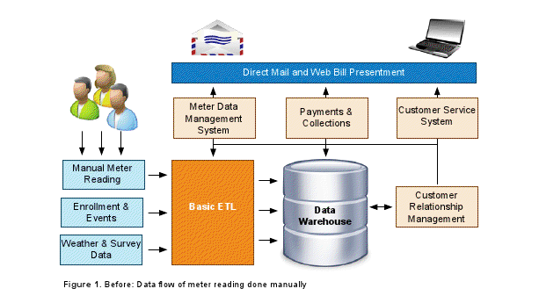
Traditional EDW

Slide 54
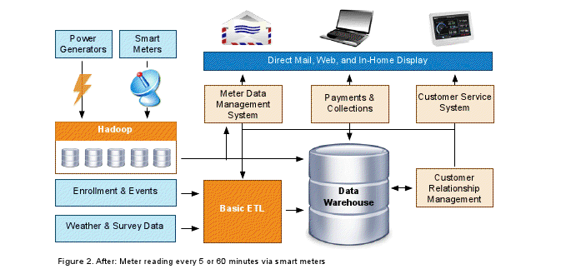
Hadoop with EDW

Slide 55
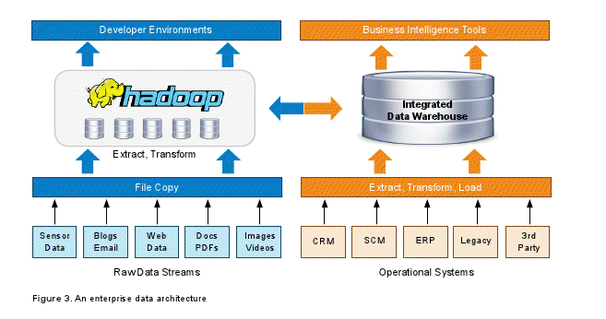
Data Flow

Slide 56



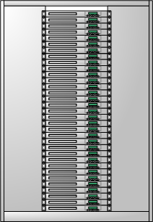


Data Warehousing at Facebook Today
Web Servers
Scribe Servers
Filers
Hive on
Hadoop Cluster
Oracle RAC
Federated MySQL

Slide 57
Hadoop Use Cases

Slide 58

Yahoo! front page - Case Study
Notes:
58
Load Balancing: Brooklyn (DNS) directs users to their local datacenter
RSS Feeds: Feed-norm leverages Yahoo Traffic Server to normalize, cache, and proxy site feeds for Auto Apps
Image and Video Delivery: All images and thumbnails displayed on the page
Substantial part the 20-25 billion objects YCS serves a day
Stats Coming
Site thumbnails (Auto-apps)
These are the Metro applications generated from web sites that are added to the left column
Metro is currently storing about 220K thumbnails replicated on both US coasts
Usage is currently about 55K/second (heavily cached by YCS) growing 100% month over month
Attachment Store
Mail uses YMDB (MObStor pre-cursor) to store 10TB of attachments
Search Index: Data mining to obtain the top-n user search queries
Ads Optimization: On-going refreshes to the Ad ranking model for revenue optimization
Content Optimization: Computation of Content centric user profiles to get user segmentation
Models generation refresh for content categorization
User centric recommendation module
Machine Learning: Model creation for various purposes at Yahoo
Spam Filters: Utilizing Co-occurrence and other data intensive techniques for mail spam detection

Slide 59
Yahoo! front page - Case Study
Search Index
Ads Optimization
Notes:
59
Load Balancing: Brooklyn (DNS) directs users to their local datacenter
RSS Feeds: Feed-norm leverages Yahoo Traffic Server to normalize, cache, and proxy site feeds for Auto Apps
Image and Video Delivery: All images and thumbnails displayed on the page
Substantial part the 20-25 billion objects YCS serves a day
Stats Coming
Site thumbnails (Auto-apps)
These are the Metro applications generated from web sites that are added to the left column
Metro is currently storing about 220K thumbnails replicated on both US coasts
Usage is currently about 55K/second (heavily cached by YCS) growing 100% month over month
Attachment Store
Mail uses YMDB (MObStor pre-cursor) to store 10TB of attachments
Search Index: Data mining to obtain the top-n user search queries
Ads Optimization: On-going refreshes to the Ad ranking model for revenue optimization
Content Optimization: Computation of Content centric user profiles to get user segmentation
Models generation refresh for content categorization
User centric recommendation module
Machine Learning: Model creation for various purposes at Yahoo
Spam Filters: Utilizing Co-occurrence and other data intensive techniques for mail spam detection

Slide 60
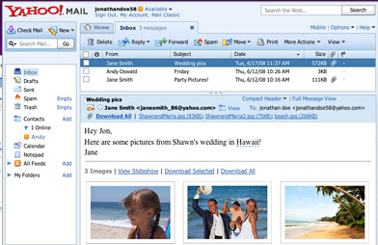
Yahoo! front page - Case Study
Content Optimization
Search Index
Machine Learned
Spam filters
Ads Optimization
RSS Feeds
Content Optimization
Notes:
60
Load Balancing: Brooklyn (DNS) directs users to their local datacenter
RSS Feeds: Feed-norm leverages Yahoo Traffic Server to normalize, cache, and proxy site feeds for Auto Apps
Image and Video Delivery: All images and thumbnails displayed on the page
Substantial part the 20-25 billion objects YCS serves a day
Stats Coming
Site thumbnails (Auto-apps)
These are the Metro applications generated from web sites that are added to the left column
Metro is currently storing about 220K thumbnails replicated on both US coasts
Usage is currently about 55K/second (heavily cached by YCS) growing 100% month over month
Attachment Store
Mail uses YMDB (MObStor pre-cursor) to store 10TB of attachments
Search Index: Data mining to obtain the top-n user search queries
Ads Optimization: On-going refreshes to the Ad ranking model for revenue optimization
Content Optimization: Computation of Content centric user profiles to get user segmentation
Models generation refresh for content categorization
User centric recommendation module
Machine Learning: Model creation for various purposes at Yahoo
Spam Filters: Utilizing Co-occurrence and other data intensive techniques for mail spam detection

Slide 61

Example: Search Assist
Database for Search Assist™ is built using Hadoop.
3 years of log-data
20-steps of map-reduce
 | Before Hadoop | After Hadoop
Time | 26 days | 20 minutes
Language | C++ | Python
Development Time | 2-3 weeks | 2-3 days

Slide 62

IBM WATSON

Slide 63
References
Hadoop Home page: http://hadoop.apache.org
Cloudera : http:cloudera.com
Hadoop Book : Hadoop definitive guide 3rd edition
Big Data University : http://bigdatauniversity.com/
HBase : http://hbase.apache.org/
Hive : http://hive.apache.org/
Pig : http://pig.apache.org/

Slide 64

Thank you
Visit www.tcs.com
Experience Certainty.
64
Notes:
64

