Slide 1
Analyzing NYC Subway Turnstile Data: Understanding subway ridership pattern and Commuter Behavior
Avinash Vijayarangan (av3134)
Nagharjun Mathi Mariappan (nm4074)
Nishal Sundarraman (ns5429)
Vikram Balaji (vb2284)

Slide 2
Abstract
The MTA Subway Analysis and Foot Traffic Prediction project analyzes and predicts foot traffic patterns in the MTA subway system in NYC.
The project uses Spark, Kafka, MongoDB, and SparkML technologies for data processing, storage, and analysis.
Data is collected from the MTA Website, including turnstile entry and exits at subway stations and train schedules.
Kafka is used for real-time streaming of data to the trained Machine Learning model for prediction.
The project focuses on predicting foot traffic in different subway stations and lines based on historical data.

Slide 3
Problem Statement
MTA Subway system struggles to predict foot traffic patterns accurately.
Lack of accurate prediction can lead to overcrowding, delays, and safety issues for commuters.
MTA Subway Analysis and Foot Traffic Prediction project aims to provide a data-driven approach to predict foot traffic.
The project uses Spark, Kafka, MongoDB, and Spark ML technologies to process and analyze large amounts of data from various sources.

Slide 4
Motivation
Turnstile data can provide insights into commuter behavior and preferences, such as identifying popular stations and lines for investment in infrastructure.
Understanding subway ridership patterns can inform transportation planning and management decisions.
Analyzing turnstile data can optimize subway schedules and improve service quality for riders.
Better MTA can help create a better future for NYC and its residents.

Slide 5
Dataset Description
Dataset: http://web.mta.info/developers/turnstile.html
Size: 12gb
Schema: C/A,UNIT,SCP,STATION,LINENAME,DIVISION,DATE,TIME,DESC,ENTRIES,EXITS
Description:
C/A = Control Area (A002)
UNIT = Remote Unit for a station (R051)
SCP = Subunit Channel Position represents an specific address for a device (02-00-00)
STATION = Represents the station name the device is located at
LINENAME = Represents all train lines that can be boarded at this station
DATE = Represents the date (MM-DD-YY)
TIME = Represents the time (hh:mm:ss) for a scheduled audit event
ENTRIES = The comulative entry register value for a device
EXITS = The cumulative exit register value for a device

Slide 6
Technologies Used
PySpark | Used for exploratory data analysis
Pandas & Matplotlib | Used to create visualizations
KAFKA | Used to stream the test data
Mongodb | Used to store the model parameters
SparkML | Used to train the model on pyspark

Slide 7
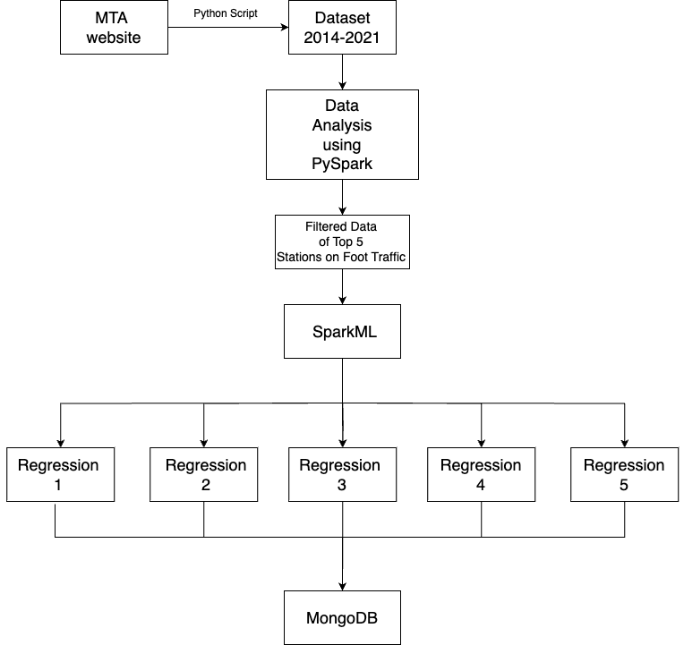

Architecture Diagram

Slide 8
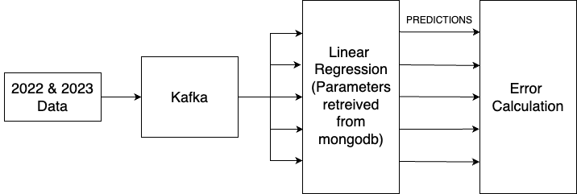

Architecture Diagram

Slide 9
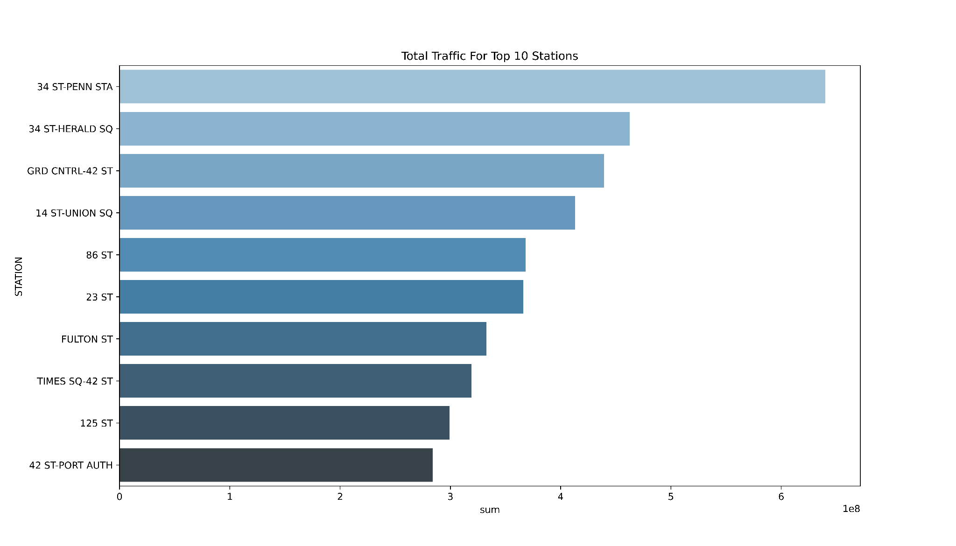
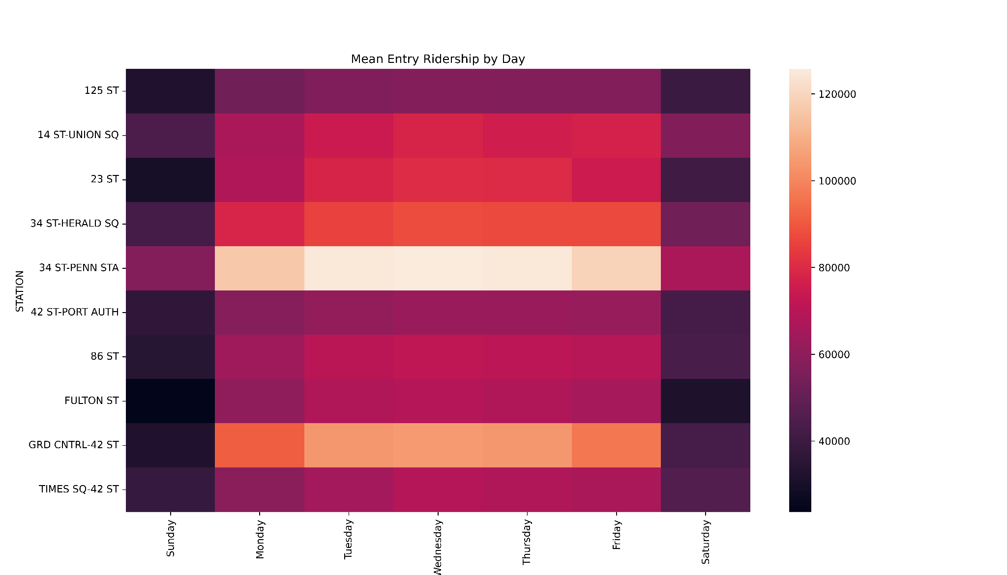
Exploratory Data Analysis
Factors affecting traffic : Business Centers, Location, Transfer Points, Tourist attractions
Notes:
Location: These stations are located in densely populated areas, with high levels of foot traffic, which contributes to their high volume of passengers.
Transfer Points: These stations serve as major transfer points for commuters traveling between different subway lines or modes of transportation, such as buses or trains. For example, Grand Central Station serves as a hub for trains that travel to the suburbs outside of the city.
Tourist attractions: Times Square is a major tourist destination, attracting millions of visitors each year, and many of these visitors use the subway to get around the city. This contributes to the high traffic at the Times Square subway station.
Business Centers: These stations are located near major business centers, such as Penn Station and Grand Central Station, which see high volumes of commuters during peak hours.

Slide 10
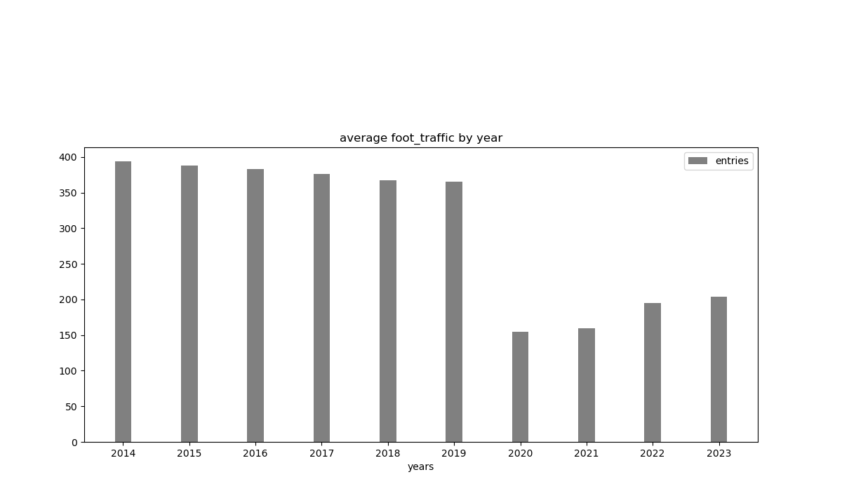
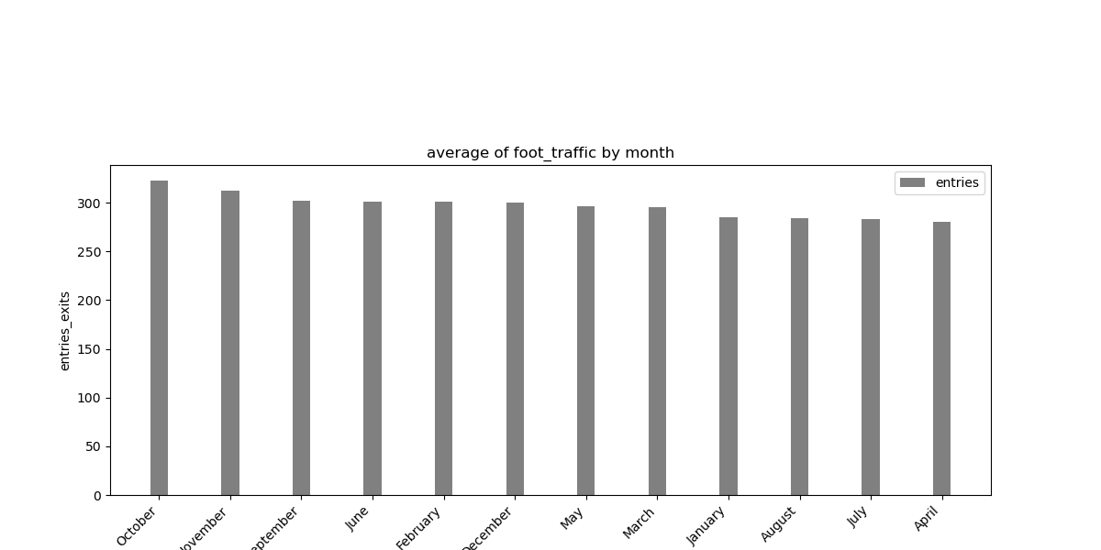
Exploratory Data Analysis
In 2020 and 2021, there has been a decrease in commute traffic due to the effect of the pandemic.
It is seen that the fall months are relatively busier than the other months.
Notes:
The COVID-19 pandemic had a significant impact on ridership in the New York City subway system. In 2020 and 2021, there was a substantial decrease in subway ridership due to various factors such as remote work, school closures, and reduced tourism.
As for the fall months, they are typically busier than other months due to various factors such as the start of the school year, return to work after the summer break, and increased tourism during the autumn season. However, even with these factors, the overall subway ridership during the fall months of 2020 and 2021 was still lower than the previous years due to the pandemic.

Slide 11
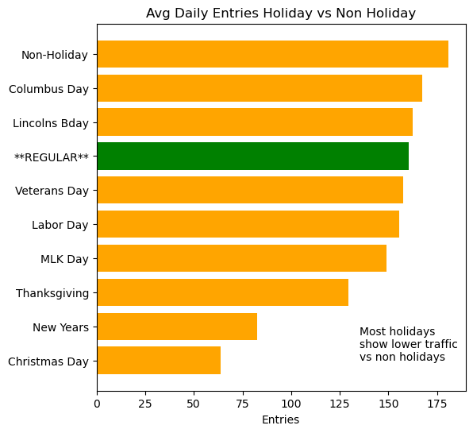
Exploratory Data Analysis
The traffic on the New York City subway system tends to be lower on holidays compared to non-holidays for several reasons.
1. Commuting patterns
2. More People Stay Home
Notes:
Work and School Schedules: On non-holidays, the subway system experiences heavy traffic during rush hour as commuters make their way to and from work or school. On holidays, many people have the day off, so there are fewer commuters.
Tourists: New York City is a popular tourist destination, and many tourists use the subway system to get around the city. On holidays, there may be fewer tourists in the city, which can contribute to lower subway ridership.

Slide 12
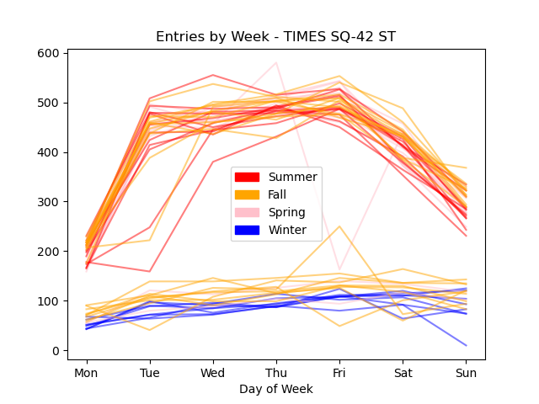
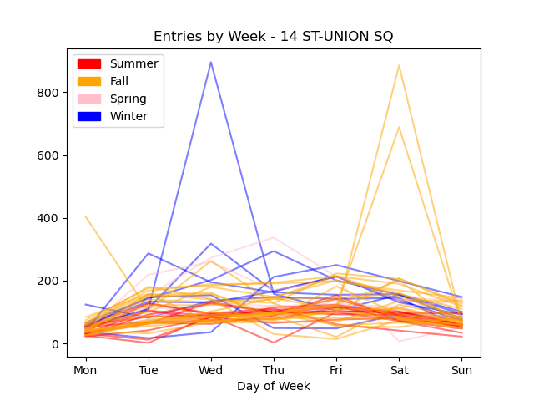
Exploratory Data Analysis
Why? peak tourist season in NYC
Why? Holiday Market and universities are back in session
Notes:
Summer is a popular time for tourists:
Outdoor events and activities:
Seasonal events: There are many seasonal events in New York City during the fall and winter months, such as Thanksgiving, Christmas, and New Year's Eve. These events can attract more people to the city, leading to more traffic on the roads.
School and work schedules: Many people's school and work schedules are different during the fall and winter months, with more people working and going to school during these months. This increased activity can lead to more traffic on the roads.

Slide 13
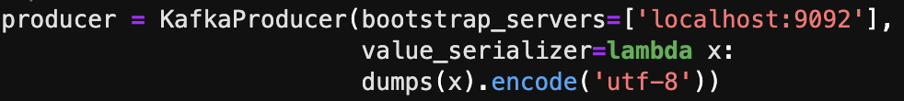
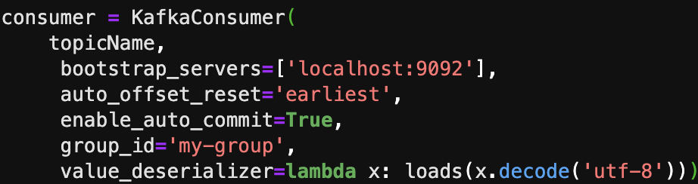
Kafka - Producers and Consumers

Slide 14

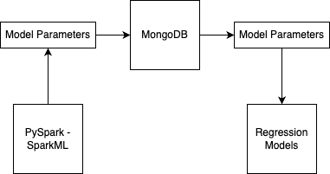
Dataflow

Slide 15
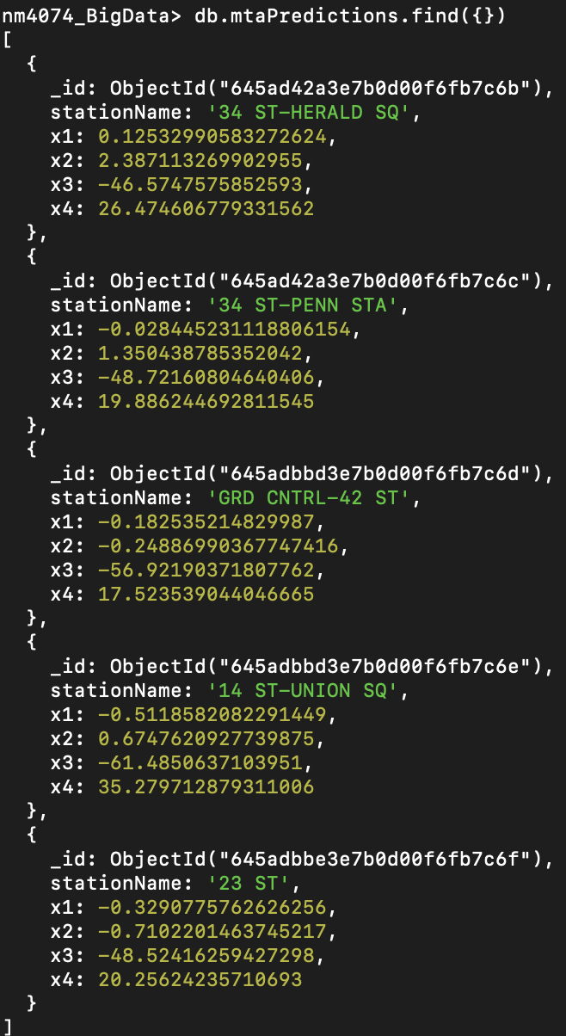
Results - Model Parameters
Collection name: mtaPredictions
Fields:
_id
stationName
x1
x2
x3
x4

Slide 16
Results - Model Performance
MODEL NAME | RMSE
34st Herald Square | 310.184
Penn Station | 273.345
Grand Central | 308.988
14th Street | 344.434
23rd Street | 275.161

Slide 17
Conclusion
Upon performing EDA we discovered a lot of patterns and insights from the dataset, with the crowdest stations being the most interesting.
It is very efficient to stream data through Kafka rather than to just have it stored in a dataframe instance of PySpark and use it to train/test models.
Spark ML is significantly useful for building Machine Learning models and to scale them in the Apache Spark platform and much faster.

Slide 18
Limitations & Future Work
With the turnstile entry and exit data, we can also find the number of people who have accessed the subway network without paying the fare by subtracting the number of people who have exited and entered. We can use this information to determine potential profit projections upon creation of a fool-proof turnstile system.
With the current foot-traffic data, we can now successfully determine the number of people who enter/exit subway stations, we can create variable pricing for advertising across these subway stations. For example: The cost of advertising at Penn Station could be made much higher than other subway stations due to it’s higher footfall and visibility.
To improve the accuracy of the model we can further incorporate weather data into the picture so that there is better correlation between the features.

Slide 19
References
http://web.mta.info/developers/turnstile.html

Slide 20
THANK YOU!

