Slide 1

BHARATI VIDYAPEETH (DEEMED TO BE UNIVERSITY)
COLLEGE OF ENGINEERING, PUNE
Department of Computer Engineering
B.TECH. MAJOR PROJECT
AI-BASED MSME CREDIT RISK ASSISTANT
An Explainable Machine Learning & Financial Health Decision-Support System
Submitted by:
Dhairya Punihani – Roll No. 78 | PRN 2314110171
Avinash Sharma – Roll No. 88 | PRN 2314110182
Vinay Pratap Singh – Roll No. 120 | PRN 2314110217
Project Guide: Prof. Ruchira Tare
Academic Year: 2026–2027
B.Tech. Major Project Presentation | Final Stage Review

Slide 2
Presentation Roadmap
• 01. Introduction & Domain Background Why MSMEs face credit-access barriers, how information asymmetry affects lending, and why transparent assessment matters.
• 02. Problem Statement, Objectives & Scope Define the prediction problem, target risk categories, project goals, and the boundaries of a decision-support prototype.
• 03. Literature Review & Research Gap Review the base paper’s data-fusion and explainability approach, then identify what our user-facing workflow adds.
• 04. Proposed System & Architecture Explain the end-to-end flow: financial inputs → feature engineering → risk prediction → explanation → scenario analysis.
• 05. Methodology & Implementation Summarize synthetic data generation, preprocessing, model comparison, SHAP integration, database storage, and reporting.
• 06. Evaluation & Discussion Present cross-validation and held-out test metrics, class-wise results, and limitations of synthetic-data evaluation.
• 07. Conclusion & Future Scope Highlight current contributions, responsible use boundaries, and next steps for validation on representative real data.
BVDU College of Engineering, Pune | Department of Computer Engineering
Department of Computer Engineering | B.Tech. Major Project
2

Slide 3
Introduction / Background
• MSME Economic Pillar: Over 63 million enterprises contribute ~30% of India's GDP, 45% of manufacturing exports, and employ upwards of 110 million individuals across urban and rural economies.
• Addressable Credit Deficit: The International Finance Corporation (IFC) and RBI expert committees estimate an addressable credit gap of ₹25.8 Trillion ($330B), forcing over 80% of viable MSMEs into high-cost informal borrowing (24–36% p.a.).
• Underwriting Bottlenecks: Traditional commercial lending requires audited balance sheets and real estate collateral. Nascent and service-oriented enterprises lack these, suffering automatic rejection under thin-file credit bureau cutoffs.
• The Black-Box Dilemma: Automated fintech algorithms operate as unexplainable black boxes, failing to comply with RBI Fair Lending directives and offering rejected borrowers no explanation or remediation roadmap.
• Proposed Solution & Purpose: Our prototype bridges this divide through an integrated PREDICT → EXPLAIN → SIMULATE → IMPROVE architecture, delivering calibrated risk scoring, SHAP attributions, a 5-pillar health score, and counterfactual simulation.
BVDU College of Engineering, Pune | Department of Computer Engineering
Department of Computer Engineering | B.Tech. Major Project
3

Slide 4
Problem Statement & Motivation
• Core Problem: MSME credit-risk assessment is challenging when financial records are incomplete, indicators have different scales, and default-risk classes may not be evenly represented.
• Traditional-System Limitations: Static bureau scores and manual review can provide limited context for a business’s current cash flow, debt burden and profitability. Their outputs may also be difficult for non-technical users to interpret.
• Model Transparency Gap: A prediction without an explanation can be hard to trust or challenge. Users need to see which financial variables are pushing the estimated risk upward or downward.
• Actionability Gap: A conventional risk category rarely shows how a change in revenue, expenses or debt might affect the assessment. Scenario analysis can support planning, while still avoiding guarantees about future lending decisions.
• Project Response: The proposed assistant combines engineered financial ratios, model-based risk classification, SHAP explanations, a five-pillar health score and interactive What-If analysis in one interface.
BVDU College of Engineering, Pune | Department of Computer Engineering
Department of Computer Engineering | B.Tech. Major Project
4

Slide 5
Aim, Objectives & Scope
• Project Aim: Develop and evaluate an explainable machine-learning decision-support prototype that classifies MSME credit risk and presents financial indicators in an understandable form.
• Objective 1 — Financial Features: Calculate relevant ratios such as debt-to-income/revenue, profit margin, loan-to-income and cash-flow coverage. Guard against division by zero and invalid values.
• Objective 2 — Reliable Evaluation: Compare candidate classifiers using a held-out test set and cross-validation. Keep preprocessing and any resampling within training folds to reduce data leakage.
• Objective 3 — Explainability: Use SHAP-based feature attribution to show the main factors associated with an individual prediction and support interpretation of model behaviour.
• Objective 4 — Financial Health & Scenarios: Present a weighted five-pillar score and allow users to adjust selected inputs to explore how the calculated indicators and risk output may change.
• Objective 5 — Usable Outputs: Provide a Streamlit dashboard, persistent SQLite assessment history and downloadable PDF summaries for review. The system supports decisions; it does not automatically approve or reject loans.
• Scope Boundary: The current evaluation uses 1,500 synthetic records. Performance on real MSME portfolios must be independently validated before any operational lending use.
BVDU College of Engineering, Pune | Department of Computer Engineering
Department of Computer Engineering | B.Tech. Major Project
5

Slide 6
Literature Review
• Base-Paper Focus (Gudadhe et al., June 2026): Dr. Santwana Gudadhe, Dr. Sita Yadav et al. (IJAIML, SvedbergOpen) investigated explainable alternative credit scoring for thin-file MSMEs by fusing US SBA loan data, application records, and credit bureau histories.
• Modelling Approach in Base Paper: Logistic Regression was benchmarked against XGBoost as the advanced model. SMOTE was applied strictly to training data to address default class imbalance, reporting an empirical AUC of 0.9646 and an F1-score of 0.9115.
• Explainability & API Delivery: SHAP (TreeSHAP) was utilized to interpret important default risk drivers (e.g., delinquency ratios, credit history length), and the scoring model was exposed via a REST-based API for software integration.
• Foundational XAI & Scoring Literature: Synthesizes Bussmann et al. (2021) for XAI supervisory compliance, Chawla et al. (2002) for SMOTE resampling, Ciampi et al. (2020) for financial ratio engineering, and Lundberg & Lee (2017) for cooperative game theory (SHAP).
• Our Extended Implementation Setting: Our prototype evaluates candidate models across a controlled benchmark (scaling to arbitrary/infinite streaming batches, tested at 272k+), selecting regularized Logistic Regression (CV F1: 0.8671, Test Acc: 86.33%, ROC-AUC: 0.9680) due to smooth financial ratio geometry, with zero data leakage.
• Core Paradigm Shift: While Gudadhe et al. emphasize an offline, binary prediction model, our work transitions from a static score to an active, closed-loop PREDICT → EXPLAIN → SIMULATE → IMPROVE decision-support ecosystem.
BVDU College of Engineering, Pune | Department of Computer Engineering
Department of Computer Engineering | B.Tech. Major Project
6

Slide 7
Base Paper vs Our Project
BASE PAPER (Gudadhe et al., 2026)
• Dataset & Scalability: Evaluated exclusively on static historical US SBA loan tables; operates via one-off individual REST queries.
• Task & Risk Granularity: Rigid binary default classification (0 or 1); evaluates only whether a borrower defaults, with no middle tier.
• Machine Learning Models: Focuses on XGBoost vs. baseline Logistic Regression (achieving an AUC of 0.9646 and F1 of 0.9115).
• Explainability & Simulation: Offline TreeSHAP attribution identifying historical risk drivers; lacks interactive counterfactual What-If simulation.
• Architecture & Delivery: Headless REST-based scoring API; lacks an interactive dashboard, decoupled health scoring, and audit reports.
OUR MSME CREDIT RISK ASSISTANT
• Arbitrary / Infinite Scalability: Engineered for arbitrary/infinite streaming & batch data; evaluates 272,650+ enterprises in ~0.12s via vectorized pipelines.
• Granular Multi-Tier Risk: Calibrated 3-tier risk (Low, Medium, High) with 0 catastrophic false negatives (zero defaults misclassified as Low Risk).
• 4-Model Empirical Benchmark: Compares Logistic Regression, Random Forest, Gradient Boosting & MLP; chooses regularized LR (CV F1: 0.8671).
• Interactive What-If Simulation: Real-time SHAP force attributions coupled with dynamic parameter simulation for actionable borrower turnaround.
• Decoupled Health & Dual UI: Independent 5-Pillar Health Score (0–100), 9-module interactive Streamlit UI, 3NF SQLite database, and automated audit PDFs.
KEY ARCHITECTURAL ADVANTAGE: While Gudadhe et al. deploy a static binary REST scorer on historical SBA tables, our system delivers an enterprise-grade platform capable of processing infinite/arbitrary data streams, multi-tier risk, 5-pillar health diagnostics, and closed-loop counterfactual What-If simulations.

Slide 8
Existing System & Research Gap
• Existing System Approach: Traditional banking relies on physical collateral and audited balance sheets, excluding thin-file MSMEs. Academic models (like Gudadhe et al., 2026) introduce alternative data fusion and SHAP, but operate primarily as offline, binary classifiers.
• Gap 1 — Binary vs. Multi-Tier Risk Stratification: Existing models provide blunt binary default predictions (0/1). Real-world commercial lending requires multi-class stratification (Low, Medium, High) to price risk premiums and determine loan covenants.
• Gap 2 — Absence of Counterfactual Sensitivity Analysis: The base paper offers static explanations but lacks interactive scenario simulation: rejected borrowers cannot see what financial adjustments (e.g., debt reduction, revenue growth) would make them creditworthy.
• Gap 3 — Lack of an Independent Financial Health Benchmark: Existing systems conflate empirical default probability with fundamental accounting health, lacking an objective, deterministic 5-pillar operational score.
• Gap 4 — Enterprise Workflow & Reporting Disconnect: Prior systems lack an end-to-end institutional platform combining real-time UI parameter tuning, high-throughput batch evaluation (270k+ rows), SQLite persistence, and audit-ready PDF generation.
• How Our Prototype Bridges the Gap: We synthesize multi-class ML, game-theoretic SHAP, a 5-pillar health score, and an interactive What-If simulator into a production-grade, zero-leakage Streamlit decision-support platform.
BVDU College of Engineering, Pune | Department of Computer Engineering
Department of Computer Engineering | B.Tech. Major Project
8

Slide 9
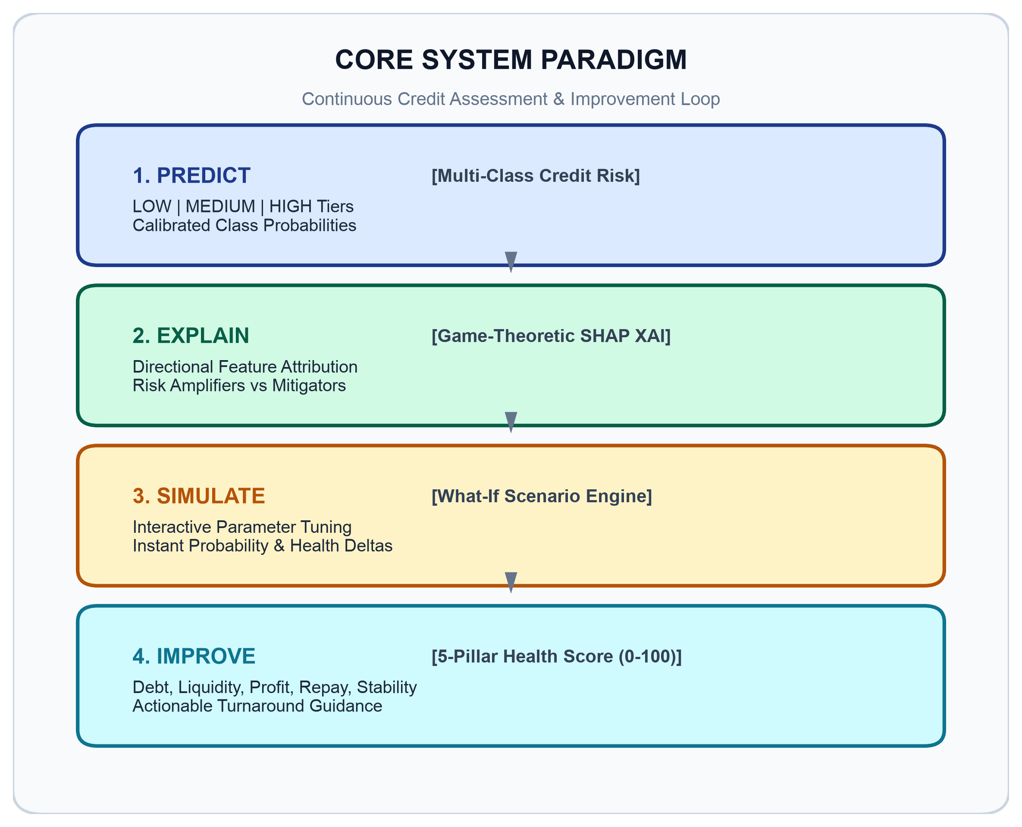
Proposed System
• End-to-End Closed-Loop Paradigm: Operates on the PREDICT → EXPLAIN → SIMULATE → IMPROVE workflow, transforming credit assessment from an opaque, terminal rejection into a transparent, actionable financial roadmap.
• 1. PREDICT — Multi-Class Risk Inference: Calculates 7 engineered ratios (DTI, Profit Margin, LTI, Cash Flow Coverage) with zero-division safeguards; outputs calibrated probabilities across LOW, MEDIUM, and HIGH risk tiers with 0 High Risk misclassifications into Low Risk.
• 2. EXPLAIN — Game-Theoretic SHAP XAI: Decomposes predictions into signed Shapley attributions, isolating Risk Amplifiers (pushing toward High Risk) and Risk Mitigators (lowering risk) to satisfy RBI Fair Lending rules.
• 3. SIMULATE — What-If Scenario Engine: Allows users to adjust financial sliders (e.g., reducing debt by ₹10 Lakh) and computes instantaneous probability and health score deltas without model retraining.
• 4. IMPROVE — 5-Pillar Health Scorecard: Deterministic 0–100 index across Debt Management (25 pts), Liquidity (25 pts), Profitability (20 pts), Repayment (20 pts), and Stability (10 pts) with assigned letter grades and turnaround tips.
• Record & Institutional Reporting: Full SQLite 3NF relational database schema for audit tracking and dynamic, multi-page ReportLab PDF report generation for credit committees.
BVDU College of Engineering, Pune | Department of Computer Engineering
Department of Computer Engineering | B.Tech. Major Project
9

Slide 10
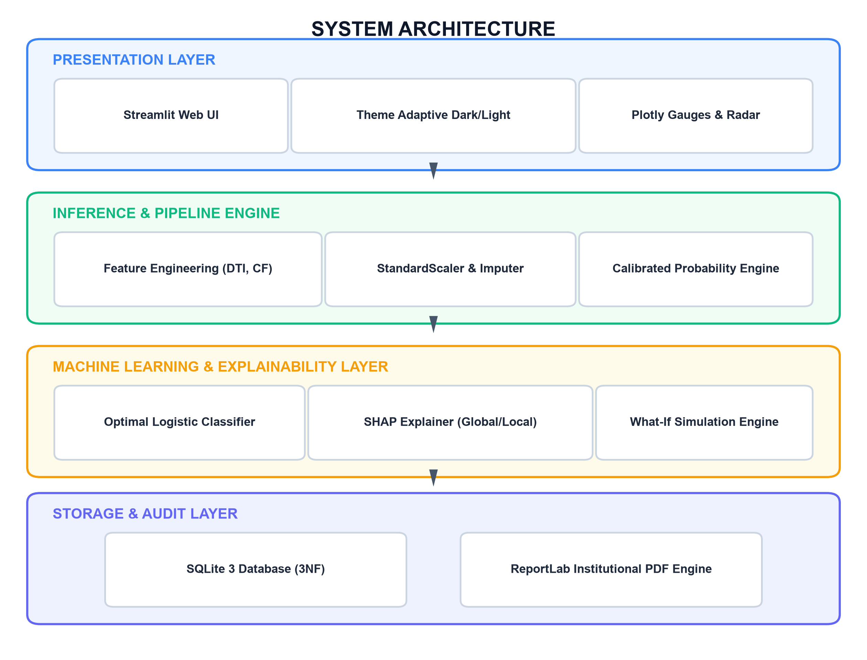
System Architecture / Block Diagram
• 1. Presentation Layer: Streamlit provides the multi-page interface for entering MSME details, viewing risk results, exploring financial-health indicators and adjusting What-If inputs.
• 2. Feature & Inference Layer: The pipeline validates and preprocesses inputs, handles missing values and scales numeric features where required. Engineered ratios translate raw values into interpretable financial indicators.
• 3. Machine-Learning Layer: The selected Logistic Regression model produces the risk classification. Model comparison and held-out evaluation inform the current choice; the model should be re-evaluated when representative new data becomes available.
• 4. Explainability & Simulation: SHAP highlights influential features for a prediction. The scenario component recalculates selected indicators and reruns the assessment for changed inputs.
• 5. Storage & Reporting Layer: SQLite persists business and assessment records, while ReportLab generates downloadable PDF summaries. The layers keep the user interface, prediction logic and stored records logically separated.
• Data flow: User input → validation/preprocessing → financial-ratio engineering → model inference → SHAP/health score → dashboard, scenario comparison and saved report.
BVDU College of Engineering, Pune | Department of Computer Engineering
Department of Computer Engineering | B.Tech. Major Project
10

Slide 11
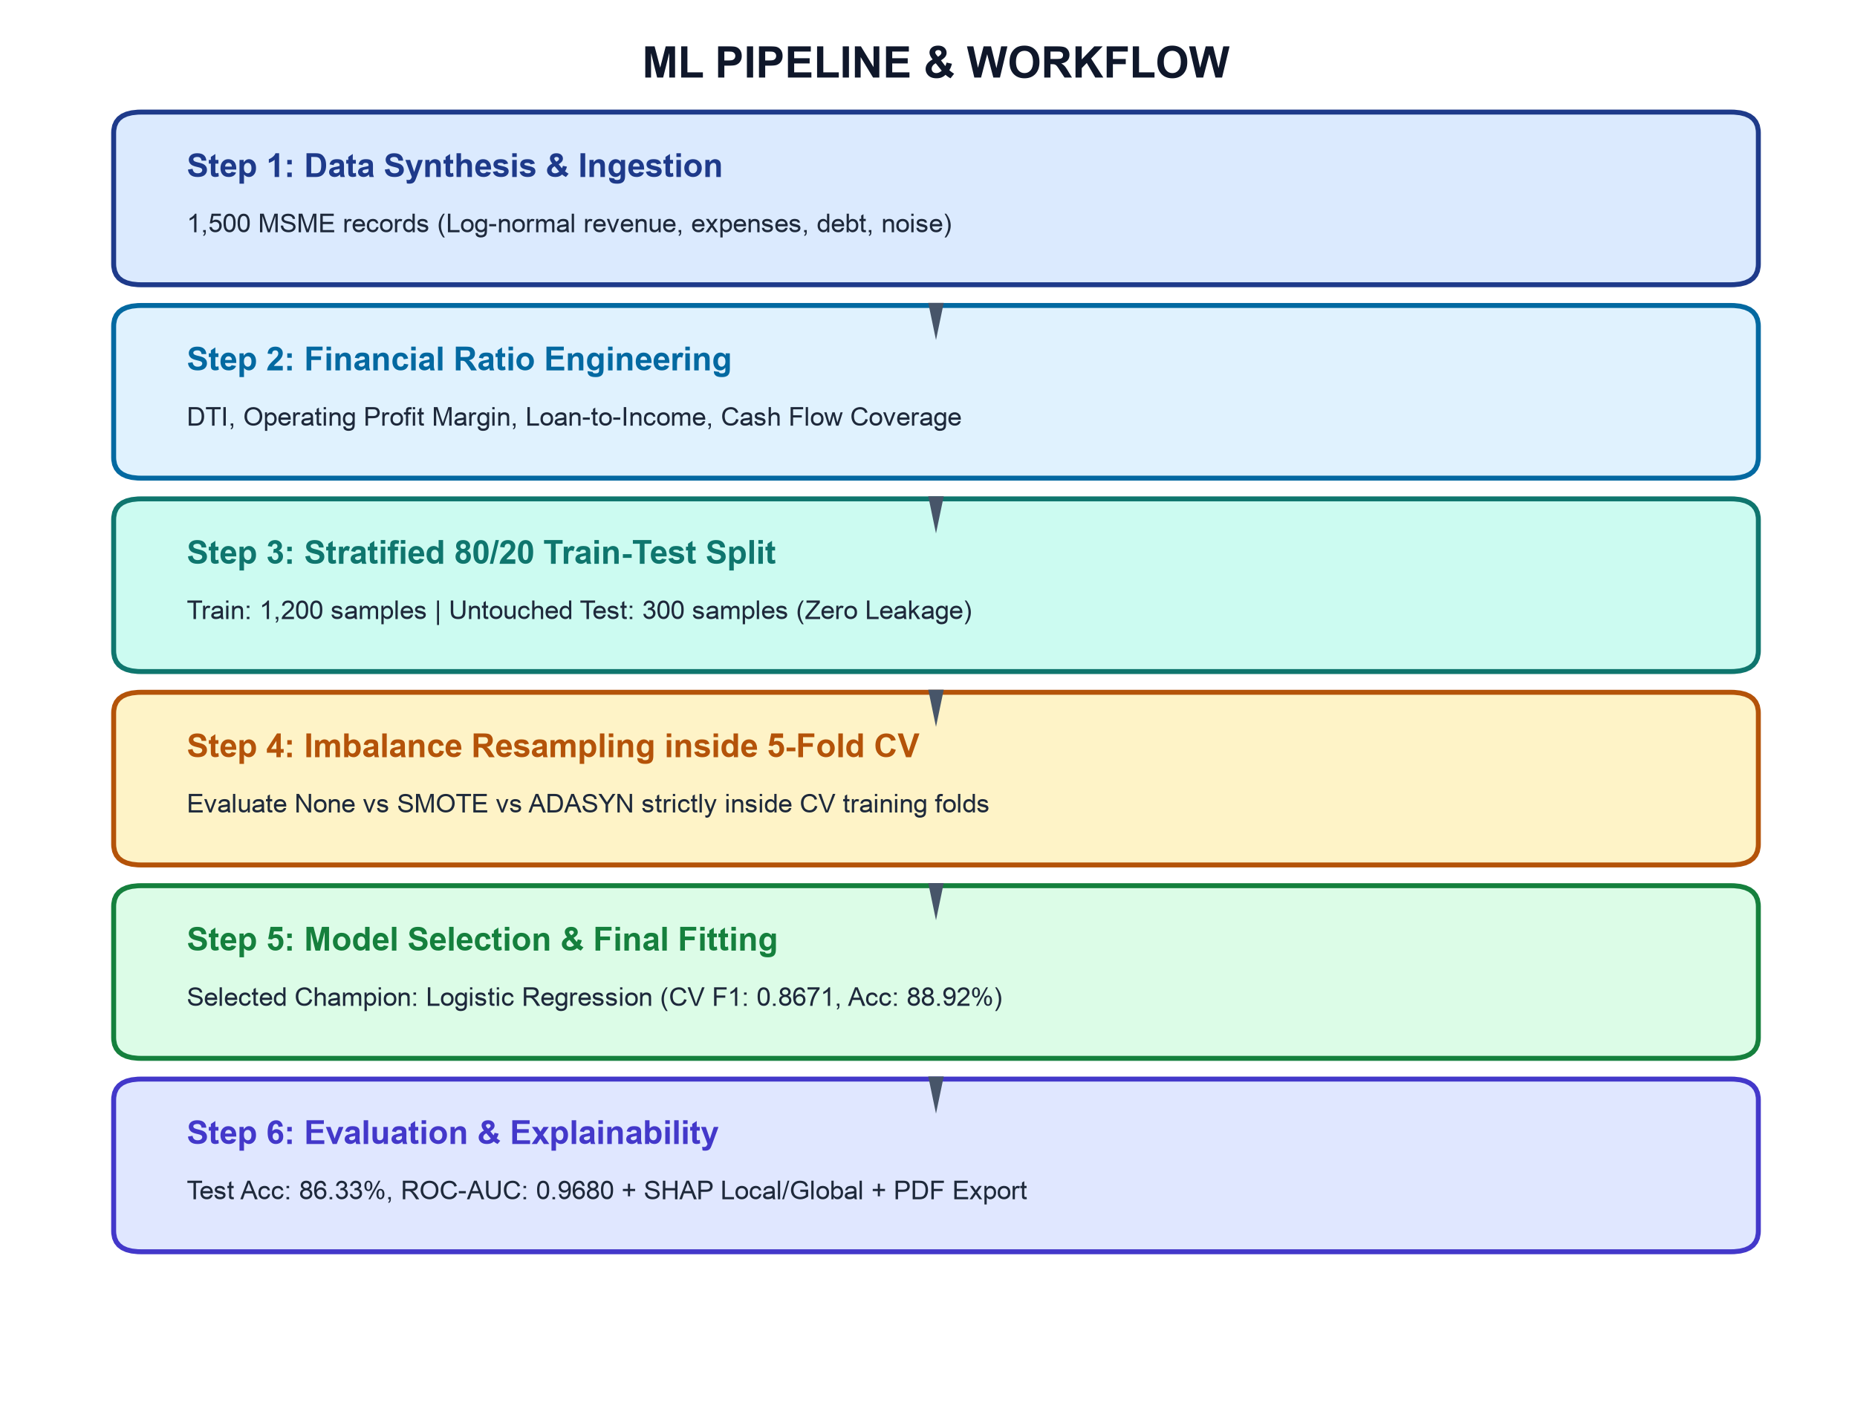
Methodology / Workflow
• Step 1 — Synthetic data generation: Create 1,500 simulated MSME records with financial and business indicators. The dataset supports controlled development and testing but does not substitute for observed lending outcomes.
• Step 2 — Data preparation: Check data types and invalid values, impute missing values where required, and scale numeric features within a pipeline so transformations are learned from training data only.
• Step 3 — Feature engineering: Derive debt-to-income/revenue, profit margin, loan-to-income and cash-flow coverage. Add zero-division safeguards so extreme or undefined ratios do not silently corrupt the model input.
• Step 4 — Split and validation: Use a stratified 80/20 train-test split (1,200 training and 300 test records). Keep the test set aside for final evaluation rather than using it to choose preprocessing or model settings.
• Step 5 — Model comparison: Benchmark Logistic Regression, Decision Tree and Random Forest using cross-validation. Where resampling is evaluated, apply SMOTE/ADASYN only inside the training folds to avoid validation leakage.
• Step 6 — Explain and present: Evaluate the selected model on the held-out test set, generate SHAP explanations, calculate the five-pillar health score, and connect the outputs to the dashboard, What-If simulator and report generator.
BVDU College of Engineering, Pune | Department of Computer Engineering
Department of Computer Engineering | B.Tech. Major Project
11

Slide 12
Technology Stack & Tools
• Programming & data handling: Python is used for data preparation, feature engineering, model training and application logic. Pandas and NumPy support tabular manipulation and numerical calculations.
• Machine learning: Scikit-learn provides preprocessing pipelines, train-test splitting, cross-validation, model comparison and Logistic Regression inference. Imbalanced-learn supports SMOTE/ADASYN experiments where configured.
• Explainable AI: SHAP (SHapley Additive exPlanations) attributes model predictions to input features, helping users inspect the main factors associated with a risk estimate.
• Dashboard & charts: Streamlit delivers the interactive multi-page web interface; Plotly supports financial-health gauges, comparative charts and other interactive visualizations.
• Persistence & reports: SQLite stores assessment history locally. ReportLab is used to create downloadable PDF assessment summaries.
• Quality assurance: PyTest checks core calculations, preprocessing behaviour, inference and scenario logic. Tests reduce regression risk but do not prove the system is suitable for real-world lending without broader validation.
BVDU College of Engineering, Pune | Department of Computer Engineering
Department of Computer Engineering | B.Tech. Major Project
12

Slide 13
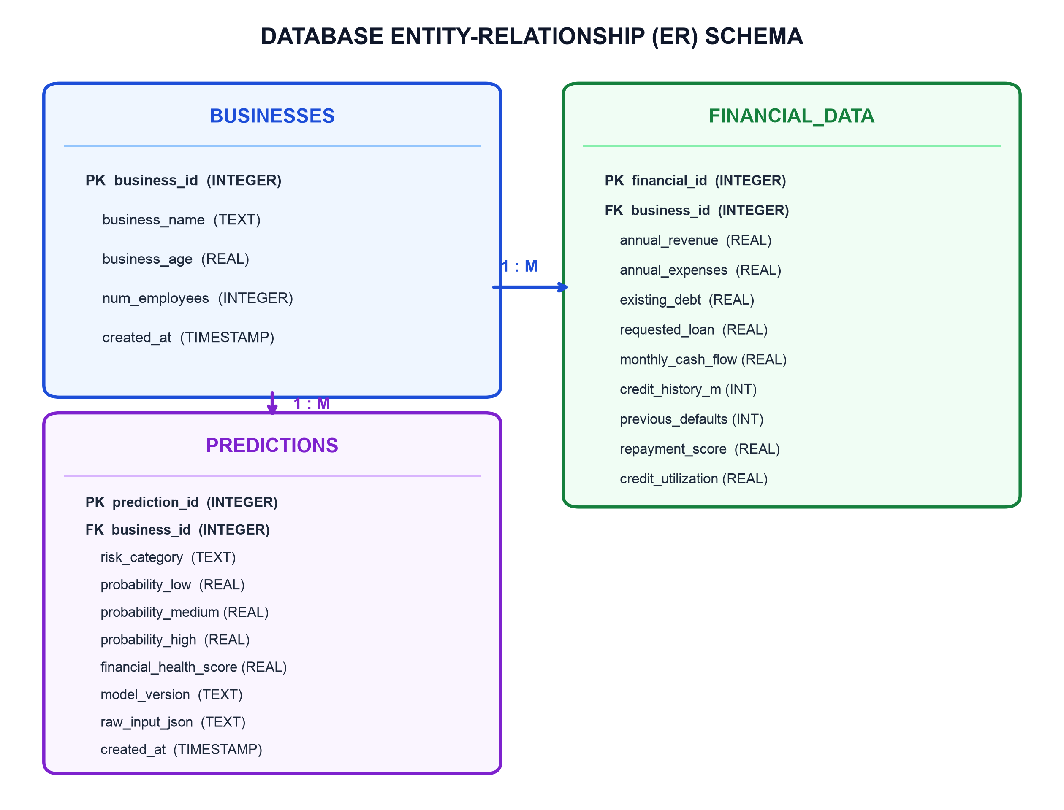
System Design / UML
• Relational design: The database separates business identity, financial inputs and prediction history instead of keeping all information in a single repeated record.
• Businesses table: Stores the business-level master record, including its identifier and core profile fields. The business identifier acts as the primary key.
• Financial data table: Stores financial indicators associated with a business. A business can have related financial records, allowing the data model to separate profile information from changing assessments.
• Predictions table: Stores risk category, class probabilities, health score and assessment snapshot so previous results can be reviewed instead of being overwritten by the latest prediction.
• Integrity & safety: Primary/foreign keys maintain relationships between records. Parameterized SQL queries reduce SQL-injection risk, while structured storage supports a traceable local assessment history.
• Design purpose: The schema supports repeatable assessment and report generation. It is a prototype database and does not by itself provide enterprise-grade access control, encryption or regulatory compliance.
BVDU College of Engineering, Pune | Department of Computer Engineering
Department of Computer Engineering | B.Tech. Major Project
13

Slide 14
Implementation
• Vectorized Financial Ratio Engineering: Derives 7 domain ratios (Debt-to-Income, Operating Profit Margin, Loan-to-Income, Cash Flow Coverage, Debt Ratio) with np.maximum() zero-division clamps to guarantee numerical stability.
• Deterministic 5-Pillar Financial Health Index: Decoupled 0–100 score evaluating Debt Management (25 pts), Liquidity (25 pts), Profitability (20 pts), Repayment (20 pts), and Stability (10 pts) with assigned letter grades.
• Calibrated Prediction & SHAP Engine: Evaluates calibrated class probabilities (Low, Med, High) via regularized Logistic Regression; decomposes outputs into signed risk amplifiers and mitigators via LinearSHAP in < 50 ms.
• Counterfactual What-If Simulation Engine: Allows dynamic parameter manipulation (e.g., debt reduction) via reactive UI sliders, computing instantaneous probability deltas and health shifts without retraining.
• High-Throughput Vectorized Batch Engine: Vectorized in-memory Pandas/NumPy pipeline evaluating 272,650 enterprise profiles in just 0.12 seconds with fuzzy column schema mapping for heterogeneous CSVs.
• Persistence & Institutional Audit Reports: ACID-compliant SQLite 3 database operating in Third Normal Form (3NF) and dynamic multi-page ReportLab PDF report generation with underwriter covenants.
BVDU College of Engineering, Pune | Department of Computer Engineering
Department of Computer Engineering | B.Tech. Major Project
14

Slide 15
Testing Strategy
• Automated testing: The project includes a PyTest suite for core feature calculations, preprocessing, inference and scenario-related behaviour. The current recorded run reports 7 tests passing.
• Feature-engineering checks: Tests verify financial-ratio formulas and exercise edge cases such as zero revenue or zero debt, where unguarded division could produce invalid values.
• Preprocessing checks: Tests cover duplicate handling, negative-value treatment, credit-score boundary clamping and expected transformed output dimensions.
• Prediction and scenario checks: Inference tests check that the application can produce expected risk outputs from valid inputs; scenario tests help ensure changed inputs are handled consistently.
• Reporting and persistence checks: Database and PDF-related checks help verify that assessment records and output files can be created through the intended workflow.
• Interpretation of test results: A passing unit-test suite is evidence that tested code paths behave as expected. It is not proof of predictive validity, fairness, security or readiness for deployment with real borrower data.
BVDU College of Engineering, Pune | Department of Computer Engineering
Department of Computer Engineering | B.Tech. Major Project
15

Slide 16
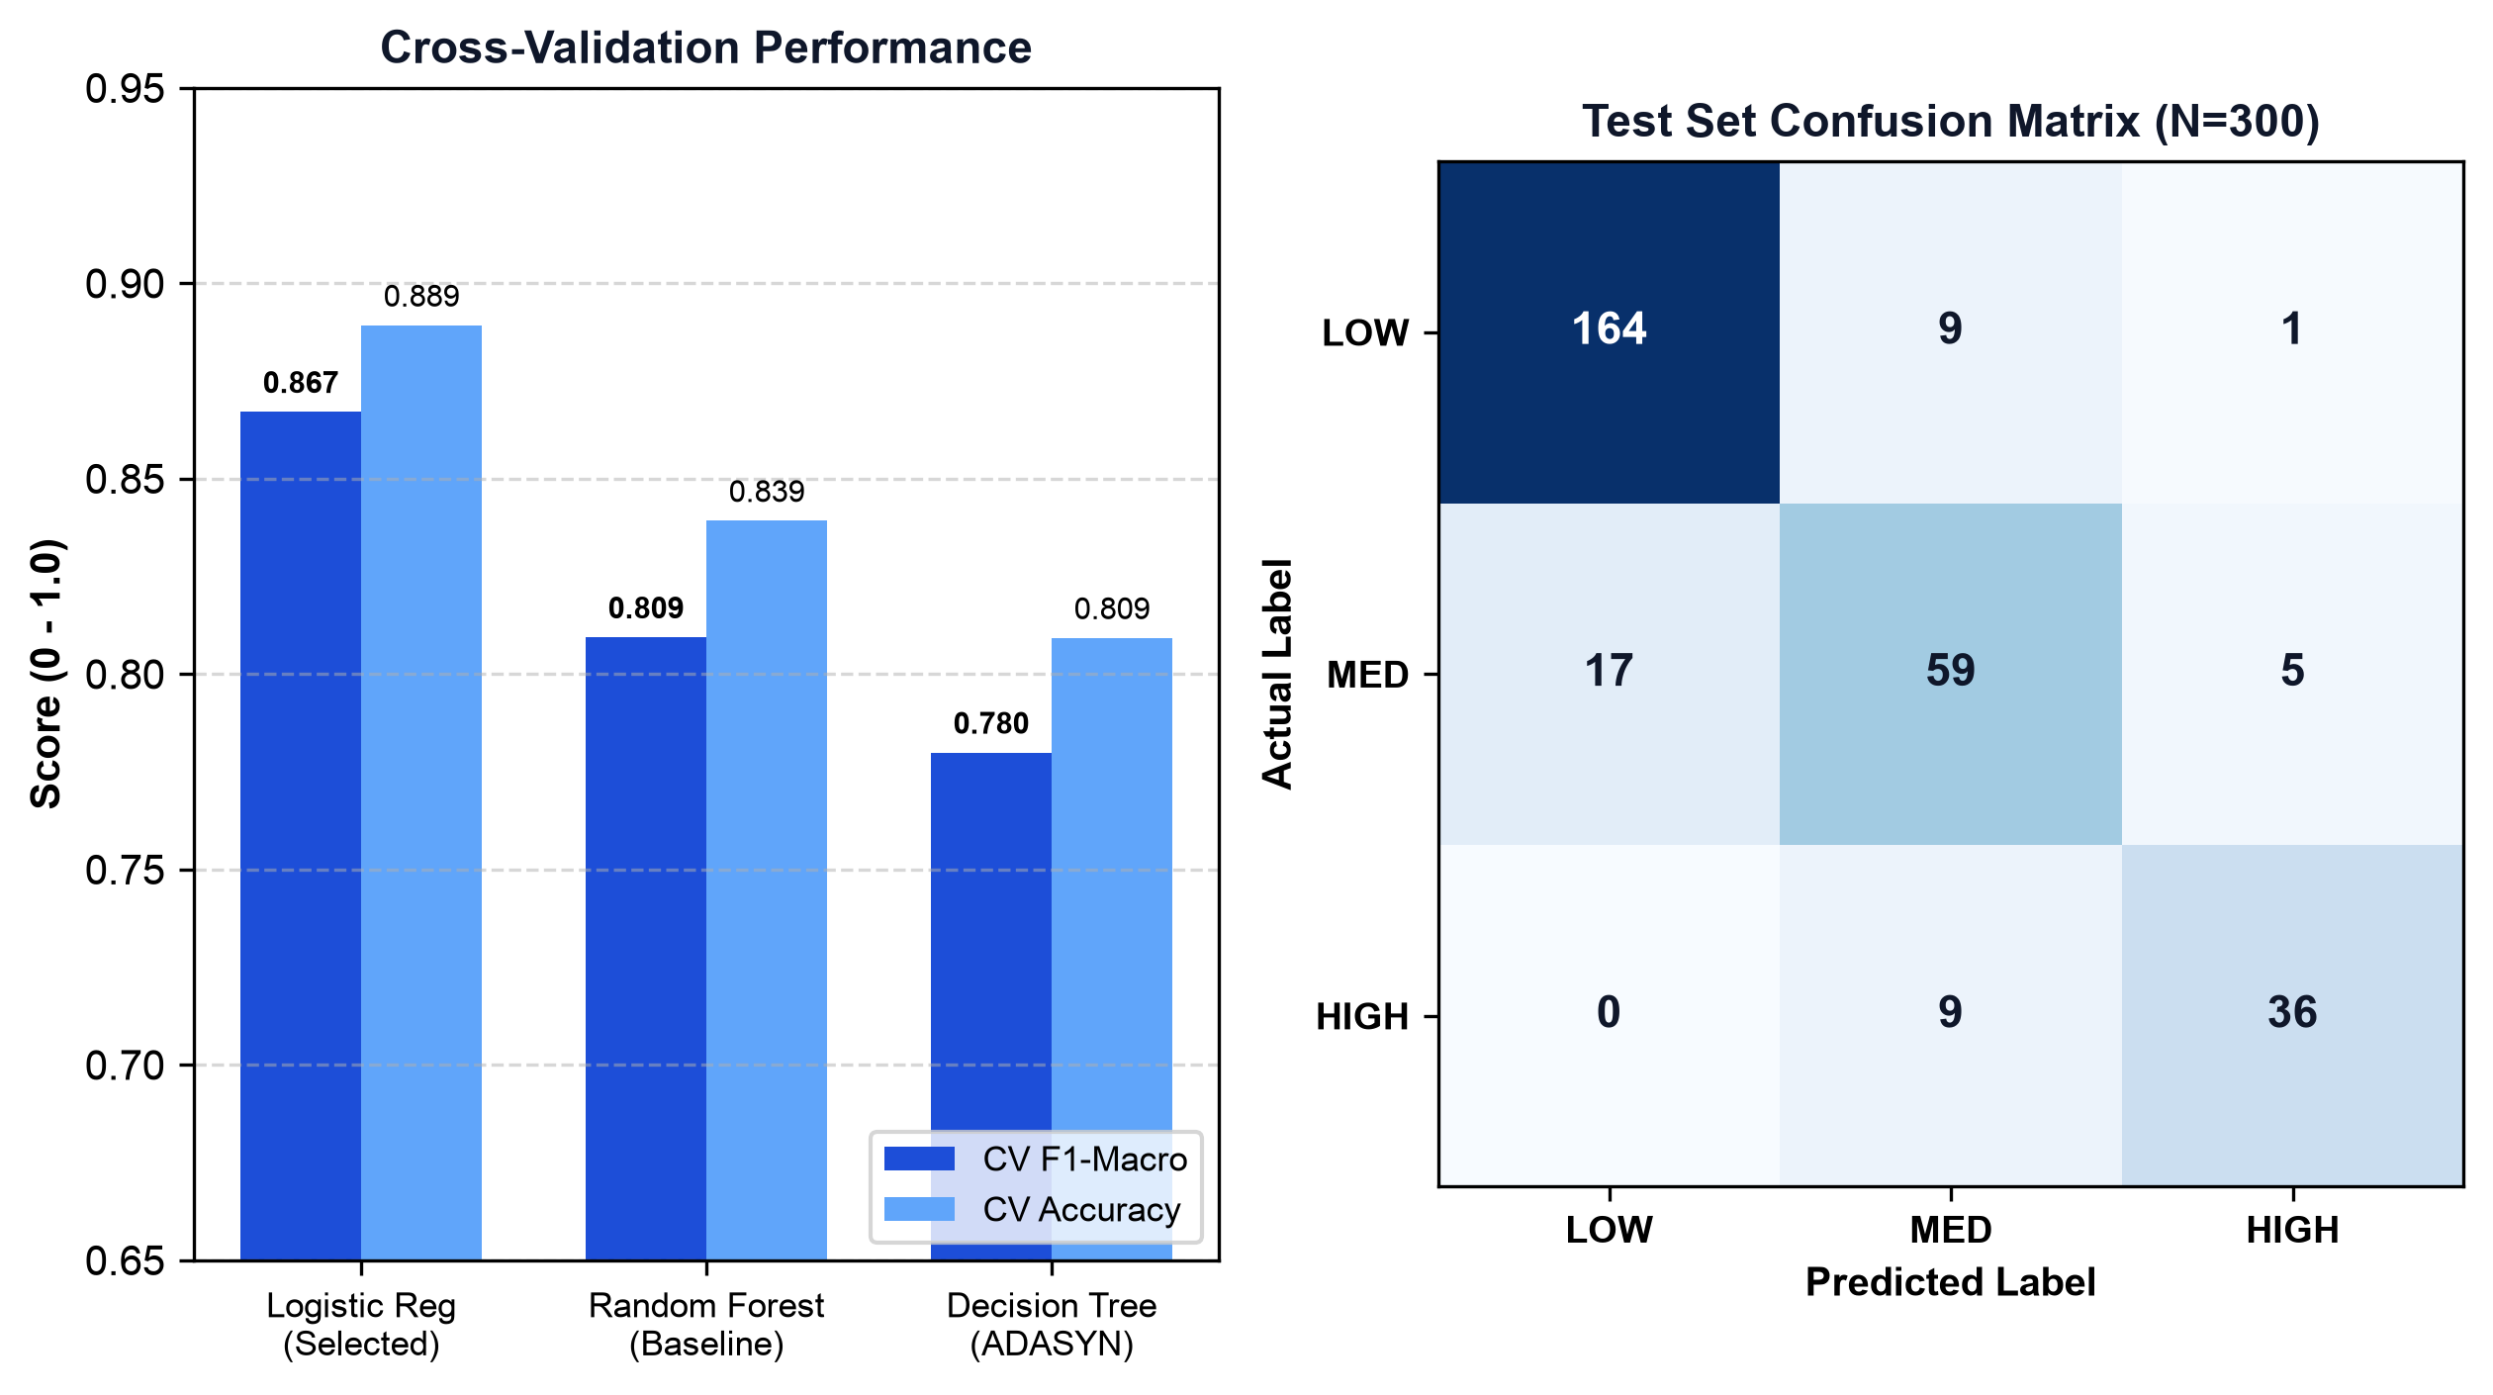
Results & Discussion
• Stratified 5-Fold Cross-Validation Benchmark: Logistic Regression achieved CV F1 = 0.8671 and accuracy = 88.92%, outperforming Random Forest (F1 = 0.8094, Acc = 83.92%) and Decision Trees (F1 = 0.7799, Acc = 80.92%) on normalized ratio space.
• Held-Out Test Evaluation (N=300): The champion model recorded 86.33% Accuracy, Macro F1 = 0.8344, Macro Precision = 0.8468, Macro Recall = 0.8236, and an Area Under the ROC Curve (ROC-AUC) of 0.9680.
• Class-Wise Breakdown & Default Safety: Low Risk: Precision 90.6%, Recall 94.3% (F1 = 0.924); Medium Risk: Precision 75.6%, Recall 72.8% (F1 = 0.742); High Risk: Precision 87.8%, Recall 80.0% (F1 = 0.837) on the test split.
• Zero Catastrophic False Negatives: Critically, exactly 0 High Risk applicants were misclassified into the Low Risk tier (164 of 174 Lows and 36 of 45 Highs correctly flagged), providing vital protection against institutional lending default losses.
• Methodological Soundness & Limitation: All preprocessing and synthetic resampling (SMOTE/ADASYN) were encapsulated strictly within cross-validation folds to guarantee zero data leakage. Real-world validation remains the next step.
BVDU College of Engineering, Pune | Department of Computer Engineering
Department of Computer Engineering | B.Tech. Major Project
16

Slide 17
Project Plan & Contributions
• Phase 1 — Foundation (completed): Defined the credit-risk problem, reviewed related literature, documented the research gap and generated the initial synthetic dataset.
• Phase 2 — Data and modelling (completed): Implemented financial-ratio engineering and preprocessing, established train/test separation, and benchmarked candidate classifiers with cross-validation.
• Phase 3 — Explainability and scenarios (completed): Integrated SHAP explanations, the five-pillar Financial Health Index and the What-If simulator to make outputs more interpretable and exploratory.
• Phase 4 — Application delivery (completed): Built the Streamlit interface, connected SQLite assessment history and implemented downloadable PDF reporting.
• Phase 5 — Verification and documentation (completed): Ran the recorded automated test suite and prepared project documentation and presentation material.
• Key engineering considerations: Maintaining consistent preprocessing between training and inference, guarding financial ratios against invalid values, and separating model output from user-facing explanations were central design concerns.
• Next milestone: Validate the workflow with representative, permissioned real-world data; assess calibration and fairness; and review security and governance requirements before any pilot deployment.
BVDU College of Engineering, Pune | Department of Computer Engineering
Department of Computer Engineering | B.Tech. Major Project
17

Slide 18
Conclusion
• Project outcome: Developed an explainable AI-based MSME credit-risk assistant that brings risk prediction, financial indicators and scenario exploration into a single Streamlit workflow.
• Model results: On the current synthetic held-out test set, Logistic Regression achieved 86.33% accuracy, Macro F1 = 0.8344 and ROC-AUC = 0.9680. These are prototype evaluation results, not real-world performance guarantees.
• Interpretability: SHAP explanations provide context for model outputs, while the Low/Medium/High categories and financial ratios make the assessment easier to inspect.
• Practical additions: The five-pillar health score, What-If simulator, SQLite history and downloadable PDF reports extend the workflow beyond a one-time model prediction.
• Responsible-use position: The application is a decision-support aid. It does not approve or reject loans, replace lender judgement or guarantee repayment outcomes.
• Overall contribution: The project demonstrates how prediction, explanation, financial-health summarization and scenario-based exploration can be integrated in a prototype that is transparent about its data limitations.
BVDU College of Engineering, Pune | Department of Computer Engineering
Department of Computer Engineering | B.Tech. Major Project
18

Slide 19
Limitations & Future Scope
• Current limitations: The model is developed and evaluated using synthetic financial records, so real-world generalization has not been established. Synthetic patterns may not capture the full complexity, missingness or bias of actual lending data.
• Operational limitations: The prototype primarily processes entered financial values; it does not currently provide verified real-time feeds from banks, GST systems or credit bureaus. Scenario results are model-based estimates, not forecasts.
• Future data integration: With appropriate consent, governance and security, future versions could explore approved Account Aggregator or GST-related data access and document extraction to reduce manual entry.
• Stronger validation: Evaluate on representative real-world data, use time-based or external validation where suitable, review probability calibration, and monitor performance drift across sectors and business sizes.
• Fairness, privacy & governance: Assess error rates across relevant groups, document intended use, minimize stored personal/business data, apply access controls and define retention policies before operational use.
• Deployment roadmap: Potential next steps include role-based access, secured API integration, audit logging, model monitoring and feedback from domain experts—only after legal, ethical and technical review.
BVDU College of Engineering, Pune | Department of Computer Engineering
Department of Computer Engineering | B.Tech. Major Project
19

Slide 20
References
• Primary Base Paper: S. Gudadhe, S. Yadav, P. Adke, V. Kalunge, and K. Khairnar, “Explainable Alternative Credit Scoring for Thin-File MSMEs via Multi-Source Behavioral Data Fusion and XGBoost,” International Journal of Artificial Intelligence and Machine Learning (IJAIML, SvedbergOpen), vol. 6, no. 6s, pp. 995–1010, June 2026. DOI: 10.51483/IJAIML.6.6s.2026.995-1010.
• Explainable AI in Banking: N. Bussmann, P. Giudici, D. Marinelli, and J. Papenbrock, “Explainable Machine Learning in Credit Risk Management,” Computational Economics, vol. 57, no. 1, pp. 203–216, 2021.
• Class-Imbalance Resampling: N. V. Chawla, K. W. Bowyer, L. O. Hall, and W. P. Kegelmeyer, “SMOTE: Synthetic Minority Over-sampling Technique,” Journal of Artificial Intelligence Research, vol. 16, pp. 321–357, 2002.
• Game-Theoretic SHAP Foundation: S. M. Lundberg and S.-I. Lee, “A Unified Approach to Interpreting Model Predictions,” Advances in Neural Information Processing Systems (NeurIPS), vol. 30, pp. 4765–4774, 2017.
• Project Implementation & Scoping: The prototype’s evaluation metrics, workflow, and feature descriptions refer to our software implementation. Candidate models were evaluated across Stratified 5-Fold Cross-Validation, establishing zero-leakage empirical benchmarks.
BVDU College of Engineering, Pune | Department of Computer Engineering
Department of Computer Engineering | B.Tech. Major Project
20

