Slide 1

EDA – No Show Appointments
Pradeep Jaladi & Avinash Alapati
Data Science, Bellevue University
DSC530-T302, Data Exploration and Analysis
Nov 19th 2020
Notes:
NOTE:
To change the image on this slide, select the picture and delete it. Then click the Pictures icon in the placeholder to insert your own image.

Slide 2
Contents
Introduction
Hypothetical Questions
Important Variables
Exploratory Data Analysis
Histograms
CDF
Scatter Plot
Modeling/Prediction
Conclusion

Slide 3
Introduction
According to the analysis, approximately 20% of the primary care and specialty appointments are no show appointments. Which causes a lot of revenue losses and not able to provide services for the people who are in need. In the United States of America where “the cost of missed appointments is estimated at $150B per year”, according to Health Care Innovation.
There are many parameters and points attached to a Missing Appointments. In this project I will be putting my focus on important factors tied to a determining the missing appointments.

Slide 4
Statistical/Hypothetical Question
Does the gender has an affect on the appointment no show
Does the diabetes has an affect on the appointment no show
Do the handicap, GovtAid, and hypertension affects the appointment no show
Does the timings & week day has affect on the appointments no show
Does the neighborhood has affect on the appointment no show
Does the gender has impact on the appointment no show
Does the SMS reminder has impact on reducing the no show

Slide 5
Important Variables
gender: Gender of a patient
Appointment date: Appointment date (Time is missing in the data)
hypertension: Patient has hypertension or not indication
diabetics: Patient has diabetics or not indication
Alcoholism: Patient has alcoholism or not indication
Sms_recieved: Patient has received sms or not
No_show: Patient showed up for the appointment or not indicator

Slide 6
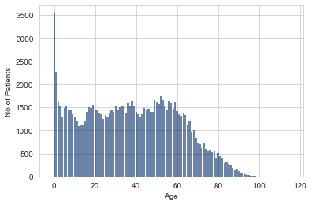
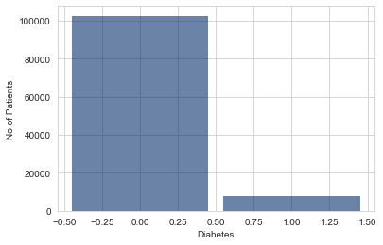
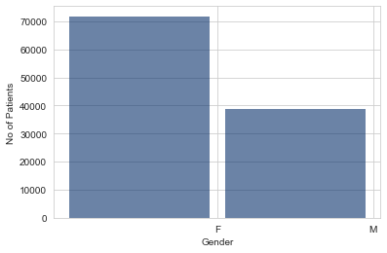
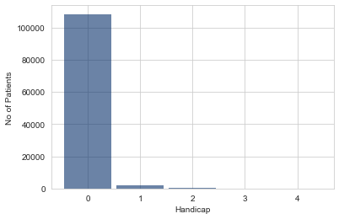
Histogram of different variables
Age
Diabetes
Gender
Handicap

Slide 7
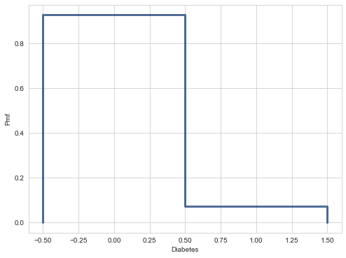
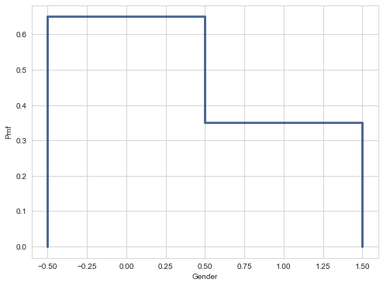
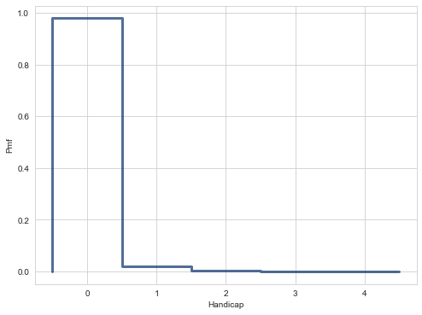
PMFs of different variables
Diabetes
Gender
Handicap

Slide 8
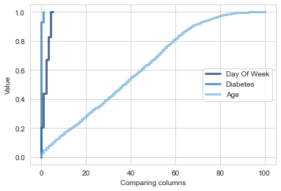
CDFs
CDFs of day of week, diabetes and Age for No Show Appointments

Slide 9
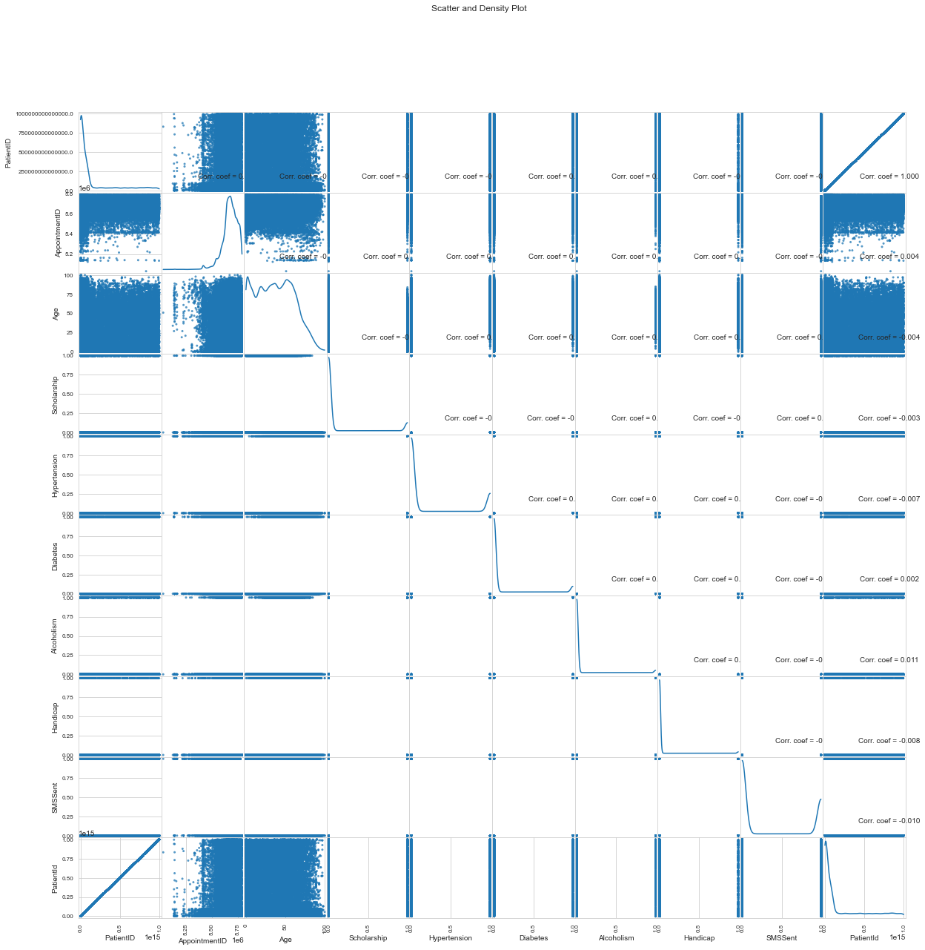
Scatter Plots

Slide 10
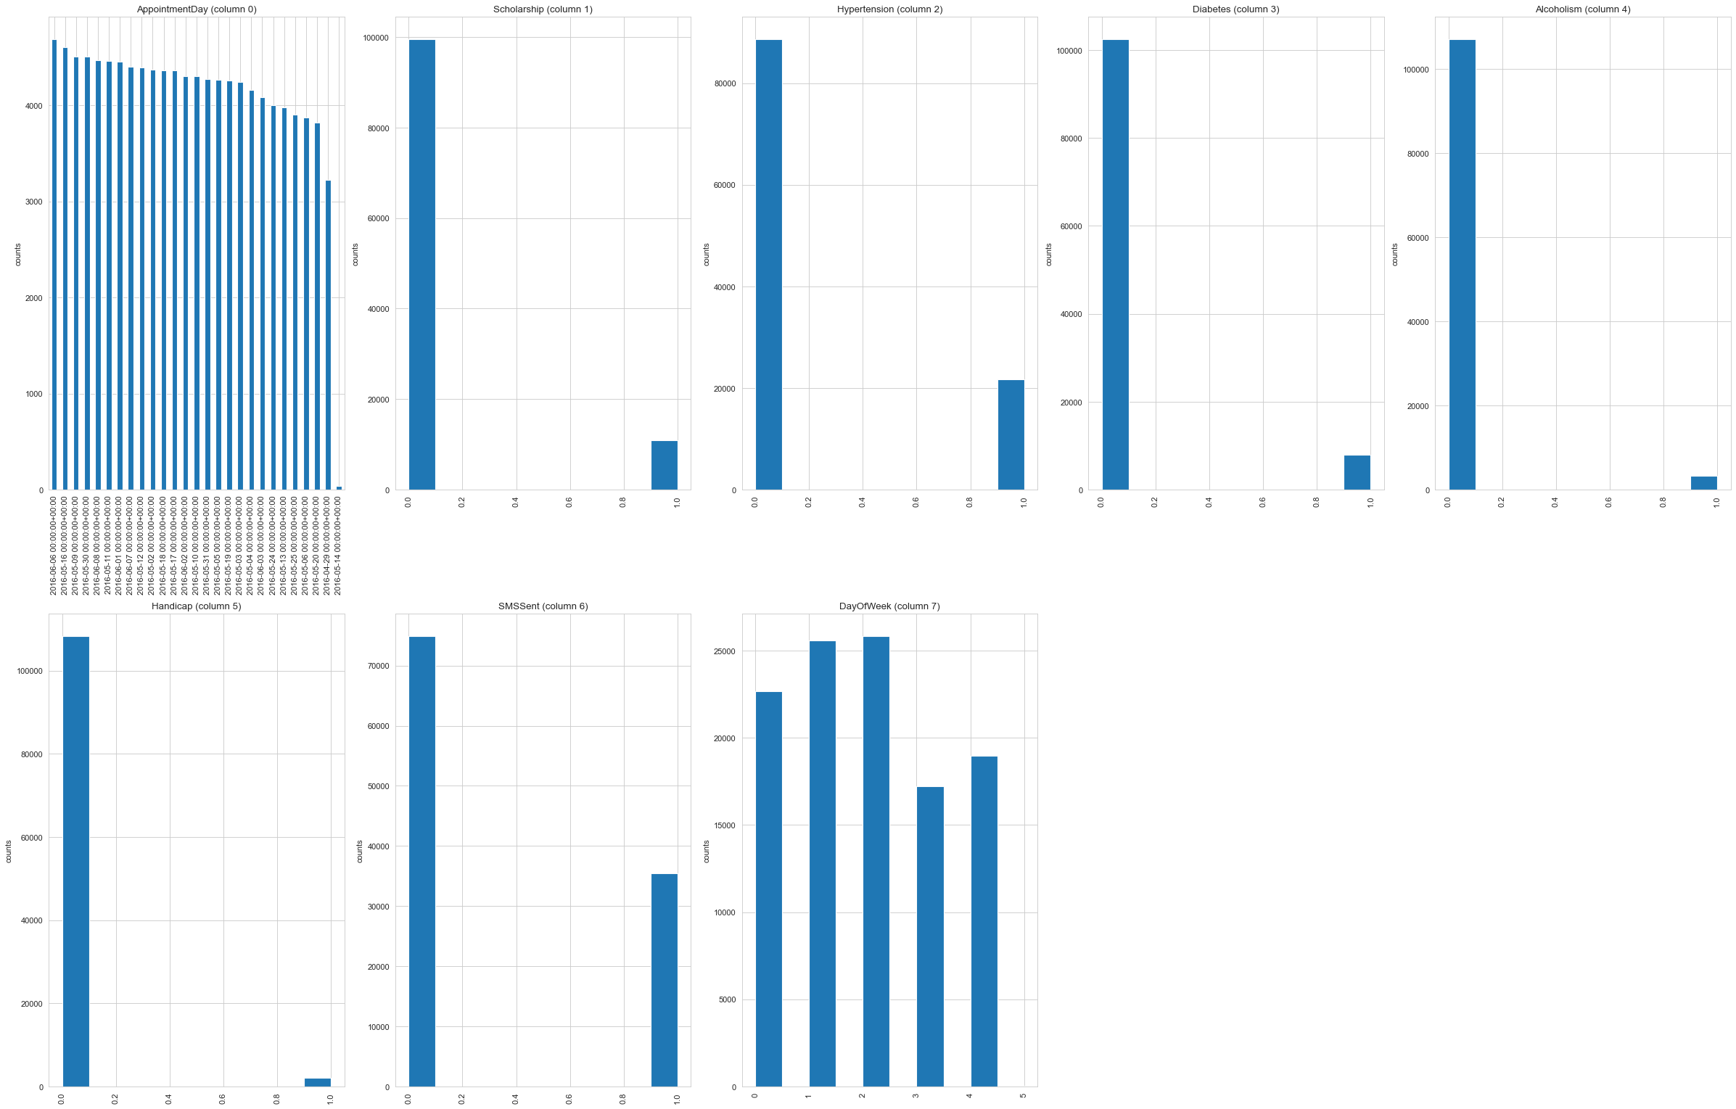
Scatter Plots

Slide 11
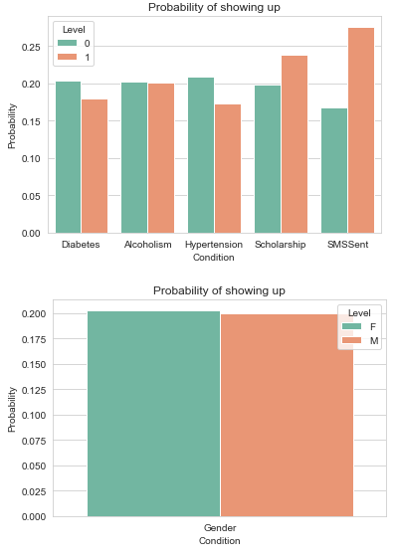
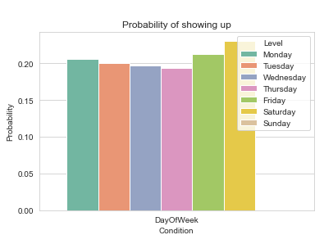
Probability of different variables

Slide 12
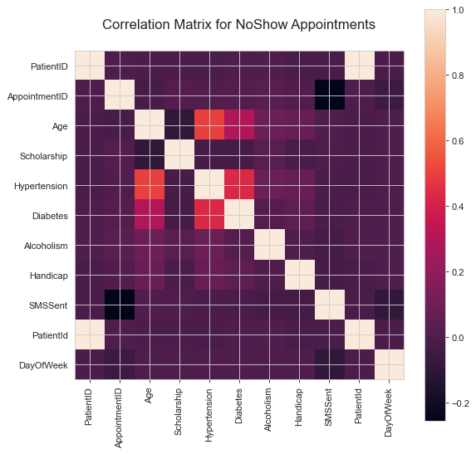
Correlation of No Show Appointments

Slide 13
Conclusions
Waiting Time In Days has a great impact on the patient not showing up.
Day Of Week has a great impact on the patient not showing up.
Gender has a slight influence on the patient no show.
Diabetes has a slight influence on the patient no show.

Slide 14
Thank You..!

