Slide 1
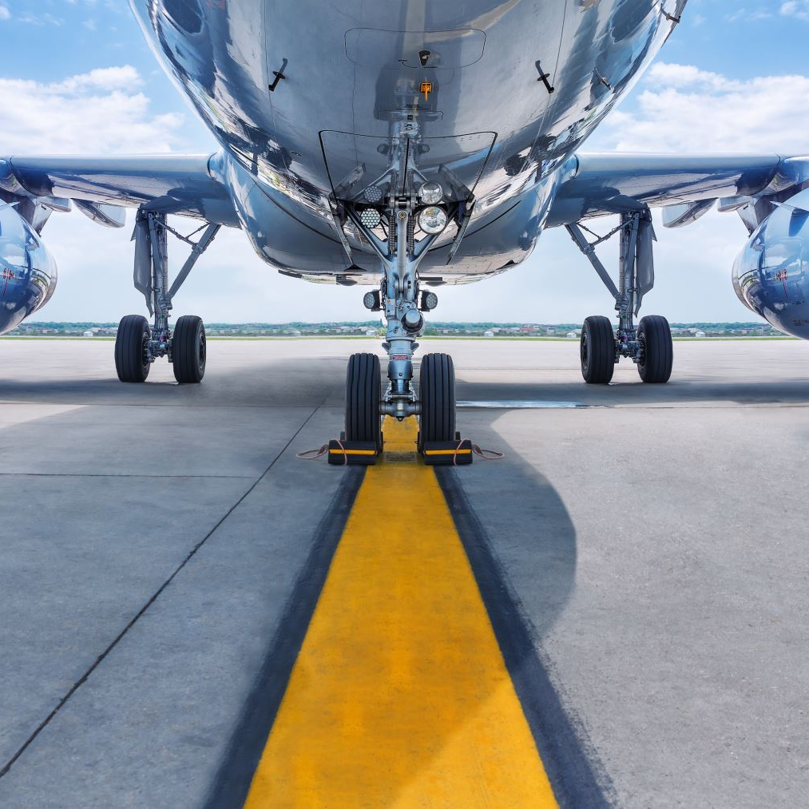



Airline Travel Safety Air travel is safer
Avinash Alapati
DSC 640 Data Presentation and
Visualization

Slide 2
Goal
Airline Travel is safer compared to previous decades.
The number of Accidents have come down significantly.
New Safety regulations, advanced aircrafts reduced incidents significantly.
Negative publicity on Air Travel Safety is biased.

Slide 3
Data Sources
The following Data sources are used to build visual charts
Primary Data source: https://github.com/fivethirtyeight/data/blob/master/airline-safety/airline-safety.csv
Secondary Data source: ttps://www.kaggle.com/datasets/saurograndi/airplane-crashes-since-1908

Slide 4
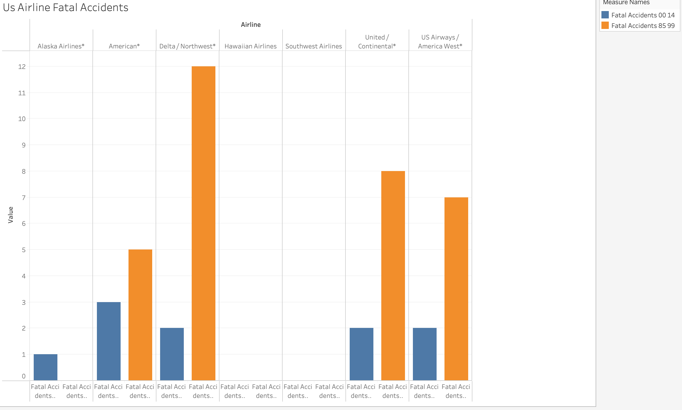
US Airlines Fatal Accidents for the period from 85-14
The Number of Fatal Accidents in US Airlines declined during the period 2000-2014 compared to 1985-1999

Slide 5
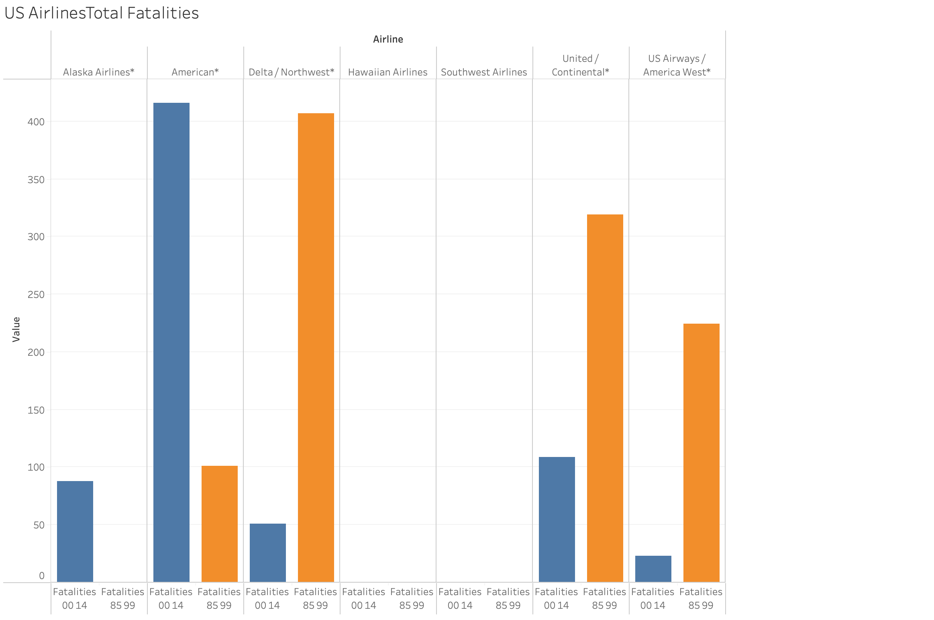
US Airlines Total Fatalities for the period 85-14
The Number of Fatalities in US Airlines declined during the period 2000-2014 compared to 1985-1999

Slide 6
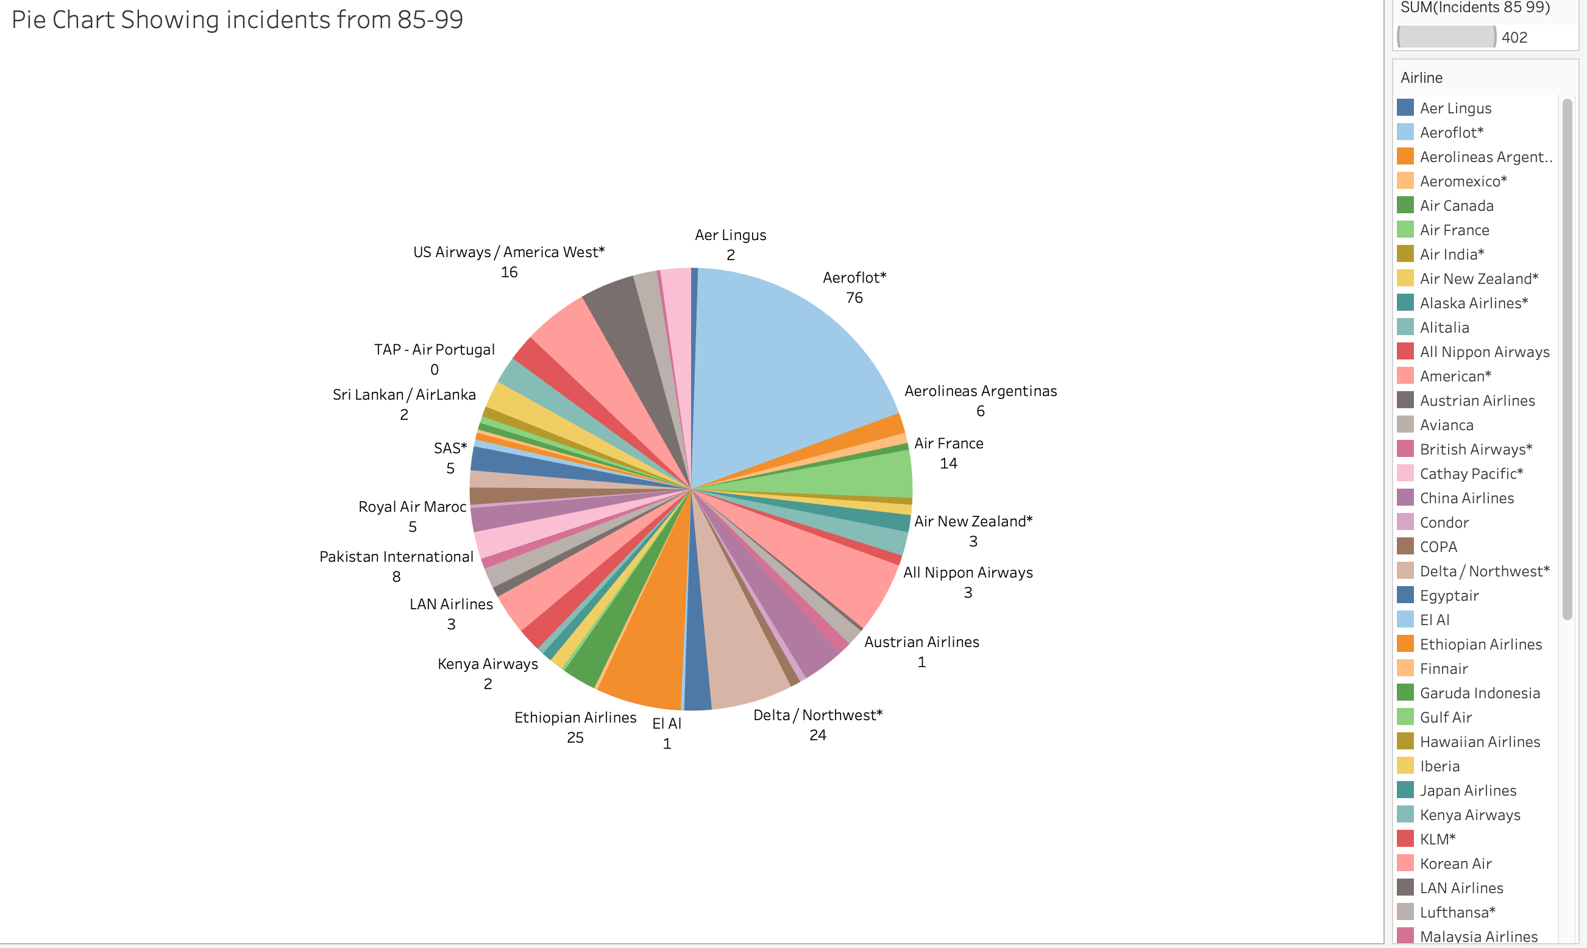
Pie Chart Airline Incidents for the period 85-99
Most number of Airlines Incidents are isolated to a singular airline compared to other airlines.
The Pie Chart Visualization Shows Aeroflot has highest number of incidents from 85-99 period.
Management of Airlines, Safety guidelines play a bigger role.

Slide 7
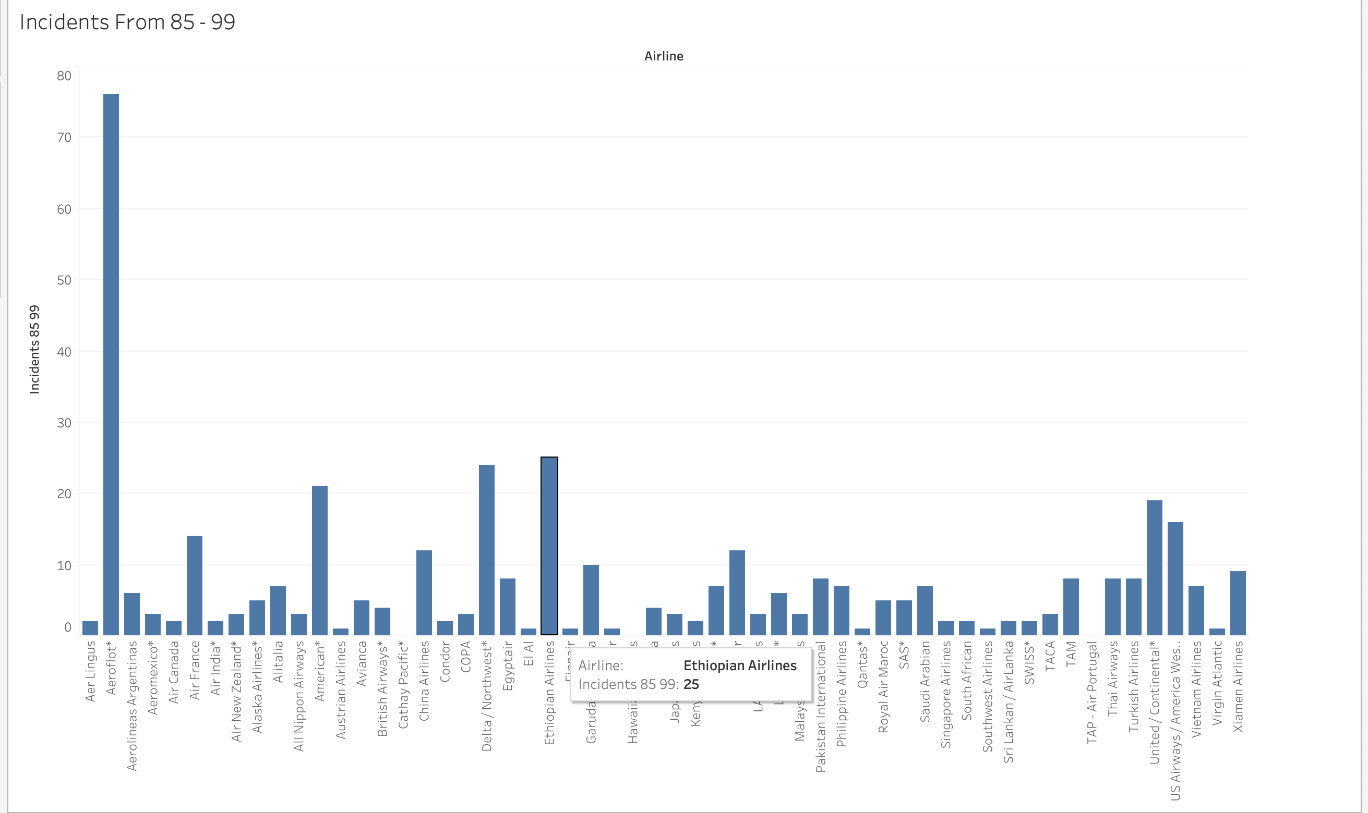
Bar Chart Airline Incidents for the period 85-99
Most number of Airlines Incidents are isolated to a singular airline compared to other airlines
The Bar Chart Visualization Shows Aeroflot has highest number of incidents from 85-99 period

Slide 8
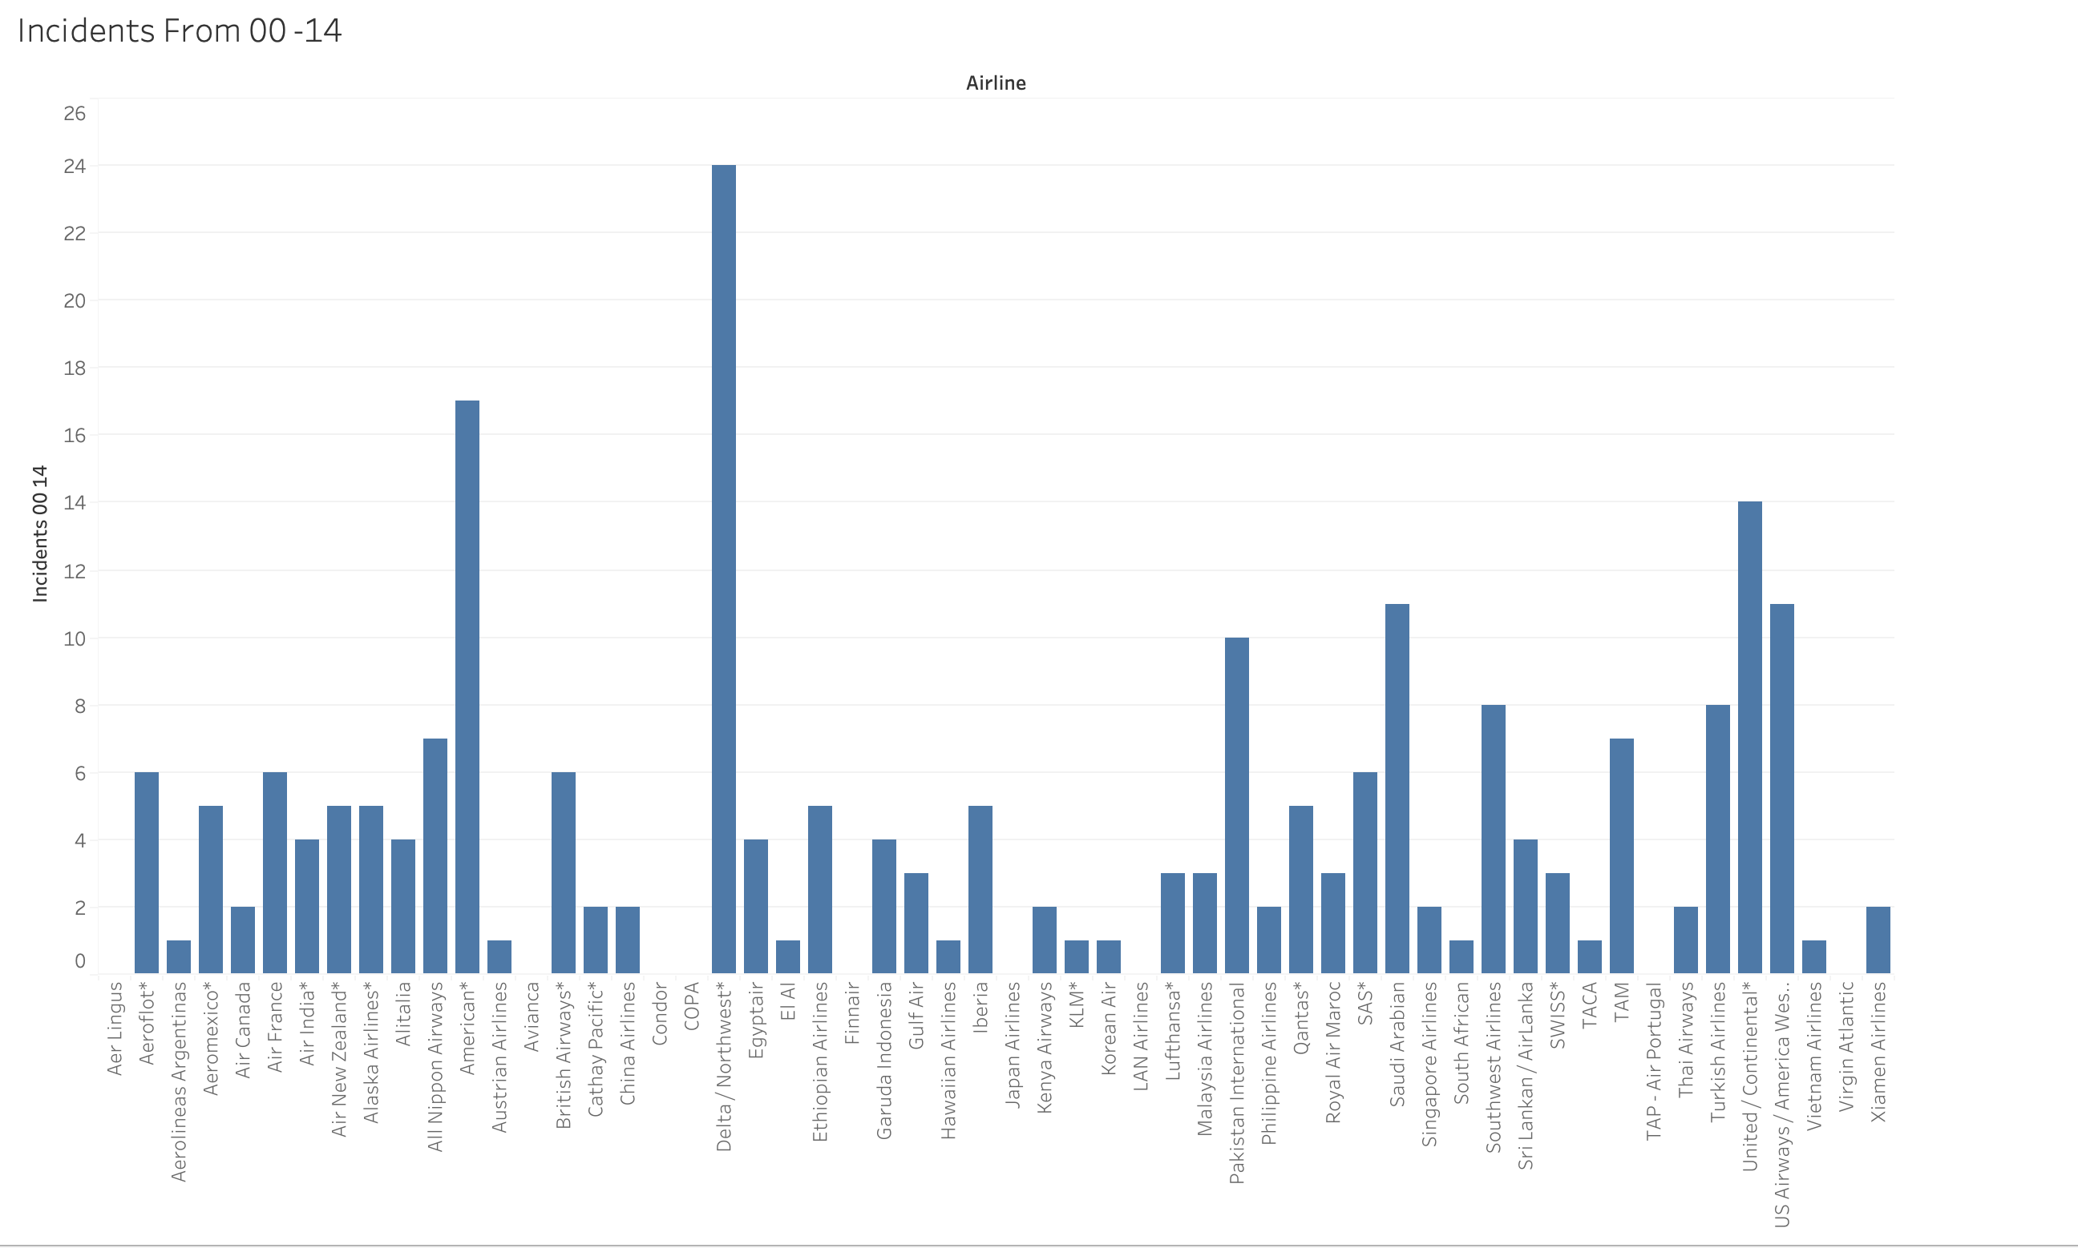
Bar Chart Airline Incidents for the period 00-14
The number of Incidents have come down significantly during the period 00-14
There is no major airline with major number of incidents
Air Travel Safety, Latest Aircraft induction have reduced the number incidents.

Slide 9
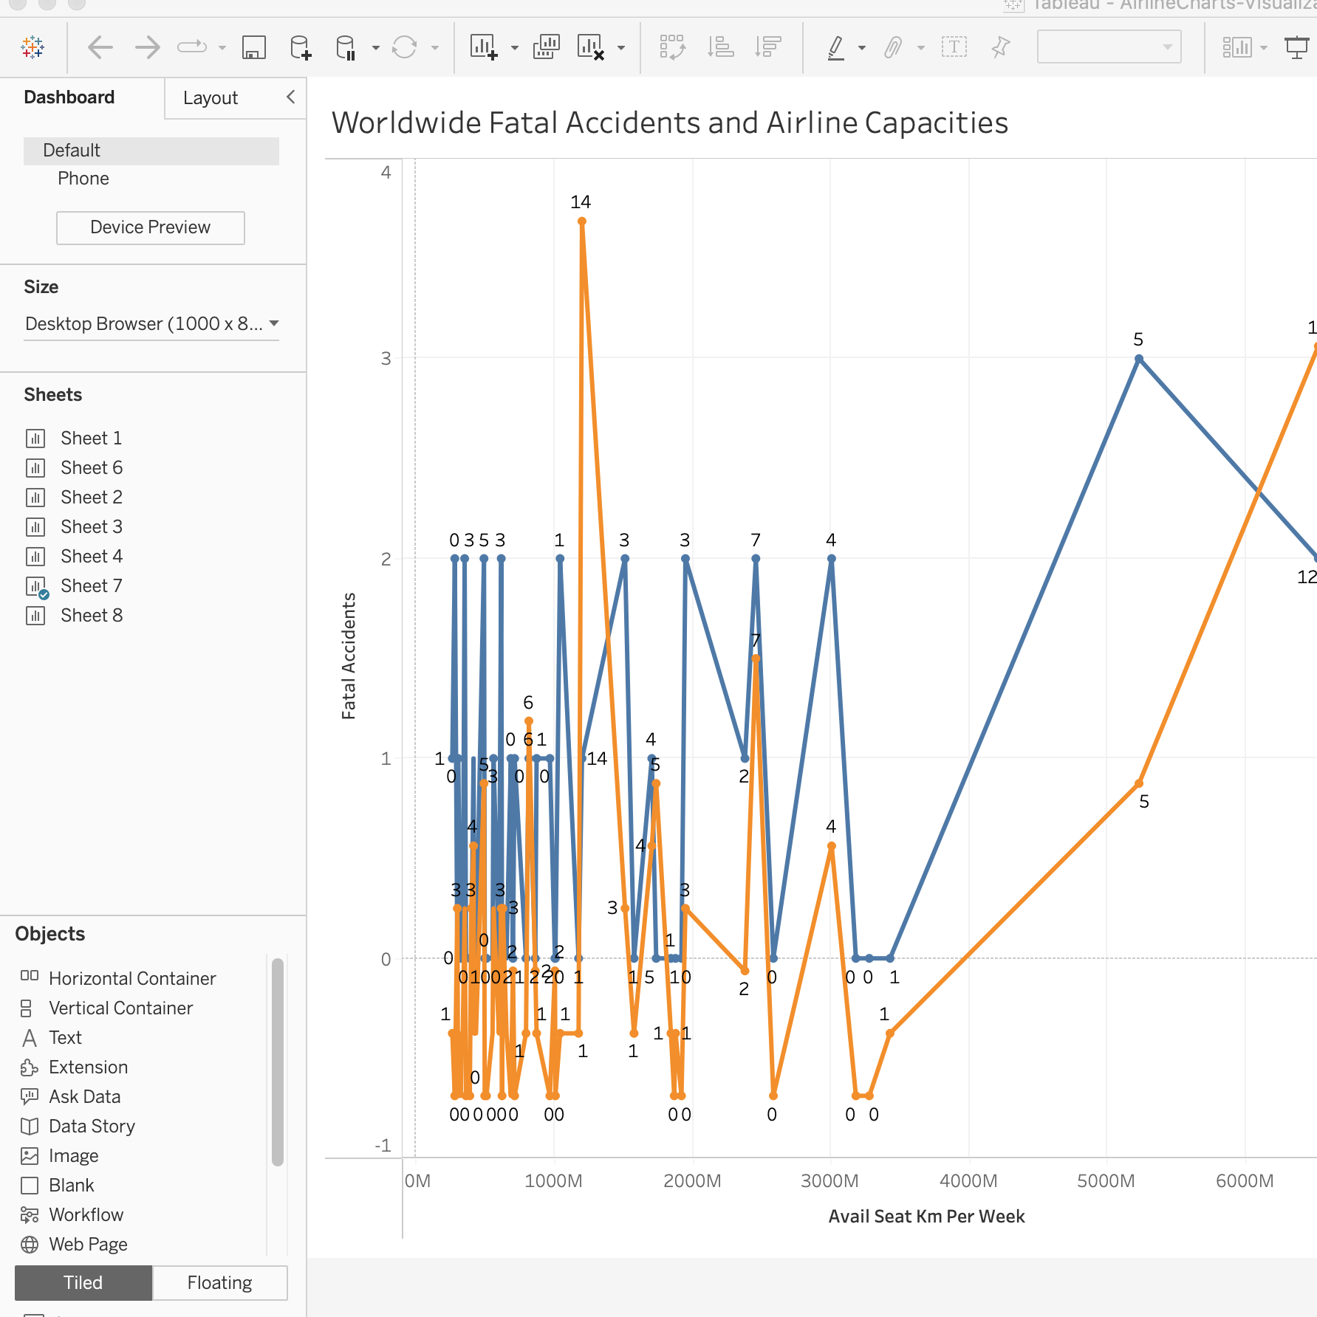
Available Seats per KM
The Available seats per kilometer metric indicate airline traffic increased significantly during the timeframe 00-14
The Fatal Accidents are very rare with increased safety standards followed and newer advanced Aircraft induction

Slide 10
Ethical Concerns and Links
Taking only required data for Visualization and recommendations
Data is taken from Public Data Source Kaggle so there are no data violations
Data taken is pre-covid so any recent changes with airline traffic or operations are not taken in consideration
https://airline-safetytravel.blogspot.com/p/debunking-air-travel-myths.html
https://www.canva.com/design/DAFkXMHnSsg/GfegaLFSXdzr42_YKsTRTQ/view?utm_content=DAFkXMHnSsg&utm_campaign=share_your_design&utm_medium=link&utm_source=shareyourdesignpanel

Slide 11
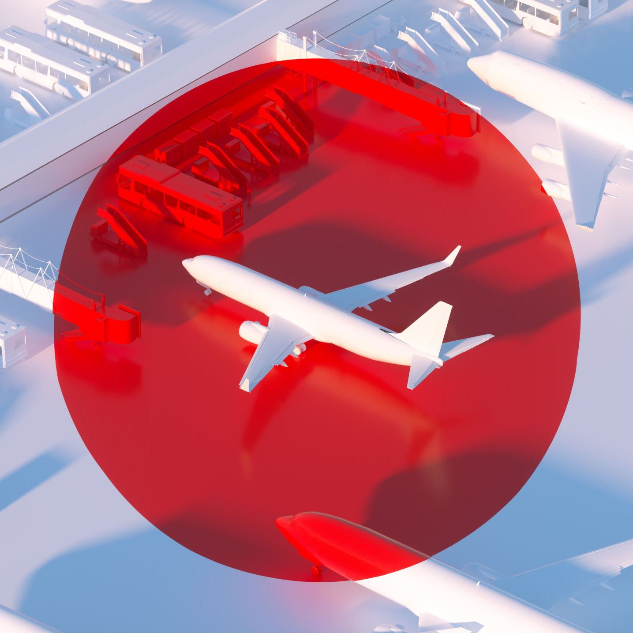
Summary
Air Travel is safer with new advanced aircraft and Regulations
False propaganda about Air Travel safety is in-accurate
Idea of investment within aviation sector is beneficial for the organization.

Slide 12
Any Questions?
Please feel free to reach me on
aalapati@my365.bellevue.edu

