Slide 1

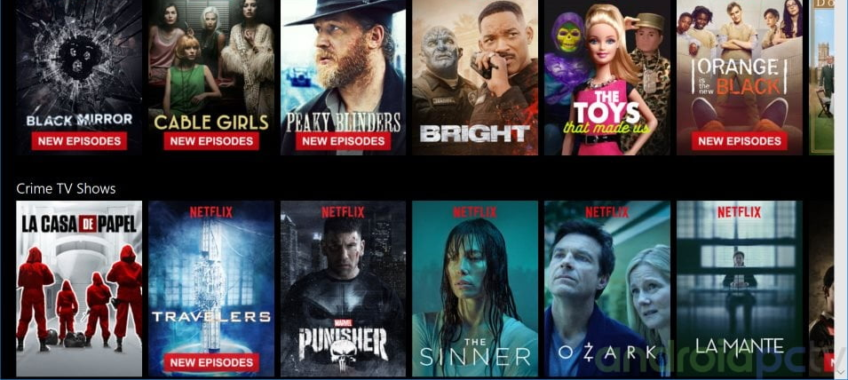

Movie Recommendation
Avinash Alapati
DSC 680

Slide 2

Introduction
Recommendation Systems are a type of information filtering systems as they improve the quality of search results and provides items that are more relevant to the search item.
They are used to predict the rating or preference that a user would give to an item. Almost every major tech company has applied them in some form or the other
Major companies like YouTube, Amazon, Netflix use recommendation system for its users to suggest more precise and accurate content to an individual according to their requirements.
This project represents the overview and approaches of techniques generated in a recommendation system.

Slide 3

Recommendation System Types
Demographic Filtering- offers users with similar demographic background with the movies that are popular and well-rated regardless of the genre or any other factors. The System recommends the same movies to users with similar demographic features.
Content Based Filtering- consider the object’s contents, this system uses item metadata, such as genre, director, description, actors, etc. for movies, to make these recommendations, it provides movie recommendation more closely to the individual’s preference.
Collaborative Filtering- focuses on user’s preference data and recommends movies based on it through matching with other users’ historical movies that have a similar preference as well and does not require movies’ metadata. This system matches persons with similar interests and provides recommendations based on this matching.

Slide 4

Data Description
Movie
Dataset
Fields
budget - The budget in which the movie was made.
genre - The genre of the movie, Action, Comedy ,Thriller etc.
keywords - The keywords or tags related to the movie.
original_language - The language in which the movie was made.
original_title - The title of the movie before translation or adaptation.
overview - A brief description of the movie.
popularity - A numeric quantity specifying the movie popularity.
release_date - The date on which it was released.
runtime - The running time of the movie in minutes.
tagline - Movie's tagline.
title - Title of the movie.
Credits
Dataset
Fields
movie_id - A unique identifier for each movie
cast - The name of lead and supporting actors
crew - The name of Director, Editor, Composer, Writer etc.

Slide 5


Demographic Filtering
Approach
Get a metric to score or rate movie
Calculate the score for every movie
Sort the scores and recommend the best rated movie to the users.
We can use the average ratings of the movie as the score but using this won't be fair enough since a movie with 9 average rating and only 10 votes cannot be considered better than the movie with 8 as as average rating but 60 votes. So, we will be using IMDB's weighted rating (wr) which is given as
v is the number of votes for the movie;
m is the minimum votes required to be listed in the chart;
R is the average rating of the movie
C is the mean vote across the whole report

Slide 6
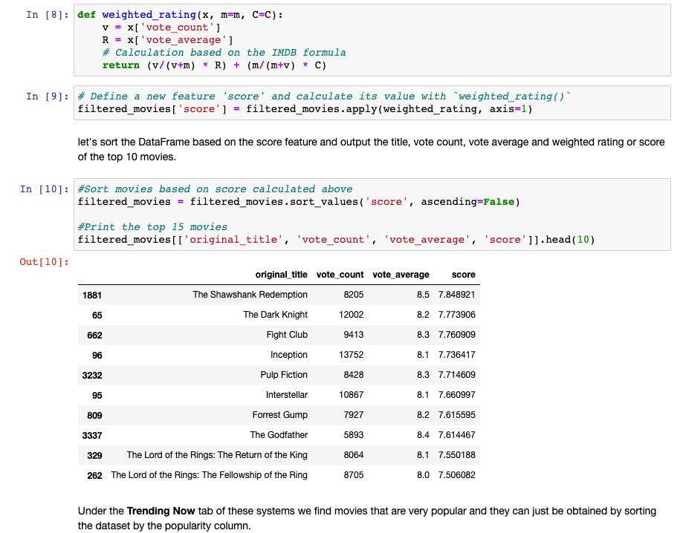
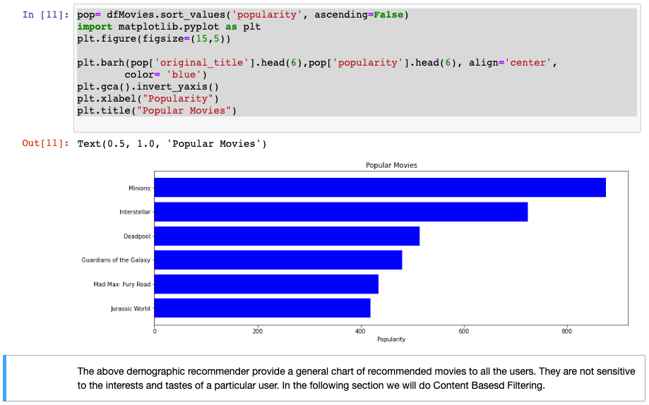
Demographic Filtering – Code Sample

Slide 7
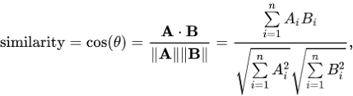
Content Based Filtering
Approach
We will compute pairwise similarity scores for all movies based on their plot descriptions and recommend movies based on it.
We will compute Term Frequency-Inverse Document Frequency (TF-IDF) vectors for each overview. The overall importance of each word to the documents in which they appear is equal to TF * IDF
This will give us a matrix where each column represents a word in the overview vocabulary and each row represents a movie.
We will be using the cosine similarity to calculate a numeric quantity that denotes the similarity between two movies, denoted as
These are the following steps we'll follow to define our recommender system :
Get the index of the movie given its title.
Get the list of cosine similarity scores for that particular movie with all movies.
Sort the mentioned list of tuples based on the similarity scores; that is, the second element.
Get the top 10 elements of this list.
Return the titles corresponding to the indices of the top elements.

Slide 8
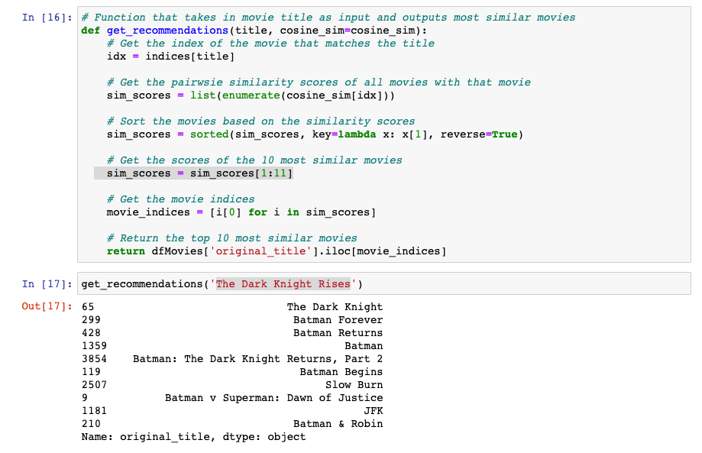
Content Based Filtering – Code Samplee
As we see, the quality of recommendations is not that great. "The Dark Knight Rises" returns all Batman movies while it is more likely that the people who liked that movie are more inclined to enjoy other Christopher Nolan movies. This is something that cannot be captured by the present system.

Slide 9
Improvements
The quality of our recommender can be increased with the usage of better metadata.
For this we are going to build a recommender based on the following metadata: the 3 top actors, the director, related genres and the movie plot keywords.
From the cast, crew and keywords features, we need to extract the three most important actors, the director and the keywords associated with that movie.
After Applying the cosine similarity, we see that our recommender has been successful in capturing more information due to more metadata and has given us better results

Slide 10
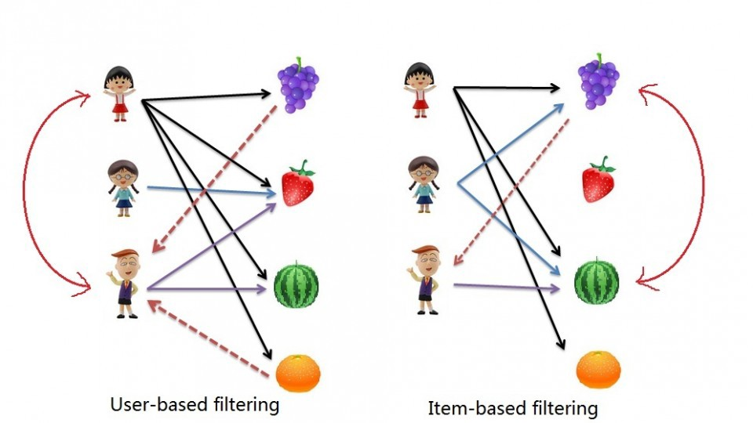
Collaborative Filtering
User based filtering- User-Based Collaborative Filtering is a technique used to predict the items that a user might like on the basis of ratings given to that item by the other users who have similar taste with that of the target user. This algorithm needs two tasks:
Find the K-nearest neighbors (KNN) to the user a, using a similarity function w to measure the distance between each pair of users:
Predict the rating that user a will give to all items the k neighbors have consumed but a has not. We Look for the item j with the best predicted rating.
Item Based Collaborative Filtering – This technique recommends items based on their similarity with the items that the target user rated. Likewise, the similarity can be computed with Pearson Correlation or Cosine Similarity.

Slide 11
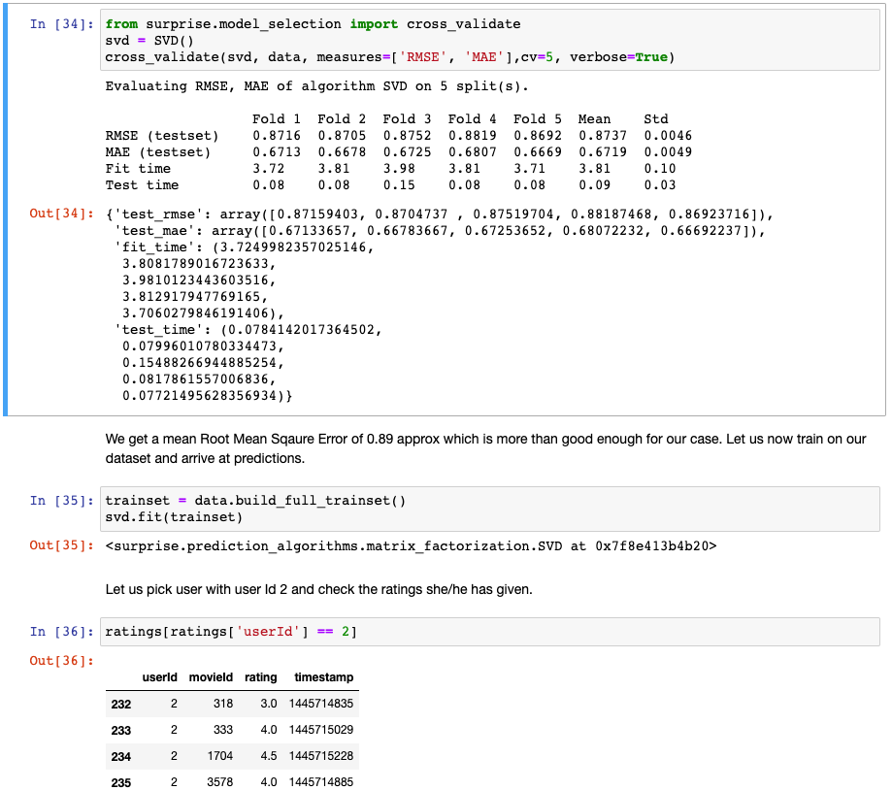
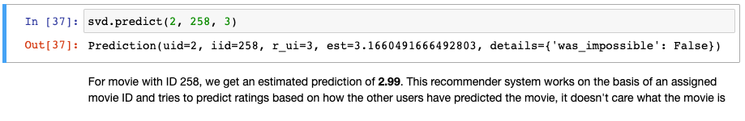
Collaborative Filtering – Code Snippet

Slide 12
Conclusion
The Recommendation system is a very powerful technology which helps people to find what they like.
If we take Collaborative Filtering as an example, then we find it is most successful and powerful algorithm.
Hybrid movie recommendation systems can take advantage of content- based and collaborative filtering as the two approaches are proved to be the best approach.
But each algorithms have its strength and weakness. Our proposed approach can handle quite a big amount of data effectively.

Slide 13

Thank You

