Slide 1


Google Stock Market Prediction
AVINASH ALAPATI
DSC 680

Slide 2
INTRODUCTION
Investors and traders in the stock market frequently seek precise forecasts of stock prices to guide their decisions on when to buy, sell, or hold stocks.
Predictive models offer valuable assistance by enabling investors to anticipate price shifts and refine their investment strategies accordingly.
Applying LSTM model to predict results and compare with actual data to analyze the performance of the model.

Slide 3

APPROACH
DATA COLLECTION
DATA CLASSIFICATION
DATA ANALYSIS

Slide 4
DATA COLLECTION
The dataset is collected from Kaggle ref: https://github.com/avinashalapati09/portfolio/blob/main/StockMarket/Google_Stock_Price_Train.csv
Date: Date of Trading.
Open: Open price of stock
High: Highest price of stock
Low: Lowest price of stock
Close: Closing price of stock
Volume: Total volume of stocks traded

Slide 5
RNN LSTM Model Implementation
The RNN LSTM Model is implemented with Keras Framework.
Regressor LSTM will include the Train Data.
Regressor will FIT the Train Data.
Train Data is trained using LSTM model
Test Data is evaluated using regressor. Predict method to find the accuracy of the results

Slide 6
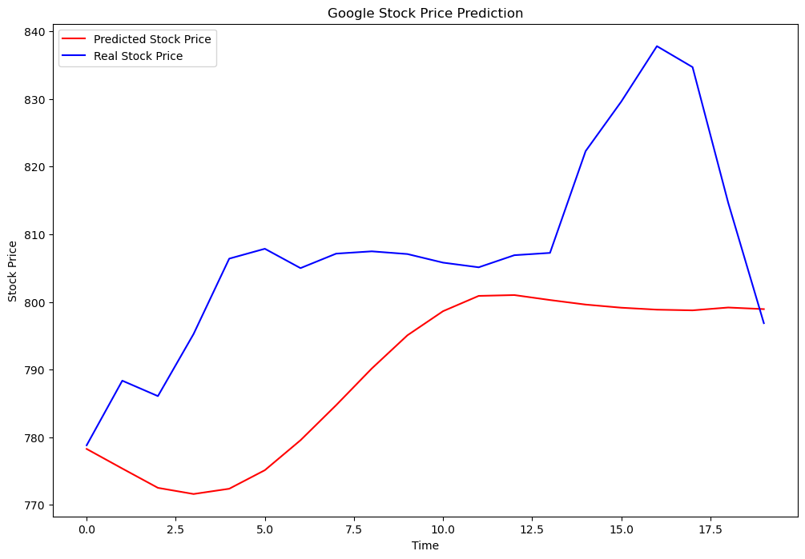
Results Visualization
The Plot channel constructed confirms Predicted Stock Price and Real Stock Price are almost same

Slide 7

CONCLUSION
The Overall Conclusion is RNN LSTM Model works accurately in predicting Google Stock Values when compared with Real Stock Value.
The Model can be leveraged for Production Model Deployments.
Github Repo: https://github.com/avinashalapati09/portfolio/tree/main/StockMarket

Slide 8

THANKYOU

