Slide 1

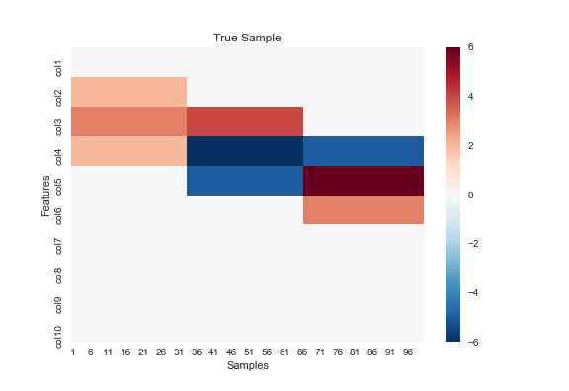
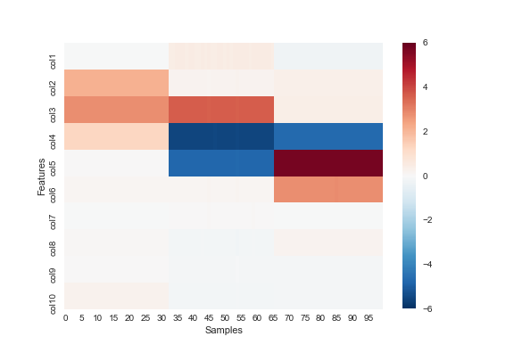




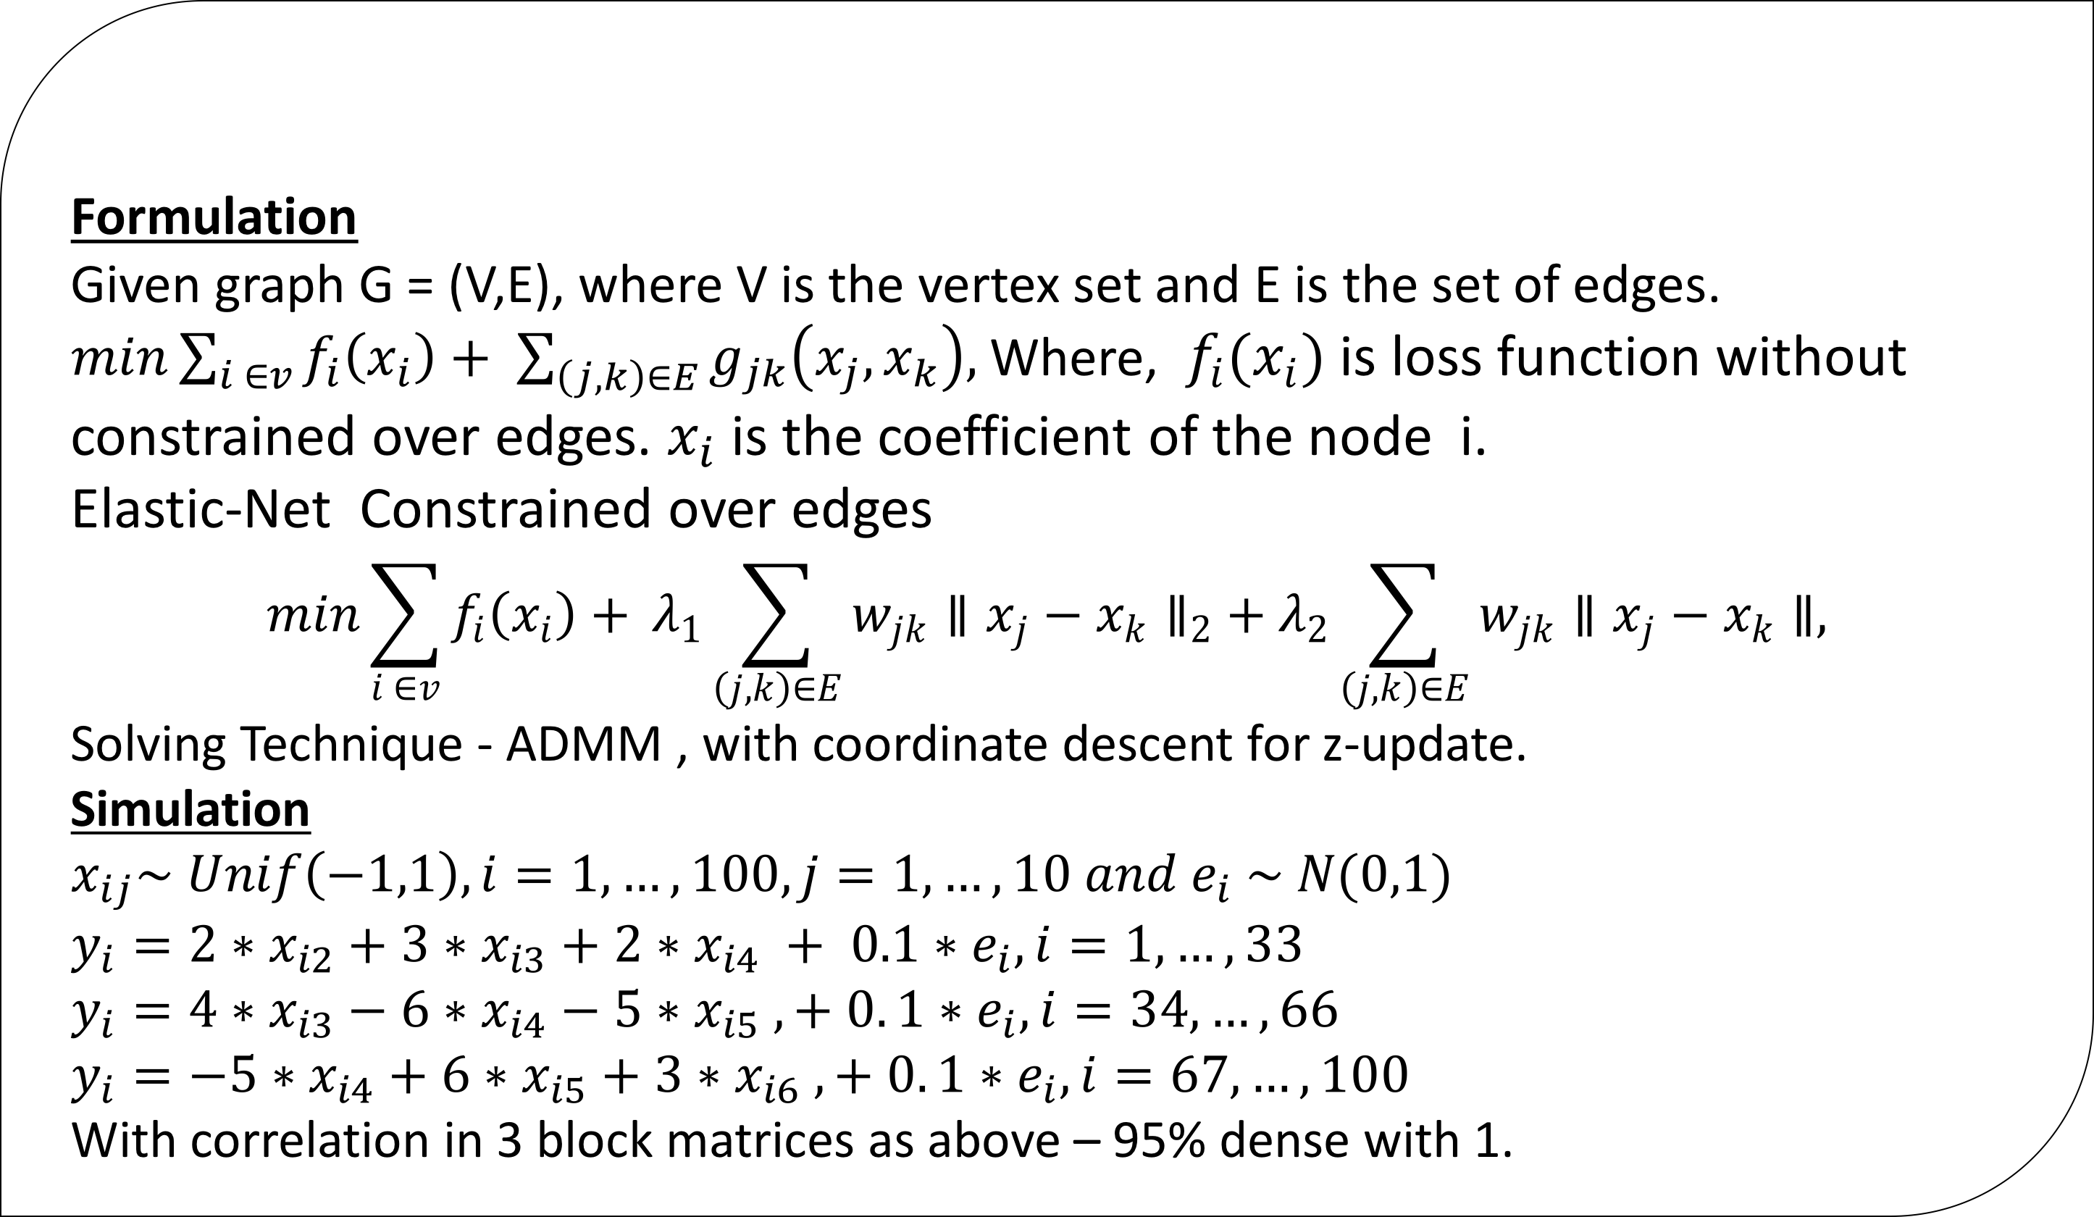
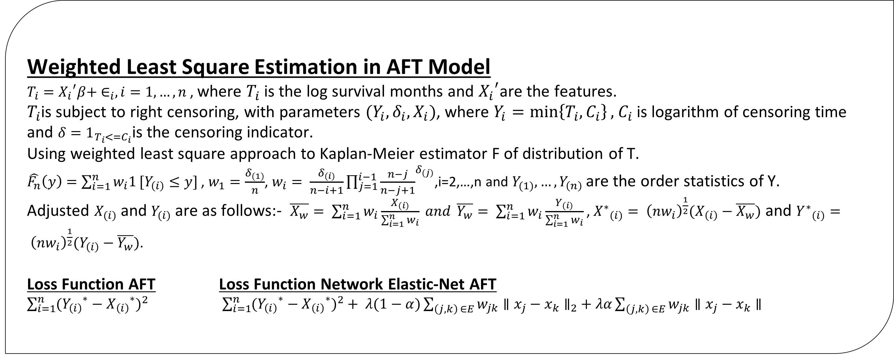
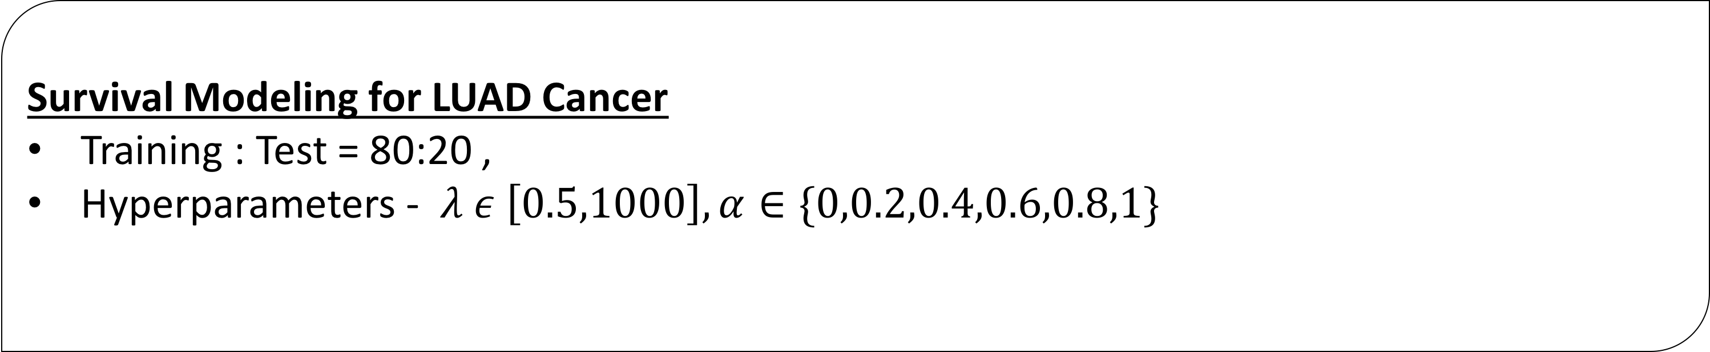
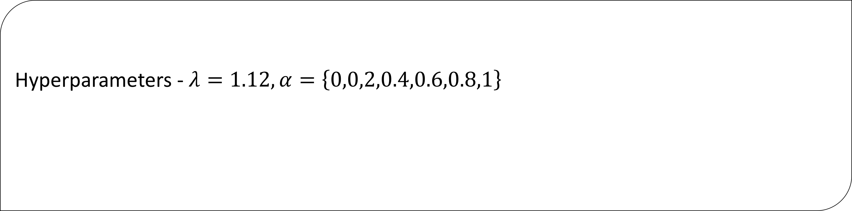
Network Elastic Net for Identifying Smoke specific gene expression for lung cancer
Avinash Barnwal
Goals
Simulation Results
Develop robust network elastic net model for identifying smoke specific gene expression for lung cancer and finding stage of lung cancer based on gene expression biomarkers.
Hyperparameters - $λ=1.12, α=\left\{0,0,2,0.4,0.6,0.8,1\right\}$
Motivation
Smokers behaving in similar manner.
Correlated data forming networks to build separate local models.
Finding the stage of cancer based on gene expression biomarkers.
Survival Model-Accelerated Failure Time(AFT)
Weighted Least Square Estimation in AFT Model
$T_{i}={X_{i}}^{′}β+ ∈_{i}, i=1,…,n$ , where $T_{i}$ is the log survival months and ${X_{i}}^{′}$are the features.
$T_{i}$is subject to right censoring, with parameters $(Y_{i},δ_{i},X_{i})$, where $Y_{i}=\min\left\{T_{i},C_{i}\right\},$ $C_{i}$ is logarithm of censoring time and $δ=1_{T_{i}<=C_{i}}$is the censoring indicator.
Using weighted least square approach to Kaplan-Meier estimator F of distribution of T.
$\hat{F_{n}}\left(y\right)=\sum_{i=1}^{n}{w_{i}1}[Y_{\left(i\right)}≤y]$ , $w_{1}=\frac{δ_{(1)}}{n}$, $w_{i}= \frac{δ_{(i)}}{n−i+1}\prod_{j=1}^{i−1}{{\frac{n−j}{n−j+1}}^{δ_{(j)}}}$,i=2,…,n and $Y_{(1)},…,Y_{\left(n\right)}$are the order statistics of Y.
Adjusted $X_{(i)}$ and $Y_{(i)}$ are as follows:- $\overline{X_{w}}= \sum_{i=1}^{n}{w_{i}\frac{X_{(i)}}{\sum_{i=1}^{n}{w_{i}}} and }\overline{Y_{w}}= \sum_{i=1}^{n}{w_{i}\frac{Y_{(i)}}{\sum_{i=1}^{n}{w_{i}}} }$, ${X^{∗}}_{(i)}= {\left(nw_{i}\right)}^{\frac{1}{2}}(X_{\left(i\right)}−\overline{X_{w}})$ and ${Y^{∗}}_{(i)}= {\left(nw_{i}\right)}^{\frac{1}{2}}(Y_{\left(i\right)}−\overline{Y_{w}})$.
Loss Function AFT Loss Function Network Elastic-Net AFT
$\sum_{i=1}^{n}{{({Y_{\left(i\right)}}^{∗}−{X_{\left(i\right)}}^{∗})}^{2}}$ $\sum_{i=1}^{n}{{({Y_{\left(i\right)}}^{∗}−{X_{\left(i\right)}}^{∗})}^{2}}+ λ(1−α)\sum_{\left(j,k\right) ∈E}{w_{jk}{∥x_{j}−x_{k}∥}_{2}}+λα\sum_{\left(j,k\right) ∈E}{w_{jk}∥x_{j}−x_{k}∥}$
Data
Molecular data from The Cancer Genome Atlas for Lung Adenocarcinoma (LUAD) and Lung Squamous Cell Carcinoma (LUSC) from cBio Cancer Genomics Portal (http://www.cbioportal.org/), Broad Firehose website (https://gdac.broadinstitute) and from Genomic Data Commons Data Portal (https://portal.gdc.cancer.gov/)
Clinical Data – 1024 patients , 77 Features
LUSC - 504 Patients, 77 Features
LUAD - 520 Patients, 77 Features
Gene Expression Data – 1016 Patients, 19223 Features(Genes)
Mapped LUSC data – 501 Patients, 19300 Features
Mapped LUAD data – 515 Patients, 19300 Features
Methodology
Survival Modeling for LUAD Cancer
Training : Test = 80:20 ,
Hyperparameters - $λ ε \left[0.5,1000\right], α∈\{0,0.2,0.4,0.6,0.8,1\}$
Formulation
Given graph G = (V,E), where V is the vertex set and E is the set of edges.
$min\sum_{i ∈v}{f_{i}\left(x_{i}\right)+ \sum_{\left(j,k\right)∈E}{g_{jk}\left(x_{j},x_{k}\right),}}$ Where, $f_{i}(x_{i})$ is loss function without
constrained over edges. $x_{i}$ is the coefficient of the node i.
Elastic-Net Constrained over edges
$$min\sum_{i ∈v}{f_{i}\left(x_{i}\right)+} λ_{1}\sum_{\left(j,k\right)∈E}{w_{jk}{∥x_{j}−x_{k}∥}_{2}}+λ_{2}\sum_{\left(j,k\right)∈E}{w_{jk}∥x_{j}−x_{k}∥,}$$
Solving Technique - ADMM , with coordinate descent for z-update.
Simulation
$x_{ij}\sim Unif\left(−1,1\right), i=1,…,100, j=1,…, 10 and e_{i} \sim N(0,1)$
$y_{i}=2∗x_{i2}+3∗x_{i3}+2∗x_{i4} + 0.1∗e_{i}, i=1,…,33$
$y_{i}=4∗x_{i3}−6∗x_{i4}−5∗x_{i5} , + 0. 1∗e_{i},i=34,…,66$
$y_{i}=−5∗x_{i4}+6∗x_{i5}+3∗x_{i6} , + 0. 1∗e_{i},i=67,…,100$
With correlation in 3 block matrices as above – 95% dense with 1.
Network Elastic-Net
Results and Conclusion
References
[1] D. H. Wolpert. “Stacked generalization”. In: Neural Networks 5.2 (1992),
[2] A. Y. Ng and Michael I. Jordan. “On Discriminative vs. Generative Classifiers: A Comparison of Logistic Regression and Naive Bayes”.(2002 NIPS)
[3] Phichhang Ou and Wang Hengshan. “Prediction of Stock Market Index Movement by Ten Data Mining Techniques”.(2009 Journal of Modern Applied Science)

